Slide 1
Politecnico di Milano
Computer Music: Languages and Systems
A.Y. 2022/2023
HW2
BIQUAD LIMITER PLUG-IN ANALYSIS
Group #11 – Power Rangers
Emma Coletta
Federico Ferreri
Lorenzo Previati

Slide 2
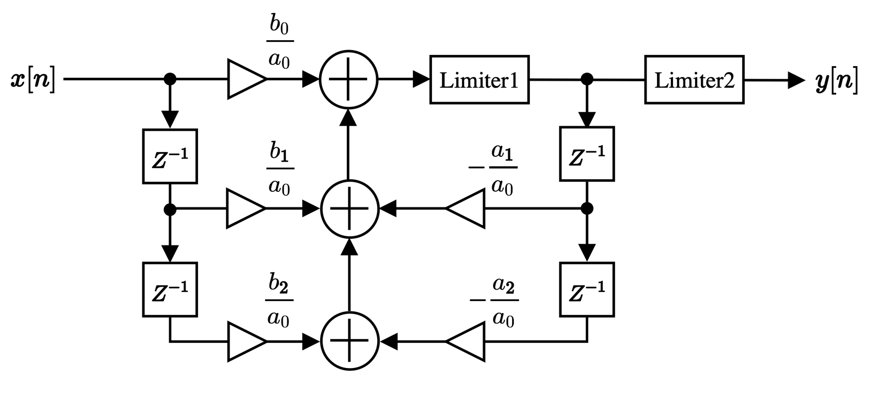
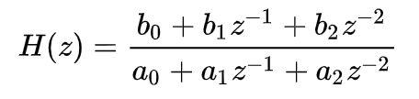
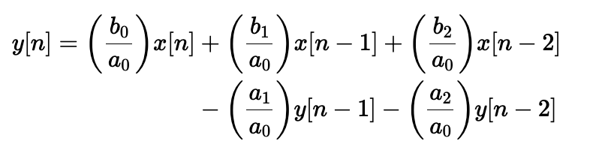
PLUG-IN DESCRIPTION
The BiquadLimiter plug-in implements a biquadratic filter with 2 dinamic range limiters, one in front of the feedback section and the other in the final section.
Digital Biquad Filter: 2nd order recursive linear filter (2 zeros, 2 poles).
Z-Domain transfer function:
Block scheme
Implementation presented in this plugin:
“Direct Form 1”
Graphical Interface
Parameters and Display Items:
In: input gain before the filter unit.
Freq: cutoff frequency of biquad filter.
Q: The Q of biquad filter.
Type: combo box to choose filter type. You can select one among LPF (low-pass), BPF (band-pass) and HPF (high-pass).
a₀, ..., b₂: coefficients of the biquad filter.
Fine: turns on / off the fine adjustment mode of coefficient slider.
Limiter LED: indicates whether the limiter is working or not.
Frequency display: The graph shows the ideal filter frequency response without the effect of the limiter. The y-axis shows the gain [dB] and the x-axis shows frequencies [Hz].
Notes:
biquadratic → ratio of 2 quadratic equations

Slide 3
HOW IT WORKS
Core of the plugin: PluginProcessor class → extension of the AudioProcessor class.
It’s responsible for processing incoming audio data and generating the output signal.
General Block Diagram:
Main used Objects:
AudioProcessorValueTreeState → stores the plugin parameters and keeps their values sinchronized between the user’s
interface and the processing code;
dsp::ProcessSpec → specifies processing specifications for the plugin. Used to inizitialize the processing chain and ensures that it’s properly configured for the incoming audio data.

Slide 4
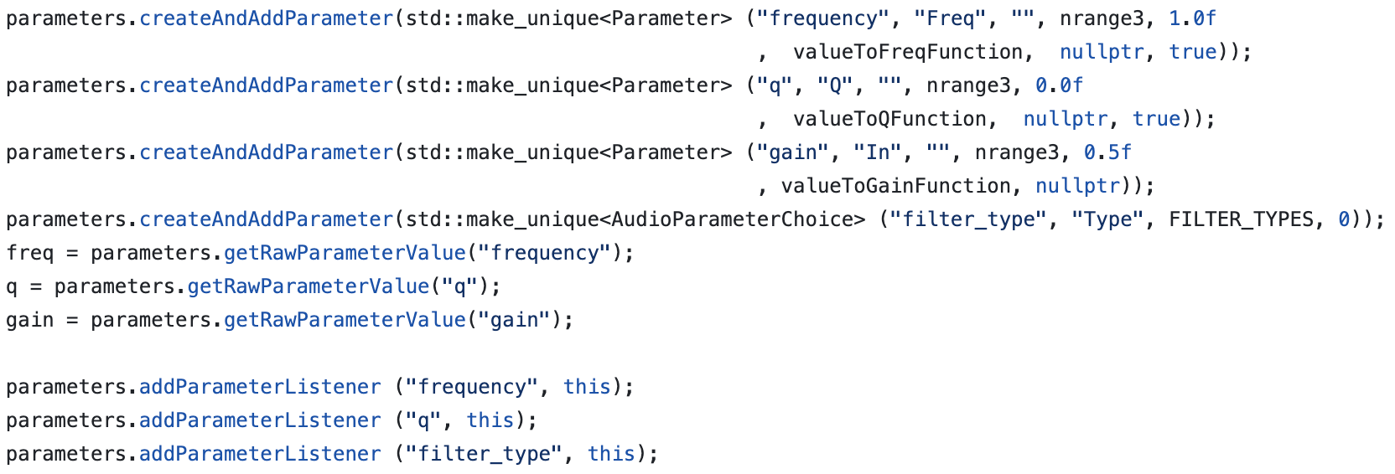
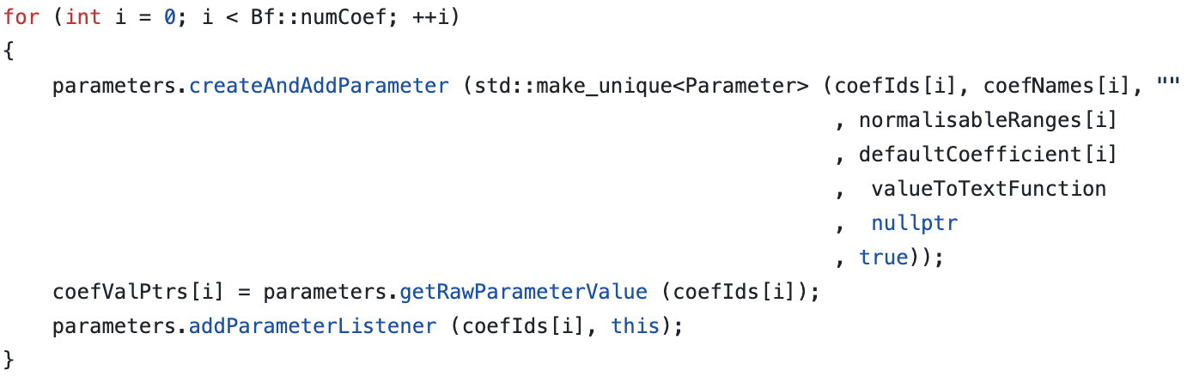
PluginProcessor class
BiquadLimiterAudioProcessor: audio plugin processor. Its constructor initizalies the following variables:
parameters: an AudioProcessorValueTreeState object that manages the plugin's parameters and their associated listeners;
defaultCoefficient: an array that contains the default coefficient values for the biquad filter;
biquadLimiter: a BiquadFilter object that implements the biquad filter using the default coefficient values;
coefIds: parameter IDs for the coefficients;
coefNames: parameter names for the coefficients;
coefValPtrs: an array of pointers to the parameter values for the coefficients;
isGraphUpToDate: a boolean flag that indicates whether the filter graph needs to be updated.
Parameter constructor: takes the ID, the name of the parameter, its NormalisableRange, a default value and a pointer to a function that converts the parameters values to string representation;
Parameters objects: defined for the filter frequency, Q value, gain and AudioParameterChoice object for the parameter;
createAndAddParameter method: returns a unique pointer to the created parameter; used to add all 4 parameters to the parameters object.
Notes:
Normalisable Range: used to specify the min and max value for each of the 6 coefficients used in the Biquad filter

Slide 5
PluginProcessor class – implemented functions and how they work
prepareToPlay → used to initialize the following items:
the processor with the given sample rate and buffer size;
the previousGain to the current value of the gain parameter;
the processing chain based on the specifications [sample rate and buffer size]
It also prepares the clipper.
setBiquadFilterCoef() → allows dynamic filtering.
The function is used to update the filter coefficients of the filter in response to changes in the filter type, frequency or Q values, retrieved from the AudioProcessorValueTreeState object. It also gets the the current filter type (LPF, HPF, BPF).
Based on the retrieved values, it creates and stores the filter coefficients in an array.
processBlock
takes the AudioBuffer as input;
sets the number of input and output channels;
sets the gain of the AudioBuffer choosing one between 2 methods:
applyGain: if the current gain = previous gain;
applyGainRamp: if the gain has changed;
updates the coefficients of the biquad filter;
applies the biquad limiter to the audio buffer for each of the input channels (if inside the range of allowed channels).
If the buffer, in the end, has any samples:
calls the process method of the clipper to apply the clipping function to the data.
setValueNofyingHost() → used to set the new parameter values and to notify the plugin host of the parameter changes.
parameterChange → called whenever a parameter in the audio processor is changed.
If the changed parameter is the frequency, Q value or filter_type, it calls the setBiquadFilterCoef() function to update the filter coefficients according to the new updated values.

Slide 6
LIMITER CLASSES – BiquadLimiterDsp and LimiterDsp
BiquadLimiterDsp
LimiterDsp
implements a digital signal processing algorithm that applies a biquad filter to an audio signal with 2 limiters
Constructed with the following parameters:
threshold level in decibels [dB];
knee width in dB;
release time in seconds, the attack time in seconds ;
number of audio channels;
a flag indicating whether to use a shared gain across all channels.
Main function: DoProcess
processes each audio sample applying the biquad filter and limiters;
updates the buffer with the filtered and limited audio signal.
Main function: DoProcessOneSample
applies limiter effect to a single audio sample;
takes as input a sidechain signal;
How does it work?
Calculates the difference between the smoothed coefficients and the current ones;
Updates the current coefficients by adding the previously found difference;
Computes the output of the filter;
Applies the 2 limiters.
How does it work?
Checks wether the limiter is in gain share mode. If it’s enabled, the limiter uses a single shared gain for all channels, ignoring the channel parameter;
Converts the sidechain signal from linear to dB value;
Calculates the static characteristic of the gain reduction curve;
Computation and smoothing out of the gain.

Slide 7

Thank You.

