Slide 1
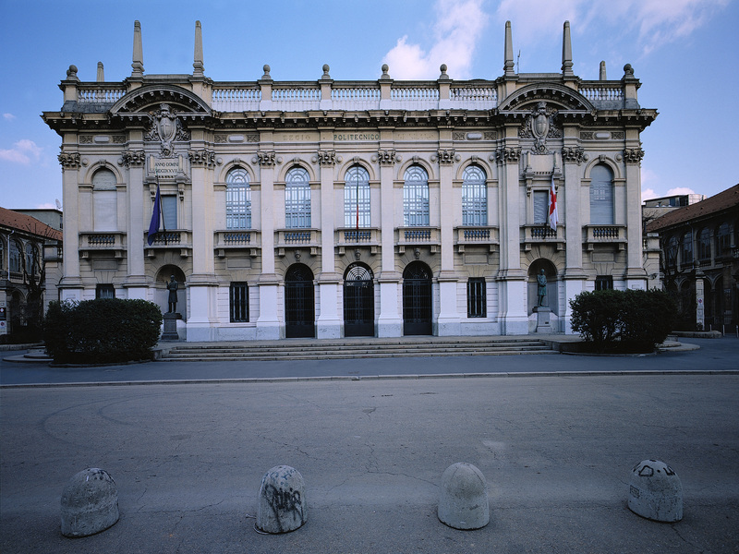

Titolo presentazione sottotitolo
Feelink : An interactive audiovisual experience
Milano, XX mese 20XX
Computer Music: Languages and Systems - Homework 3
Group 9 – The Sine of The Times
Francesco Colotti, Gioele Fortugno, Matteo Gionfriddo, Emanuele Greco

Slide 2
The concept
COLOR
Mapping inspired
by a survey
proposed in a psychology paper*
EMOTION
AUDIO-VISUAL REPRESENTATION
*https://www.psychologytoday.com/us/blog/color-psychology/202202/why-links-between-colors-and-emotions-may-be-universal
CMLS HW3 – Group 9 presentation – 05/06/2023
Notes:
If you read this I’m using the wrong presentation mode

Slide 3
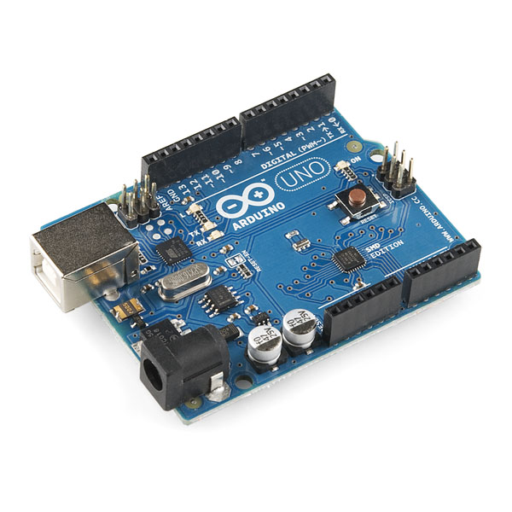
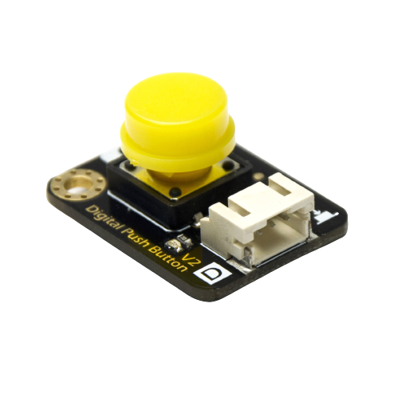
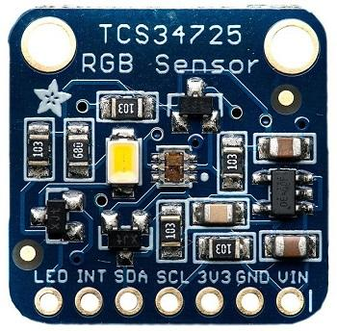
Setup: main components (Arduino version)
TCS34725 RGB Color Sensor
Arduino UNO SMD
Gravity : Digital Push Button
CMLS HW3 – Group 9 presentation – 05/06/2023
Notes:
If you read this I’m using the wrong presentation mode

Slide 4
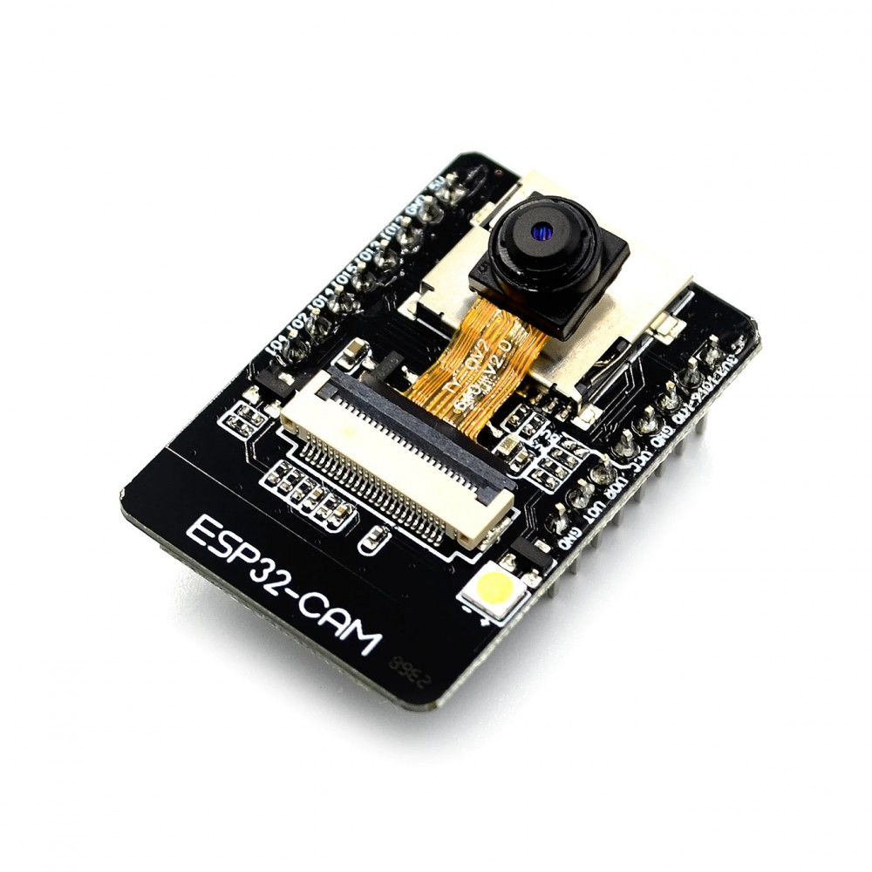
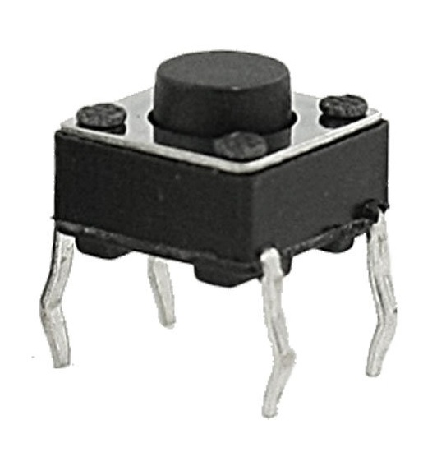
Setup: main components (ESP32-Cam version)
TCS34725 RGB Color Sensor
ESP-32 Cam
4-pin Button
CMLS HW3 – Group 9 presentation – 05/06/2023
Notes:
If you read this I’m using the wrong presentation mode

Slide 5
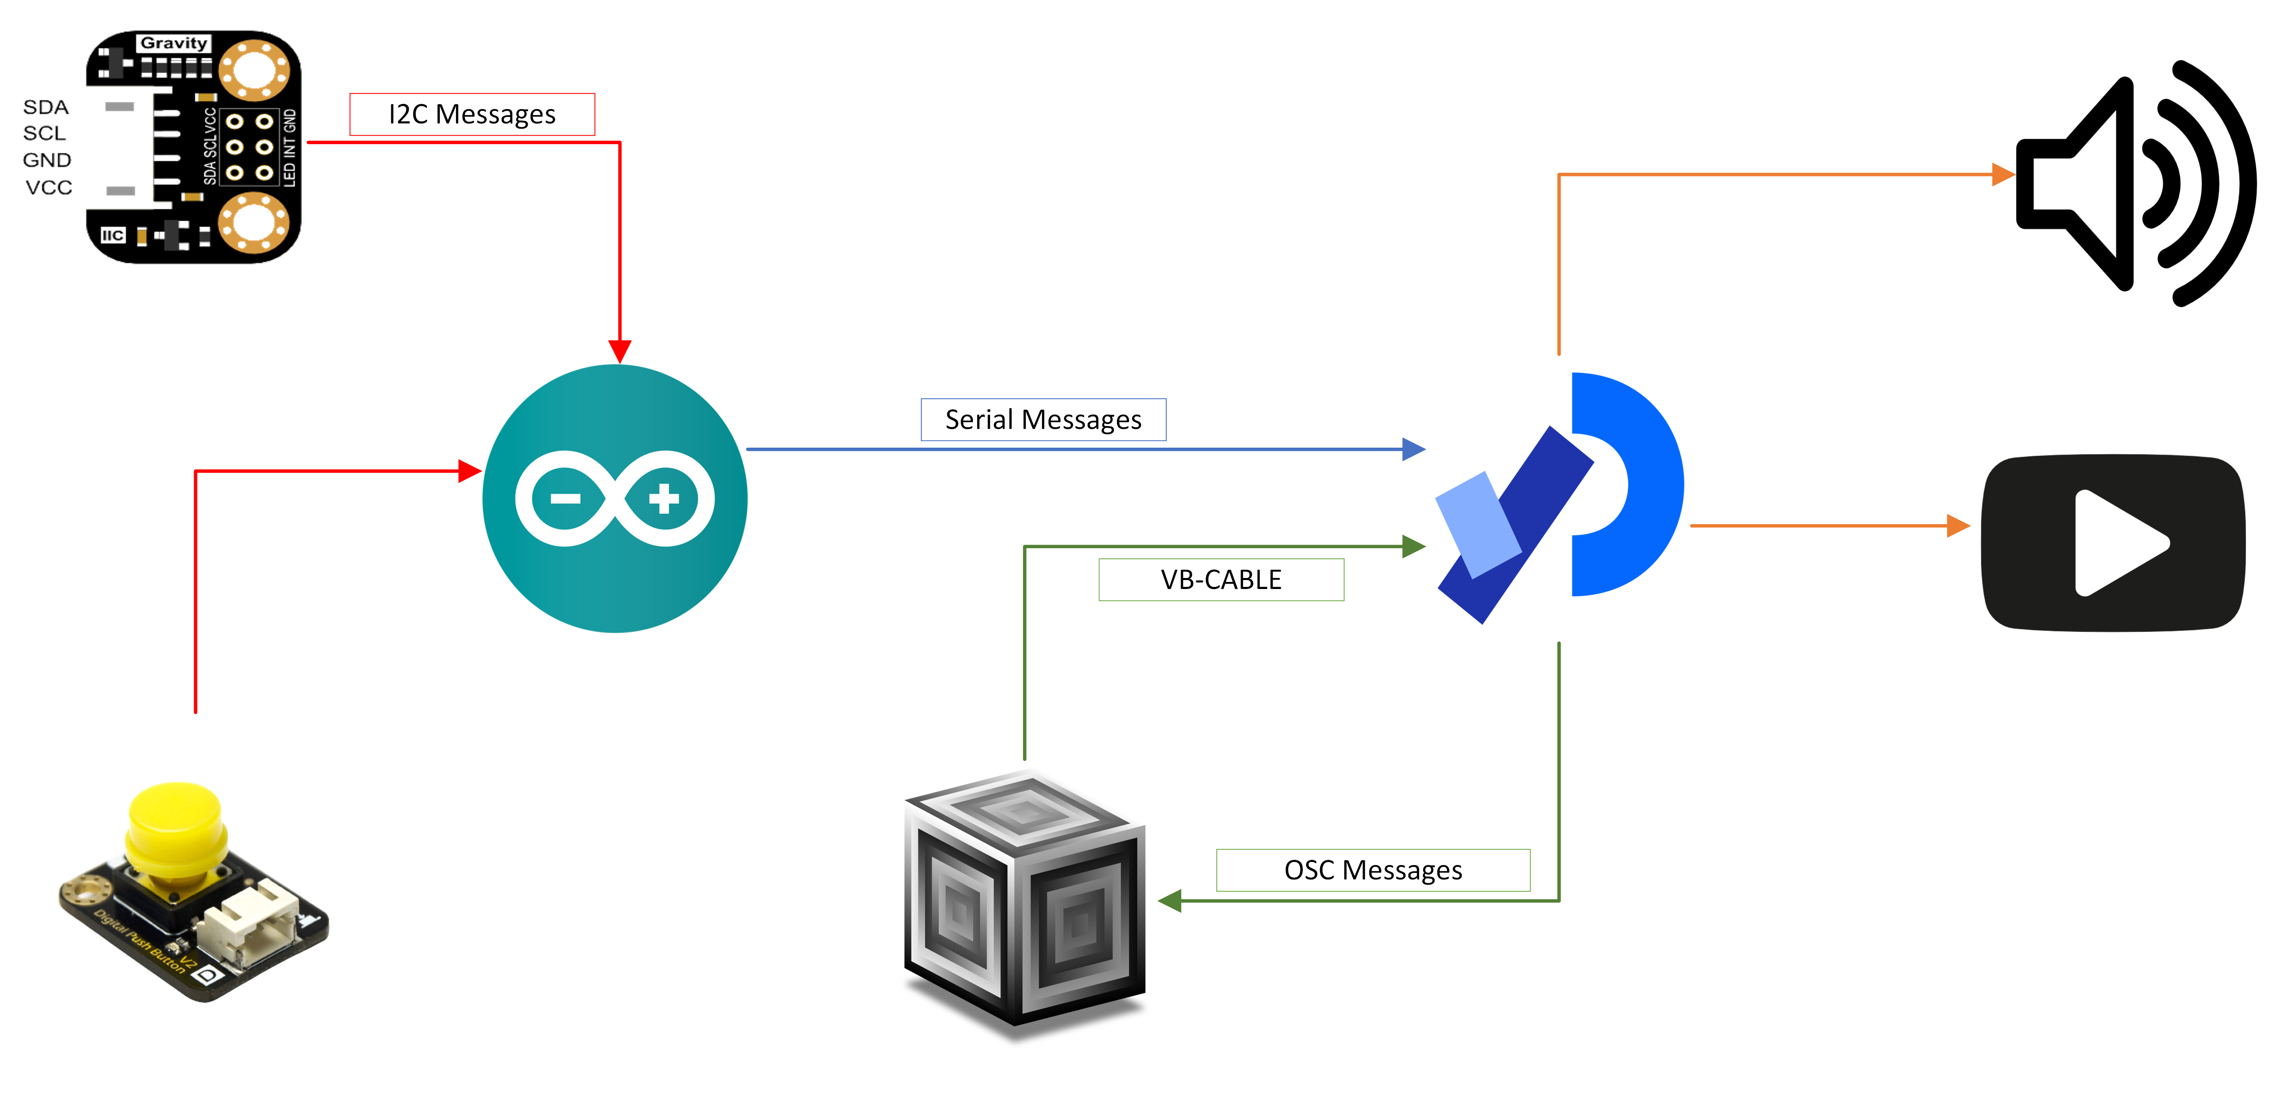
Communication between units
CMLS HW3 – Group 9 presentation – 05/06/2023
Notes:
If you read this I’m using the wrong presentation mode

Slide 6
Visuals – key points
Dots and lines ("triangles")
Sentences reflecting 4 emotions/states of mind shown around the screen in text boxes
4 states of mind imply
→ 4 color palettes (each made of 20 colors)
→ 4 source texts given as a source to a RiTa.markov object, which generates new texts
User reads color (→switches state) using sensor
CMLS HW3 – Group 9 presentation – 05/06/2023
Notes:
If you read this I’m using the wrong presentation mode

Slide 7
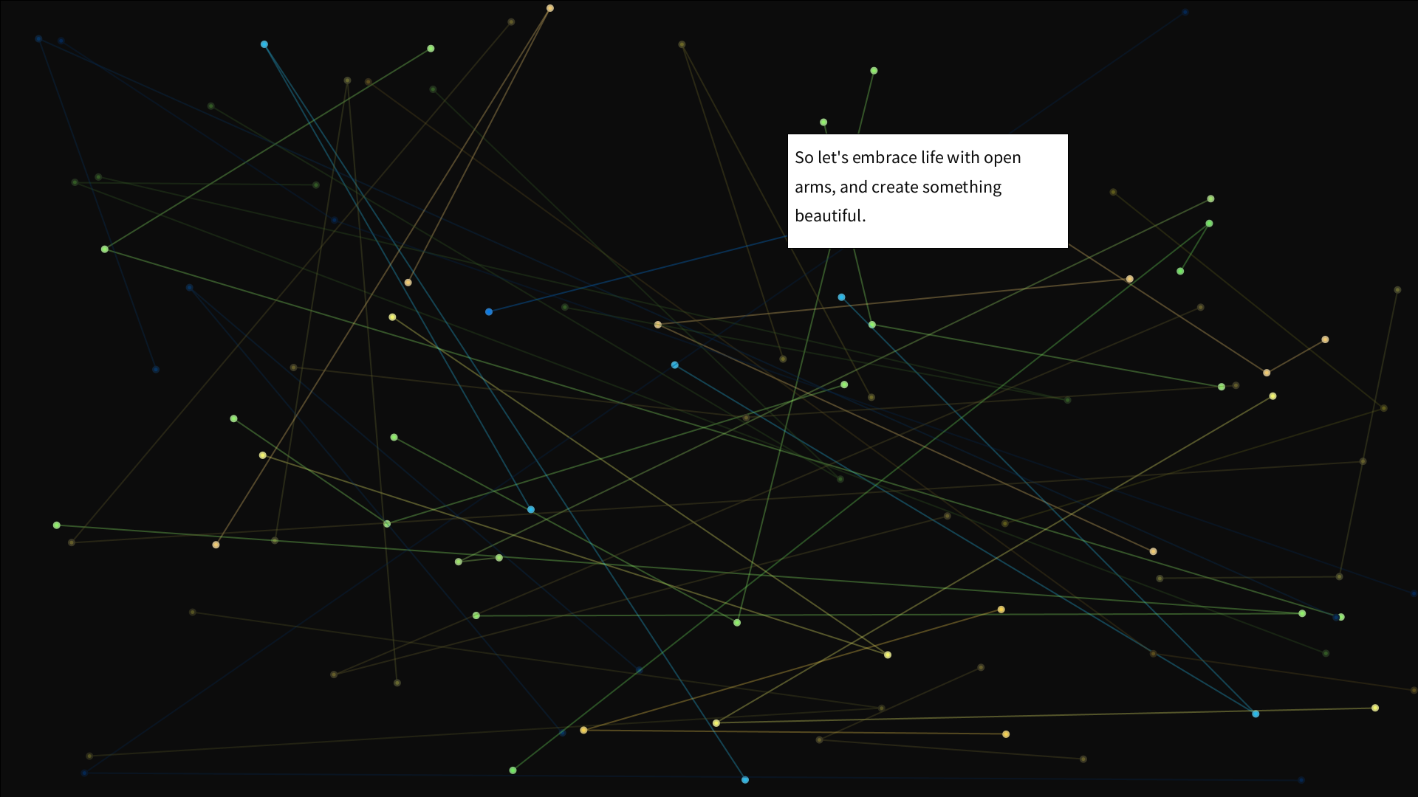
Visuals example – HAPPY State
CMLS HW3 – Group 9 presentation – 05/06/2023
Notes:
If you read this I’m using the wrong presentation mode

Slide 8
Visuals – additional info
Movement reacts to sound (FFT data)
Texts generated with ChatGPT and random song lyrics
Sometimes RiTa.markov fails; in that case the original source text is instead displayed in order to always show something
CMLS HW3 – Group 9 presentation – 05/06/2023
Notes:
If you read this I’m using the wrong presentation mode

Slide 9
Audio unit
Audio is constantly playing by using Pbind and Pseq.
Audio transition for each change of emotion.
Use of different chord quality in order to express feeling
Combination of synthetic sounds (from a bunch of SynthDefs) and environmental recordings (external precomputed sounds).
CMLS HW3 – Group 9 presentation – 05/06/2023
Notes:
If you read this I’m using the wrong presentation mode

Slide 10
Live demo!
CMLS HW3 – Group 9 presentation – 05/06/2023
Notes:
If you read this I’m using the wrong presentation mode

Slide 11
Thank you for your attention!
CMLS HW3 – Group 9 presentation – 05/06/2023

