Slide 1
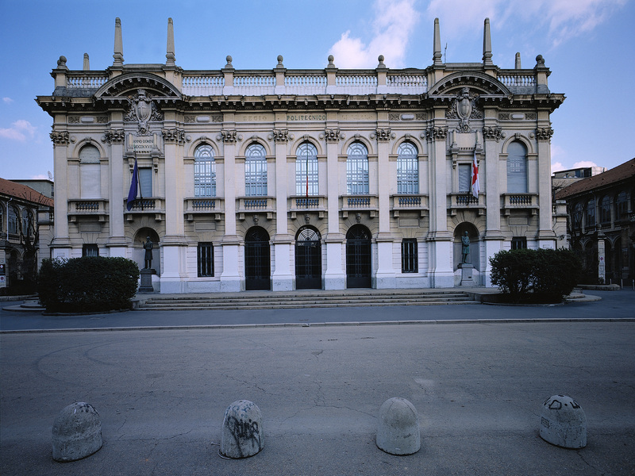

Titolo presentazione sottotitolo
Fire: a Multi-Band Distortion Plugin
Milano, XX mese 20XX
Computer Music: Languages and Systems - Homework 2
Group 9 – The Sine of The Times
Francesco Colotti, Gioele Fortugno, Matteo Gionfriddo, Emanuele Greco

Slide 2
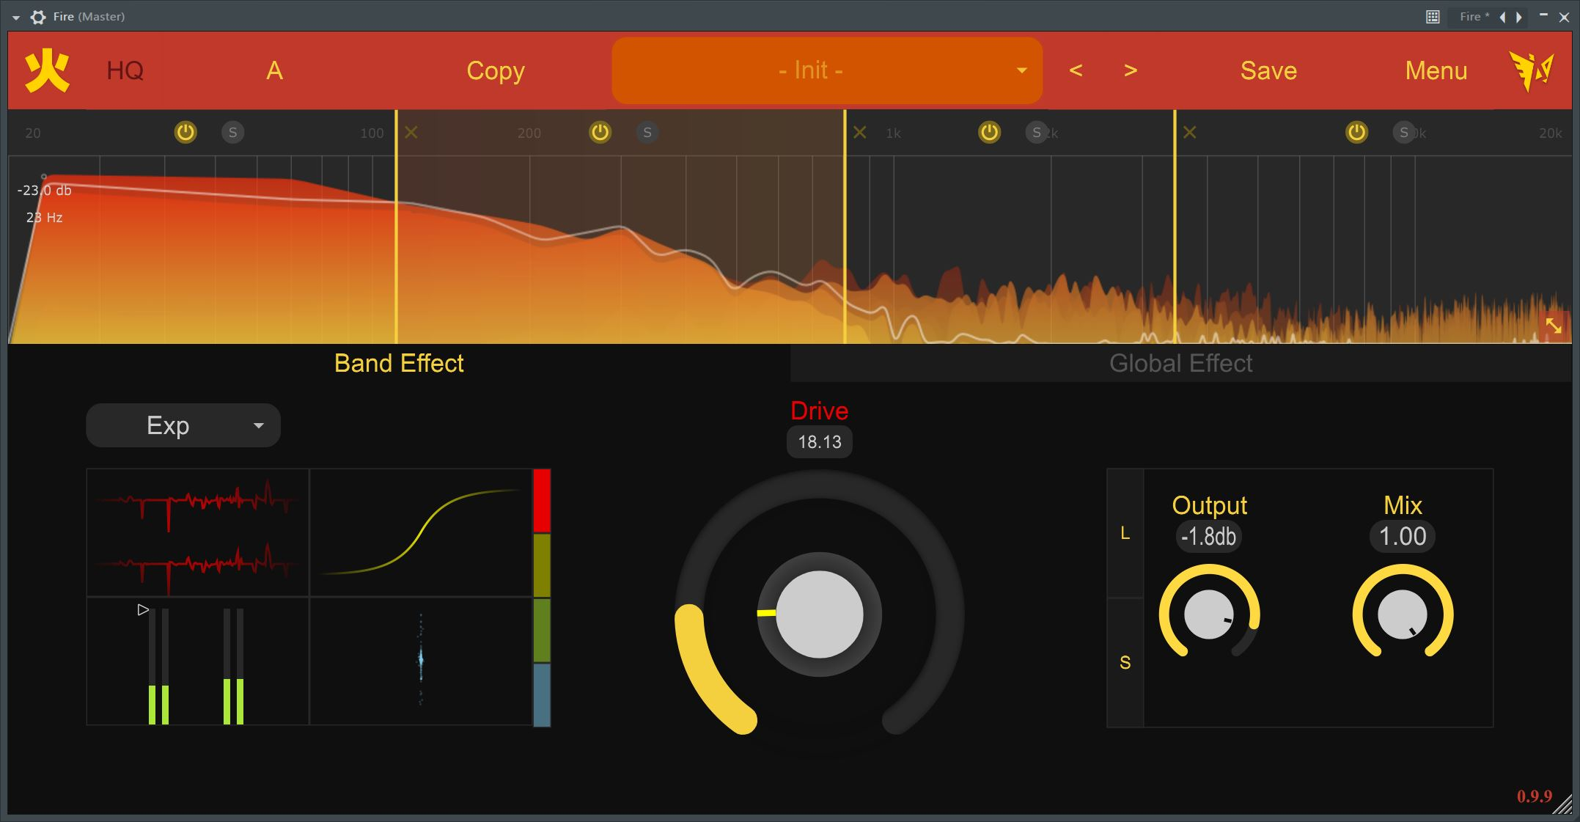
GUI: key points – BAND tab
CMLS HW2 – Group 9 presentation – 31/05/2023
Notes:
If you read this I’m using the wrong presentation mode

Slide 3
GUI: key points – BAND tab
CMLS HW2 – Group 9 presentation – 31/05/2023
Notes:
If you read this I’m using the wrong presentation mode

Slide 4
GUI: key points – BAND tab
CMLS HW2 – Group 9 presentation – 31/05/2023
Notes:
If you read this I’m using the wrong presentation mode

Slide 5
GUI: key points – BAND tab
CMLS HW2 – Group 9 presentation – 31/05/2023
Notes:
If you read this I’m using the wrong presentation mode

Slide 6
GUI: key points – BAND tab
CMLS HW2 – Group 9 presentation – 31/05/2023
Notes:
If you read this I’m using the wrong presentation mode

Slide 7
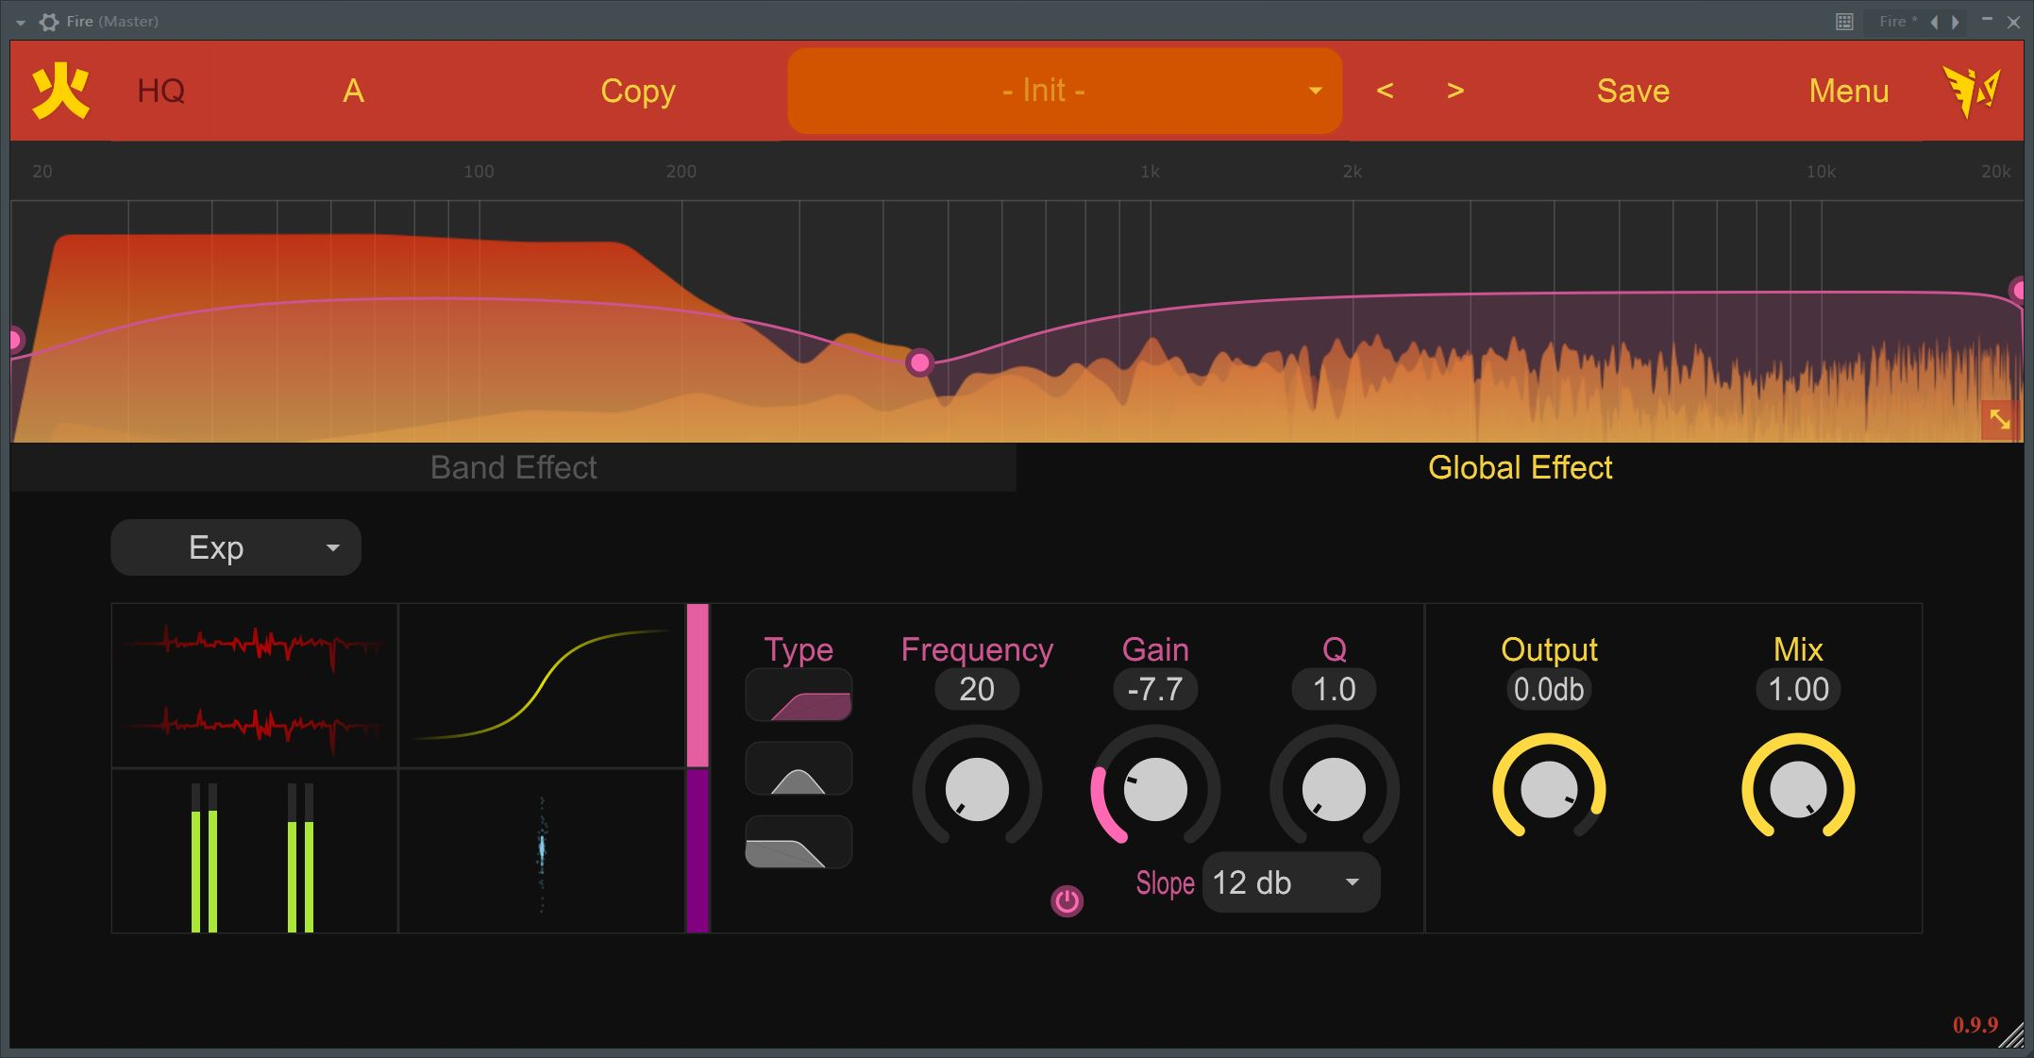
GUI: key points – GLOBAL tab
CMLS HW2 – Group 9 presentation – 31/05/2023
Notes:
If you read this I’m using the wrong presentation mode

Slide 8
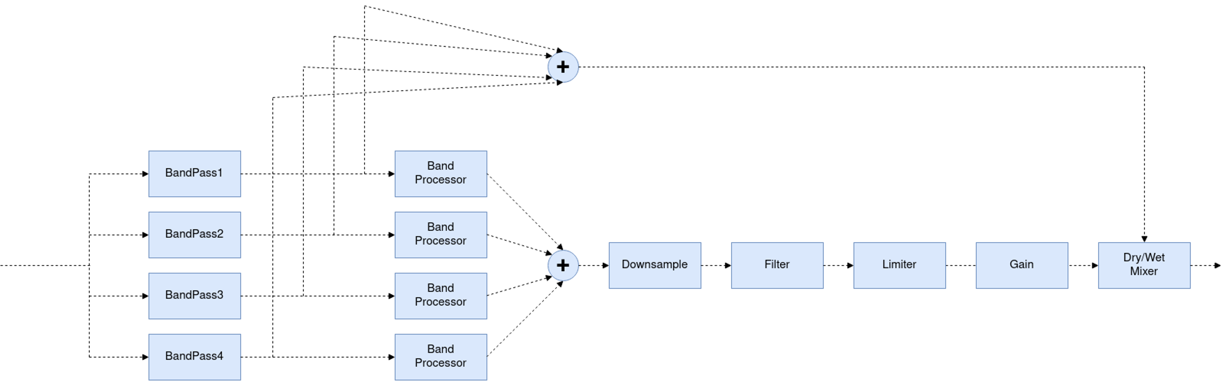
ProcessBlock()
This function within the PluginProcessor encompasses the main steps of the signal flow. In the figure below we have an overview of the structure of the plug-in.
CMLS HW2 – Group 9 presentation – 31/05/2023
8

Slide 9
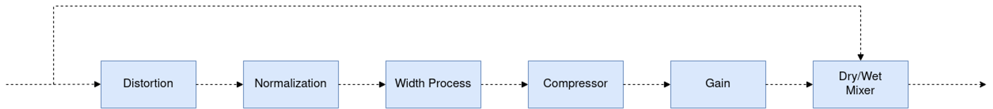
ProcessOneBand()
A general block diagram of the signal path is visualized in the figure below. This is the chain where the signal is processed after dividing into several parts. Each band will be processed by these functions in a different way so as to be able to set parameters for each block.
CMLS HW2 – Group 9 presentation – 31/05/2023
9

Slide 10
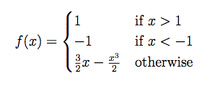
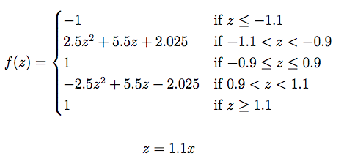
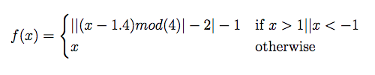

ClippingFunctions.h
Clipping function: the distortion functions in this code use various non-linear saturation algorithms to create distortion effects. Specifically we have 12 different functions grouped into 3 categories (SoftClipping, HardClipping, Foldback), below we represent some of them:
CubicSoftClipping
SausageFattener
with
LinFoldBack
LogicClip
CMLS HW2 – Group 9 presentation – 31/05/2023
10

Slide 11
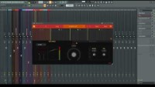
Video demo
CMLS HW2 – Group 9 presentation – 31/05/2023
11

Slide 12
Thank you for your attention!
CMLS HW2 – Group 9 presentation – 31/05/2023

