Slide 1
Lifestyle in an app

Slide 2
Team Architecture
Team Lead: Rudy
Design Lead: Imane Laaroussi
Test Lead: Polina

Slide 3
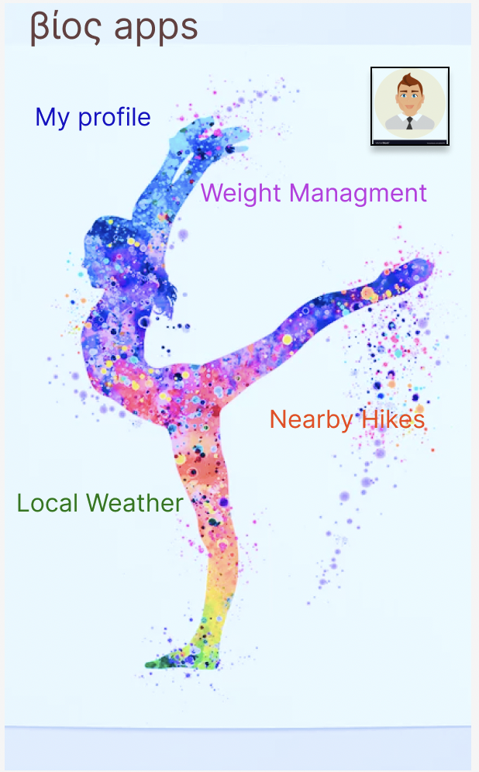
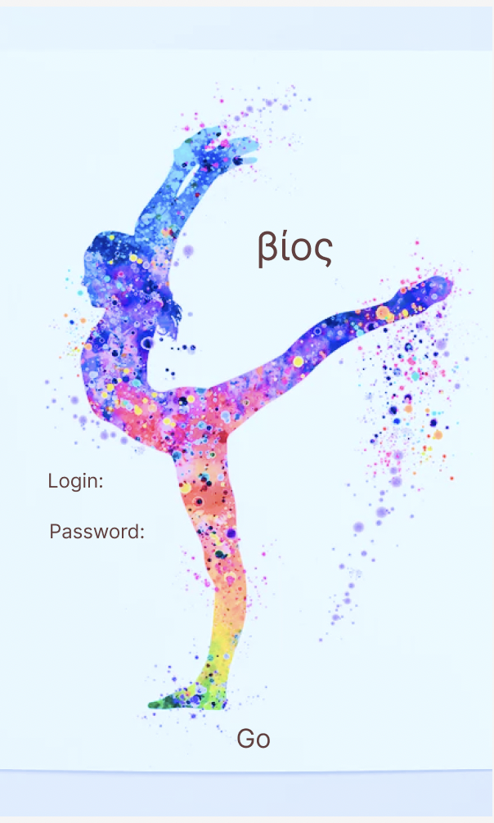
Design
For mock-up we used Figma

Slide 4
Design
Nearby Hikes show up on Google Maps API

Slide 5
Design
Weather app is not here yet

Slide 6
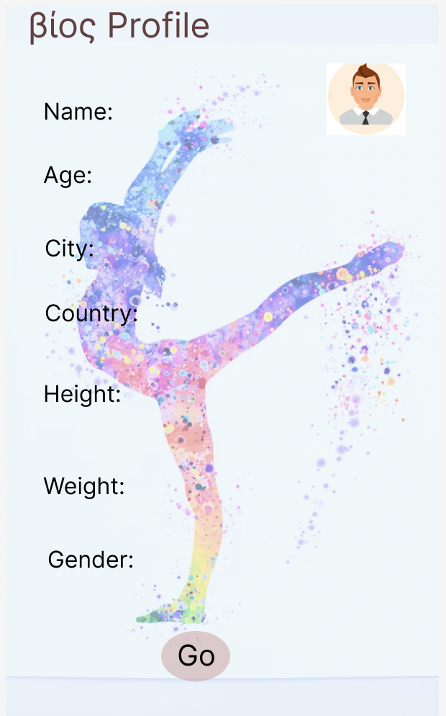
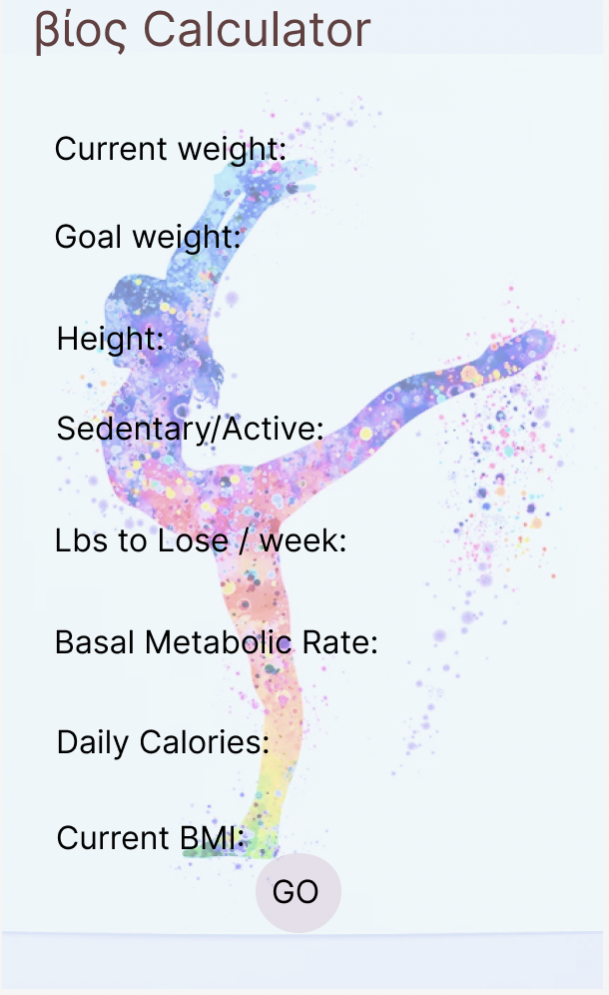
Design

Slide 7
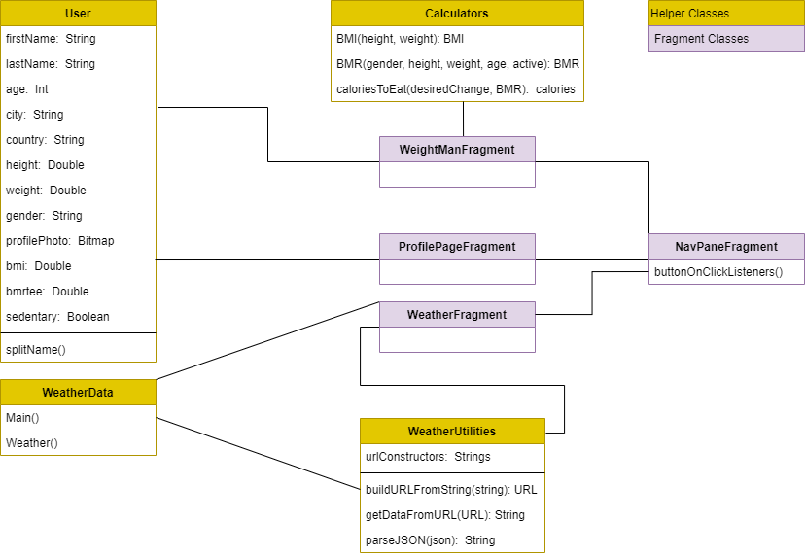
Class Diagram

Slide 8
Data requirements

Slide 9
Bugs and Enhancements

Slide 10
Tests feedbacks

