Slide 1

FitLife

Slide 2
Team Architecture
🤷🏻‍♂️ Team Lead: Anirudh Lath aka RUDY
👧🏻 Design Lead: Imane Laaroussi
💃🏻 Test Lead: Polina Lyubavina

Slide 3
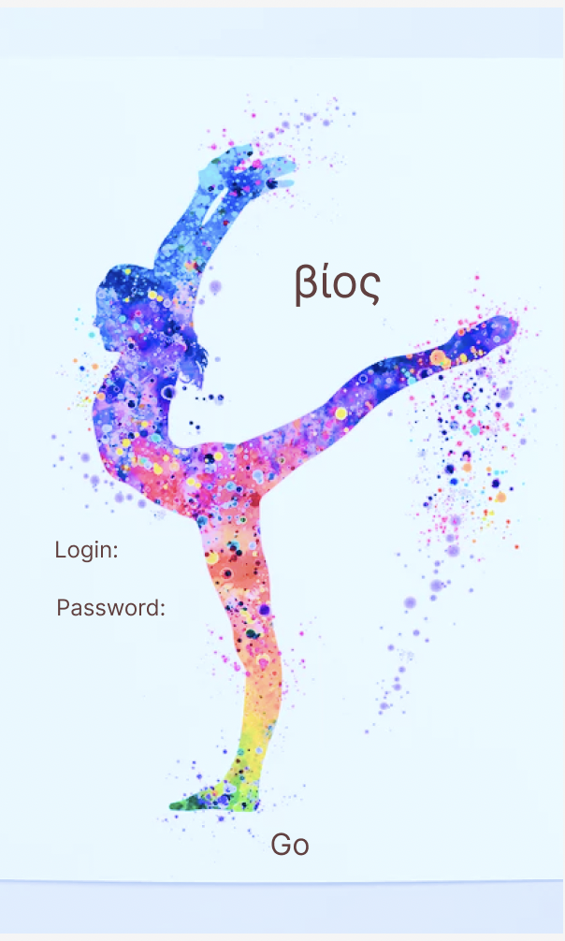
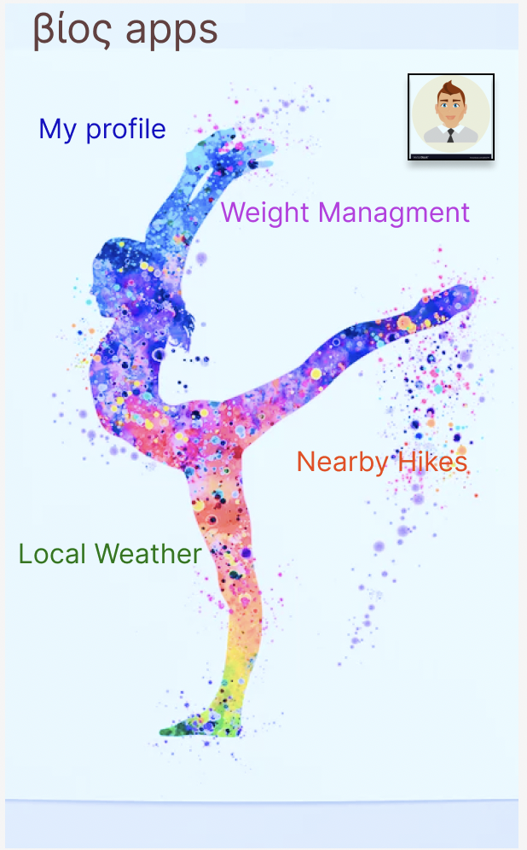
UI Design
For mock-up we used Figma

Slide 4
BMI Calculator
FILL THIS IN

Slide 5

Google Maps
Nearby Hikes show up on Google Maps API, this works through using the city the user enters in the personal details section, and then formulating a search of “Hikes” + <City Name> in Googles Maps.

Slide 6

Weather
Weather also uses the personal details to automatically fill in the city that you are currently location in and gives you a detailed summary of the weather in your city.

Slide 7
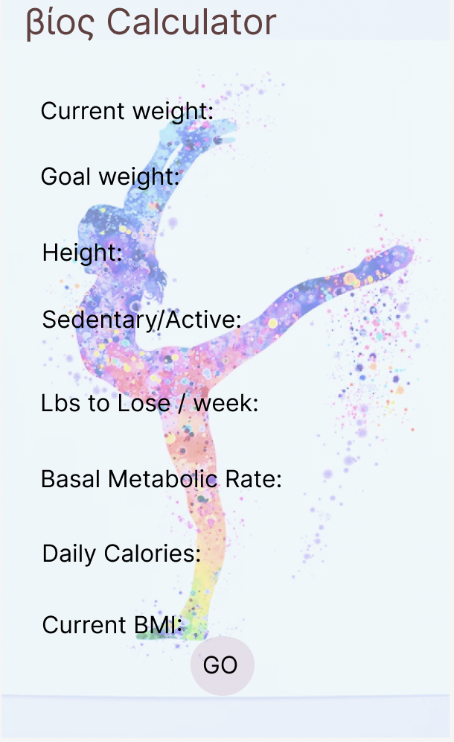
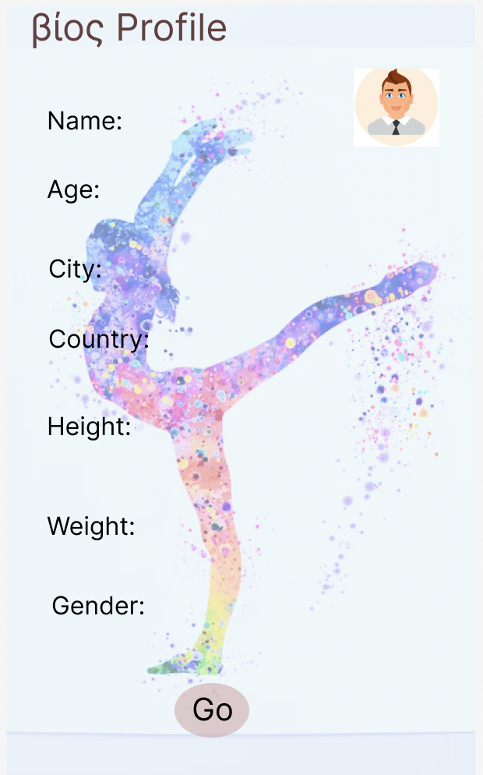
UX Design

Slide 8
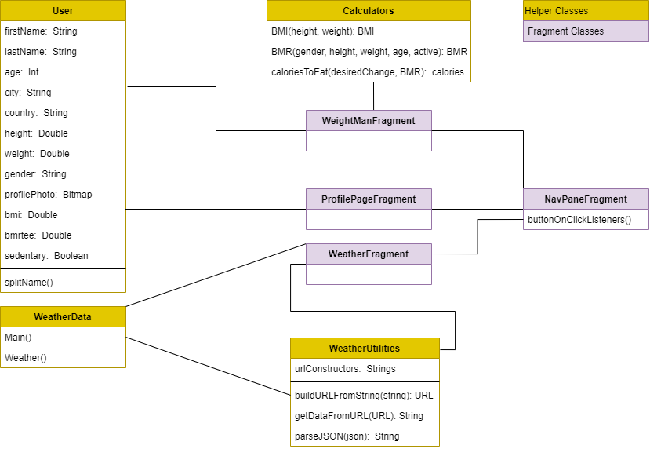
Class Diagram

Slide 9
Exploring Firebase
User Authentication:
We explored Firebase authentication API to manage users. Even though it is not in the current implementation of this app, it is being explored on a different repo.
User Data:
We are in the processing of understanding how the realtime database system for firebase works. Once we do this, it should enable us to provide a seamless industry standard user experience to the users of our app.

Slide 10
Data requirements

Slide 11
Bugs and Enhancements

Slide 12
Tests feedbacks

