Slide 1
CUSTOMER SEGMENTATION ANALYSIS
By Poline Haroutounian

Slide 2
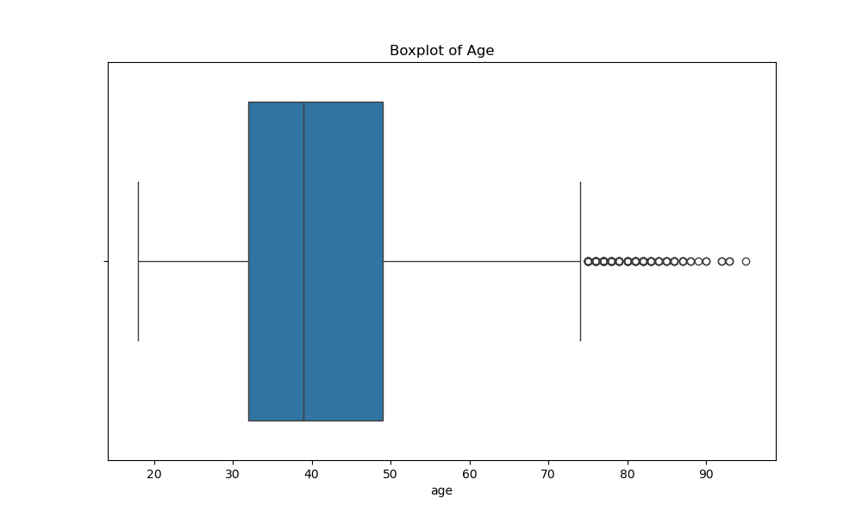
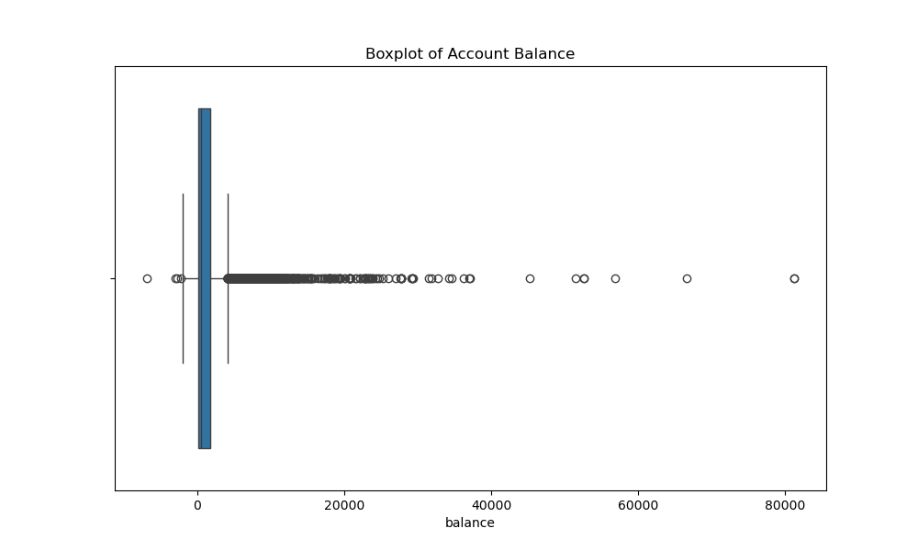
Introduction & Dataset Overview
Dataset Overview
Research Questions:
How can the bank leverage customer clusters to tailor financial products?
How can association rules help improve customer assessment models for predicting loan defaults?
How can the bank optimize resource allocation by identifying high-demand segments?
Numerical variables: balance and age
Categorical variables: job, marital, education, default, housing and loan
Data preprocessing: data was cleaned by handling missing values and outliers were identified and removed from “age” and “balance” columns by visualizing their boxplots.

Slide 3
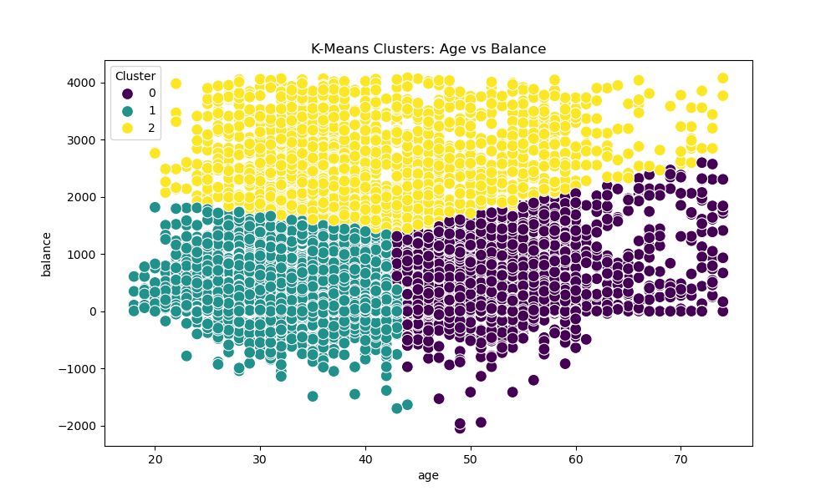
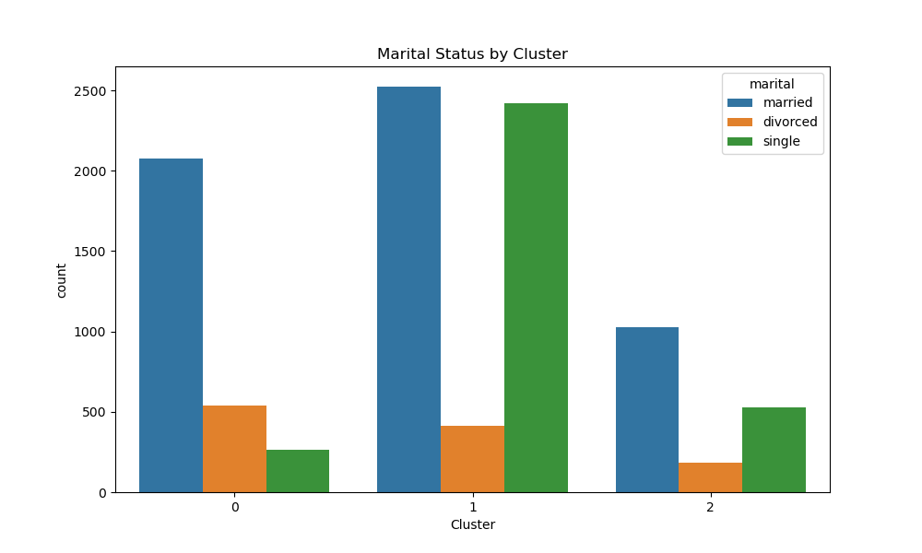
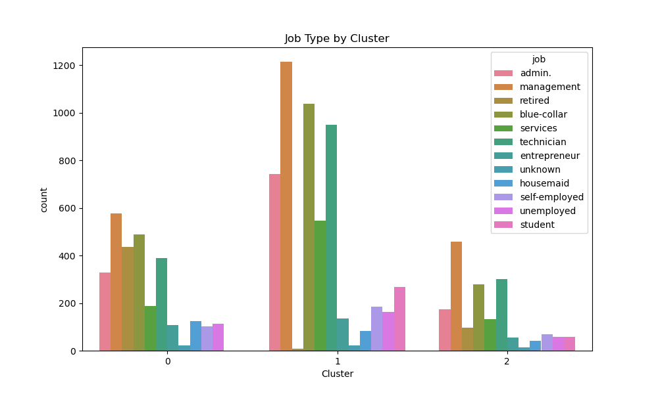
Clustering Approach & Results
Clustering Method:
Results:
K-means clustering was performed to group customers based on age and balance.
No PCA used, since reducing dimensionality was not necessary.
StandardScaler was used to scale the data.
Outliers were removed in order to gain clear clusters
Cluster 0: represents middle-aged individuals with low balance
Cluster 1: represents mostly young customers with average to low balance
Cluster 2: represents all customers with high balance
Marital and job status: cluster 1 has the highest proportion of married and single individuals and management jobs are the most prevalent.

Slide 4
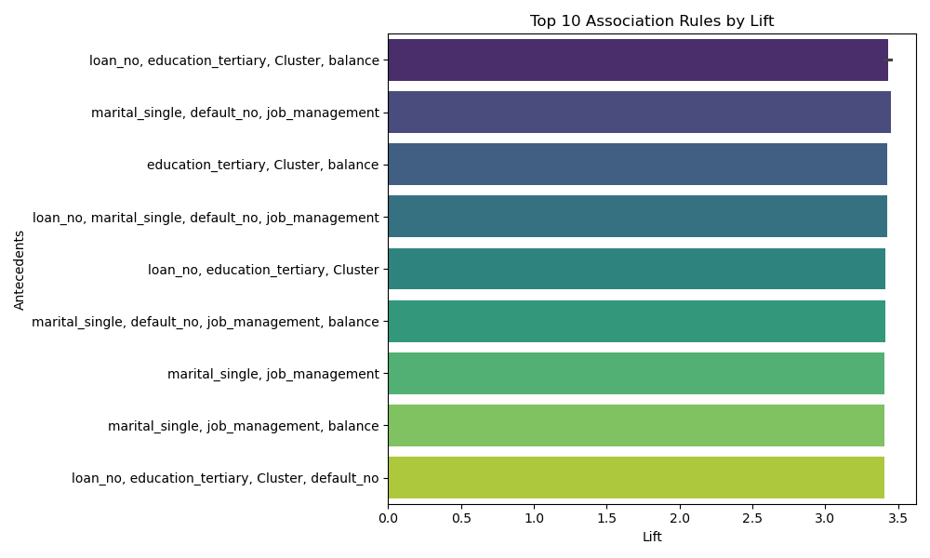
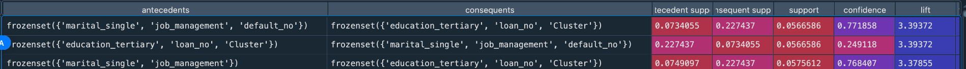
Association Rules & Results
Data Processing:
Data was binarized so that all values were binary(One-Hot Encoding)
Numerical variables (age and balance) were split into 2 categories : above median and below median.
Apriori algorithm was used for association rule mining.
The support threshold was set to 0.05 to filter out rare item sets.
Lift was used to identify strong relationships
Key rule:
Single customers with a management job and not in default are the most likely not to have a loan and to have tertiary education.

Slide 5
Business Insights & Recommendations
Insight 1: middle-aged customers with low balances may be facing financial struggles and may risk not having enough savings for emergencies or retirement.
Recommendation 1: the bank can offer savings plans to encourage customers to make small and consistent deposits in order to build up their funds.
Insight 2: single customers with management jobs who are not in default are less likely to have loans which implies higher financial stability.
Recommendation 2: the bank can make alternative offerings such as wealth planning services or even investment advice.
Insight 3: younger customers who have low to average account balances may be in the beginning of their financial journey and may be in need of financial assistance.
Recommendation 3: the bank could offer smaller and more manageable loans to these individuals, with lower interest rates in order for them to build up their credit history.

Slide 6
Limitations & Ethical Considerations
Limitations:
Limited variables: this dataset does not fully capture the complexity of customer behavior as it does not include information on spending habits and income.
Loss of information: during association rule mining, continuous variables such as balance were transformed into binary variables causing the loss of potential strong relationships.
Ethical Considerations:
Bias: demographic variables such as marital status and age may lead to creating false assumptions and in turn inappropriate recommendations for financial services.
Data privacy and transparency: customers should be aware of their data being used for analysis and this data should be handled securely and ethically.

Slide 7
Conclusion & Next Steps
Clustering has helped provide customer segments to which the bank can personalize services based on age and account balance.
Association rules have highlighted areas in which the bank should look into reallocation of services such as wealth management and investment guidance.
Next steps:
We could refine segmentation by adding more variables for a broader view of customer clusters.
We could also expand rule mining by adding more customer behavioral data that would be categorical in order to not lose valuable information.

Slide 8
Thank you for your attention!

