Slide 1
Audio Deepfake Detection

Slide 2
MODULE 1
Welcome & Context
01
Icebreaker poll + overview of the two modules.
0:00 – 0:15 · 15 min
Section 1 of 7
2 / 79

Slide 3
COURSE OVERVIEW
Two Modules · One Goal: Tell Real from Fake
3 / 79
A six-hour workshop in two modules — generation & attacks first, then detection & evaluation.
MODULE 1 · ~3 HOURS
MODULE 2 · ~3 HOURS
How Fake Voices Are Made
How We Detect Them
▸ Evolution & societal impact of voice synthesis
▸ Text-to-Speech (TTS): text → waveform
▸ Voice Conversion (VC): swap the speaker
▸ Logical Access (LA) & Replay attacks
▸ The artifacts each method leaves behind
▸ The passive detection pipeline
▸ Features: CQCC / LFCC → Wav2Vec2 / XLS-R
▸ ASVspoof datasets & train / dev / eval splits
▸ Evaluation: EER, t-DCF, AUC + generalization
▸ SincNet → RawNet → AASIST (end-to-end)
Both modules end with a hands-on lab and a worked example with answers.

Slide 4
LEARNING OUTCOMES
By the End, You Will Be Able To…
4 / 79
Explain how TTS and Voice Conversion synthesise or clone speech — and the spectral, temporal, phase and prosodic artifacts each leaves behind.
Distinguish the four attack scenarios (Logical Access, Physical Access, Replay, Deepfake) and what signal each exposes.
Build a passive detector: extract features, train a classifier, and output a real / fake score.
Evaluate a detector with EER, t-DCF and AUC — and reason about the cross-dataset generalization gap.
Trace the progression from hand-crafted features → SincNet → RawNet → AASIST toward end-to-end detection.
Connect detection to real-world security: voice-cloning fraud, biometric spoofing, and robustness under noise & compression.

Slide 5
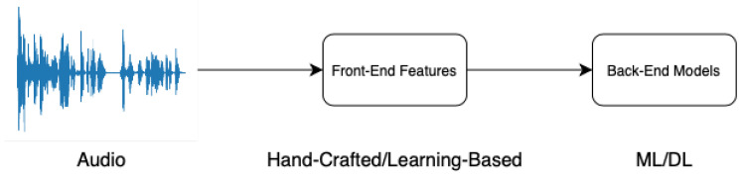
WHAT IS IT · 1 OF 3
What is Audio Deepfake Detection?
5 / 79
Audio deepfake detection = automatically deciding whether a voice clip is genuine human speech or AI-synthesised / manipulated audio.
A detector takes one audio clip → extracts features → classifies it as REAL or FAKE. (Zhang et al., Sensors 2025, CC BY 4.0)
▸ Why automatic? humans correctly spot fake speech only ~73% of the time — too unreliable to guard a phone line or a bank.
▸ One clip, one decision: the detector outputs a single real/fake verdict in real time — the job of every countermeasure in this course.

Slide 6
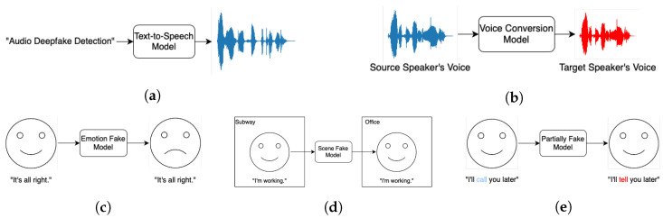
WHAT IS IT · 2 OF 3
What is Audio Deepfake Detection?
6 / 79
To detect a fake, you first have to know how it is made. Two engines create almost all fake speech:
Audio deepfake types: (a) text-to-speech (b) voice conversion (c–e) emotion / scene / partial fakes. (Zhang et al., Sensors 2025, CC BY 4.0)
Text-to-Speech (TTS)
Voice Conversion (VC)
Reads text in a voice that needs no original recording — the whole signal is synthesised from scratch.
Takes a real recording and re-renders it in someone else's voice — keeps the words, swaps the speaker.
Beyond TTS & VC: emotion / scene / partially-faked audio change only PART of a genuine clip — even harder to catch.

Slide 7
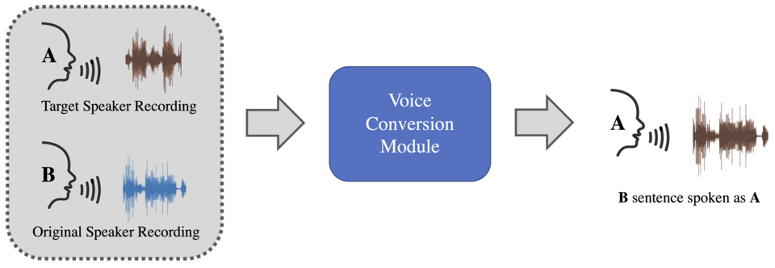
WHAT IS IT · 3 OF 3
What is Audio Deepfake Detection?
7 / 79
Cloning a voice now needs only seconds of audio — so detection is a security problem, not a curiosity.
Imitation-based audio deepfake generation: a few seconds of a target voice is enough to synthesise entirely new speech. (Wikimedia Commons, CC BY-SA 4.0)
73%
$25.6M
~3 sec
humans correctly spot fake speech — too unreliable to protect anything.
lost in one Hong Kong deepfake 'CFO' video call (2024).
of audio cloned from social media — then it can say anything.
So the task: build a detector that works in real time, on one clip, and generalises to voices it has never seen.
Source: Mai et al. (2023) PLoS ONE 18:e0285333; Hong Kong Police briefing, Feb 2024; diagram: Wikimedia Commons (CC BY-SA 4.0)

Slide 8
MODULE 1
Evolution & Societal Impacts
02
History of voice synthesis; real-world harms; ethics & regulation.
0:15 – 0:50 · 35 min
Section 2 of 7
8 / 79

Slide 9
ETHICS & REGULATION
Laws Restricting Audio Deepfakes — by Jurisdiction
9 / 79
Four jurisdictions, one shared idea: label synthetic audio, get consent, keep provenance.
European Union · AI Act (Reg. 2024/1689) · in force Aug 2024
Art. 50 transparency — deepfake audio/video must be labelled as AI-generated, and altered election media disclosed. Non-compliance fines reach up to €35M or 7% of global turnover.
United States · Federal (FCC / FTC) + State laws · 2024–25
FCC (2024): AI-voice robocalls illegal under the TCPA (fake Biden case). FTC §5 bans deceptive AI voices; Take It Down Act (2025) mandates 48h removal of intimate deepfakes. States (CA, TX, MN) add liability.
China · Deep Synthesis Provisions (CAC) · 2023; marking 2024
AI audio/video must be labelled and watermarked; deep-synthesis providers must verify users’ real identity. Using a person’s voice or likeness without consent, or publishing misleading synthetic content, is prohibited.
South Korea · PIPA + AI Basic Act · 2020; 2025
Non-consensual deepfakes are a criminal offence (imprisonment + fines); 2024 rules require AI election content to be labelled. The AI Basic Act (2025, effective 2026) adds oversight of high-risk AI and transparency duties.
Source: Reg. (EU) 2024/1689 Art. 50; FCC TCPA declaratory rul. (2024); Take It Down Act Pub.L. 119-12 (2025); CAC Deep Synthesis Provisions (2023); Korea PIPA / AI Basic Act (2025)

Slide 10
MODULE 1
Key Generation Techniques
03
TTS, Voice Conversion, LA & Replay attacks — and the artifacts each leaves behind.
0:50 – 1:20 · 35 min
Section 3 of 7
10 / 79

Slide 11
ROADMAP
Three Attack Types We Will Cover
11 / 79
Three ways a voice can be faked — each leaves different clues, so each needs a different detection strategy.
Text-to-Speech
Voice Conversion
Replay Attack
TTS
VC
REPLAY
Synthesises a brand-new voice from written text. No recording of the target is needed — the entire signal is artificial.
Takes a real recording and re-renders it in someone else’s voice — keeping the words, swapping the speaker.
The simplest: a genuine human voice is recorded and simply played back to the system. No AI is used, yet it still fools the verifier.
For each: how it is generated → what artefacts it leaves → how a detector catches it.

Slide 12
TTS · CONCEPT
Text-to-Speech — Three Stages
12 / 79
A modern neural TTS is a three-stage pipeline — each stage shapes how the result sounds.
① Text front-end
② Acoustic model
③ Vocoder
Tokens → phonemes (G2P); predict stress & prosody.
Phonemes → mel-spectrogram (the voice's time-frequency recipe).
Spectrogram → playable waveform (phase + samples).
Source: van den Oord et al. (2016) WaveNet arXiv:1609.03499; Shen et al. (2018) Tacotron 2 arXiv:1712.05884

Slide 13
TTS · BUILDING BLOCKS
Tokens & Phonemes — Atoms of Text and Sound
13 / 79
Before a model can speak a word, it first turns the text into units of sound.
EXAMPLE · how the word “speak” becomes sounds
“speak”
tokenize →
[ sp ]
[ eak ]
G2P →
/s/
/p/
/iː/
/k/
Token — a unit of TEXT
Phoneme — a unit of SOUND
▸ The chunk of text the model reads at once.
▸ Whole word: speak → [speak]
▸ Sub-word (BPE): speak → [sp][eak]
▸ Characters: speak → s p e a k
▸ Sub-words cover any word — even unseen ones.
▸ One speech sound — the atom of pronunciation.
▸ speak = /s p iː k/
▸ Letter “c”: /k/ in cat, /s/ in city
▸ G2P: grapheme → phoneme (spelling → sound)
▸ Tells the model how to SAY the word.
Source: IPA chart (Intl. Phonetic Association); Sennrich et al. (2016) BPE arXiv:1508.07909; Yao & Zweig (2015) G2P

Slide 14
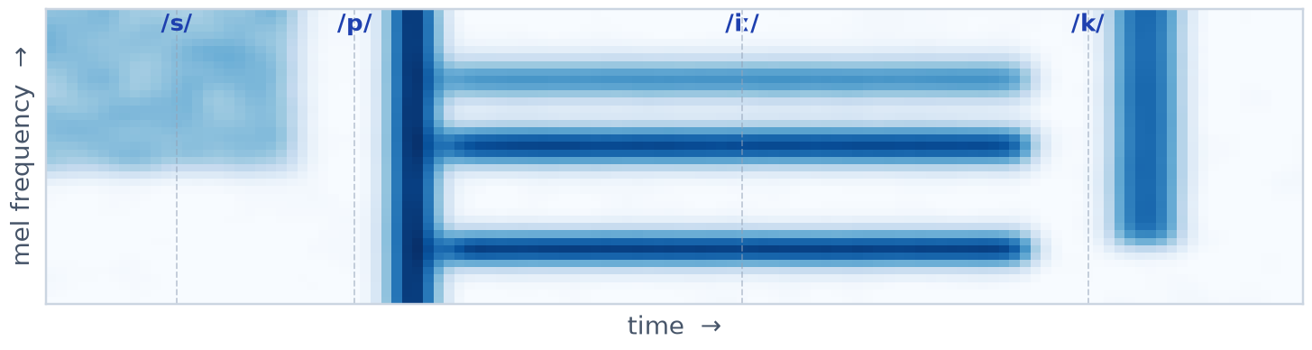
TTS · ACOUSTIC MODEL
The Acoustic Model — From Phonemes to a Voice
14 / 79
The acoustic model is the heart of TTS: it maps the phoneme sequence to a mel-spectrogram — a time × frequency picture of the voice.
Phonemes
Acoustic Model
Mel-spectrogram
Vocoder
Waveform
→
→
→
→
/s p iː k/
neural net
time × freq
neural net
audio
Mel-spectrogram for “speak” — the acoustic model’s output. Bright horizontal bands = vowel formants; dashed lines mark the four phonemes /s p iː k/.
What it does: a neural network (Tacotron 2, FastSpeech 2, SpeechT5) that converts the phoneme sequence into a mel-spectrogram — fixing pitch, timing, loudness and timbre. A separate vocoder (HiFi-GAN, WaveNet) then turns that picture into audible waveform samples.
Source: Shen et al. (2018) Tacotron 2 arXiv:1712.05884; Ren et al. (2020) FastSpeech 2 arXiv:2006.04558; Ao et al. (2022) SpeechT5 arXiv:2110.07205

Slide 15
TTS · MODEL
SpeechT5 — A Unified Speech Transformer
15 / 79
TTS is the task — turning text into speech. SpeechT5 is one model that performs it: built on T5’s encoder–decoder, it also does ASR, voice conversion and speech enhancement by swapping modular pre-/post-nets around a shared core.
Text
Text pre-net
Encoder–Decoder
Speech post-net
Vocoder
Waveform
→
→
→
→
→
raw words
tokens → hidden
shared core (T5)
→ mel-frames
HiFi-GAN
audio
SpeechT5 & TTS
Why it is unified
Deepfake angle
▸ TTS = the task: text → speech.
▸ SpeechT5 = one model that does TTS.
▸ Sits beside Tacotron 2, FastSpeech 2.
▸ One encoder–decoder for every task.
▸ Swap pre-/post-nets to switch task.
▸ Trained jointly on speech–text pairs.
▸ Open weights: microsoft/speecht5_tts.
▸ Makes clean, convincing cloned voices.
▸ Next page: run it in 7 lines.
Source: Ao et al. (2022) SpeechT5: Unified-Modal Encoder-Decoder Pre-Training for Spoken Language Processing, arXiv:2110.07205

Slide 16

TTS · CODE & DEMO
Example: Synthesize Speech with SpeechT5
16 / 79
What the code does
tts_demo.py
▸ Load: SpeechT5 TTS model + HiFi-GAN vocoder.
▸ Speaker: an x-vector embedding picks the timbre.
▸ Generate: text → acoustic model → vocoder → waveform.
▸ Classic demo: Google Duplex (2018) booked a restaurant by phone; the human could not tell.
# Text-to-Speech with SpeechT5
from transformers import (SpeechT5Processor,
SpeechT5ForTextToSpeech, SpeechT5HifiGan)
from datasets import load_dataset
name = "microsoft/speecht5_tts"
processor = SpeechT5Processor.from_pretrained(name)
model = SpeechT5ForTextToSpeech.from_pretrained(name)
vocoder = SpeechT5HifiGan.from_pretrained("...hifigan")
inputs = processor("Hello, class begins now.", return_tensors="pt")
spk = load_dataset("Matthijs/cmu_arctic",
split="validation")[0]["speaker_embeddings"]
wav = model.generate_speech(inputs["input_ids"], spk, vocoder=vocoder)
🎧 Listen: original vs. algorithm output
▶ Reference voice (real)
▶ SpeechT5 output

Slide 17
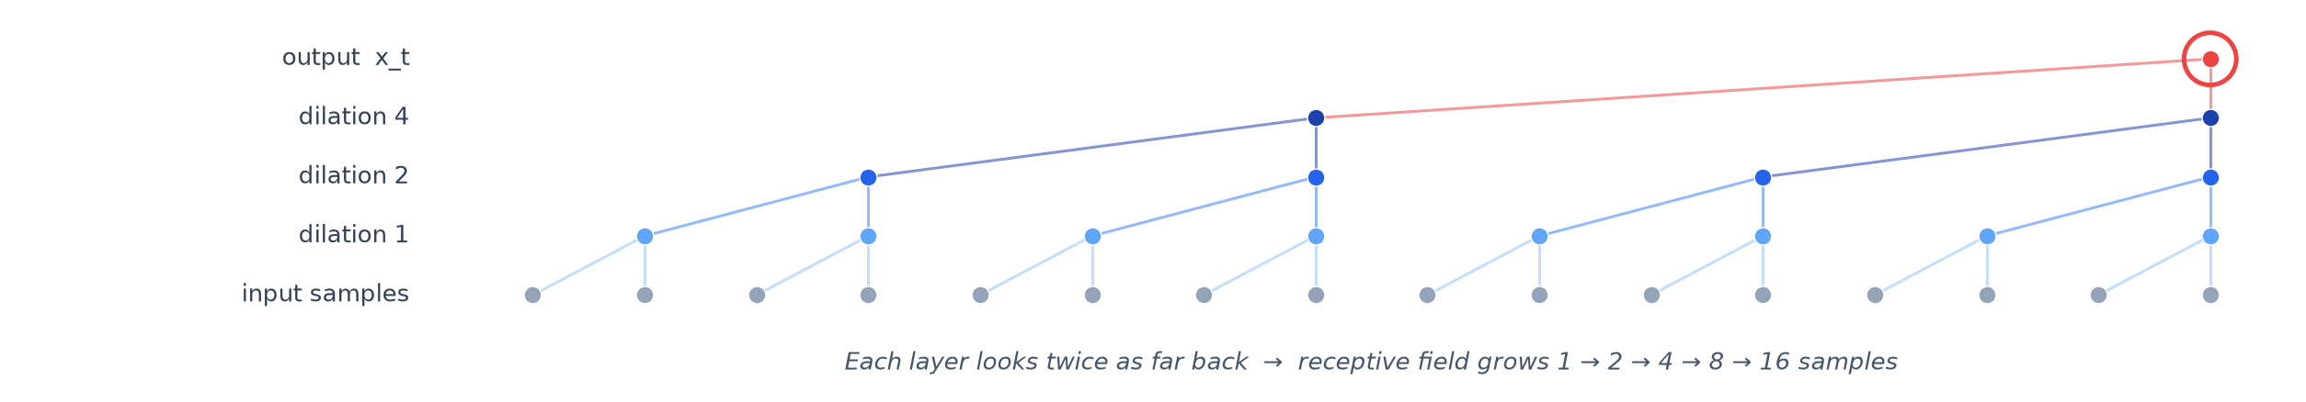
TTS · MODEL
WaveNet — Generating Audio One Sample at a Time
17 / 79
WaveNet (DeepMind, 2016) generates raw audio directly — predicting one waveform sample at a time from all past samples, using stacked dilated causal convolutions. It was the first neural net to sound truly human and still powers the vocoder inside TTS pipelines.
Stacked dilated causal convolutions — each layer looks twice as far into the past, so a deep stack covers thousands of samples with few parameters.
Causal + dilated
Autoregressive
Why it matters
▸ Causal: sees only the past → can generate.
▸ Dilated: each layer doubles the look-back.
▸ Deep stack → long history, few params.
▸ Predicts x_t from all past samples x_<t.
▸ Sample-by-sample, fed back in.
▸ Formula on the next slide.
▸ First neural TTS to sound human (2016).
▸ Vocoder in Tacotron 2 (mel → wave).
▸ Backbone of neural voice cloning.
Source: van den Oord et al. (2016) WaveNet: A Generative Model for Raw Audio, arXiv:1609.03499

Slide 18
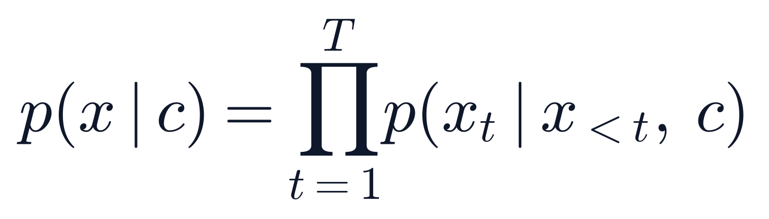
FORMULA · ①
WaveNet — Autoregressive Generation
18 / 79
Belongs to: TTS — Text-to-Speech — the generating rule that defines how a neural TTS makes each audio sample.
Symbols
x = waveform; c = condition (text); t = sample index; x_{<t} = past samples; T = total samples; ∏ = product over all t.
How to read it
Generate one sample at a time — each x_t depends only on the past x_{<t} and condition c; multiply all step probabilities for the whole waveform.

Slide 19
VC · PIPELINE
Voice Conversion — Change the Speaker, Keep the Words
19 / 79
Voice Conversion re-renders a recording in a different speaker’s voice: a content encoder keeps what is said, a target speaker embedding swaps whose voice it is, and a vocoder synthesises a new waveform.
Source speech
Content encoder
Target speaker
Conversion model
Vocoder
Converted speech
→
→
→
→
→
waveform
what is said
x-vector
content + speaker
CycleGAN
new voice
Keep content
Swap speaker
Re-synthesise
▸ Content encoder keeps the words.
▸ Features: bottleneck / PPG / mel.
▸ Speaker-independent — only what is said.
▸ Target x-vector sets the new voice.
▸ Model fuses content + speaker.
▸ Same words, different identity.
▸ Vocoder renders the fused features.
▸ Clean waveform in target voice.
Source: Qian et al. (2019) AutoVC arXiv:1905.05879; Li et al. (2021) FreeVC arXiv:2206.08847; CycleGAN-VC / StarGAN-VC → next slides

Slide 20
VC · CYCLEGAN-VC
CycleGAN-VC — Convert Voices Without Parallel Data
20 / 79
CycleGAN-VC converts a source speaker into a target speaker with two generators (source↔target) and two discriminators, tied by cycle-consistency — it needs no parallel recordings (the same sentences spoken by both).
Source X
G_ST
Fake Y
G_TS
Recon X
D_S , D_T
→
→
→
→
→
your voice
X → fake Y
target voice
Y → fake X
≈ Source X
real vs fake
Cycle consistency
Adversarial
No parallel data
▸ Round-trip G_TS(G_ST(x)) ≈ x.
▸ Preserves the linguistic content.
▸ Forces a realistic, faithful conversion.
▸ D_T pushes Fake Y toward a real target.
▸ D_S judges reconstructions of X.
▸ Each D tells real from converted.
▸ Trains on separate source & target sets.
▸ Same sentences by both NOT needed.
▸ Only a few samples of each speaker.
Source: Kaneko & Kameoka (2018) CycleGAN-VC arXiv:1711.11294; Zhu et al. (2017) CycleGAN arXiv:1703.10593

Slide 21
PRACTICE · Q1
Question 1
21 / 79
A text-to-speech system can read the SAME sentence in many different people’s voices.
▶ Question: what does the system change to switch from one speaker to another?
And in Voice Conversion (turning a recording into someone else’s voice) — what does it swap?

Slide 22
PRACTICE · Q1 — Answer
Answer 1
22 / 79
TTS: it swaps the speaker embedding — a small vector (an “x-vector”) that stands for “whose voice”. Same text + different embedding → different voice.
Voice Conversion: keep the content (z_c = what is said), swap in a new embedding (e_tgt = whose voice), then regenerate the audio.

Slide 23
M1 · CHALLENGE · QUANTITATIVE
WaveNet — Joint Probability of a Sequence
23 / 79
Problem. A WaveNet generates 5 audio samples with conditional probabilities 0.9, 0.8, 0.75, 0.6, 0.5 (each depends on the past). (a) What is the joint probability of the whole sequence? (b) Its natural-log probability? (c) A spoof clip scores a joint probability of 0.10 — which clip is more likely to be real?
Worked solution
Step 1. P(x₁..x₅) = 0.9 × 0.8 × 0.75 × 0.6 × 0.5 = 0.162
Step 2. log-prob = ln(0.162) = −1.82
Step 3. Compare the two clips by joint probability (higher = more likely real).
Step 4. 0.162 (clip 1) > 0.10 (spoof) → clip 1 is more likely real.
Answer. Joint P = 0.162 (log-prob −1.82); clip 1 is more likely real than the spoof.
Worked challenge — multi-step quantitative. WaveNet: P(x)=∏ P(xₜ|x_{<t},c) — slide p18.

Slide 24
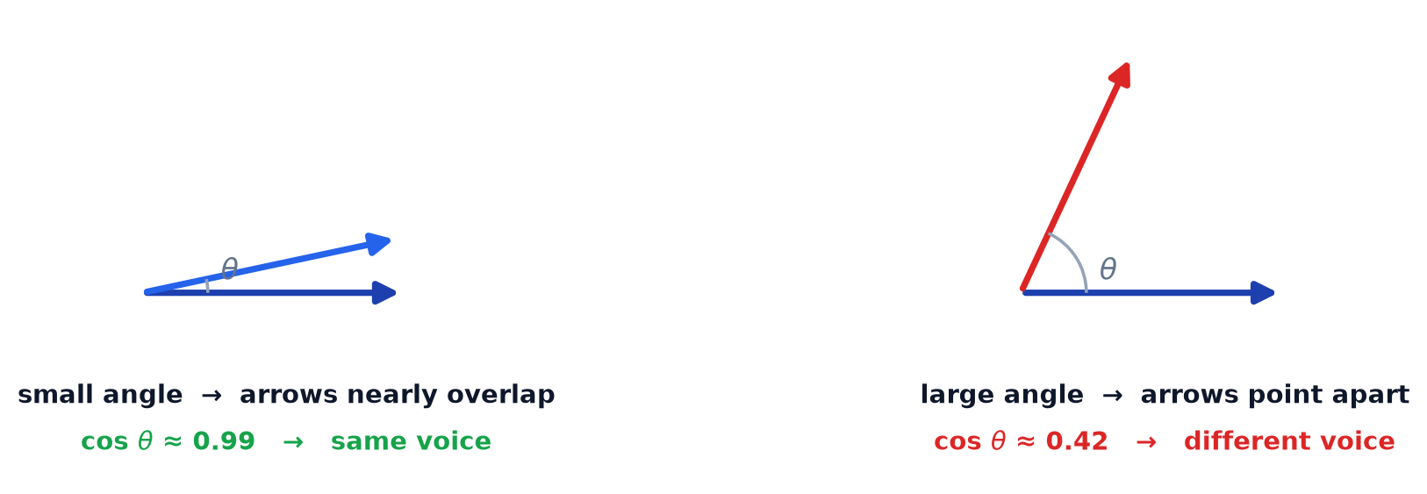
SPEAKER · COSINE SIMILARITY
Cosine Similarity — Do Two Voices Point the Same Way?
24 / 79
A neural net turns each voice into a list of numbers — think of it as an arrow. Cosine similarity simply asks: do two arrows point the same way? Same direction = same speaker.
The score is the cosine of the angle θ between the two arrows.
Same voice
Different voice
Why direction?
▸ Two arrows nearly overlap.
▸ Score close to 1.
▸ → same speaker.
▸ Arrows point apart.
▸ Score well below 1.
▸ → different speaker.
▸ Ignores loudness and length.
▸ Only the voice’s identity matters.
▸ So it is robust to volume.
Source: Speaker embeddings (x-vector) + cosine similarity — standard in ASV / ASVspoof

Slide 25

SPEAKER · COSINE SIMILARITY
Cosine Similarity — The Score & Catching a Fake
25 / 79
The score is the cosine of the angle between the two arrows — always between −1 and +1. A speaker-verifier compares a new clip to a stored reference: a high score means “same voice”, so a convincing fake scores dangerously high.
Top = how much the arrows agree. Bottom = cancels out loudness and length, leaving only direction.
opposite
unrelated
same voice
-1
0
+1
A real repeat of the same speaker sits near +1; a different voice drops toward 0.
How detectors use it: voice-conversion and TTS training try to push this score up (fake → target). A detector flags a clip whose embedding is too close to a known target, yet lacks a real recording’s natural variability.
Source: cosine scoring on speaker embeddings — ASVspoof challenge; used in the verification code on later slides

Slide 26
PRACTICE · Q4
Question 4
26 / 79
After Voice Conversion, we score how close the result is to the target voice:
1 = identical voice, 0 = completely unrelated.
The score comes out as 0.98.
▶ What does 0.98 tell you? And what would a score of about 0.5 mean?

Slide 27
PRACTICE · Q4 — Answer
Answer 4
27 / 79
0.98 (≈ 1): the converted voice is almost identical to the target — the conversion succeeded.
≈ 0.5: only halfway similar — the target’s voice did not really transfer; the conversion mostly failed.

Slide 28
M1 · CHALLENGE · QUANTITATIVE
Cosine Similarity — Compute It by Hand
28 / 79
Problem. An enrolled speaker has embedding e = (3, 4), so |e| = 5. Three test clips arrive: a = (2, 1), b = (4, 5), c = (1, 3). Compute the cosine similarity of each to e. A clip is accepted as the same speaker only if cosine ≥ 0.95. Which clip(s) pass?
Worked solution
Step 1. cos(e,a) = (3·2 + 4·1) / (5·√5) = 10 / 11.18 = 0.894
Step 2. cos(e,b) = (3·4 + 4·5) / (5·√41) = 32 / 32.02 = 0.999
Step 3. cos(e,c) = (3·1 + 4·3) / (5·√10) = 15 / 15.81 = 0.949
Step 4. Threshold check: only b (0.999) ≥ 0.95.
Answer. Only clip b passes (cos 0.999); a = 0.894 and c = 0.949 are rejected.
Worked challenge — multi-step quantitative. cos(θ)=e·v/(|e||v|) — slides p21–22.

Slide 29
REPLAY · CONCEPT
Replay Attack — Record a Real Voice, Play It Back
29 / 79
A replay attack is the simplest spoof: record a genuine human utterance, then play it back to the voice verifier. No AI is used — the voice is 100% real, so words, prosody and timbre are genuine. It fools any system that only asks ‘does this match the enrolled voice?’
Genuine speech
Record
Speaker + Room
Verifier mic
System
→
→
→
→
real utterance
→ wav file
the 2nd channel
records it
decides
Classification — by playback chain (easy → hard to detect)
Phone → phone
Speaker, quiet room
Studio monitor + mic
▸ Tiny speaker, compressed, band-limited.
▸ Strongest channel coloration.
▸ Easiest to detect.
▸ External / Bluetooth speaker.
▸ Cleaner playback, less coloration.
▸ Medium difficulty.
▸ Hi-fi playback, low reverb.
▸ Weak channel signature.
▸ Hardest to detect.
Source: ASVspoof 2017 Physical-Access (PA) replay corpus; Chen et al. (2015) CQCC features

Slide 30
REPLAY · DETECTION
The Second Channel — How a Replay Gives Itself Away
30 / 79
The replayed voice is genuinely human, so there is nothing synthetic to find. The one clue a replay cannot hide: it was played through a loudspeaker and a room — a second acoustic channel that imprints its own signature on the sound.
Loudspeaker
Room
Recorder
▸ Band-limits and colors the sound.
▸ A mic never records a speaker cleanly.
▸ → timbre shifts, high frequencies cut.
▸ Adds reverberation.
▸ Echoes of the replay room.
▸ → smeared, hollow reverb tail.
▸ The verifier mic captures all of it.
▸ Double coloration on top of the voice.
▸ → the channel fingerprint.
Detection & defence: classifiers (CQCC/MFCC + GMM, or neural nets) learn this channel signature — a live genuine utterance lacks it, so the replay is flagged. The strongest fix is liveness / challenge-response, asking the speaker for something a recording cannot give.
Source: Todisco et al. (2017) CQCC-GMM for replay detection arXiv:1710.06635; liveness / challenge-response countermeasures

Slide 31
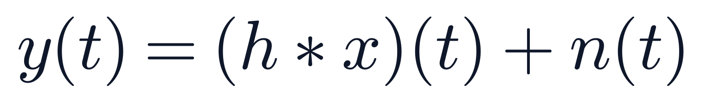
FORMULA · ④
Replay — Signal Model
31 / 79
Belongs to: Replay attack — why a replay is detectable even though the voice is genuinely human.
Symbols
y = mic signal; x = real recording; h = speaker + room; n = noise; ∗ = convolve.
How to read it
Replay passes x through a speaker+room (convolve with h) and adds noise n — that channel is the only fingerprint.

Slide 32
REPLAY · CODE & DEMO
Example: Mount a Replay Attack
32 / 79
What the code does
replay_attack.py
▸ Record: take a genuine (bona-fide) utterance.
▸ Channel: convolve with speaker + room impulse response h.
▸ Noise: add ambient noise n → the re-recorded clip.
▸ Detect side: countermeasures look for reverb / coloration, not synthesis.
# Mount a replay attack: re-record a real voice through a speaker+room
import soundfile as sf, numpy as np
from scipy.signal import fftconvolve
bona_fide, sr = sf.read("victim_enrollment.wav")
# replay channel = loudspeaker + room impulse response h, plus noise n
# y(t) = (h * x)(t) + n(t)
h_room = np.load("room_ir.npy")
replayed = fftconvolve(bona_fide, h_room)
replayed = replayed[:len(bona_fide)]
replayed += np.random.normal(0, 1e-3, replayed.shape)
sf.write("replay_attempt.wav", replayed.astype(np.float32), sr)
🎧 Listen: original vs. algorithm output
▶ Original recording
▶ Replayed (speaker+room)

Slide 33
PRACTICE · Q2
Question 2
33 / 79
A bank checks who you are by your voice. Two fraud attempts:
(A) The fraudster plays a REAL recording of the customer — through a laptop speaker — into the phone.
(B) The fraudster sends an AI-generated voice file of the CEO through the bank’s website.
▶ For each: is it a Replay attack or a Logical-Access attack? And what clue should the detector look for?

Slide 34
PRACTICE · Q2 — Answer
Answer 2
34 / 79
(A) Replay — a real recording is just played back. The voice is genuine, so look for the loudspeaker+room effects: reverb, muffling, noise.
(B) Logical Access — a fake file sent straight in. It never touched a mic, so look for synthesis traces: unnatural spectrum / phase.

Slide 35
M1 · CHALLENGE · QUANTITATIVE
Replay Attack — High-Frequency Loss in Decibels
35 / 79
Problem. A replay loudspeaker band-limits the signal so the clip keeps only 18% of its original high-frequency energy. (a) Express this loss in decibels. (b) A detector flags any clip whose high-frequency loss exceeds 6 dB — is this replay flagged? (c) The room adds reverberation with T₆₀ = 0.4 s; for a 1.2 s clip, how many reverb 'tails' smear it?
Worked solution
Step 1. Loss = 10·log₁₀(0.18) = 10 × (−0.745) = −7.45 dB
Step 2. Magnitude of loss = 7.45 dB, which is > 6 dB → flagged.
Step 3. Reverb tails = clip duration / T₆₀ = 1.2 / 0.4 = 3.
Step 4. So the replay is both band-limited (−7.45 dB) and smeared by ~3 tails.
Answer. −7.45 dB loss → flagged; ~3 reverb tails smear the 1.2 s clip.
Worked challenge — multi-step quantitative. Replay signal model y = h ∗ x + n — slide p25.

Slide 36
MODULE 1
Passive Detection Methods & Datasets
04
Traditional vs learning-based detection; ASVspoof LA / PA / DF, WaveFake, In-the-Wild, ADD.
1:35 – 2:05 · 30 min
Section 4 of 7
37 / 79

Slide 37
M1 · DETECTION
What is Passive Detection?
38 / 79
Passive = the detector only listens to the audio and decides real or fake. It cannot challenge the speaker (unlike active methods that ask for a random phrase).
Audio clip
Features (CQCC / MFCC / Wav2Vec2)
Model (GMM / CNN / AASIST)
Score s
s ≥ τ ? → Real
›
›
›
›
Why passive matters
▸ No interruption: a bank's voice lock must verify a real call without asking 'please read this random sentence'.
▸ Real-time: the decision happens in milliseconds, on a single clip of audio.
▸ Adversarial: the attacker knows the detector exists and tries to evade it — so the detector must generalize beyond known attacks.

Slide 38
M1 · ARTIFACT
Artifacts — Three Dimensions a Fake Cannot Hide
39 / 79
A deepfake is never a perfect copy — it leaves measurable traces (artifacts) in three independent dimensions, taken apart in the pages that follow.
Spectral
Temporal
Phase
The frequency make-up of the voice. A vocoder fake can’t rebuild the fine high-frequency texture a real voice has — its highs look smoothed.
How the sound changes over time. A deepfake over-smooths the sharp transitions and tiny pitch jitter of real speech.
The exact timing alignment within each cycle. Generators ignore phase, so reconstruction leaves a buzzy incoherence.
▸ Cue: missing high-freq detail.
▸ Detect: CQCC / spectrogram CNN.
▸ Cue: smeared transitions.
▸ Detect: F0 / modulation features.
▸ Cue: phasey / metallic buzz.
▸ Detect: phase / raw-waveform net.
Next: Spectral → Temporal → Phase — each gets a concept page and a listen page (p27–p32); summary on p33.
Source: Patel & Patil (2017) deepfake artifacts; Bonetti & Nanni phase cues; ASVspoof countermeasures exploit these three classes

Slide 39
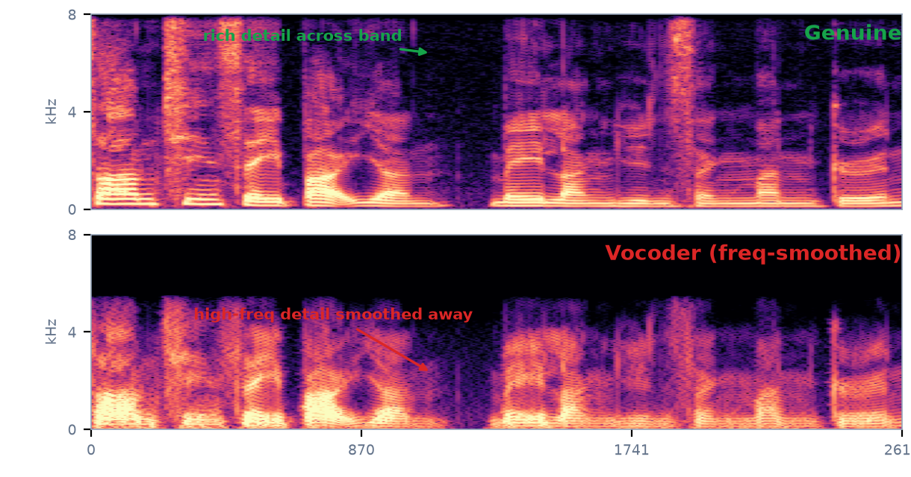
M1 · ARTIFACT 1 / 3 · SPECTRAL
Spectral Artifacts — Where the Fine Detail Vanishes
40 / 79
A spectrogram-based deepfake rebuilds sound from a coarse set of spectral bands. It cannot recreate the fine, high-frequency texture a real vocal tract always produces — so the upper part of its spectrogram looks smoothed and empty.
WHY IT HAPPENS
▸ Low resolution at high freq — mel-bands & neural vocoders average the highs.
▸ Vocoder resynthesis blurs fine harmonic / formant structure.
▸ Listen for: missing 'air', softened s, sh, f sounds.
Magnitude spectrogram of REAL speech. The vocoder fake loses detail above ~3 kHz.
Source: Spectral artifacts of neural vocoders; ASVspoof LA countermeasures (CQCC / spectrogram CNN)

Slide 40

M1 · ARTIFACT · LISTEN
Hear the Spectral Artifact
41 / 79
A real human recording vs. the same speech put through the deepfake step that breaks this dimension.
Genuine · real recording
WHAT TO LISTEN FOR
▸ Genuine: bright, crisp, full of air.
▸ Deepfake: duller, muffled, the highs washed out.
▸ Same words — the fake lost the sparkle.
Deepfake · vocoder resynthesis
Takeaway: this washed-out high end is exactly the spectral signature a detector flags.
Source: Audio: real human speech (16 kHz corpus) · converted with the actual deepfake DSP (STFT magnitude manipulation / Griffin-Lim) to isolate each artifact

Slide 41
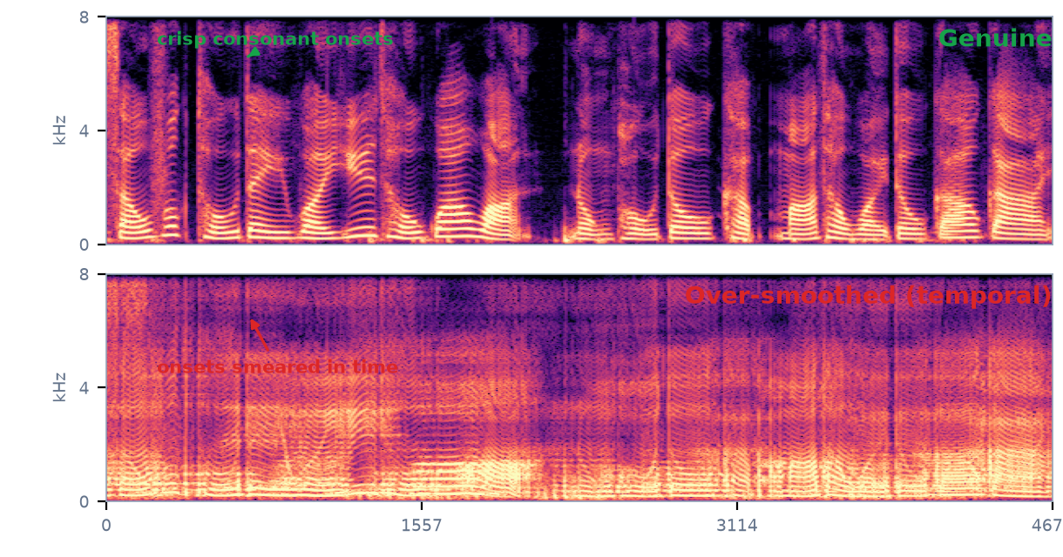
M1 · ARTIFACT 2 / 3 · TEMPORAL
Temporal Artifacts — A Pulse That's Too Smooth
42 / 79
Real speech carries fast changes — the crisp onset of a 't', the snap of a 'k'. A deepfake trained for smoothness over-smooths these in time, so the transitions blur together and the micro-randomness of a real voice flattens out.
WHY IT HAPPENS
▸ Generators blur fast temporal modulations.
▸ Consonant onsets & micro-jitter get averaged away.
▸ Listen for: slurred, lispy, 'watery' transitions.
Spectrogram of REAL speech. The over-smoothed fake smears onsets across time.
Source: Temporal over-smoothing in neural TTS/VC; modulation-frequency features capture it

Slide 42
M1 · ARTIFACT · LISTEN
Hear the Temporal Artifact
43 / 79
A real human recording vs. the same speech put through the deepfake step that breaks this dimension.
Genuine · real recording
WHAT TO LISTEN FOR
▸ Genuine: sharp consonants, lively detail.
▸ Deepfake: slurred, smeared, slightly watery.
▸ The blurring of fast changes is the cue.
Deepfake · temporal over-smoothing
Takeaway: detectors measure this modulation sharpness; transitions that smear read as synthetic.
Source: Audio: real human speech (16 kHz corpus) · converted with the actual deepfake DSP (STFT magnitude manipulation / Griffin-Lim) to isolate each artifact

Slide 43
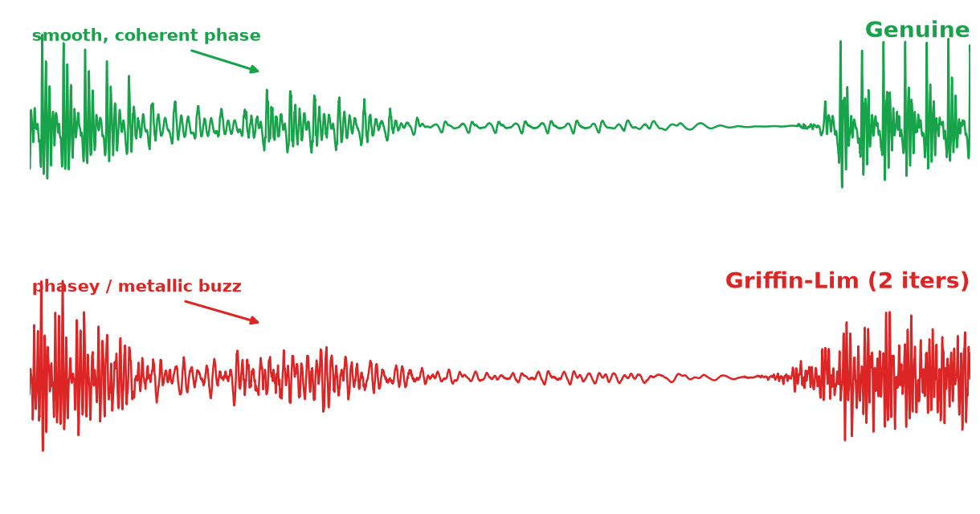
M1 · ARTIFACT 3 / 3 · PHASE
Phase Artifacts — When the Waveform Won't Line Up
44 / 79
Phase is the exact timing offset within each cycle. Humans are nearly deaf to absolute phase, so generators neglect it. But reconstructing speech from a magnitude spectrogram (Griffin–Lim, overlap-add) leaves phase incoherence — a buzzy, metallic edge a person barely hears.
WHY IT HAPPENS
▸ Griffin–Lim / vocoder hops guess the phase, imperfectly.
▸ Concatenation joins frames that don't align in phase.
▸ Listen for: a buzzy, metallic, 'phasey' tinge.
Waveform zoom of REAL speech. The Griffin–Lim fake shows incoherent, phasey cycles.
Source: Phase as a deepfake cue; STFT / Griffin–Lim phase reconstruction artifacts

Slide 44
M1 · ARTIFACT · LISTEN
Hear the Phase Artifact
45 / 79
A real human recording vs. the same speech put through the deepfake step that breaks this dimension.
Genuine · real recording
WHAT TO LISTEN FOR
▸ Genuine: a clean, coherent waveform.
▸ Deepfake: buzzy / metallic / phasey.
▸ Subtle to a person — loud to a model.
Deepfake · Griffin–Lim (2 iters)
Takeaway: people ignore phase, so it is one of the strongest tells a detector exploits.
Source: Audio: real human speech (16 kHz corpus) · converted with the actual deepfake DSP (STFT magnitude manipulation / Griffin-Lim) to isolate each artifact

Slide 45
M1 · ARTIFACT → DETECTION
From Artifacts to Detectors
46 / 79
Each artifact dimension maps to a family of detector features. The next two pages turn those features into a working real/fake classifier.
Dimension
The artifact — the cue
Detector we study
Spectral
Smoothed, missing high-frequency detail
CQCC + GMM (p34)
Temporal
Over-smoothed transitions
Wav2Vec2 (Lecture2)
Phase
Incoherent / phasey waveform
AASIST (Lecture2)
In depth: three detectors — CQCC + GMM (p34–35) → AASIST (Lecture2) → Wav2Vec2 (Lecture2).
Source: three detectors studied in depth: CQCC+GMM, AASIST, Wav2Vec2 (p34–39)

Slide 46
M1 · DETECTION 1 / 3 · CQCC + GMM
CQCC + GMM — The Classic Countermeasure
47 / 79
The ASVspoof baseline: hand-crafted CQCC features + a Gaussian-Mixture classifier per class. Simple, fast, interpretable — the reference every neural model is compared against.
Audio
Constant-Q transform
log + DCT = CQCC
GMM real + spoof
LLR score
→
→
→
→
16 kHz wav
log-spaced freq
cepstral vector
two mixtures
real vs spoof
What is CQCC?
Why a Gaussian Mixture?
▸ Constant-Q transform — log-spaced frequency bins (octaves), so low frequencies get fine resolution where speech detail lives.
▸ Then log-power and a DCT → cepstral coefficients.
▸ Why it works — this fine spectral resolution exposes the smoothing a vocoder leaves; MFCC is too coarse.
▸ GMM — a weighted sum of Gaussians modelling each class's feature distribution.
▸ Score — log-likelihood ratio LLR = log P(real) − log P(spoof).
▸ Decide — LLR > threshold τ ⇒ real, else spoof.
▸ Result — ~9–11% EER on ASVspoof 2019 unseen attacks.
Source: Todisco et al. (2017) CQCC; Reynolds GMM; ASVspoof 2015–19 baseline countermeasure

Slide 47
M1 · DETECTION 1 / 3 · CODE
CQCC + GMM — in Code
48 / 79
Extract CQCC, fit two GMMs, score by log-likelihood ratio.
cqcc_gmm.py
# CQCC + GMM spoof detector (scikit-learn)
from sklearn.mixture import GaussianMixture
from cqcc import cqcc # constant-Q cepstral coefficients
import numpy as np
def feat(x, fs): # 1. CQCC features per clip
c, T = cqcc(x, fs, num_ceps=30)
return np.mean(c, axis=0) # average over time -> 1 vector
X_real = [feat(x, fs) for x in real_clips]
X_spoof = [feat(x, fs) for x in spoof_clips]
gmm_real = GaussianMixture(64).fit(X_real) # 2. one model per class
gmm_spoof = GaussianMixture(64).fit(X_spoof)
def score(x): # 3. log-likelihood ratio
f = feat(x, fs)[None, :]
return gmm_real.score(f) - gmm_spoof.score(f)
decision = "real" if score(new_clip) > tau else "spoof" # 4. threshold
Source: cqcc package; sklearn GaussianMixture; LLR scoring — ASVspoof baseline

Slide 48
M1 · DATASETS · BENCHMARK
ASVspoof — The Benchmark Series
49 / 79
Where the detectors above are judged. Each edition added harder attacks, and the eval set always holds unseen spoofs — testing the generalization the artifact lesson (p33) said matters.
2015
2017
2019
2021
2024+
→
→
→
→
synthetic + VC
+ replay (PA)
LA + PA — most cited
+ deepfake, codecs
adversarial DF
Why this benchmark design matters
▸ LA · PA · DF — Logical Access (TTS/VC), Physical Access (replay), DeepFake: three sub-tasks mapping to the three attack types.
▸ Unseen-eval — the EVAL set uses spoof systems absent from training, so a detector that merely memorized training attacks fails here.
Link: a detector that watches all three artifact dimensions (p33) is exactly what survives an unseen-eval benchmark.
Source: ASVspoof 2015–2024 challenge series; Wu et al. 2019, Yamagishi et al. 2021

Slide 49
MODULE 1
Evaluation & Accuracy
05
2:05 – 2:35 · 30 min
Section 5 of 7
50 / 79

Slide 50
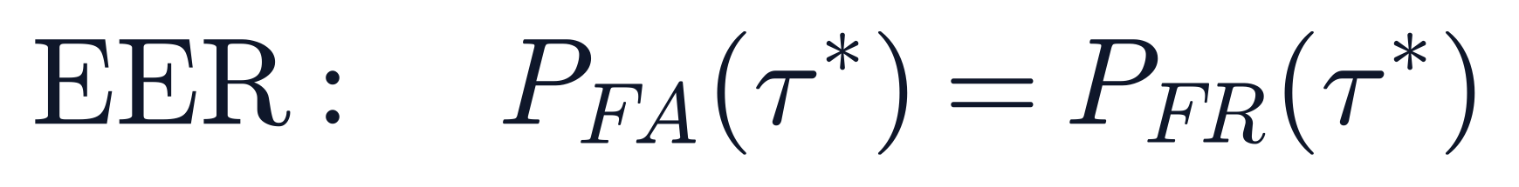
FORMULA · ⑤
EER — Equal Error Rate
51 / 79
Belongs to: Detection — evaluation — the metric that scores how good a spoofing countermeasure is.
Symbols
τ = threshold; P_FA = false-accept rate; P_FR = false-reject rate.
How to read it
Tune τ until false-accepts equal false-rejects — that shared rate is the EER; lower = better.

Slide 51
M1 · EVALUATION
Computing EER in Code
52 / 79
How to get EER from raw scores:
compute_eer.py
▸ Step 1: feed all test-clip scores + true labels to roc_curve.
▸ Step 2: find the point where FAR (fpr) = FRR (1 − tpr).
▸ Step 3: that rate is the EER; the corresponding threshold is τ*.
▸ Tip: AUC = area under the full ROC curve — report both.
# Compute EER and AUC from detection scores
from sklearn.metrics import roc_curve, auc
import numpy as np
# labels: 1 = bonafide, 0 = spoof
# scores: higher = more likely bonafide
fpr, tpr, thresholds = roc_curve(labels, scores)
# EER: the point where fpr == 1 - tpr
eer_idx = np.argmin(np.abs(fpr - (1 - tpr)))
eer = fpr[eer_idx]
eer_thresh = thresholds[eer_idx]
# AUC: area under the ROC curve
auc_score = auc(fpr, tpr)
print(f"EER = {eer:.1%} at threshold {eer_thresh:.3f}")
print(f"AUC = {auc_score:.3f}")

Slide 52
PRACTICE · Q3
Question 3
53 / 79
A fake-voice detector scores every clip 0–1. A cut-off τ decides: score ≥ τ ⇒ accepted as REAL.
Two mistakes can happen: False-Accept (a fake slips through) and False-Reject (a real clip rejected).
τ = 0.40 → 20% of fakes accepted, 5% of reals rejected.
τ = 0.60 → 5% of fakes accepted, 20% of reals rejected.
▶ The EER is the point where the two error rates are equal. Find the EER.

Slide 53
PRACTICE · Q3 — Answer
Answer 3
54 / 79
As τ rises from 0.40 to 0.60:
fake-accepts fall 20% → 5%, and real-rejects rise 5% → 20% (both move 15 points over Δτ = 0.20).
They move at the same speed, so they cross in the middle:
τ ≈ 0.50, where both error rates equal ≈ 12.5%.
EER = 12.5%

Slide 54
M1 · CHALLENGE · QUANTITATIVE
EER from a Score Table
55 / 79
Problem. Eight test clips (4 real R, 4 spoof S), sorted high → low (score ≥ τ ⇒ accepted as REAL): 0.93 R, 0.85 R, 0.72 R, 0.68 S, 0.64 R, 0.58 S, 0.41 S, 0.22 S. Sweep the threshold τ and find the EER (the point where false-alarm rate FAR = false-reject rate FRR).
Worked solution
Step 1. FAR = P(score ≥ τ | spoof); FRR = P(score < τ | real).
Step 2. Try τ ≈ 0.66 (between 0.68 S and 0.64 R): spoofs ≥ τ = {0.68} → FAR = 1/4 = 0.25.
Step 3. Reals < τ = {0.64} → FRR = 1/4 = 0.25.
Step 4. At τ ≈ 0.66 the two error rates are equal → that rate is the EER.
Answer. EER = 25% at τ ≈ 0.66 (one real and one spoof cross over at the boundary).
Worked challenge — multi-step quantitative. EER = the shared rate where FAR = FRR — slide p42.

Slide 55
M1 · GENERALIZATION
Why Cross-Dataset Detection Fails
56 / 79
A model trained on ASVspoof 2019 can score 0.83% EER — but test it on 2021 and EER jumps to ~17%. Why?
Unseen TTS
Compression
Domain shift
Each TTS system leaves a different spectral fingerprint. A model trained on WaveNet + Tacotron spoofs may miss spoofs from VITS or a brand-new system it has never seen.
Real-world audio goes through mp3, opus, or AMR codecs. These add quantization noise that MASKS the subtle artifacts the detector learned to spot.
Different recording devices, languages, accents, noise conditions. The statistical distribution of the test data differs from training — the model's assumptions break.

Slide 56
MODULE 1
Guided Lab 1
06
Extract features, train a baseline detector, visualize real vs fake.
2:35 – 2:50 · 15 min
Section 6 of 7
57 / 79

Slide 57
M1 · LAB
Lab — Build a Deepfake Detector
58 / 79
A self-contained Colab notebook — it synthesizes its own bonafide vs spoof clips, so it runs with no downloads. Your job: extract features, train a classifier, score, and report the EER.
Your four tasks
Setup
▸ Task 1 — Features: take 13 MFCC coefficients per clip (torchaudio), averaged over time.
▸ Task 2 — Train: fit one Gaussian (mean + covariance) per class on 200 train clips.
▸ Task 3 — Score: score 200 test clips by log-likelihood ratio LLR = log P(spoof) − log P(real).
▸ Task 4 — Evaluate: sweep a threshold; find the EER where false-alarm rate = false-reject rate.
▸ Open Colab → paste the code (p41).
▸ Needs only numpy, scipy, torchaudio — all preinstalled.
Deliverable
▸ One number: the EER.
▸ A DET curve (false-alarm vs false-reject).
▸ Compare with the reference answer on p42.
Source: Self-contained synthetic dataset (no download); mirrors the spectral-artifact idea from p27

Slide 58
M1 · LAB · CODE
Lab — Reference Code (Colab-ready)
59 / 79
Copy into one Colab cell → Run. Output: EER = 12.0%
lab_deepfake_detector.py
# Lab: Audio Deepfake Detector — MFCC -> Gaussian -> EER (Colab, no downloads)
import numpy as np, torch, torchaudio
from scipy.signal import butter, filtfilt
SR=16000
MFCC=torchaudio.transforms.MFCC(SR,n_mfcc=13,melkwargs=dict(n_fft=512,hop_length=160,n_mels=40))
np.random.seed(0)
def synth(spoof,n=16000): # 1. bonafide vs spoof vowel clip
t=np.arange(n)/SR; ph=2*np.pi*np.cumsum(np.random.uniform(95,135)+4*np.sin(2*np.pi*4*t))/SR
s=sum(0.7*np.exp(-((h*120-700)/150)**2)*np.sin(h*ph) for h in range(1,40))+np.random.randn(n)*0.08
r=np.random.rand()
if spoof: cut=np.random.uniform(6000,7400) if r<0.30 else np.random.uniform(3000,4600)
elif r<0.18: cut=np.random.uniform(5200,6800) # a few reals are slightly muffled
else: cut=None
if cut is not None: s=filtfilt(*butter(4,cut/(SR/2)),s)
return s.astype('f')
def feat(x): return MFCC(torch.from_numpy(x)).mean(1).numpy() # 2. MFCC feature
def mk(N): y=np.array([i%2 for i in range(N)]); return np.array([feat(synth(b)) for b in y]), y
Xtr,ytr=mk(200); Xte,yte=mk(200)
def fit(X): return X.mean(0), np.cov(X,rowvar=False)+np.eye(13)*1e-3
def lp(X,m,c):
_,ld=np.linalg.slogdet(c); d=X-m
return -0.5*(13*np.log(2*np.pi)+ld+np.einsum('ij,jk,ik->i',d,np.linalg.inv(c),d))
mr,cr=fit(Xtr[ytr==0]); ms,cs=fit(Xtr[ytr==1])
score=lp(Xte,ms,cs)-lp(Xte,mr,cr) # 3. LLR (high => spoof)
sr_,ss_=score[yte==0],score[yte==1]; best=eer=1.0
for t in np.unique(score): # 4. sweep threshold -> EER
far,frr=np.mean(sr_>=t),np.mean(ss_<t)
if abs(far-frr)<best: best=abs(far-frr); eer=far
print(f"EER = {eer*100:.1f}%")
Source: Verified runnable: numpy + torchaudio + scipy; prints EER = 12.0% on a CPU laptop / Colab

Slide 59
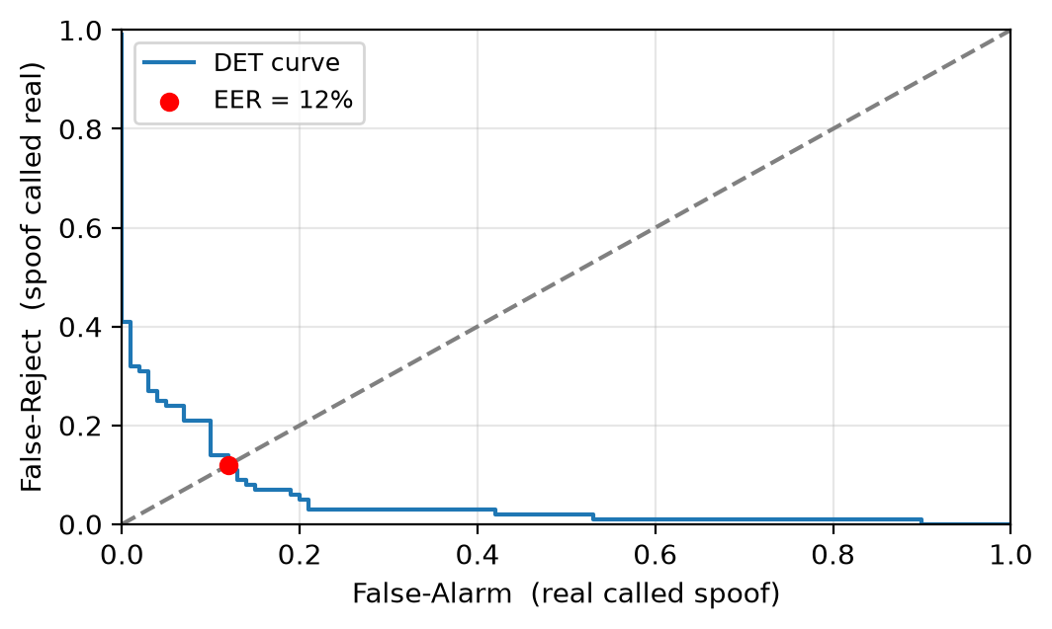
M1 · LAB · ANSWER
Lab — Reference Answer
60 / 79
Reference result: EER ≈ 12% — a realistic, non-trivial number (not 0%).
Why ≈ 12% and not 0%?
▸ Mild spoofs (cutoff 6–7.4 kHz) look nearly real → false rejects.
▸ A few muffled reals → false alarms.
▸ The overlap IS the EER.
How to push EER lower
▸ Richer features: CQCC / raw spectrogram.
▸ Stronger model: GMM-64 or a small neural net.
▸ Real data: swap in ASVspoof clips.
Source: DET curve from the exact code on p41; EER = false-alarm where FAR = FRR

Slide 60
M1 · ASVSPOOF 2019
ASVspoof 2019 — LA & PA Tasks, Deep Dive
61 / 79
LA — Logical Access (synthetic speech)
PA — Physical Access (replay)
▸ Train / Dev: 6 known spoof systems (WaveNet, Tacotron, FastSpeech, neural VC…). The model learns these.
▸ Eval: 13+ UNSEEN systems — completely new TTS/VC the model has never seen.
▸ Design: eval tests generalization, NOT memorization.
▸ Scale: ~25k clips (train), ~25k (dev), ~71k (eval).
▸ This is the most cited anti-spoofing benchmark.
▸ Setup: genuine speech is played through a loudspeaker into a mic, in a real room.
▸ Variety: 26+ loudspeaker + room + microphone combinations.
▸ Train / Dev: known replay configurations.
▸ Eval: unseen replay setups (different speakers, rooms, distances).
▸ Tests: can the detector catch re-recorded audio, not just synthesis?

Slide 61
M1 · ASVSPOOF 2021
ASVspoof 2021 — Harder: Compression & Deepfakes
62 / 79
Three tasks, each tougher than 2019:
LA
Re-test of 2019 LA — same spoof systems, BUT audio now passes through codecs (mp3, opus) and transmission effects.
PA
Replay attacks — harder rooms, more speaker/mic combinations, background noise.
DF (new)
Deepfake speech — entirely new synthetic systems not in 2019. A fresh generalization test.
THE KEY FINDING
Train on 2019 LA (EER ~1%), test on 2021 LA → EER jumps to ~17%. Compression + unseen attacks = much harder.

Slide 62
M1 · RESULTS
Results — Who Wins on ASVspoof 2019 LA?
63 / 79
How detection quality improved over the years (EER on ASVspoof 2019 LA):
GMM + CQCC
~9–11%
Hand-crafted features + statistical model. The official baseline.
LCNN + CQCC
~5%
Light CNN learns from CQCC spectrograms.
RawNet2
~2–3%
End-to-end on raw waveform — no feature engineering.
AASIST
~0.83%
Spectro-temporal graph attention. State of the art (2022).
Wav2Vec2 + classifier
~0.5–1%
Self-supervised pre-training on millions of hours of speech.
Lesson: learned features (neural / self-supervised) beat hand-crafted ones — and the gap grows on UNSEEN attacks.

Slide 63
M1 · FEATURES
Feature Landscape — What the Classifier Sees
64 / 79
Four ways to turn audio into model input — each trades interpretability for performance.
CQCC
Spectrogram
Raw waveform
SSL embeddings
Hand-crafted cepstral coefficients
Visual time- frequency image
Direct samples (no extraction)
Pre-trained (Wav2Vec2)
Traditional GMM baseline. Interpretable but fixed.
Fed to a CNN — the model learns spatial patterns. Most common neural input.
SincNet / RawNet learn their own filters. No human feature design.
Rich representations from millions of hours of speech. Fine-tune for detection.
Trend: left → right = more automatic, more data-hungry, better on unseen attacks.

Slide 64
M1 · LA TASK
Logical Access — Synthetic Speech, Injected Digitally
65 / 79
What it is
Four artifacts LA spoofs leave behind
▸ Delivery: a TTS/VC-generated .wav file fed straight to the verifier API — no microphone, no room.
▸ Attack systems (ASVspoof 2019 LA): WaveNet, Tacotron, FastSpeech, neural VC, etc. — 6 known + 13 unseen in eval.
▸ The signal is 100% synthetic— there is no genuine human component.
▸ No channel artifacts→ the detector must catch the SYNTHESIS itself.
▸ Spectral: over-smooth formants; vocoder cuts the high band → dull / metallic.
▸ Temporal: irregular phoneme durations; autoregressive alignment slips → stutter.
▸ Phase: magnitude-only vocoders invent phase (Griffin-Lim) → inconsistencies.
▸ Prosodic: pitch (F0) too flat; stress / rhythm too regular; missing emotion.
All four are exploitable because LA has no channel to hide behind.

Slide 65
M1 · PA TASK
Physical Access — Replay Through a Speaker + Room
66 / 79
What it is
Artifacts PA spoofs leave behind
▸ Delivery: genuine speech played through a loudspeaker into the verification mic.
▸ The signal IS real human speech— words, prosody, timbre are genuine.
▸ ASVspoof 2019 PA: 26+ loudspeaker × room × microphone combinations.
▸ No synthesis artifacts→ the detector must catch the CHANNEL, not the synthesis.
▸ Reverb: room impulse response adds echo tails and smearing.
▸ Coloration: the loudspeaker's frequency response tints the signal.
▸ Noise: ambient room noise + microphone self-noise.
▸ Double encoding: the original was already digitized; re-recording adds a 2nd layer.
Signal model: y(t) = (h ∗ x)(t) + n(t) — detect h and n, not x.

Slide 66
M1 · DF TASK
DeepFake — The Newest, Hardest Category
67 / 79
What it is
Why DF is the hardest
▸ New in ASVspoof 2021: deepfake speech from entirely new, more advanced TTS/VC systems.
▸ Difference from LA: DF systems are newer, more natural, harder to distinguish from genuine.
▸ Real-world: TikTok voice clones, political deepfakes, scam calls.
▸ Compression added: DF clips go through codecs (mp3, opus) → masks subtle artifacts.
▸ Better synthesis: the latest TTS leaves fewer spectral / phase traces.
▸ Compression: codec effects mask whatever traces remain.
▸ Cross-domain: models trained on 2019 LA fail on 2021 DF → EER jumps from ~1% to ~20%+.
▸ Open problem: generalizable DF detection is an active research frontier.

Slide 67
M1 · DATASET SUMMARY
Dataset Summary — Where to Get the Data
68 / 79
All links verified July 2024. Download from the official sites (some require registration).
Dataset
Year
Tasks
Scale
Where
ASVspoof 2019
2019
LA + PA
~20k train / ~71k eval
asvspoof.org (Zenodo / Datashare)
ASVspoof 2021
2021
LA + PA + DF
similar + compression
asvspoof.org (Zenodo: 4835108)
WaveFake
2021
6 TTS systems
104k+ clips
github.com/RUB-SysSec/wavefake
ADD 2023
2023
FG + RL + AR
in-the-wild
addchallenge.cn (arXiv:2305.13774)
AT-ADD
2024
robustness + generalization
real-world
at-add.com (Codabench)

Slide 68
MODULE 1
Debrief, Key Takeaways & Preview
07
Lab observations; Module 2 preview (raw waveform & AASIST); homework.
2:50 – 3:00 · 10 min
Section 7 of 7
69 / 79

Slide 69
M1 · DEBRIEF
Debrief & Module 2 Preview
70 / 79
Lab observations
Module 2 preview + homework
▸ Hand-crafted features work —MFCC + MLP catches obvious fakes (~10% EER).
▸ But they generalize poorlyto unseen attack types.
▸ Neural models are betterbut need more data and compute.
▸ Next step:go beyond spectrograms — use the raw waveform.
▸ Module 2:raw waveform → SincNet → RawNet → AASIST.
▸ Goal:end-to-end learning, no hand-crafted features.
▸ Homework:read the AASIST paper (Jung et al., 2022).
▸ Brainstorm:a project with a societal angle (e.g., NGO fact-checking tool).

Slide 70
M1 · COLAB
Full Detection Pipeline — Copy & Run
73 / 79
colab_deepfake_demo.py
# === Audio Deepfake Detection — Full Colab Pipeline ===
# 1. Setup
!pip install librosa soundfile scikit-learn
import librosa, numpy as np
from sklearn.neural_network import MLPClassifier
from sklearn.metrics import roc_curve, auc
# 2. Extract MFCC features from each clip
def features(path):
y, sr = librosa.load(path, sr=16000)
return librosa.feature.mfcc(y=y, sr=sr, n_mfcc=20).mean(axis=1)
X = np.array([features(f) for f in clip_paths])
y = np.array(labels) # 1 = bonafide, 0 = spoof
# 3. Split & train
from sklearn.model_selection import train_test_split
X_tr, X_te, y_tr, y_te = train_test_split(X, y, test_size=0.3)
clf = MLPClassifier(hidden_layer_sizes=(64, 32), max_iter=300)
clf.fit(X_tr, y_tr)
# 4. Evaluate: EER + AUC
scores = clf.predict_proba(X_te)[:, 1]
fpr, tpr, thresh = roc_curve(y_te, scores)
eer = fpr[np.argmin(np.abs(fpr - (1 - tpr)))]
print(f"EER = {eer:.1%} AUC = {auc(fpr, tpr):.3f}")

Slide 71
M1 · EXAMPLE
Worked Example — Computing EER from Scores
74 / 79
You have 6 test clips. Scores (higher = more likely real) and true labels:
Clip A: 0.92 (real) Clip B: 0.71 (real) Clip C: 0.45 (fake)
Clip D: 0.83 (real) Clip E: 0.18 (fake) Clip F: 0.61 (fake)
Sort low to high: E=0.18(fake), C=0.45(fake), F=0.61(fake), B=0.71(real), D=0.83(real), A=0.92(real)
At threshold 0.66: accepts {B,D,A} = 3 real, rejects F(0.61,fake). FAR=0%, FRR=0%.
At threshold 0.50: accepts {F,B,D,A} but F is fake! FAR=33%, FRR=0%.
EER is where FAR = FRR. Here scores barely overlap, so EER is near 0%.
In real systems scores overlap heavily; EER of 1-10% is typical.

Slide 72
M1 · EXAMPLE
Worked Example — ASVspoof Generalization Gap
75 / 79
Scenario: Your team trains a CNN on ASVspoof 2019 LA train (6 known spoof systems).
Results: EER on train = 1.2% | EER on eval = 14.8%
Q1: Why is eval EER so much higher?
A1: Eval has 13+ UNSEEN systems. Model memorized the 6 known fingerprints but cannot generalize.
Q2: Boss says add eval systems to training. Why wrong?
A2: Eval tests generalization. Train on eval = testing memorization, not robustness.
Q3: How to improve 14.8%?
A3: Augmentation (codecs, noise), Wav2Vec2 features, or multi-dataset training.

Slide 73
M1 · EXAMPLE
Worked Example — Classify the Attack
76 / 79
Three voice clips arrive at a bank voice system:
(A) Customer real voicemail played through laptop speaker into phone.
(B) AI voice file of CEO sent via bank website API.
(C) Live call with real-time voice changer to sound like customer.
Answers:
(A) Replay — catch the channel (reverb, coloration).
(B) Logical Access — catch synthesis artifacts (spectral, phase).
(C) Logical Access (VC) — catch synthesis + latency artifacts.

Slide 74
WRAP-UP
Key Takeaways
77 / 79
Synthetic voice is cheap and convincing.
TTS turns text into speech; VC swaps the speaker from seconds of audio — good enough to fool the ear and the phone.
A fake reaches the system in one of two ways — and that decides how you catch it.
A digital file (Logical Access) has no mic/room to hide behind → catch the synthesis. A re-played real recording (Replay) sounds human → catch the channel.
Detection is a yes/no classifier scored by EER.
Extract features → score → compare to a threshold; EER is where wrong-accepts equal wrong-rejects — lower is better.

Slide 75
REFERENCES · 1 / 2 · TTS & Vocoders
References
78 / 79
1. van den Oord, A., et al. (2016). WaveNet: a generative model for raw audio. Preprint.
2. Shen, J., et al. (2018). Natural TTS synthesis by conditioning WaveNet on mel-spectrogram predictions. Proc. ICASSP.
3. Ren, Y., et al. (2019). FastSpeech: fast, robust and controllable text to speech. Proc. NeurIPS.
4. Kim, J., et al. (2021). A conditional variational autoencoder with adversarial learning for end-to-end TTS (VITS). Proc. NeurIPS.
5. Wang, C., et al. (2023). VALL-E: neural codec language models for zero-shot text-to-speech synthesis. Preprint.
6. Le, M., et al. (2023). Voicebox: text-guided multilingual universal speech generation. Preprint.
7. Ao, J., et al. (2022). SpeechT5: unified-modal encoder-decoder pre-training for spoken language processing. Proc. ACL.
8. Hunt, A. J., & Black, A. W. (1996). Unit selection in a concatenative speech synthesis system using a large acoustic database. Proc. ICASSP.
9. Griffin, D. W., & Lim, J. S. (1983). Signal estimation from modified short-time Fourier transform. IEEE Trans. ASSP, 31(2), 236–243.
Continued on next page →

Slide 76
REFERENCES · 2 / 2 · Voice Conversion · Features · Evaluation
References
79 / 79
10. Kameoka, H., et al. (2018). StarGAN-VC: non-parallel many-to-many voice conversion using StarGAN. Proc. IEEE SLT.
11. Kaneko, T., & Kameoka, H. (2018). CycleGAN-VC: non-parallel voice conversion using cycle-consistent adversarial networks. Proc. APSIPA ASC.
12. Qian, K., et al. (2019). AutoVC: zero-shot voice style transfer with only autoencoder loss. Proc. ICML.
13. Snyder, D., et al. (2018). X-vectors: robust DNN embeddings for speaker recognition. Proc. ICASSP.
14. Davis, S. B., & Mermelstein, P. (1980). Comparison of parametric representations for monosyllabic word recognition. IEEE Trans. ASSP, 28(4), 357–366.
15. Todisco, M., et al. (2017). Constant-Q cepstral coefficients: a spoofing countermeasure for automatic speaker verification. Computer Speech & Language, 45, 145–156.
16. Todisco, M., et al. (2019). ASVspoof 2019: future horizons in spoofed and fake audio detection. Proc. INTERSPEECH.
17. Yamagishi, J., et al. (2021). ASVspoof 2021: accelerating progress in spoofed and deepfake speech detection. Proc. ASVspoof Workshop, INTERSPEECH.
18. Kinnunen, T., et al. (2018). T-DCF: a detection cost function for the tandem assessment of spoofing countermeasures and ASV. Proc. Odyssey.
Venues: ICASSP · INTERSPEECH · NeurIPS · ICML · ACL · IEEE SLT · APSIPA · Odyssey

