Slide 1

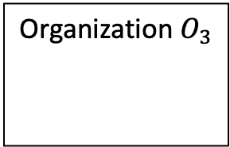




















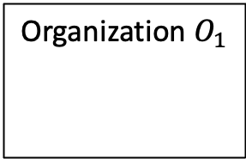




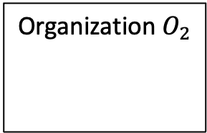




$$J_{1}$$
$$J_{5}$$
Big Data Pipeline
$$J_{r}$$
⊗
$$J_{2}$$
⊗
$$J_{4}$$
⊕
$$J_{6}$$
⊕
$$J_{3}$$
$$J_{7}$$
Organization $O_{1}$
Organization $O_{2}$
Organization $O_{3}$
Coalition
$$J_{1}$$
$$J_{r}$$
$$J_{3}$$
$$J_{1}$$
$$J_{5}$$
$$J_{6}$$
$$J_{7}$$
$$J_{4}$$
$$J_{2}$$
$$O_{2}$$
$$J_{5}$$
$$O_{1}$$
$$O_{2}$$
$$O_{3}$$
$$O_{2}$$
Processing Lineage
$$J_{r}$$
$$J_{1}$$
$$J_{4}$$
⊕
$$J_{6}$$
⊕
$$O_{3}$$
$$J_{7}$$

Slide 2




Transformation enforcement
AC-driven
Transformations
T₁
T₂
</> M₁
</> M₂
</> M₃
Data Lineage
D₁
D₂
D₃
J₁
J₂
Processing Lineage
$$J_{1}^{S_{1}}$$
$$J_{2}^{S_{3}}$$
Coalition building
$$J_{1}^{S_{i}}$$
$$J_{2}^{S_{i}}$$
Candidate Service Selection

