Slide 1

Design Patterns in PHP
Part 1

Slide 2
My name is Peter,
and I'm Software Engineer...

Slide 3
The first steps
mov ax,seg vesainfo
mov es,ax
mov di,offset vesainfo
mov ax,4F01h
mov cx,114h
int 10h
mov ax,seg cardinfo
lea di,cardinfo
mov es,ax
mov ah,4fh
mov al,0
int 10h
Notes:
a) you started web development with writing your own CMS, I did that, index.php, functions.php, admin.php
b) we are better than C/Java
c) structural code, functional code

Slide 4
The first steps
<body>
<form method="post" action="index.php">
<!-- HTML -->
</form>
<?php
if(!empty($_POST['host']) && !empty($_POST['db'])) {
echo '<form method="post" action="index2.php?nick='.$nick.'">
<input type="hidden" name="pass" value='.$_POST['pass'].'>';
$file = fopen("pass.php", "w");
$p = '<? $host="'.$_POST['host'].'"; $db="'.$_POST['db'].'"; $nick="'.$_POST['nick'].'"; $pass="'.$_POST['pass'].'"; ?>';
fwrite($file,$p);
fclose($file);
$db = mysql_connect($_POST['host'],$_POST['nick'],$_POST['pass']);
if (!$db) die('Cannot connect: ' . mysql_error());
else echo 'Connected<br>
<input type="submit" value="next>"/>
</form>';
}
?>
</body>
</html>
Notes:
a) you started web development with writing your own CMS, I did that, index.php, functions.php, admin.php
b) we are better than C/Java
c) structural code, functional code

Slide 5
“Advanced” level
<body>
<!-- some HTML -->
<?php framework_login_form(); ?>
<img src="kitten.gif" alt="Kitten">
<?php framework_login_me(); ?>
<!-- another awesome HTML -->
<?php include('footer.php'); ?>
</body>
Notes:
a) you started web development with writing your own CMS, I did that, index.php, functions.php, admin.php
b) we are better than C/Java
c) structural code, functional code

Slide 6
Single Responsibility Rule
(don't forget about good naming)

Slide 7
OOP
will solve all your problems
(sort of...)

Slide 8

Design Patterns
Reusable solution to a commonly occurring problem
Formalized best practices
Show relation between classess or objects
Give the unified dictionary for devs
It's a template, not implementation

Slide 9
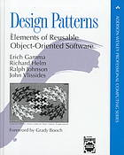
Design Patterns
Elements of Reusable Object-Oriented Software by Erich Gamma, Richard Helm, Ralph Johnson and John Vlissides
Program to an interface, not an implementation
Favor object composition over class inheritance

Slide 10
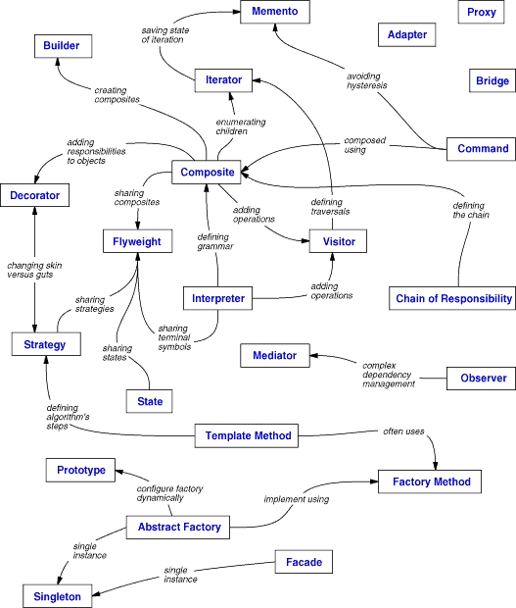
OOP

Slide 11
Anti-patterns project managemenent & software design
Cart-before-the-horse
Resume-builder
Overengineering
Scope Creep
Smoke and mirrors
Big ball of mud
Input kludge
Interface bloat
Magic pushbutton
Race hazard
http://en.wikipedia.org/wiki/Anti-pattern
Notes:
Cart-before-the-horse: Focusing too much resources on a stage of a project out of its sequence
Scope Creep: Uncontrolled changes or continuous growth in a project’s scope, or adding new features to the project after the original requirements have been drafted and accepted
Smoke and mirrors: Demonstrating unimplemented functions as if they were already implemented
Input kludge: Failing to specify and implement the handling of possibly invalid input
Interface bloat: Making an interface so powerful that it is extremely difficult to implement
Race hazard: Failing to see the consequence of different orders of events
Magic pushbutton: Coding implementation logic directly within interface code, without using abstraction

Slide 12
Anti-patterns
OOP & Programming in common
Anemic Domain Model
BaseBean
Call super
Circular dependency
God object
Sequential coupling
Yo-yo problem
Accidental complexity
Blind faith
Boat anchor
Hard code
Magic numbers
Spaghetti code
Lasagna code
Lava flow
http://en.wikipedia.org/wiki/Anti-pattern
Notes:
Anemic Domain Model: The use of the domain model without any business logic. The domain model's objects cannot guarantee their correctness at any moment, because their validation and mutation logic is placed somewhere outside (most likely in multiple places).
BaseBean: Inheriting functionality from a utility class rather than delegating to it
Yo-yo problem: A structure (e.g., of inheritance) that is hard to understand due to excessive fragmentation
Boat anchor: Retaining a part of a system that no longer has any use
Hard code: Embedding assumptions about the environment of a system in its implementation
Lava flow: Retaining undesirable (redundant or low-quality) code because removing it is too expensive or has unpredictable consequences[4][5]

Slide 13

Anti-patterns
Methodological
Copy and paste programming
Golden hammer
Improbability factor
Not Invented Here
Premature optimization
Programming by permutation
Reinventing the square wheel
Silver bullet
TDD - Tester Driven Development
It works on my VM
http://en.wikipedia.org/wiki/Anti-pattern
Notes:
Golden hammer: Assuming that a favorite solution is universally applicable
Not Invented Here (NIH) syndrome: The tendency towards reinventing the wheel
Silver bullet: Assuming that a favorite technical solution can solve a larger process or problem
Tester Driven Development: Software projects in which new requirements are specified in bug reports

Slide 14
Creational Patterns

Slide 15
Singleton
class Logger {
private static $_instance;
private function __construct() { }
private final function __clone() { }
public static function getInstance() {
if (self::$_instance === null) {
self::$_instance = new Logger();
}
return self::$_instance;
}
}
Logger::getInstance()->log('The log statement');

Slide 16
Singleton
Restricts to create only one instance of class
Allows easy access to that instance
Makes testing more difficult
When overused it's considered as anti-pattern

Slide 17
Multiton
class DbConnection {
const PRIMARY = 'primary';
const LOGS = 'logs';
private static $_instances = array();
public static function getInstance($name) {
if (!isset(self::$_instances[$name])) {
self::$_instances[$name] = new self();
}
return self::$_instances[$name];
}
}
DbConnection::getInstance(DbConnection::PRIMARY);
DbConnection::getInstance(DbConnection::LOGS);

Slide 18
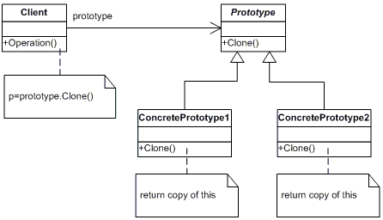
Prototype

Slide 19
Prototype
$table = new HTMLTable();
/**
* <tr>
* <td class="idField"></td>
* <td class="nameField"></td>
* </tr>
*/
$prototypeRow = new HTMLReportRow();
foreach ($reportArray as $data) {
$row = clone $prototypeRow;
$row->setId($data['id']);
$row->setName($data['name']);
$table->inject($row);
}

Slide 20
Prototype
creates objects by cloning an existing object
allows to avoid the cost of creating an object in standard way

Slide 21
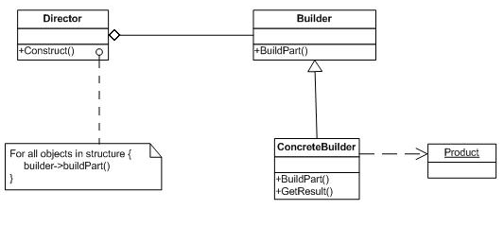
Builder

Slide 22
Builder
interface TreeBuilder {
function reset();
function addValues($values);
function getTree();
}

Slide 23
Builder
class Director {
private $_builder;
function __construct(TreeBuilder $_builder) {
$this->_builder = $_builder;
}
function constructTree($values) {
$this->_builder->reset();
$this->_builder->addValues($values);
}
function getConstructedTree() {
return $this->_builder->getTree();
}
}

Slide 24
Builder
$values = array(1, 3, 4, 6, 2, 4, 6, 2, 5, 7);
$treeBuilder = new DefaultTreeBuilder();
//$treeBuilder = new RandomTreeBuilder();
$director = new Director($treeBuilder);
$director->constructTree($values);
echo "<pre>";
print_r($director->getConstructedTree());

Slide 25
Builder
Allows Director to build different products without knowledge how to do that
Director knows only the list of steps
public function buildPizza() {
$this->_builder->buildDough();
$this->_builder->buildSauce();
$this->_builder->buildTopping();
}

Slide 26
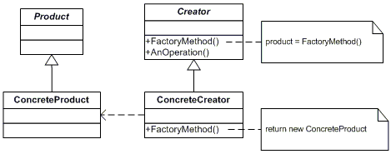
Factory Method

Slide 27
Factory Method
class SimpleReaderFactory implements AReaderFactory {
const TXT_READER = "txt";
const XML_READER = "xml";
public function createReader($type) {
switch($type) {
case SimpleReaderFactory::TXT_READER:
return new TextFileReader();
case SimpleReaderFactory::XML_READER:
return new XMLFileReader();
default :
$error = "Illegal reader type"
throw new InvalidArgumentException($error);
}
}
}

Slide 28
Factory Method
$fileName = 'application';
$rf = new SimpleReaderFactory();
$type = SimpleReaderFactory::TXT_READER;
//$type SimpleReaderFactory::XML_READER;
$reader = $rf->createReader($type);
echo "Content loaded:";
echo htmlentities($reader->read($fileName));

Slide 29
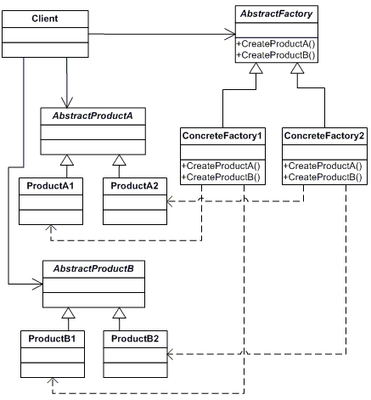
Abstract Factory

Slide 30
Abstract Factory
interface AbstractReaderWriterFactory {
function createReader();
function createWriter();
}

Slide 31
Abstract Factory
class XMLFileReaderWriterFactory implements AbstractReaderWriterFactory {
public function createReader() {
return new XMLFileReader();
}
public function createWriter() {
return new XMLFileWriter();
}
}

Slide 32
Abstract Factory
$fileName = 'application';
$content = "Very important data";
//$rwFactory = TextFileReaderWriterFactory::getInstance();
$rwFactory = XMLFileReaderWriterFactory::getInstance();
$reader = $rwFactory->createReader();
$writer = $rwFactory->createWriter();
$writer->write($fileName, $content);
echo "Content loaded: " . htmlentities($reader->read($fileName));
echo "Content saved: " . $content . "\n";

Slide 33
Abstract Factory
provides a way to encapsulate a group of individual factories that have a common theme without specifying their concrete classes
use of this pattern makes it possible to interchange concrete implementations without changing the code that uses them, even at runtime

Slide 34
Questions ?

Slide 35
Links and info
http://en.wikipedia.org/wiki/Anti-pattern
http://en.wikipedia.org/wiki/Design_Patterns_(book)
https://github.com/domnikl/DesignPatternsPHP
https://github.com/piotrmiazga

