Slide 1
Twitter Data Report
26/06/2022
Notes:
https://github.com/politusanalytics/add-metadata-to-twitter-user-objects/blob/main/province_gender_available-metadata_statistics.ipynb

Slide 2
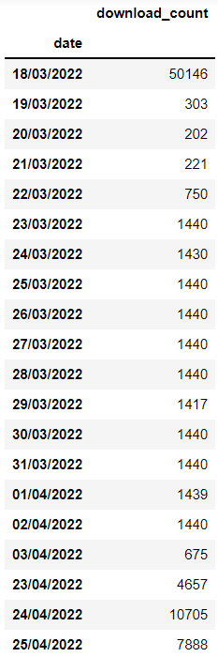
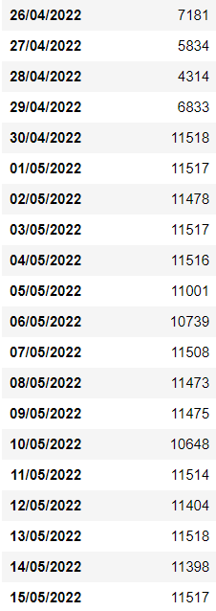
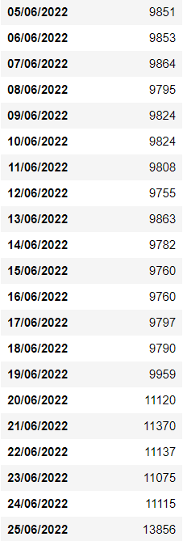
Metadata Statistics
# of Users: 728.465
# of Tweets: 26.906.644
# of Unique Tweets: 18.626.450
Daily User Download Counts
11.5K daily user downloads with 8 API keys

Slide 3
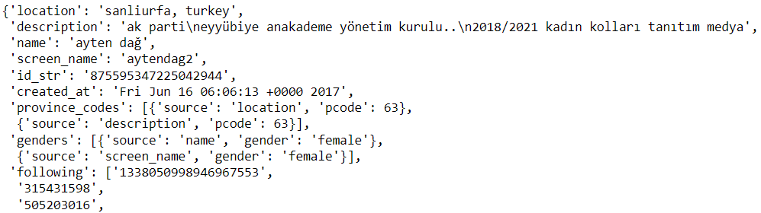

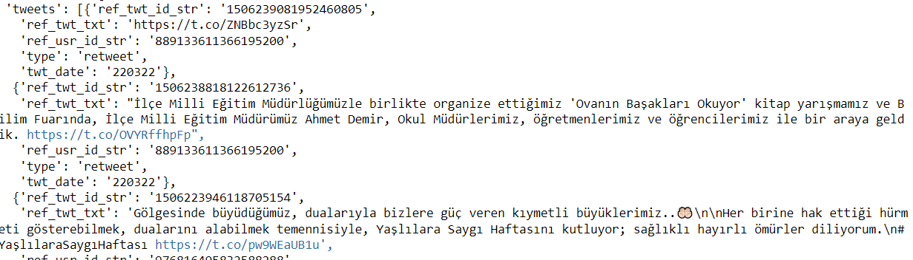

Data Fields
Location (‘location’)
Description (‘description’)
Name (‘name’)
Username/handle (‘screen_name’)
User ID (‘id_str’)
Date account was created (‘created_at)
Province codes (‘province_codes’) → Source (location, description) & Province Code
Genders (‘genders’) → Source (name, screen_name, description) & Gender
Following (‘following’) → 100 IDs by default
Followers (‘followers’) → 100 IDs by default
Tweets (‘tweets’)
We request recent 10 tweets from users’ timelines of types: Original, Reply, Retweet, Quote
We request recent 100 tweets from users’ Favorites
For each tweet, we get (ref) tweet ID, (ref) tweet text, tweet type, tweet date
Following count (‘following_count’)
Followers count (‘followers_count’)
Date of user downloaded (‘downloaded’)
Profile picture URL (‘pp’)
: Available in User Objects collected earlier
: Added by Ali Hürriyetoğlu
: Added metadata

Slide 4
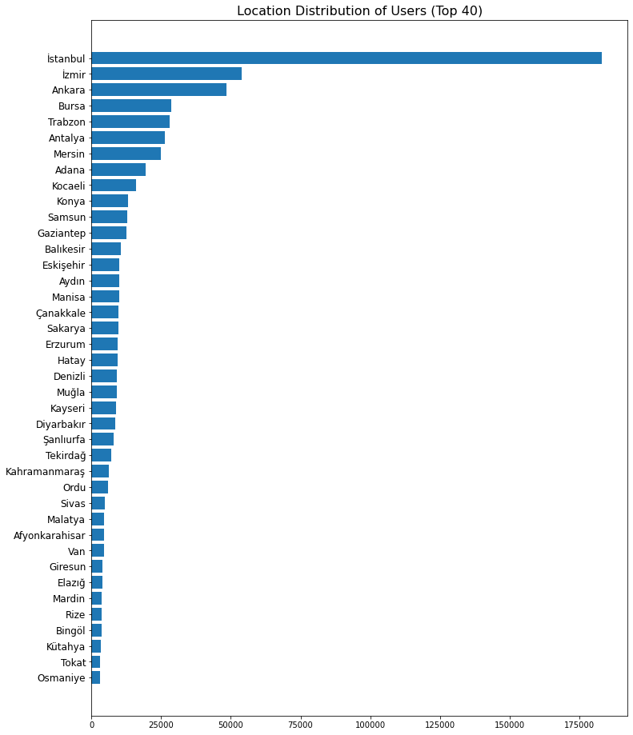
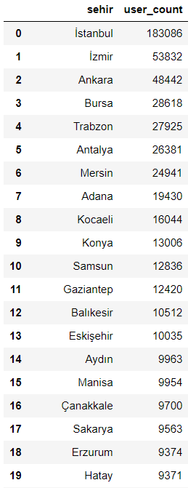
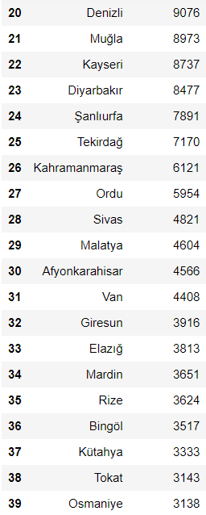
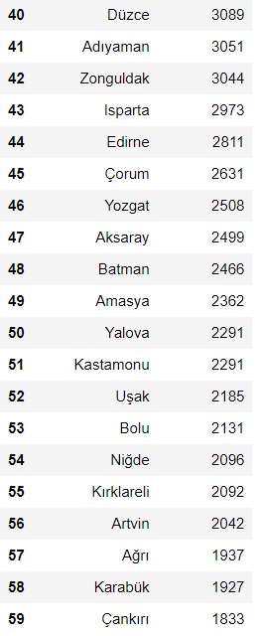
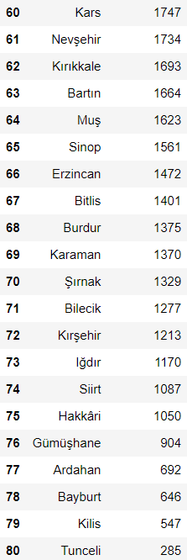
User Statistics – Location

Slide 5
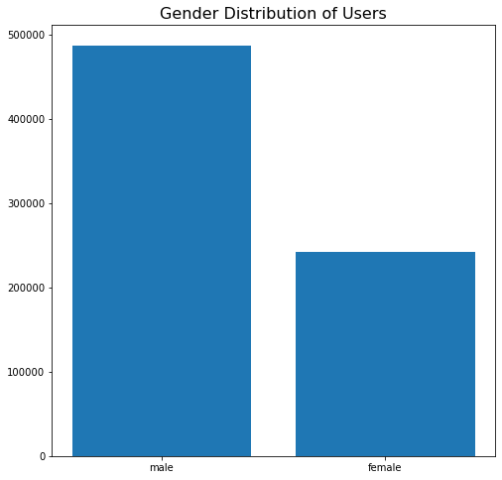
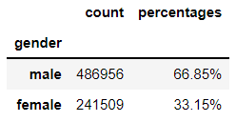
User Statistics – Gender

Slide 6
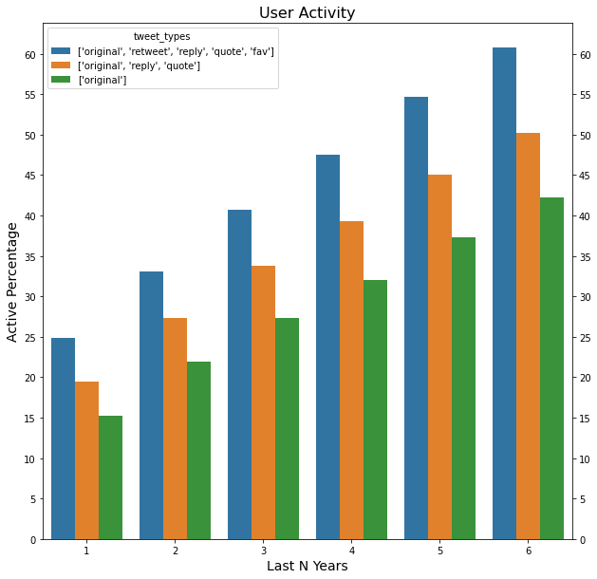
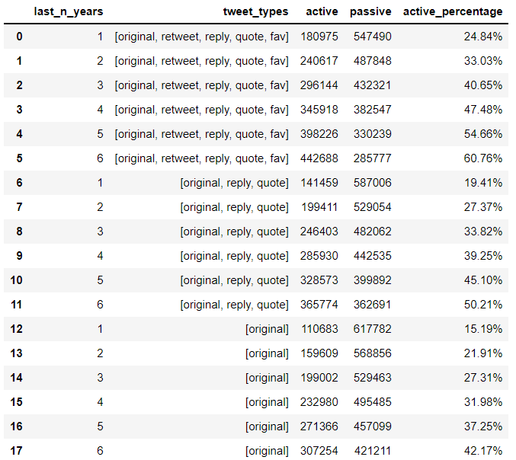
User Statistics – Activity

Slide 7
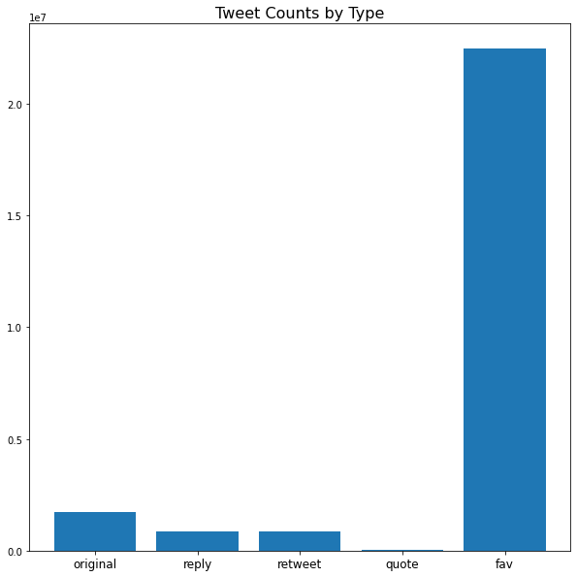
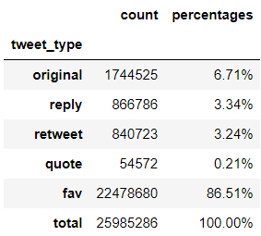
Tweet Statistics – Tweet Counts by Tweet Type
Notes:
As opposed to the second slide, the total number of tweets in this slide takes referenced tweets (“reply” and “quote”) as a single tweet (for example, if a tweet is reply to another tweet, this statistic counts both as a single tweet, since they are a single tweet object in the “tweets” parameter).

Slide 8
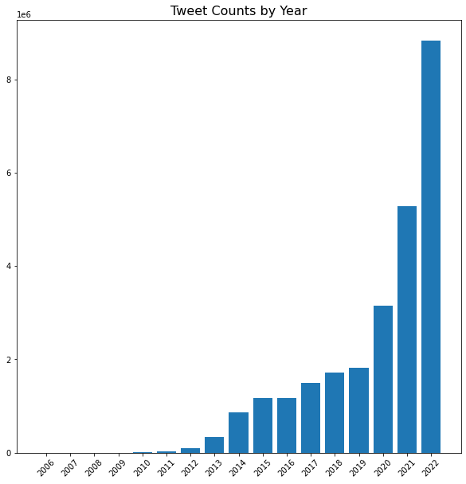
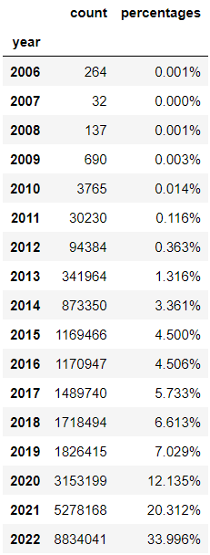
Tweet Statistics – Tweet Counts by Year

