Slide 1
Twitter Data Report
09/05/2022

Slide 2
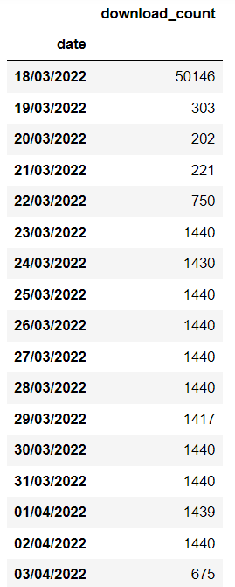
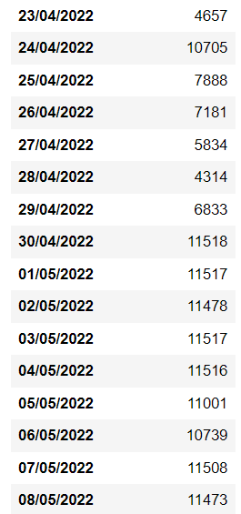
Metadata Statistics
# of Users: 217.790
# of Tweets: 7.475.461
# of Unique Tweets: 5.525.390
Daily User Download Counts
11.5K with 8 API keys

Slide 3
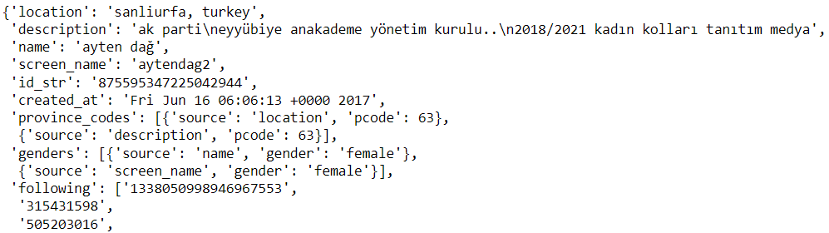

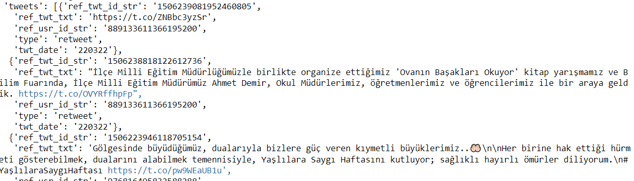

Data Fields
Location (‘location’)
Description (‘description’)
Name (‘name’)
Username/handle (‘screen_name’)
User ID (‘id_str’)
Date account was created (‘created_at)
Province codes (‘province_codes’) → Source (location, description) & Province Code
Genders (‘genders’) → Source (name, screen_name, description) & Gender
Following (‘following’) → 100 IDs by default
Followers (‘followers’) → 100 IDs by default
Tweets (‘tweets’)
We request 10 tweets from types: Original, Reply, Retweet, Quote
We request 100 tweets from Favorites
For each tweet, we get (ref) tweet ID, (ref) tweet text, tweet type, tweet date
Following count (‘following_count’)
Followers count (‘followers_count’)
Date of user downloaded (‘downloaded’)
Profile picture URL (‘pp’)
: Available in User Objects collected earlier
: Added by Ali Hürriyetoğlu
: Added metadata

Slide 4
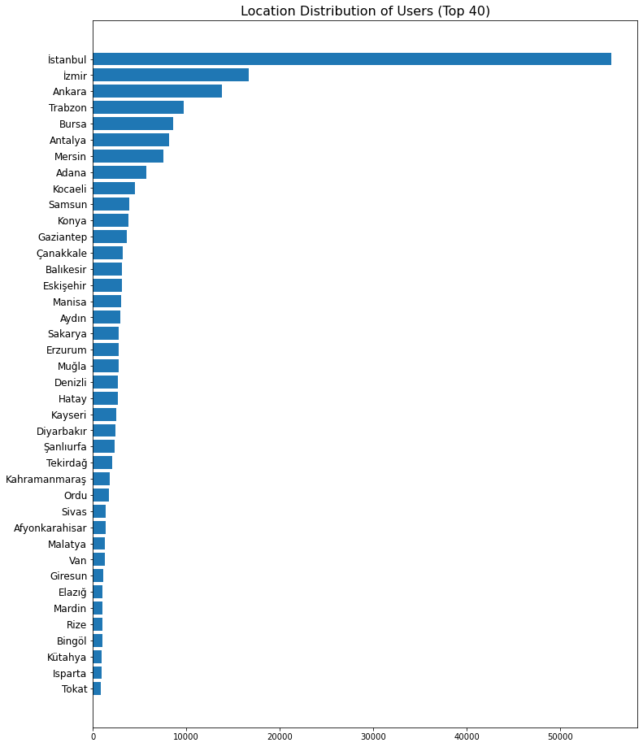
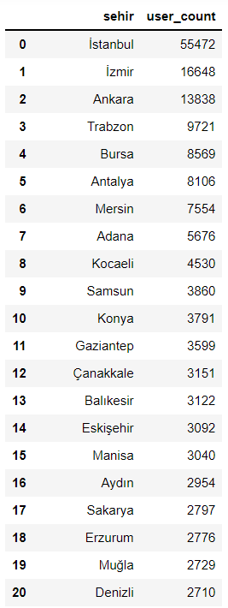
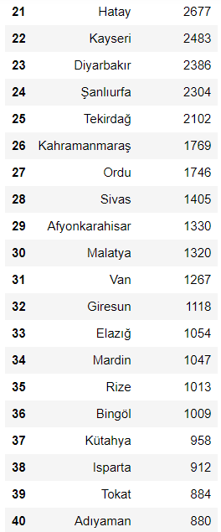
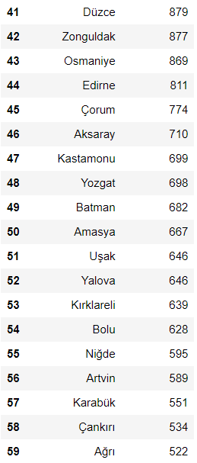
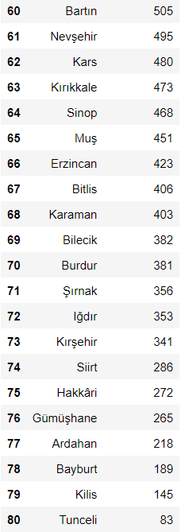
User Statistics – Location

Slide 5
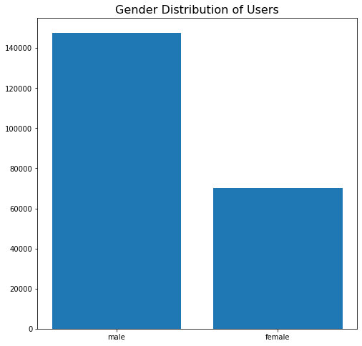
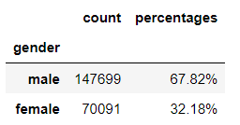
User Statistics – Gender

Slide 6
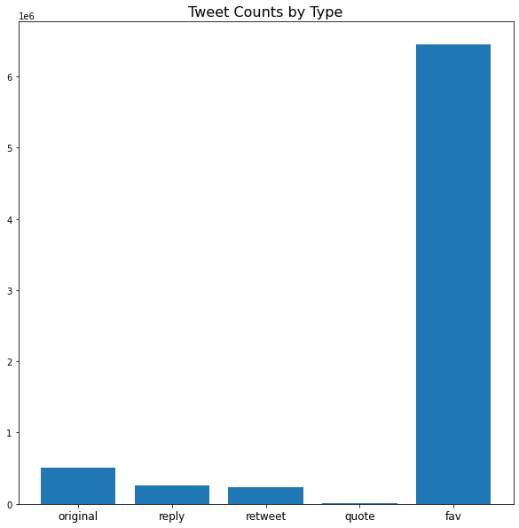
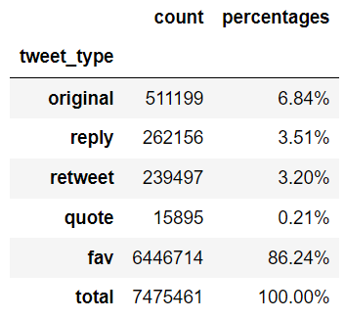
Tweet Statistics – Tweet Counts by Tweet Type

Slide 7
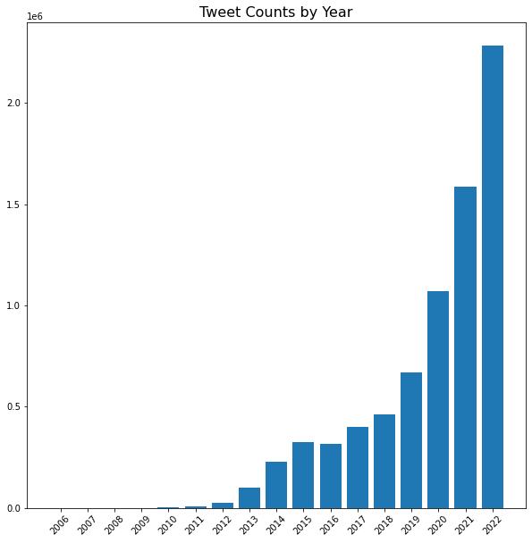
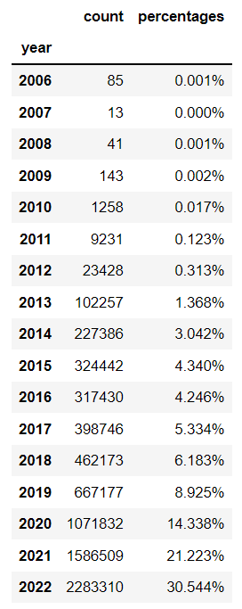
Tweet Statistics – Tweet Counts by Year

