Slide 1
Twitter Data Report
27/07/2022
Notes:
https://github.com/politusanalytics/add-metadata-to-twitter-user-objects/blob/main/province_gender_available-metadata_statistics.ipynb

Slide 2
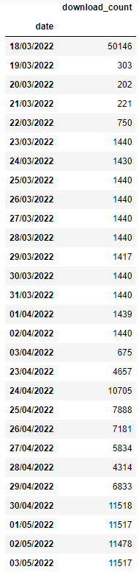
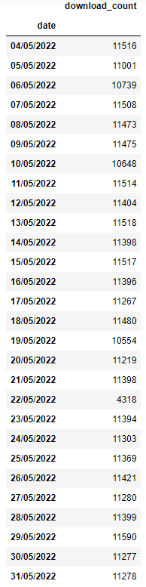
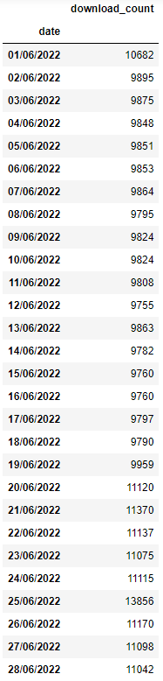
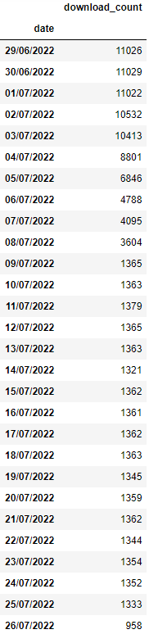
Metadata Statistics
# of Users: 867.934
# of Tweets: 32.098.727
# of Unique Tweets: 21.865.425
Daily User Download Counts
≈11.5K daily user downloads with 8 API keys
≈1.4K daily user downloads with 1 API key

Slide 3
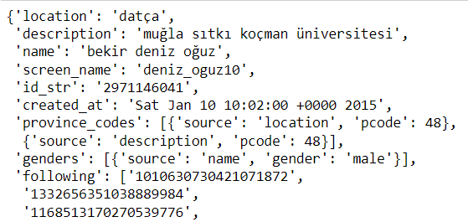

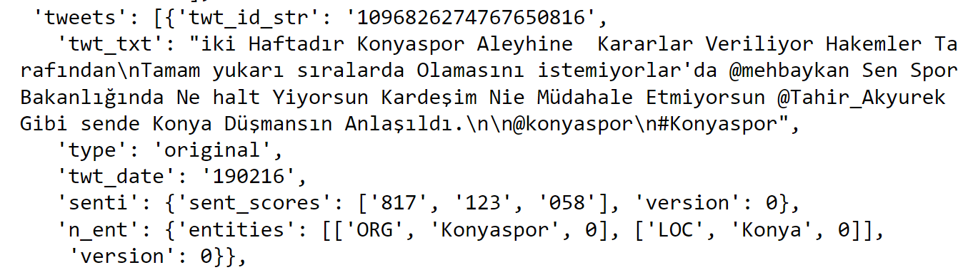
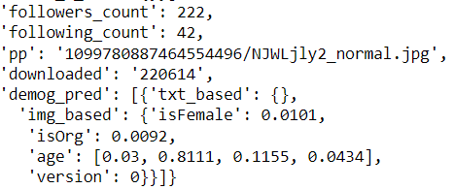
Data Fields
Location (‘location’)
Description (‘description’)
Name (‘name’)
Username/handle (‘screen_name’)
User ID (‘id_str’)
Date account was created (‘created_at)
Province codes (‘province_codes’) → Source (location, description) & Province Code
Genders (‘genders’) → Source (name, screen_name, description) & Gender
Following (‘following’) → 100 IDs by default
Followers (‘followers’) → 100 IDs by default
Tweets (‘tweets’)
We request recent 10 tweets from users’ timelines of types: Original, Retweet,Reply, Quote
We request recent 100 tweets from users’ Favorites
For each tweet, we get (ref) tweet ID, (ref) tweet text, tweet type, tweet date
For each tweet, we added sentiment scores (negative, neutral, positive) and named entities
Following count (‘following_count’)
Followers count (‘followers_count’)
Date of user downloaded (‘downloaded’)
Profile picture URL (‘pp’)
Demographic predictions (‘demog_pred’)
: Available in User Objects collected earlier
: Added by Ali Hürriyetoğlu
: Added metadata

Slide 4
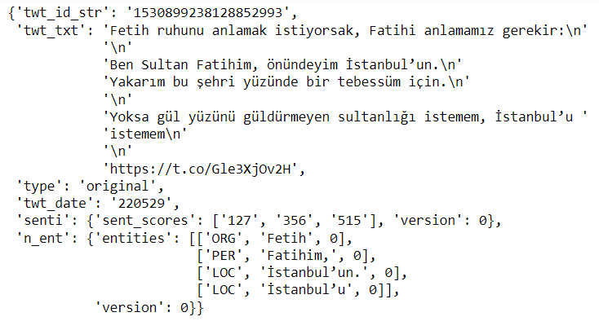
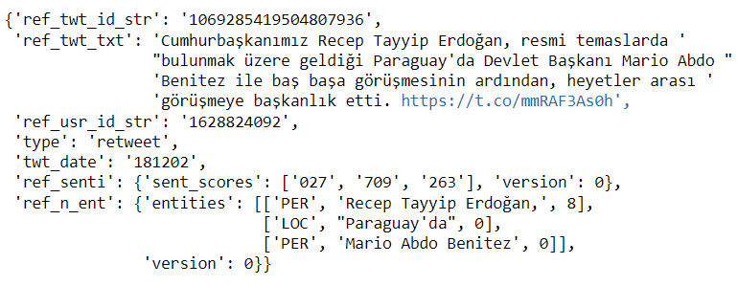
Tweet Types & Fields
Original: “twt_id_str”, “twt_txt”, “type”,
“twt_date”, “senti” (sentiment),
“n_ent” (named entities)
Retweet: “ref_twt_id_str”, “ref_twt_txt”,
“ref_usr_id_str”, “type”, “twt_date”,
“ref_senti” (sentiment),
“ref_n_ent” (named entities)

Slide 5
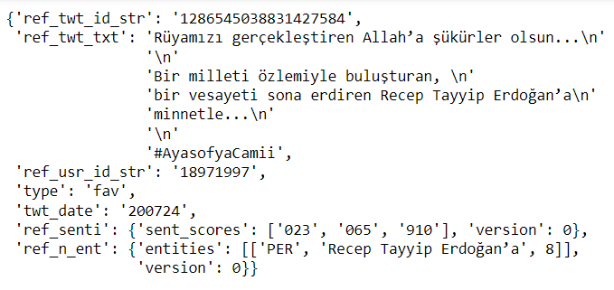
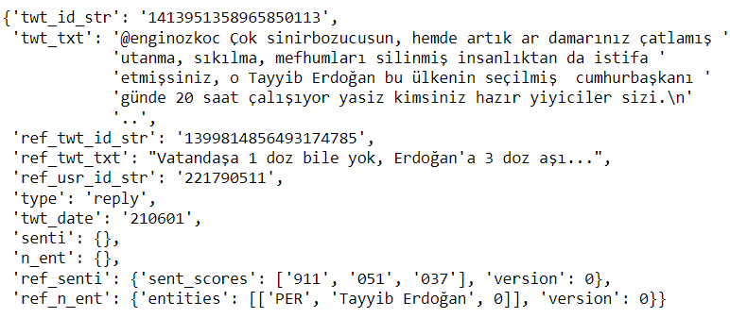
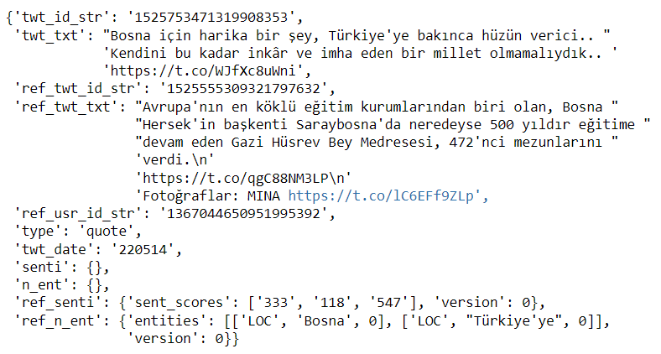
Tweet Types & Fields
Favorite: “ref_twt_id_str”, “ref_twt_txt”,
“ref_usr_id_str”, “type”, “twt_date”,
“ref_senti”, “ref_n_ent”
Reply: “twt_id_str”, “twt_txt”, “ref_twt_id_str”,
“ref_twt_txt”, “ref_usr_id_str”, “type”,
“twt_date”, “ref_senti”, “ref_n_ent”
Quote: “twt_id_str”, “twt_txt”, “ref_twt_id_str”,
“ref_twt_txt”, “ref_usr_id_str”, “type”,
“twt_date”, “ref_senti”, “ref_n_ent”

Slide 6
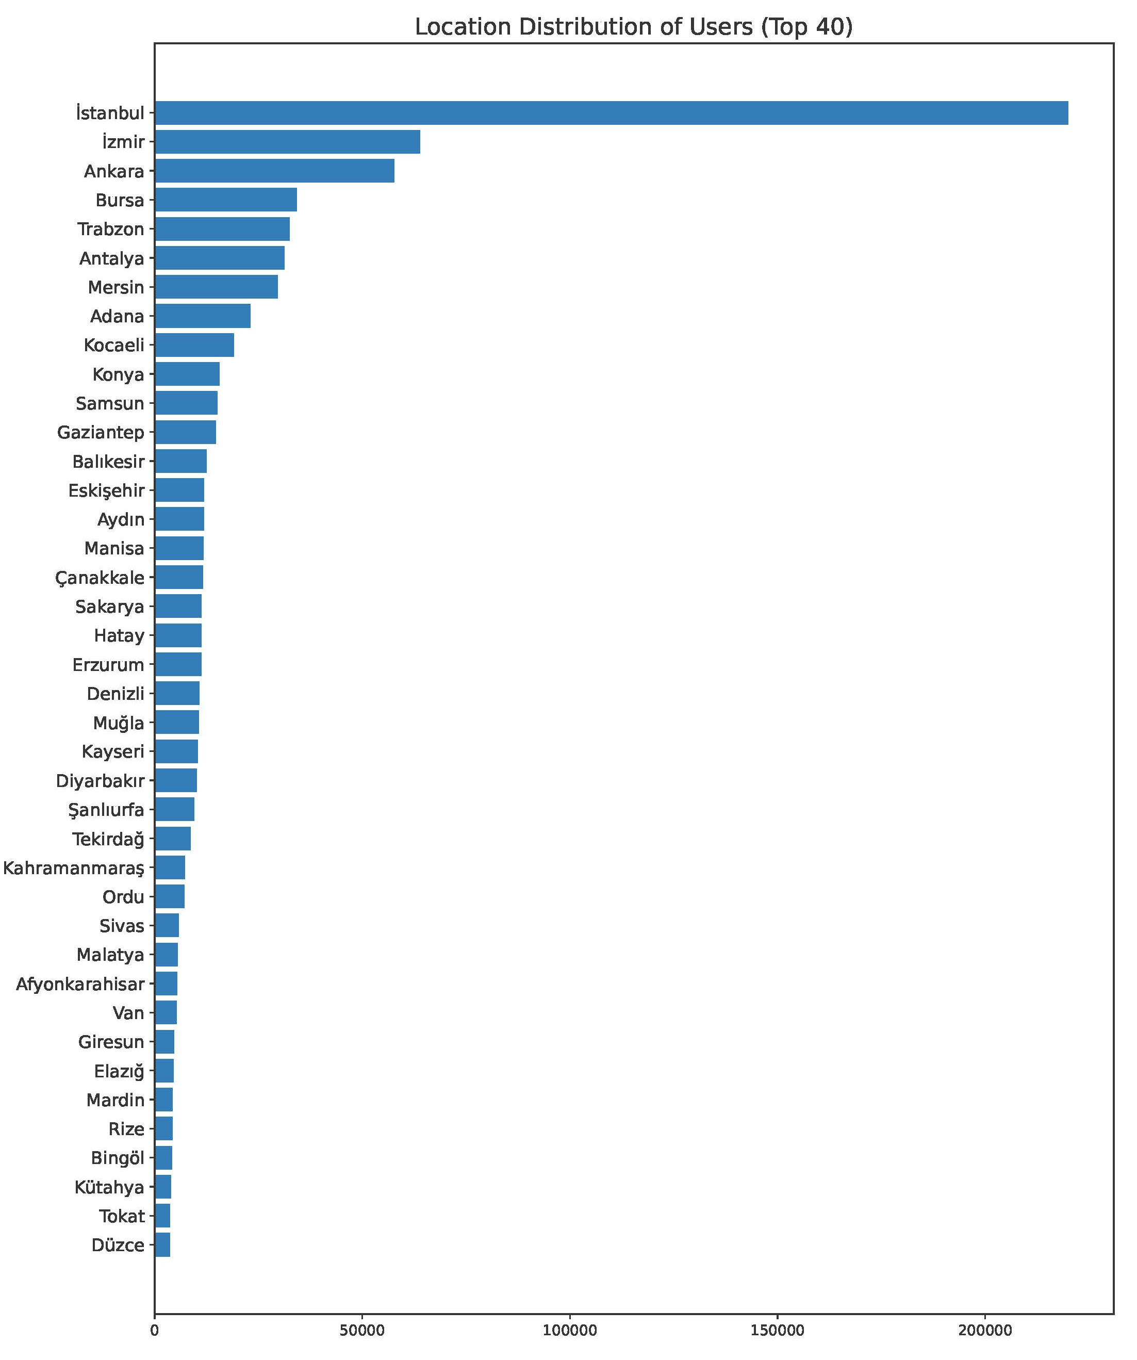
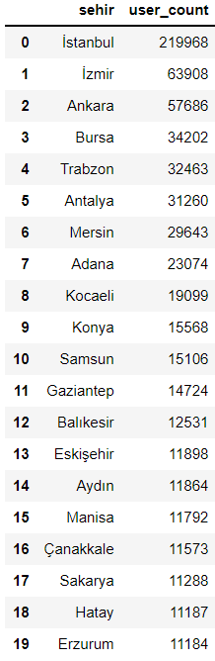
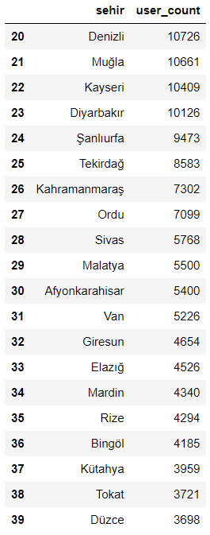
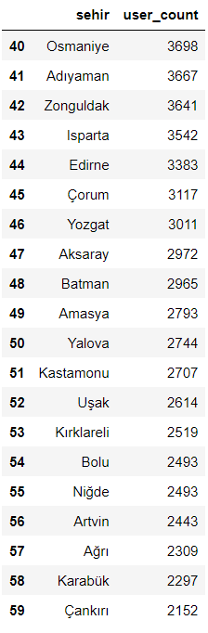
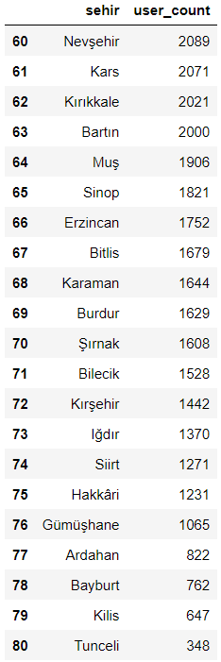
User Statistics – Location

Slide 7
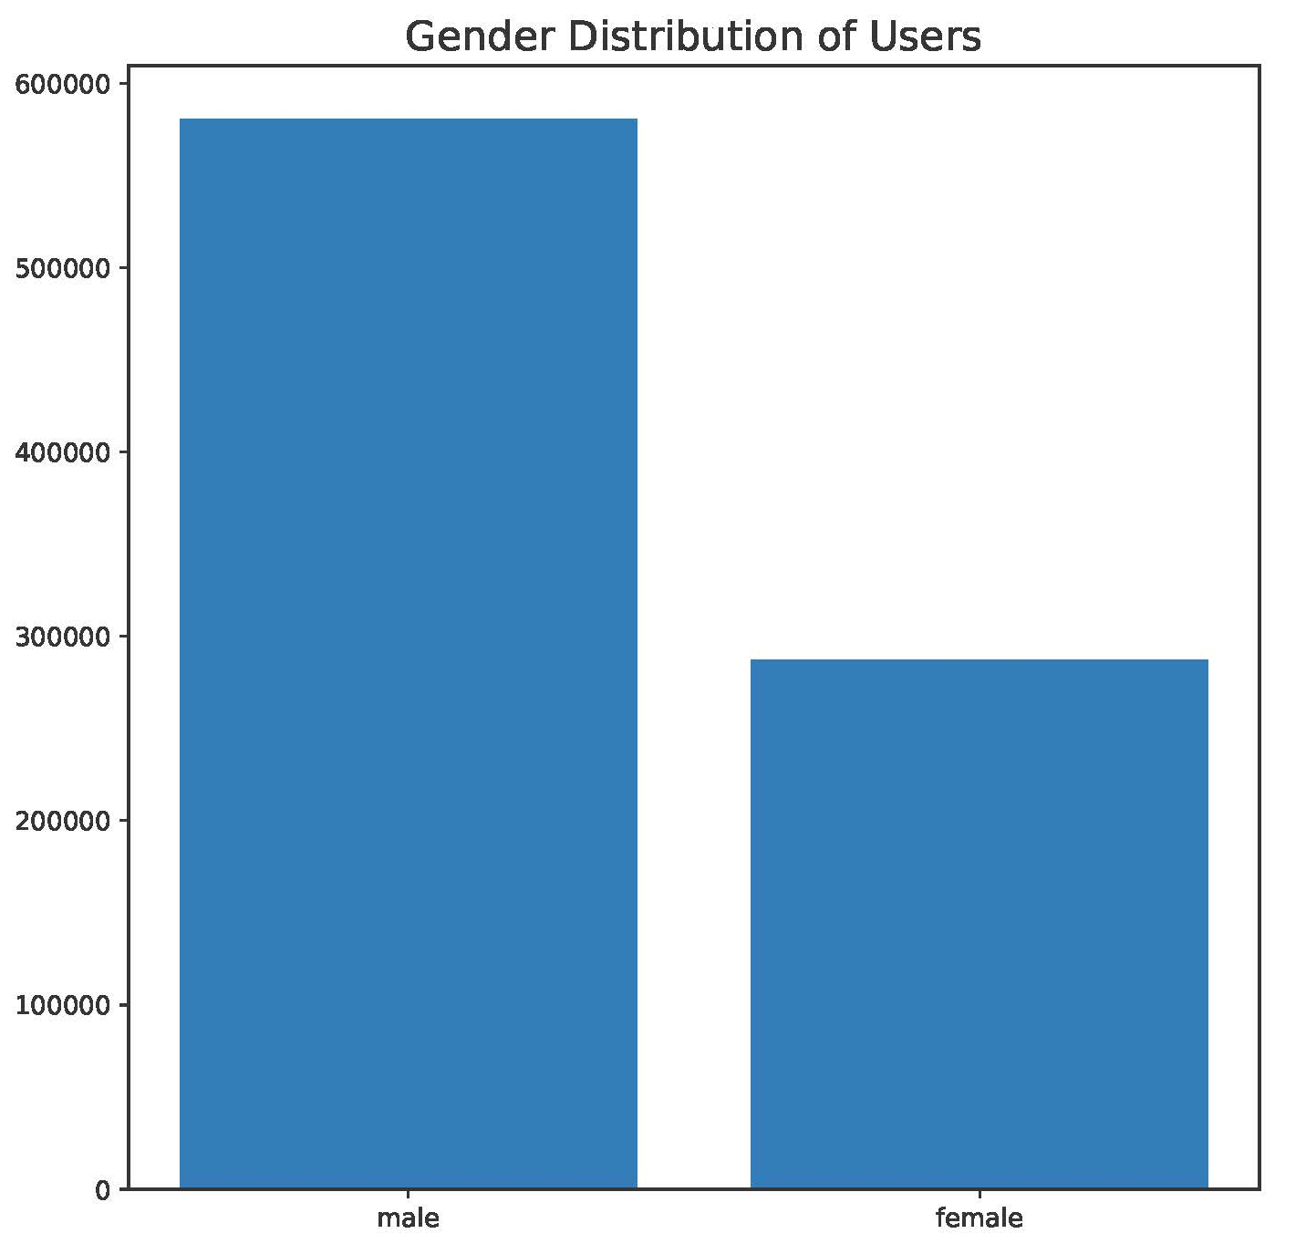
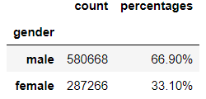
User Statistics – Gender

Slide 8
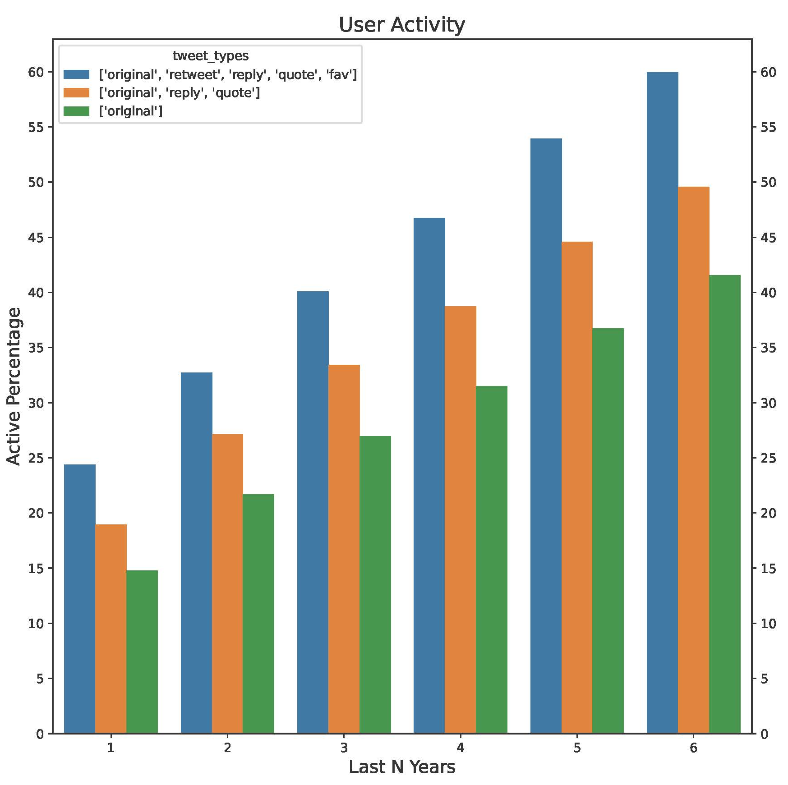
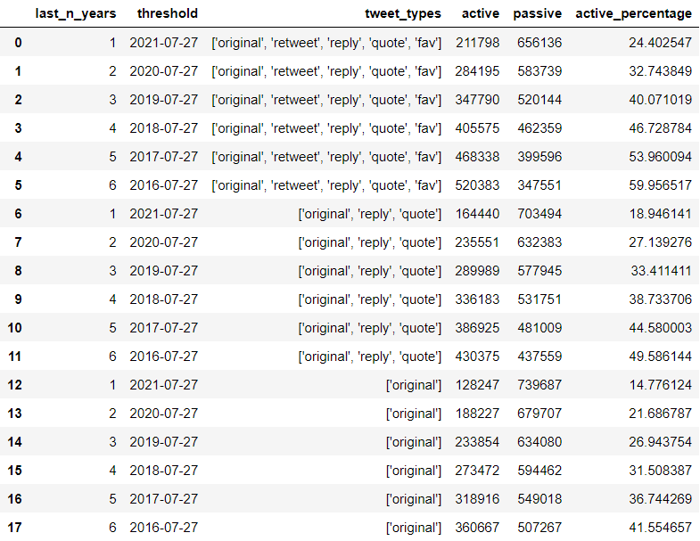
User Statistics – Activity

Slide 9
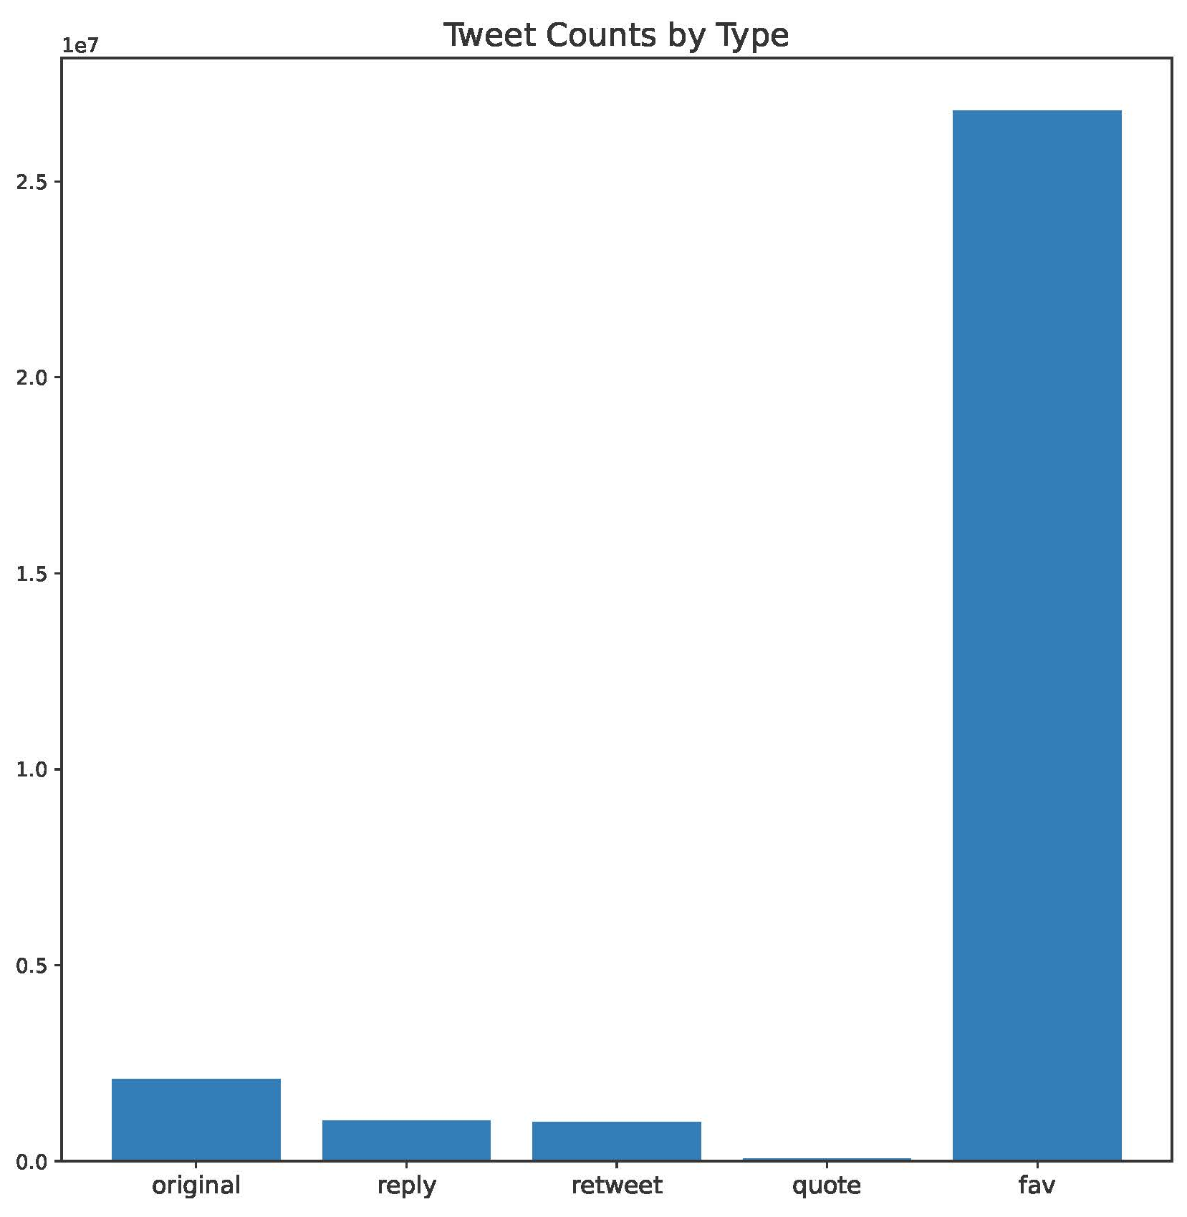
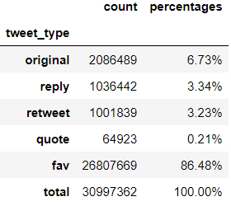
Tweet Statistics – Tweet Counts by Tweet Type
Notes:
As opposed to the second slide, the total number of tweets in this slide takes referenced tweets (“reply” and “quote”) as a single tweet (for example, if a tweet is reply to another tweet, this statistic counts both as a single tweet, since they are a single tweet object in the “tweets” parameter).

Slide 10
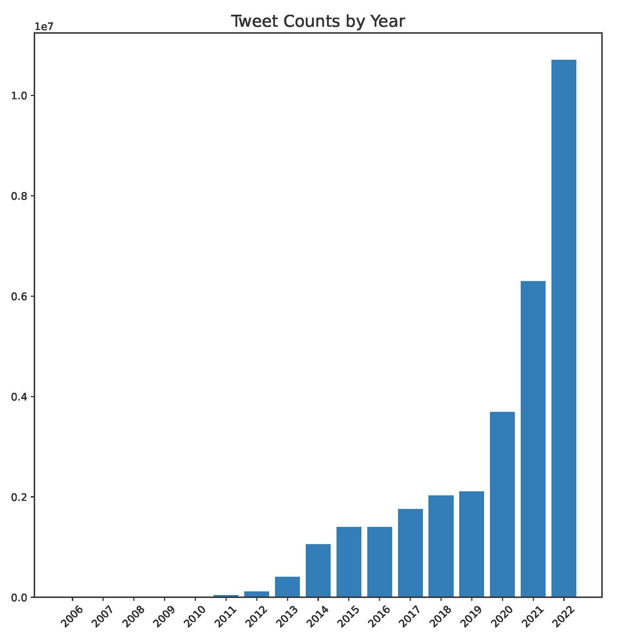
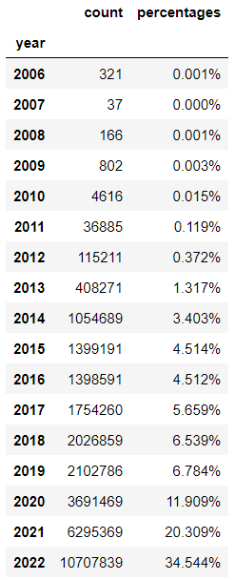
Tweet Statistics – Tweet Counts by Year

