Slide 1
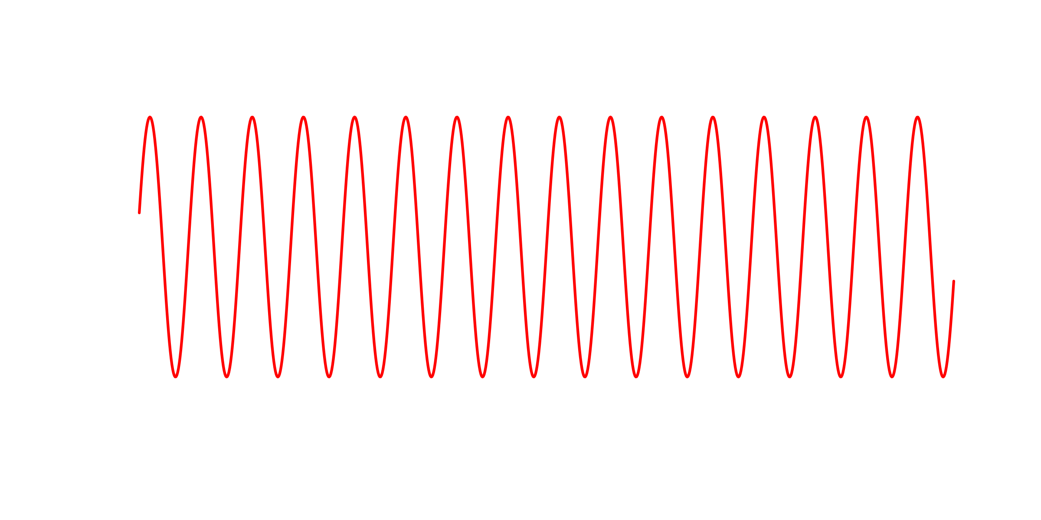
High frequency

Slide 2
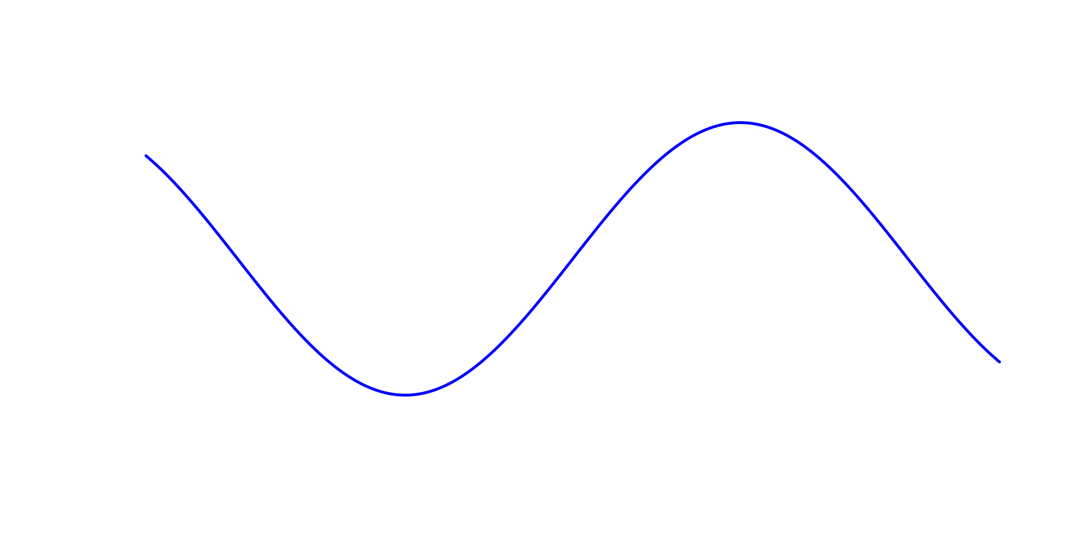
Low frequency

Slide 3
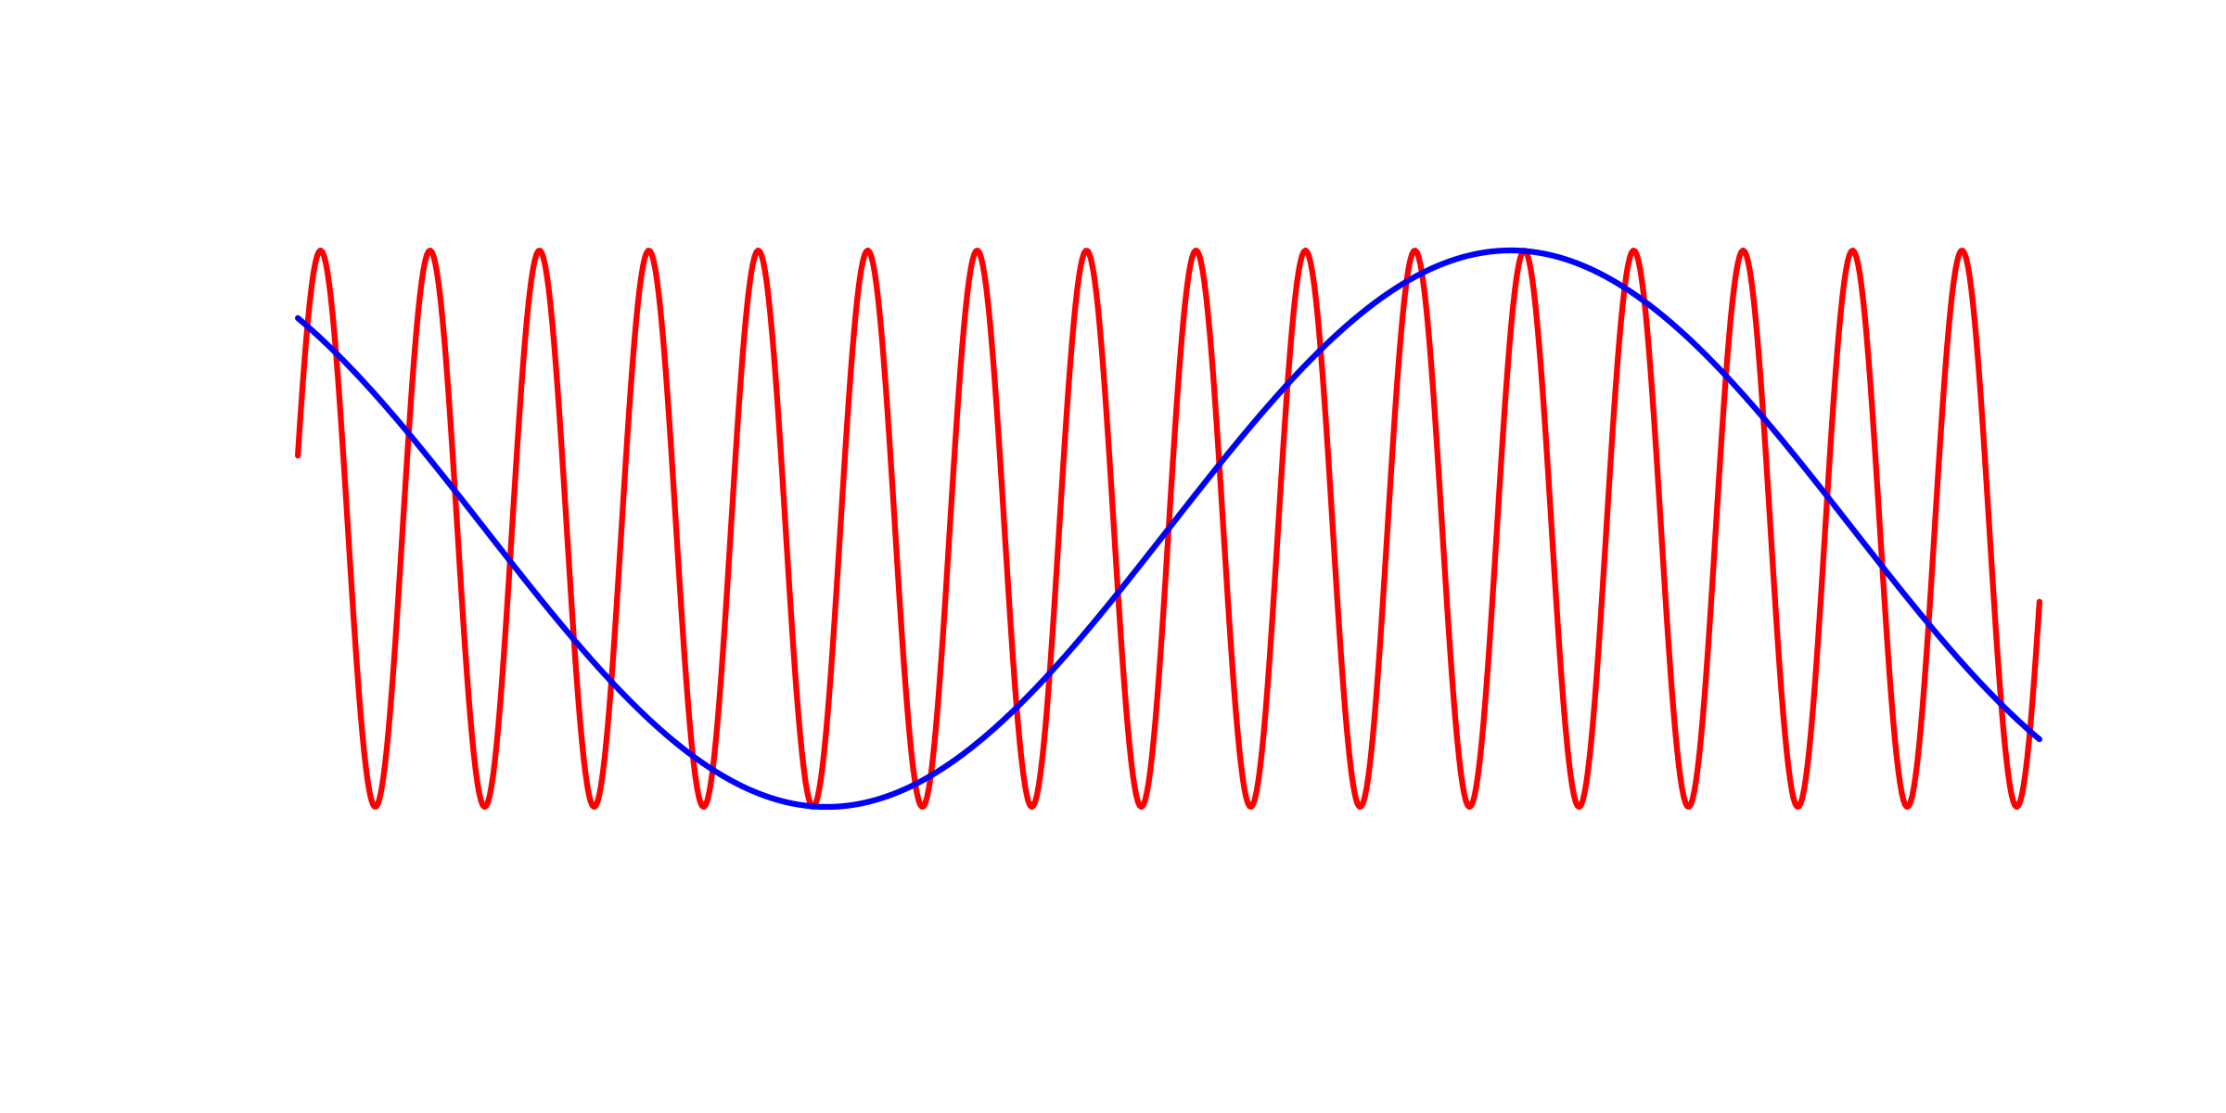
Two waves together

Slide 4
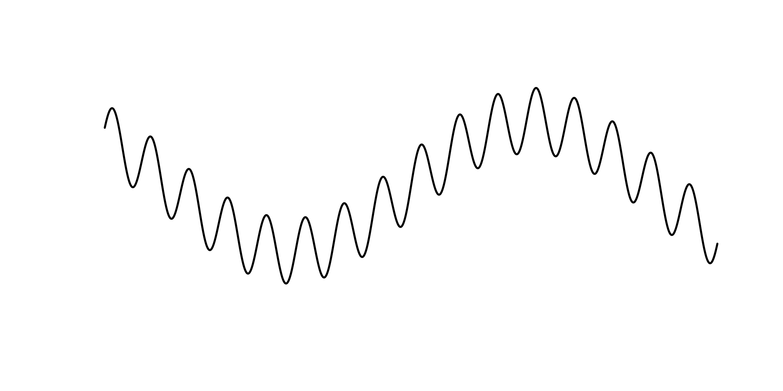
Complex wave

Slide 5
Low-pass filter

Slide 6
High-pass filter

Slide 7
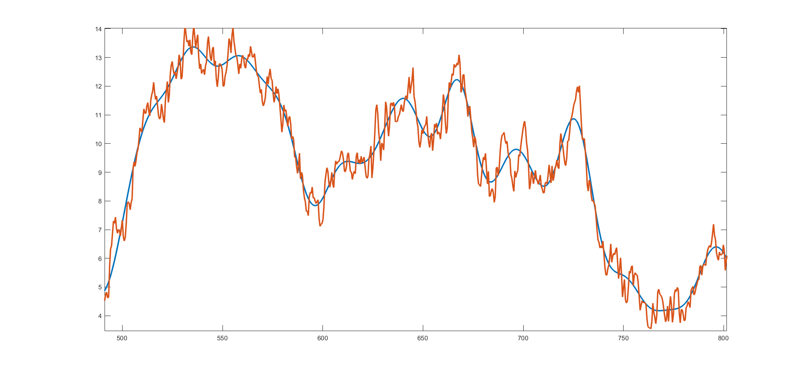
Low-pass filtered ERP data
500
550
600
650
700
750
800

Slide 8
