Slide 1
1. Refresher on the general linear model, interactions, and contrasts
UCL Linguistics workshop on mixed-effects modelling in R
18-20 May 2016

Slide 2
Code at:
http://users.ox.ac.uk/~cpgl0080/UCL_Rworkshop/

Slide 3
The general linear model
Ŷ = b₀ + b₁x₁ + b₂x₂ + b₃x₃ …

Slide 4


Slide 5
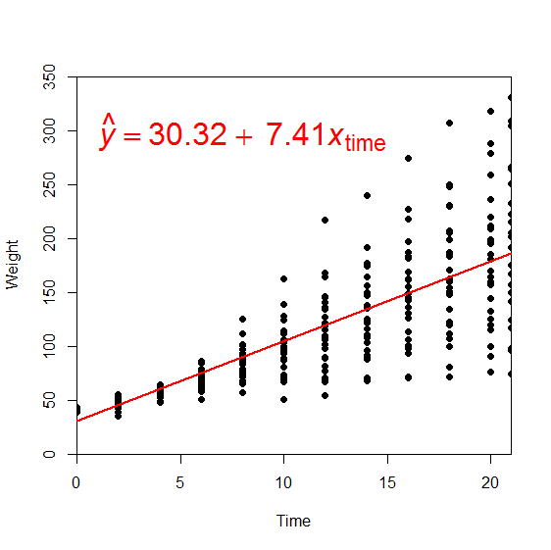

An example with one continuous predictor

Slide 6
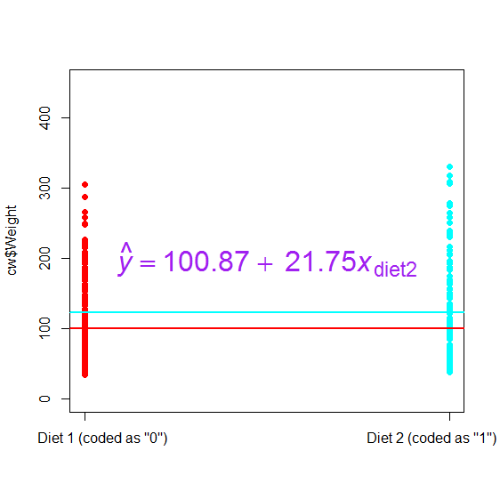

An example with one categorical predictor

Slide 7


Slide 8
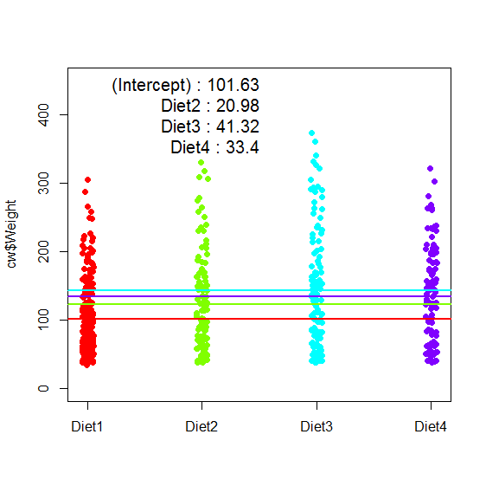

An example with one polytomous categorical predictor

Slide 9
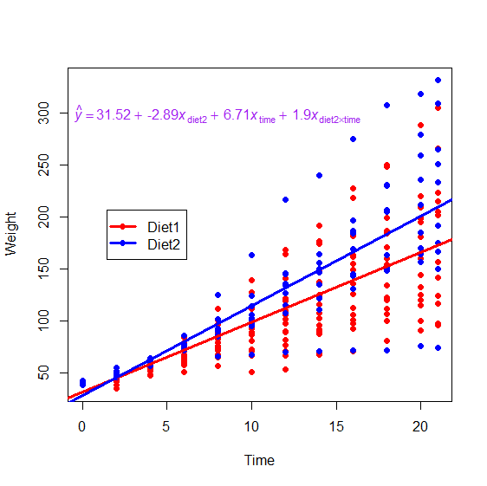

An example with their interaction

Slide 10


That interaction again, with the continuous IV centered

Slide 11
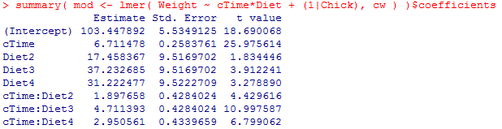
Interpreting interactions: crossed interaction

Slide 12
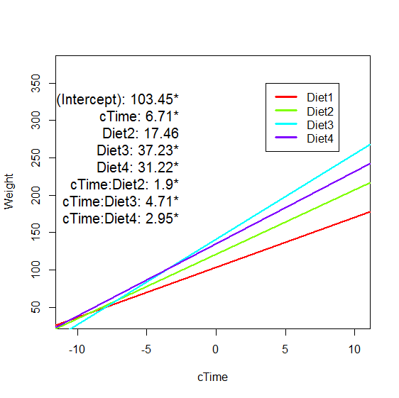
Time is the slope of the regression line of Time for Diet1
Time:Diet2 is how much different the slope of the regression line of Time is for Diet2 than it was for Diet1
6.71 + 1.9 = slope of 8.61
etc.
Interpretation: For any given condition’s regression line, test whether it’s different from the baseline condition’s regression line

Slide 13
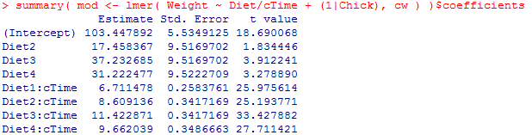
Interpreting interactions: nested interaction

Slide 14
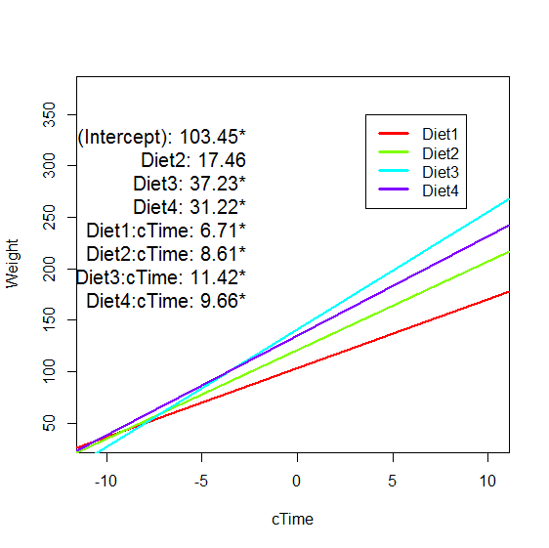
Interactions in a nested model
Now each condition has its own regression line in the model summary
Interpretation: For any given condition’s regression line, test whether it’s significantly different from zero

Slide 15
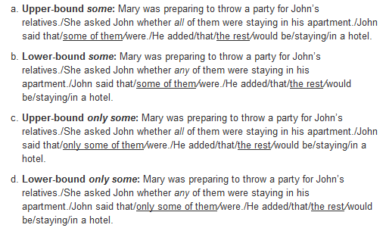

Slide 16
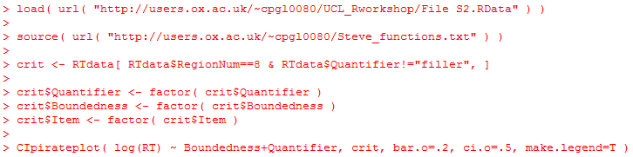
Now let’s recreate these interaction tests with two categorical variables (rather than a categorical and a continuous), using real psycholinguistic data

Slide 17
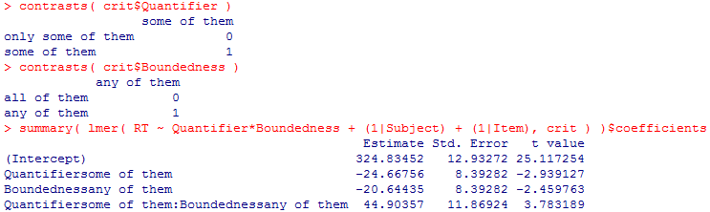
Main effects and dummy coding?
(See also http://users.ox.ac.uk/~cpgl0080/coding_schemes.html)

Slide 18
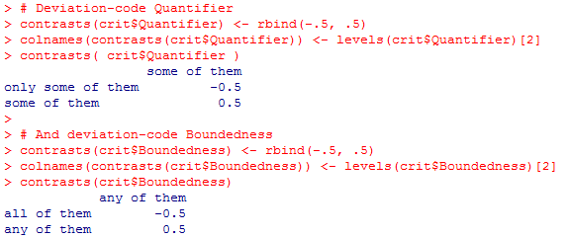
Deviation coding

Slide 19
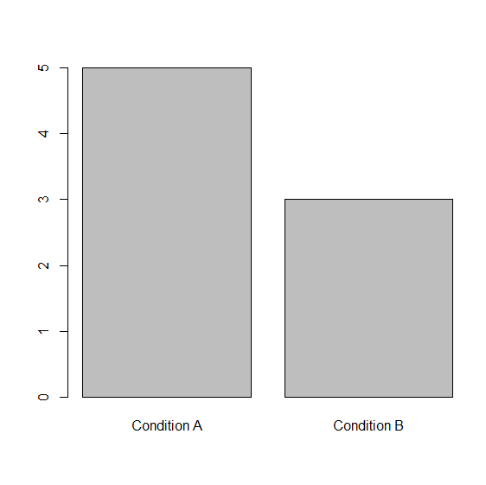
Simple example of dummy coding
Intercept: 5
b_{condition}: -2
Ŷ = 5 + ⁻2x_{condition}
x_{condition} can be either 0 or 1. So Ŷ will be {5 + ⁻2*0 = 5} or {5 + ⁻2*1 = 3}

Slide 20
Simple example of deviation coding
Intercept: 4
b_{condition}: -2
Ŷ = 4 + ⁻2x_{condition}
x_{condition} can be either -.5 or .5. So Ŷ will be {4 + ⁻2*.5 = 3} or {4 + ⁻2^{*-.}5 = 5}

Slide 21
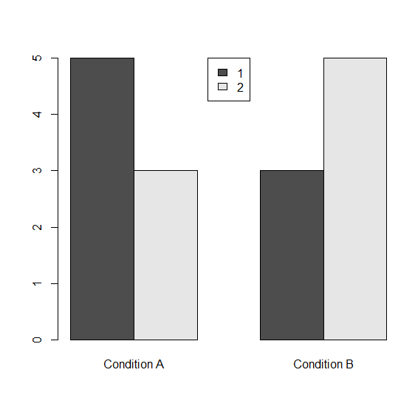
Dummy coding in an interaction
Intercept: 5
b_{Avs.B}: -2
b_{1vs.2}: -2
Since x_{Avs.B} can have values of 0 or 1, and so can x_{1vs.2}, this means the effect of b_{Avs.B} is the effect when x_{1vs.2}==0, i.e., only the dark bars

Slide 22
Sum coding in an interaction
Intercept: 4
b_{Avs.B}: 0
b_{1vs.2}: 0
Since x_{Avs.B} and x_{1vs.2} have values of ⁻.5 or .5, this means the effect of b_{Avs.B} is the effect when x_{1vs.2}==0, i.e., at the ‘mean’ level of ‘1vs.2’

Slide 23
Take-home message on interaction coding
If you care about simple effects at each level of some factor, then use dummy coding
If you want to be able to look at your results like an ANOVA table (i.e. if you care about main effects and “main interactions”), then use deviation coding

Slide 24
Deviation coding vs. sum coding
Although these terms are often used interchangeably, technically deviation coding usually means (in R, at least) coding contrasts as -.5 and .5, whereas sum coding means coding as ‑1 and 1
What’s the difference?
(-.5, 5) deviation coding is useful for binomial (2-level) factors
(-1, 1) sum coding can be useful for polytomous (>2-level) factors
Same p-values, just different interpretation of the coefficient estimates

Slide 25
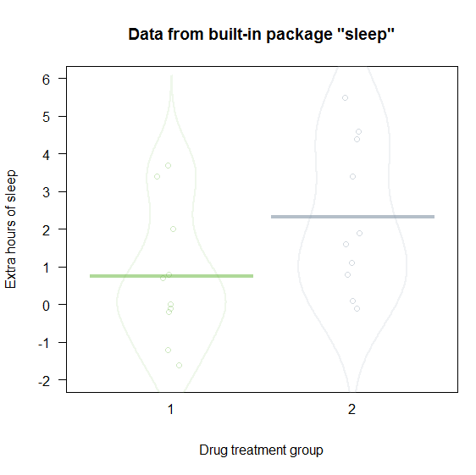
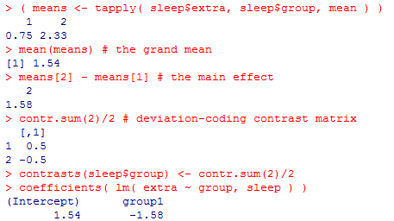
A binomial factor, deviation coding
Deviation coding tells us how much the two levels differ from each other

Slide 26
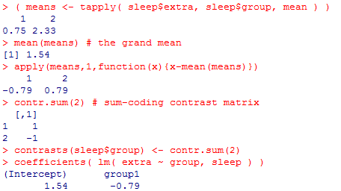
A binomial factor, sum coding
Sum coding tells us how much the non-reference level differs from the grand mean

Slide 27
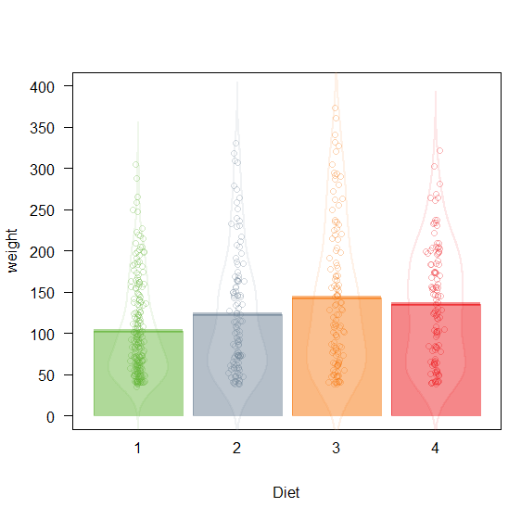
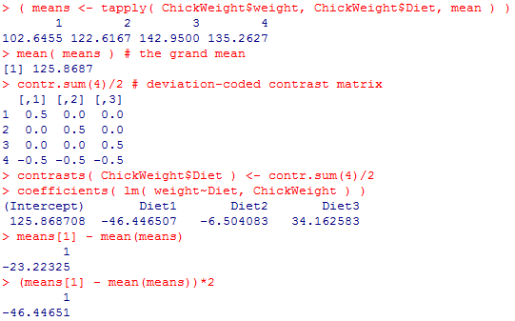
A polytomous factor, deviation coding
Deviation coding tells us 2× how much a given level differs from the grand mean

Slide 28
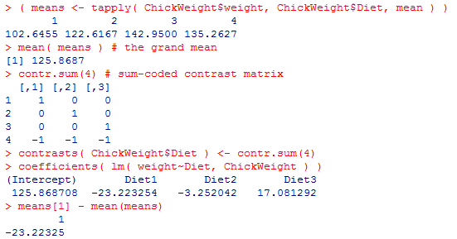
A polytomous factor, sum coding
Sum coding tells us how much a given level differs from the grand mean

Slide 29
Custom contrast coding
What if we want to test hypotheses on custom combination conditions, e.g.,
Does Diet 3 have higher weight than the average of Diets 2 and 4?

Slide 30
Custom contrast coding
Set up series of codes which
Sums to 0
Conditions you don’t care about are all 0
The two sets of conditions you want to respect sum to, respectively, 1 and -1
If non-orthogonal (i.e., if the sum of the products of these columns is not 0), run with glht {multcomp}
If orthogonal, you can use directly in the model, but the interpretation of the estimates is complicated (although the p-values are reliable)
 | Diet 1 | Diet 2 | Diet 3 | Diet 4
3 vs avg(2,4) | 0 | -1/2 | 1 | -1/2
1 vs avg(2,3,4) | 1 | -1/3 | -1/3 | -1/3
4 vs 1 | -1 | 0 | 0 | 1

Slide 31
Shortcomings of custom contrast coding
Putting custom contrasts directly in the original model requires orthogonal contrasts (I think?) and even then the coefficients are confusing
Testing with glht requires you to put in multiple contrasts even if you only care about one (this seems to be new)
This also means the p-values are multiple-comparison-corrected even if you don’t want that. Fortunately, the b, SE, and t values are reliable, so you can still use them to re-calculate raw p-values

Slide 32
Directly comparing two coefficients
Recall our nested interaction example:
The intercept for Diet2 is non-significant but Diet3 is significant. But “the difference between significant and non-significant is not itself significant” (Gelman). How to directly compare these?

Slide 33
Directly comparing two coefficients
Re-code the model, with Diet2 or Diet3 (rather than Diet1) as the baseline
glht
Hack a t-test from the variance-covariance matrix
Model comparison (this afternoon!)

Slide 34
Directly comparing coefficients (by manually hacking a t-test
varcov <- vcov(model)
t <- (fixef(model)[9] - fixef(model)[10]) / sqrt(varcov[9,9] + varcov[10,10] - 2*varcov[9,10])

Slide 35
Coding more complex interactions
Technically, an interaction is coded as e.g. A:B
A*B is shorthand for A + B + A:B (i.e. both main effects and their interaction)
R expands this ‘under the hood’
Sometimes you don’t care about, or don’t even want all the effects; then there are some tricks you can use to customize your interaction

Slide 36
Interaction coding tricks
A*B – B or A/B (expands to A + A:B )
Tests the main effect of A and the A:B interaction, but no main effect of B
(A+B+C)^2 (expands to A + B + C + A:B + A:C + B:C )
Tests all the main effects and two-way interactions, but not the three-way
In general, (A+B+C+D….)^n tests all the possible interactions of n^{th} order and below, but no higher-order interactions
Therefore, (A+B+C)^3 is the same thing as A*B*C
Useful when we do model comparison (this afternoon)
(A+B+C+D)*E (expands to A + B + C + D + E + A:E + B:E + C:E + D:E )
Tests all main effects, and all interactions with E, but doesn’t allow [A,B,C,D] to interact with one another
Useful when you care about a few crucial interactions but have no predictions about the others and want to avoid very complex interactions

