Slide 1
2. Bringing random effects into the mix[ed model]
UCL Linguistics workshop on mixed-effects modelling in R
18-20 May 2016

Slide 2
Code at:
http://users.ox.ac.uk/~cpgl0080/UCL_Rworkshop/

Slide 3
Why use mixed effects?
Motivated by boring statistical concepts
Captures different effects for different subjects/items
Captures multiple random effects
Flexibility
Can be used on data that don’t meet some ANOVA assumptions
Can include many kinds of independent variables

Slide 4
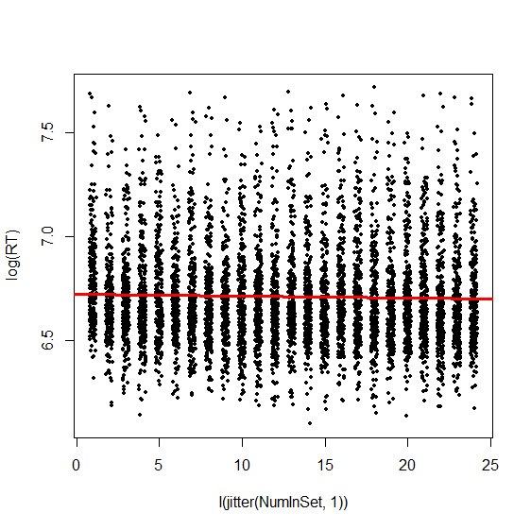
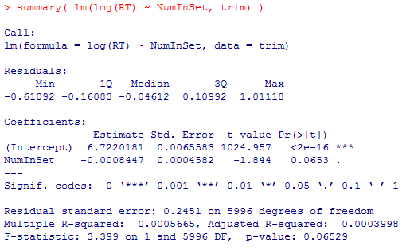
An example of a very flawed analysis using traditional regression…

Slide 5
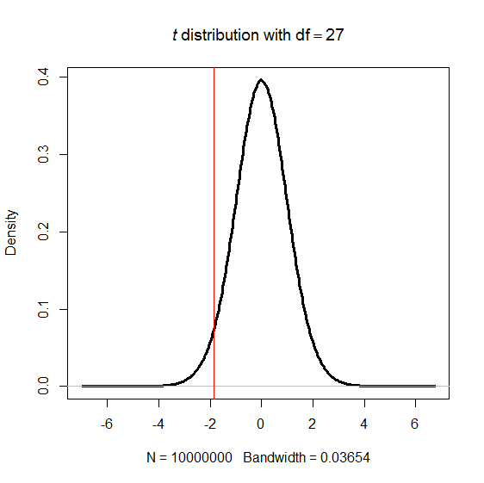
How do we decide whether that tiny but t=‑1.844 effect is “significant”?
We know the properties of the t distribution, and we believe that regression coefficients in the wild theoretically follow a t distribution…
…so we know the likelihood of that t-value occurring through sampling error under the null hypothesis

Slide 6
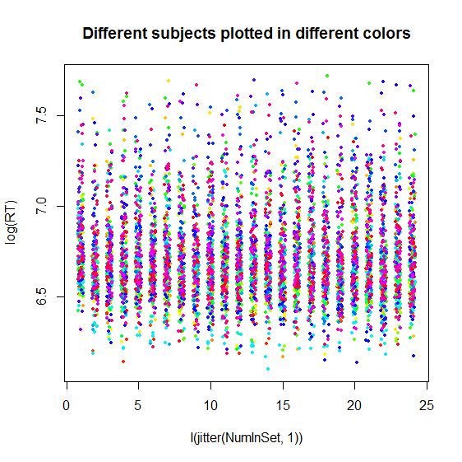
But!
The t-value for this test only has the properties of the t distribution if it meets the assumptions of parameters that have t distributions
One of those assumptions for regression coefficients is independence of the observations…
But this assumption is violated when we have dependencies: repeated measures

Slide 7
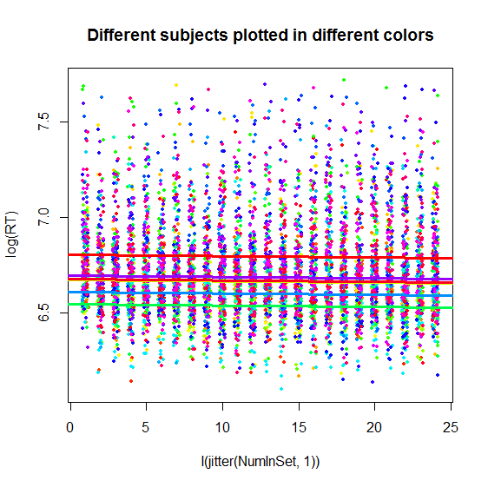
Other, practical reasons the repeated measures matter (1)
Different participants might have different intercepts (i.e., be faster or slower overall)
Even if we don’t actually care about that variance, it’s good to capture it

Slide 8
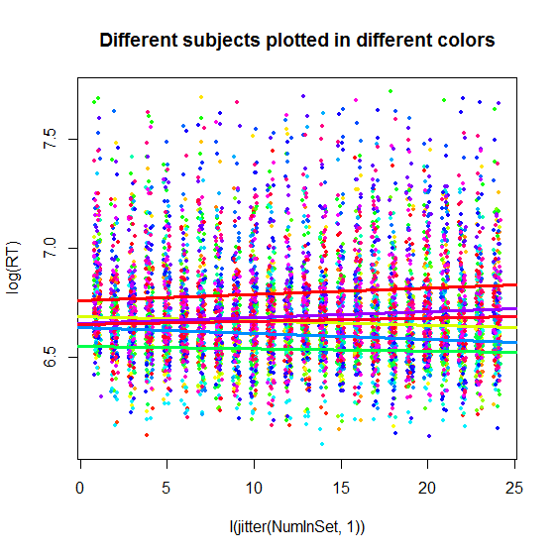
Other, practical reasons the repeated measures matter (2)
Different participants might also have different slopes (i.e., very different effects of the experimental variable)

Slide 9
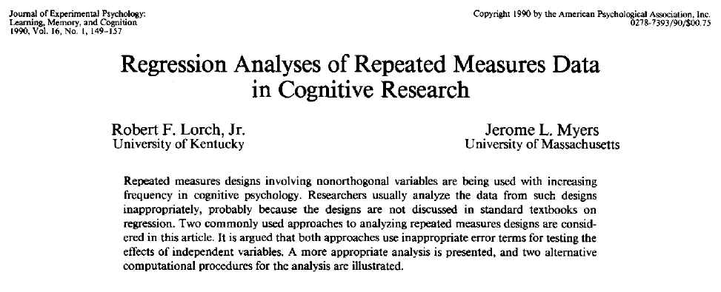
How we used to handle this: random regression (aka regression coefficient analysis)

Slide 10
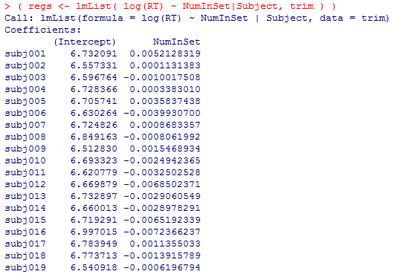
Random regression: fitting a different regression to each subject

Slide 11
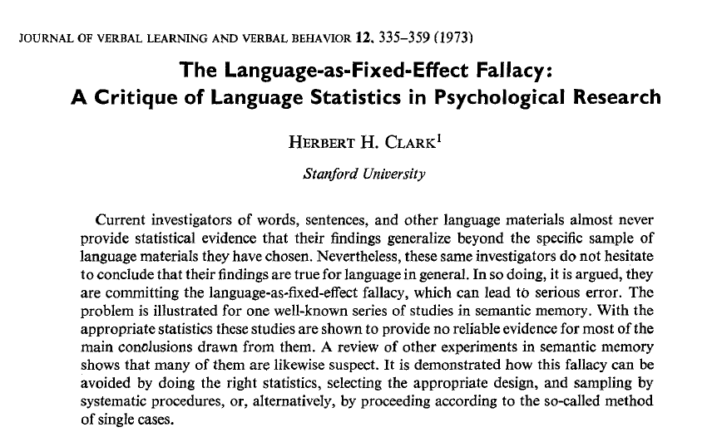
Shortcomings of random regression
What if you don’t have many trials per subject?
Fitting separate regressions for each subject assumes complete independence, failing to recognize the shared sources of variance for all the subjects
What if you have more than one grouping of repeated measures?

Slide 12
Crossing subjects and items: the old way (Clark, 1973)
Subject | Item | Condition | RT
1 | a | Cond1 | 3.5
1 | b | Cond1 | 3.1
1 | a | Cond2 | 2.8
1 | b | Cond2 | 2.8
2 | a | Cond1 | 4.2
2 | b | Cond1 | 3.9
2 | a | Cond2 | 3.6
2 | b | Cond2 | 3.7
Subj1 Cond1: 3.3
ItemA Cond1: 3.85
Subj1 Cond2: 2.8
ItemA Cond2: 3.2
Subj2 Cond1: 4.05
ItemB Cond1: 3.5
Subj2 Cond2: 3.65
ItemB Cond2: 3.25
F₁ ANOVA
F₂ ANOVA
min F’

Slide 13
Problems with using by-subject and by-item ANOVAs
min F’ often overconservative, and variations often anticonservative
(as shown by simulations)
Few people were actually using it as intended anyway
E.g., “F₁ and F₂ both significant” is not the same as “min F’ significant”
Picking and choosing how to do the statistic (i.e., whether or not to report min F’; what to conclude when F₁ and F₂ are significant but min F‘ not; what to conclude when F₁ is significant and F₂ is not)
Researcher degrees of freedom: anyone could cherry-pick the results that go with the story they prefer

Slide 14

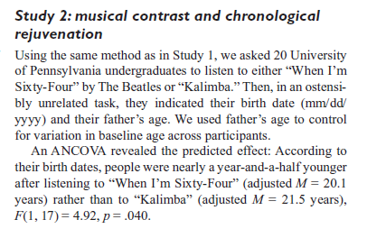
Why flexibility of how to carry out by-subject and by-subject ANOVA could be a bad thing

Slide 15
Interim summary: the problem with crossed repeated measures data
Doesn’t meet the assumptions of simple OLS regression
Random regression could only account for one repeated measure at a time
min F’ statistics meant to handle crossed repeated measures but were unevenly applied and introduced a worrisome amount of flexibility in interpretation
Linear mixed effects models are potentially a solution for many of these problems

Slide 16
What are mixed effects?
Fixed effects
Usually, the effects that are actually of interest
What we put into a regression model (for example) or as factors in an ANOVA
Random effects
Usually, the effects within which measures are being repeated
What we often thought of as unwanted error variance (although in repeated measures ANOVA terms this is technically different from error variance)
A simple heuristic to distinguish them: if you replicate the study, the meaning of fixed effect levels stays the same (frequency of 1000 is still frequency of 1000; unprimed still means unprimed) whereas the meaning of random effects changes (“Subject 001” in the replication isn’t the same person as “Subject 001” in the original study)

Slide 17
Mixed-effect models combine both fixed and random effects into the same model
In psycholinguistics it’s often fine to just put in random effects of subjects and (usually) items, as our designs are almost always like this. But it’s useful to remember the difference

Slide 18
Crossed vs. nested random effects
Crossed: each level of one random effect occurs at each level of the other random effect, and vice versa
e.g., each subject sees every item, and each item is seen by every subject [modulo outlier exclusion]
Nested: There are some levels of one random effect (the nested one) that only occur within one level of the other random effect (the nesting one)
E.g. tested several students in several schools. A given student only occurs in one school, not in every school
A model can include both (e.g. Students nested under Schools, but Items fully crossed with those)

Slide 19
Structure of a [overly simple] crossed mixed-effects model
A random effect
RT ~ Quantifier*Boundedness + (1|Subject) + (1|Item)
Specifies that we’ll give a unique intercept to each level of the random effect
Dependent variable
Another (crossed) random effect
Independent variables
Specifies that we’ll give a unique intercept to each level of the random effect

Slide 20
Structure of a nested mixed-effects model (in psycholinguistics we rarely need this)
Nested random effects: we randomly sampled several schools, and several kids within each school
RT ~ Quantifier*Boundedness + (1|School/Subject)
Specifies that we’ll give a unique intercept to each level of the random effect
Dependent variable
Independent variables

Slide 21
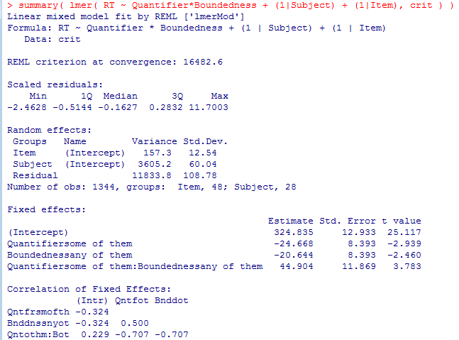
What mixed-effect models give you
Amount of variance for each random term
Typical model coefficients for fixed effects
We usually don’t care about this

Slide 22
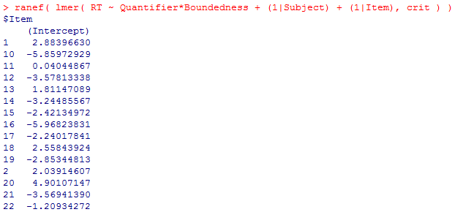
What mixed-effect models give you (2)
We can also see, for each random effect, how much each item’s or subject’s effect differs from the overall fixed effect

Slide 23
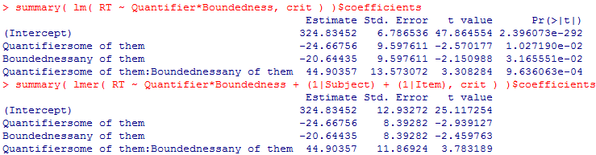
Dude, where’s my p-values?
?

Slide 24
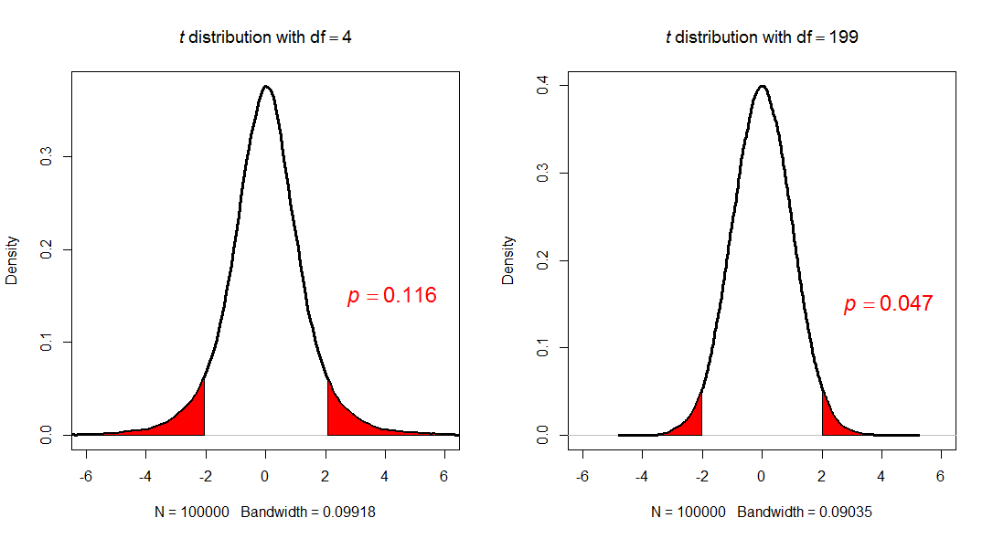
Why doesn’t lmer() give p-values?
The shape of the t distribution is based on degrees of freedom: the more degrees of freedom, the skinnier the distribution (and thus the less likely effects near the tails are)
For mixed-effects models, no one is sure how to count the degrees of freedom

Slide 25
Tricks to get p-values
Use the t distribution and estimate degrees of freedom
Just assume dfs are high
Estimate based on the parameters in the model
Use a mathematical estimation
Eschew the t distribution and use non-parametric bootstrapping
Eschew the t distribution and use model comparison
*Warning: Older texts recommend using Markov Chain Monte Carlo sampling (pvals.fnc() in R); this is no longer recommended and is no longer implemented in R

Slide 26
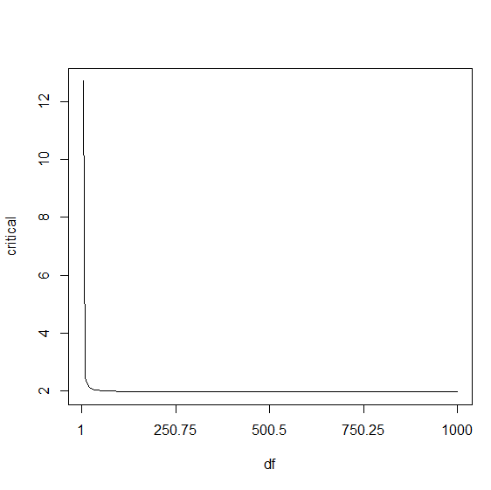
P-value trick 1a: Pretend you have a lot of dfs
With high dfs, the critical t-value for two-tailed α=.05 approaches 1.96
Many people use this (or, to be conservative, 2)
While rarely done, when you have a directional hypothesis you could (and maybe should) instead use the critical value for one-tailed α=.05, which is closer to 1.64
This is most reliable when you have hundreds (or more) observations

Slide 27
P-value trick 1a: Pretend you have a lot of dfs (some examples from the literature)
Baayen (2008, Analyzing Linguistic Data): "Since for large numbers of degrees of freedom (> 100) the t distribution approximates the normal distribution, a simple way of assessing significance at the 5% significance level is to check whether the absolute value of the t-statistic exceeds 2.”
Luo, Yan, & Zhou (2013, JEP:LMC): "Estimates larger than 2 standard errors (i.e., absolute t values greater than 2) were interpreted as significance.“
Kush, Lidz, & Phillips (2015, JML): "A fixed effect was considered significant if its absolute t-value was greater than 2, which indicates that its 95% confidence interval does not include 0 (Gelman & Hill, 2007).... We adopt the assumption that a reported coefficient is marginally significant (p<.10) if the absolute value of its t-value is greater than 1.65 (based on the 90% confidence interval)."

Slide 28
P-value trick 1b: Estimate dfs from model
Per Baayen (2008:270) you can get an upper-bound estimate of the dfs by taking the number of observations minus the number of fixed-effects parameters, and plug these dfs into the t distribution
For any model: 2 * (1 - pt( abs( summary(model)$coefficients[,"t value"] ), nrow(model@frame) - nrow(summary(model)$coefficients) ) )
For this to be reliable you should have at least a couple thousand observations; otherwise it’s anticonservative (gives p-values that are lower than reality, increasing Type I error).
In my experience it is also not very accurate for very high p-values (e.g. >.8), although such high p-values arguably don’t mean much anyway

Slide 29
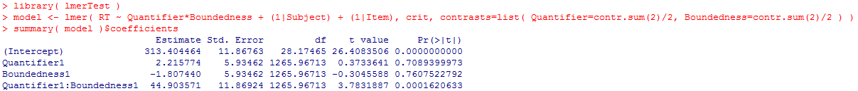
P-value trick 1c: Approximate dfs mathematically
Satterthwaite method (from SAS) estimates the appropriate dfs for t-values of mixed-effect model coefficients
After you load the {lmerTest} package, these will be shown automatically in model summaries

Slide 30
Notes on Satterthwaite approximation
Anecdotally, this seems to be what most people in psycholinguistics are using now
Note that the authors of {lme4} did not intend for lmer() models to give parametric p-values
They could have added this approximation to the function (and indeed many people have asked them to) but have repeatedly said they will not because they aren’t convinced that these p-values are legitimate
Take-home message: the {lmerTest} approximation is widely used but potentially controversial; I think whether or not to use it is more or less a personal/philosophical choice

Slide 31
P-value trick 2: bootstrapping
Bootstrapping: a powerful non-parametric method for statistically evaluating data that don’t meet the assumptions of particular parametric distributions (like t, F, χ², etc.)
See https://thepsychologist.bps.org.uk/volume-22/edition-5/methods-giving-your-data-bootstrap for a simple tutorial
Since it doesn’t require assumptions about the distribution of known test parameters, it is a handy too for evaluating mixed-effect model coefficients

Slide 32
How bootstrapping works
Sample your data with replacement. E.g., if you have 500 observations, then…
Randomly grab a datapoint and jot down its value, then return it to the dataset
Repeat this process until you’ve jotted down 500 values (some of these may be repeats of the same datapoint)
Calculate your parameter (e.g., the model coefficient) on this sample
Repeat the process a few hundred times
Instead of using a known test statistic distribution (like t), you can now use this distribution of bootstrap statistics as a distribution of samples of that parameter;
there are several different formulae for calculating the confidence interval of the parameter under this distribution (http://influentialpoints.com/Training/bootstrap_confidence_intervals-principles-properties-assumptions.htm)
If the CI does not include zero it’s considered significant

Slide 33
Bootstrapping mixed-effect model coefficients
Implemented in bootMer(); detailed examples in ?bootMer
Slow (just think: to test the significance of coefficients in one model, you have to run a few hundred more models!)

Slide 34
Advantages and disadvantages of CIs
Advantages
More information than p-values (gives an estimate of the likely range of possible values for the “real” effect
More stable across replications (see The Dance of the P-Values)
Many statisticians consider CIs good practice
Disadvantages
When you only pay attention to their binary interpretation (i.e. “Does the CI cross zero?”) they may actually be less informative than p-values
Some contexts may still require p-values

Slide 35
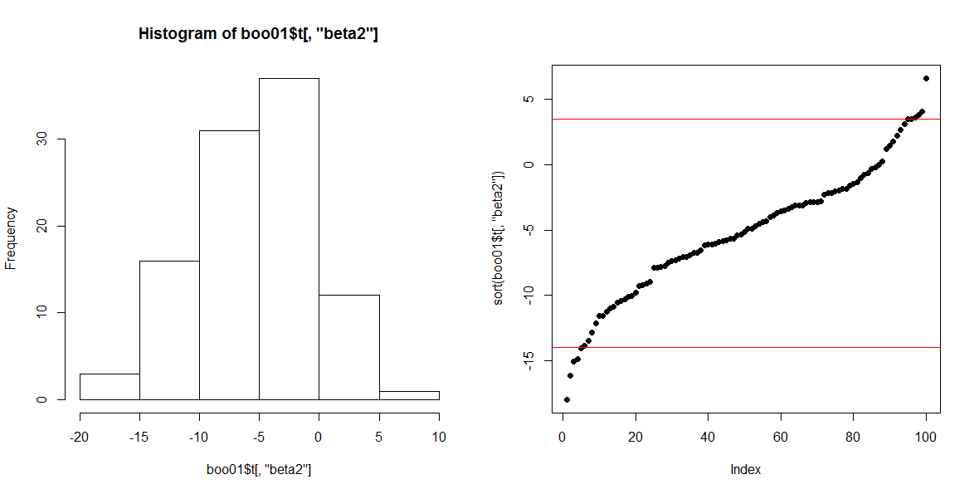
Getting p-values from a bootstrap distribution
p-value is related to CI
95% CI: the middle 95% of coefficients from the bootstrap distribution
We know that if the edge of this only barely touched 0, we would have p_{2-tailed}=.05. So to find the p-value we just need to find the biggest CI that doesn’t quite touch 0.

Slide 36
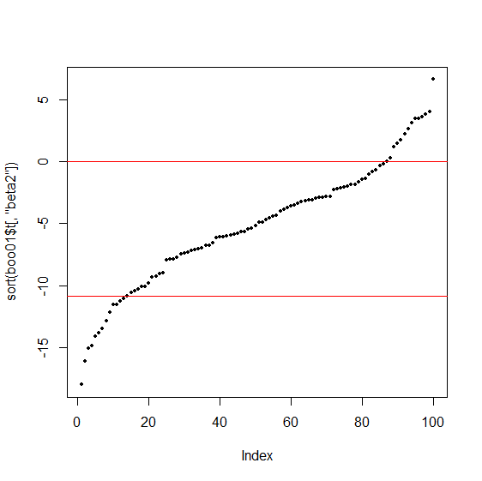
Getting p-values from a bootstrap distribution
The biggest CI that doesn’t include 0 is the 74% CI
Therefore, the two-sided p value is .26
This really just amounts to counting the proportion of bootstrap estimates that are on the “wrong” side of 0 (opposite the real model parameter) and doubling it (for a two-sided p-value)

Slide 37
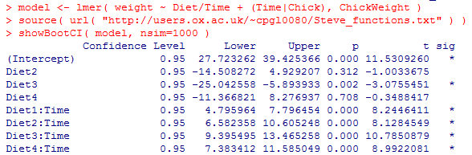
A wrapper function for showing all the CIs in a model

Slide 38
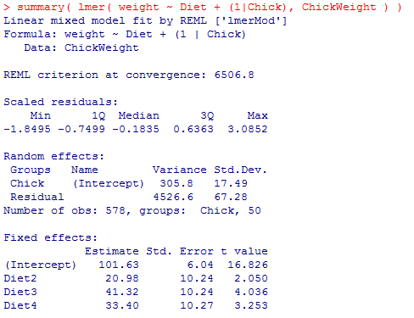
P-value trick 3: Model comparison
A quandary with polytomous categorical variables: where’s the main effect of Diet?
There is no coefficient or contrast that tests this. We need model comparison.

Slide 39
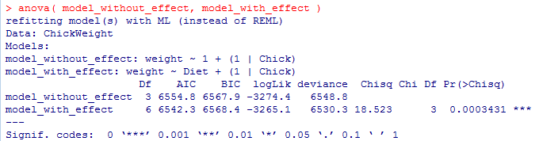
Model comparison: seeing if a model with your effect of interest fits the data significantly better than a maximally similar model without your effect
Same interpretation as an ANOVA main effect. If the model comparison is significant, you can proceed to planned comparisons within various levels of that factor

Slide 40
Model comparison caveats
Models must be on the same object
One model must nest the other

Slide 41
To get all possible model comparisons in the model….
Creating pairs of models and comparing them one at a time is ideal, but can be a pain
Quick-and-dirty methods to get “model comparisons” for each factor (and interaction) in a model:
Anova {car}
anova {lmerTest}
Warning: these methods give slightly different p-values from each other and from regular model comparison. I generally use them for a quick-and-dirty overview of the data but not for serious analysis
classic model comparison > anova {lmerTest} > Anova {car}

Slide 42
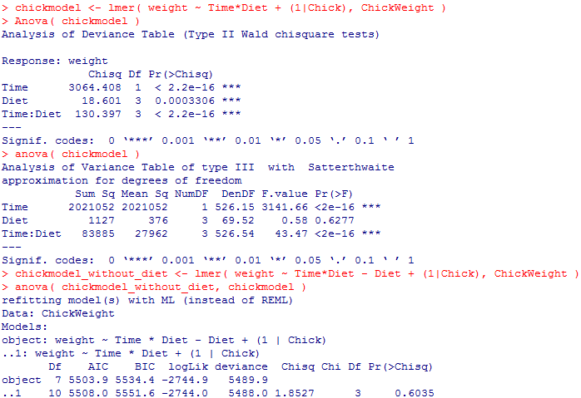

Slide 43
Note: while this was an example with polytomous variables, model comparison can also be used to get p-values for any other variable

Slide 44
To know more about getting p-values…
Type ?pvalues in R (when you have {lme4} loaded) to open a help page with more detailed information on even more ways to test significance

Slide 45
Mixed-effect model misconceptions
“It doesn’t matter that out items weren’t controlled for X between conditions; we put in random effects of items so that takes care of that”
The random effects for items correct for bias in the test statistic—i.e., helping to ensure that a test is not conservative or anticonservative. They don’t make potential confounds disappear
“mixed effects models can handle data that violate all the ANOVA assumptions”
True for some assumptions (lmer works with incomplete designs, missing data, and heterogeneous amounts of data per cell) but still requires homogeneity of variance (of residuals) and Gelman’s other major assumptions…

Slide 46
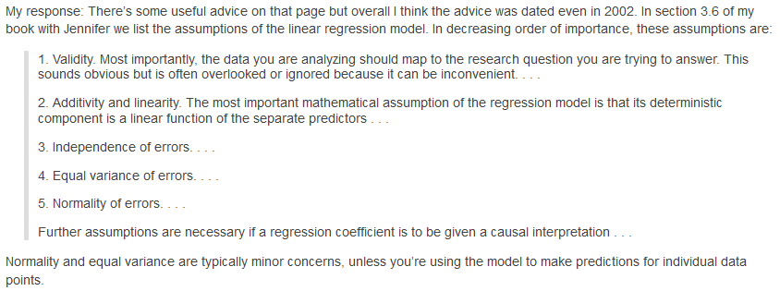
Mixed-effect model assumptions that are common to any linear regression
http://andrewgelman.com/2013/08/04/19470/

Slide 47
Assumptions specific to mixed-effect models
Random effects are normally distributed
If items or subjects are not controlled on some dimension and the fixed effects in the model don’t account for that, this might be violated

Slide 48
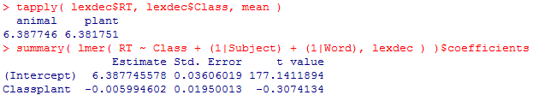
Practical consequences of non-normally distributed item effects
In the lexdec {languageR} dataset, it looks like there’s a small RT difference between animal and plant words, but it doesn’t look significant!
But are “animal” and “plant” words really comparable, or are they confounded on other variables…

Slide 49
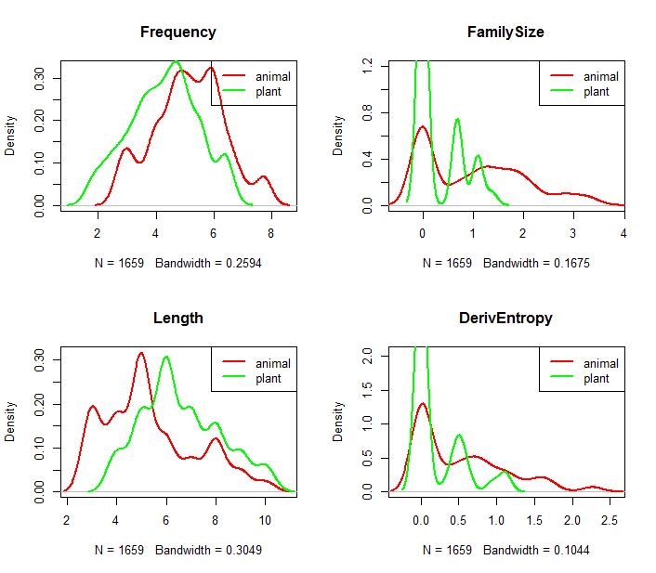
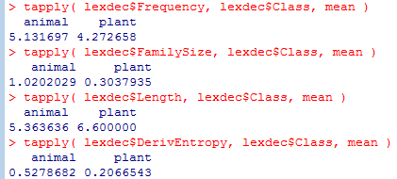
Animal and plant differ on many measures; any of these could be obscuring the effects

Slide 50
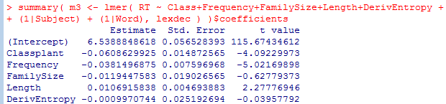
Once we account for some of those differences (and the variance they were causing in the random effects), the effect of Class becomes highly significant

Slide 51
This example showed [hopefully] the importance of accounting for confounding variables (by including them in the fixed-effects structure). But it also highlights an additional strength of mixed-effect models: instead of trying to come up with two “bins” of items that are perfectly controlled for everything, you can use the model to account for confounding variables that could have been obscuring between-condition differences in the model
(This assumes that you can think of relevant variables to include in the model; it is always possible that there are additional important confounding variables that nobody thought to include in the model)

Slide 52
Another example of a bad random effects specification: implicit priming data (Politzer-Ahles & Zhang, in press)
ItemSets
bi set | qi set | zhi set | zhu set
bi³shi⁴ bi³sai⁴ bi³an⁴ | qi³ye⁴ qi³dong⁴ qi³gai⁴ | zhi³bi⁴ zhi³bu⁴ zhi³yi⁴ | zhu³mu⁴ zhu³fan⁴ zhu³fu⁴
Items
We used:
lmer( RT ~ Experiment/Tone/Condition + (1|Subject) + (1|Item), trim )
Should have used:
lmer( RT ~ Experiment/Tone/Condition + (1|Subject) + (1|ItemSet/Item), trim )

Slide 53
Summary of benefits of mixed-effect models
Can account for multiple kinds of random effects (repeated measures) at once
Robust to some (but not all) design issues that would violate ANOVA assumptions: mixed-effects works with missing data and unbalanced designs
Very flexible: can include many kinds of variables and account for many kinds of confounds

