Slide 1
3. The dreaded maximal random effects
UCL Linguistics workshop on mixed-effects modelling in R
18-20 May 2016

Slide 2
Code at:
http://www.mypolyuweb.hk/~sjpolit/UCL_Rworkshop/

Slide 3
Reminder: what random effects are
lmer( RT ~ Class+Frequency + (1|Subject) + (1|Item), lexdec )
This is a model formula – a specification of the IVs that predict the DV
These are also model formulae!
So what does it mean when the model formula is only “1”?

Slide 4

A formula with only “1” only calculates an intercept
That’s just another way of saying, a formula with only “1” just gives the mean

Slide 5
Intercepts and random effects
A random effect specification essentially means “For each level of the random effect, fit this formula”
lmer( RT ~ Class + (Class|Subject), lexdec )
== “Fit an effect of Class (and an intercept), plus estimate the different effects of Class (and different intercepts) for each subject”
lmer( RT ~ Class + (1|Subject), lexdec )
== “Fit an effect of Class; allow each subject to have a different mean; but assume every subject has the same effect of Class”

Slide 6
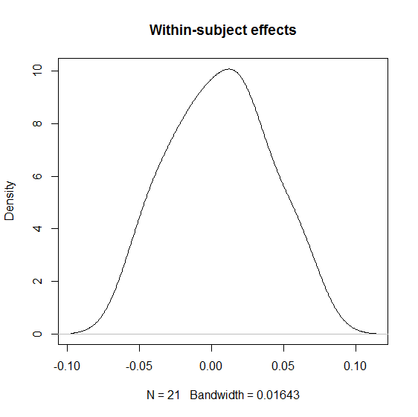
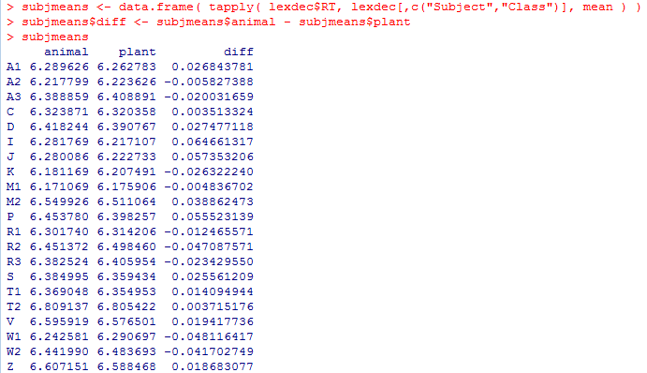
But in traditional tests (e.g. ANOVA, dependent t-test) we allow different effects for each subject…

Slide 7
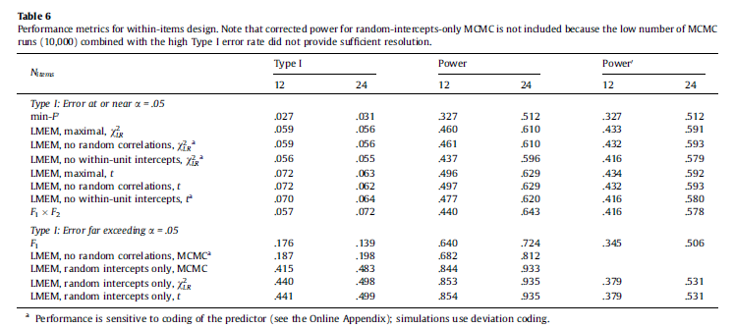
Consequences of using only random intercepts (Barr et al., 2013)

Slide 8

Recommendation of Barr et al. (2013)
Use the maximum random effect structure justified by the design
What does “justified by the design” mean?

Slide 9
What random effects are justified by the design?
lmer( RT ~ Class+Frequency + (Class+Frequency|Subject) + (1|Word), lexdec )
It’s possible for different subjects to have different Class and Frequency effects, since each subject sees trials of varying Class and Frequency
It’s NOT possible for different items to have different Class and Frequency effects, since each item only ever occurs as one Class and one Frequency!
Random effects of Class and Frequency for Items would be meaningless, and should not be included.
Bottom line: If a factor is between-items, don’t put in item-wise random slopes for it. Likewise for factors that are between-subjects.
WARNING: But R often won’t complain if you include these! So be careful and don’t rely on R to catch unreasonable models for you.

Slide 10
Pop quiz: What random effects to include?
lmer( RT ~ NativeLanguage + (?|Subject) + (?|Word) , lexdec )
lmer( RT ~ NativeLanguage + (1|Subject) + (NativeLanguage|Word), lexdec )
lmer( RT ~ PrevCorrect + (?|Subject) + (?|Word) , lexdec )
lmer( RT ~ PrevCorrect + (PrevCorrect|Subject) + (PrevCorrect|Word) , lexdec)
lmer( RT ~ Sex + Complex + (?|Subject) + (?|Word) , lexdec )
lmer( RT ~ Sex + Complex + (Complex|Subject) + (Sex|Word), lexdec )

Slide 11
Let’s try fitting a maximal random effects model now…

Slide 12
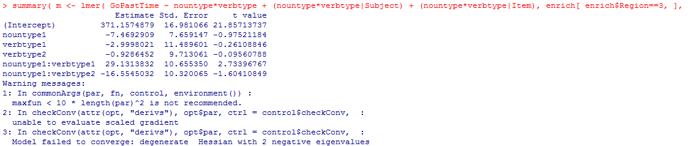
Convergence failures
Usually a result of trying to fit a model with more parameters than the data justify

Slide 13
Ways to deal with convergence failure
Diagnose whether the warning is really a concern
Identify problems with the data or model
Use a more powerful modelling algorithm
Simplify the model

Slide 14
Diagnosing convergence failures
Sometimes convergence warnings are false alarms
Some recommend re-running the model using different optimizers (e.g., control=lmerControl(optimizer=“…”), where the value of ‘optimizer’ can be “bobyqa”, “Nelder_Mead”, “optimx”, “nloptr”, and others; see https://cran.r-project.org/web/packages/lme4/vignettes/lmerperf.html and ?lmerControl
If the model fits (i.e. log-likelihood) are very close across many different optimizers, it may be ok to ignore convergence warning
Drawback: no hard-and-fast criterion (as far as I know) for how similar the fits need to be

Slide 15
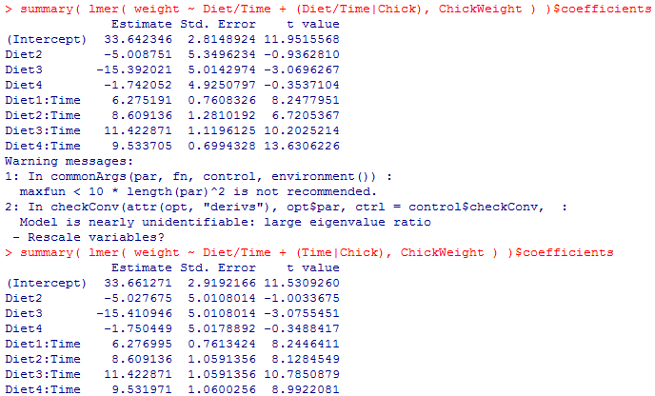
Issues with the data or the model
Making sure the random effects are actually justified by the design
Centering [for continuous] or sum-coding [for categorical] the predictors; sphering (z-scoring) also helps
Trimming outliers
Removing subjects/items with very few observations

Slide 16
Powering up the lmer algorithm
lmer( DV ~ IV + (IV|Subject) + (IV|Item), control=lmerControl( optimizer=“bobyqa”) )
In older versions of {lme4}, using the BOBYQA optimizer instead of the default sometimes resolved convergence errors
In the current version, BOBYQA is now the default, so this may be moot
nloptr may be even more powerful; see https://cran.r-project.org/web/packages/lme4/vignettes/lmerperf.html

Slide 17
Powering up the lmer algorithm (2)
Sometimes the model isn’t intrinsically un-fittable, but the algorithm just needs more iterations
This model has at least 18 parameters (6 fixed effects, 6*2 random effects), so needs at least 10*18^2 == 3240 iterations.

Slide 18
It’s possible to increase the number of iterations allowed:
lmer( ……., control=lmerControl( optimizer=“bobyqa”, optCtrl=list( maxfun=10000))
With enough iterations, almost any model can converge
Drawback: this can take a long time
And if you want to evaluate statistics with bootstrap CIs, which requires running the model a few hundred times, you don’t want a model that needs 48 hours to converge!

Slide 19
Simplifying the random effects structure
If the model still doesn’t converge, this usually means you are trying to fit more terms than are justified by the amount of data you have
It’s acceptable to remove terms until the model converges
The question is which terms to remove…

Slide 20


References on model simplification: Barr et al. (2013), Bates et al. (submitted), Jaeger (2011)
https://hlplab.wordpress.com/2011/06/25/more-on-random-slopes/

Slide 21
Model simplification strategies
Theory-motivated
Remove random effect correlations
Preferentially keep random effects of interest (vs. nuisance covariates)
Preferentially keep random slopes (vs. random intercepts)
Preferentially keep lower-order effects (vs. higher-order interactions)
Data-driven
Backward selection based on variance
Backward selection based on significance
Forward selection (model building)
Dimensionality reduction

Slide 22
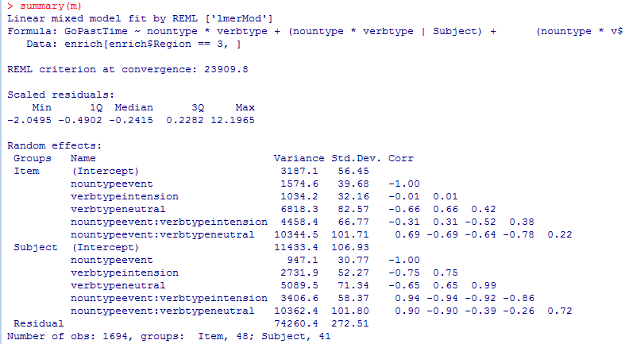
Random effect correlations
Do we really need all this?

Slide 23
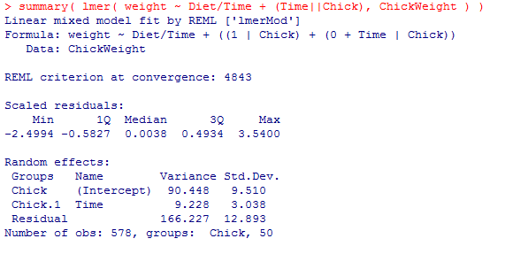
Removing random effect correlations: when the random slopes are continuous
Double-bar || syntax
(Time||Chick) == (1|Chick) + (0+Time|Chick)
Notice that now the random effect correlations are gone

Slide 24
Removing random effect correlations: when the random slopes are categorical
Removing the random effect correlations requires you to have only one effect within each set of parentheses (hence (1|Chick)+(0+Time|Chick), which (Time||Chick) is shorthand for)
But a categorical variable like Diet intrinsically is multiple variables (after dummy-coding or whatever)
Annoyingly, this means the categorical covariates need to be re-coded into actual numbers (like you would have to do in SPSS); i.e., the re-coding that R normally does ‘under the hood’, you have to do for real here
See https://rpubs.com/Reinhold/22193
The best way to do this is to steal them from the model.matrix() of your model

Slide 25
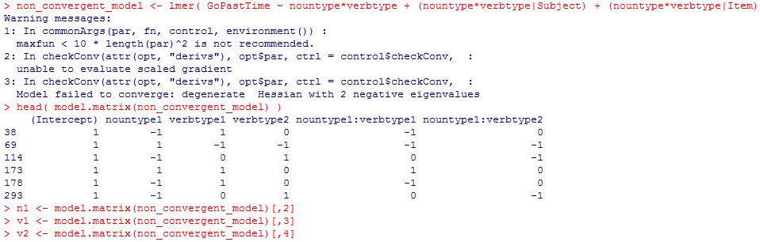

Slide 26
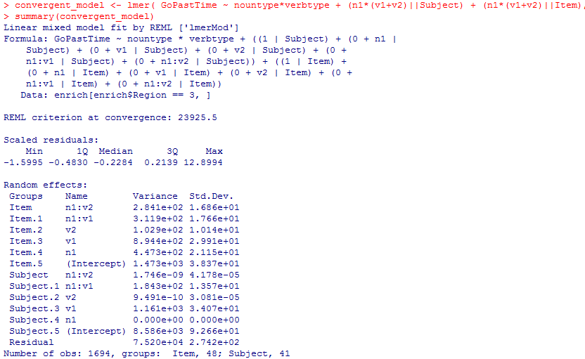

Slide 27
Random effects of interest vs. nuisance covariates
Random effect of interest is one corresponding to a fixed effect that you care about testing (rather than just controlling for)
lmer( RT ~ Frequency + Complex + (Complex|Subject) + (1|Word), lexdec )
If the research question is “Do complex words yield slower RTs after accounting for frequency differences”, keep random slope of Complex and lose Frequency. (Vice versa if the research question is “Do high-frequency words yield faster RTs after accounting for differences in morphological complexity?”)

Slide 28
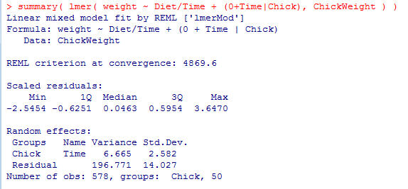
Random slopes vs. random intercepts
(0+<slope>|<randomeffect>) syntax to remove intercept
Note that Chicks have a random slope for Time but no random intercept
Doesn’t seem to be common practice in the field yet (most people do the opposite, keeping intercepts and removing slopes), but recommended by Barr et al. 2013

Slide 29
Effects of interest
If the purpose of the experiment is to test an interaction, the interaction is of more interest than the main effects

Slide 30
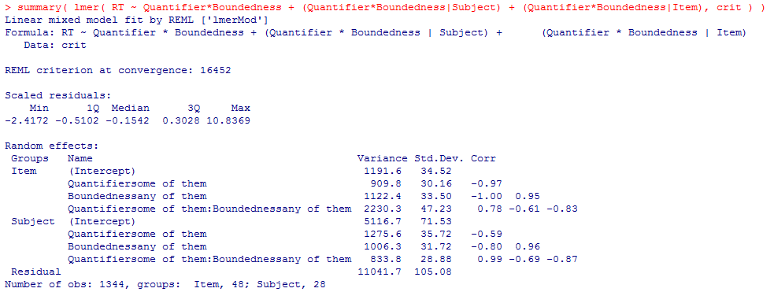
Removing higher-order interactions
* vs. + syntax which should be familiar from our work with model comparisons

Slide 31
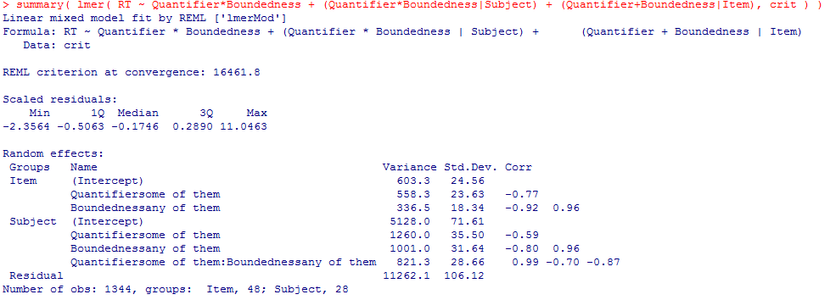
Removing higher-order interactions
Now no interaction for Items

Slide 32
Data-driven selection algorithms
The general idea: blindly add or remove random effects terms until some numerical criterion tells you that you’ve hit the ideal model
Forward vs. backward
Forward: start with the simplest model and progressively add effects
Backward: start with the biggest model and progressively remove effects
Based on variance vs. based on significance
Variance: add the effect that accounts for the most variance (or remove the effect that accounts for the least)
Significance: add effects that significantly improve fit (or remove effects that don’t)

Slide 33
Selection: forward vs. backward
Forward can be faster than backward, since you might be able to stop before computing complex models with random effects
But forward selection biases you towards stopping with fewer random effects
Recall that Barr et al. (2013) recommend using the maximum possible random effects structure, not the minimum possible (but see Bates et al., submitted)
Thus, backward selection is better

Slide 34
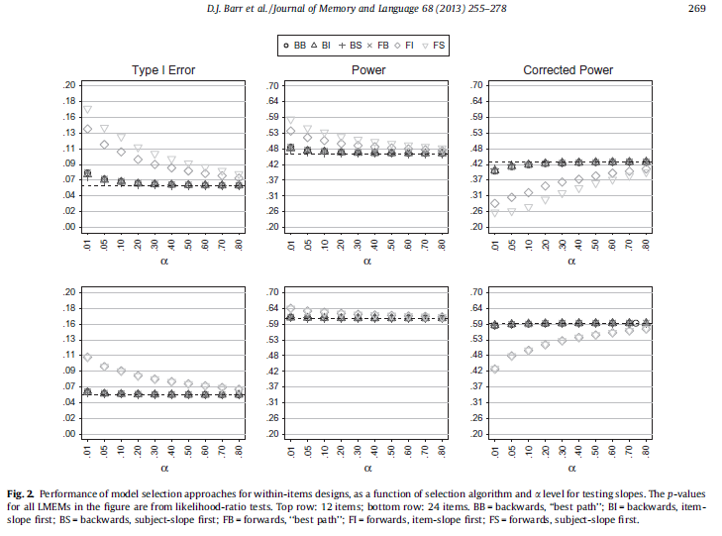
Backward selection gives better power and type I error rates

Slide 35
Selection based on significance or variance
Selection based on significance requires model comparisons, and thus requires computing a lot of models (which may be prohibitive if each model takes hours)
Selection based on variance only requires glancing at the random effects summary

Slide 36
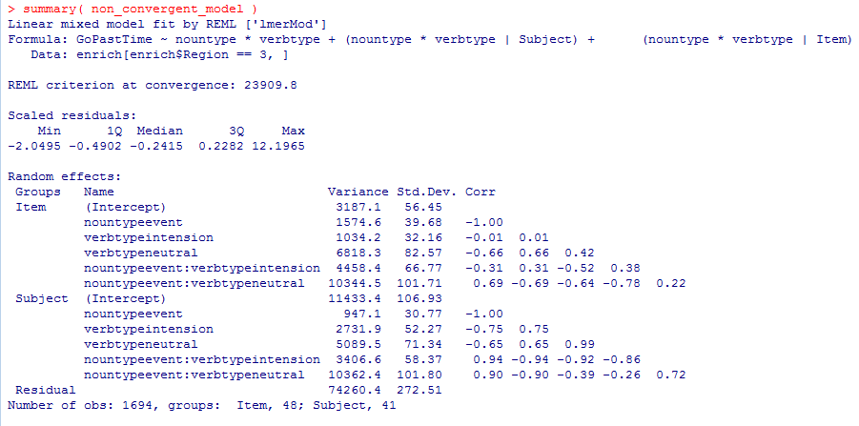

Slide 37
One last trick: bootstrapping
When one model doesn’t converge, it is possible that bootstrap replicates of the model do converge, especially if the model is right at the border of being too complex
This can be used to estimate model coefficients based on a bootstrap distribution
However, it’s also possible that you wait all day for your 500 models to run and actually none of them converges

Slide 38
My recommended procedure
Check that the model is reasonable (i.e., no random slopes for between-unit factors), sphere continuous predictors, deviation-code categorical predictors if you don’t need them dummy coded for interpretation
Remove correlation parameters
Hybrid backwards selection based on variance and theory until the model converges
i.e., among the nuisance covariates, remove the component that accounts for the least variance; repeat as long as there are still nuisance covariates
Once nuisance covariates are all gone, remove the intercept that accounts for the least variance; repeat as long as there are intercepts
Once intercepts are gone, remove the uninteresting effects (e.g. main effects) in order of variance accounted for
Notes:
NOTE that some of the strategies we discussed are not included in my procedure: I don’t do post-hoc outlier removal, or trying to diagnose whether the convergence failure can be ignored.

