Slide 1
4. Extra topics: logistic models, ordinal variables, effect sizes, power analysis, transformations, confidence intervals
UCL Linguistics workshop on mixed-effects modelling in R
18-20 May 2016

Slide 2
Code at:
http://users.ox.ac.uk/~cpgl0080/UCL_Rworkshop/

Slide 3
Logistic models

Slide 4
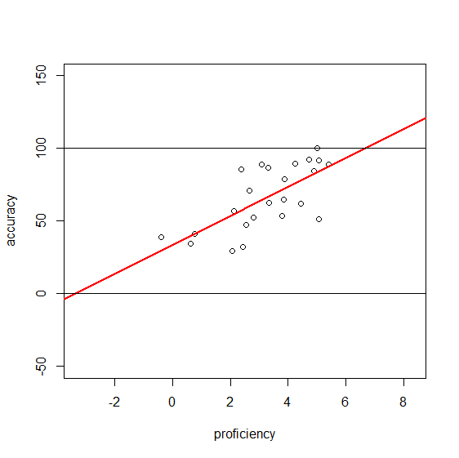
Categorical outcomes
Categorical data do not meet the assumptions for a simple linear model
Old solution: within each subject, aggregate the binary response to get a numeric proportion
Problems:
  Requires aggregating over either subjects or items
  Doesn’t meet linear assumptions; data are bounded between 0 and 100

Slide 5
Logistic regression
Represents coefficients in terms of log odds rather than proportions
Odds: representing the proportion of some response (e.g. ‘correct’) as the number of that response per every other response
50% correct: 1 correct for every 1 incorrect, so odds = 1/1 = 1
33% correct: 1 correct for every 2 incorrect, so odds = 1/2 = .5
75% correct: 3 correct for every 1 incorrect, so odds = 3/1 = 3
Logistic regression looks at the log of the odds. While proportion is bounded between 0 and 1, log odds is unbounded and linear

Slide 6
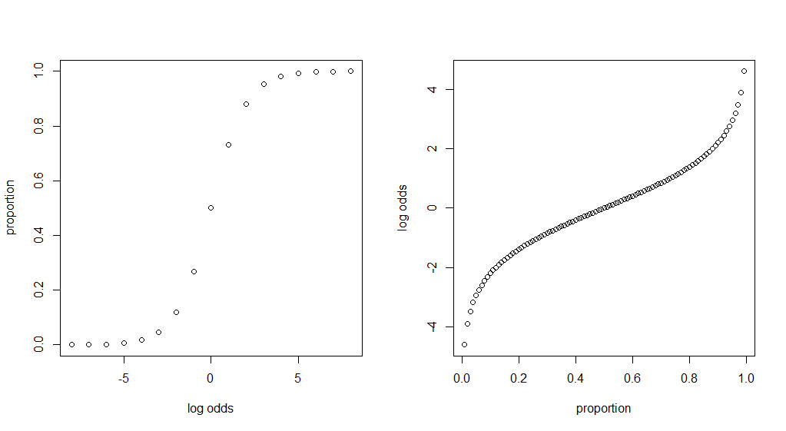

Slide 7
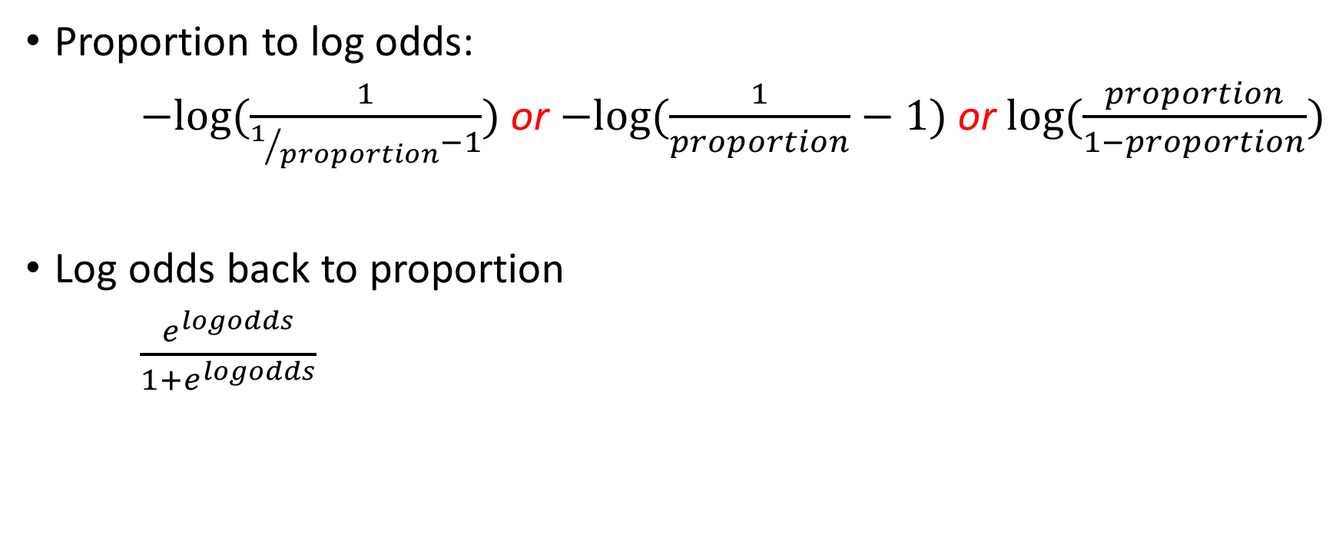
Converting between proportions and log odds
Proportion to log odds:
$−log(\frac{1}{1/{proportion}−1})$ or $−log{(\frac{1}{proportion}−1)}$ or $log⁡(\frac{proportion}{1−proportion})$
Log odds back to proportion
$\frac{e^{logodds}}{1+e^{logodds}}$

Slide 8
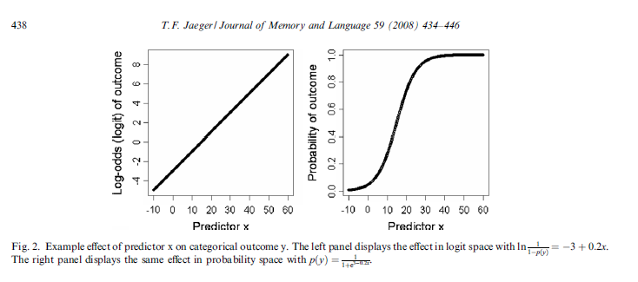

Slide 9
Doing a logistic mixed model
Use glmer() instead of lmer() [g is for generalized]
Specify family=“binomial” in the model
Use a binomial (factor or logical) DV
glmer( Correct ~ Condition + (Condition|Subject) + (Condition|Item), data, family=“binomial” )

Slide 10
Logistic model coefficients
Negative means a lower proportion (of correct responses or whatever) than whatever it’s being compared to
Often useful to convert these from log odds into proportions in order to make sense of what everything means

Slide 11
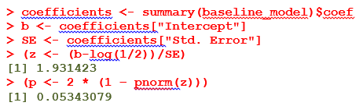
Logistic model coefficients
The z statistic for the intercept is comparing it to 0
  We know from the log_odds-to-proportion formula from earlier that log odds of 0 means 50%. So the z-score is for b – log(1/1) == b – 0 == b
What if your chance level is not truly 50%?
  E.g., if your experiment was a 3-alternative forced choice task, but you later recoded the variable into “correct” vs. “incorrect”, chance level is 33% (1/2 odds) rather than 50% (1/1 odds)
We can recalculate our z-score, comparing the intercept to some arbitrary chance level rather than to 0

Slide 12
The bad news about logistic models
Slow!
Convergence failures more likely

Slide 13
Ordinal variables

Slide 14
Ordinal IVs
  Can be put into a regular mixed-effect model (either lmer or glmer)
  But be careful whether it actually makes sense as an ordinal IV…
    If some levels are not well represented, it may make more sense to recode as binary
    If there are enough levels (≥7; some say ≥5) you can treat it as continuous and make your life easier
Ordinal DVs
  Use clmm() {ordinal} rather than lmer/glmer

Slide 15
Effect sizes

Slide 16
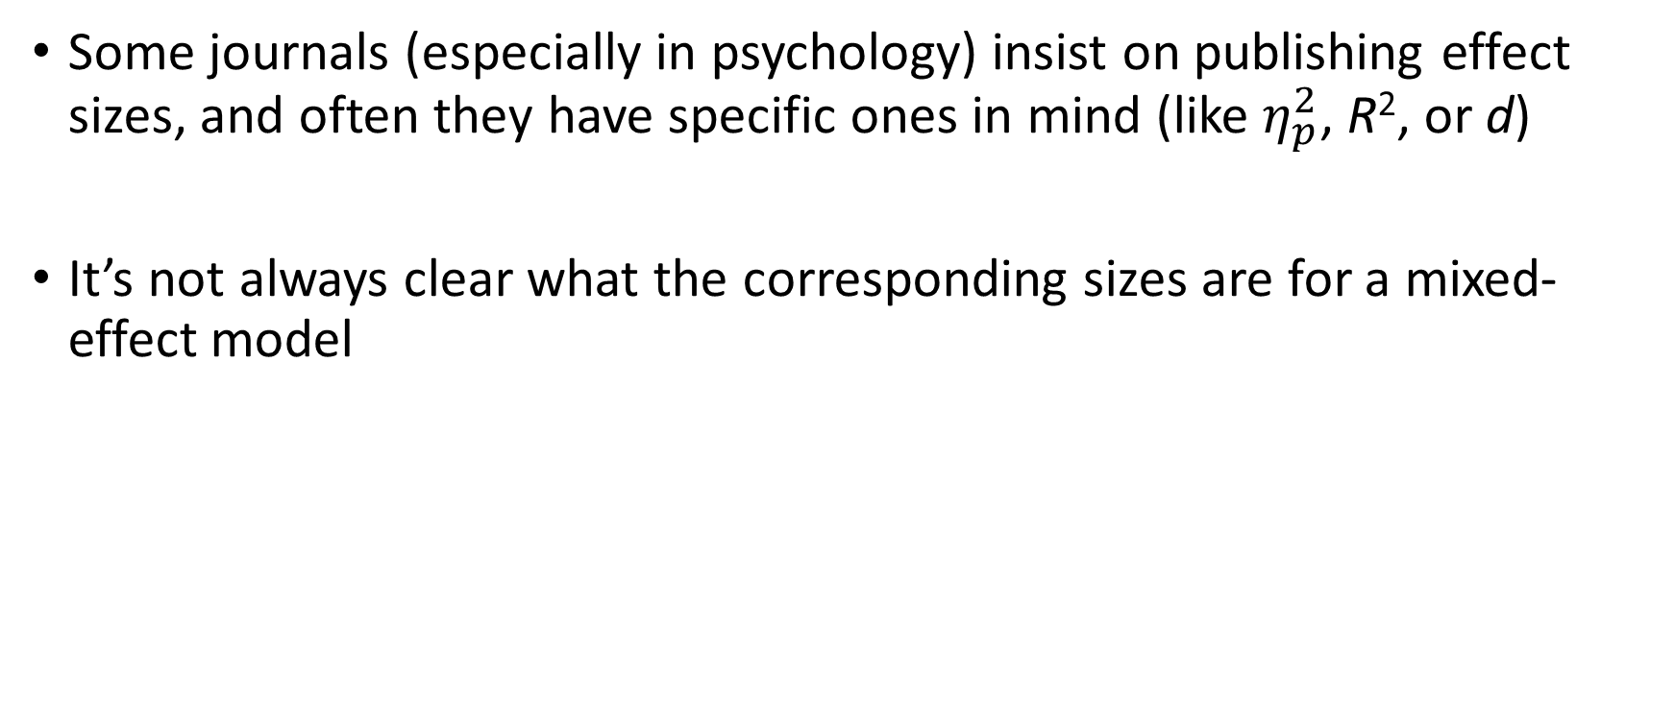
Effect sizes in mixed-effect models
Some journals (especially in psychology) insist on publishing effect sizes, and often they have specific ones in mind (like $η_{p}^{2}$, R², or d)
It’s not always clear what the corresponding sizes are for a mixed-effect model

Slide 17
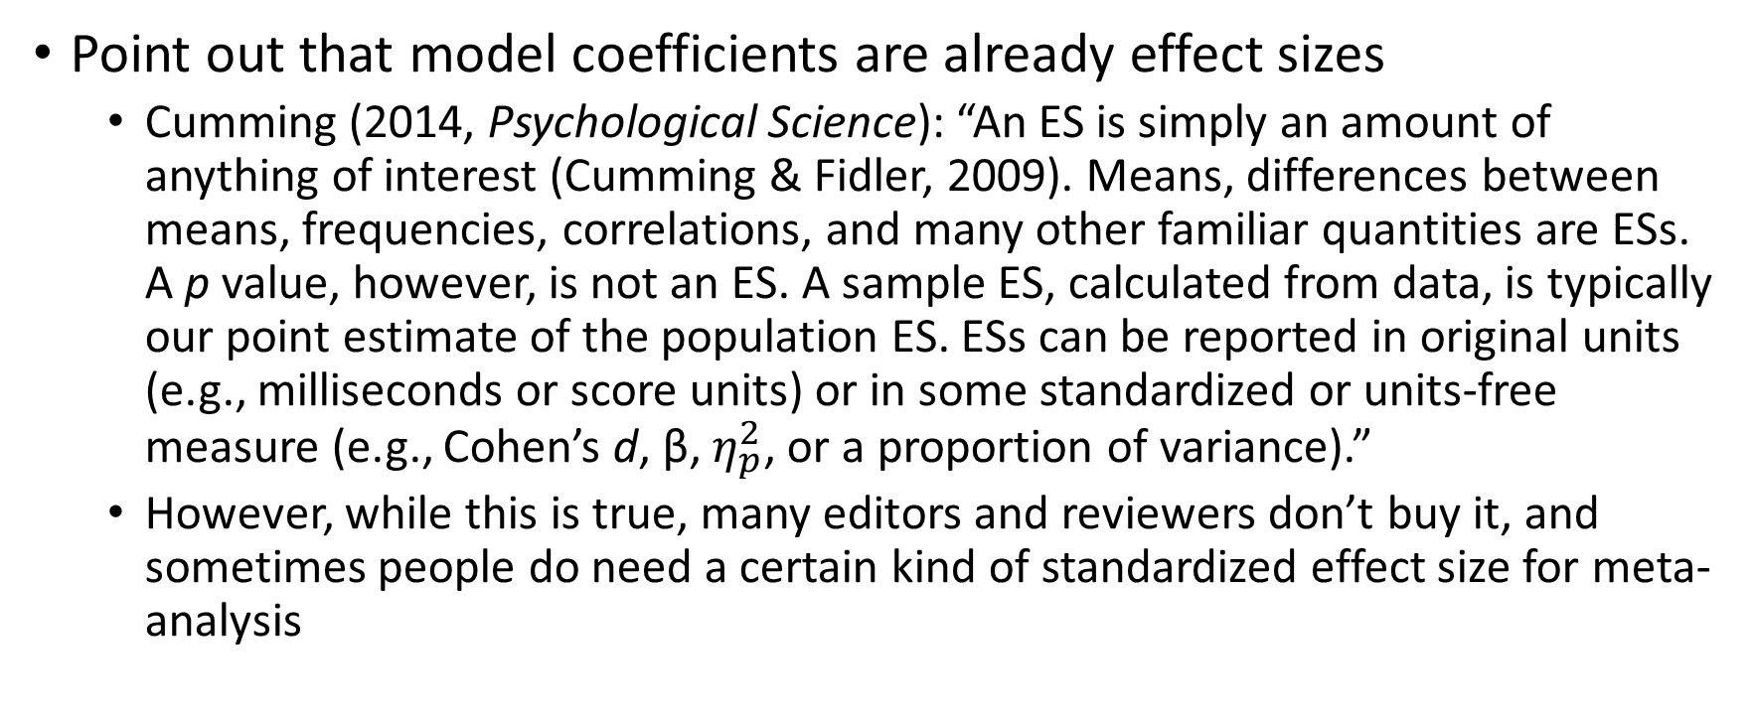
Strategies for dealing with effect size (1)
Point out that model coefficients are already effect sizes
  Cumming (2014, Psychological Science): “An ES is simply an amount of anything of interest (Cumming & Fidler, 2009). Means, differences between means, frequencies, correlations, and many other familiar quantities are ESs. A p value, however, is not an ES. A sample ES, calculated from data, is typically our point estimate of the population ES. ESs can be reported in original units (e.g., milliseconds or score units) or in some standardized or units-free measure (e.g., Cohen’s d, β, $η_{p}^{2}$, or a proportion of variance).”
  However, while this is true, many editors and reviewers don’t buy it, and sometimes people do need a certain kind of standardized effect size for meta-analysis

Slide 18
Strategies for dealing with effect size (2)
Just provide the data so that meta-analysts are welcome to get whatever effect size they like from it
  Anecdotally, I have also heard stories of editors not being won over by this…
Use mixed-effect models for your main analysis, but also report supplementary traditional analyses (e.g. ANOVA or t-tests) that give traditional effect size measures

Slide 19
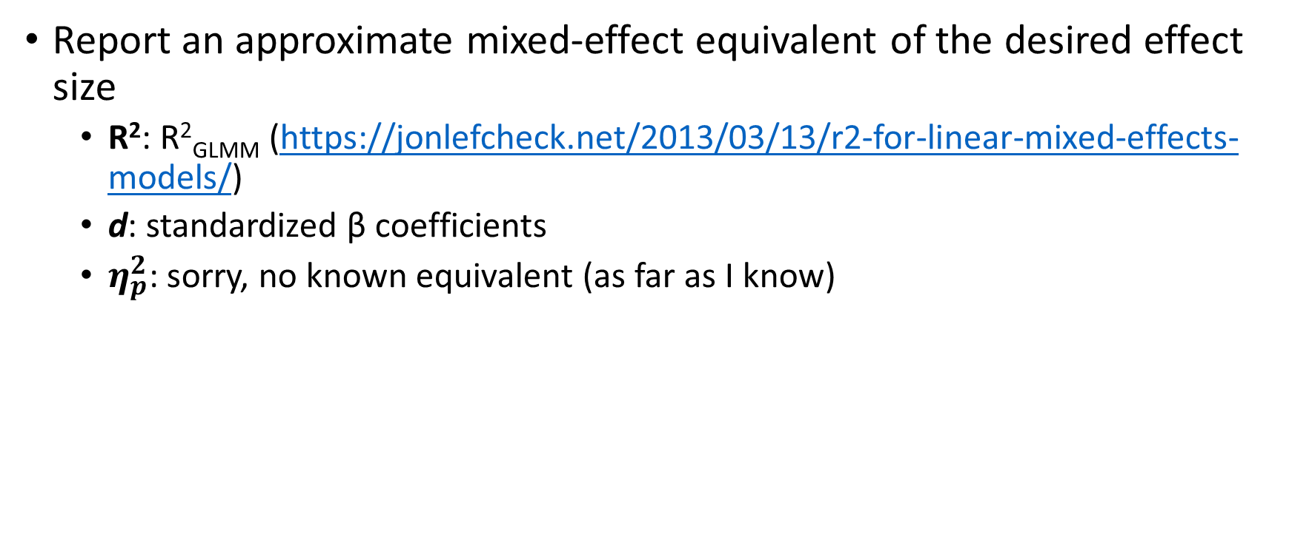
Strategies for dealing with effect size (2)
Report an approximate mixed-effect equivalent of the desired effect size
  R²: R²_{GLMM} (https://jonlefcheck.net/2013/03/13/r2-for-linear-mixed-effects-models/)
  d: standardized β coefficients
  $η_{p}^{2}$: sorry, no known equivalent (as far as I know)

Slide 20
Power analysis

Slide 21
Power analysis
lmmpower() or liu.liang.linear.power() {longpower}; see http://stats.stackexchange.com/questions/48374/sample-size-calculation-for-mixed-models
Simulation
  {pamm} https://cran.r-project.org/web/packages/pamm/pamm.pdf
    Apparently only tests random effects
  simulate() {lme4} http://stats.stackexchange.com/questions/82615/a-priori-power-analsis-for-generalized-linear-mixed-effects-model
  Simulate it manually (e.g. http://toddjobe.blogspot.co.uk/2009/09/power-analysis-for-mixed-effect-models.html)

Slide 22
Transformations

Slide 23
The motivation behind transformation
Assumption of normality [of residuals]

Slide 24
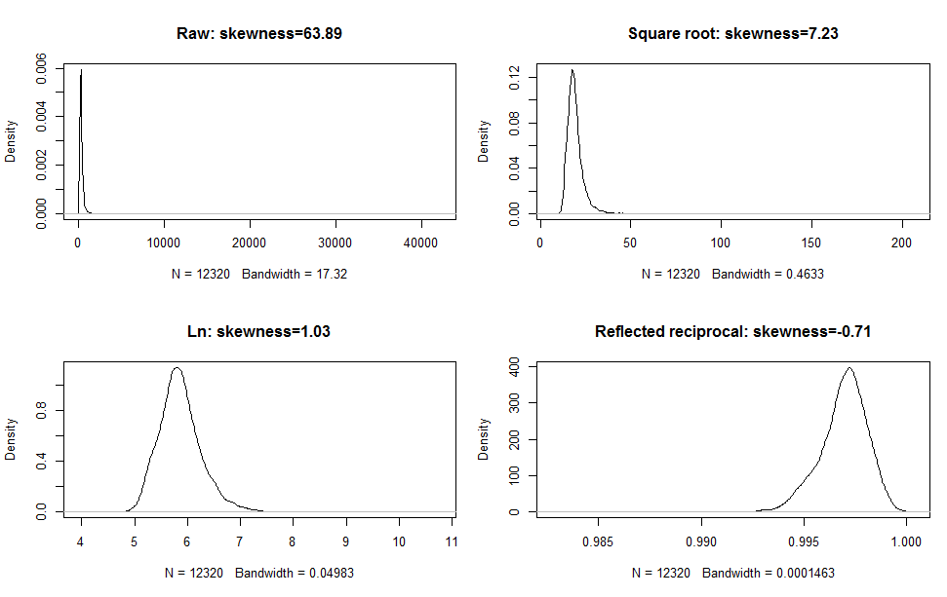

Slide 25
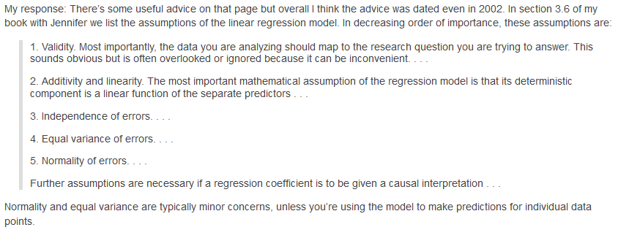
Nowadays people say we shouldn’t transform data…
http://andrewgelman.com/2013/08/04/19470/

Slide 26
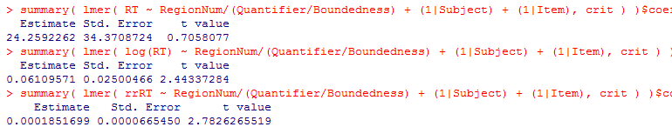
But skewness has a large effect on the results…
Bootstrapping is (surprisingly) not robust to this (i.e., bootstrapped coefficients will be very different in their significance depending on the transform of the DV)

Slide 27
My current practice: if I have a priori reason to expect the data to be problematic (e.g., skewed RT data), I try the simple transforms (sqrt, log10, log, reflected reciprocal) and use whichever one gives the lowest skewness absolute value (using the skewness() function from {e1071})

Slide 28
Keeping on top of developments in stats

Slide 29
Good blogs to follow
Simine Vazire: http://sometimesimwrong.typepad.com/wrong/
Andrew Gelman: http://andrewgelman.com/
Uri Simonsohn: http://datacolada.org/
Daniel Lakens: http://daniellakens.blogspot.co.uk/
Sanjay Srivastava: https://hardsci.wordpress.com/
Deborah Mayo: https://errorstatistics.com/
R-bloggers: http://www.r-bloggers.com/
Sho Tsuji & Christina Bergmann: https://cogtales.wordpress.com/
Page Piccinini: https://pagepiccinini.com/
Shravan Vasishth: http://vasishth-statistics.blogspot.co.uk/
Michael Frank: http://babieslearninglanguage.blogspot.co.uk/

