Slide 1
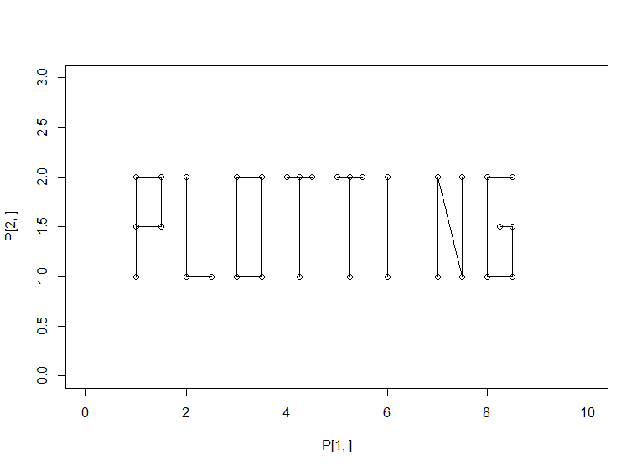
UCL Linguistics workshop on mixed-effects modelling in R
18-20 May 2016

Slide 2
Code at:
http://users.ox.ac.uk/~cpgl0080/UCL_Rworkshop/

Slide 3
Confidence intervals
(see also http://users.ox.ac.uk/~cpgl0080/confidenceintervals.html)

Slide 4
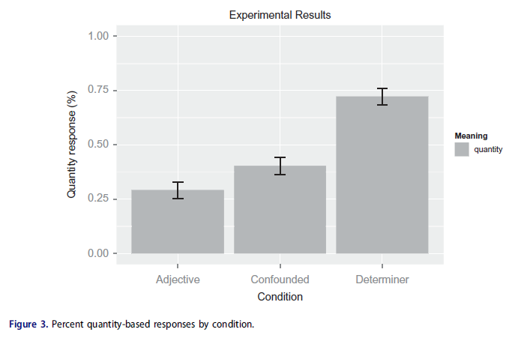
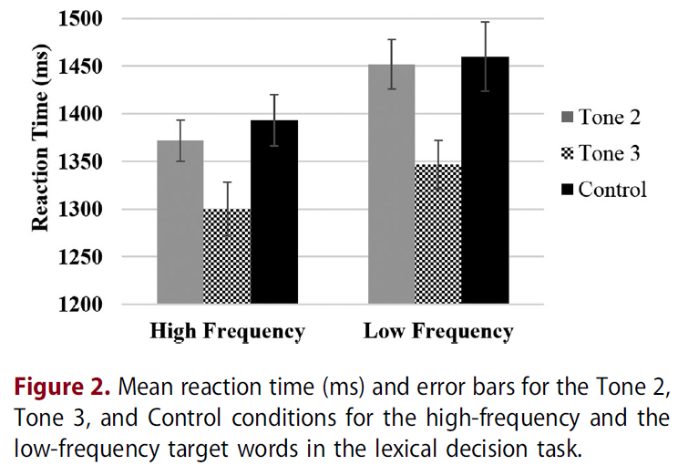
Some examples: what do error bars mean?

Slide 5
Error plots are commonly used for…
±2 SE
±1 SE
95% CI
±1 SD
Standard error of all conditions
If you want readers to make inferences about which bars are significantly different, then the best is the 95% CI (Cumming & Finch, 2005)

Slide 6
The formula for SE and CIs
SE: SD / sqrt(N)
CI: mean ± t_{crit} * SE
Important caveat: this is a CI across subjects; it’s useful for between-subject comparisons but not for within-subject comparisons

Slide 7
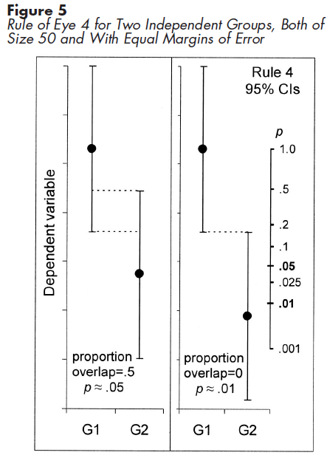
CIs for between-group comparisons have straightforward interpretations
Per Cumming & Finch (2005), assuming the two groups are independent and have similar-sized CIs:
If the CIs just barely touch each other, p≈.01
If the CIs overlap by about 50%, p≈.05

Slide 8
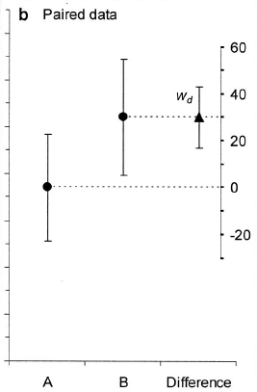
But this breaks down for between-group comparisons…
For a between-group comparison, to know the difference between the groups, you are interested in estimating the population mean of each group
For a within-group comparison, you don’t care about the population mean of any condition; you care about the population mean of the difference
Cumming & Finch (2005), fig 3

Slide 9
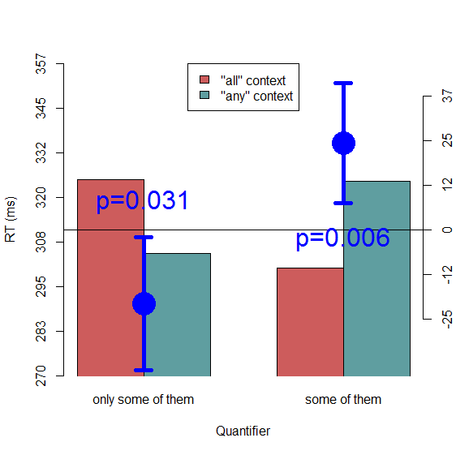
Plotting CIs around differences instead of around condition means

Slide 10
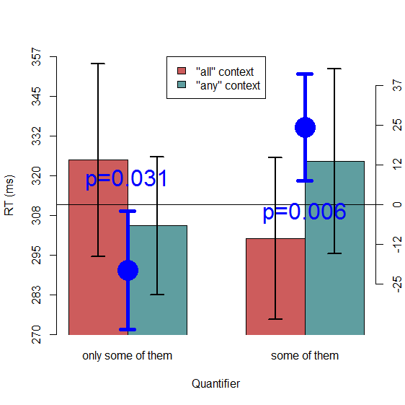
Plotting the between-subject CI on each condition is misleading…

Slide 11
What we want in a within-subjects CI
Ignores between-participant variance in the individual condition; captures between-participant variance in the effects
Allows for somewhat arbitrary comparisons

Slide 12
One solution: plotting between-subject CIs around the differences instead of the condition means
As we saw above, this is straightforward and accurate
But with complex designs it can become clunky.
Here we’ve only plotted two differences: the Boundedness simple effect at each level of Quantifier.
We could also have plotted:
Quantifier simple effect at each level of Boundedness
Each main effect
The interaction
For more complex designs it gets out of hand quickly (imagine a 2×2×4 design…)

Slide 13
Another solution: within-subject CIs
Essential reading: Loftus & Masson (1994), Cousineau (2005), Morey (2008)
These involve various calculations to yield confidence intervals that are meaningful for within-subject comparisons

Slide 14
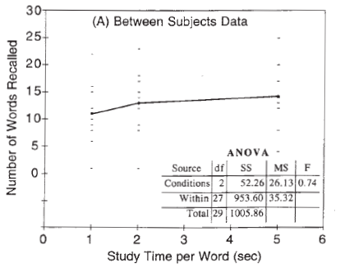
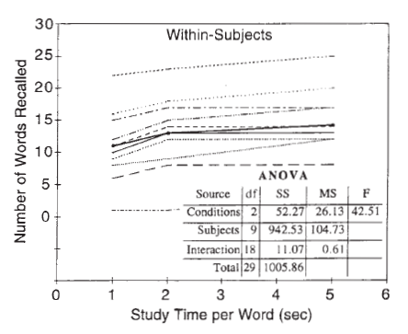
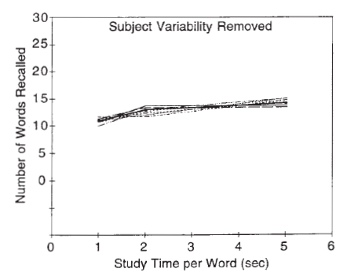
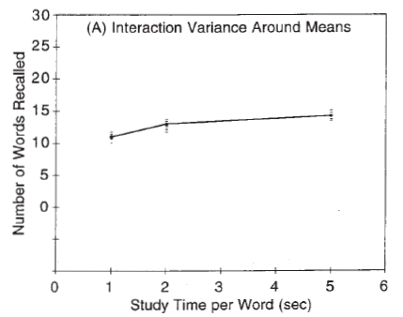
Cousineau-Morey CI
For each condition for each subject, subtract the subject’s mean and add the grand mean
After this, all subjects have the same mean and the SD represents between-condition variance
Loftus & Masson (1994)

Slide 15
Cousineau-Morey CI
After normalizing the participants’ condition means, compute the CI using the usual formula, and multiply by a correction factor ( sqrt(K/(K-1)), where K is the number of conditions )

Slide 16

Cousineau-Morey CIs

Slide 17
Caveats (1)
With complex designs these still might not be appropriate; it depends on the comparisons you want to illustrate
E.g., for a mixed design, you might want between-subject (traditional) CIs around the condition means, and condition differences (with between-subject CIs) plotted separately. i.e., this plot might be reasonable if Quantifier is a between-subjects factor

Slide 18
Caveats (2)
Cousineau-Morey CIs involve aggregating over items for each subject (or over subjects for each item, in theory)
So they’re not showing quite the same thing as what we test with mixed-effect statistics
The best way to represent within-subject CIs for mixed effect models seems to be still under debate
When in doubt, make your dataset available (if possible)

Slide 19
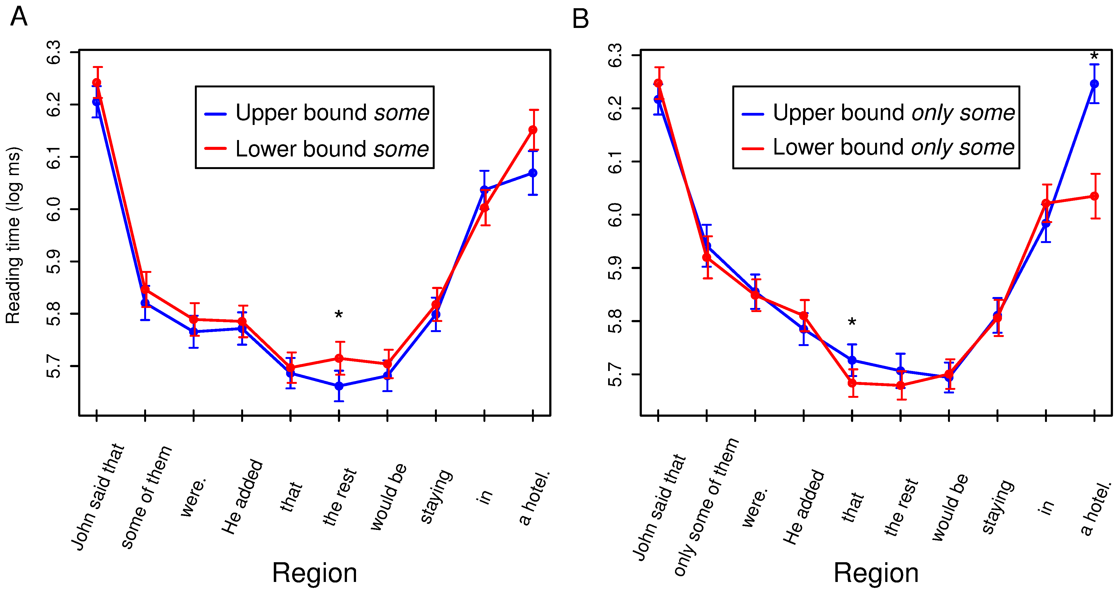

Slide 20
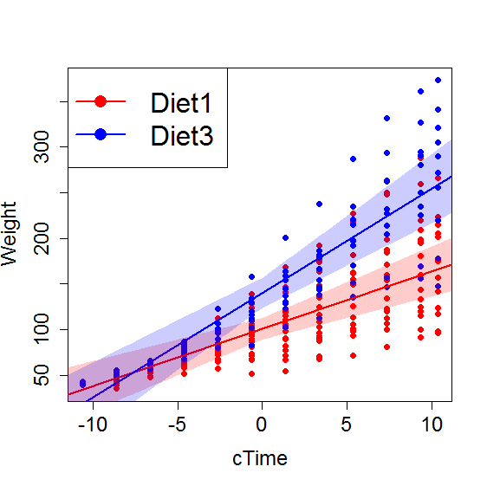

Slide 21
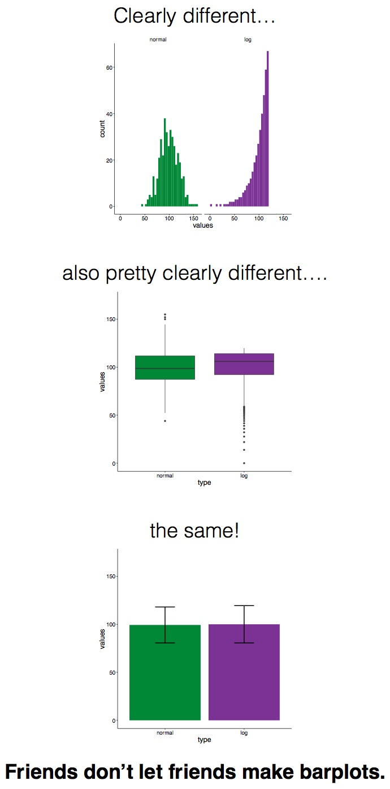
Plotting philosophy
While we often use bar plots, we probably ought to use plots that give more information about the distribution of our data
https://pagepiccinini.com/2016/02/23/boxplots-vs-barplots/ (source of this figure)
https://www.kickstarter.com/projects/1474588473/barbarplots
However, this is not a blanket condemnation of all bar plots; there are still some cases where barplots are appropriate

Slide 22
“Showing or summarizing the distribution can be a useful way to put your cards on the table for readers to see that you are not trying to hide or obfuscate any unusual outliers or strange trends. Especially in the language sciences we often deal with small effect sizes and larger intersubject or interitem variability, and if we plot the entire distribution the effect is hard to see (as in the example you posted above). Luckily, there are many compromises that can be made - for example, plot a grand mean, along with (less visually prominent) subject means, so that the variability in the data is more apparent.”
Rory Turnbull (p.c.)
Bottom line: there’s usually no hard-and-fast answer about what plot is best; the important thing is to think (rather than just always making the same kind of plot out of habit) about what is important to show based on your research question, and how it makes the most sense to show it

Slide 23
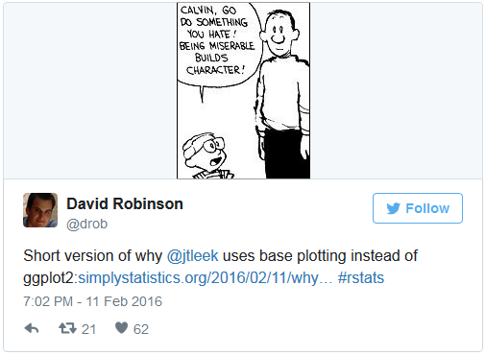
Y U NO ggplot2?
“Why I don’t use ggplot2” http://simplystatistics.org/2016/02/11/why-i-dont-use-ggplot2/
“Why I use ggplot2” http://varianceexplained.org/r/why-I-use-ggplot2/

Slide 24
Using or not using ggplot2 is fine either way
Neither {base} nor {ggplot2} produces publication-quality figures right out the gates; figures always need some tweaking based on the context in which they’ll be presented (for example, fat lines and big text for slide presentations)
ggplot2 can usually do things with less code if you take the defaults (but maybe sometimes the defaults can be limiting)
Having to manually figure out all the right numbers in {base} is useful for understanding what you’re actually doing (but this argument is somewhat hypocritical because even {base} is a shortcut relative to, e.g., making your figures with a pen and ruler like it’s 1960)

