Slide 1
Behaviour Classification for Temporal Data

Slide 2
Driving Question
Is it possible to quantify the behavioural change of items in temporal data?
What is the best reference point to compare the behaviour change with?

Slide 3
This Thesis
So basically, this thesis can be considered as study in the data analysis field as it proposes two methods in this area to answer the primary question.
Method for measuring the amount of changes in the items’ behaviour.
A method for classifying items’ behaviour in temporal data sets.

Slide 4
Results
It is possible to quantify behaviour change of items in the temporal data sets using clustering and cluster validity indices
Yes, we can classify items according to their behaviour in temporal data by optimising rules which are provided by the filed experts.

Slide 5
Measuring changes over time
Clustering
Quantifying
Training
Assesment
Cluster items in each time point independently from other time points.
Kmeans, cmeans, PAM
Quantify the changes between time points using ECVI and a reference of behavoiur .
VI, Jaccard Rand, FM

Slide 6
Reference of Behaviour
First time point
Previous time point
Overall behaviour through the temporal data set

Slide 7
Why This method
While multiple methods exist for measuring changes in data streams however these methods focus on.
Cluster internal change like size, density and location
Cluster external change like appeared, disappear, merge and split

Slide 8
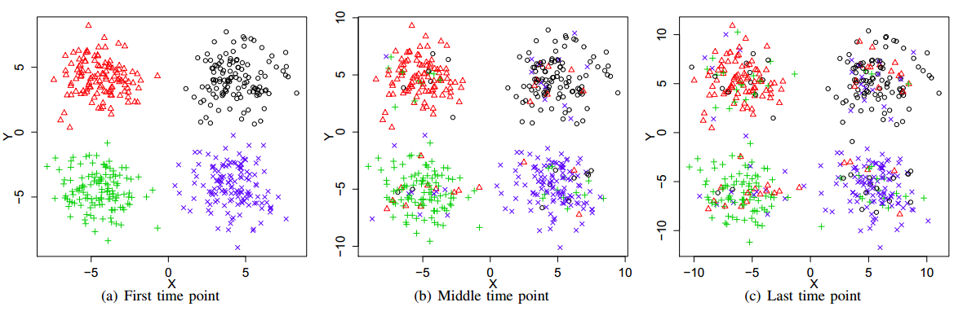
Synthetic Data

Slide 9
Clustering

Slide 10

Measuring Cluster Changes
CVI
Reference point
CVI

Slide 11
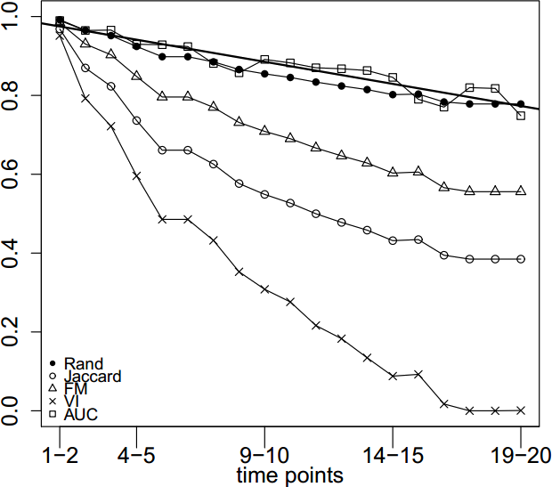

Measuring Change Results
All criteria measure the change
Results of AUC ≃ Rand
AUC, Rand and FM might be good measures
VI, Jaccard are sensitive (overreacting!)
Notes:
test

Slide 12
Why Classification
First time point
Previous time point
Overall behaviour through the temporal data set

Slide 13
Temporal Rule-Based Classification
Rule
Generation
Rule
Optimization
Training
Assesment
Generating classification rules using field experts opinions and definitions. With the help of profiling
Finding the optimum rules among the generated pool of rules. So that the final classes will produce the most compacted groups of items in each time point

Slide 14
Rule Generation
Use experts’ definition for classes
Rules are expressed in the form of aggregated attributes of the temporal attributes. Like mean, stdev and IQR
The rules are flexible and the class boundary values are evaluated by a range of [min, max] values

Slide 15
Rule Optimisation
The goal of optimisation is to find optimum rules for classes.
The optimum classifier will produce the most compacted groups of class items in each time point. The Compactness can be measured using Euclidian and stdev
After this step the [min, max] ranges will be converted to a scalar.

Slide 16
Rule Generation Example

Slide 17
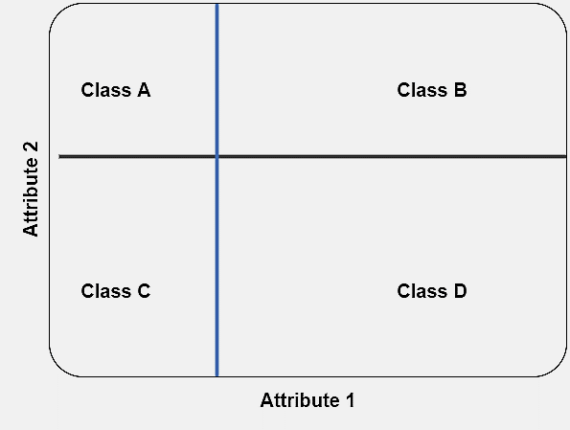
Rule Optimisation Example

Slide 18
Advantages
It provides simple classification rules that are easy to be understood and manage by experts of the field
Taking advantage of the temporal dimension of the data to provide the optimum class for each item

Slide 19
Data sets
Synthetic data set of 500 items with 20 time points
Two data sets of public goods games
10 rounds with 140 players
27 rounds with 128 players
Stock market data set of S&P 500 between 1/1/2015-1/7/2015

Slide 20
Synthetic data set
Successfully validated the measuring changes over time method.

Slide 21
PGG data set
The proposed classification method reflects players actual behaviour more than the available method.
The proposed method for measuring changes over time + MONIC both confirmed that the players strategy changes over time are stable.

Slide 22
Stock market data set
Stocks are classified into four classes according to their market price stability.
Provide a method for classifying stock market stability
Present another evidence for random walk case in the debate of stock market predictability.

Slide 23
Both of the proposed algorithms proved to be scalable and flexible with different data sets.

Slide 24
Thank You

