Slide 1

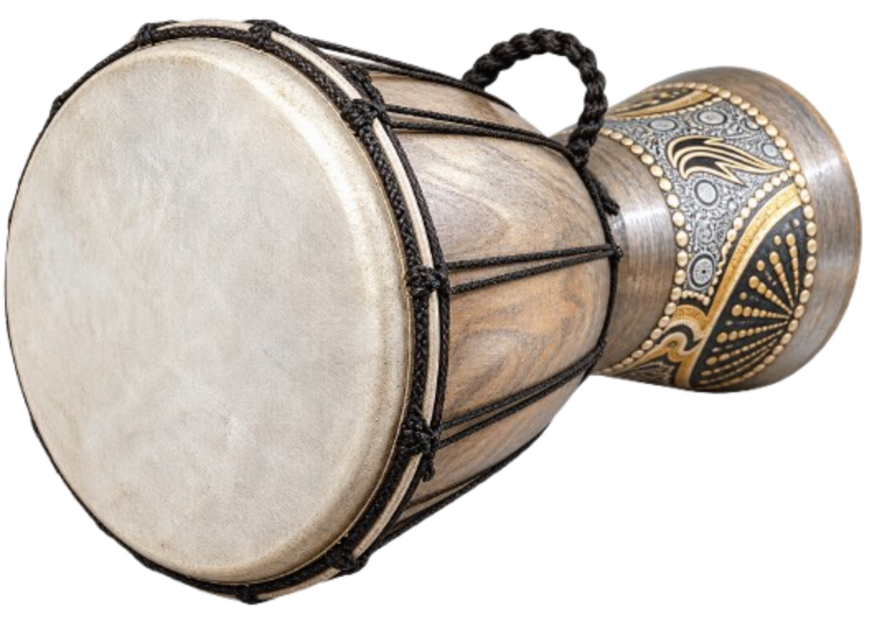

FROM DATA TO THESIS
Using Python for Non-Technical
Modern Data Analysis in the Age of AI
by Polla Fattah and an Ensemble of LLMs

Slide 2

From Data To Thesis Using Python
Turn messy data into a defended, publication-ready thesis.
For many postgraduate and academic researchers, collecting data is only the beginning of the real challenge. The hardest hurdle is turning spreadsheets, surveys, and lab observations into robust statistical models and defendable written arguments. Commercial point-and-click tools leave your analysis opaque, while standard programming textbooks bury you in abstract computer science theory.
From Data to Thesis bridges that divide. Written specifically for graduate students, doctoral researchers, and academic professionals, this book provides a complete, modern roadmap for empirical research using Python. Rather than abstract mathematics, every concept is taught through a single, realistic running case study following 600 students across four semesters.
  Every chapter guides you through five clear steps:
  A Concrete Research Question.
  A Minimal Working Example .
  The Case-Study Analysis.
  In Your Field.
  Thesis Reporting & Interpretation .
From exploratory data analysis and hypothesis testing to mixed-effects models, machine learning, time-series forecasting, and ethical AI assistance, this book gives you the tools, code, and confidence to defend your research with scientific rigor.
Inside you will discover:
How to clean, reshape, and visualize complex data using modern workflows.
How to choose the right statistical test—and how to diagnose and fix common assumption violations.
Practical machine learning and predictive modeling without the computational overwhelm.
Reproducible research workflows using Quarto and Jupyter that generate thesis-ready tables and figures.
Interactive browser playgrounds to practice every method without installing a single package.
Whether you are writing your first Master’s dissertation, completing your doctoral defense, or preparing an empirical journal article, this book is your desk companion from raw data to submitted thesis.
by Polla Fattah
and Collection of LLMs

