Slide 1

ConsoleX Website Presentation

Slide 2
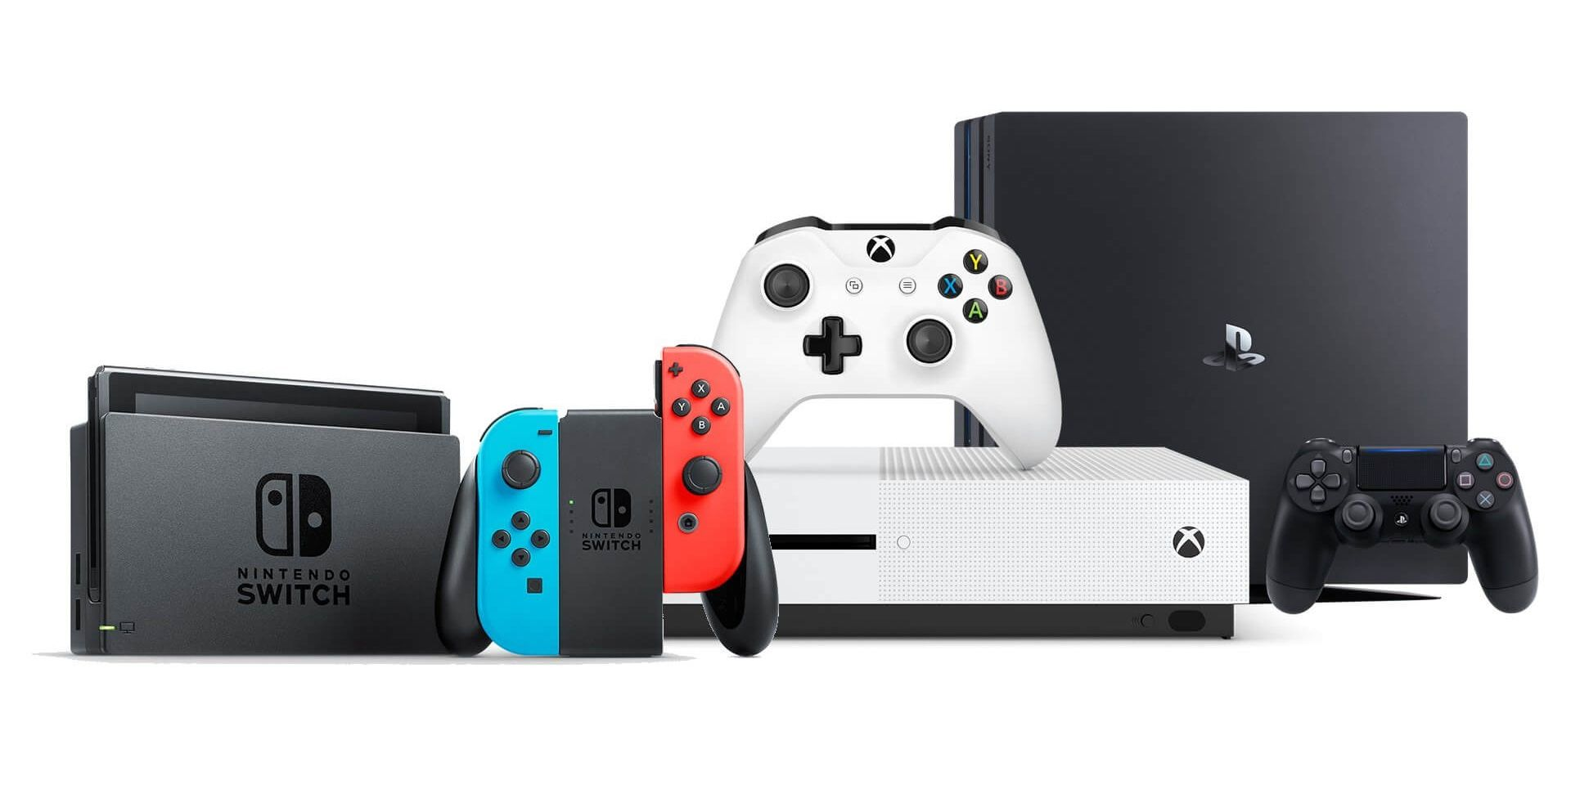
What is the ConsoleX?
ConsoleX is your online destination for gaming.
From the latest consoles to must-have video games and accessories, we make it easy for gamers to find and order everything they need all in one place.
ConsoleX delivers top-tier products and a seamless shopping experience tailored for every kind of gamer.

Slide 3


Design That Delivers: A Seamless User Journey
This presentation outlines the frontend architecture and implementation of ConsoleX, a video game webshop developed using Vue.js and styled with Tailwind CSS.
ConsoleX is a single-page application (SPA) that enables users to browse video games, view product details, manage a shopping cart, and proceed to checkout — all through a responsive and performant UI.

Slide 4




Modern Tools, Fast Interfaces
The Tech Behind the UI
Vue.js
Vue.js is a progressive JavaScript framework for building user interfaces with a reactive, component-based architecture.
Tailwind CSS
Tailwind CSS is a utility-first CSS framework that enables developers to build custom, responsive designs directly in their HTML templates using low-level utility classes.
Vuetify
Vuetify is a Vue.js UI library that provides pre-styled, responsive components following the Material Design specification.
Node.js
Node.js is an event-driven JavaScript runtime built on V8, designed for building scalable, non-blocking server-side applications.

Slide 5

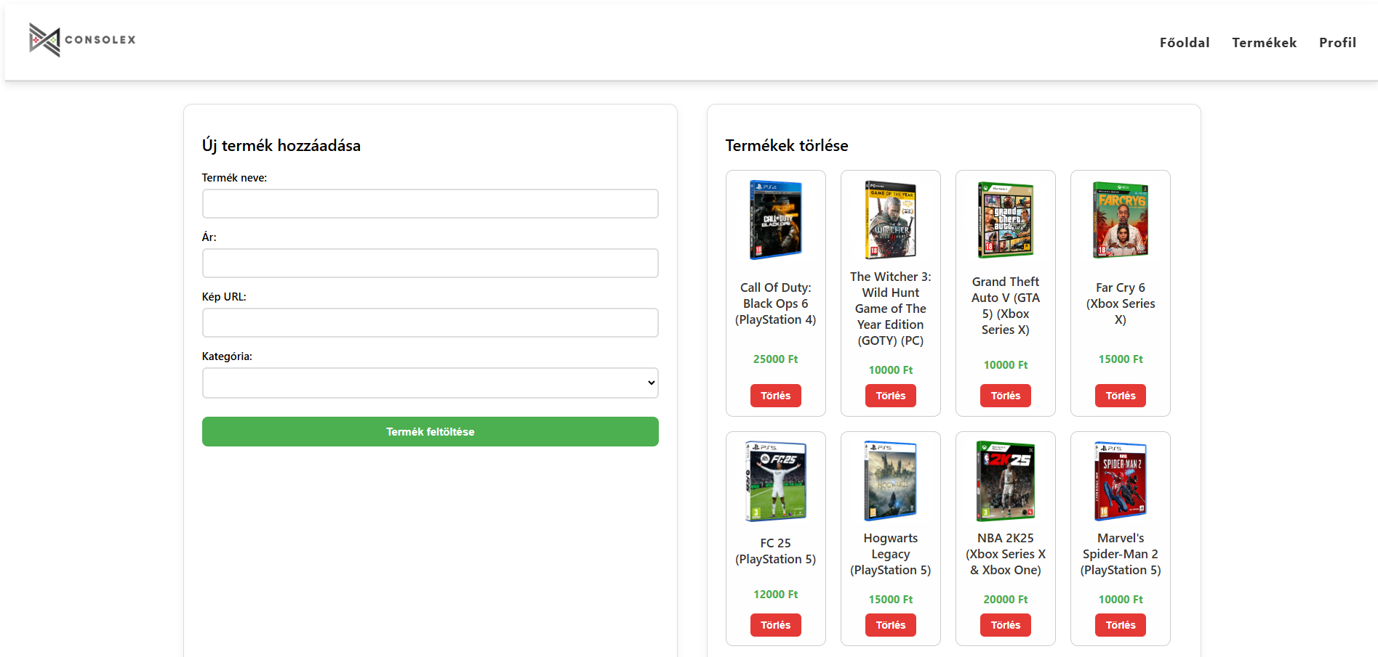
Functions of the website
Login
Registration
Order
Admin: add/delete products
Change password
Filters

Slide 6

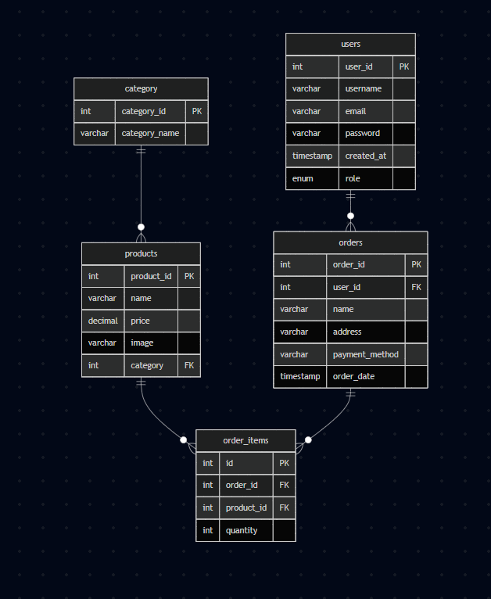

Database
Database tables:
Users:
User_id
Username
Email
Password
Created_at
role
Orders
Order_id
User_id
Name
Address
payment_method
Order_date
Order_item
Id
Order_id
Product_id
quantity
Products
Product_id
Name
Price
Image
category
Category
Category_id
Category_name
We used MySQL
and phpMyAdmin to create the database.

Slide 7
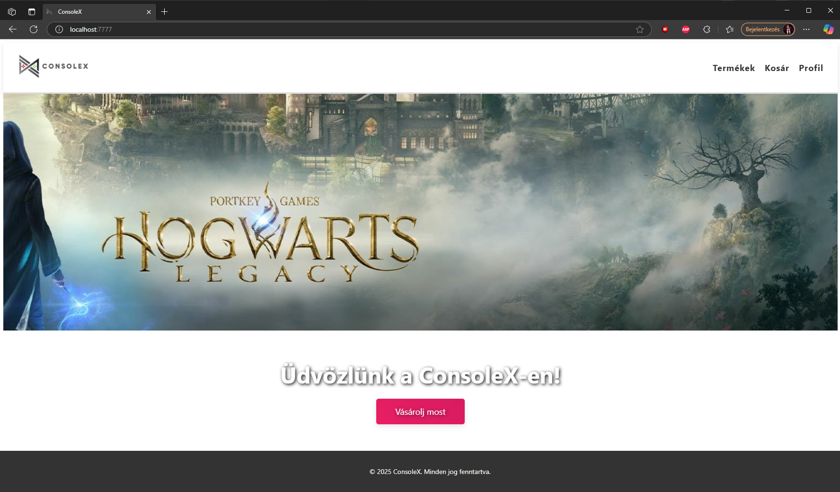
Landing Page
Your Gateway to Gaming Starts Here
The landing page serves as the main entry point of ConsoleX, welcoming users with a visually engaging hero section that highlights featured games, promotions, or upcoming releases. It includes quick access to the product catalog, search functionality, and dynamic banners tailored to current trends. Users can navigate to the following pages using the Navigation Bar: Products (Termékek), Cart (Kosár) and Profile (Profil).

Slide 8

Responsivity
All pages are responsive
On smaller screens the header changes to a hamburger menu

Slide 9
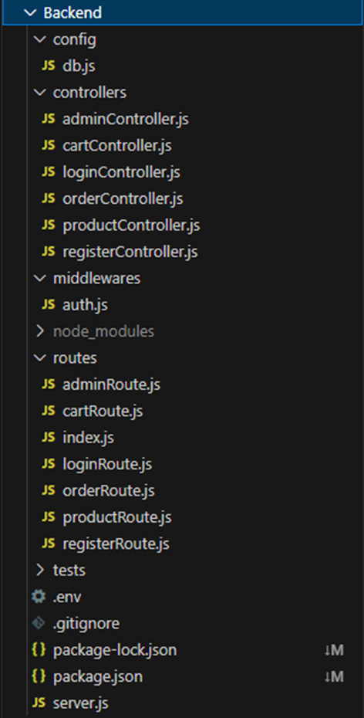
Backend
We used:
dotenv to manage environment variables securely.
CORS to handle cross-origin requests between frontend and backend.
Organized controllers for admin, cart, orders, login, products, and registration.
Clean routing system for easy API management.
Middleware for authentication and request validation.
The backend of ConsoleX is built using Node.js with the Express framework to handle server-side logic and routing.
It connects to a MySQL database

Slide 10

THANK YOU FOR YOUR ATTENTION
Presentation Made By:
Dancsik Dávid
Keskeny Kevin
Juhász Gergő

