Slide 1
Pollak Pizza
Flavor that doesn’t wait.

Slide 2
TABLE OF CONTENTS
The purpose of the software
Functionality
01
04
Technical implementation
Project management tools
02
05
Team roles
03
We explain why we chose this for our project
How it operates
Let’s take a look at what we used
What we used to coordinate the project
The way we chose to split our work

Slide 3
The purpose of the software
- The reason for us choosing this project is that one of our team members family relative works in this industry.
- We want to achieve a user-friendly pizza ordering website

Slide 4
Technical implementation
Fronend
Testing
Backend
Database
Vuetify
- CSS
TestJS
Node.JS
MySQL

Slide 5
Team roles
Huszár Imre’s part
Login, admin, profile page backend
JWT token, password encryption
Toast alerts
Backend test
Database schema and planning
Password change

Slide 6
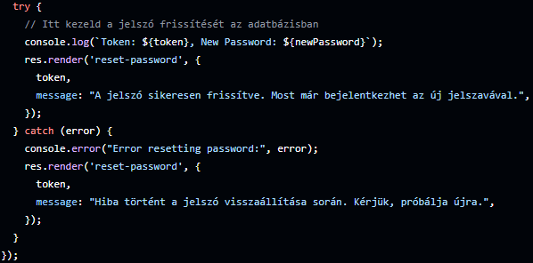
Huszár Imre’s main function
Huszár Imre considers his main function the password changing, it send an mail to the user email account in which if the client clicks the link will be redirected to a page where he can change it

Slide 7
Team roles
Sztojka Milán’ part
Figma desing
Database review, and fill
Ordering site
Unique pizza ordering
Admin Css designing
Documentation Styling

Slide 8
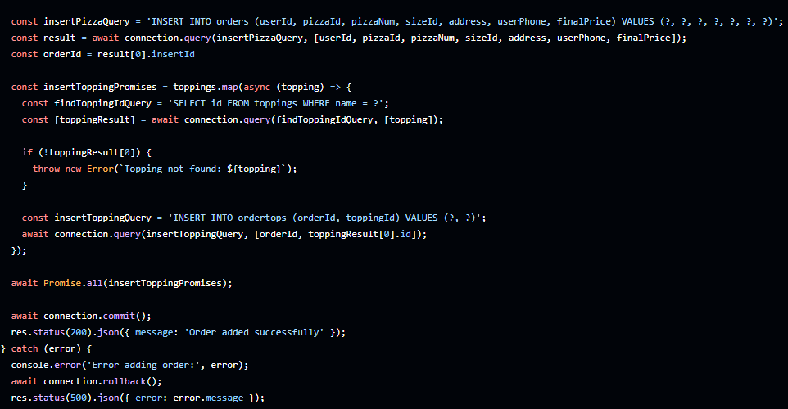
Sztojka Milán’s main function
Sztojka Milán did the ordering so the most impactful function is the unique pizza ordering

Slide 9
Team roles
Héja Gábor’s part
Database planning
General Css desing
Responsivity
Home, Menupage
Pizza listing and searching
Documentation content

Slide 10
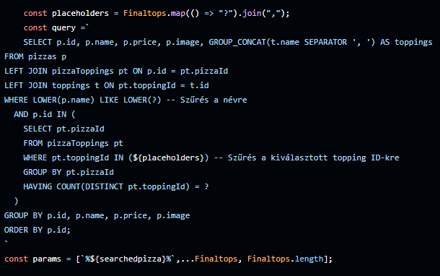
Héja Gábor’s main function
Héja Gábor main function is about the pizza searching, he made it able to seach by name or with toppings on the pizza, or with both.

Slide 11
Functioality
The user first encounters the login page where they have to either login or register
After the user logs in will be presented the homepage, the user can relocate to the order page
The client can order a pizza which he can check at the profile page and the admins will see it

Slide 12
Project management tools
Trello
Team coordination
Github
- Version management
Gmail, discord
- Discussing

Slide 13
Thanks for watching!

