Slide 1
Bellora
„If you don't wear it, sell it.”

Slide 2
Table of contents
Purpose of the Software
Project setup
Project management tools
Csák’s contributions
Gere’s contributions

Slide 3
Purpose of the Software
Seamless Integration & User- Friendly Design:
Makes buying second hand items less stressful, easier and faster
Reduces the time spent searching through listings with smart filtering and personalized suggestions
Encourages sustainable shopping habits by making second‑hand purchases more appealing
Builds trust through transparent profiles, clear item descriptions, and smooth communication
Innovative Web Platform:
Accessible on both mobile devices and computers through a fully responsive design
Provides a clean, intuitive interface that helps users navigate effortlessly
Built with modern web technologies to ensure reliability and long‑term stability
Supports secure communication and safe interactions between buyers and sellers

Slide 4
Project setup
Frontend
React.js + VITE
Tailwindcss
Axios
Socket.io-client
Backend
Node.js
Express.js
Multer
Socket.io
Testing
Backend - JEST
Frontend - Playwright
Database
Prisma ORM with MySQL

Slide 5
Project management tools
Github
Version management
Canva
Logo design
Discord
Communication
Figma
Plan designing

Slide 6
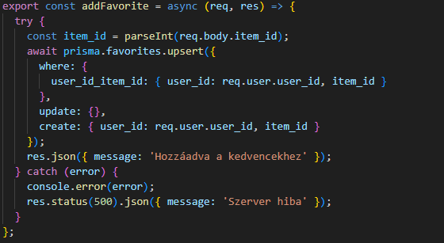
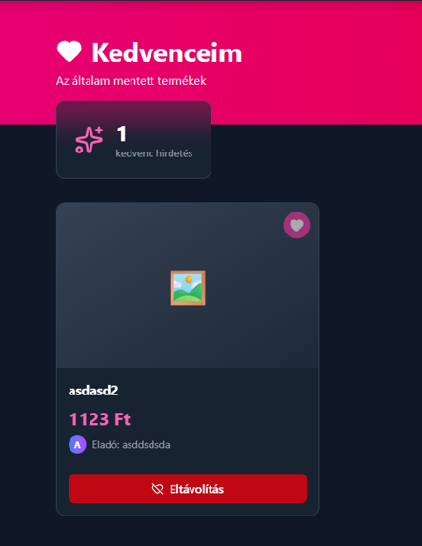
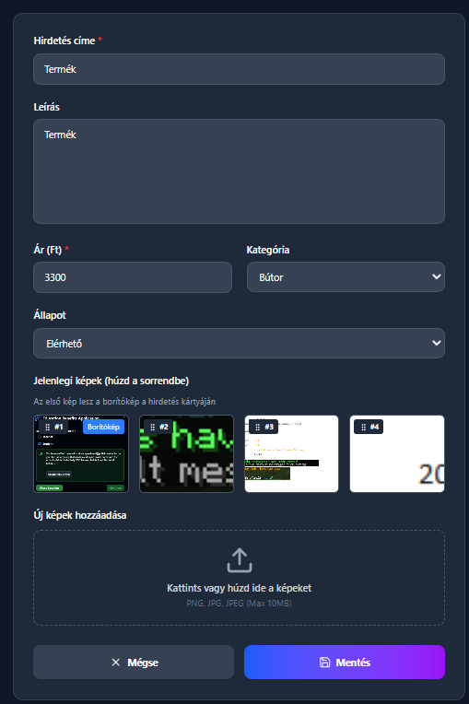
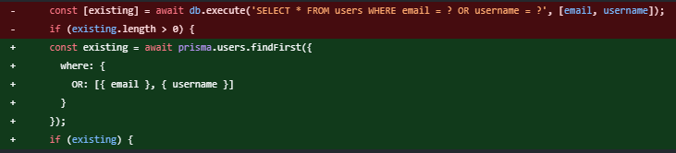
Csák Zoltán Barnabás’ Contributions
Backend
Frontend
Conversion from raw MySQL to Prisma
Favourites function
Registration
Favourites design
Navbar
Item detail, edit

Slide 7
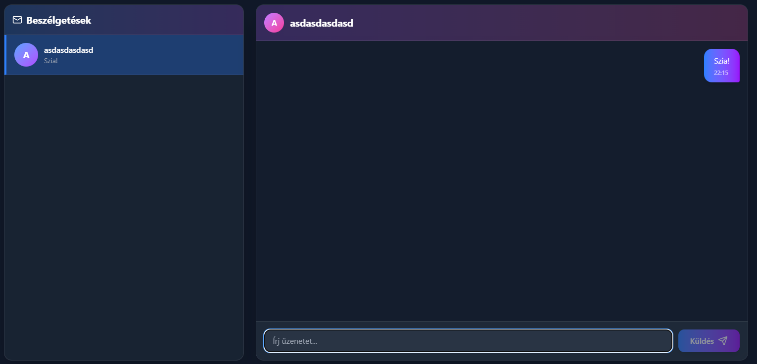
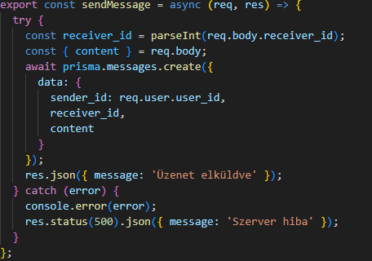
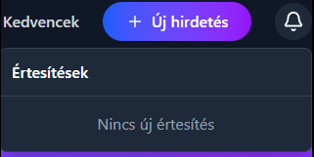
Gere Dániel’s Contributions
Backend
Frontend
Notifications
Public profile
Messages function
Login
Notifications design
Messages design

Slide 8
Thank You for your attention!
Made by: Csák Zoltán Barnabás Gere Dániel
Notes:
Pls like and sub

