Slide 1
ISAAI
Dual-module automation program
ISA · Architecture & Integration

Slide 2
Can we eliminate 30–40 minutes of daily manual report work—and still strengthen auditability and control?
Pause. Do not answer yet.

Slide 3
Why this matters
30–40 minutes daily manual effort on structured XML reports
Error risk: import, wrong field/version, inconsistent outputs
Archive gap when steps are skipped

Slide 4
Manual labor today (IST)
Phase 1: Mail → ZIP → XML extraction
Phase 2: Spreadsheet import and threshold checks
Phase 3: Evidence + distribution mail
Phase 4: Document repository sign-off

Slide 5
Risk & control gap
Media break: collaboration storage vs. document repository
Upload → sign-off not system-enforced
Naming convention friction = highest automation leverage

Slide 6
Automation vision (SOLL)
Automated ingest, rule engine, exception queue
Supervisor only on exceptions (human-in-the-loop)
Standardized audit trail per event

Slide 7
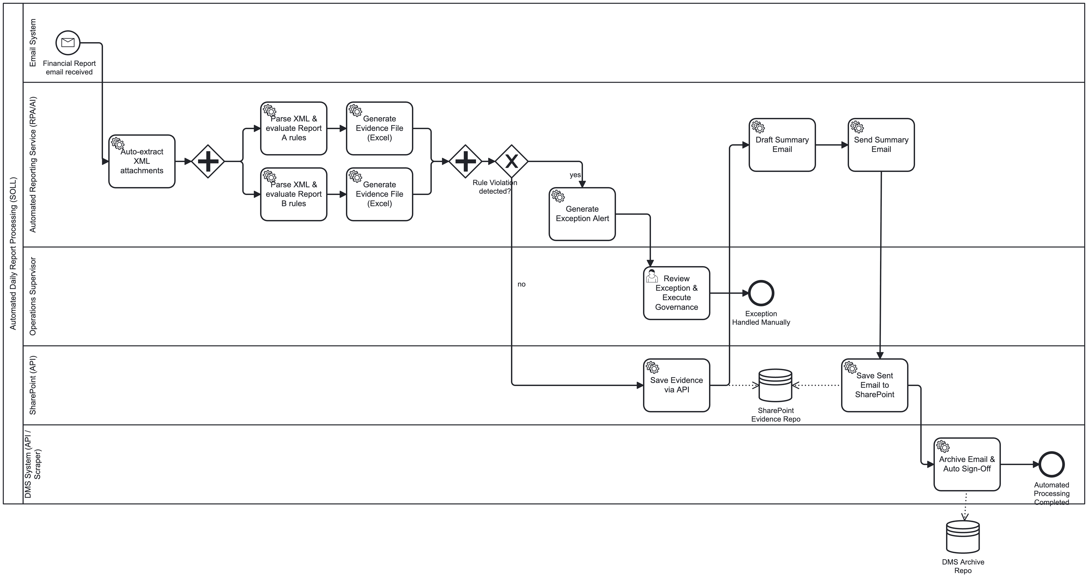
BPMN GOAL — automated main flow
Ingest → validate → archive; automation lanes

Slide 8
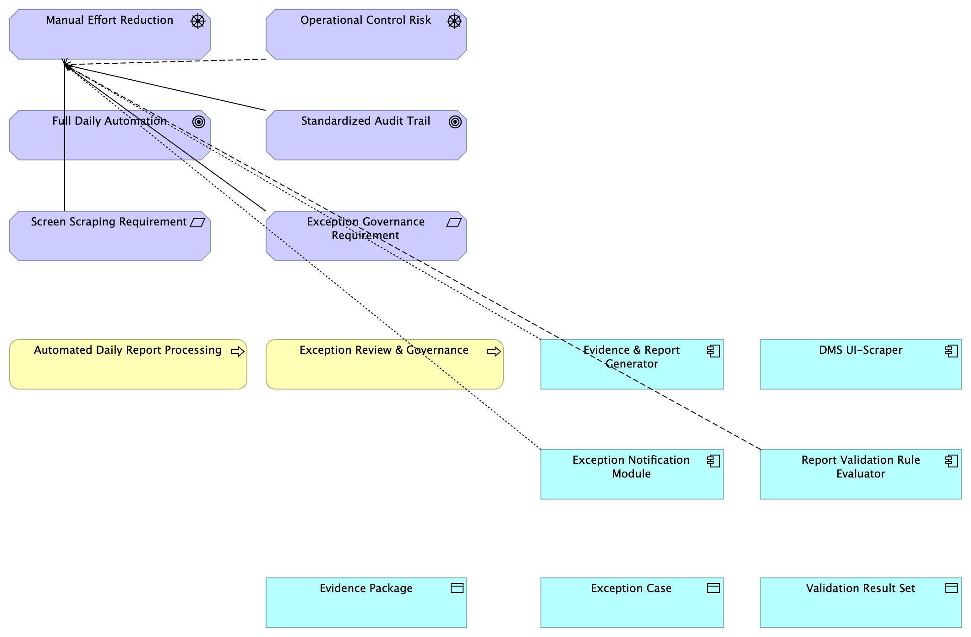
BPMN GOAL — exception governance
Exception path and audit-trail goal

Slide 9
How ISA shapes this project
Enterprise alignment via ArchiMate
Exchange invoice: PDF/OCR → JSON/CSV → charts
Delivers presentation-ready visual evidence

Slide 10
How A+I shapes this project
Operable BPMN and XML/GOAL validation
Integration architecture and white-box APIs
SharePoint/DMS mocks for archival simulation

Slide 11
ISA vs A+I — influence matrix
ISA: structure, alignment, invoice track
A+I: process operability, financial report track
Shared repo; separate branches and acceptance criteria

Slide 12
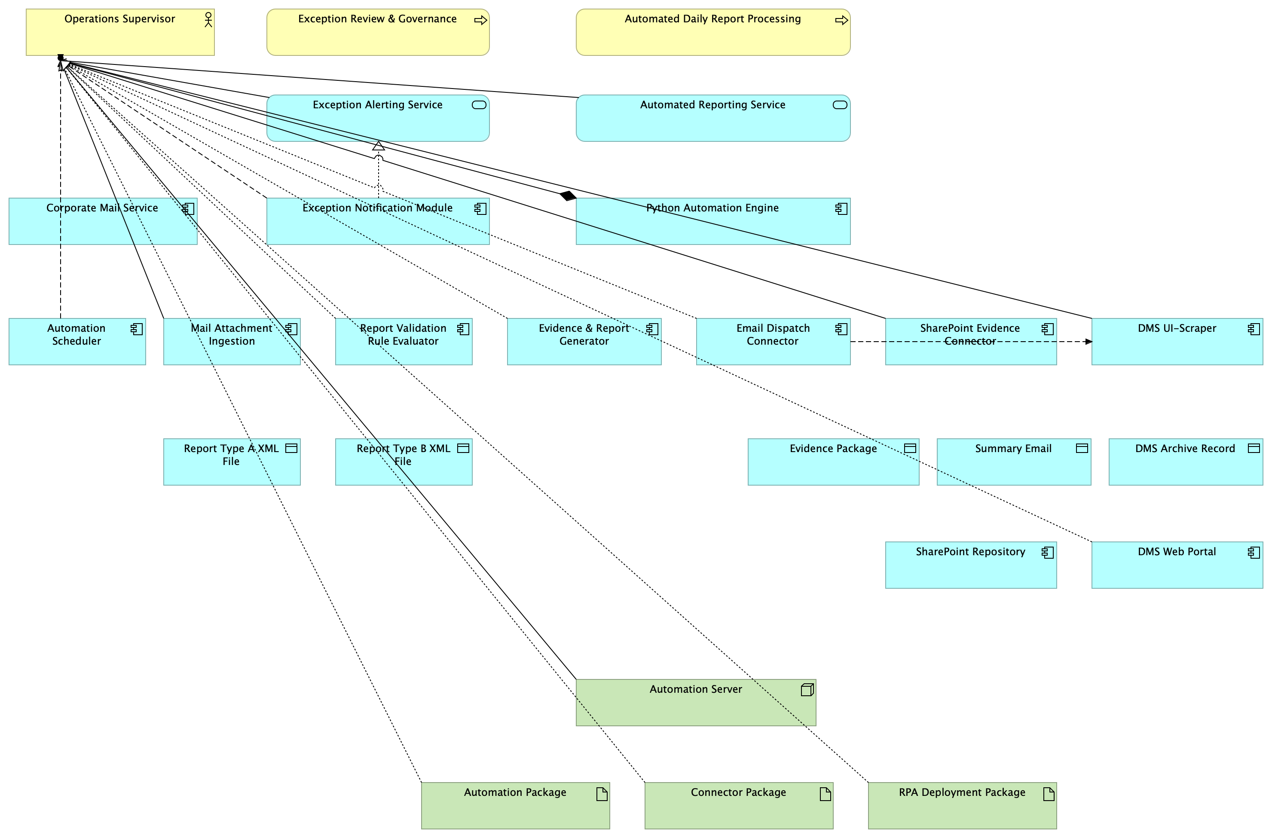
Architecture IST → GOAL

Slide 13
Compliance & audit trail
Event model: who, when, action, source hash, approval state
Pseudonymize before internal LLM (project default)
OpenAPI v3 mocks document intended interfaces

Slide 14
Roadmap to submission
M2 ISA module · M3 A+I module · M4 integration
M5: models, docs, boardroom deck
Target: 16 June 2026

Slide 15
The answer
Can we eliminate 30–40 minutes of daily manual report work—and still strengthen auditability and control?
Yes—with scope discipline: automate ingest → validate → archive; humans only for exception governance.
ISA: enterprise ArchiMate alignment, invoice PDF/OCR, chart automation.
A+I: operable BPMN, XML/GOAL validation, OpenAPI integration mocks.
Open: production LLM gateway, DMS access, sandbox account (see compliance docs).

