Slide 1





Meet Our Team
Issac Riad
AbdElmesseh Malak
[Role: Flutter Developer]
[Role: Backend Developer / Secuirty Engineer]
Kerolos Essa
Marvy Ehab
[Role: ML Engineer , Data Scienctist]
[Role:UI/UX Designer ]

Slide 2



GRADUATION PROJECT · AI-POWERED CARDIAC SCREENING
Concept & The "Why”
Presented as part of a graduating engineering cohort

Slide 3







THE PAIN POINT
A Global Crisis, Measured in Heartbeats
Cardiovascular disease remains the leading cause of death worldwide — and most of it is preventable.
1 in 3
75%
80%
33% global deaths is caused by cardiovascular disease which equal to 18 million people
of premature heart attacks & strokes are preventable
75% of CVD deaths occur in low-to-middle income countries due to late diagnosis and prohibitive diagnostic costs.
Placeholder statistic — verify with WHO source
Placeholder statistic — verify with WHO source
Placeholder statistic — replace before final submission

Slide 4



THE QUESTION THAT INSPIRED US
What if we could hear a heart’s warning signs before it becomes an emergency?
Person
Heart Health
AI Detection
We didn't ask how to replace physicians. We asked a simpler question: how can we help more people recognize their cardiovascular risk before it's too late?
That question became the foundation of HeartGuard.

Slide 5

HEART GUARD
AI-Powered Heart Disease Prediction & Health Monitoring

Slide 6




PROJECT OBJECTIVES
What HeartGuard Sets Out to Achieve
Screening
Humanitarian
Economic
Educational
HeartGuard is an early screening application — not a replacement for physicians.
We don’t replace doctors; we help more people reach them at the right time.
Reducing sudden cardiac mortality through early detection and timely intervention, saving lives globally.
Minimizing expensive diagnostic costs in low-income areas by providing accessible, free screening tools.
Raising public awareness about critical yet overlooked risk factors such as smoking and obesity.

Slide 7




Core Features
Prediction Model
Real-time cardiovascular risk probability calculation based on 22 validated health parameters including age, cholesterol, blood pressure, and lifestyle factors.
Longitudinal Progress Dashboard
Visual health trend tracking over time through interactive line charts, enabling users to monitor improvements or deterioration in key health metrics.
AI Medical Chatbot
Natural Language Processing-driven conversational assistant providing symptom analysis and WHO-based health guidance available 24/7.
Personalized Health Advisor
Targeted content recommendations based on feature importance analysis—prioritizing critical interventions like smoking cessation if it's identified as the highest risk factor.
Smart Referral System
GPS-based cardiologist recommendations matching patient location, risk level, and accessibility requirements for seamless care coordination.

Slide 8
GRADUATION PROJECT · AI-POWERED CARDIAC SCREENING
Design Identity & UI Strategy
Presented as part of a graduating engineering cohort

Slide 9
PROCESS
The Design Process
A five-phase process, each stage grounded in the one before it — nothing here was designed in isolation.
01
02
03
04
05
Research
Define
Wireframe
UI Kit
Design & Test
Competitor audits + patient/clinician needs
User flows mapping the full patient journey
Low-fidelity structure, before any visual style
Colour, type, and component system
High-fidelity screens, prototyped and tested
3

Slide 10
RESEARCH · 1 OF 2
Competitor Research
Three representative apps in the cardiovascular / general-health-tracking space were reviewed against the same criteria.
General Wellness Tracker
Cardiology Clinic Portal
AI Symptom Checker
Broad fitness/health app with a cardio module bolted on.
Hospital-issued portal for existing cardiology patients.
General chatbot triage app, not heart-specific.
PROS
PROS
PROS
Polished, mainstream UI
Strong step/activity tracking
Directly tied to real doctors
Trusted, clinical tone
Conversational, low-friction entry
Available 24/7
CONS
CONS
CONS
No clinical risk scoring
No path to a real referral
Dated, form-heavy UI
Only usable if already a patient
Generic, not cardiovascular-specific
No historical trend view
Illustrative competitor set based on common patterns in this app category — swap in named competitors and cited sources for a client-facing version.
4

Slide 11


RESEARCH · 2 OF 2
Gaps → Opportunities for Heart Guard
No app combined clinical scoring with an easy referral path
Heart Guard's Result screen pairs a risk score directly with a doctor referral
→
Trend data, when it existed, wasn't compared to clinical guidelines
Health Overview plots every metric against WHO / clinical reference bands
→
Chatbots were generic, not scoped to cardiovascular health
Heart Guard's assistant is heart-specific, with guided quick-questions
→
Clinical portals looked trustworthy but felt cold and form-heavy
Heart Guard keeps a clinical tone while staying warm and step-by-step
→
5

Slide 12






DEFINE
User Flow
Mapped before a single screen was designed, so every later decision serves a known path through the app.
Login
Home
Assessment
(4 steps)
Result
Health
Overview
Find a
Doctor
AI
Chatbot
Optional / conditional: a referral only appears in the flow when risk warrants one.
6

Slide 13
WIREFRAME
Low-Fidelity Wireframes
Sketched in greyscale first, so structure and hierarchy get validated before any colour or branding is applied.
Home
Assessment
Result
7

Slide 14


WIREFRAME
Why These Structures
Content Before Colour
One Primary Action per Screen
Wireframes used only greyscale blocks, so feedback stayed focused on layout and priority — not on button colours.
Every wireframe has exactly one prominent button, keeping the next step unambiguous even at low fidelity.
Form Fields Sketched at Real Density
Result Hierarchy Set Early
The assessment wireframe used the actual field count per step, to catch crowding early — before it became a development problem.
The score-first, actions-second layout was fixed at the wireframe stage, so later visual design didn't have to re-litigate structure.
8

Slide 15
UI KIT · 1 OF 3
Colour Palette
One dominant blue for trust and action, with a small, purposeful set of status colours — never decorative.
Primary Blue
Navy
Teal Green
Amber
Alert Red
Purple
#2F6FED
#12213E
#12B886
#F0A202
#E63946
#7C4DFF
CTAs, links, active states
Headers on dark, title slides
Positive trend, low risk, success
Medium risk, caution states
High risk, referral, urgent action
Find-a-Doctor accent
NEUTRALS
Text Dark
Muted / Captions
Borders / Dividers
Background
Surface / Cards
9

Slide 16
UI KIT · 2 OF 3
Typography
A single type family, weighted for a strict hierarchy — so patients always know what to read first.
Inter / Poppins SemiBold
Usage Rules
Headline · 24–32pt · Bold
One headline per screen — never two competing large titles.
Body copy is left-aligned; never centre long text.
Muted grey is for captions only, never for primary content.
Bold is used for emphasis, not decoration — one bold phrase per paragraph, at most.
Section Title
Section header · 18–20pt · SemiBold
Body text sits at 14–16pt Regular — legible at arm's length, never smaller.
Body · 14–16pt · Regular
Caption / helper text
Caption · 11–12pt · Regular, muted colour
10

Slide 17

UI KIT · 3 OF 3
Core Components
A small, reusable set — every screen in the app is built from these same pieces.
BUTTONS
STATUS BADGES
CARDS & ICONS
Primary CTA
Low Risk
Medium
High Risk
Card title
Supporting caption text
Secondary
Same three colours everywhere risk is shown — dashboard, result, and history.
12–16px radius, soft shadow, icon always in a coloured circle
Full-width, 8px radius, one primary action per screen
11

Slide 18
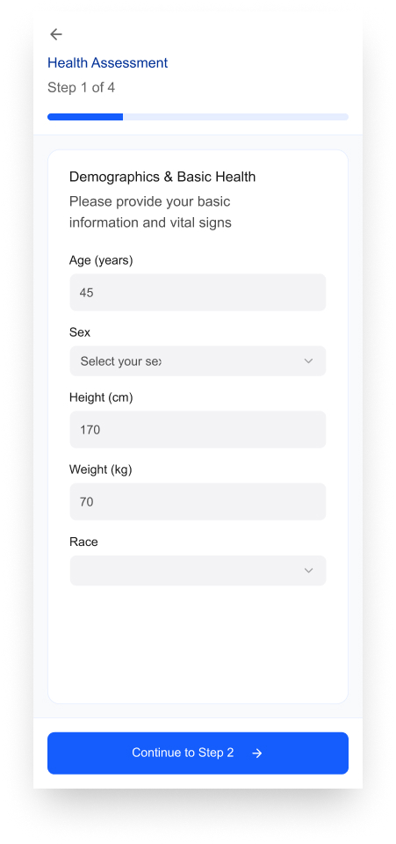
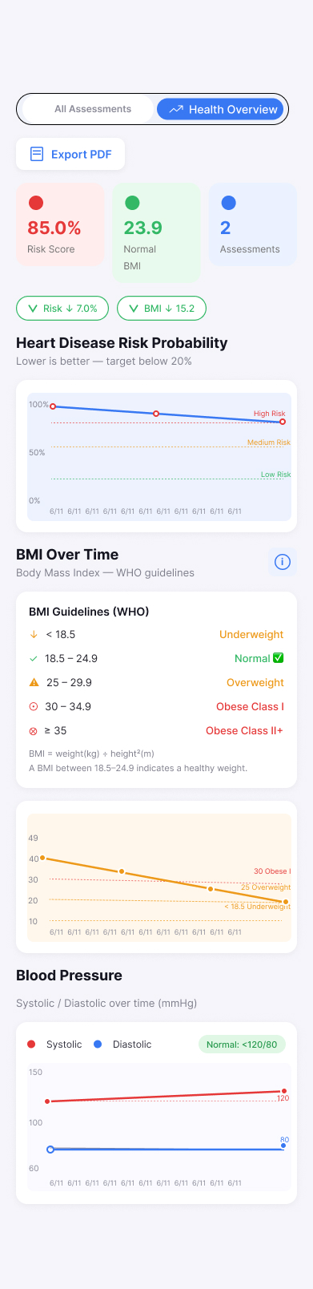
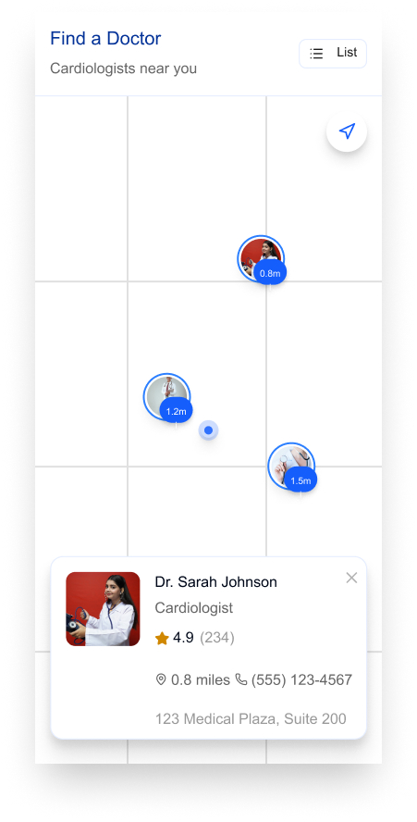
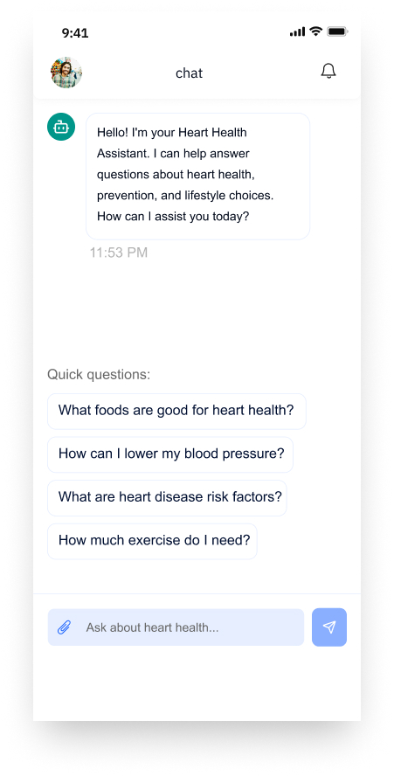
FINAL DESIGN · 3 OF 3
More Screens, Same System
Assessment intake, health trends, doctor search, and the AI chatbot — all built from the same UI kit.
Assessment
Health Overview
Find a Doctor
AI Chatbot
14

Slide 19








WHAT IT DOES
Core Features
Guided Assessment
ML Risk Result
History Dashboard
PDF Export
Enter vital signs & lifestyle data
Structured, AHA-aligned risk report
Animated trend charts over time
Shareable health status report
Chat Assistant
Articles
Profile & Settings
Offline Caching
Answers questions, reads medical files
Prevention & nutrition education
Account, language, notifications
In-memory + persistent local storage
4

Slide 20
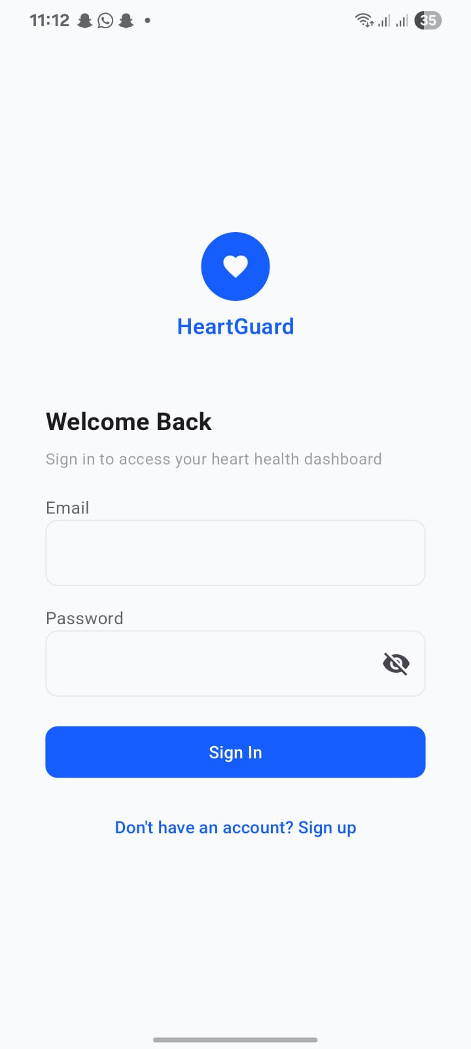
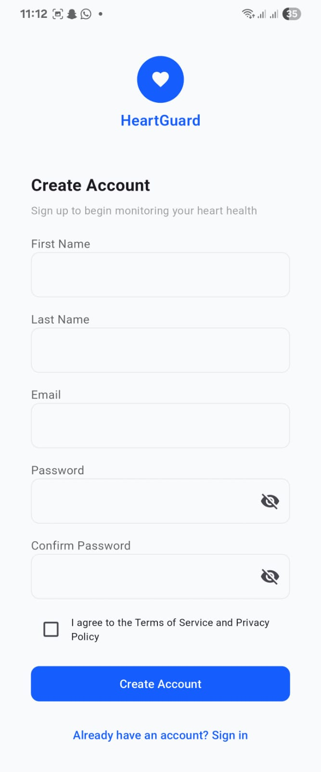
USER INTERFACE
Simple, Secure Onboarding
Clean Sign In screen for returning patients
Quick Create Account flow: name, email, password
Terms & Privacy Policy acceptance built in
Session-based authentication via the Node.js API
5

Slide 21
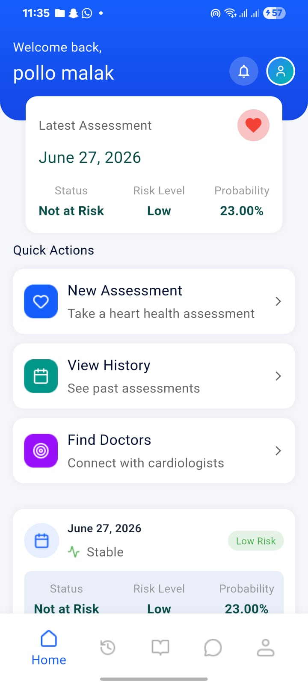
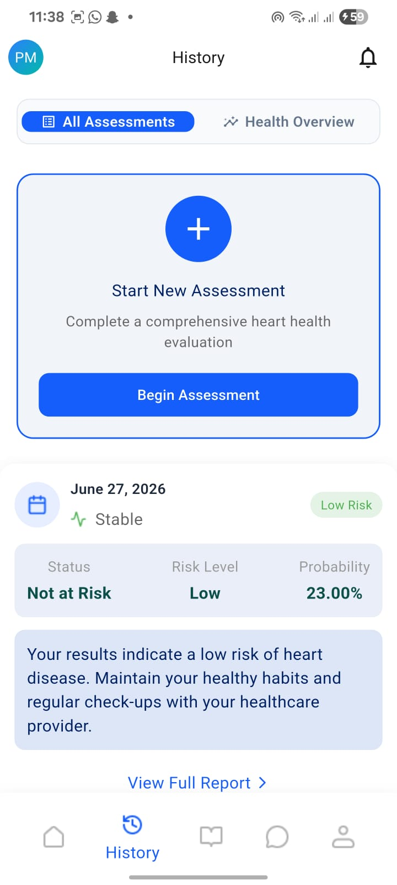
USER INTERFACE
Home & Assessment History
Home greets the patient with their latest risk summary
One-tap Quick Actions: New Assessment, History, Find Doctors
All Assessments tab lists every past evaluation
Each entry links to its full risk report
6

Slide 22
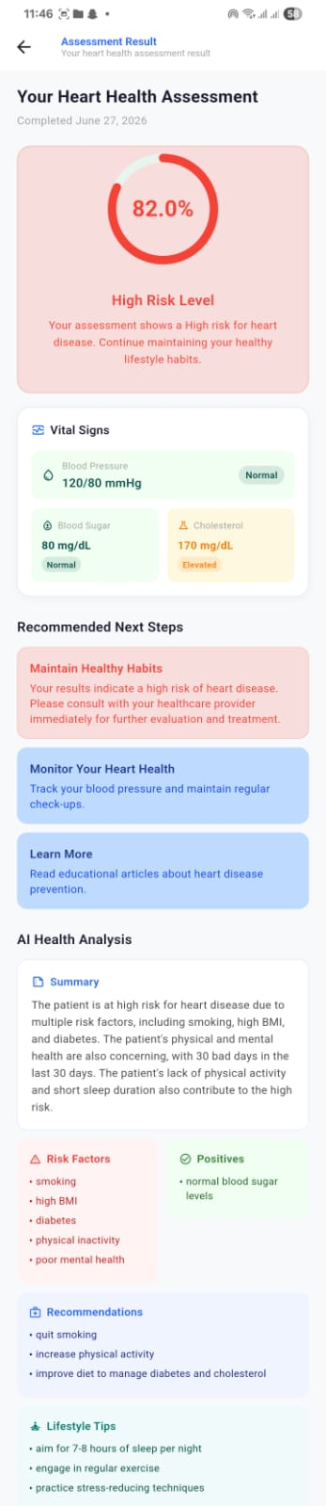
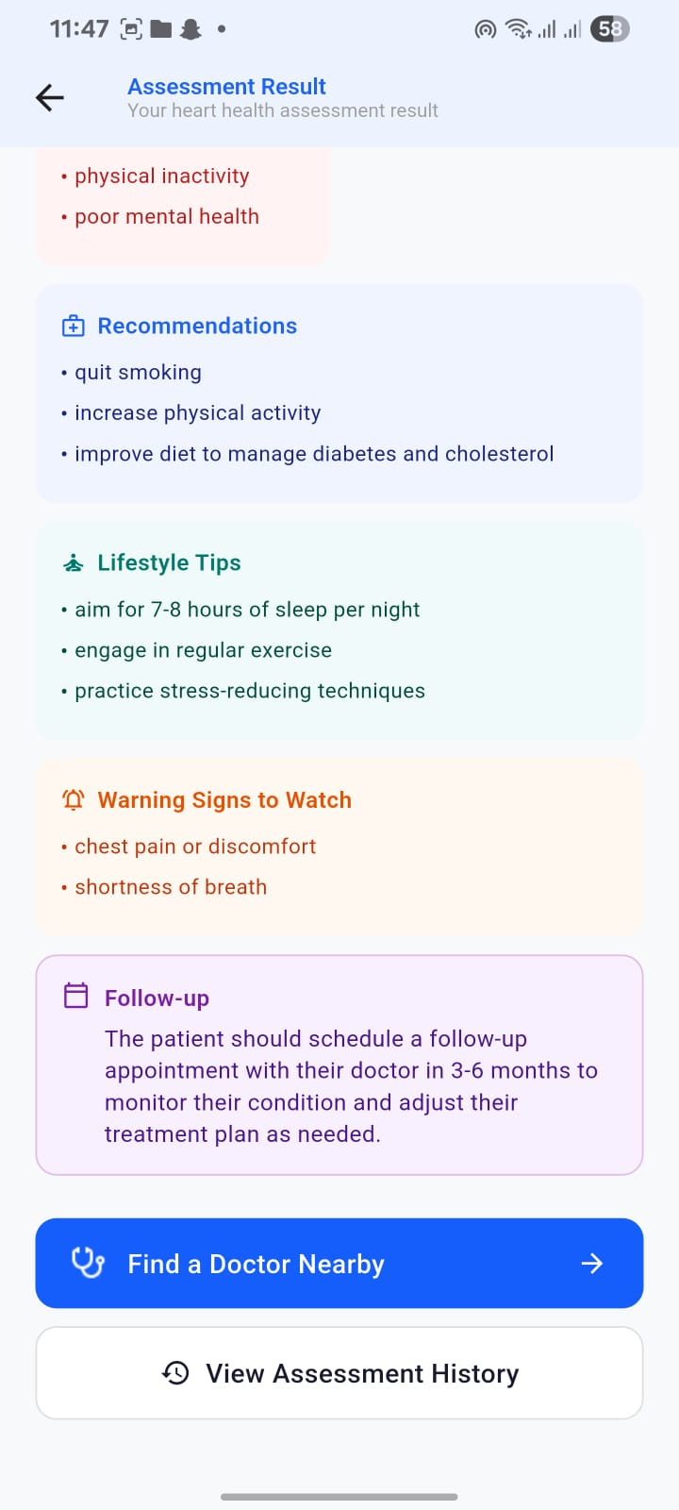
FLAGSHIP FEATURE
ML-Generated Risk Result
Overall risk probability & risk level at a glance
AHA-aligned status for blood pressure, sugar & cholesterol
Structured breakdown: risk factors, positives, recommendations
Lifestyle tips, warning signs & a suggested follow-up timeframe
7

Slide 23
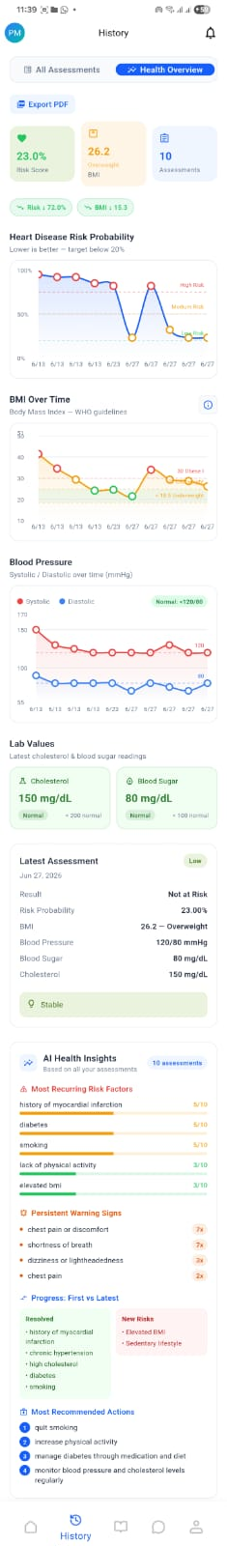
USER INTERFACE
History & Analytics Dashboard
Animated fl_chart line charts for risk, BMI & blood pressure
Tracks trends across every assessment over time
Surfaces recurring risk factors & persistent warning signs
Latest lab values shown alongside long-term progress
8

Slide 24
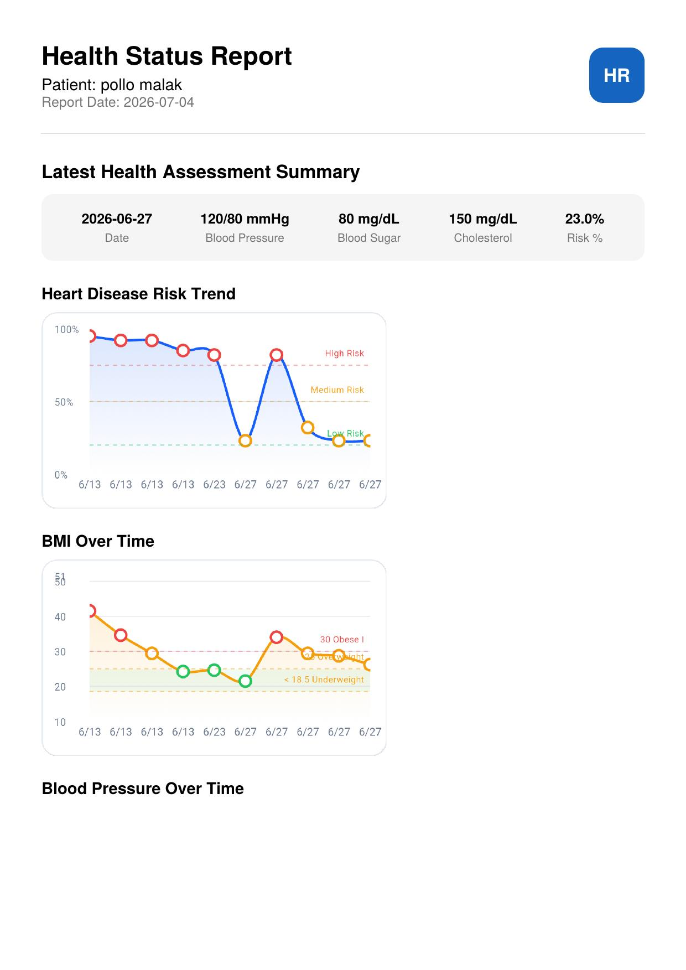
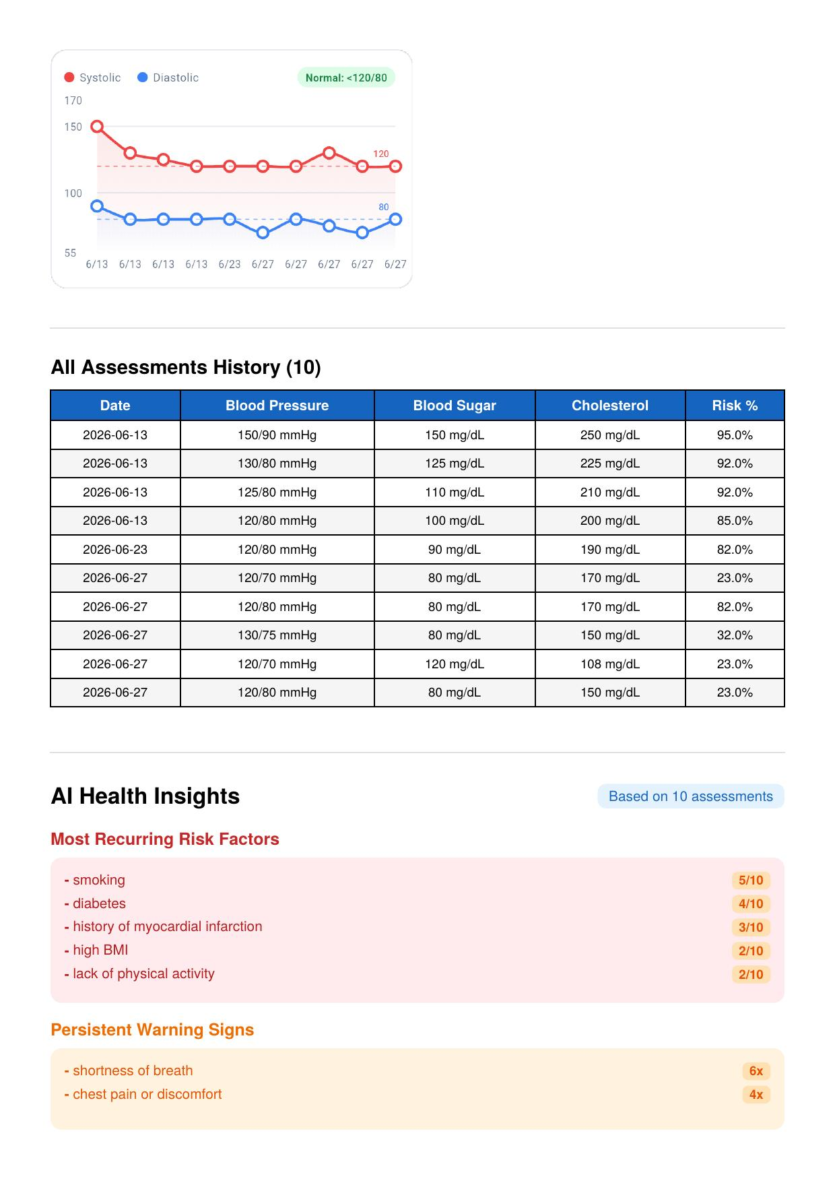
USER INTERFACE
Shareable PDF Report
One-tap export of the full Health Status Report
Includes trend charts, assessment history table & insights
Designed to be shared directly with a physician
Generated on-device with the pdf & printing packages
9

Slide 25
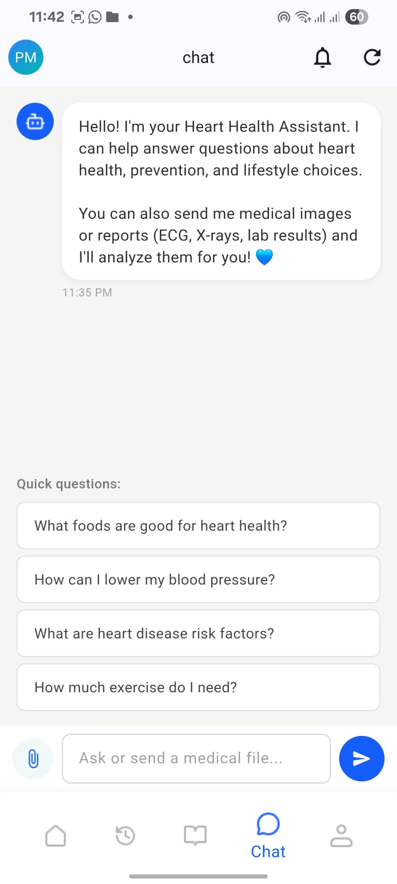
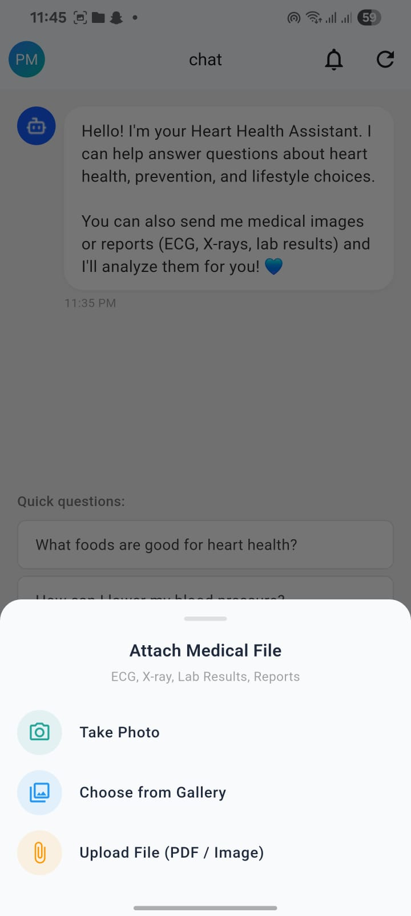
USER INTERFACE
Chat Assistant
Answers heart-health, prevention & lifestyle questions
Quick-question suggestions for common topics
Attach photos, camera shots, or PDF medical files
Analyzes ECGs, X-rays & lab reports on request
10

Slide 26
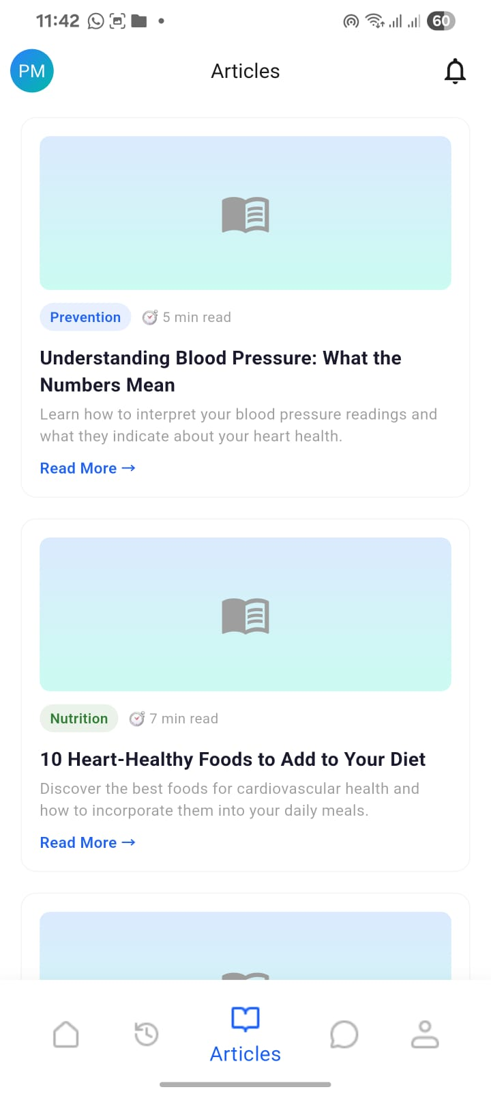
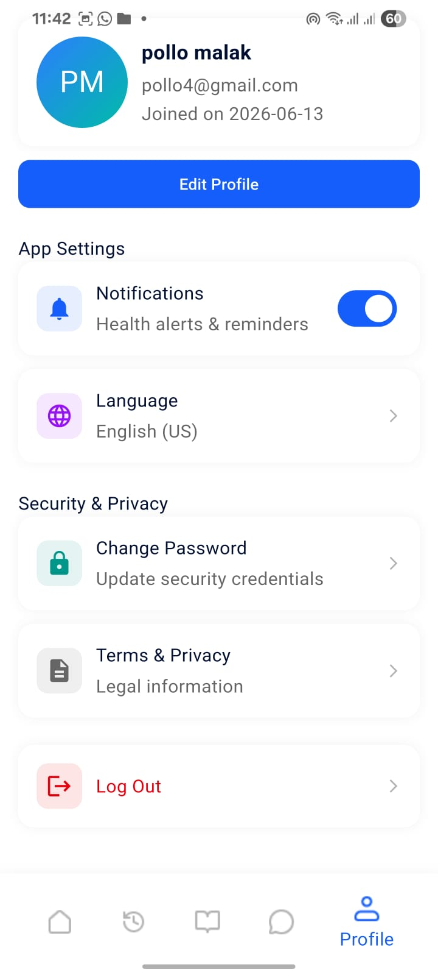

USER INTERFACE
Articles, Profile & Settings
Educational articles on prevention & nutrition
Profile with account info, security & privacy options
Language switcher: English / Arabic
Instant updates across the app after any profile edit
11

Slide 27



UNDER THE HOOD
Clean Architecture & BLoC State Management
Clean Architecture
BLoC / Cubit Pattern
core / features / shared / theme — data & presentation split per feature, domain layer omitted for simplicity
UI dispatches Events → Bloc calls Repository → emits State → BlocBuilder rebuilds only what changed
Multi-Layered Caching
GetIt Dependency Injection
In-memory + SharedPreferences keep the app fast and usable offline, refreshing only when data is stale
A single shared MainBloc instance serves the Home, History & Profile tabs consistently
12

Slide 28
GRADUATION PROJECT · AI-POWERED CARDIAC SCREENING
System Architecture
And Security

Slide 29




Technical Stack & System Architecture
Frontend
Backend
Built with Flutter for a cross-platform, high-performance mobile experience
Powered by Node.js, ensuring fast, non-blocking asynchronous processing
Communication
Mongo DB
Secured RESTful APIs to connect the Mobile App with the ML Server
Data persistence

Slide 30

Project Overview
System purpose and technology stack
System Purpose
Tech Stack
Securely register patients and manage their health records
Receive health data and forward it to the Flask model for prediction
Return risk results, sugar and cholesterol levels, and AI analysis
AI chat assistant for heart health conversations (Groq / OpenRouter)
Runtime
Node.js
Framework
Express.js
Database
MongoDB (Mongoose)
Auth
JWT + bcryptjs
ML Integration
Flask REST API (Python)
AI Chat
Groq (LLaMA 3) + OpenRouter
Logging
Winston
Validation
express-validator
EchoHealth — Backend & Security
2

Slide 31







Project Architecture (MVC)
Clear separation of layers for easy maintenance and scaling
Routes
Middleware
Controllers
Defines endpoints (auth, patient, healthData, chat)
JWT verification, rate limiters, slow-down, validation
Business logic: registration, profile update, health data submission, chat
Models
Validators
Utils
Patient (data + account protection), HealthData (prediction results)
express-validator: length, regex, enums, numeric ranges
Winston logger and a unified responseHandler for responses
EchoHealth — Backend & Security
3

Slide 32




Key API Endpoints
Base URL: http://localhost:5001 — all responses are JSON
Authentication
Patient
Health Data
Chat Assistant
POST /api/auth/register
POST /api/auth/login
POST /api/auth/refresh
POST /api/auth/logout
GET /api/patient/profile
PUT /api/patient/profile (whitelist)
POST /api/health-data/submit
25 fields → Flask ML → Prediction
POST /api/chat/message
Text or image/medical report (Vision)
EchoHealth — Backend & Security
4

Slide 33

Data Models
Patient and HealthData in MongoDB
Patient Model
HealthData Model
password: bcrypt hash (cost 12) — always select: false
role: patient / admin (Enum, automatic)
loginAttempts + lockUntil for automatic lockout protection
refreshToken stored encrypted to enable true logout
passwordChangedAt to invalidate old tokens
25 input fields + min/max constraints at the database level (e.g. BMI 10-80)
Binary fields (yes/no) enforced as strict Enums
aiAnalysis: summary, risk_factors, recommendations, lifestyle_tips…
Compound Index on (patient, createdAt) for fast record retrieval
EchoHealth — Backend & Security
5

Slide 34

Security Architecture
16 independent protection layers before any request reaches Controller logic
16
Helmet
CORS
Content-Type Check
Mongo-Sanitize
15+ HTTP security headers
Whitelist of ALLOWED_ORIGINS only
Rejects anything other than application/json
Prevents NoSQL Injection
Security Layers
XSS Filters
HPP
Auth Rate Limit
Auth Slow-Down
Sanitizes HTML/Script from inputs
Prevents duplicate query params
10 requests / 15 minutes
+300ms after 3 attempts
Global Rate Limit
JWT alg Lock
Token Expiry
Account Lockout
100 requests / 15 minutes
HS256 only — alg:none rejected
Access 15 minutes / Refresh 7 days
15-minute lockout after 5 failed attempts
Input Validation
Mass-Assignment Guard
Timing-Safe Compare
Security Logging
Strict rules for all fields
Whitelist for profile updates
Prevents timing-based enumeration attacks
Winston: security.log
EchoHealth — Backend & Security
6

Slide 35
Request Flow
13 sequential middleware layers — any layer can reject the request immediately
1
2
3
4
5
6
7
Request ID
Helmet
CORS
Body Parser
Content-Type Check
Mongo-Sanitize
XSS Clean
8
9
10
11
12
13
HPP
Rate Limiter
Auth Slow-Down
authMiddleware (JWT)
Input Validator
Controller
Every request passes through all layers in order before reaching Controller logic.
Key HTTP Status Codes
401
423
429
415
503
400
Missing/invalid token
Account locked
Rate limit exceeded
Invalid Content-Type
Flask ML service down
Input validation failed
EchoHealth — Backend & Security
7

Slide 36

Security Vulnerabilities & Defenses (1/2)
Real attack examples and how EchoHealth defends against them
5.1
5.2
5.3
XSS — Cross-Site Scripting
NoSQL Injection
Fake / Forged Token
The Problem: Injecting malicious script into a field like firstName to run in the browser of any user viewing the profile.
The Problem: Sending MongoDB operators like $gt instead of real values at login to bypass password verification.
The Problem: Sending a forged JWT, or using an alg:none attack, to impersonate any user including admins.
The Solution: Two independent layers: xss-filters sanitize all inputs globally, and an express-validator regex accepts letters only, rejecting any HTML tag with a 400 error.
The Solution: express-mongo-sanitize strips any key starting with $ or containing a dot, and express-validator confirms the field is a string, not an object.
The Solution: authMiddleware verifies the token structure (3 parts) and locks the algorithm to HS256 only via jwt.verify — any other algorithm is rejected.
EchoHealth — Backend & Security
8

Slide 37



Security Vulnerabilities & Defenses (2/2)
Real attack examples and how EchoHealth defends against them
5.4
5.5
5.6
Missing Authorization Token
Weak Password
Mass Assignment
The Problem: A direct request with no Authorization header to a protected route like /api/patient/profile.
The Problem: Registering with a weak password like 123456 that can be cracked in a fraction of a second.
The Problem: Sending hidden fields like role or password in a profile update to escalate to admin.
The Solution: Protection middleware is explicitly opt-in on every protected route and immediately rejects with a 401 if the header does not start with Bearer.
The Solution: express-validator requires at least 8 characters with an uppercase letter, lowercase letter, number, and special character — any violation is rejected with a detailed 400 error.
The Solution: The Controller uses a strict whitelist of only 5 fields — any other field (role, password, _id) is completely ignored before it reaches the database.
EchoHealth — Backend & Security
9

Slide 38
GRADUATION PROJECT · AI-POWERED CARDIAC SCREENING
Machine Learning

Slide 39

CHAPTER 2 · THE DATA
HeartGuard
Dataset Overview
27,493
23
TARGET CLASS DISTRIBUTION
Patient Records
Total Columns
(22 features + target)
Not at risk (~95%)
At risk (~5%)
22
2
Input Features
NHANES Cycles Combined
(2017–2020 & 2021–2023)
Dataset Source
Target Variable
CDC NHANES — National Health and Nutrition Examination Survey, official U.S. government public health data, combining the 2017–2020 and 2021–2023 survey cycles.
HeartDisease — binary label: 0 = no heart disease, 1 = heart disease present. Structured tabular data spanning demographics, lifestyle, medical history, vital signs, and lab results.
01 / 10
Notes:
This project uses the CDC NHANES dataset, a real-world clinical survey combining two recent cycles for 27,493 patient records and 22 input features. The target, HeartDisease, is binary and notably imbalanced — only about 5% of patients are positive cases, which shapes every modeling decision from here forward.

Slide 40




CHAPTER 4 · PREPROCESSING
HeartGuard
Data Preprocessing — Understanding the Features
FEATURE TYPE
EXAMPLES
WHY SPECIAL HANDLING IS NEEDED
Core Numerical Features
AgeCategory, BMI, SleepTime, AlcoholDrinking
Continuous measurements always expected in the input; standardized and imputed jointly with lab features.
Optional Laboratory Features
SystolicBP, DiastolicBP, BloodSugar, Cholesterol, HbA1c
May be legitimately absent when a test wasn't performed; need missing-flagging and clinical defaults before scaling.
Binary Features
Sex, Smoking, BrainStroke, DiffWalking, Diabetic, and 7 other history indicators
Already encoded as 0/1; passed through without scaling or additional encoding.
Nominal Features (Race)
Race — 5 categories
Unordered categorical field; needs One-Hot Encoding rather than a single numeric column to avoid implying rank.
02 / 10
Notes:
Before any transformation, the 22 input features are organized into four functional groups — core numerical, optional laboratory, binary, and the nominal Race field. Each group needs a different treatment because each represents a different kind of clinical information, which directly determines how the preprocessing pipeline in the next slide is built.

Slide 41









TECHNICAL CHALLENGES & SOLUTIONS
Challenges
Highly Imbalanced Dataset
Missing Clinical Values
Healthy patients vs. rare disease-positive cases
Incomplete records reconstructed using feature relationships
CHALLENGE
CHALLENGE
Only a small percentage of patients had cardiovascular disease, making the dataset highly imbalanced and causing traditional accuracy to become misleading.
Several laboratory and clinical variables contained missing values that could reduce model performance.
SOLUTION
SOLUTION
SMOTEENN
Iterative Imputer
Recall-focused evaluation
Preserve patient records
Threshold optimization
Estimate values via feature relationships

Slide 42





FROM CHALLENGES TO DEPLOYMENT
Model Selection Journey
STEP 1
STEP 2
STEP 3
Evaluate Candidate Models
Select the Best Model
Threshold Optimization
0.50 › 0.40 › 0.30 › 0.20 › 0.15 › ★ 0.10
All models were evaluated under identical conditions using the default threshold (0.50), comparing Recall, F1-Score, Accuracy, and ROC-AUC.
Gradient Boosting was selected for the strongest overall balance for early cardiovascular screening, with excellent discriminative performance.
The decision threshold was optimized to support screening goals. 0.10 maximized Recall, reducing missed high-risk patients while keeping acceptable performance.
Next: Detailed comparison of all evaluated models

Slide 43
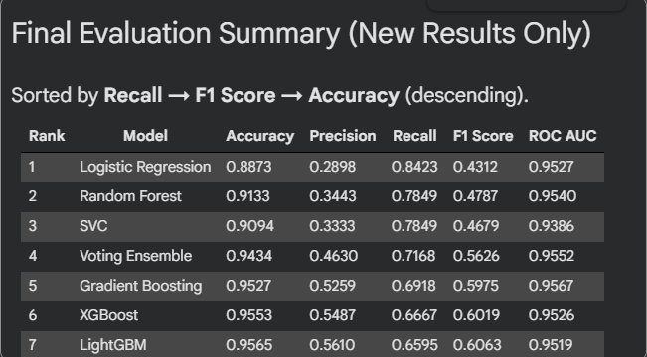
CHAPTER 5 · MODEL SELECTION
HeartGuard
Comparing Six Candidate Algorithms
FINAL SELECTED MODEL
Gradient Boosting
Classifier
Accuracy
95.27%
Precision
52.59%
Recall
70%%
F1-Score
59.75%
ROC-AUC
95.67% (highest)
Table 5.2 — Accuracy, Precision, Recall, F1-Score & ROC-AUC across all six candidates (from project documentation)
04 / 10
Notes:
Six candidate algorithms — Logistic Regression, Random Forest, SVM, Gradient Boosting, XGBoost, and LightGBM — were trained and compared under identical conditions. Gradient Boosting was selected as the final model: it posted the highest ROC-AUC of the group at 95.67%, with a well-balanced profile across the remaining metrics, even though Logistic Regression edged it on raw Recall at the default threshold.

Slide 44

CHAPTER 5 · RATIONALE
HeartGuard
Why Gradient Boosting?
FINAL SELECTED MODEL
Gradient Boosting
Classifier
Balanced Performance
Strong, well-rounded results across Accuracy, Precision, Recall and F1 rather than excelling at just one metric.
Accuracy
83%
Precision
21%%
Recall
92%
Highest ROC-AUC (95.67%)
Best discrimination between at-risk and not-at-risk patients of all six candidates, independent of threshold.
F1-Score
35.45%
ROC-AUC
95.67% (highest)
05 / 10
Notes:
Gradient Boosting wasn't chosen for one standout number — it combined balanced performance, the top ROC-AUC, and probability outputs stable enough to support a lowered clinical decision threshold. It also stayed consistent as a tree ensemble compatible with SHAP, so the same model powers training, interpretation, and the deployed application.

Slide 45
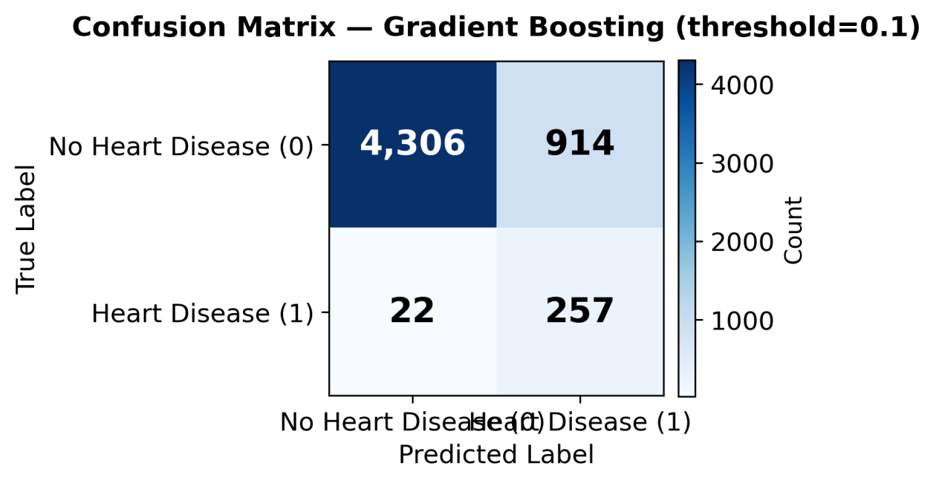
CHAPTER 7 · RESULTS
HeartGuard
Confusion Matrix at the Deployed Threshold
True Positive
257
Correctly identified as at-risk
True Negative
4,306
Correctly identified as healthy
False Positive
914
Healthy patient flagged as at-risk
Figure — Confusion matrix, Gradient Boosting classifier, threshold = 0.10 (project documentation)
False Negative
22
Interpretation: at the deployed 0.10 threshold, HeartGuard misses only 22 of 279 at-risk patients (92.1% Recall) at the cost of 914 false alarms — an intentional, clinically-motivated trade-off for a screening tool where an unnecessary check-up is far less costly than an undetected risk.
At-risk patient missed
07 / 10
Notes:
The confusion matrix shows 257 true positives against only 22 false negatives — a 92% Recall. That comes at the cost of 914 false positives, which is an accepted trade-off: in a screening context, missing a genuinely at-risk patient is far more costly than sending a healthy patient for an unnecessary follow-up.

Slide 46
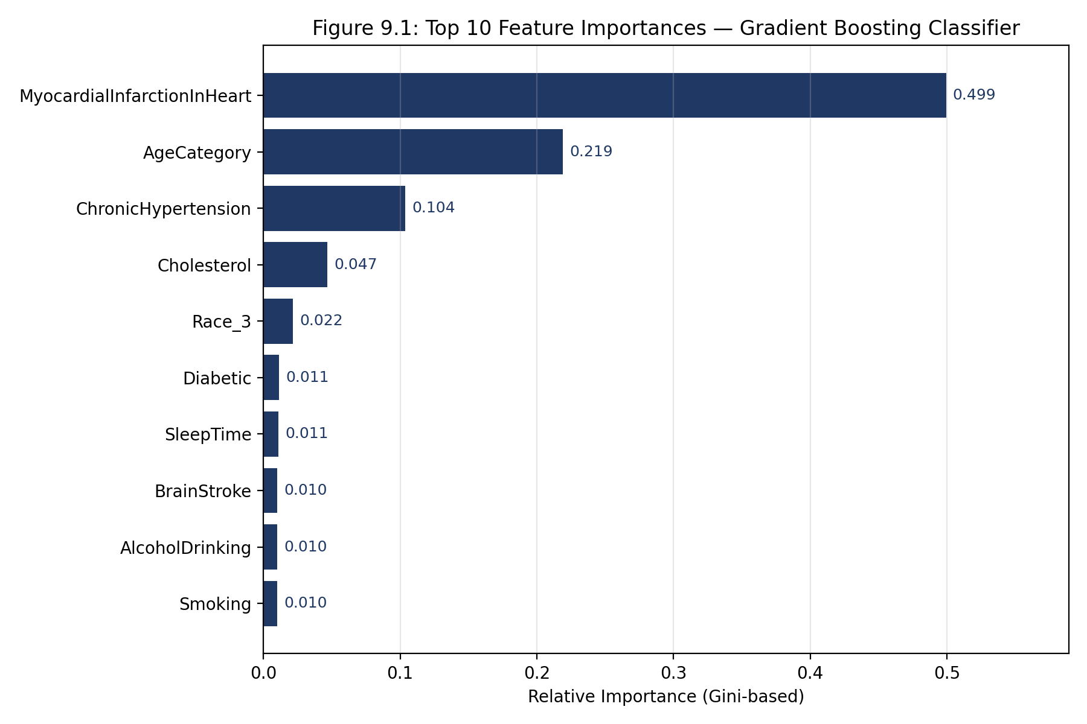


EXPLAINABILITY
HeartGuard
From Model Predictions to Clinical Insights
Feature Importance Analysis
identify which clinical variables contribute most to cardiovascular risk prediction. These scores were used to understand the model's overall behavior.
Rule-Based Patient Interpretation
One signed contribution value per feature, computed fresh for each patient, showing how it pushed that patient's risk up or down.
Personalized Risk Factors
The application selects the patient's most influential abnormal risk factors from the predefined ranked features and converts them into understandable clinical messages rather than displaying technical model outputs.
Global feature importance (Ch.8) — the same engineered features SHAP explains per-patient at inference time.
08 / 10
Notes:
SHAP was chosen because Gradient Boosting is a tree-based model, letting us use TreeExplainer for fast, exact explanations. Unlike the global feature importance chart shown here, SHAP produces a directional, per-patient explanation at inference time — that's what actually drives the specialist recommendation and action plan the clinician sees.

