Slide 1
HIGHLIGHT
NORMAL
02

Slide 2
Why can you kill mosquitoes in the dark?
Towards solving sound localization with a biologically plausible spiking neural simulation
26.11.2024 | Paolo Marzolo
Notes:
This presentation will follow a standard format, so let’s get started with the theory background

Slide 3
Contents
01
02
03
04
05
Introduction and
Background
Objectives
Methods
Results
Discussion
Auditory Cues
Biological sound processing:
  Peripheral
  Neural
Input range and bioplausibility
Myoga's MSO
IC evaluation by sigmoid fit pre vs post MSO
Peripheral processing
Neural processing
Auditory Nerve Fibers output
Higher centers
MSO impact on IC
Peripheral processing properties
Neural bioplausibility
IC impact and literature

Slide 4
Background
01

Slide 5
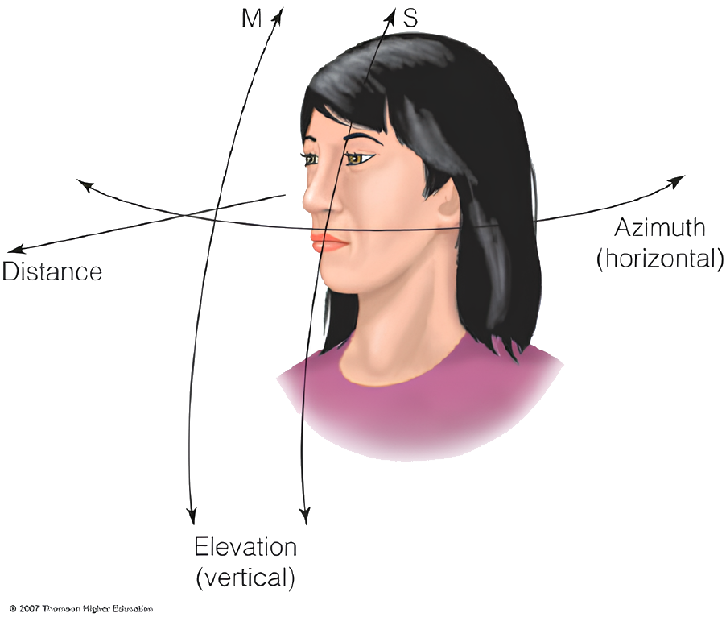
Sound localization basics
Determining the source location of a sound
Must be derived
Derivation based on three main features (auditory cues)
Thompson Higher Education

Slide 6
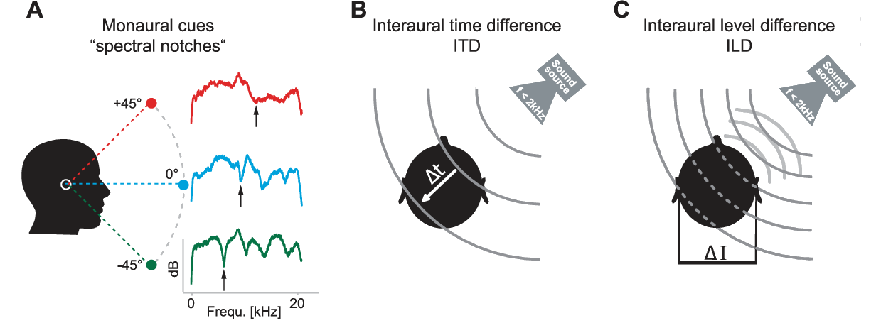
Auditory Cues
Notes:
HRTF! HRTF! HRTF!

Slide 7
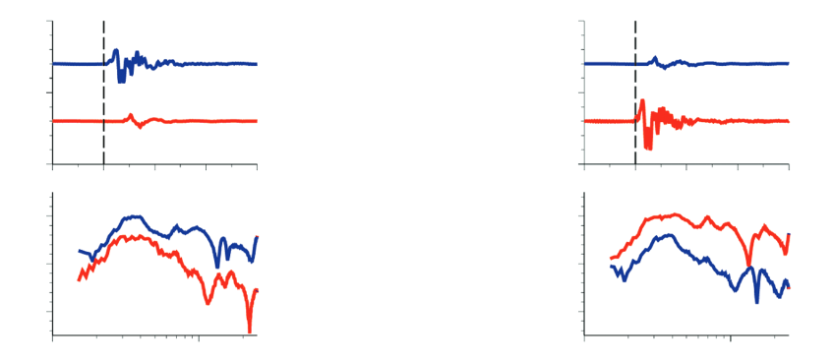
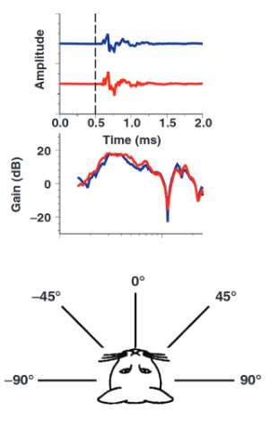
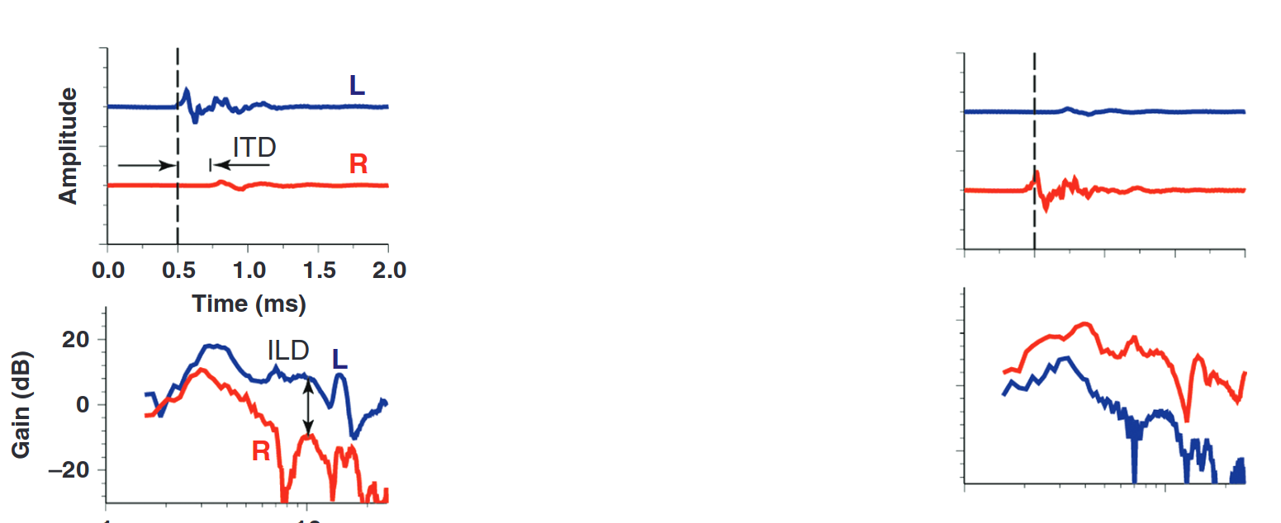

Slide 9
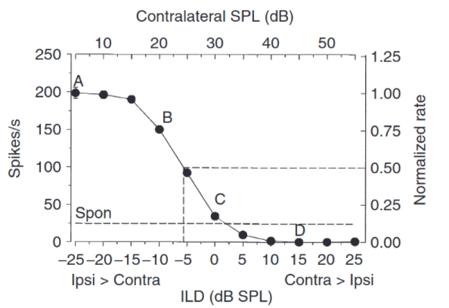
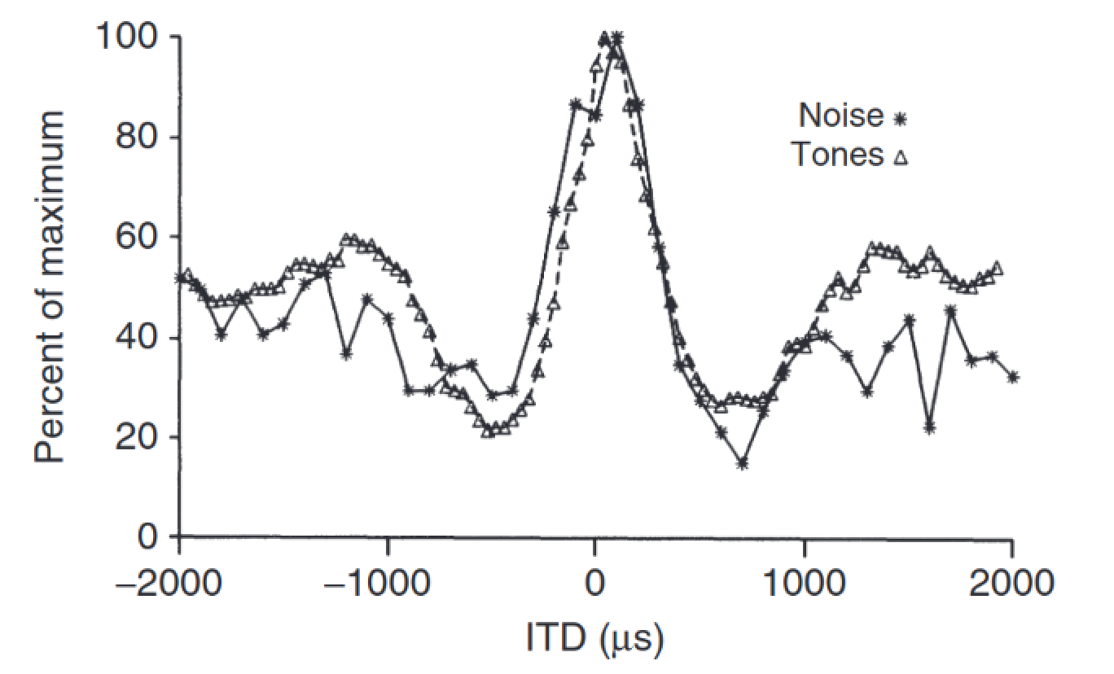
Associated Nuclei
Lateral Superior Olive (LSO) -> ILD
Medial Superior Olive (MSO) -> ITD
Notes:
These cues are especially important because they are the main driver for the response behavior of the two nuclei where binaural information first converge, the LSO and MSO

Slide 10
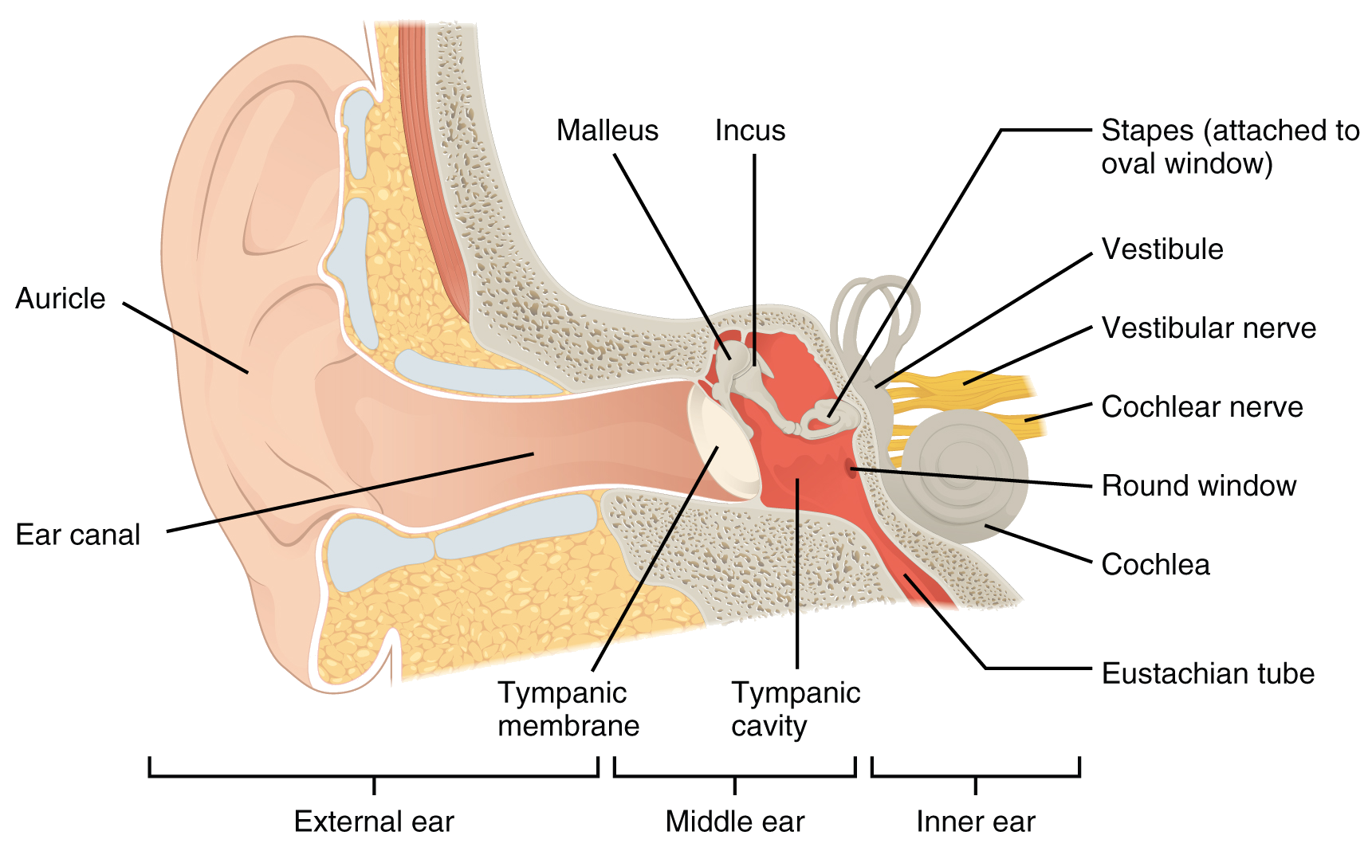
Peripheral Processing
Pinna/auricle
Middle ear
Cochlea
Inner Hair Cell
Auditory Nerve Synapse
L. M. Biga et al., Anatomy & Physiology. OpenStax/Oregon State University, 2019. Accessed: Nov. 27, 2024. [Online]. Available: https://open.oregonstate.education/aandp/
Notes:
These are the main steps of the process, from which two main properties (for localization task)

Slide 11
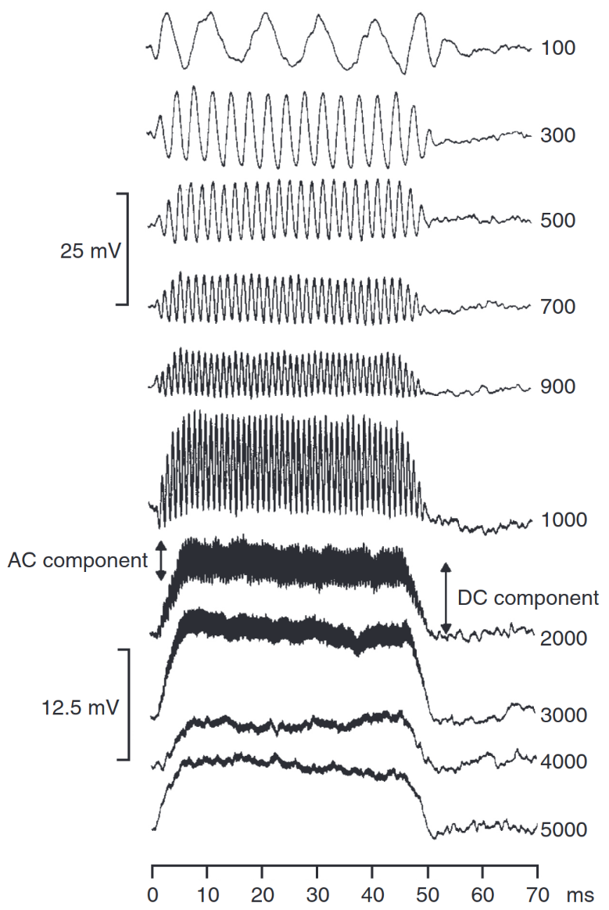
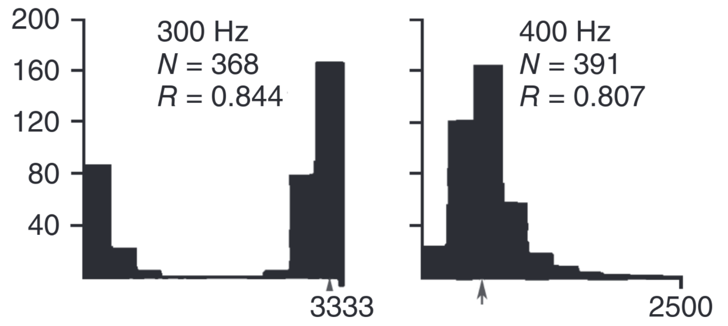
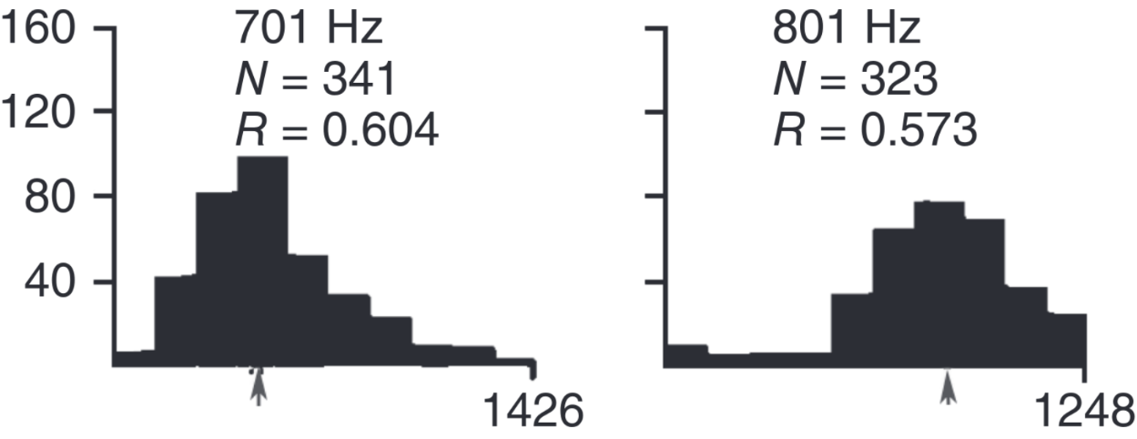
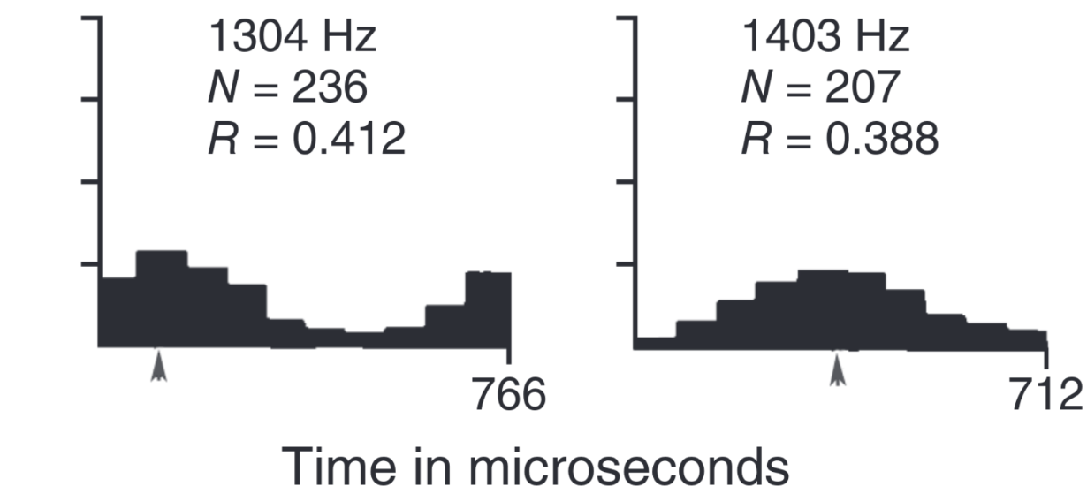
Property 1:
Phase Locking
The ability of fibers to synchronize firing rate with a specific phase of the input wave
Falls off around 2 kHz
Possible metric to evaluate is Vector Strength
Notes:
Property 1: phase locking at low freq
Vector Strength: each spike is a a vector (of angle=phase), take the average vector length

Slide 12
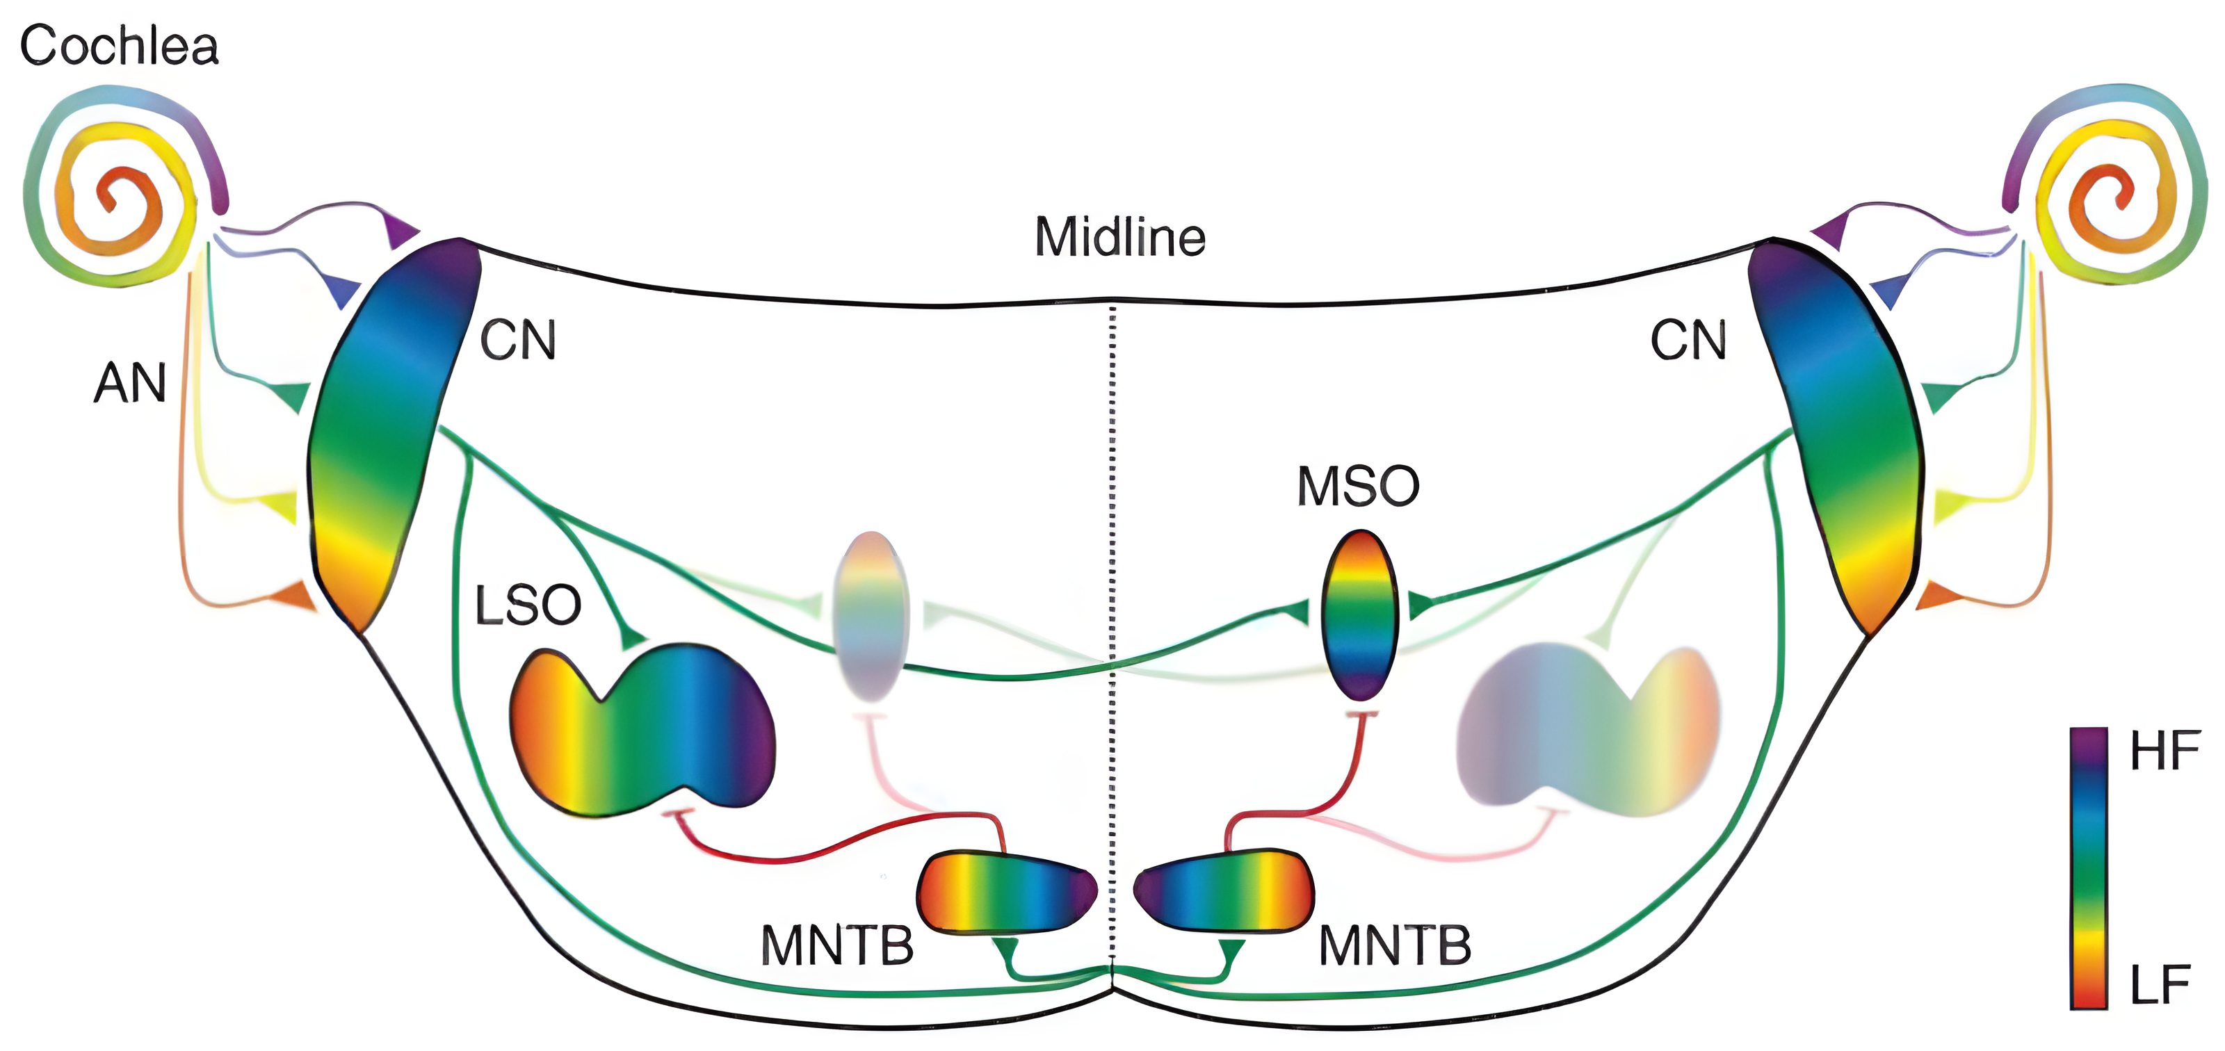
Property 2: Tonotopic Organization
HIGH FREQUENCY
LOW FREQUENCY
Notes:
Property 2: tonotopic organization

Slide 13
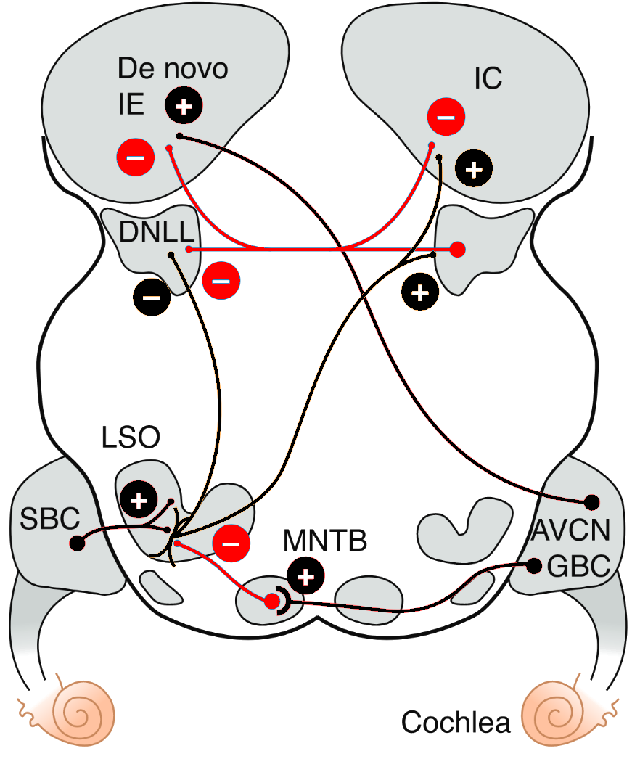
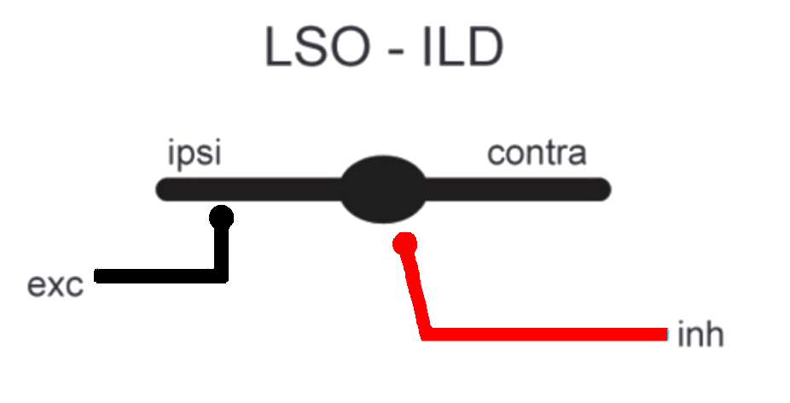
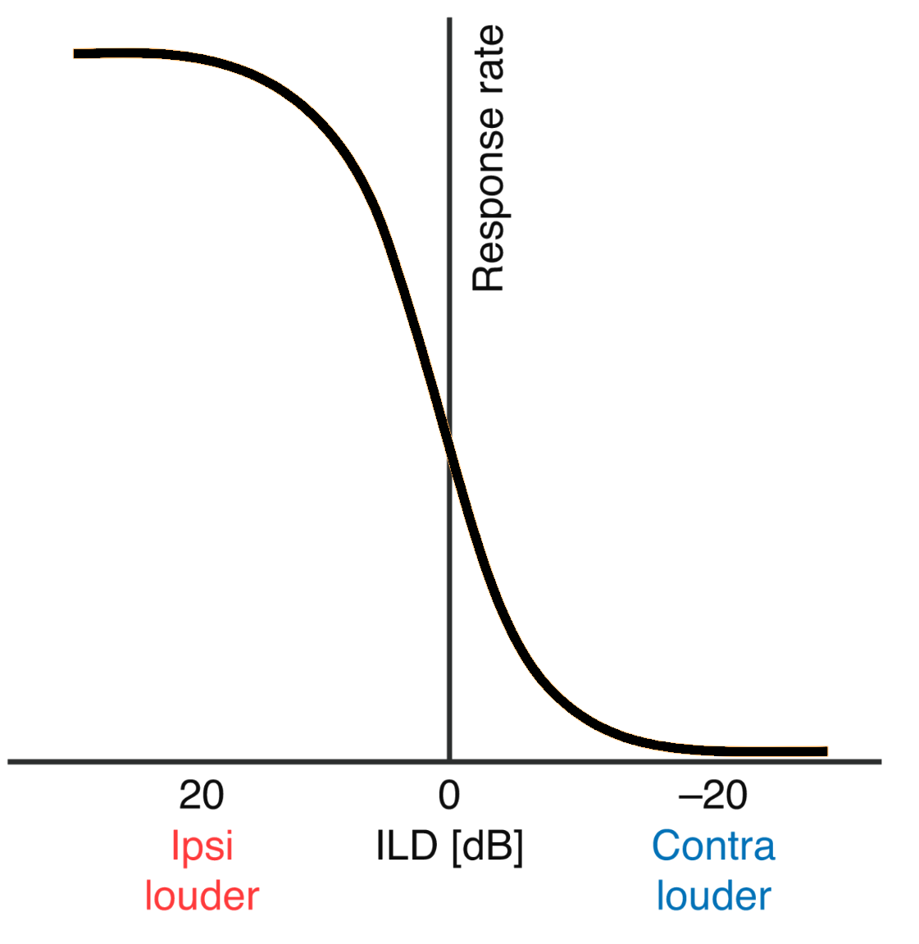
Complete network
Auditory Nerve Fibers (ANFs) first neural component
Bushy cells refine phase-locking
Medial and Lateral Nuclei of the Trapezoid Body provide inhibition
Notice convergence
ANF
ANF

Slide 14
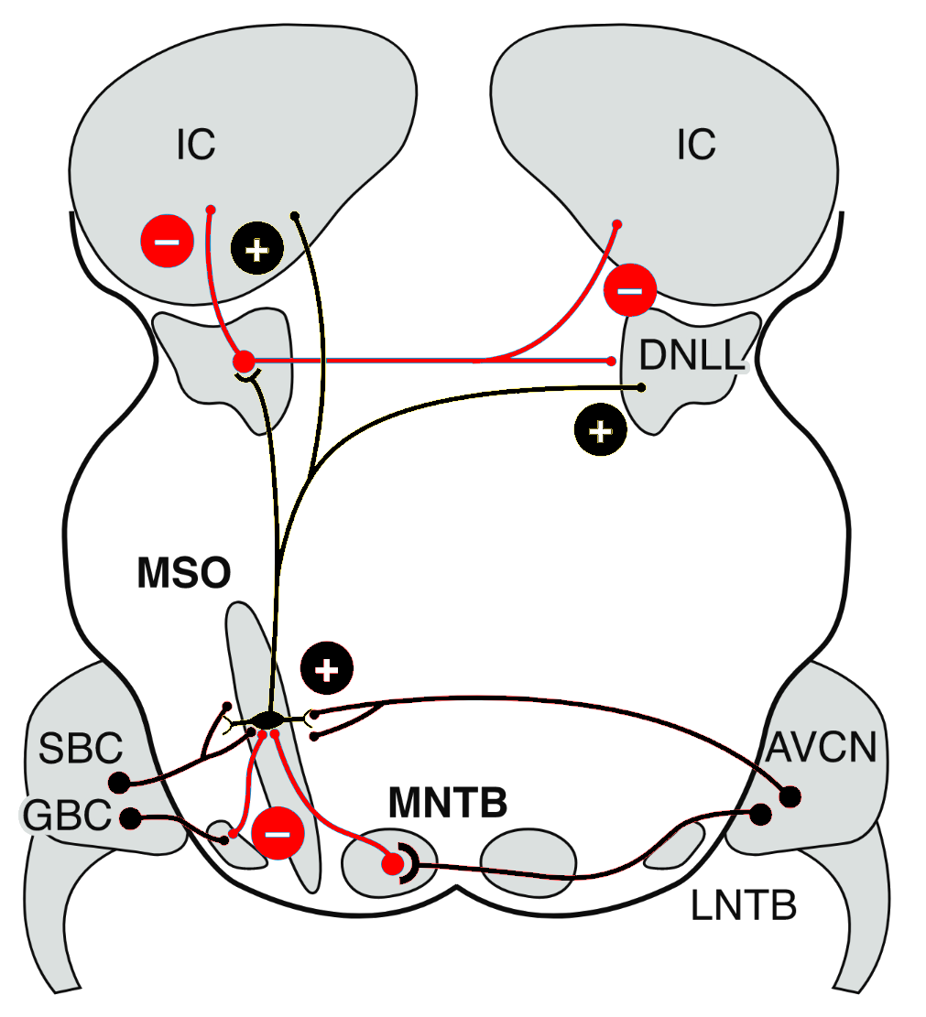
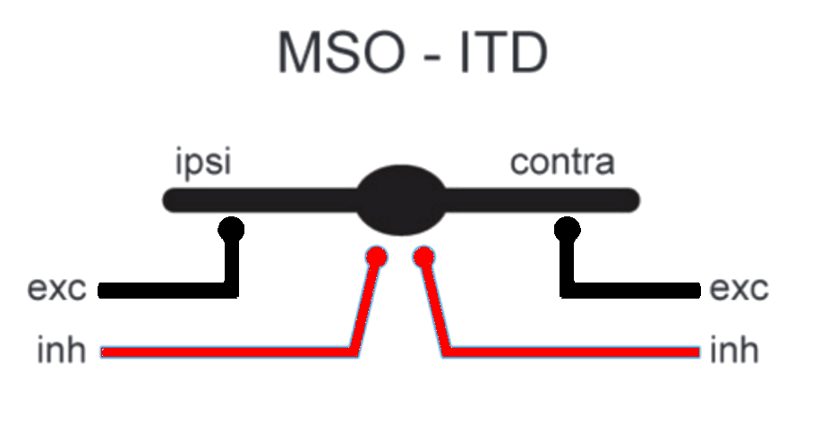
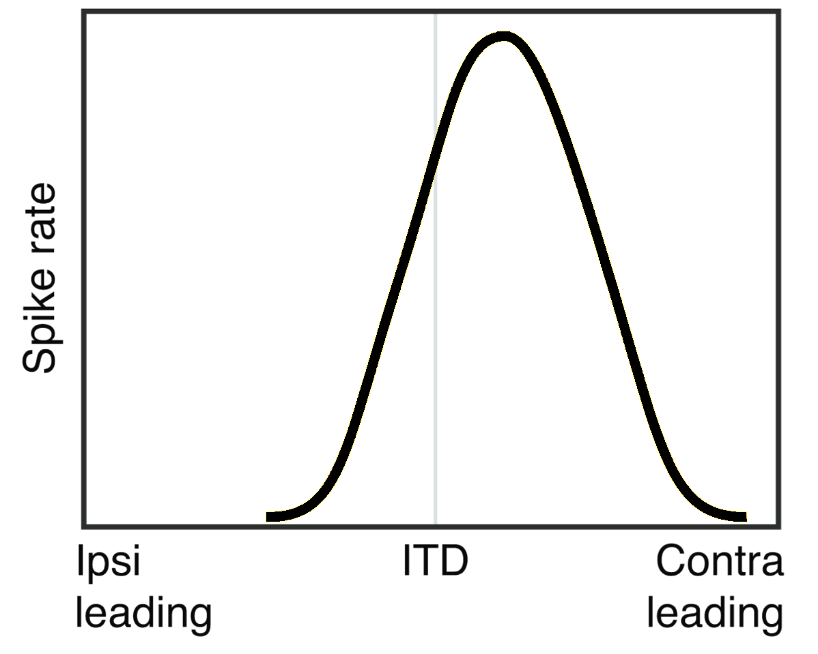
Complete network
Auditory Nerve Fibers (ANFs) first neural component
Bushy cells refine phase-locking
Medial and Lateral Nuclei of the Trapezoid Body provide inhibition
Notice convergence
ANF
LNTB
ANF

Slide 15
Left/right integration mechanism
ILD coding in LSO
ITD coding in MSO
Known
Based on IE
Multiple possible strategies
More complex scheme:
  Two inh sources
  Two exc sources
Notes:
LSO noto, MSO no

Slide 16
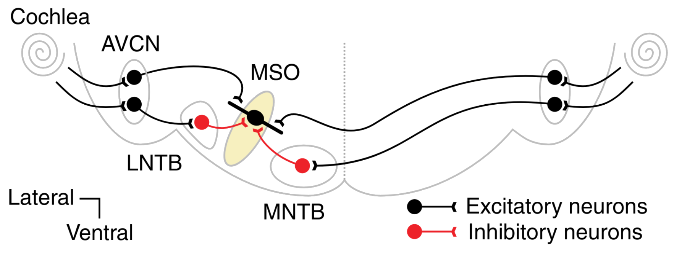
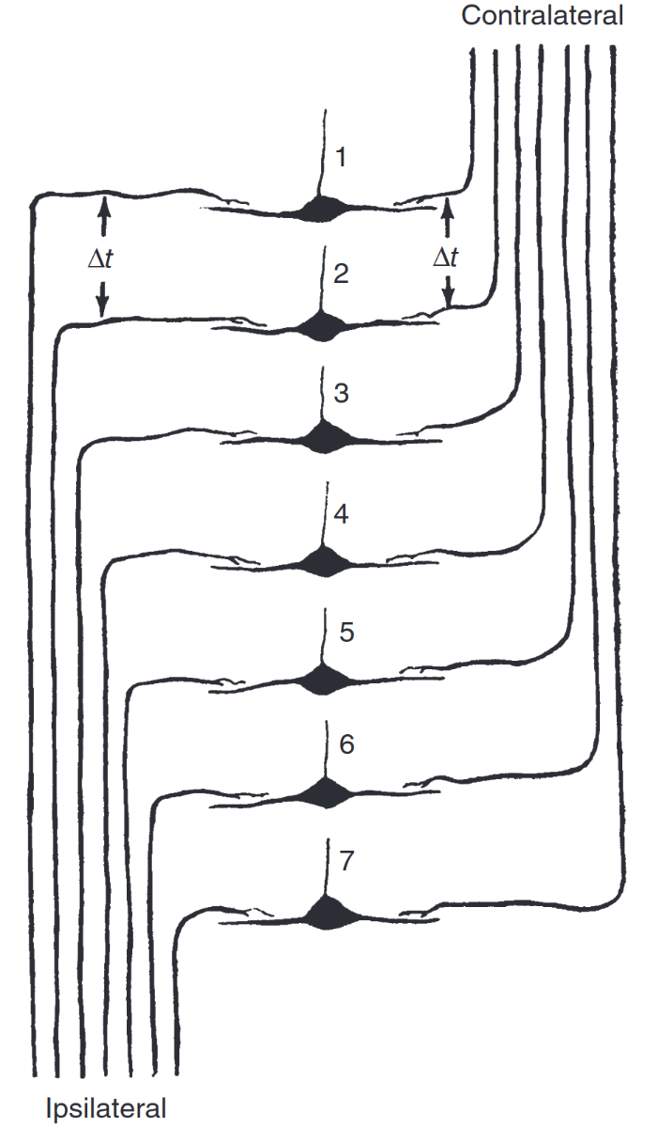
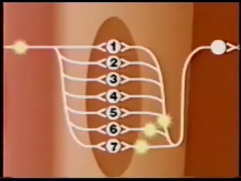
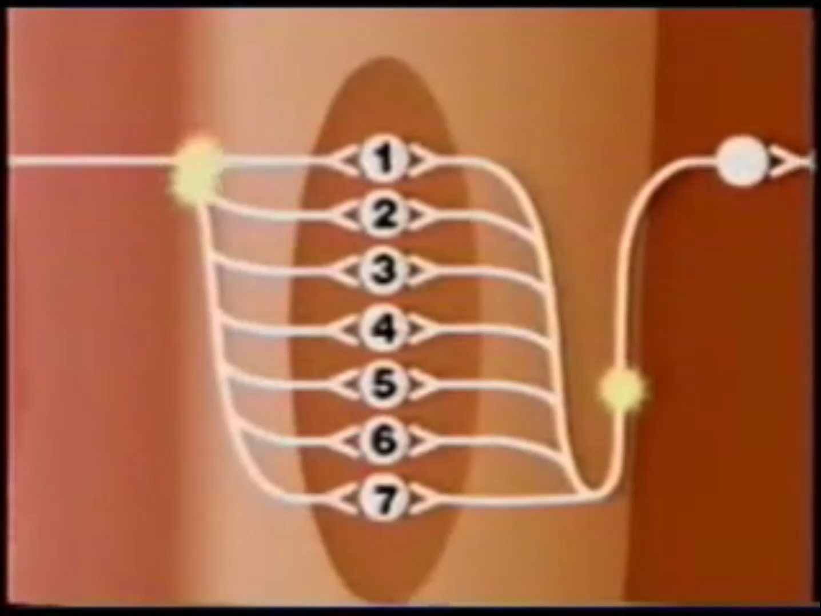
ITD coding strategies
Jeffress-based
ISSUES
No evidence of delay lines in mammals
ITD differ at different frequencies (suggests IPD)
No role for inhibition (MNTB!)
Notes:
MSO Jeffress e problemi

Slide 17
Objectives
02

Slide 18
Objectives
Implement peripheral processing sections at different bioplausibility levels:
  Pulse-packet generators
  Gammatone-based
  Tan Carney-based
Evaluate effect of these peripheral sections on higher nuclei
Improve bioplausibility of the model
Notes:
Mention existing model

Slide 19
Objectives
Implement peripheral processing sections at different bioplausibility levels:
  Pulse-packet generators
  Gammatone-based
  Tan Carney-based
Evaluate effect of these peripheral sections on higher nuclei
Improve bioplausibility of the model
Use Myoga’s principles for ITD coding in the MSO
Used fixed difference in arrival times of each inh to the exc from same side to obtain shift of ITD with maximal response
Notes:
Mention existing model

Slide 20
Objectives
Improve bioplausibility of the model
Implement peripheral processing sections at different bioplausibility levels:
  Pulse-packet generators
  Gammatone-based
  Tan Carney-based
Evaluate effect of these peripheral sections on higher nuclei
Notes:
Mention existing model

Slide 21
Objectives
Improve bioplausibility of the model
Use Myoga’s principles for ITD coding in the MSO
Used fixed difference in arrival times of each inh to the exc from same side to obtain shift of ITD with maximal response
Notes:
Mention existing model

Slide 22
Objectives
Improve bioplausibility of the model
Use Myoga’s principles for ITD coding in the MSO
Consider a simple IC for cue integration above SOC
IC
Excitatory
Excitatory
MSO (ipsi)
LSO (contra)
Notes:
The connectivity above the nuclei we mentioned becomes complex, but one clear pathway is excitatory…

Slide 23
Methods
03

Slide 24
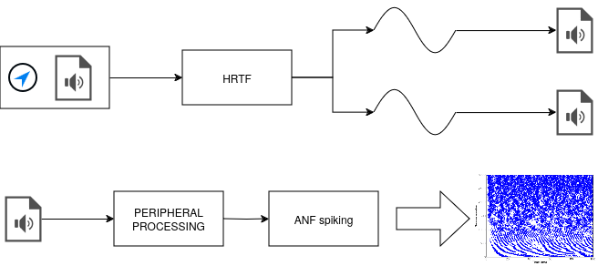
Peripheral Processing
Identified common scheme for all peripheral processing
HRTF creates two sounds
Exact following steps depend on the peripheral processing
Notes:
let's start with peripheral processing

Slide 25
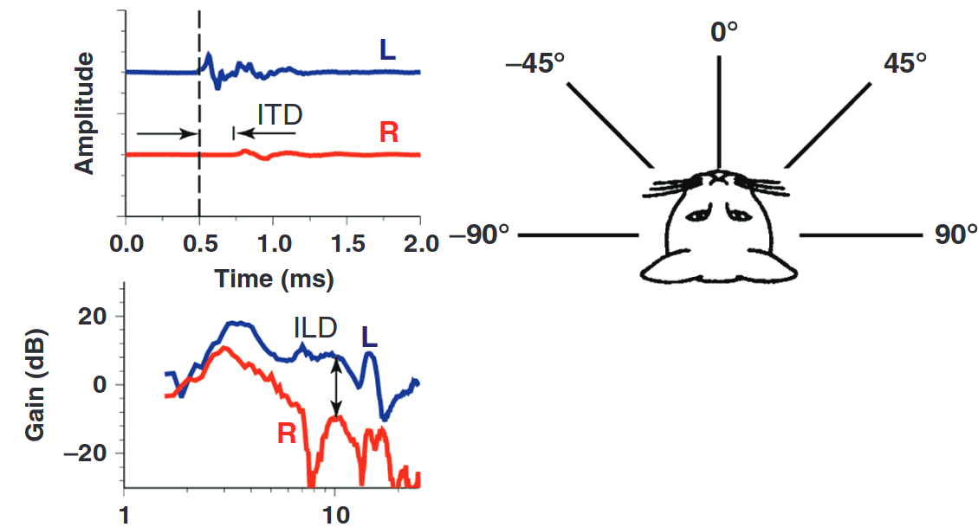
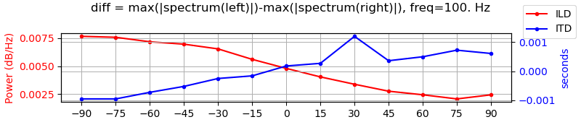

Peripheral Processing:
HRTFs
Evaluate HRTF impact on auditory cues
Verify vector strength plots between peripheral sections

Slide 26
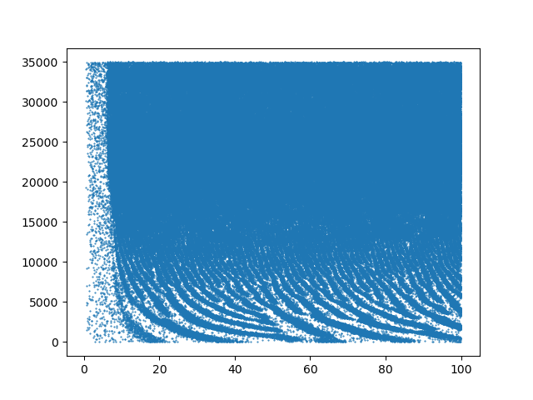
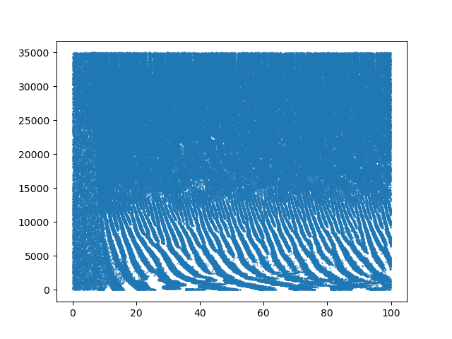
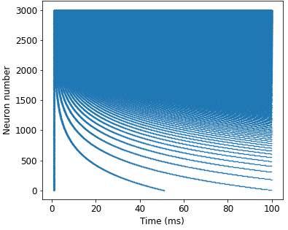
Peripheral Processing: Inner Ear
Three different peripheral processing sections at three bio-plausibility levels
Pulse Packet Generators
Gammatone-based
Tan-Carney-based

Slide 27
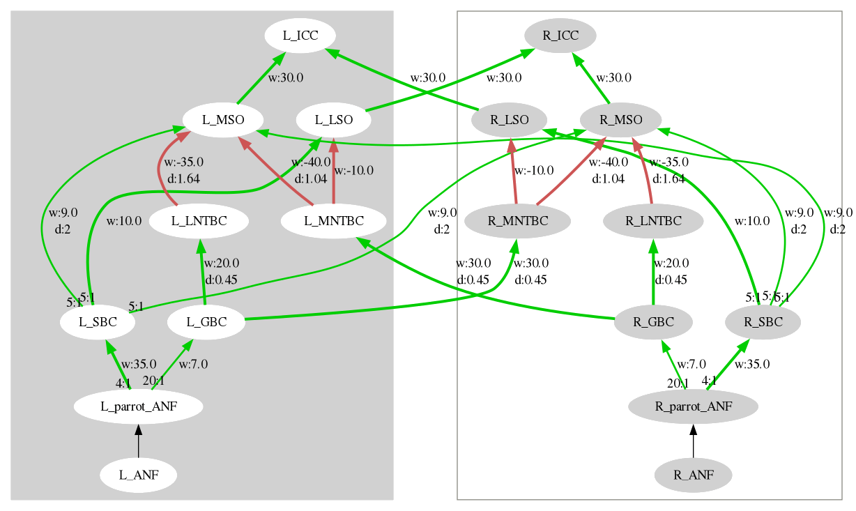

Network Structure
Notes:
Evidenzi una pop: come possiamo valutare la response di una pop neurale? Prox slide

Slide 28
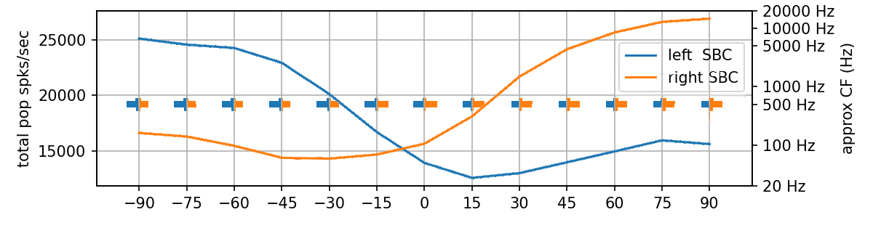
Neural Processing
Bushy cells, gammatone, 500Hz
Total population activation
Tonotopic fiber activation (where?)
Notes:
Example result image to explain the plot

Slide 29
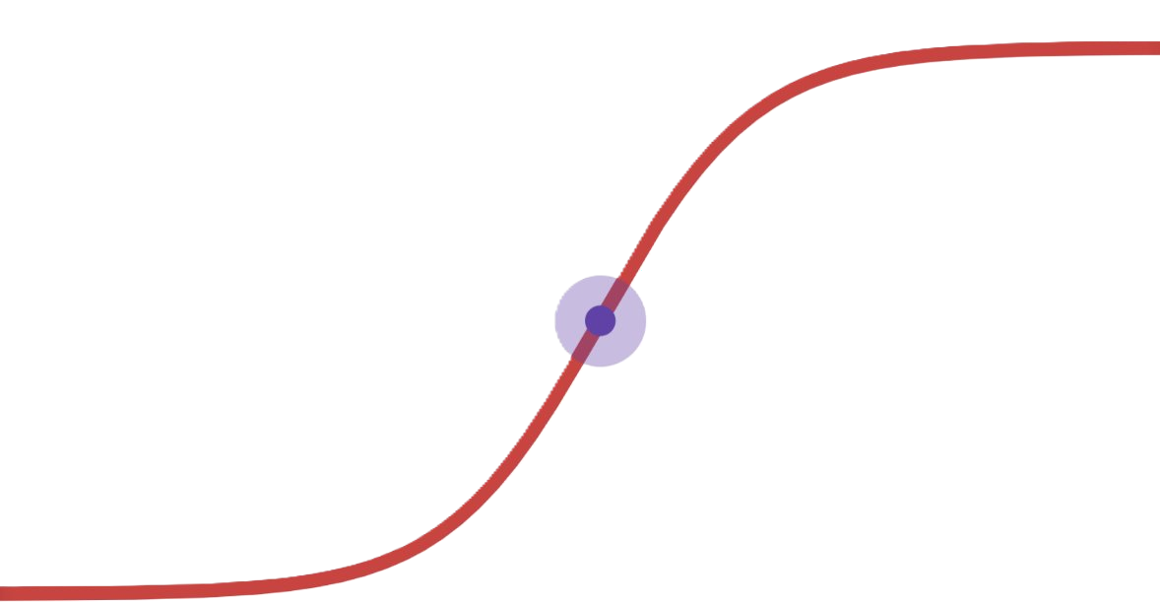
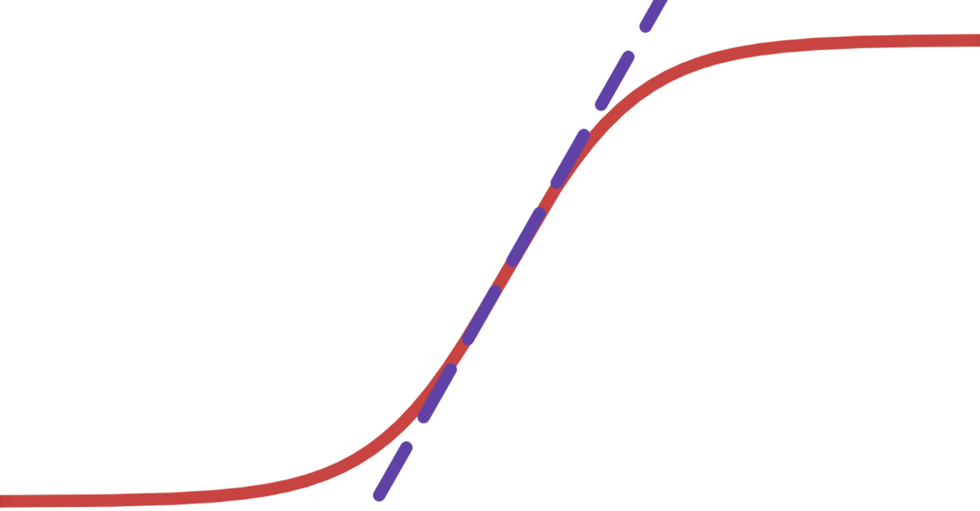
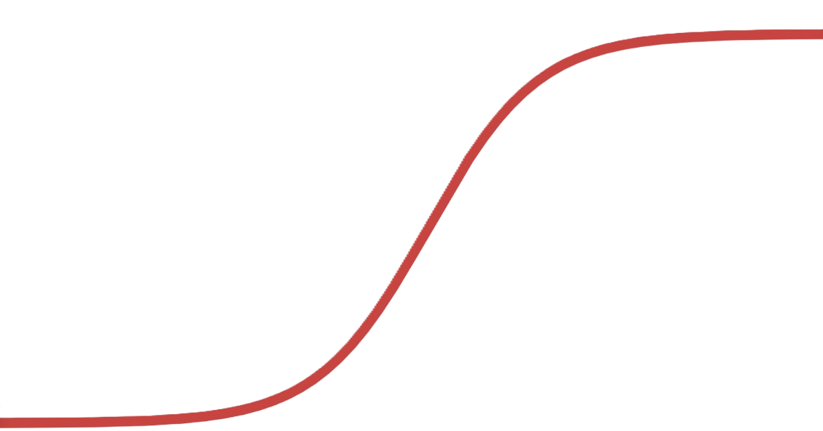
Inferior Colliculus Model
Zero-degree accuracy
Steepness around zero
Used sigmoid
Following metrics were evaluated:
Range
Notes:
Since behavioral results show no difference between right and left azimuthal localization accuracy, the center point (zero degrees) should show equal activation in both populations;
Just noticeable difference, a metric that shows the lowest detectable degree difference between sounds, is lowest in humans around zero azimuth. Hence, a steeper curve is an improvement;
Difference between maximum and minimum total population spike index to maximize the difference in lateralization.

Slide 30
Results
04

Slide 31
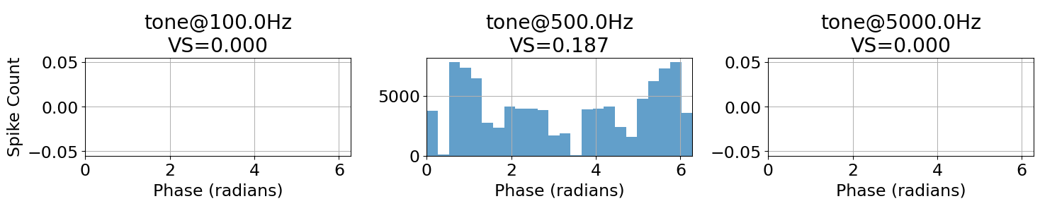
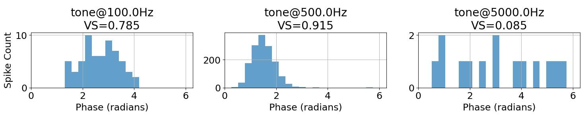
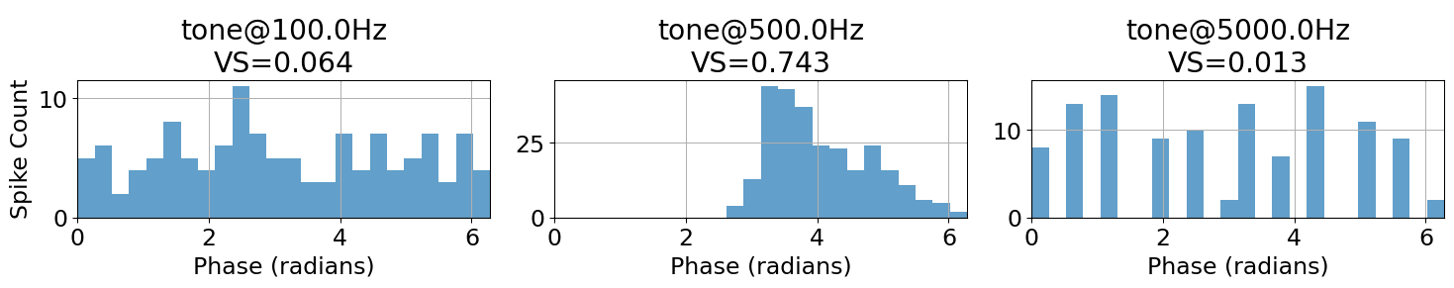
Peripheral Processing
PPG
Evaluated using vector strength:
PPG low phase locking
Gammatone too high
Gammatone fast falloff
Gammatone
Tan-Carney
Notes:
Gammatone si sincronizza anche a freq diverse

Slide 32
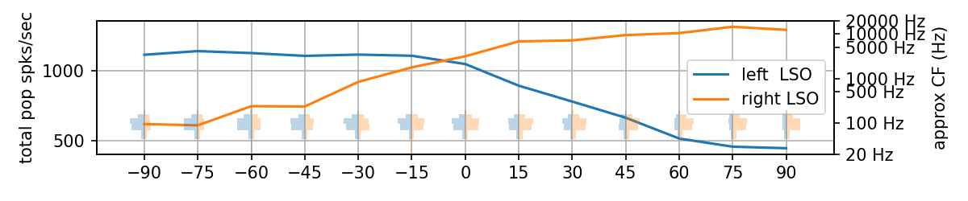
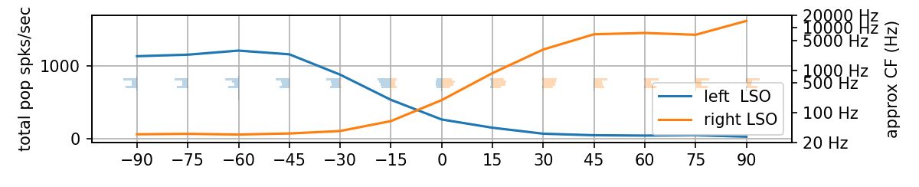
Higher centers: LSO
LSO, 100 Hz
LSO, 500 Hz
Notes:
It is, in fact, a sigmoid

Slide 33
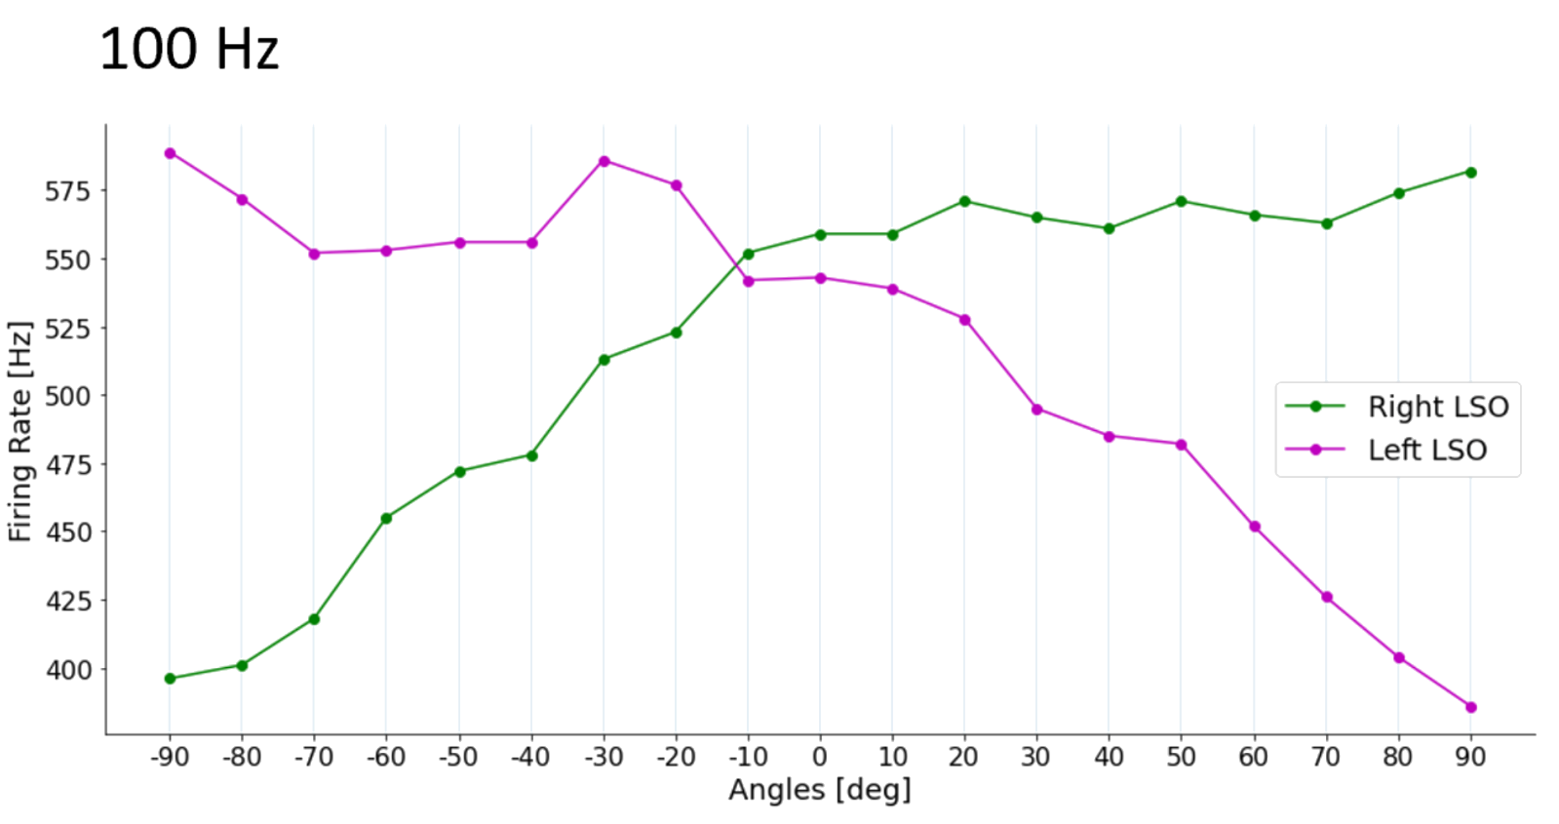
Higher centers: LSO; previous model
Notes:
This was also achieved by the model we based our work on, but with an unrealistically low membrane time constant

Slide 34
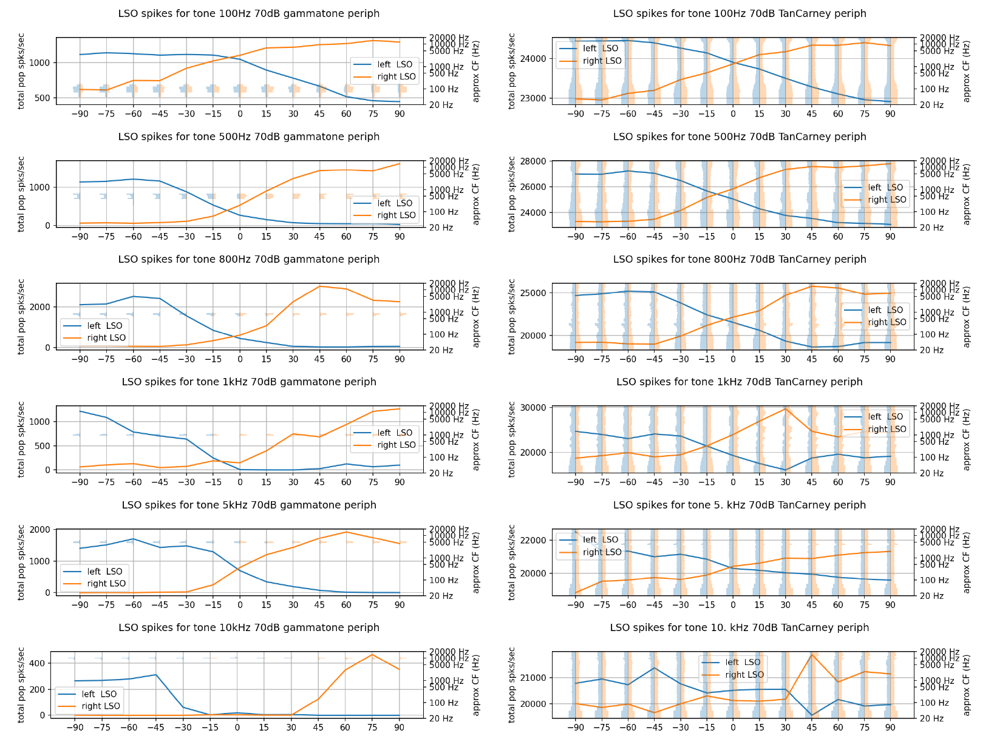
Higher centers: LSO with varying frequency
100 Hz
Notes:
Sigmoidal shape already present but little range

Slide 35
Higher centers: LSO with varying frequency
1000 Hz
Notes:
Increased range, still noisy sigmoid

Slide 36
Higher centers: LSO with varying frequency
5000 Hz
Notes:
Best sigmoidal shape yet, strong range

Slide 37
Higher centers: LSO with varying frequency
10000 Hz
Notes:
Degraded as inhibition begins flooding the neurons, lowering spikes

Slide 38
Higher centers: LSO with varying frequency
100 Hz
Improves with increasing frequency
Degrades above 10 kHz
Only activates a specific frequency range
1000 Hz
5000 Hz
10000 Hz

Slide 39
Higher centers: LSO with real inputs
Similar behavior wrt gammatone
Generalized population activation
100 Hz
800 Hz
5000 Hz

Slide 40
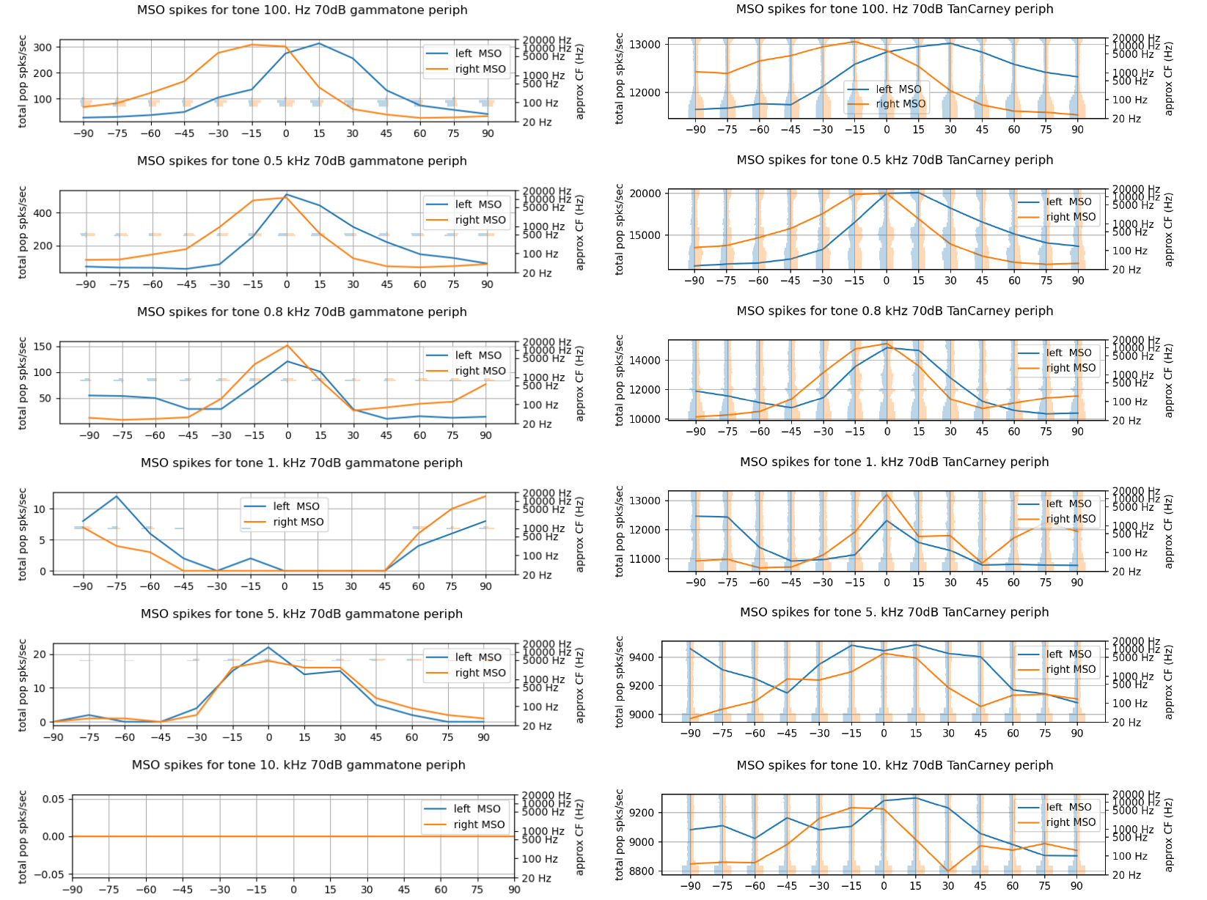
Higher centers: MSO
100 Hz
GAMMATONE
100 Hz
TAN-CARNEY
Notes:
Existing model not comparable: MSO mechanism was different, and they focused on single neuron response instead of population response

Slide 41
Higher centers: MSO
500 Hz
GAMMATONE
500 Hz
TAN-CARNEY
Notes:
Existing model not comparable: MSO mechanism was different, and they focused on single neuron response instead of population response

Slide 42
Higher centers: MSO
800 Hz
GAMMATONE
800 Hz
TAN-CARNEY
Notes:
Existing model not comparable: MSO mechanism was different, and they focused on single neuron response instead of population response

Slide 43
Higher centers: MSO
1000 Hz
GAMMATONE
1000 Hz
TAN-CARNEY
Notes:
Existing model not comparable: MSO mechanism was different, and they focused on single neuron response instead of population response

Slide 44
Higher centers: MSO
100 Hz
Degrades with higher frequency (expected)
Contralateral favoring
500 Hz
800 Hz
1000 Hz
Notes:
As frequency grows the quality of the MSO response degrades, which is expected to a certain extent; we would expect the MSO to work also at 1kHz, but Myoga only shows up to 800Hz as well

Slide 45
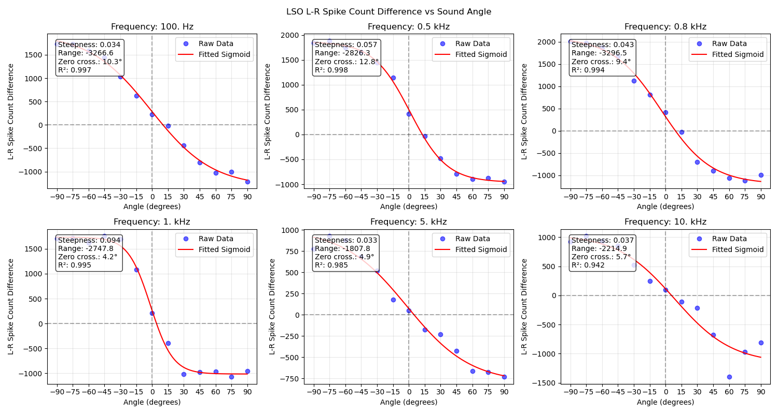
Cue integration: LSO vs IC
Notes:
Tan Carney only

Slide 46
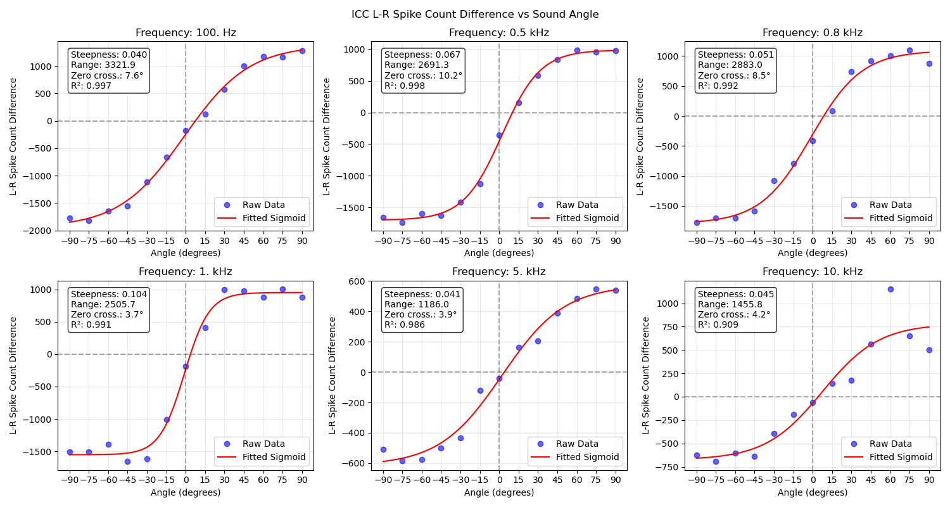
Cue integration: LSO vs IC
Notes:
Remember that contralateral LSO connects to IC

Slide 47
Results: LSO vs IC
ZERO-CROSSING ACCURACY
STEEPNESS
RANGE
+18.1%
-15.5%
+19.1%
(2⁰)

Slide 48
Discussion
04

Slide 49
Conclusions and future work
Peripheral
Myoga MSO
Inferior Colliculus
Bioplausible peripheral processing sections are needed
Solutions based on digital filters are accurate and efficient
The results show promise, and echo biological results
More investigation needed at the single neuron level
The MSO does not seem to provide valuable information for a simple EE scheme
More complex cue integration schemes may be needed
Additional research may focus on MSO as dynamic, sound segregating machine
Grothe, B., Pecka, M., 2014. The natural history of sound localization in mammals - a story of neuronal inhibition. Front. Neural Circuits. 8. https://doi.org/10.3389/fncir.2014.00116
Notes:
Mention maybe MSO for dynamic difference

Slide 50
Thank you for your attention
Paolo Marzolo

Slide 51
Questions that I could think of
CHILL
TOUGH
Wouldn't steepness be maximized by a step function (unable to localize)?
<your own>
Why are you comparing LSO response to ILD (bio experiments) to LSO response to hrtf (silico)?
Why are you comparing single neuron response MSO (bio) to population response (silico)?

Slide 52
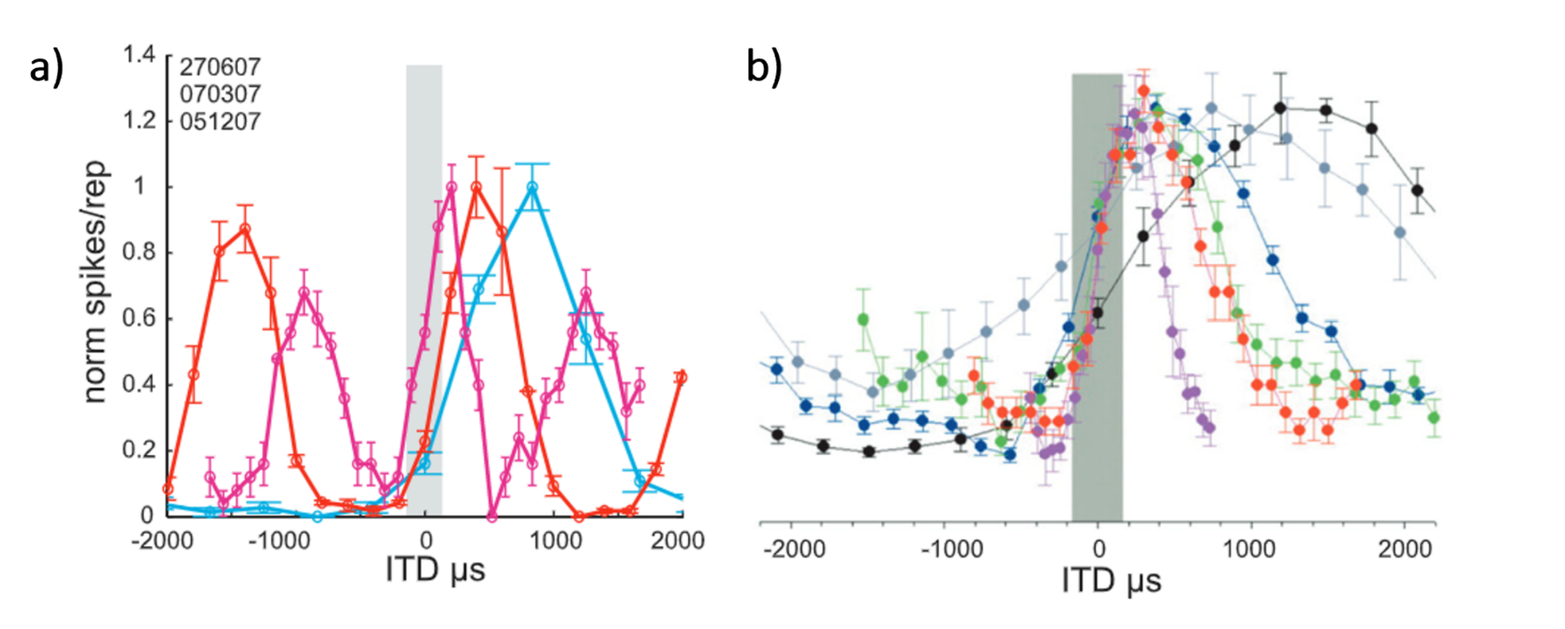
MSO single vs population

