Slide 1
CRM Presentation
Bank of GTA
Mar 18, 2020 Prepared by Team 10

Slide 2



Background
Banking Industry is dominated by Big 5
Over the last five years, smaller FinTechs have been joining
Threat: large tech companies are making inroads
75% of Canadians do banking digitally
23% do mobile banking
Millennial customers switch banks twice as often than others
Banking-Customer relationship has changed from value/advice to more transactional based
Goal: Quadruple customer base within 2 years. Within 5 years, the goal is to surpass 1 million banking customers and to compete legitimately with the Big5
Strategy: provide a full suite of financial solutions to new and existing customers with relevant timely conversations across the customer’s lifecycle
Challenge: GTA currently does not have a CRM system and uses batch campaigns to market to its customer base

Slide 3
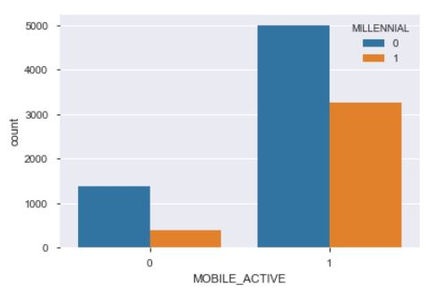
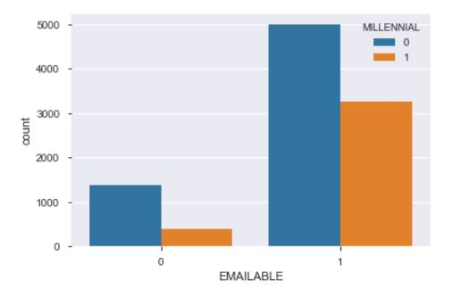
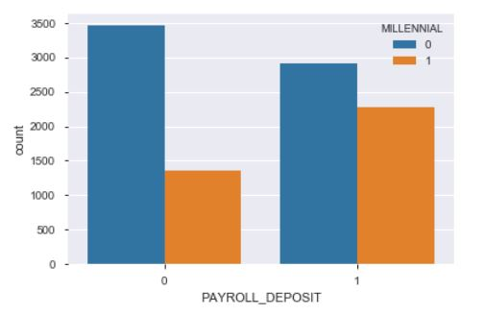

Opportunities Within the Millennial Segment
Within this millennial segment, 64% of them are Non-Millennial and 35% are Millennial.
Notes:
Polly

Slide 4
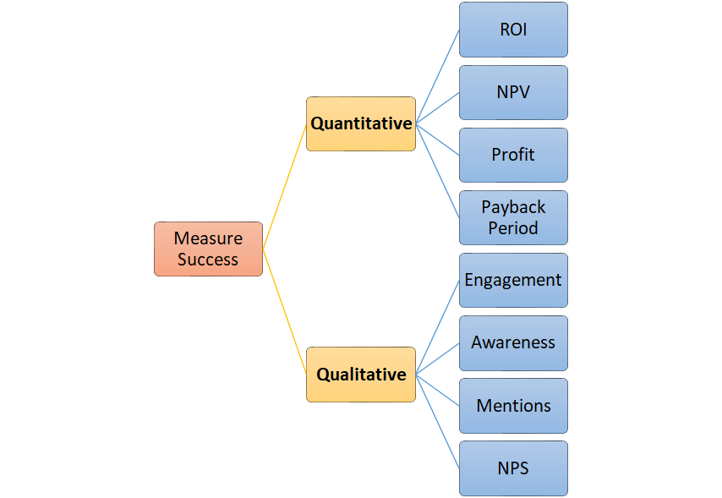
Measures of the Campaigns
We can measure the success of the campaigns through two main metrics, Quantitative vs Qualitative.
Notes:
Polly

Slide 5
Better Campaign
Retention
Out of the three channels (email, calling, mail)
Email channel provides the optimal profit (83% are email deliverable)
$500,000 acquisition cost on email delivering can save $6.9 millions.
Customers feel they are valued
Credit Card Cross Sell
Email channel still provides the optimal profit
$1 million acquisition cost (for every 10,000 customers) on email channel can bring $4.1 millions profit
Engagement
10 times more likely to stay with the bank, can cross sell other product, CLV is the key.
$2.5 millions acquisition cost (for every 10,000 customers) on email channel can bring $1.69 millions profit
Best Customer Recognition
Can potentially reduce attrition rate
Better NPS Score
Lower Cost
Notes:
Vinny

Slide 6
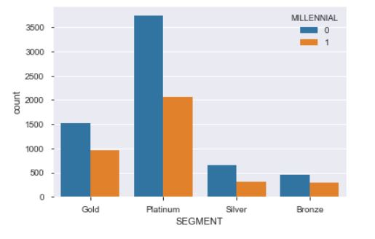
Segmentations
We can also segment customers by rating from wrose to better: Bronze, Silver, Gold, Platinum.
Bronze(7.58%):
Average profit on Line of Credit: $1502
Average profit on Credit Card: $1563
Average profit on Deposits: $227
Average profit on Mortgage: $269
Silver(9.62%):
Average profit on Line of Credit: $1835
Average profit on Credit Card: $930
Average profit on Deposits: $285
Average profit on Mortgage: $188
Gold(24.83%):
Average profit on Line of Credit: $2143
Average profit on Credit Card: $935
Average profit on Deposits: $333
Average profit on Mortgage: $913
Platinum(57.94):
Average profit on Line of Credit: $2557
Average profit on Credit Card: $473
Average profit on Deposits: $417
Average profit on Mortgage: $947
Notes:
Vinny

Slide 7
Potential CRM & Other Data Sources
Go forward with a potential CRM system:
ROI & Payback Period to measure success
K-means clustering, Hierarchical Clustering
Cancel/reduce direct mails for millennial
Customer Life Value to segment customers
Data Sources:
Demographic: age, income, occupation, marital status
Behavioural: usage, loyalty, occasion, and benefits
Psychographic: lifestyle, personality traits, values and attitude, social status
Incremental Financial Return from Marketing Investment & Cost of Marketing Investment to calculate ROI
Monthly Recurring Revenue to calculate payback period
Notes:
FeiFei

Slide 8
Potential issues & Recommendations
Potential issues on profit calculation
Email channels are not totally free, human capitals are still involved.
No acceptance rate was considered for approved credit cards
Improvement on campaign
For unsecured leading like credit cards, higher risk customers are more likely revolvers and lower risk customers are more likely transactors. More profit gained from Bronze customers, meaning more risk involved. Little profit gained from Platinum customers because they are transactors, they don’t usually carry balance over. Bank should offer different type of credit cards for different segments (CLV) of customers
Since Millennials like payroll deposits, most of the customers have more than 1 product with the bank, and 95% of the customers have deposit account with bank while only 62% have mortgages. Engagement campaign is best to acquire new customers, and cross sell (especially mortgages) to keep customers within the bank
Notes:
Harry

Slide 9

Thank you!
Any Questions?

