Slide 1
Day 13:
Pressure, Density, Buoyancy
SHS Physics Club Summer Camp 2026

Slide 2
Overview
01
HW/Quiz
Brief MCQ review quiz, go over homework questions
02
Density
Density for solids and liquids
03
Pressure
Pressure, air pressure, water pressure
04
Buoyancy
Buoyancy force, floating/sinking, advanced buoyancy problems

Slide 3
1 - HW/Quiz

Slide 4
HW/Quiz
Homework Questions?

Slide 5
HW/Quiz
Quiz
  10 min
  5 MCQ

Slide 6
2 - Density

Slide 7
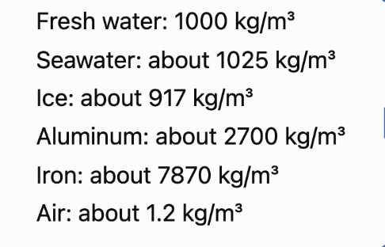
Density
How much mass is packed into a certain volume
  Mass to volume ratio
  ⍴ = m / V
  What is heavier, a gram of metal or a gram of plastic?
Specific gravity:
  Nothing to do with gravity
  Ratio of a substance’s destiny to the density of water
Average density
  An object's density might not be uniform
  Total mass over total volume!

Slide 8
Practice Problems
A metal block has a mass of 18 kg and a volume of 0.006 m³.
What is the density of the block?
A hollow plastic ball has a total mass of 2.4 kg and a volume of 0.0040 m³. The plastic itself has a density greater than water, but the ball contains air.
Find the average density of the entire ball.
Notes:
ρ = 3000 kg/m³

Slide 9
3 - Pressure

Slide 10
Pressure
Force over area
  P = F/A (pascal)
  Needle vs bed of nails
Water pressure
  Water has a weight, so whatever is underneath experiences some form of pressure
  Same thing as air pressure, but air is less dense
  Derive pressure in terms of height:
Absolute pressure
  Gauge pressure + atmospheric pressure (I’ll explain)

Slide 11
Practice
A person stands on the floor and then lifts one foot. What happens to the pressure exerted on the floor?
Three containers have different shapes. Each contains water filled to the same height. Points A, B, and C are located at the bottom of each container.
Container A is narrow.
Container B is wide.
Container C is wider at the top and narrow at the bottom.
Compare the water pressure at points A, B, and C.

Slide 12
Practice
A rectangular aquarium is filled with fresh water to a depth of 1.5 m. A viewing window on one side is 0.80 m wide and 0.60 m tall. The top of the window is 0.40 m below the water’s surface.
Find:
a. The depth of the center of the window
b. The water pressure at the center of the window
c. The average force exerted by the water on the window

Slide 13
4 - Buoyancy

Slide 14
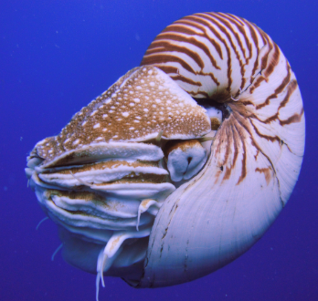
Buoyancy Force
Pressure scales with depth, so more pressure from the bottom than from the top
  F_{B} = weight of water displaced (derive equation)
Floating: when the weight of a submerged object is less than the bouyancy force
Sinking: quite the opposite
Neutral buoyancy: when both are =
Nautilus?

Slide 15
Practice
A block with a volume of 0.015 m³ is completely submerged in fresh water.
a. What volume of water does the block displace?
b. What is the buoyant force acting on the block?
You slowly dip one finger into a cup of water without touching the bottom or sides.
What happens to the reading on a scale underneath the cup?
A. It decreases
B. It increases
C. It stays the same
D. It becomes zero
An ice cube floats in a full glass of water. After the ice completely melts, what happens to the water level?
A. It rises
B. It falls
C. It stays the same
D. The glass overflows

Slide 16
Floating - explanation

Slide 17
Practice
A metal block has a mass of 12 kg and a volume of 0.0030 m³. It hangs from a spring scale and is completely submerged in fresh water without touching the bottom.
a. Find the block’s weight.
b. Find the buoyant force.
c. Find the tension in the rope.
d. What does the spring scale read?
A wooden block has a density of 720 kg/m³ and floats in fresh water.
a. What fraction of the block is submerged?
b. What percentage of the block is above the water?

Slide 18
See you next class!

