Slide 1
Day 3: Dynamics pt. 2
SHS Physics Club Summer Camp 2026

Slide 2
Overview
01
HW/Quiz
Brief MCQ review quiz, go over homework questions
02
Elevators
Elevator problems, acceleration direction, and “weightlessness”
03
Friction
Advanced friction problems with a focus on normal force
04
Pulleys
Tension, Atwood machines with pulleys, and more?

Slide 3
1 - HW/Quiz

Slide 4
HW/Quiz
Homework Questions?

Slide 5

HW/Quiz
Quiz
  10 min
  5 MCQ
https://forms.gle/Nh3T7144E6mbwntk9

Slide 6
2 - Elevator Problems

Slide 7
F=ma review
F=ma and normal force
  Net force and acceleration have the same direction
  Normal force is perpendicular to the surface and acts as a support force for the object
Elevator problems:
  Focuses on the relationship between gravity and normal force
  Focus on the direction of acceleration!
Example problem:
  A box of 5 kg is placed inside an elevator. Gravity is 10 m/s² for ease of calculation
  a) if this elevator is traveling upward at a constant velocity what normal force does the box experience?
  b) if this elevator is traveling downward and slowing down at 5 m/s², what normal force does the box experience?
50N - Constant velocity means no acceleration, so gravity and normal force will balance
75N - downward + slowing down means acceleration is 5m/s² upward.
F_{N} - mg = ma, F_{N} = 5 (10 + 5) = 75N

Slide 8
Free fall
What is free fall?
  When an object only experiences the force of gravity, it is in free fall
  Kinematics!
  All objects accelerate at the same rate, ignoring air resistance!
More Elevator problems:
  A box of 10 kg is placed in another elevator, this time on top of a scale.
  If the scale reads 200 N, what is the acceleration of elevator? Let g = 10m/s²
  What about if it read 50N? 0N?
Bowling ball vs feather!
10 m/s² upward. The normal force is 100 N greater than gravity, giving a 100 N net force upward. 100/10 = 10 m/s²
5 m/s² downward. The normal force is 50 N less than gravity. Same solve as before.
10 m/s² downward. There is no normal force. The elevator and box are in free fall!

Slide 9


Slide 10
3 - Advanced Friction Problems

Slide 11
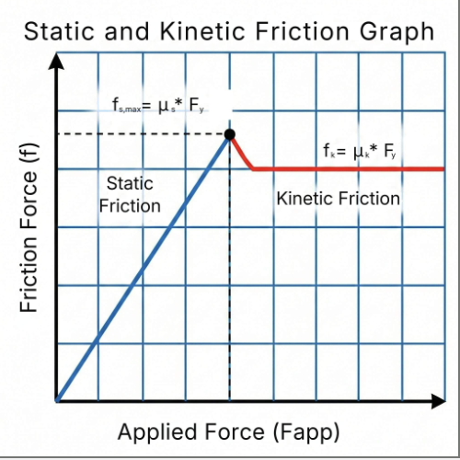
Friction Review
Friction
  Two kinds of friction:
  Kinetic friction
    F_{k}=μ_{k}F_{N}
    Opposes sliding movement
  Static friction
    F_{s}≤μ_{s}F_{N}
    Opposes net external force up until its max value
  μ_{s/f} is the coefficient of friction and depends only on the materials
  Must be multiplied with the normal force
  ex. When you push a piano, its harder to get it to start moving than it is to keep it moving, because the coefficient kinetic friction is typically lower

Slide 12
Friction problems
Quick Quiz
  Cyrus and Aaron and trying to slide crates on a rough warehouse floor. Aaron pushes down on a crate at a 30 degree angle to move it while Cyrus uses a rope to pull a crate at 30 degree angle above the horizontal to move it. Who made the right choice?
Truck Problem:
  A tailgate of a pickup truck is down, there is an unsecured crate of 15 kg sitting on the pickup truck. The coeff. of static friction between the crate and the truck is 0.7. If the truck accelerates at 7 m/s², will the crate fall off? Why?
Cyrus made the better choice. Pulling at an upward angle reduces normal force, in turn reducing friction. Aaron’s downward push does the opposite.
The crate will fall off. Max static friction is mgμ, which is 0.7 * 15 * 9.8, which is 102.9 N. The force needed to accelerate the crate with the truck is F = ma = 15*7, which is 105 N. That means static friction is not enough!

Slide 13
4 - Springs and Pulleys

Slide 14
Springs
Springs
  Springs are coils of metal that can both compress and stretch
  Each spring has a unique spring constant that depends on the properties of the spring
Spring force
  All springs have a resting length, and so always resist changes in length, wanting to return to the resting length
  This resistive force is called the restoring force, and is always proportional to the amount of stretch or compression
  F_{s} = -kx
  k is the spring constant and the negative sign is because the spring force is a resistive force
A spring has a spring constant of 100 N/m and is stretched by 5 cm. What is the direction and magnitude of the restoring force?
5 cm = 0.05 m 0.05 * 100 = 5N
Notes:
A spring is a coil of wire, and the basic idea of a spring is that it is in a relaxed state, which is the natural state at which the spring wants to be at.
What happens though if you compress or stretch the spring, the spring exerts a force. The spring constant is thus a constant that depends on the properties or rigidity of the spring, and is proportional to the force it takes to stretch or compress the spring.
[Draw stretched spring, force Fs pointing inward; compressed spring, force Fs pointing outward]
So the length of the spring in its relaxed state is the resting length [draw on diagram], but when we change that length by either stretching or compressing it, the spring will always resist changes in length because it wants to return to the resting length. This creates a force exerted by the spring as drawn.
This resistive force is called the restoring force, and is always proportional to the amount of stretch or compression. Thus we have an equation for the force a spring exerts when stretched or compressed: [underline equation]. “K” is the spring constant mentioned earlier, and the negative sign exists because the spring force is a resistive force. For example if we were to apply 5N, the spring would exert -5N back.
So now you guys can try this example: [read example]. I’ll give you guys a couple minutes to try it, and make sure your final answer has the correct units!
Soln is just to apply eqn.

Slide 15
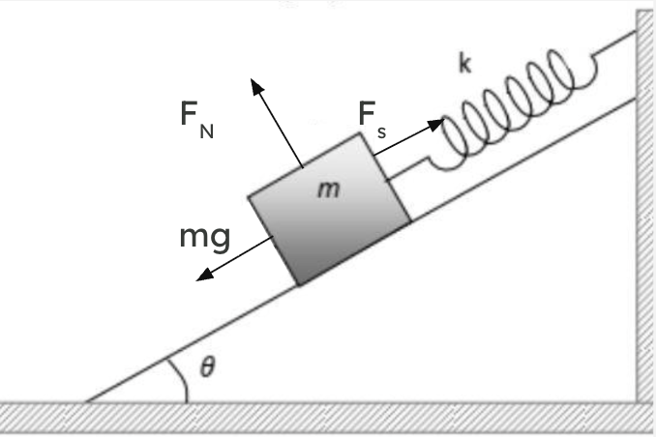
Spring Problems
Example Problem
  A block of mass 30 kg is on a frictionless slope 45 degrees above the horizon and attached to a spring of constant 250 N/m. If block is at rest, how far is the spring stretched by? Draw a free body diagram first.
F_{N} F_{s}
mg
x = 0.83m
F_{S} - F_{g} = ma = 0 ⇒ F_{S} = F_{g}
30*9.8*sin 45 = 250*x
x = 0.83m
Notes:
Ok, so now we are going to try another example that’s a little more complicated. [read out problem]. First I’ll give you guys a couple seconds to draw the free-body diagram, please hold it up to the screen and react with a thumbs up when you’re done.
Alright yeah, many of you all got it which is great because the spring force is a new force, but essentially [reveal diagram] this is what it looks like. So we can see [annotate forces]. Now you guys can go ahead and solve the problem, which should be pretty easy because you have your diagram.
[explain problem, net force is 0 because block is at rest, so our forces parallel to the slope is equal to 0].

Slide 16
Pulleys
Tension
  Tension is the force transmitted through a string, rope, or cable
  Along the rope and always away from the object it’s pulling
  It can only be in tension and holds no compressive resistance
Pulleys
  Pulleys only change the direction of force, they don't influence it
  Direction of force becomes CW and CCW
  Frictionless and massless wheel with a frictionless and massless rope/string that cannot stretch
Spring Scales
  Uses an internal spring to measure tension
  Has nothing to do with spring calculations
Atwood Machine
  A simple rope-pulley system with blocks connected by ropes
  The motion of an Atwood machine is typically induced by gravity
Notes:
So now we’re going to move on to pulleys, which is another application of dynamics. Honestly the process is pretty much the same - there are a few assumptions you have to make, but if you follow the same problem solving steps, there’s nothing really any different than what we’ve done before.
So often you’ll see ropes go around the pulley, you might know that. Effectively, all its doing is changing the direction that we’re applying force. There are some assumptions you make for this unit, like the mass of the rope being negligible (0), but the problem will state that. Just know that if you think too hard about pulleys, just make sure you understand the assumptions, because if these assumptions are violated, then some things don’t actually work out and are probably a bit advanced, bcs pulleys are a complicated scenario, and so are ropes.
Alright, so as we said, the rope creates tension, which is a force that occurs along the rope and is always away from the object it’s pulling [draw short diagram].
The pulley as a whole never changes the magnitude of force, only its direction, and because pulleys have a circular axis, the direction of force becomes CW and CCW instead of strictly hztl and vtcl. Again, we assume the wheel and rope are frictionless and massless.
On another topic, spring scales are scales that use an internal spring to measure tension, and the weight of an object is thus calculated by the tension force, because it will be equal to force of gravity, or weight of the object. This has nothing to do with spring calculations, just know that in spring scales Ft = Fg.
Finally, there are atwood machines [ use slides ].

Slide 17
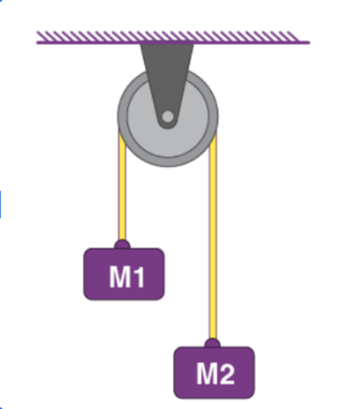
Basic Atwood machine
180 degree change in force direction
Internal vs external force
  Depends on system
  Internal forces are forces within the system that exert itself between objects within the system
  Newton's 3rd law
  External forces are forces exerted from outside the system
  If system is rope blocks and pulley, then rope is an internal force and gravity is an external force
Notes:
Let’s take a look at this atwood machine. As you can see, it creates a 180 degree change in force direction - when M2 moves down, M1 moves up.
An important concept for atwood machines is the differentiation between internal force and external force. This depends on system you are given, but in general, internal forces are forces within the system that exert itself between objects within the system. Because of Newton’s 3rd law, there will always be a force that opposes any internal force. The biggest example is tension - tension is an internal force, and is always opposed because it is created by an external force, like gravity or applied force.
External forces, on the other hand, are forces exerted from outside the system. If our system is an Atwood machine consisting of rope, blocks, and a pulley, then the rope is an internal force and gravity is an external force.

Slide 18
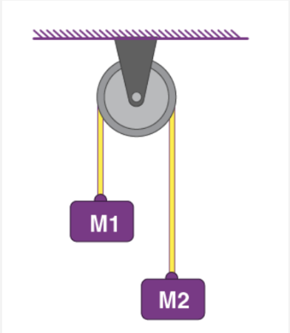
Basic Atwood machine
Assume M1 is 5 kg and M2 is 3kg
Atwood machine Questions
  Solve for acceleration (same for both blocks)
  2 methods:
    System of equations
    Internal forces
Notes:
a) So for this atwood machine, let’s solve for the acceleration of the blocks, which you should know are the same, because the blocks are connected and thus have the same accel. The first method we can use is a systems of equations, where we use F=ma for both the first and second block:
(M_1)g - F_T = (M_1)a
F_T - (M_2)g = (M_2)a
Note T = force of tension, which is unknown.
We can plug in the mass of the blocks which is known [ ] and solve for the force of tension.
b) The second way we can solve for acceleration is more simpler - it’s almost like a cheat solution. Essentially, since F_T is an internal force, meaning it’s not a force being exerted on the system like gravity or someone pulling the block, we can calculate acceleration of whole system and use that in Fnet=ma. The net force is the sum of the gravitational forces, which go in the opp direction [draw] .
Note that a good tip would be to set the positive direction to the direction of acceleration. Since M1 is heavier than M2, acceleration of the whole pulley system is downward. This means we’d want the positive direction to be downward. With this information, when writing our F=ma equation, we’d subtract FM1 from FM2 because we know FM1 is the greater force.
Writing this equation gets us:
(M_1)g - (M_2)g = (M_1 + M_2)a

Slide 19
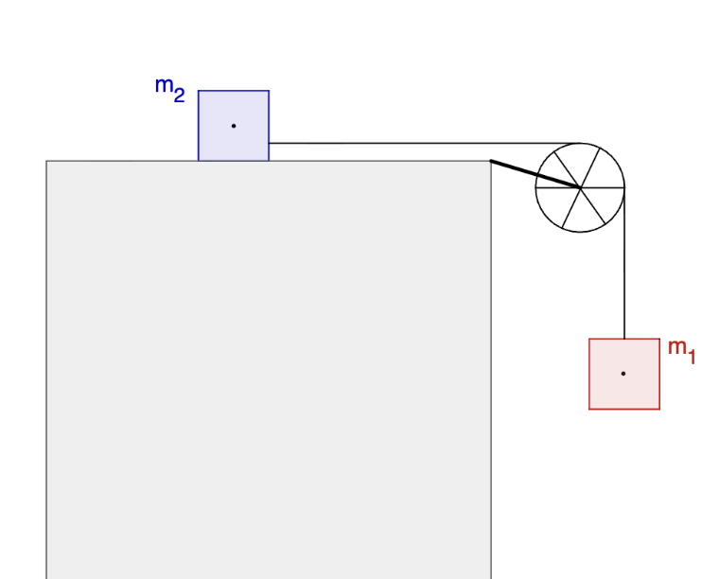
Pulley Problems
Two blocks are connected with an ideal string pulley system. Mass 2 of 5kg is on a frictionless plane, and mass 1 of 10 kg in hanging in the air. What is the acceleration of the system?
What is the acceleration of the system if the coefficient of kinetic friction between mass 2 and the surface is 0.4?
(m1 + m2)a = m1g a = (m1)g/(m1+m2) = 6.53m/s²
F_{f} = μ_{k}mg = 0.4 * 5 * 9.8 = 19.6N
m1g - F_{f} = (m1 + m2) a a = 5.23 m/s²
Notes:
Ok, so now you guys are going to try some pulley problems on your own. In this scenario, we have two blocks which are connected with an ideal string pulley system. An ideal string pulley system just means that the string and wheel are frictionless and massless.
Like the first slide, ur going to solve for acceleration. I’ll give ygs about 3 mins for this one.
I’m seeing some great answers, which is wonderful. You all are right, so we’re going to use F=ma once again and us e[explanation].
Now take 3 mins to do the next part if you haven’t already.
So now we’re incorporating friction, which makes it a little mor challenging, but if you break down the problem into the forces present it becomes really easy [explanation].

Slide 20
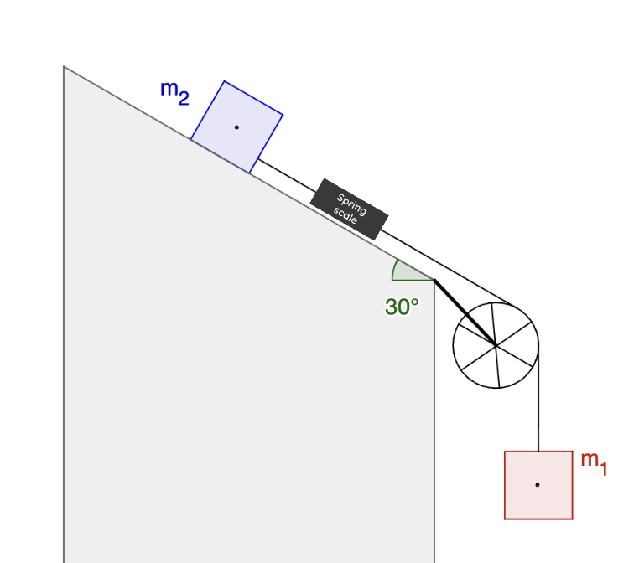
Pulley Problems P2
Two blocks are connected with an ideal string pulley system. Mass 2 of 6 kg is on a frictionless slope 30 degrees above the horizontal, and mass 1 of 12 kg in hanging in the air. What is the acceleration of the system?
What is the reading on the spring scale that is on the string connecting the blocks?
Spring scale
m1g + m2g*sin30 = ma a = 4.9 m/s²
m1g - T = m1a T = m1 (g - a) = 4.9 * 12 = 58.8 N
Notes:
Alright! Last problem of the day [read it out loud]. A good hint would be to decompose your force of gravity into its hztl and vtcl components. I won’t tell you which one to break down, but if you understood the quiz question earlier, you’ll know how to do this one.
… [and finish it off]

Slide 21
See you next class!

