Slide 1
Day 4:
Circular Motion and Gravitation
SHS Physics Club Summer Camp 2026

Slide 2
Overview
Centripetal Force
Gravitation
Constant speed but changing direction, inward force
Universal law of gravitation, orbits, orbital speed derivation
01
02
03
04
HW/Quiz
Circular Motion
Brief mcq review quiz, go over HW questions
Car problems, tether ball problems, slope normal force problems

Slide 3
01
HW/Quiz

Slide 4
HW/Quiz
HW Questions?

Slide 5

Quiz
Quiz
  6 mcq
  12 minutes
https://forms.gle/xoFuWDAqYrTio3zT9

Slide 6
02
Centripetal Force

Slide 7
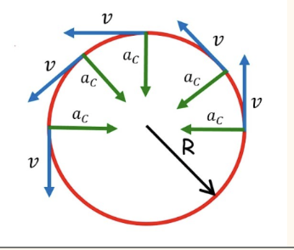
Centripetal Acceleration
Acceleration Definition
  Change in velocity
  Velocity is a vector
Centripetal Acceleration
  The acceleration for an object whose velocity is changing directions
  Always points toward the center of the circle
  For now, only constant speed or constant direction, not both
a_{c} = v²/r
  v is the tangential speed, r is the radius of the circle
Velocity and acceleration will always be perpendicular

Slide 8
Centripetal Acceleration Derivation

Slide 9
Centripetal Force
F = ma
  Same old equation, this time with acceleration involved
  Questions are solved in the same way. Use the direction of acceleration to look for relevant forces
F_{c} = mv²/r
  Same units as before
IMPORTANT
  F_{c} is NOT a new type of force!!! It is the name for the net force toward the center, and varies per problem! The centripetal force is simply a combination of any of the other forces we have already learned! That means no drawing it into a FBD!
Car turning example:
  If a car is making a turn on flat ground, what force provides the centripetal force?
Notes:
Answer: Static friction between the car's tires and the road surface.

Slide 10
Practice Problems
A 1200 kg car needs to make a right turn with a turn radius of 50m. The coefficient of static friction between the tires and the road is 0.6. What is the maximum speed that the car can hit the turn with without slipping?
The car must take another turn, this time on a slick road of coefficient 0.4, and cannot slow down. What is the minimum safe turn radius this time?
Notes:
Answer: 17.15 m/s
Answer: 75 m

Slide 11
03
Circular Motion

Slide 12
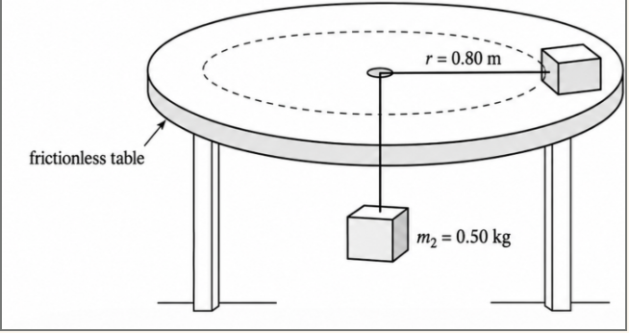
Practice Problem + Terms
A 2 kg block rests on the tabletop, and a frictionless, massless string is threaded through a hole in the table such that a 0.5 kg block hangs in the center, below the table. The hanging block remains at rests as the 2 kg block moves in a horizontal circle of radius 0.8 m at a constant velocity.
  What is the tension in the string?
  What is the speed of the 2 kg mass?
  What is the period for this circular motion?
  What will happen to each block when the string is cut?
Terms:
  Turn radius
  Turn speed
  Bank
  Period
  Frequency
Notes:
Answer: 4.9 N
Answer: 1.4 m/s
Answer: 3.59 s
Answer: The 2 kg tabletop block will fly off in a straight line tangent to its circular path at a constant speed of 1.4 m/s (until it hits the edge of the table or experiences friction). The 0.5 kg hanging block will enter free fall and accelerate downward at g = 9.8 m/s until it hits the floor.

Slide 13
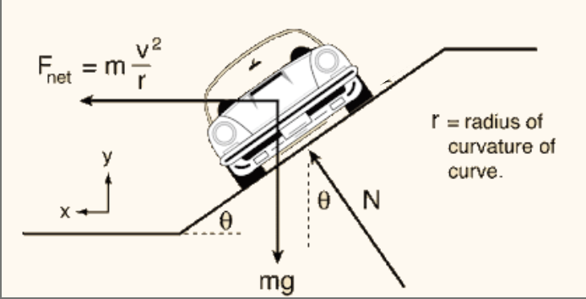
Normal Force and Tension
Normal force review
  It is always perpendicular to the surface and not necessarily equal to mg
2 step problems - example
  A car is driving on a frictionless banked surface. How does it not slip?
Notes:
Answer: The normal force from the banked surface is tilted inward. The horizontal component of this normal force F_Nsin(theta) points toward the center of the turn, acting as the centripetal force holding the car in its circular path.

Slide 14
Banking Practice Problems
A 1500 kg car is on another banked race track. What is the minimum necessary banking angle to maintain a speed 25 m/s? The turn radius is 75 m.
An amusement park ride spins guests and then drops the floor out from under them as they spin. If the surface of the ride is frictionless, for a guest of 50 kg, what what is the perfect turn radius so that the rider will not slide up or down? The banking angle is 75 degrees (steep slope), and the speed of the rider is 15 m/s.
Notes:
Answer: 22.63°
Answer: 6.15 m

Slide 15
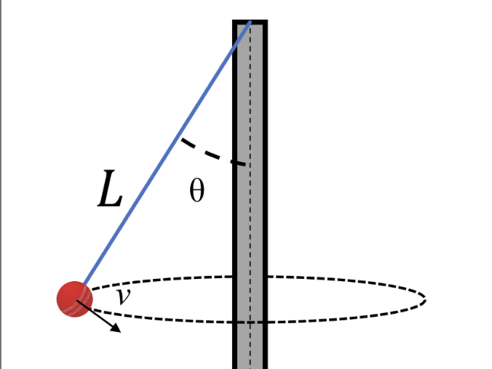
Tetherball Practice Problems
A playground has a tetherball game. The actual ball has a mass of 3 kg. The length of the rope is 10 m. If the angle between the rope and the pole is 35 degrees, what is the speed of the ball.
Find the angle if the ball’s speed is 15 m/s.
Notes:
Answer: 6.27 m
Answer: 67.94°

Slide 16
Vertical Circles
Strings and normal force - limits
  Both of these things cannot “push” outward
  Only inward force is possible
Vertical Circles
  Velocity will not be uniform
  Gravity is constant but tension/normal force will vary
Water cup???
Practice Problem
  A student swings a cup of water in a vertical circle of radius 0.80 m. At the top of the circle, the cup is moving at 4.0 m/s.
  a) What is the centripetal acceleration of the water at the top?
  b) What normal force does the cup exert on 0.25 kg of water at the top?
Notes:
Answer: 20 m/s^2
Answer: 2.55 N

Slide 17
04
Gravitation

Slide 18
Universal Law of Gravitation
What is the law?
  Every object with mass attracts every other object with mass
  Always attractive
F_{g}= G(m1*m2)/r²
  M1 and M2 represent 2 objects, and F_{g} is the gravitational force between them
  r is how far their center of masses are from each other (typically the center of a sphere)
  G is the universal gravity constant, not to be mixed up with g, which is the acceleration on the surface of the earth
  G = 6.67 x 10⁻¹¹ N*m²/kg²
Calculating “g”, earth's radius is 6371 km

Slide 19
Practice Problems
Planet X has a mass of 8.0×10²⁴ kg and a radius of 7.0×10⁶ m. A 500 kg spacecraft is located 3.0×10⁶ m above the planet’s surface.
a. What is the spacecraft’s distance from the center of Planet X?
b. What gravitational force does Planet X exert on the spacecraft?
Two objects with masses m and 2m are separated by a distance r. Their gravitational force is F. The second object’s mass is then increased to 6m, while the distance between their centers is increased to 3r. What is the new gravitational force in terms of F?
Notes:
Answer:
1.0 * 10^7 m
Answer: 2,670 N
Answer: 1/3 F

Slide 20
Orbital Speed Derivation
A satellite orbits Earth in a circular path at a distance of 7.0 * 10⁶ m from the earth's center. Earth’s mass is 6.0 * 10²⁴ kg. Calculate the satellite orbit speed.
Notes:
Answer: 7,563 m/s

Slide 21
See you tomorrow!

