Slide 1
Epicurious dataset
Using a combination of wide and deep models to make predictions with nutritional and food categorical data

Slide 2
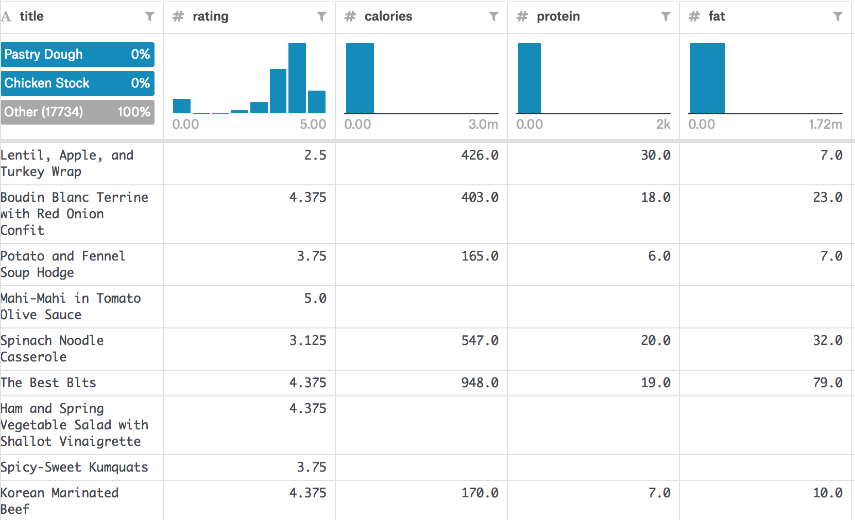
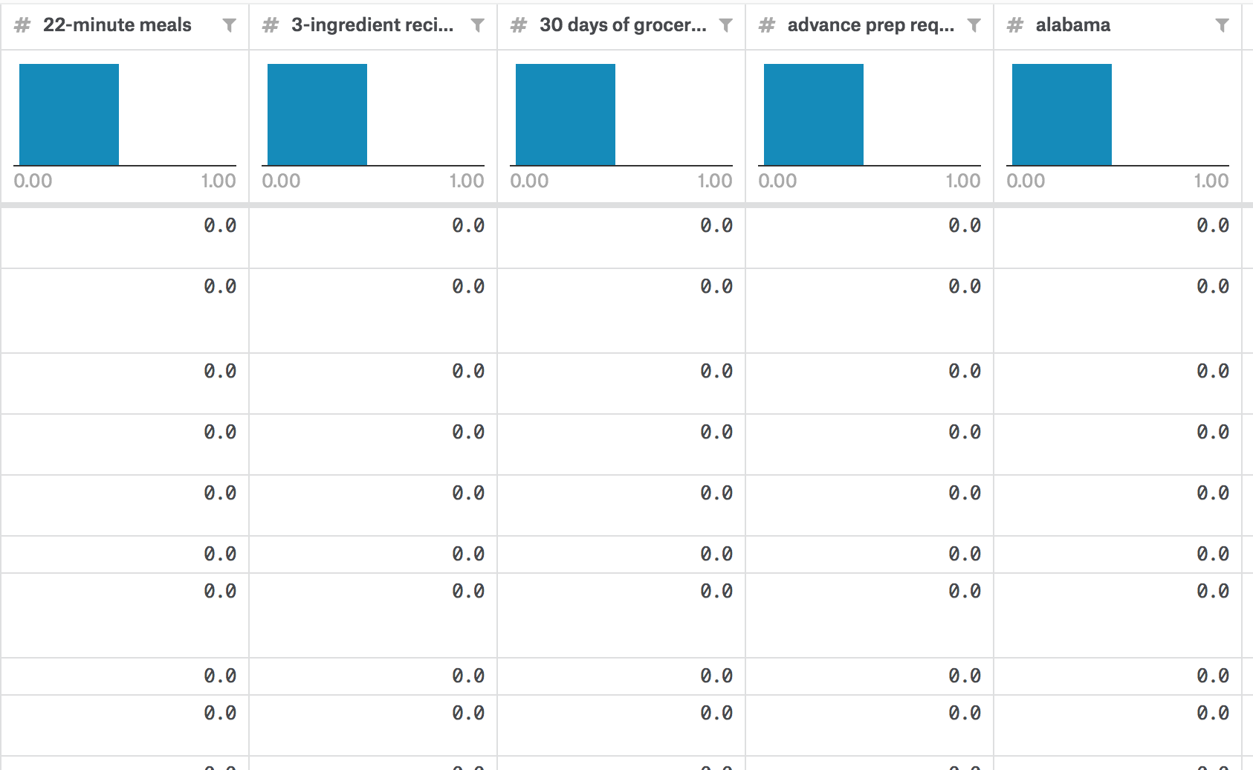
Dataset
Prediction:
Rating (categorical data from 1 – 5)
Whether dessert or not
4 features with continuous profile: calories, protein, fat and sodium
~675 features with sparse binary values e.g. almonds, anchovy

Slide 3
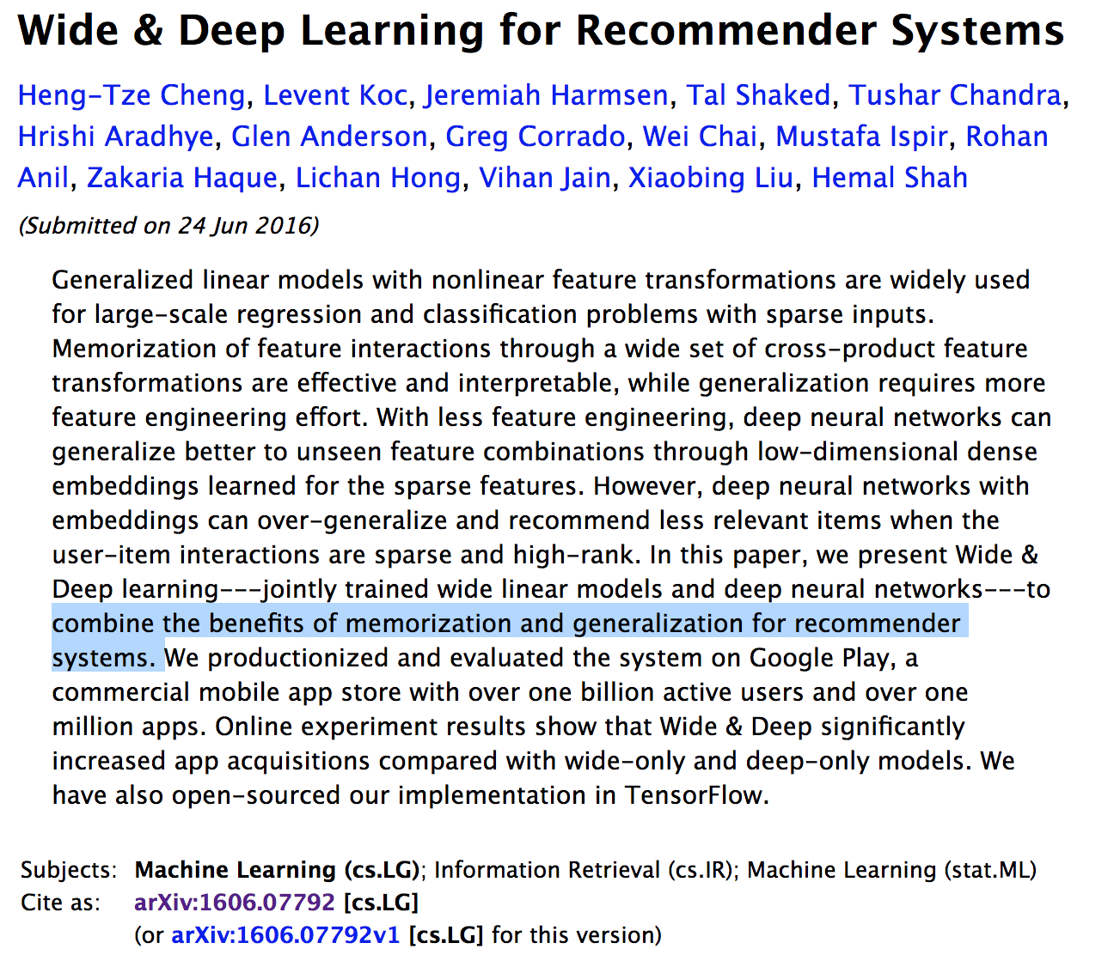
Wide and deep learning: best of both worlds
Jointly train wide linear models and deep neural network:
Research used to evaluate benefits of a combined model in Recommender System:
Binary values: gender=female, language=en
Generalized values: user_installed_category=video

Slide 4
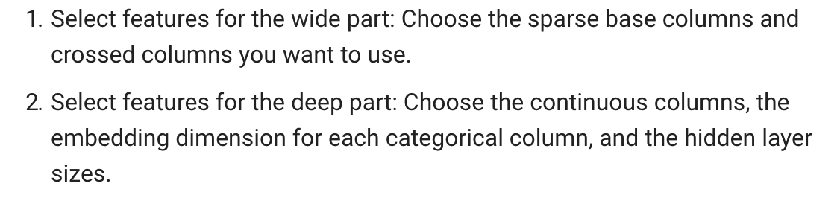

Applying wide and deep learning model
From TensorFlow website:
Binary columns i.e. almonds = 1
Continuous columns i.e. calories, protein, fat, sodium
Using:

Slide 5
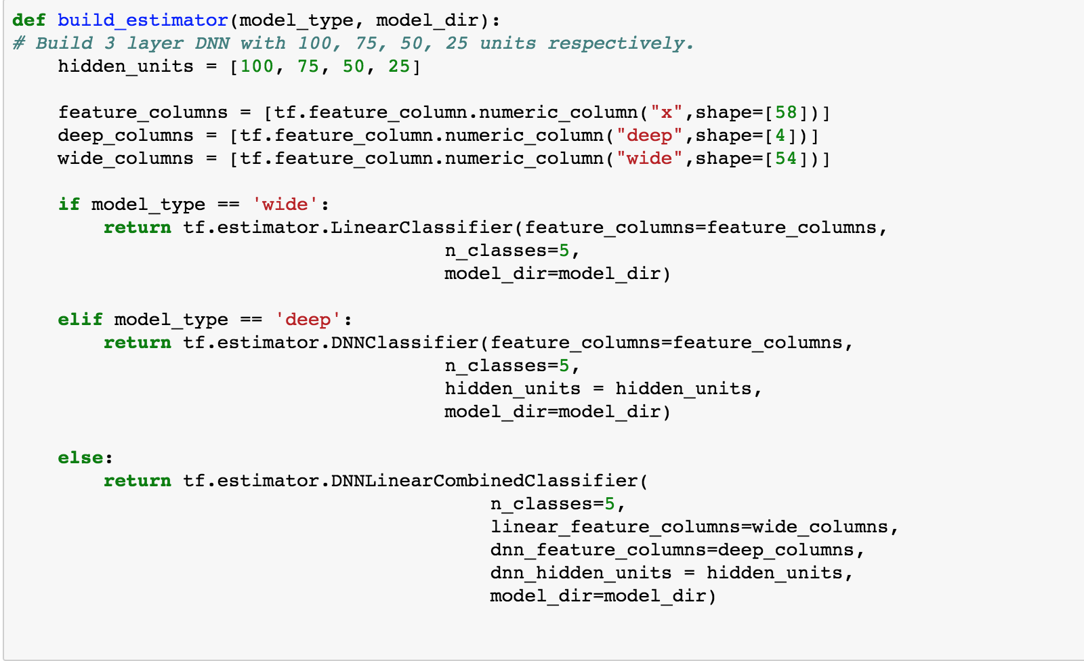
Implementing the model
 | Wide | Deep | Wide & Deep
Binary sparse features | Wide | Deep | Wide
Continuous features | Wide | Deep | Deep

Slide 6
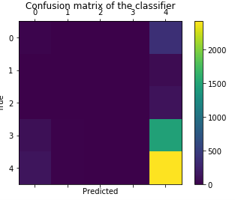
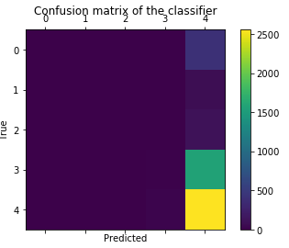
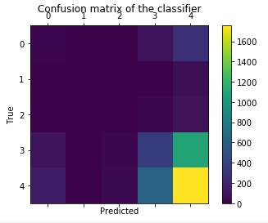
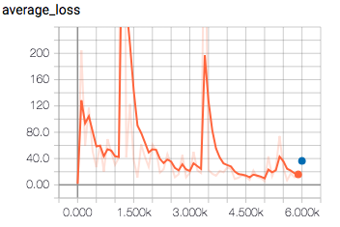
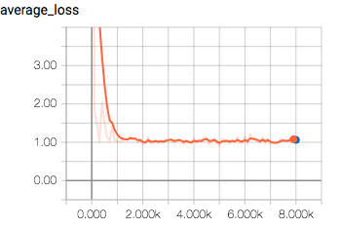
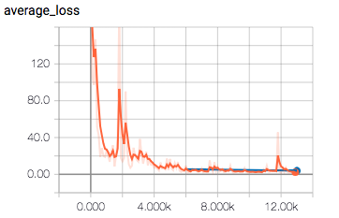
Accuracy Comparison: Predict Rating
 | Wide Model | Deep Model | Wide + Deep
Accuracy Score | 0.535084 | 0.541597 | 0.490966
Confusion matrix
Average Loss

Slide 7
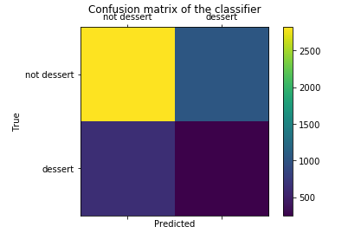
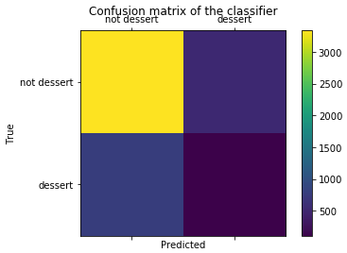
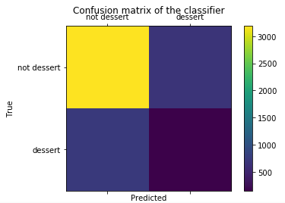
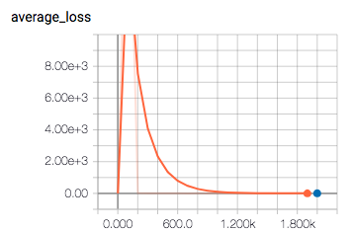
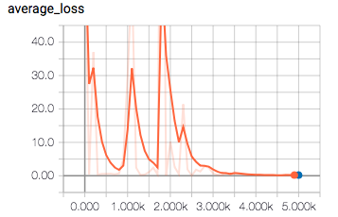
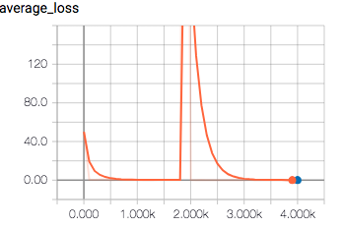
Accuracy comparison: predict dessert
 | Wide Model | Deep Model | Wide + Deep
Accuracy Score | 0.889706 | 0.920378 | 0.940966
Confusion matrix
Average Loss

