Slide 1
ARC 515 - Professional Practice and Management
Pol Mag Aoidh
B00807914

Slide 2
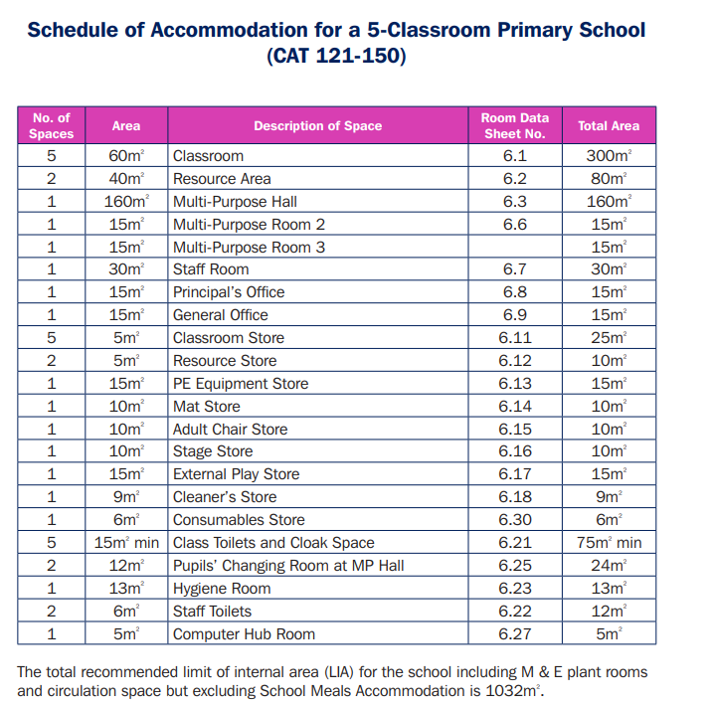
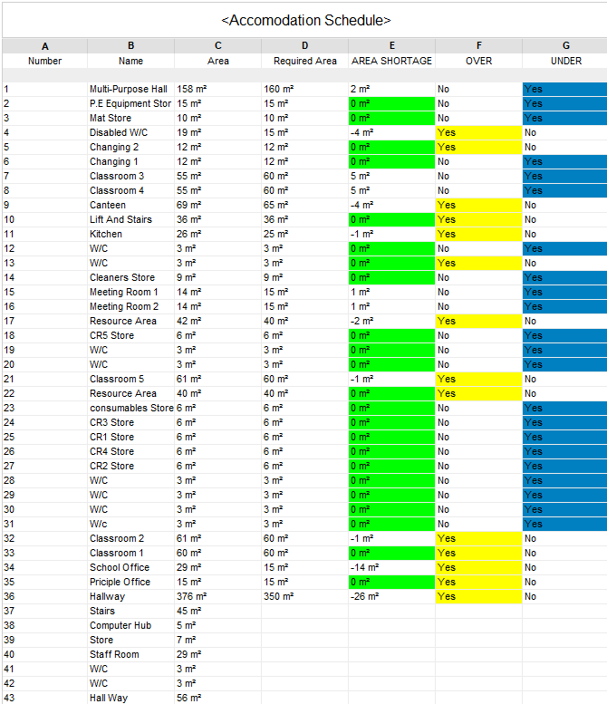
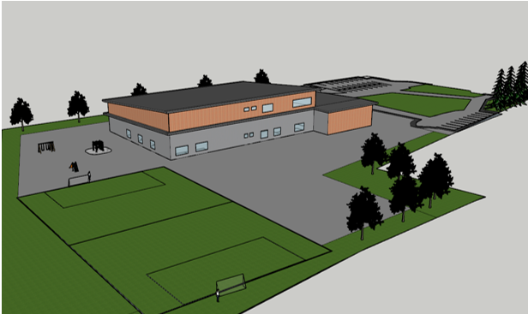
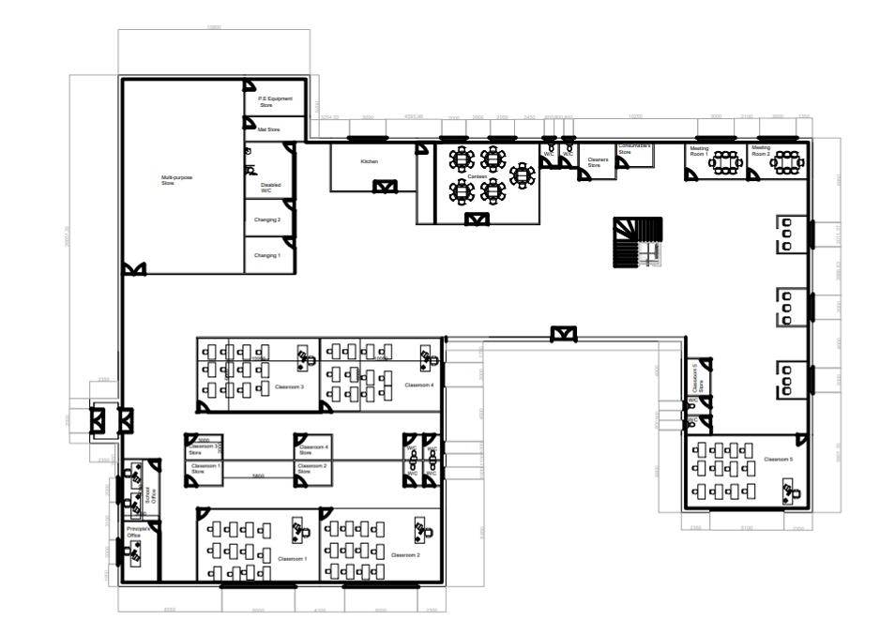
D.1
D.1
Analysing and interpreting instructions/briefs to determine the project scope for design deliverables, including all stakeholder requirements

Slide 3
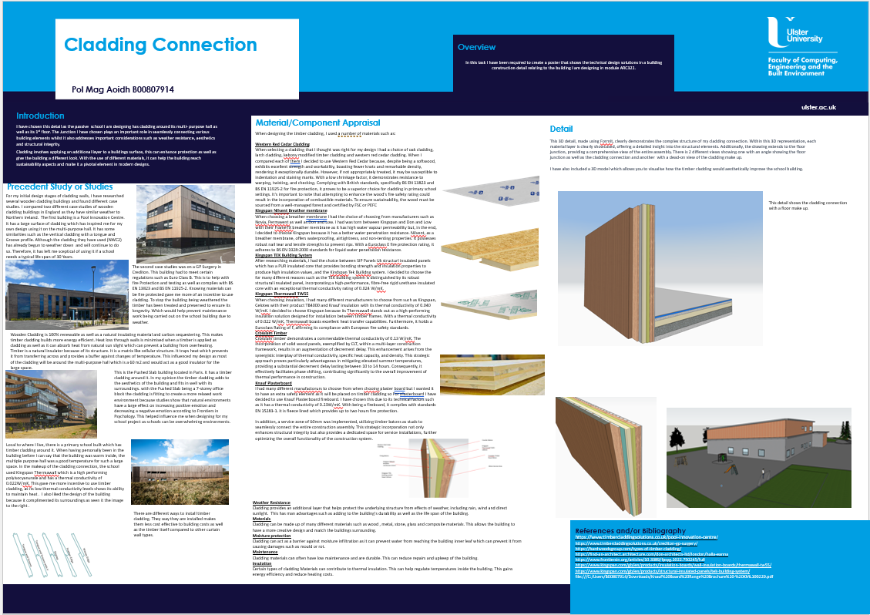
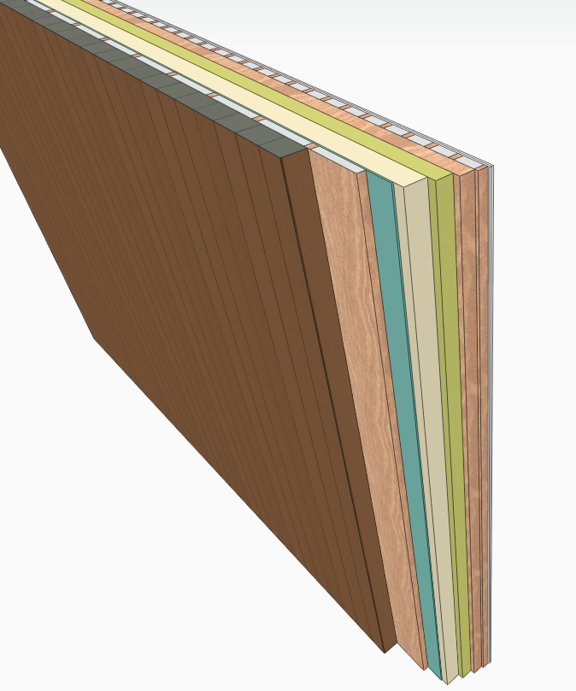
D.3
Developing design solutions that are inclusive, safe, resilient, robust and
sustainable

Slide 4
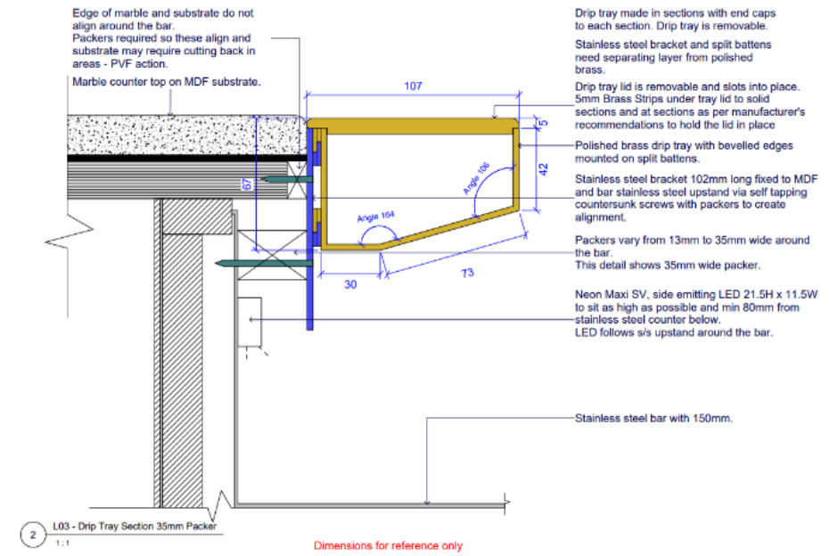
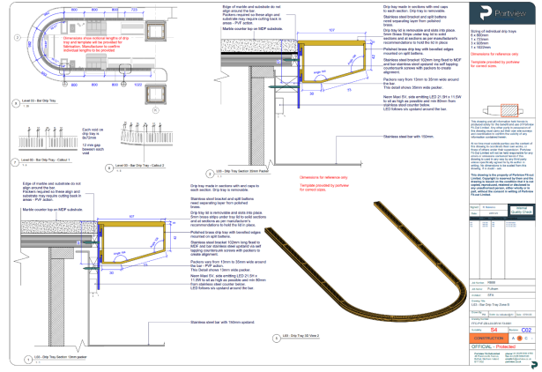
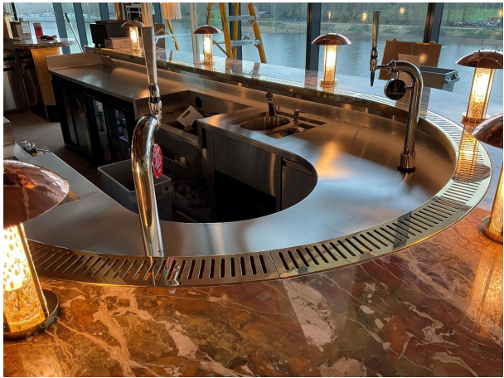
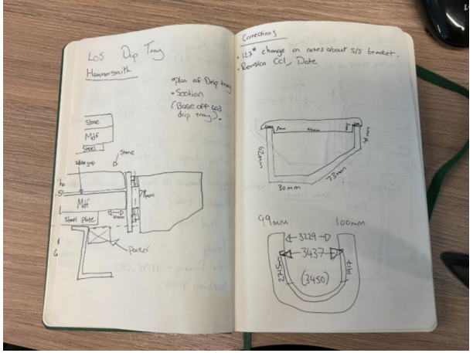
D.4
Designing and specifying critically evaluated systems, components, materials and methods used within a project to satisfy both production and building performance parameters

Slide 5
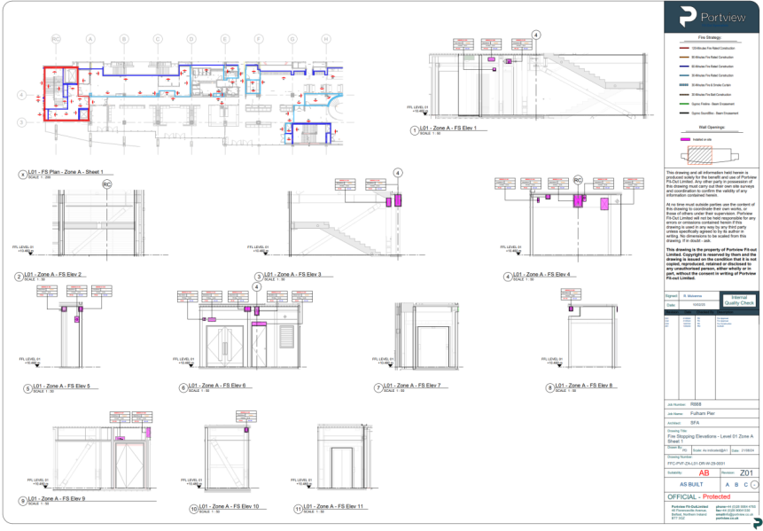
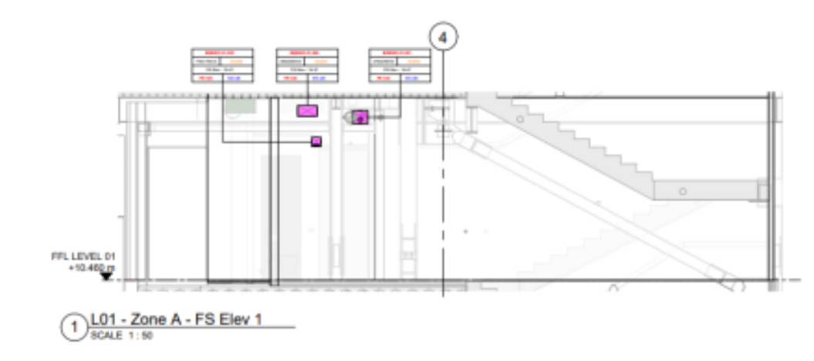
M.1
Leading or managing design projects independently and as part of a team within the scope of their responsibilities

Slide 6
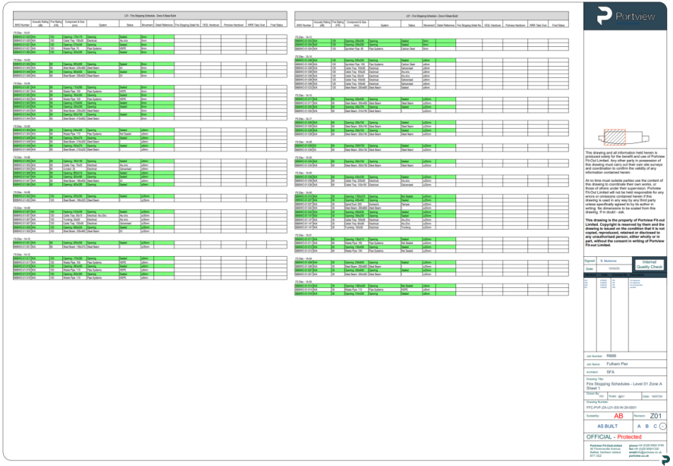
M.3
Identifying and assessing design risks to mitigate impact on the project brief, people, climate and natural environment.

Slide 7
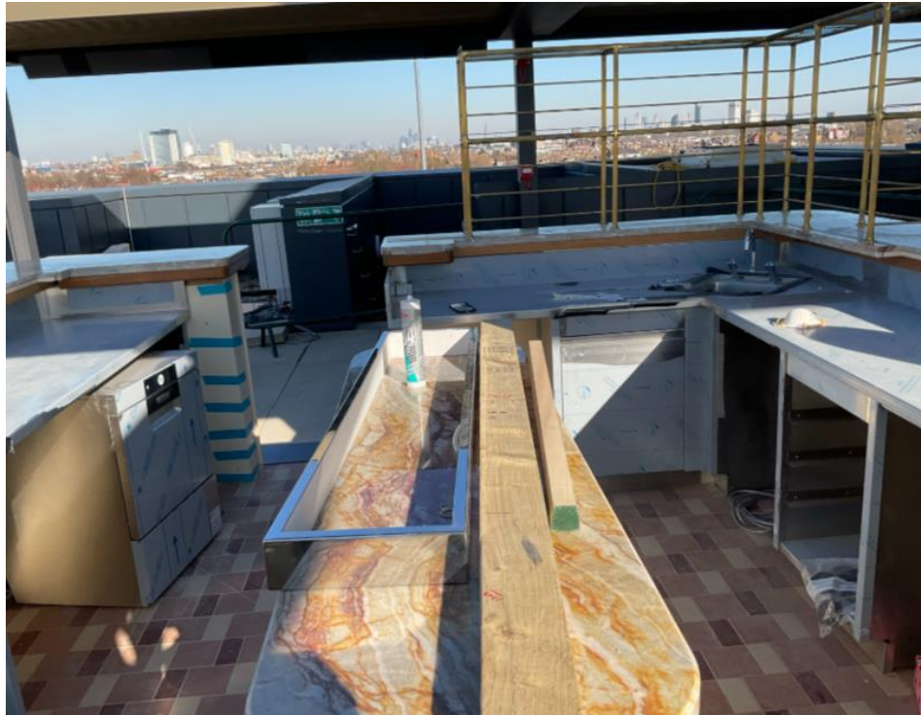
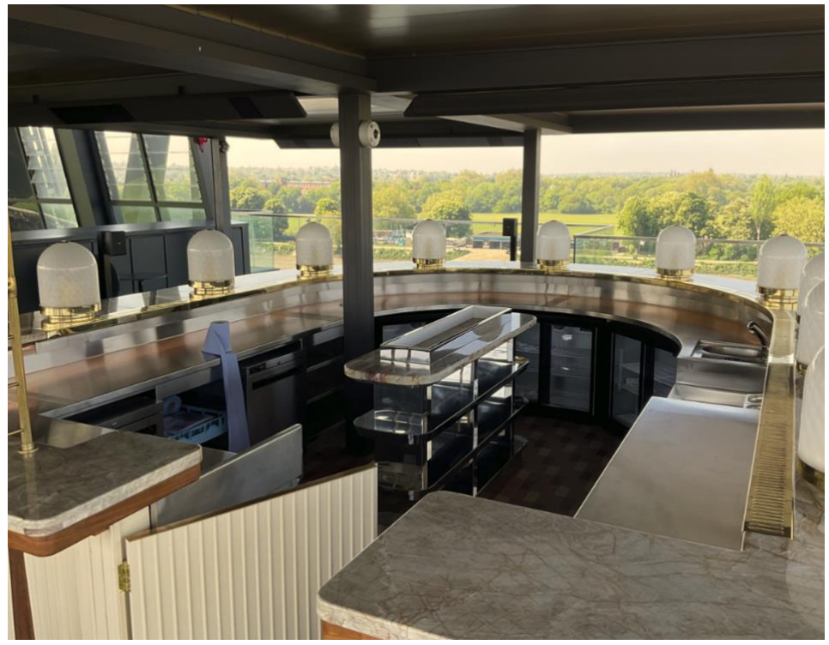
M.4
Effectively and efficiently managing the planning and execution of design and work, addressing conflicts and resolving issues that may arise.

Slide 8

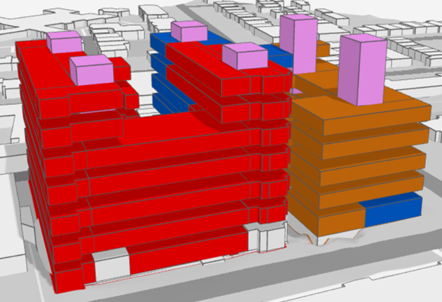
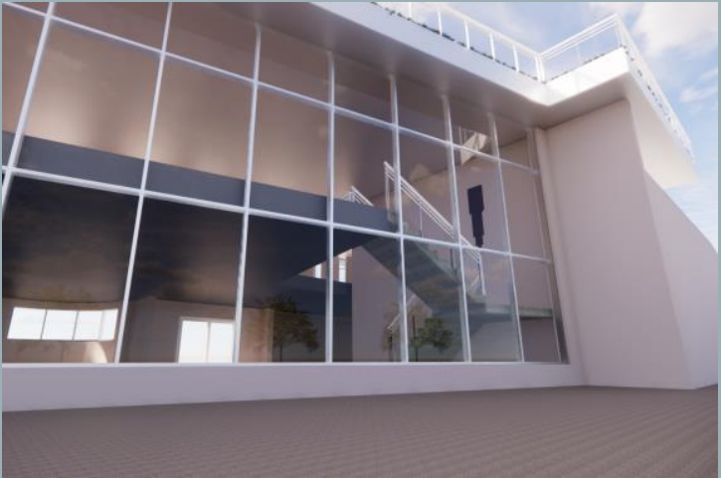
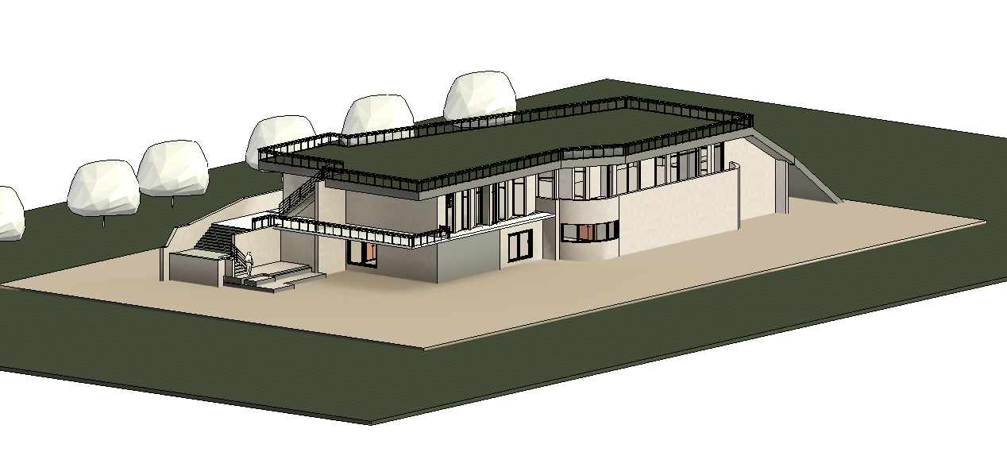

P.1
Applying and using current and emerging technologies in building design, ensuring that buildings and/or assets perform efficiently, effectively, safely and sustainably
Forma
Enscape
Sketchup
Revit

Slide 9
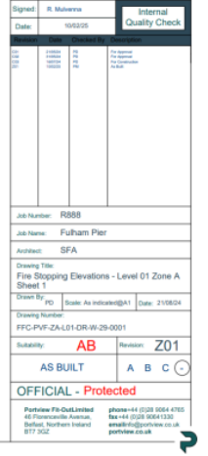
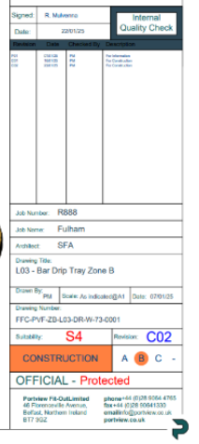
P.3
Identifying factors affecting project evolution and delivery, including hazards and risks, by developing, implementing, and maintaining systems and records

Slide 10
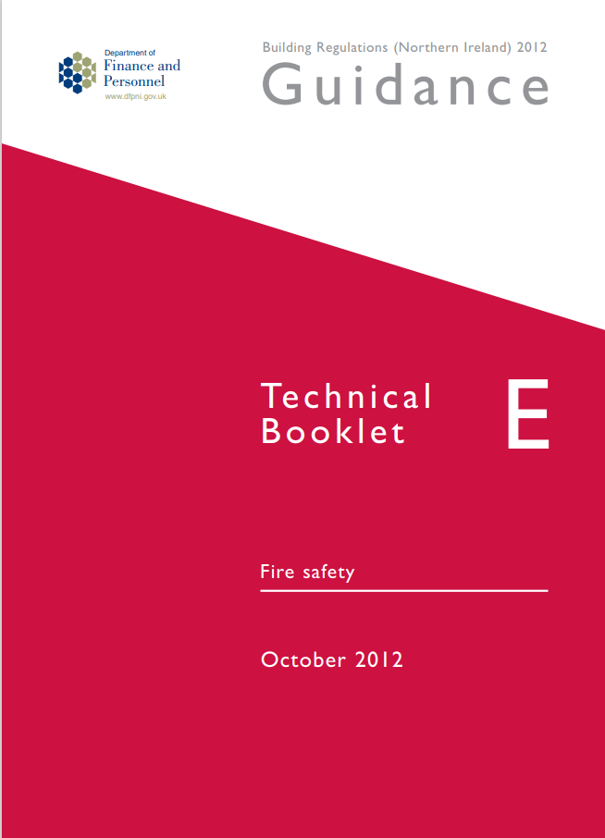
SD.2
Demonstrating self-reflection and continuous improvement in understanding current and emerging topics relevant to their context and jurisdiction of practice
ISO Standards
ISO 19650 – Building Information Modelling
ISO 14001 – Environmental Impact
ISO 50001:2018 – Energy management systems
ISO/IEC TR 20226:2025 – Information Technology – Environmental Sustainability aspects of AI Systems

Slide 11
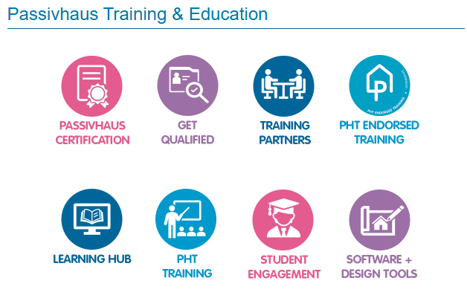
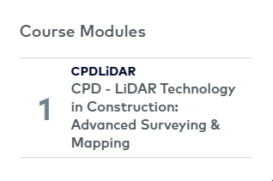
SD.3
Identifying personal development, education, skills, experience and/or training needs and meeting them through regular action planning and monitoring to maintain fitness to practice.
I aim to progress my career with keeping up to date with 3 key areas:
Passive house
Lidar Scanning
Fire Design and safety requirements

