Slide 1
Esta diapositiva fue intencionalmente dejada en blanco.

Slide 2

Python
Notes:
- 1991
- GvR
- ABC , cualquiera programa
- Pseudocodigo ejecutable
- procedural, luego objetos

Slide 3
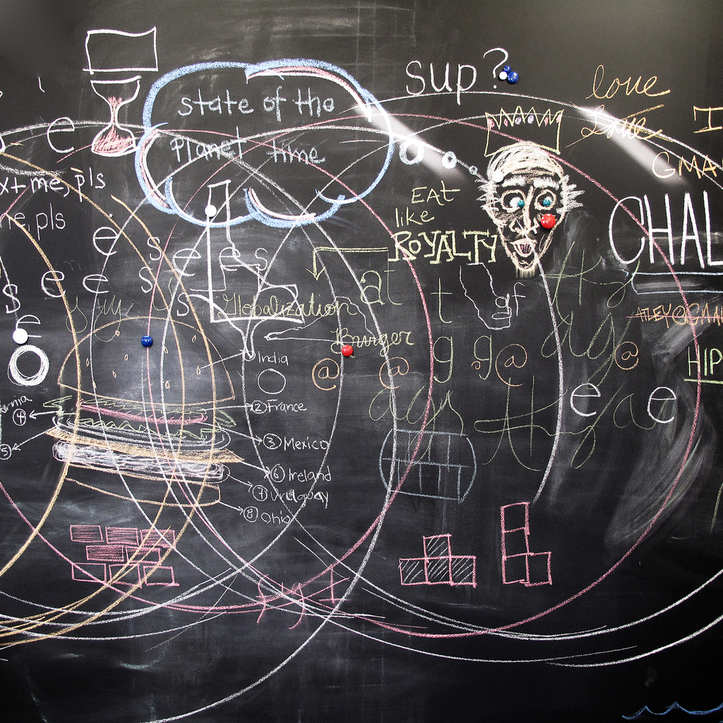
Características
Notes:
- Interpretado (pero bytecode)
- Dinamicamente tipado, fuertemente tipado
- OO con toques funcionales
- Varias implementeciones, Jython, PyPy, Stackless

Slide 4
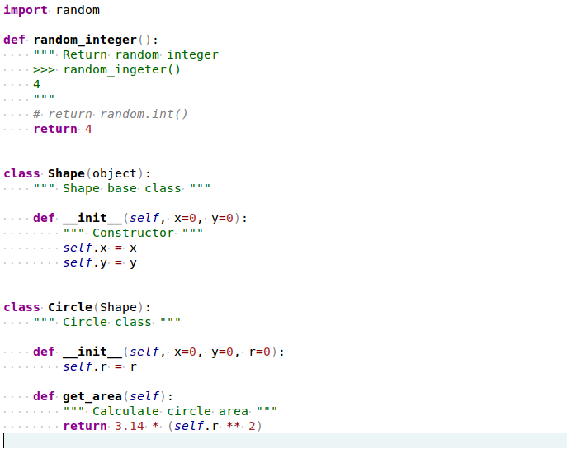
Some Code
Notes:
- Whitespace
- funciones y clases

Slide 5
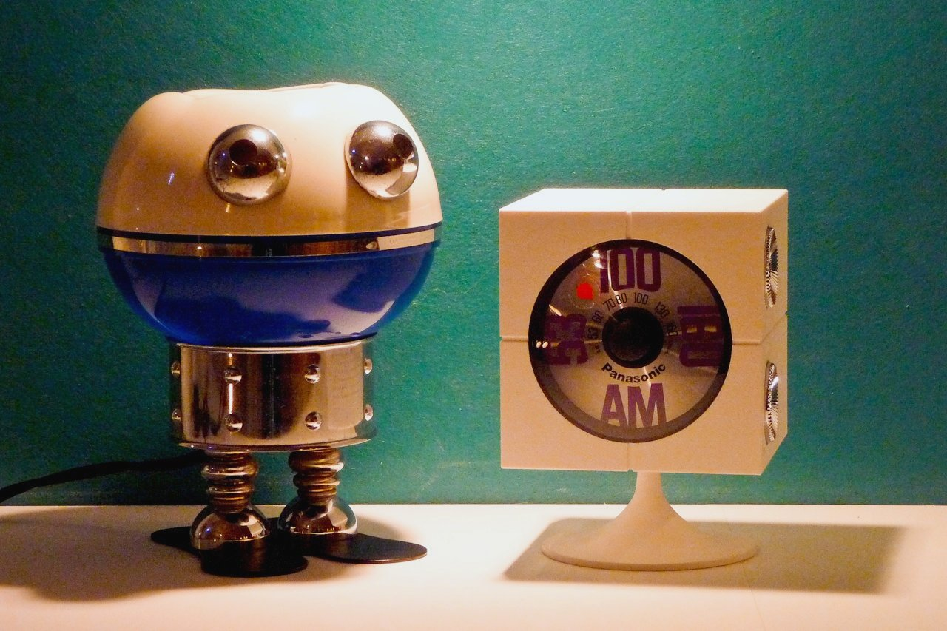
Cool stuff
Notes:
- Virtualenv
- C Bindings
- Numpy
- PyPI, librerias solidas
- Twisted

Slide 6
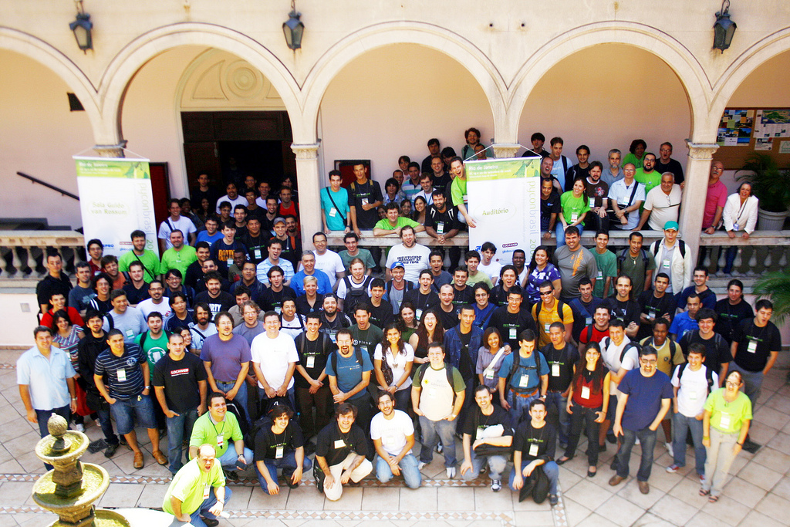
Comunidad
Notes:
- TIOBE
- Conferencias anuales en USA, Europa y muchas otras regiones
- PyAr, PyConAr, PyCamp, Cocos2D, CDPedia

Slide 7

Usuarios
Notes:
- Google
- Mozilla
- NASA
- CERN
- EVE Online
- Dropbox
- Ubuntu
- Youtube
- Reddit
- Quora
- FriendFeed

Slide 8

Python y la web
Notes:
- Zope fue pionero
- Actualmente muchos frameworks
Zope, Pylons, Pyramid, Web2Py, Plone
- WSGI, Python Standard

Slide 9
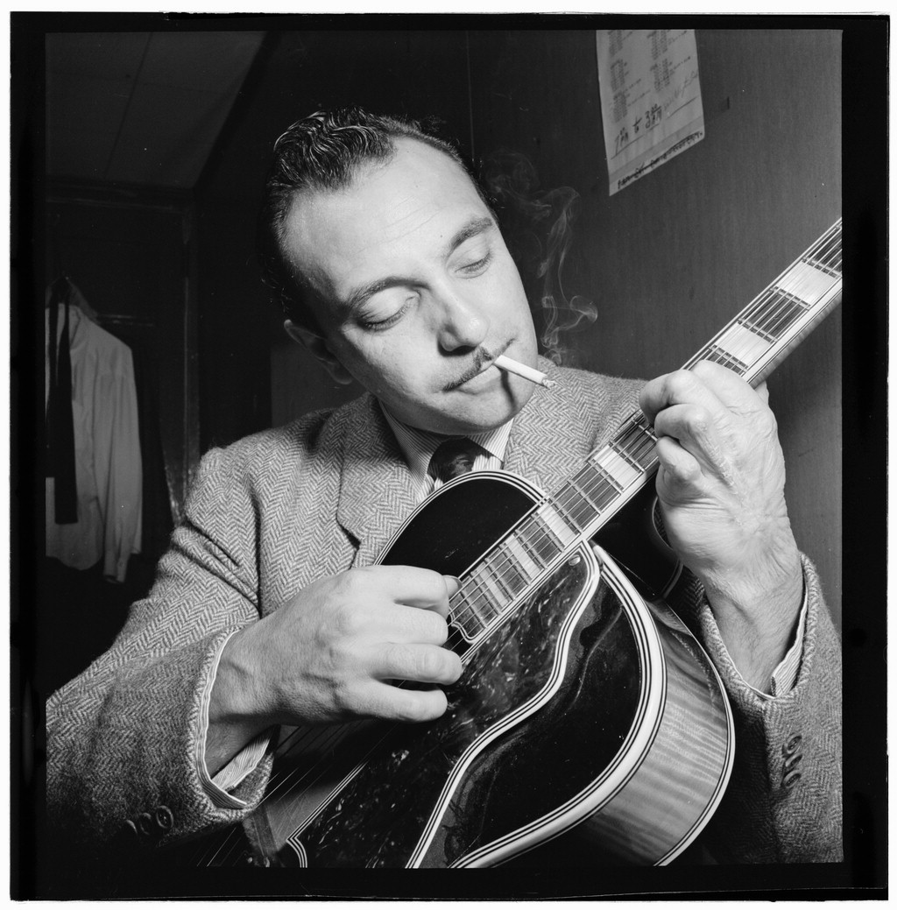
Django
Notes:
- Creacion
- News oriented sites
- Lawrence, Kansas
- Proposito general

Slide 10

I want my MTV
Notes:
- MVCish
- Model, Template, View
- MVC por donde lo mires

Slide 11

Models & ORM
Notes:
- ActiveRecord
- Clases buscan objectos, objetos se persisten
- Soporte para MySQL, PostgreSQL, sqlite3, Oracle

Slide 12
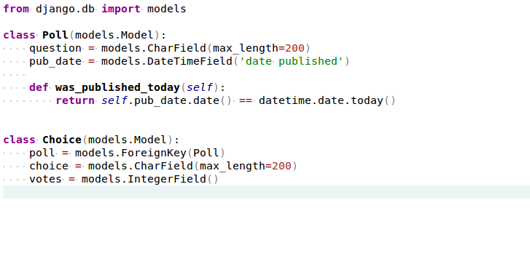
More Code

Slide 13

Database
Notes:
- Master Slave
- Partitioning
- Sharding
- Algo de soporte para NoSql

Slide 14

Views
Notes:
- actions
- mapeo a urls
- manejo de get/post

Slide 15
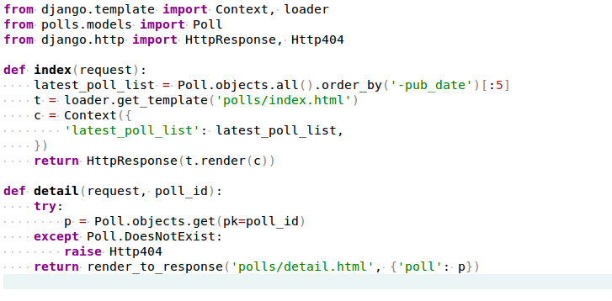
Teh Codez

Slide 16

Templates
Notes:
- Tags, if, for, custom
- Herencia
- Jinja2

Slide 17
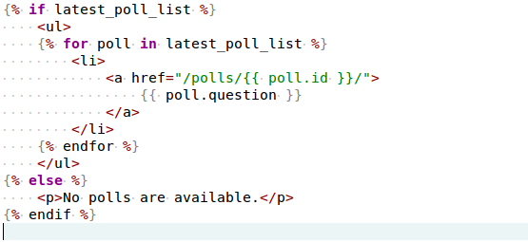
S0m3 C0d3

Slide 18

Apps
Notes:
- separacion de partes del proyecto, moduralizacion
- reusables
- Pinax, social sites common parts

Slide 19

Testing
Notes:
- xUnit
- django testcase para requests

Slide 20
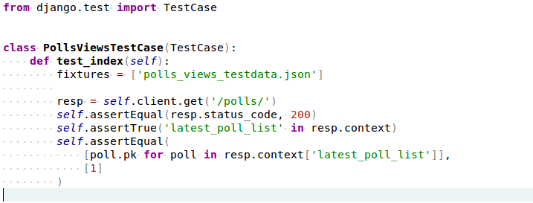
No, Mr. Bond...
I expect you to test!

Slide 21
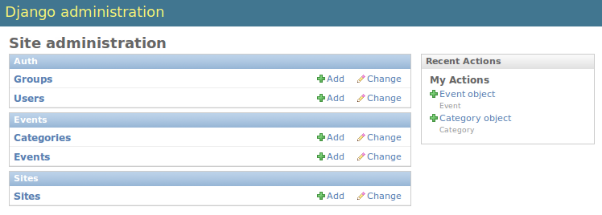
Admin
Notes:
- autodiscover de Modelos
- Customizable con admin models
- Lo facil esta hecho, lo dificil es relativametne facil

Slide 22

Caching
Notes:
- Views, por tiempo
- Fragmentos, por tiempo
- ORM caching
- low level cache api

Slide 23





Users
Notes:
- Mozilla Add-ons
- Disqus
- Kind of GAE
- RestMock?

Slide 24

South
Notes:
Migraciones programaticas
Herramienta por defecto

Slide 25
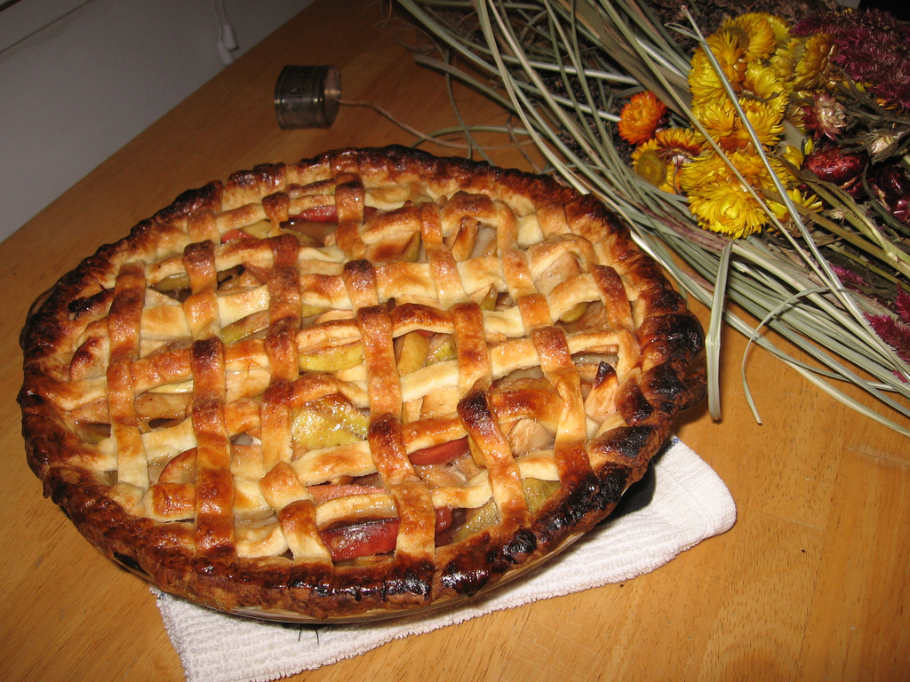
Tastypie
Notes:
- rest all verbs
- authentication
- authorization
- relations
- paginado
- custom search (eg. Full text)
- caching
- throttling

Slide 26
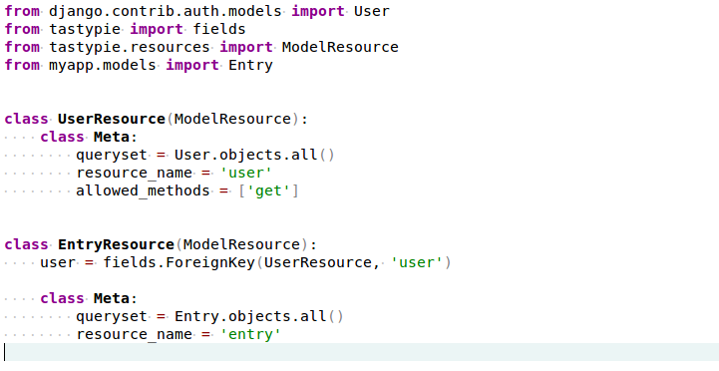
Tasty API

Slide 27
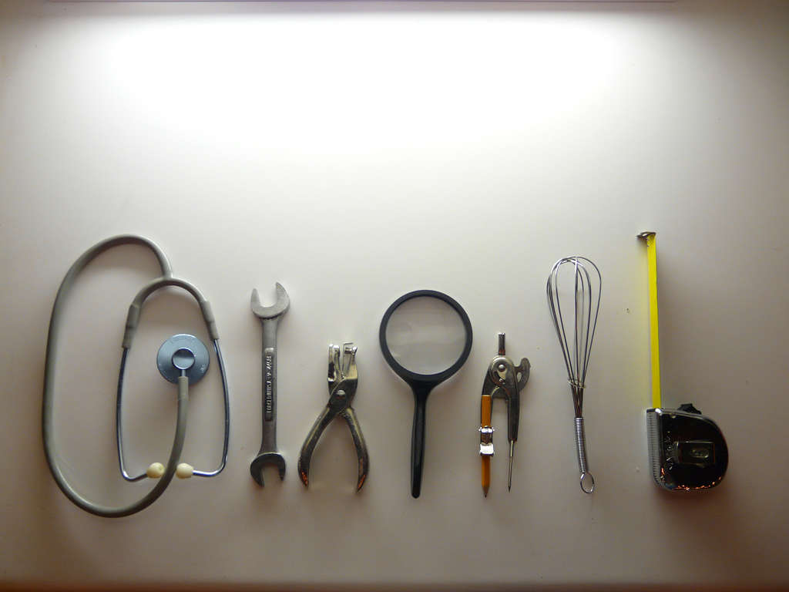
debug-toolbar
Notes:
Middleware, expone datos del request
paneles
Muy facil encontrar errores
Ver datos del request
Si no estas midiendo, no estas optimizando

Slide 28
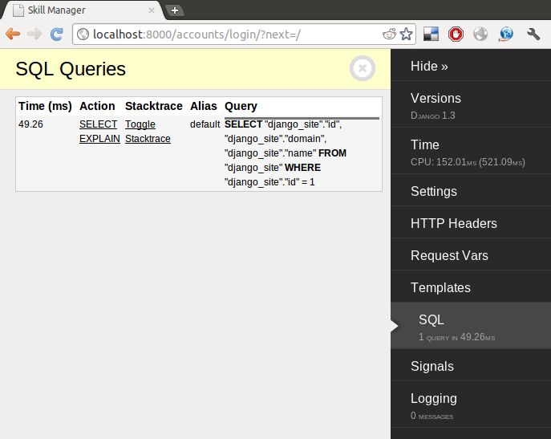
The toolbar

Slide 29

Sentry
Notes:
Sentry is a log tracking application
1. Intelligently grouping error messages.
2. Identifying erring servers, functions, and URLs.
3. Streaming errors to the list as they happen without a manual refresh.

Slide 30
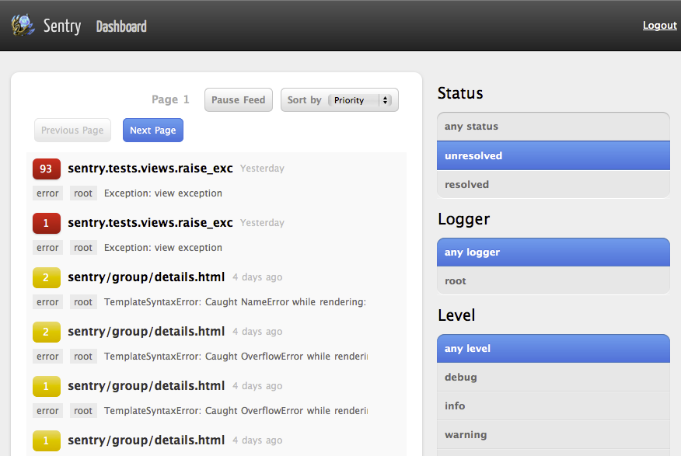
...

Slide 31
Preguntas?
The Zen of Python, by Tim Peters
Beautiful is better than ugly.
Explicit is better than implicit.
Simple is better than complex.
Complex is better than complicated.
Flat is better than nested.
Sparse is better than dense.
Readability counts.
Special cases aren't special enough to break the rules.
Although practicality beats purity.
Errors should never pass silently.
Unless explicitly silenced.
In the face of ambiguity, refuse the temptation to guess.
There should be one-- and preferably only one --obvious way to do it.
Although that way may not be obvious at first unless you're Dutch.
Now is better than never.
Although never is often better than *right* now.
If the implementation is hard to explain, it's a bad idea.
If the implementation is easy to explain, it may be a good idea.
Namespaces are one honking great idea -- let's do more of those!

