Slide 1

BirdCLEF+ 2026
Jan pol Obrador u231844 • Darcy Thomas Robertson u231964
SLIDE 1 / 14

Slide 2

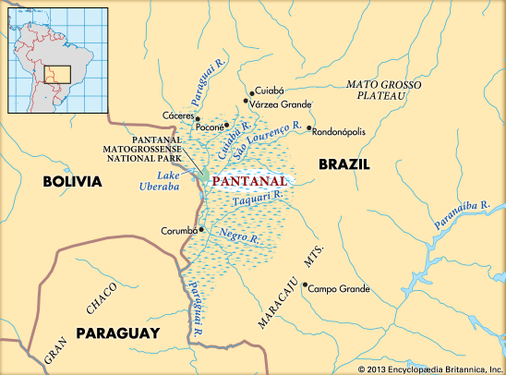
Introduction & Motivation
CONTEXT
BirdCLEF+ 2026 competition.
Goal: Train a model that identifies species in the Pantanal region of Brazil from passive acoustic monitoring (PAM) recordings.
CHALLENGES
Complex Soundscape
Large Class Imbalance
Strict RAM & Compute quota
First time working with audio & kaggle

Slide 3
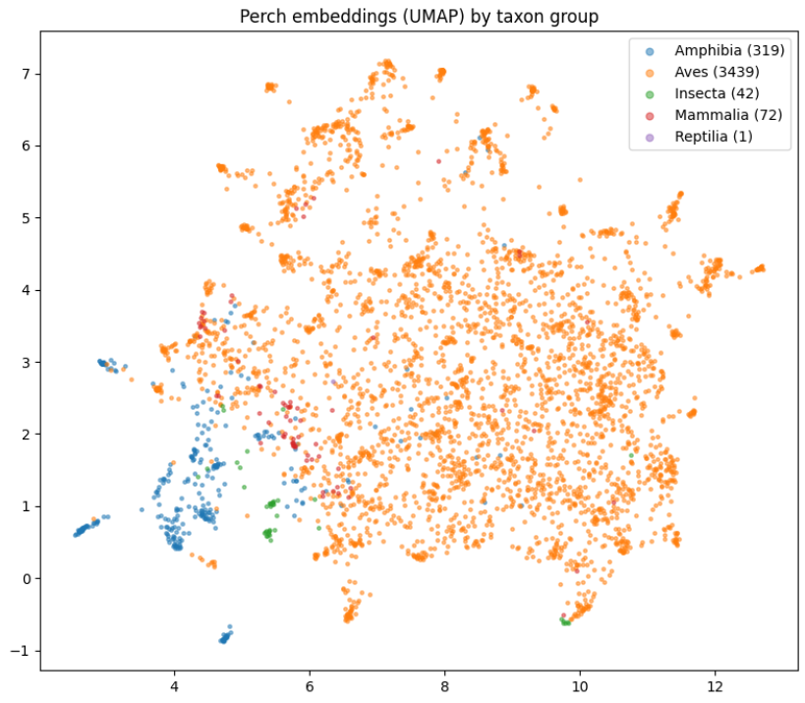
State of the Art
What had won in previous BirdCLEF+ Editions
01 · Transfer Learning
Perch / Perch-v2 (Google): self-supervised on Xeno-Canto, frozen, 5 s @ 32 kHz → 1536-d.
02 · Data Pipeline
BirdNET (Kahl 2021): Old standard CNN for PAM.
Pre-Processing: Mixup, Background mixing, TTA (for inference) & Training Chunk Length.
Post-Processing: TopN (N=1)
03 · Architecture
Sparsely-gated MoE (Shazeer 2017) Earns conditional compute, & specialisation fo experts.
SLIDE 2 / 14

Slide 4


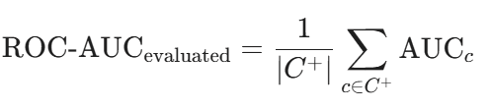
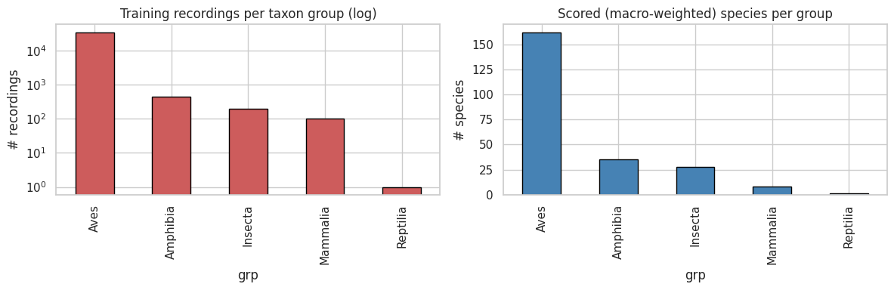
Data Imbalance & Evaluation Metric
EVALUATION
Macro averaged ROC-AUC that skips classes that have no true positive labels.

Slide 5
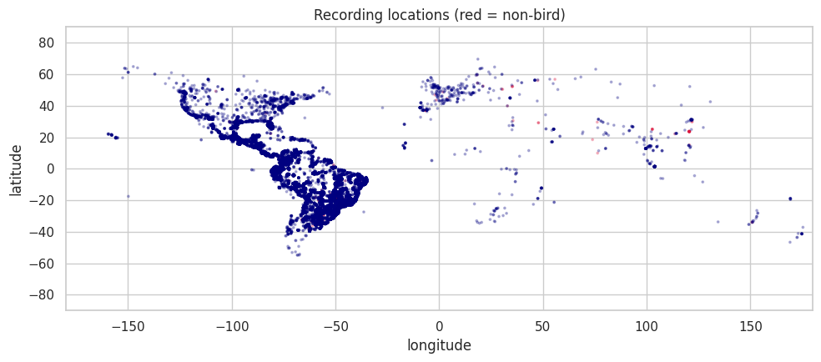
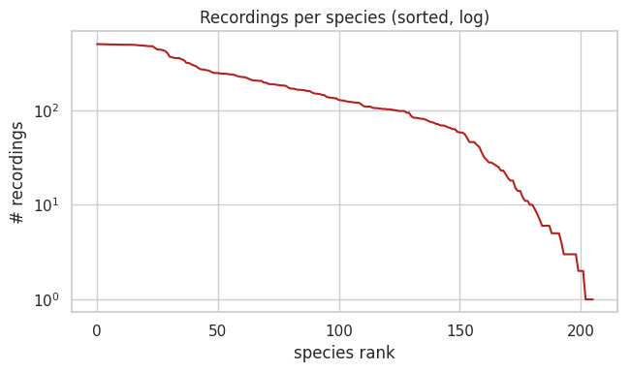
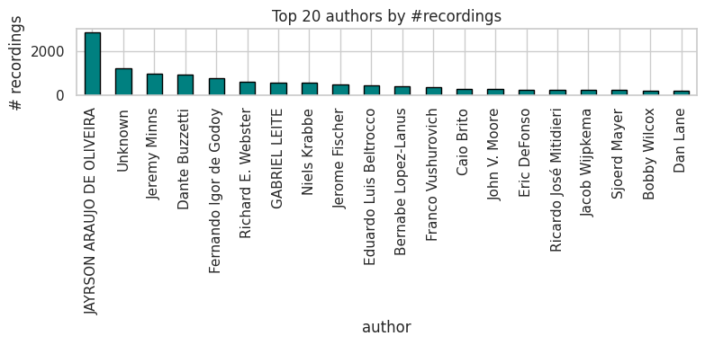
Dataset Study
28
scored species have zero training audio, 25 Insecta + 3 Amphibia. These are unlearnable from train.csv.

Slide 6
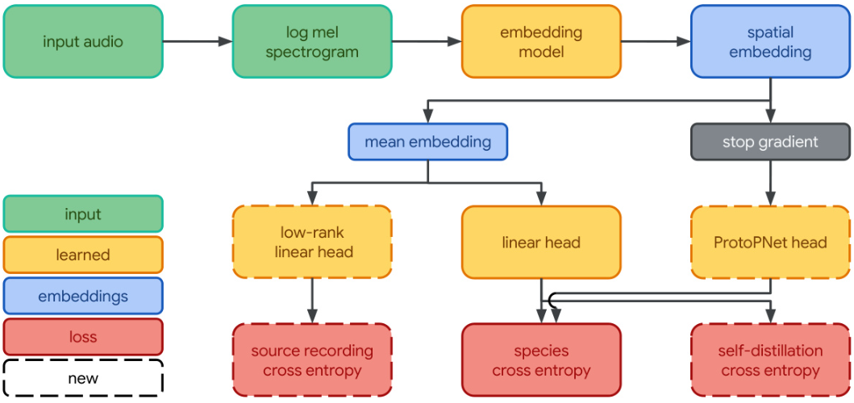
Methodology: Transfer Learning — Frozen Perch-v2 Embeddings
→
→
INPUT
PERCH-V2 FROZEN
OUTPUT
Raw waveform
Bioacoustic backbone
1536-d embedding
5 s @ 32 kHz mono 160,000 samples
Internal mel-spectrogram, EfficientNet-B3 CNN
per 5 s window mean-pooled per recording
Perch is a fixed feature extractor, We transfer learn on top of it.

Slide 7
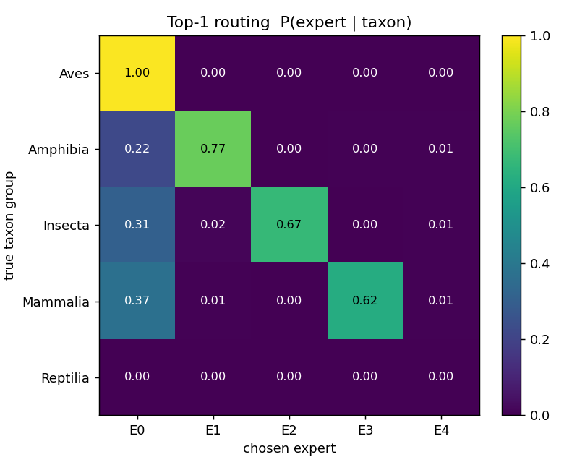
Methodology: Classifier Head — Top-1 Mixture-of-Experts
4 experts ≡ 5 taxon groups · one fires per sample
E1
E2
E3
E4
Aves
Amphibia
Insecta
Mammalia/Reptilia
E1
Router
E2
1536d
Perch Embedding
E3
Pred
nn.Linear(1536, 256)
nn.BatchNorm1d
nn.ReLU
nn.Linear(256, 4)
Softmax
E4
nn.Linear(1536, 512)
nn.BatchNorm1d
nn.ReLU
nn.Dropout(0.2)
nn.Linear(512, 234)

Slide 8
Classifier Head: Average Mixture-of-Experts
4 experts ≡ 5 taxon groups · one fires per sample
E1
E2
E3
E4
Aves
Amphibia
Insecta
Mammalia/Reptilia
E1
Router
E2
1536d
Perch Embedding
Pred
E3
nn.Linear(1536, 256)
nn.BatchNorm1d
nn.ReLU
nn.Linear(256, 4)
E4
nn.Linear(1536, 512)
nn.BatchNorm1d
nn.ReLU
nn.Dropout(0.2)
nn.Linear(512, 234)
SECTION 2: SIGNAL CONDITIONING & STRUCTURAL PRE-PROCESSING
SLIDE 3 / 14

Slide 9


Loss Function & Optimizer
Loss Function
Binary Cross Entropy
Focal Loss
- Winning solution 2025
- Foreground-background class imbalance
- Uniform weight across all samples
- Dynamic weighting depending on confidence
- Background samples are mathematically suppressed
Optimizer
Adam
Dynamically computes adaptive learning rates per parameter, allowing all experts & router synchronize their training speeds.

Slide 10
Validation Strategy
Standard Random Split
GroupKFolds
There is risk of windows of the same sample ending up on train and val separately.
Windows of the same sample will go together in train or validation.
Solution
Data Leakage
We train 5 separate folds
5 trained models
Final result is the average of the prediction of each model
Out - of - Fold Cross Validation pipeline

Slide 11
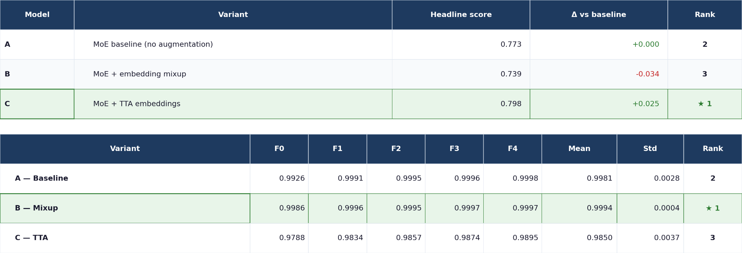
Experiments & Configurations

Slide 12

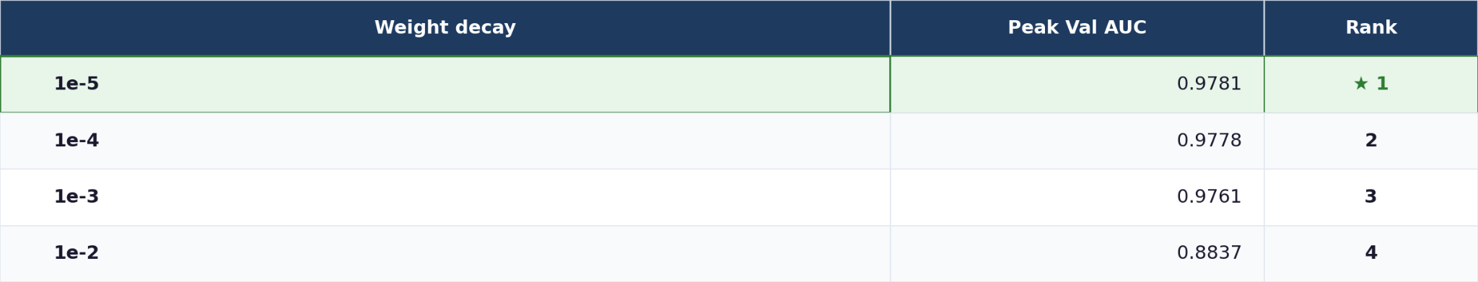
Experiments & Configurations

Slide 13
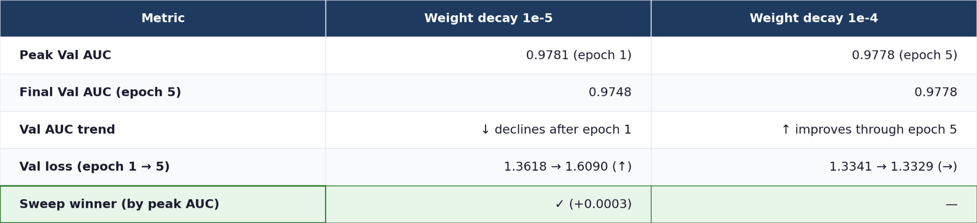
Experiments & Configurations

Slide 14
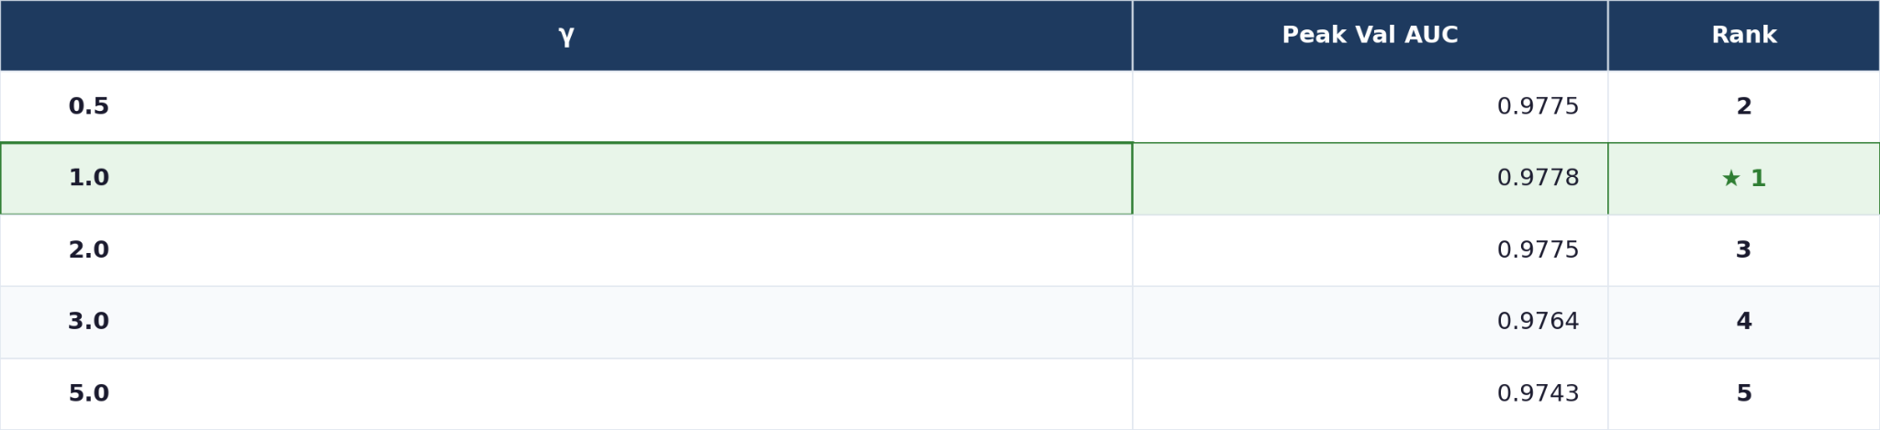

Experiments & Configurations

Slide 15
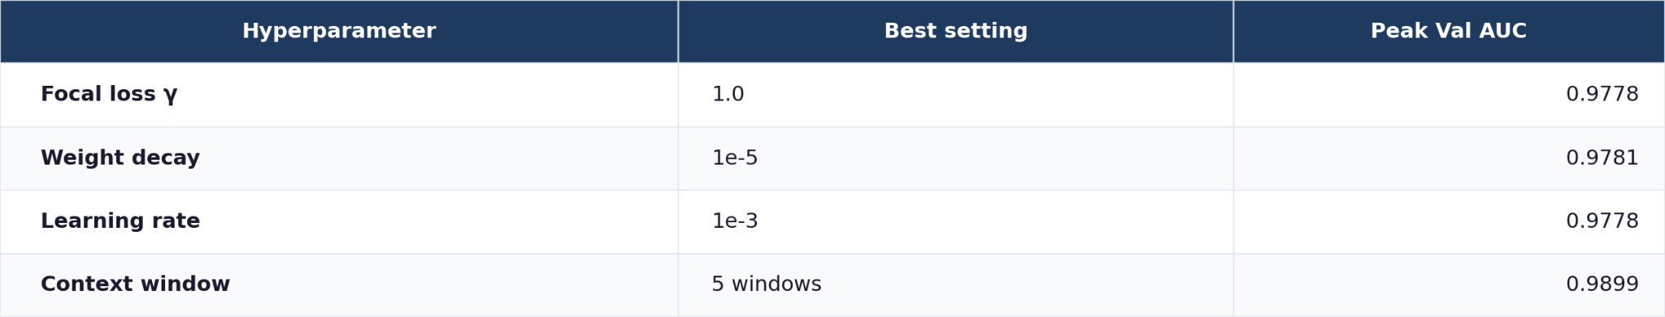
Experiments & Configurations
Context window 5 was not a good solution because it memorized the environmental footprint and the background noise, it overfitted in training and on the validation set. Temporal resolution was also lost.
Context window 1 ended performing much better, the network could focus on immediate transients.

Slide 16
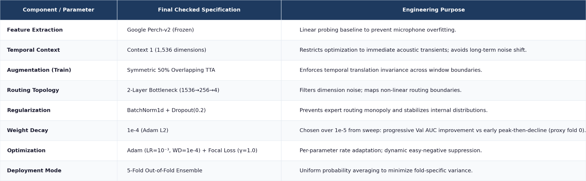
Best Model Configuration

Slide 17
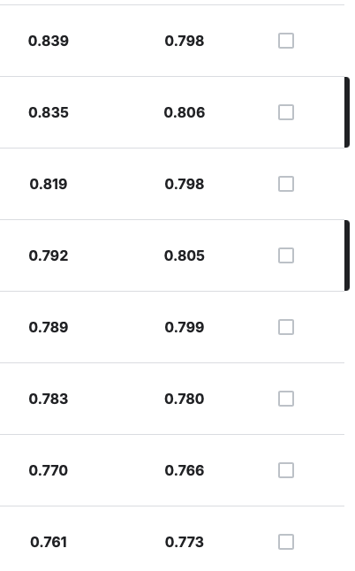
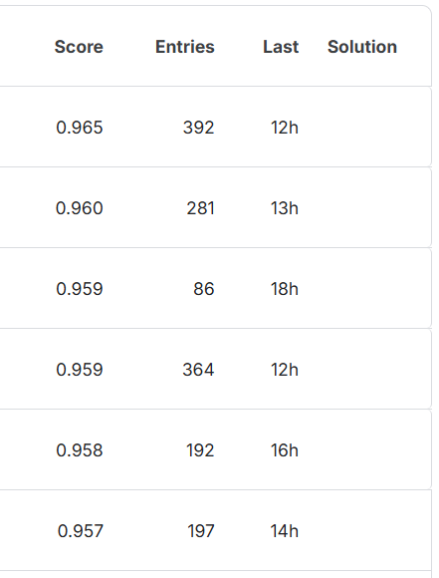
Results, Baseline Comparison and Analysis
Competition Notes
Large variation in pub v. priv results: This was suspected in multiple forum posts.
Winner had ~400 submissions and is the same winner as last year
Analysis Notes
Saturated Head: The domain gap (Focal/Soundscape) was the main source of loss at test time.
Our Results
Public leaderboard

Slide 18
Further Work
Challenges
Bounded by time
Bounded by Complexity
Bounded by Experience
Make full use of background-mixing in training:
AUC only moved 0.9976 → 0.9971.
Our background-mixing was naive, a better implementation could yield greater gains.
Sourcing external training data for rare classes.
~12% of classes have no training data.
Full pseudo-labeling run. We only trained on a subset to conserve time.
Dedicated rare group models
Sigmoid output is more principled. We currently use softmax.

