Slide 1
Credit Card Fraud Detection Using XGBoost
Shakib Ibna Shameem Polock
Notes:
Git: https://github.com/polock11/data_viz_spring_2024/tree/main/credit_card_fraud_XGBoost

Slide 2
Table of Contents
01
Problem
02
Implementation
03
Further Improvements
& Learnings

Slide 3
01
Problem

Slide 4
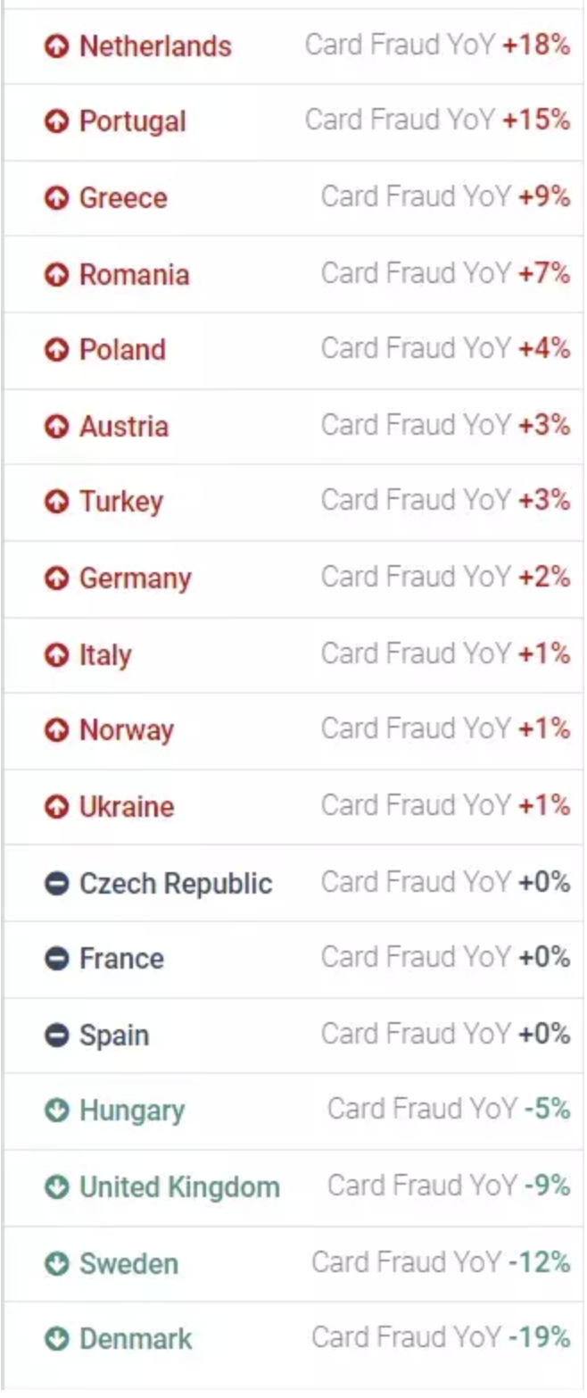

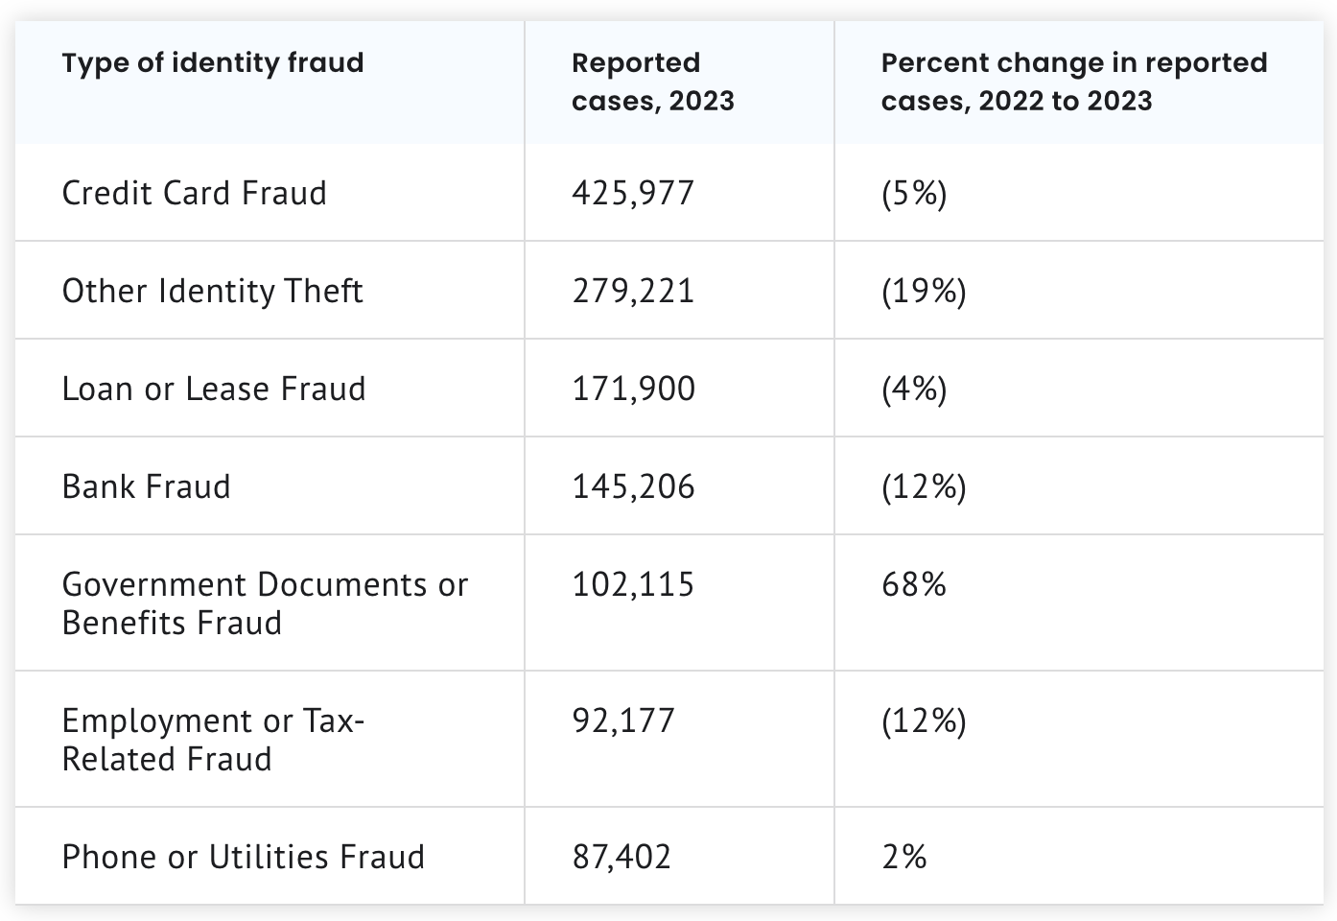
Credit card fraud statistics
Eurpoe
USA
Notes:
Ref: 1. European Card Fraud in 2021: Winners, Losers and Scams (fico.com), 2. Identity Theft and Credit Card Fraud Statistics for 2024 | The Motley Fool

Slide 5
Solution
Existing solutions are Rule Based Systems, Anomaly Detection Systems, Multi-Factor Authentication, IP and Geolocation Analysis.
Implement Machine Learning to build a predictive model that can identify the authenticity of the transactions.

Slide 6
02
Implementation

Slide 7
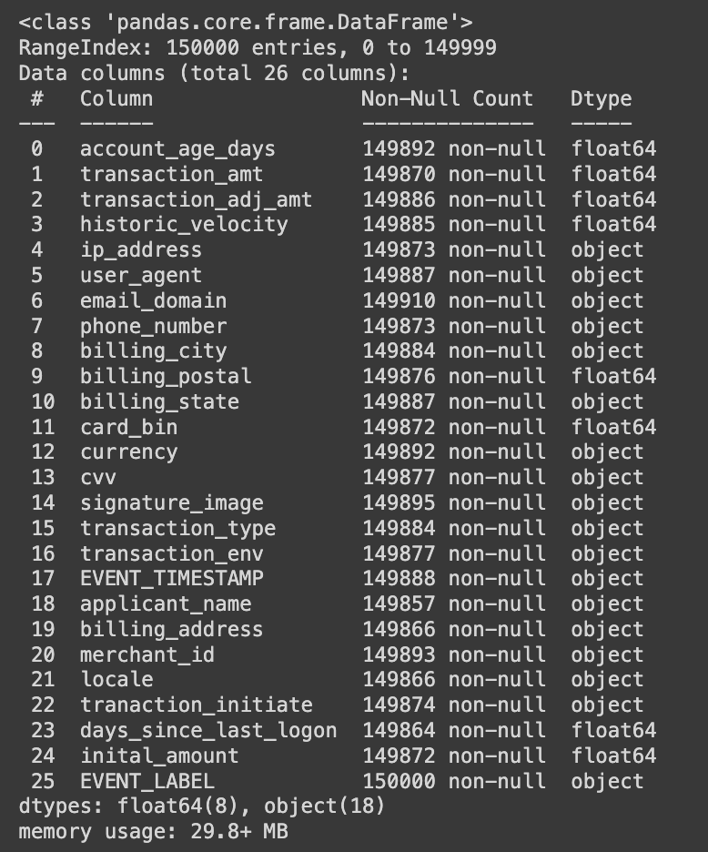
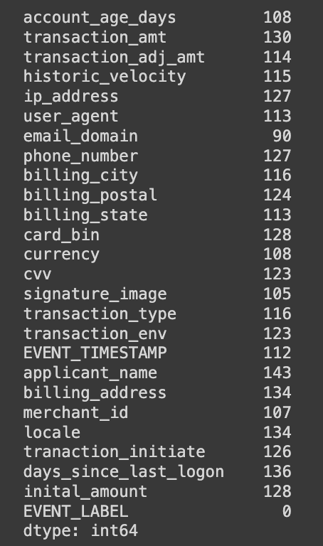
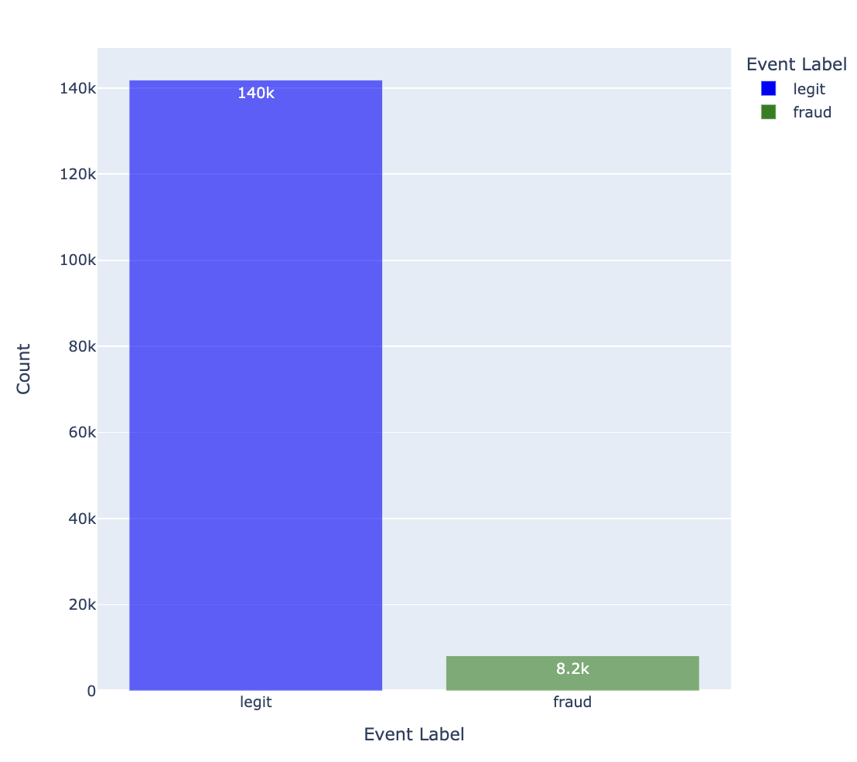
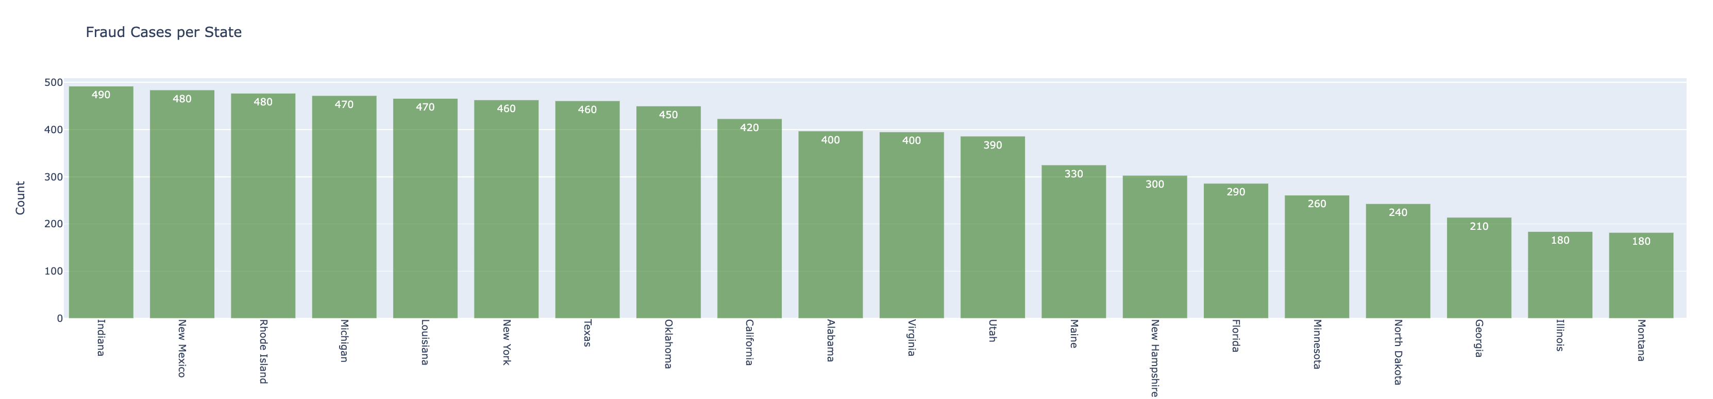
Exploratory Data Analysis

Slide 8
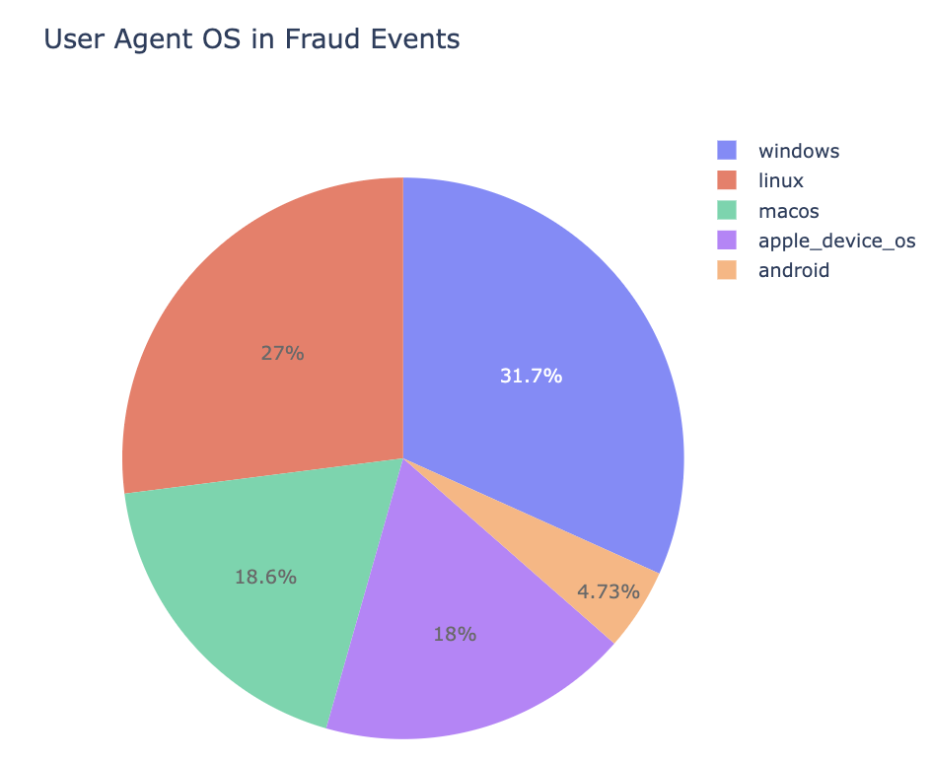
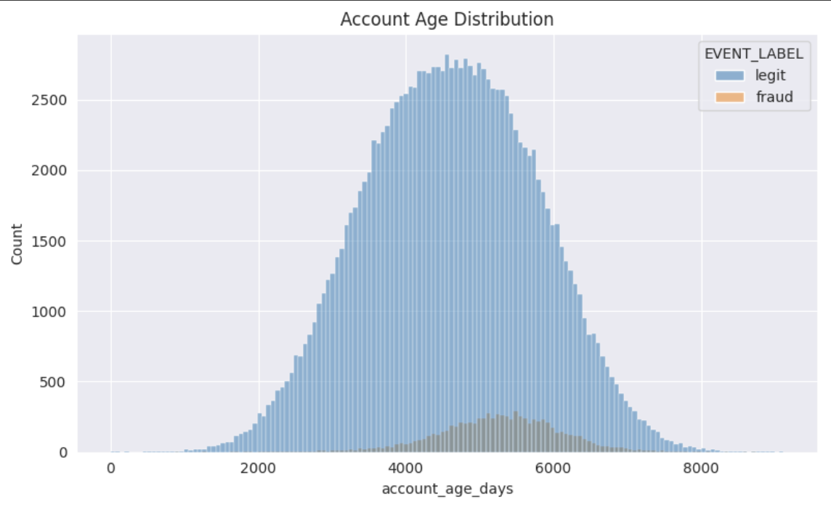
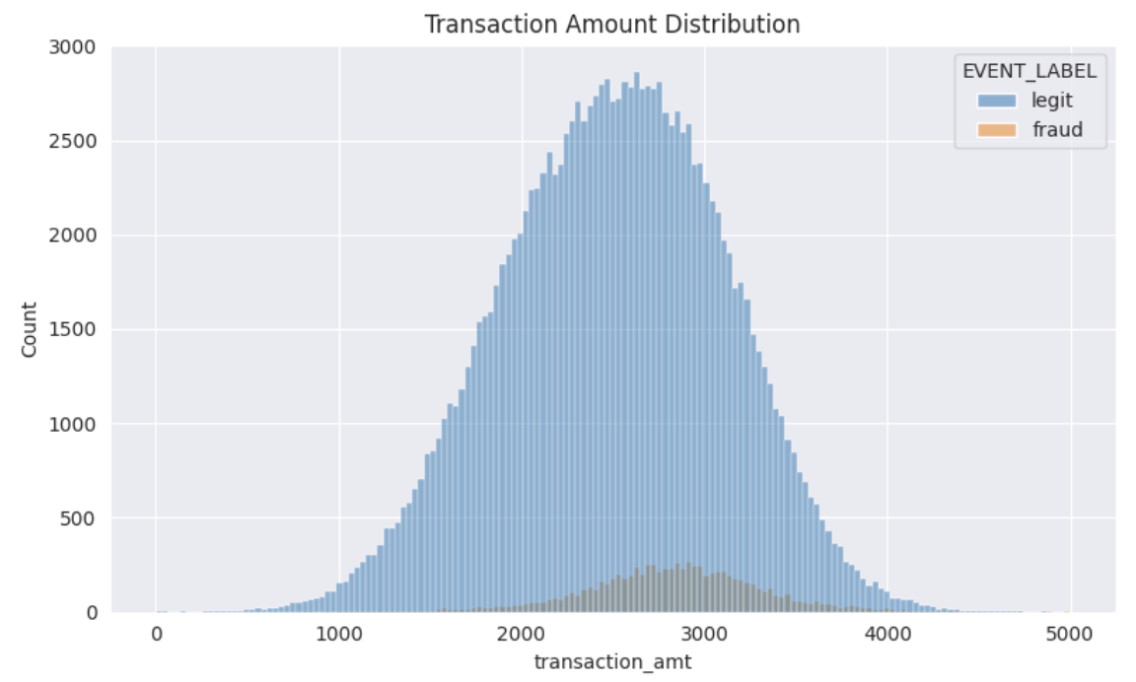
Exploratory Data Analysis

Slide 9
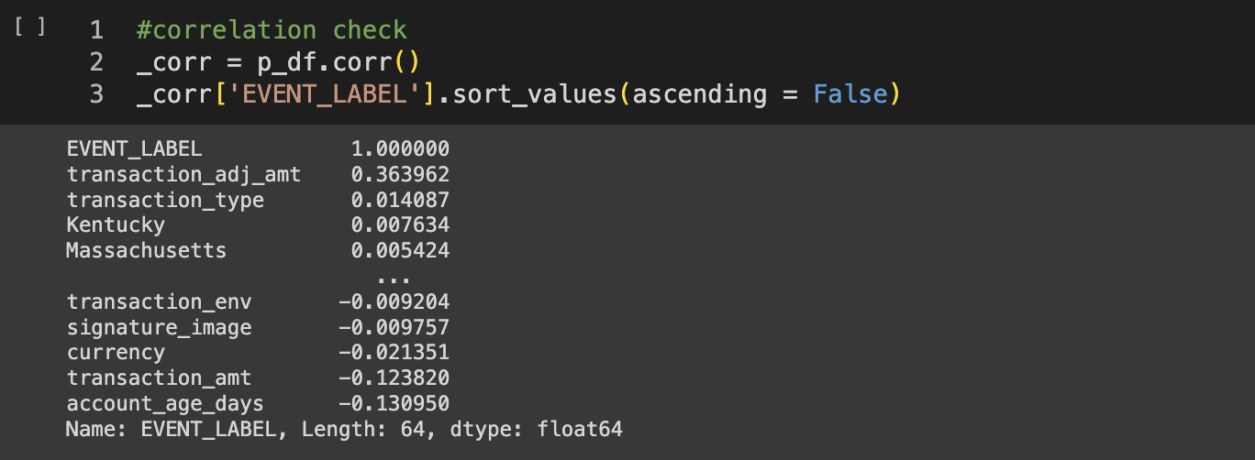
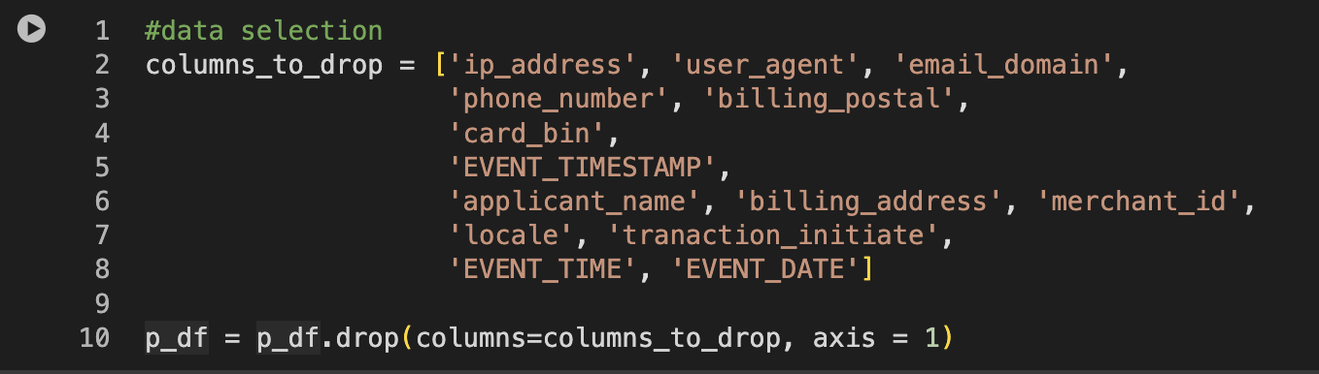
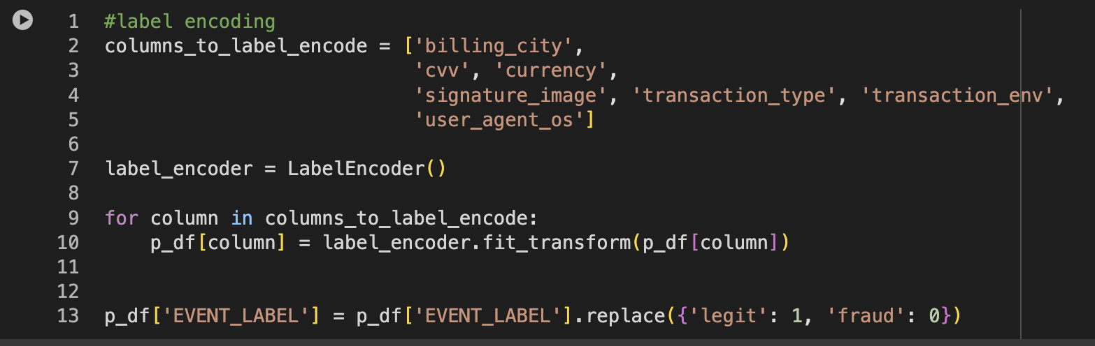
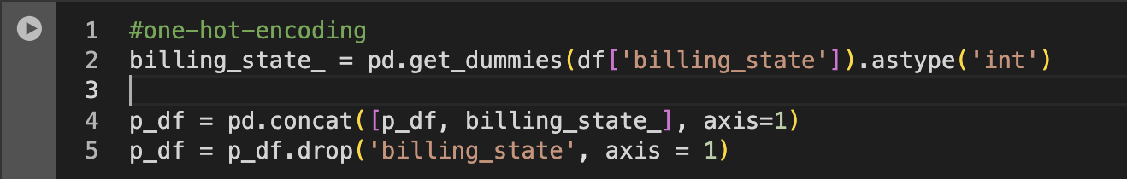
Data Transformation

Slide 10

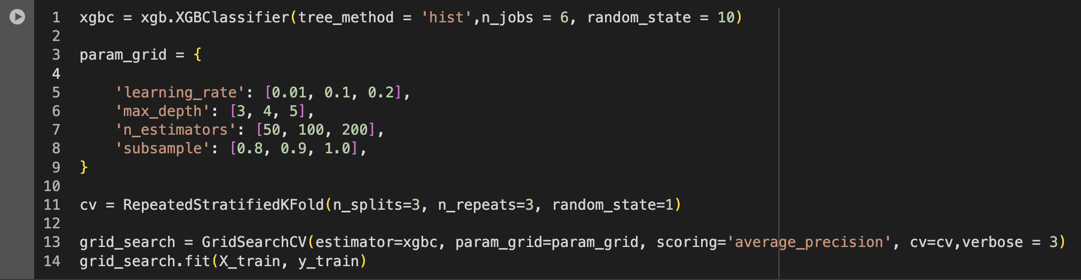
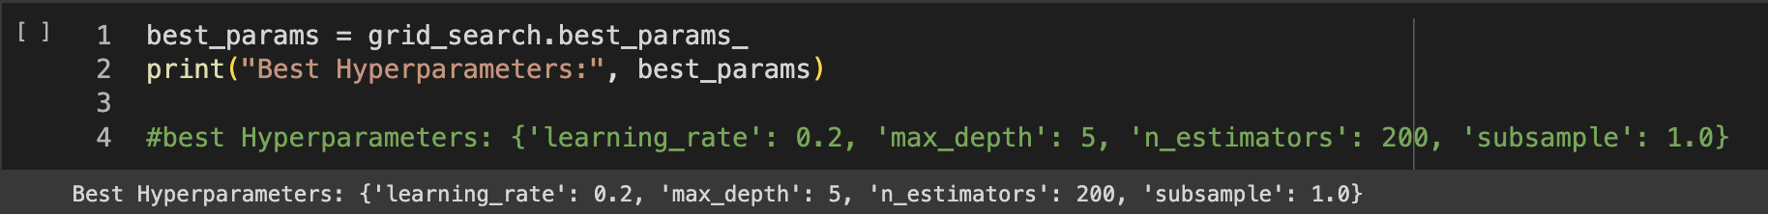
Model Building

Slide 11
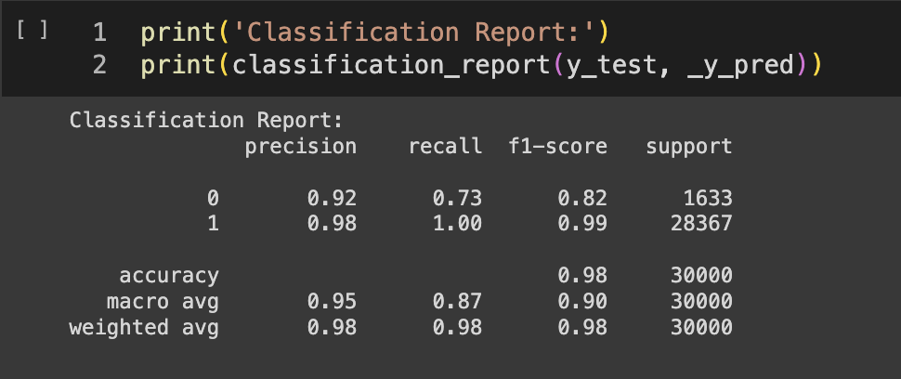
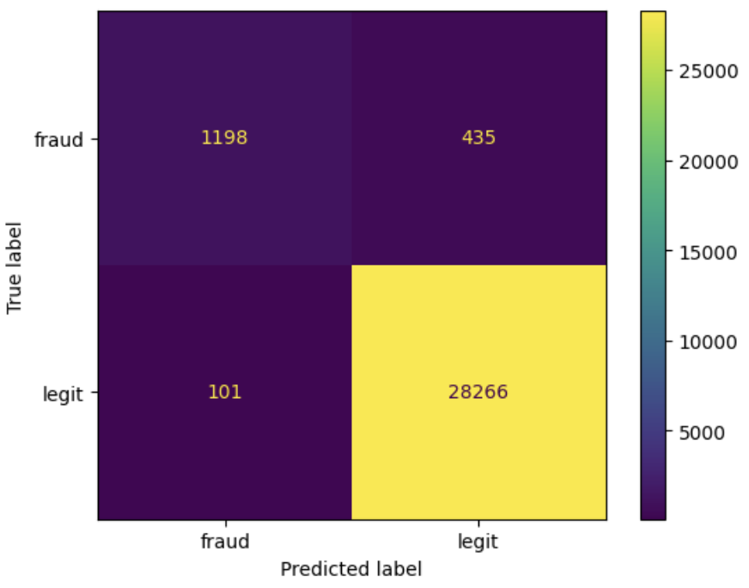
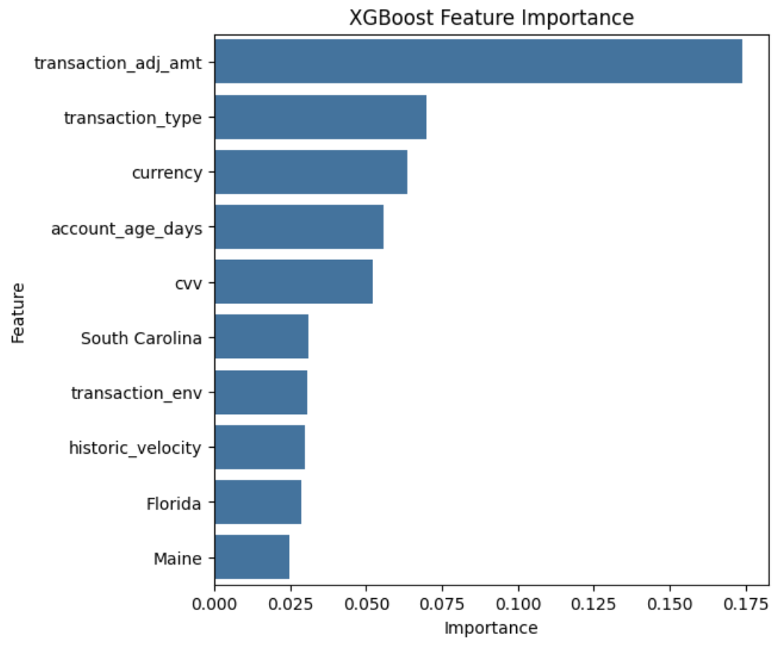
Results
Confusion Matrix
Problem
Dataset
Model

Slide 12
03
Further Improvements

Slide 13
Further Improvements
Re-train the model with more data for the fraud class.
Implement XGBoost with ‘scale_pos_wight’ and regularization parameters parameters
Experiment with other hyperparameters
Apply other classification models or ensemble methods like bagging

Slide 14

Learnings
Choose Correct KPI’s for model evaluation
Spend more time with data
Acquire Domain Knowledge

Slide 15
Thank you

