Slide 1
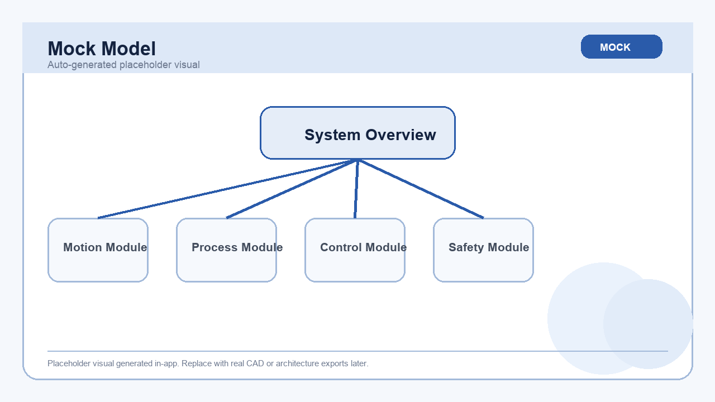
DESIGN FOR MANUFACTURING
DFM Auto-Generated Report
Mock Model | Mock STEP + BOM driven MVP
Product: Mock Model
Assembly: Mock Model Assembly
CAD Parser: Mock parser via CADParser interface
Review Scope: Structure / module / spare / LLT / software architecture
CAD parts: 6
BOM items: 12
Modules: 4
Overview placeholder image
DFM Auto-Generated Report
01 / 15

Slide 2
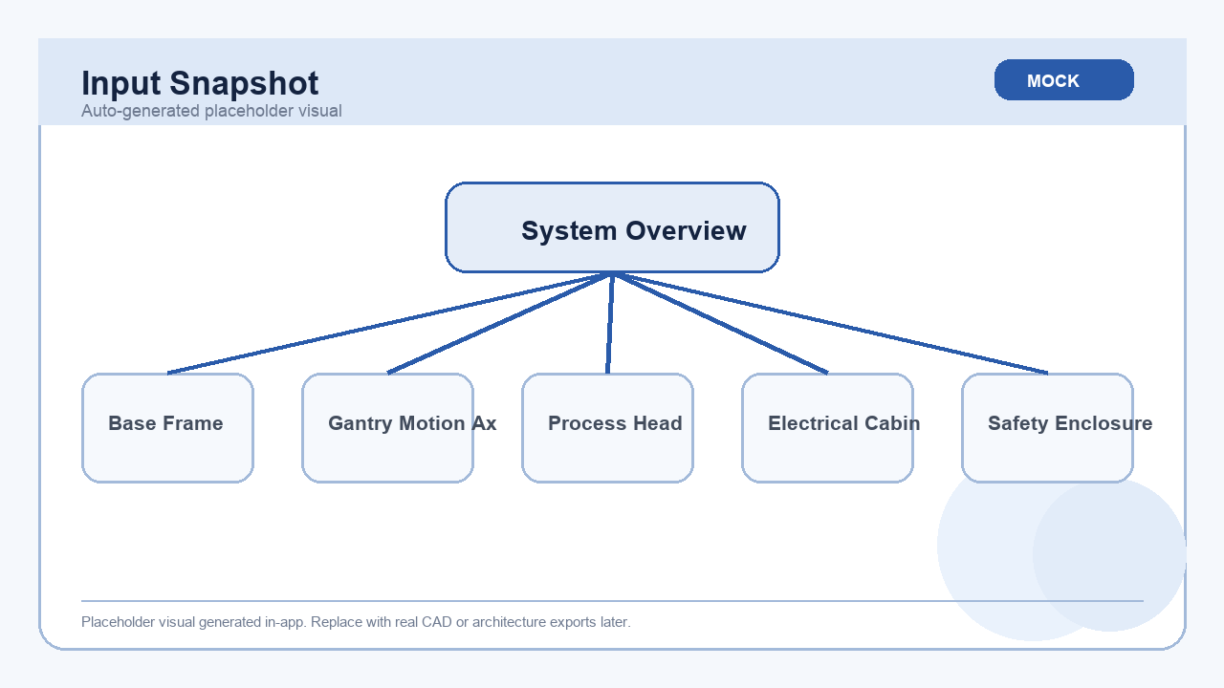
DFM REPORT
Input Snapshot
• STEP source: mock_model.step
• Assembly name: Mock Model Assembly
• BOM lines: 12
• Current version uses mock CAD parsing and mock visual generation.
Mock supporting visual
DFM Auto-Generated Report
02 / 15

Slide 3
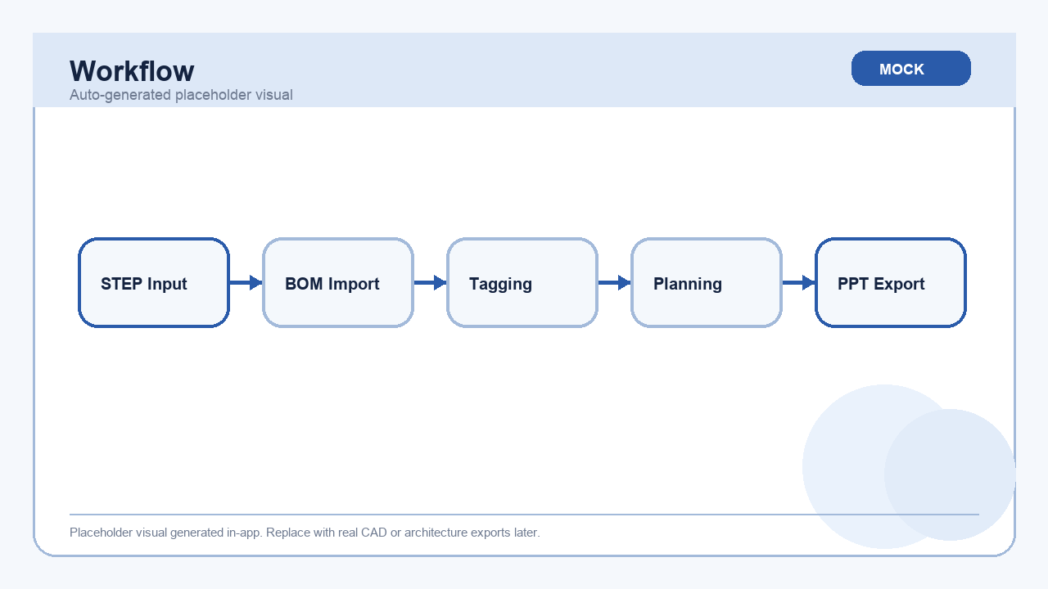
DFM REPORT
DFM Workflow Overview
1. STEP Mock
v
2. BOM JSON
v
3. Tagging
v
4. Planning
v
5. PPT Output
Workflow placeholder image
DFM Auto-Generated Report
03 / 15

Slide 4
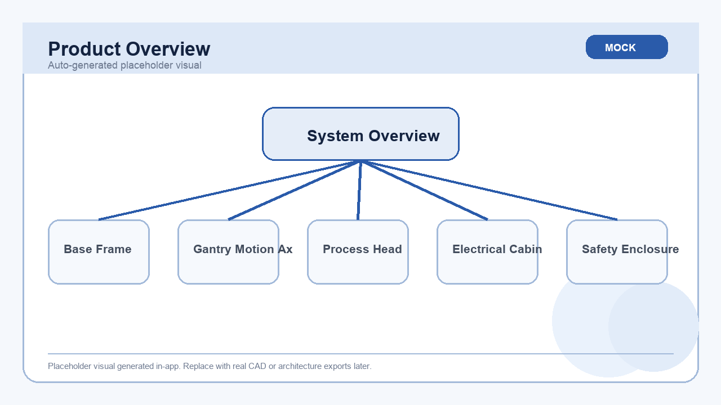
DFM REPORT
Product Structure Diagram
Mock Model Assembly
Base Frame
Gantry Motion Axis
Process Head
Electrical Cabinet
Safety Enclosure
Overview placeholder image
DFM Auto-Generated Report
04 / 15

Slide 5
DFM REPORT
Assembly Hierarchy
Level | Part No | Part Name | Notes
0 | ASSY-001 | Main Assembly | Top-level assembly parsed from mock STEP input.
1 | FRAME-001 | Base Frame | Welded structure and mounting datum.
1 | GANTRY-001 | Gantry Motion Axis | Carries linear rails, servo and ballscrew.
1 | TOOL-001 | Process Head | Tooling or dispense module.
1 | CTRL-001 | Electrical Cabinet | PLC, IO and power distribution.
1 | SAFE-001 | Safety Enclosure | Guarding and interlock interfaces.
DFM Auto-Generated Report
05 / 15

Slide 6
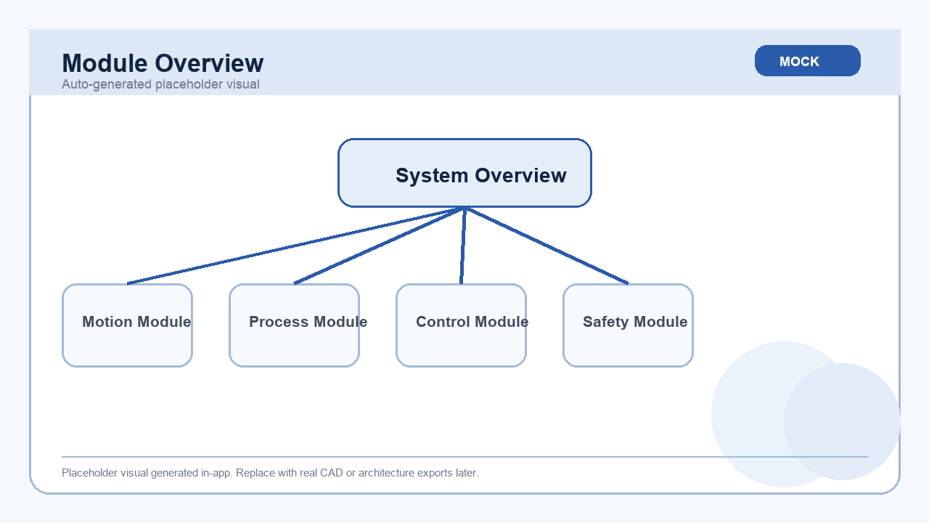
DFM REPORT
Module Decomposition Overview
Motion Module (7)
Base Frame, Gantry Motion Axis, Base Frame
Process Module (4)
Process Head, Process Nozzle, Product Fixture
Control Module (4)
Electrical Cabinet, Vision Sensor, PLC Controller
Safety Module (2)
Safety Enclosure, Safety Enclosure
Module overview placeholder image
DFM Auto-Generated Report
06 / 15

Slide 7
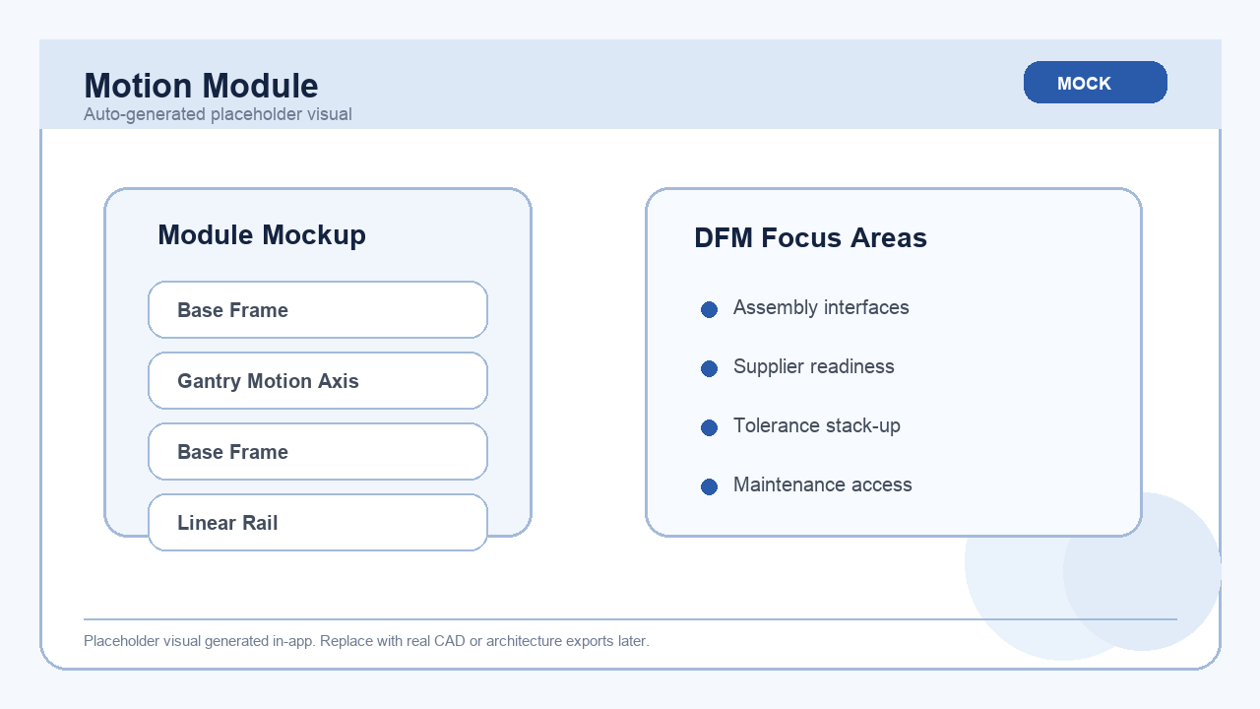
DFM REPORT
Motion Module Detail
Summary
• Motion Module contains 7 tagged parts/items.
• This page is generated from keyword-based mock classification.
• DFM review focus: interfaces, assembly sequence and supplier readiness.
Module placeholder image
Part Name | Qty | Process | Lead Time
Base Frame | 1 | Weldment | 20 d
Linear Rail | 2 | Standard Part | 18 d
Servo Motor | 2 | Purchased Part | 35 d
BallScrew Assembly | 2 | Purchased Part | 30 d
Timing Belt | 2 | Purchased Part | 21 d
DFM Auto-Generated Report
07 / 15

Slide 8
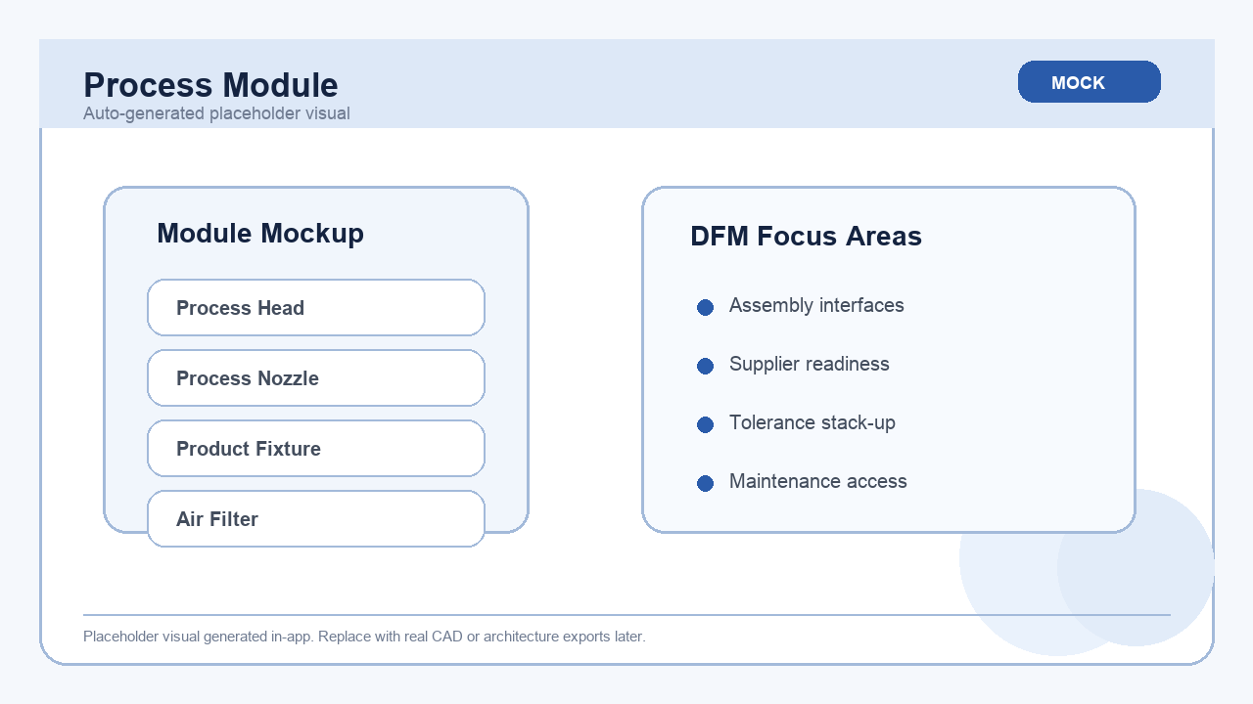
DFM REPORT
Process Module Detail
Summary
• Process Module contains 4 tagged parts/items.
• This page is generated from keyword-based mock classification.
• DFM review focus: interfaces, assembly sequence and supplier readiness.
Module placeholder image
Part Name | Qty | Process | Lead Time
Process Nozzle | 1 | Machining | 12 d
Product Fixture | 1 | Machining | 15 d
Air Filter | 4 | Purchased Part | 7 d
DFM Auto-Generated Report
08 / 15

Slide 9
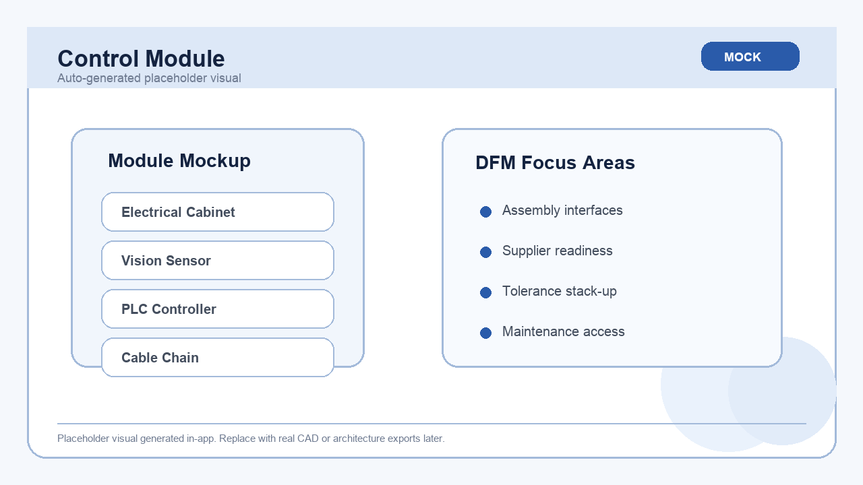
DFM REPORT
Control Module Detail
Summary
• Control Module contains 4 tagged parts/items.
• This page is generated from keyword-based mock classification.
• DFM review focus: interfaces, assembly sequence and supplier readiness.
Module placeholder image
Part Name | Qty | Process | Lead Time
Vision Sensor | 1 | Purchased Part | 28 d
PLC Controller | 1 | Purchased Part | 42 d
Cable Chain | 2 | Purchased Part | 14 d
DFM Auto-Generated Report
09 / 15

Slide 10
DFM REPORT
BOM Summary
Category | Count
structural | 1
motion | 3
tooling | 2
electrical | 3
safety | 1
maintenance | 2
DFM Auto-Generated Report
10 / 15

Slide 11
DFM REPORT
Spare Parts And Consumables
Item | Type | Qty | Supplier | Lead Time
Timing Belt | Spare | 2 | Mock Motion | 21 d
Air Filter | Consumable | 4 | Mock Utility | 7 d
DFM Auto-Generated Report
11 / 15

Slide 12
DFM REPORT
Long Lead Time Items
Item | Qty | Lead Time | Supplier | Risk
Servo Motor | 2 | 35 d | Mock Servo | Early sourcing required
BallScrew Assembly | 2 | 30 d | Mock Motion | Early sourcing required
Vision Sensor | 1 | 28 d | Mock Vision | Early sourcing required
PLC Controller | 1 | 42 d | Mock Controls | Early sourcing required
DFM Auto-Generated Report
12 / 15

Slide 13

DFM REPORT
DFM Observations
• Detected 4 logical modules from CAD + BOM mock tagging.
• Found 4 long lead time items that should be tracked early.
• Spare parts count: 1; consumables count: 1.
• Current CAD parsing is mocked, so geometry-driven manufacturability checks are placeholders.
Mock supporting visual
DFM Auto-Generated Report
13 / 15

Slide 14
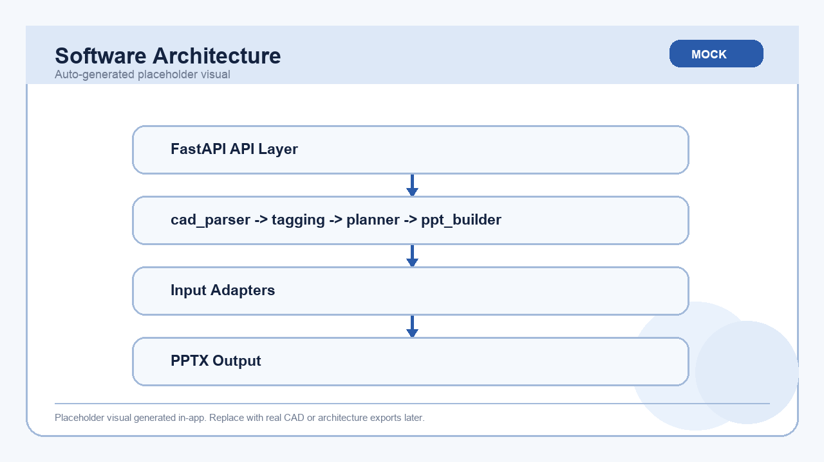
DFM REPORT
Software Architecture
FastAPI API Layer
v
cad_parser -> tagging -> planner -> ppt_builder
v
Mock STEP / BOM Input
v
PPTX Output
Software architecture placeholder image
DFM Auto-Generated Report
14 / 15

Slide 15
DFM REPORT
Next Steps
• Replace mock STEP parser with a real CAD/assembly extractor.
• Add geometry-based DFM rules for machining, sheet metal and assembly clearance.
• Integrate template control, branding and richer chart/image rendering.
DFM Auto-Generated Report
15 / 15

