Slide 1
Git and Github Meetup
By James Muriithi

Slide 2
What we will cover
What is version control
Why version control (git)
Staging files
Making your first commit
Git remote
Branches
Merging branches
Setting up a repository on github
Forking
Pull requests
Merge conflicts and how to solve them (https://www.atlassian.com/git/tutorials/using-branches/merge-conflicts)

Slide 3
What is a version control
Version control is a system that records changes to a file or set of files over time so that you can recall specific versions later.
This helps because you can go back to a specific version any time you want.

Slide 4
What is git
Git is a distributed version control system.
This means that
Different people can collaborate on a project and have their own versions of the project files locally.
Git records changes you make to your files over time and you can go back to a specific version any time you want.

Slide 5
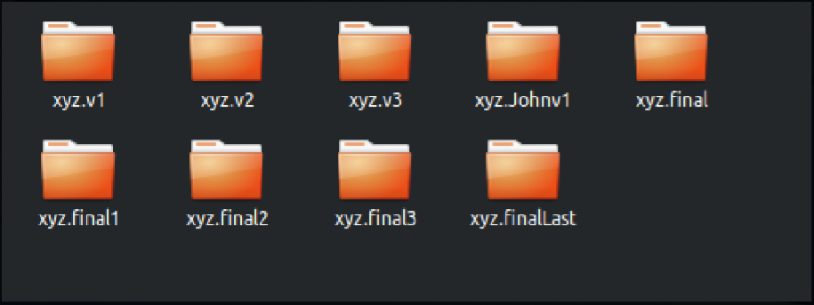
Why version control?

Slide 6
Creating your first repository
A repository is a container for your project. It tracks all changes made to files in your project, building a history over time.
To create your first repo you run `git init` on a your project folder.
That’s it
If its your first time to install git you should configure your user name and email using
git config --global user.name "Sam Smith"
git config --global user.email sam@example.com

Slide 7
Staging files
There are 3 stages of git and we use ` git status `to know the stage
Untracked – the file exists but not part of git’s version control.
Staged – the file has been added to git’s version control but changes have not been committed
Committed – the changes have been committed
We use `git add <file_name.ext>` to stage a file.
We can also use `git add .` to stage all untracked files.

Slide 8
Committing
To commit the staged files we use `git commit -m “short message’’`.
-m is used to give a small description for your commit.
To ignore files or not to track some files we include them in a file called `.gitignore`

Slide 9
Git remote
Git remote serve as convenient names that can be used to reference a not-so-convenient URL
Create a remote configuration: git remote add <name> <url>
Viewing remote connections: git remote
Viewing remote connections with URLs: git remote –v
Delete the remote connection: git remote rm <name>

Slide 10
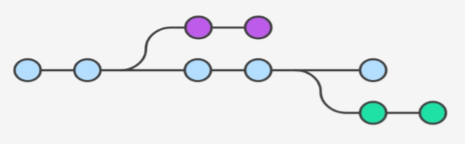
Branches
A branch in Git is simply a lightweight movable pointer to one of these commits. In other words a git branch is an independent line of development.
The default branch name is master
Branching is useful when you want to branch out of the original codebase and isolate your work from others.

Slide 11
Branches (continuation)
Branching helps us work on new features or fix bugs without affecting the existing code.
To know which branch you are currently working on we use `git branch` and the current branch will be in green and with an astrerik (*) prefix.
To create a new branch we use `git branch <branch_name>`.
To switch to a branch we use `git checkout <branch_name>`.
To create and checkout to a branch we use: git checkout –b <branch-name>

Slide 12
Merging branches
Merging lets you take the independent lines of development created by git branch and integrate them into a single branch.
Run `git merge <branch_name>` to merge a branch into the current branch.
Deleting branches
To delete a local branch we use: git branch –D <branch-name>
To delete a remote branch we use: git push <origin> --delete <branch>

Slide 13
Merge conflicts
Sometimes multiple developers may try to edit the same content. If Developer A tries to edit code that Developer B is editing a conflict may occur.
To alleviate the occurrence of conflicts developers will work in separate isolated branches. The git merge command's primary responsibility is to combine separate branches and resolve any conflicting edits.
Conflicts generally arise when two people have changed the same lines in a file, or if one developer deleted a file while another developer was modifying it.

Slide 14
What is github
Github is a service that lets us set up hosted repositories.
It creates a central place where multiple developers can access a shared repository.

Slide 15
Pull Requests
There are 2 main work flows when dealing with pull requests:
Pull Request from a forked repository
Pull Request from a branch within a repository

