Slide 1
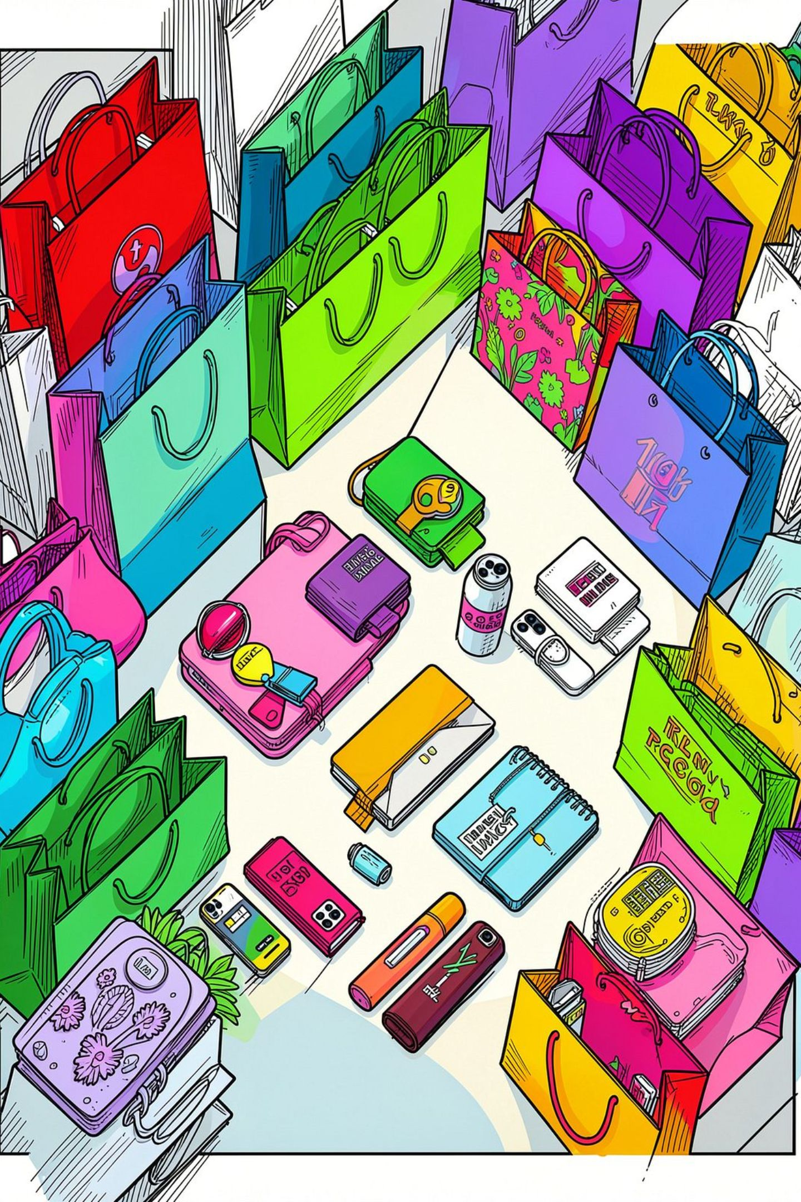
Consumer Behavior Analysis
Uncovering spending patterns, customer segments, and product preferences from 3,900 transactions to guide strategic business decisions.

Slide 2
Dataset at a Glance
3,900
18
Transactions
Features
37
4
Missing Values
Categories
Review Rating only
Clothing, Footwear, Accessories, Outerwear

Slide 3




Data Preparation in Python
Cleaning
Imputed missing Review Ratings using category medians; standardized column names
Feature Engineering
Created age_group and purchase_frequency_days columns
Database Load
Cleaned DataFrame loaded into PostgreSQL for SQL analysis

Slide 4
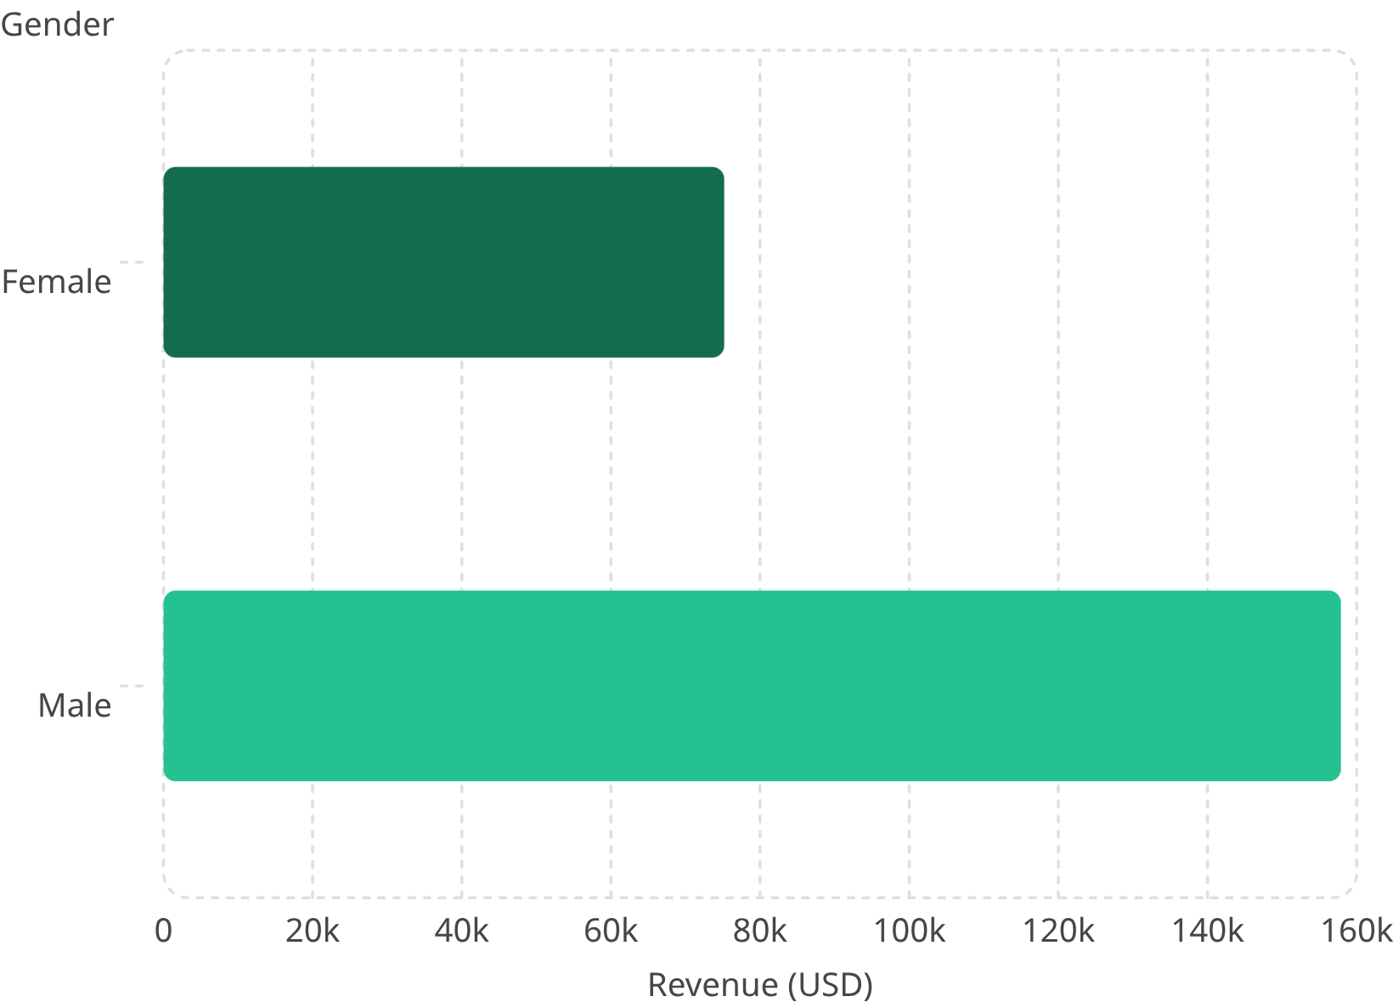

Revenue by Gender
Key Insight
Male customers generated 2.1× more revenue than female customers.
Total dataset revenue: $233,081

Slide 5
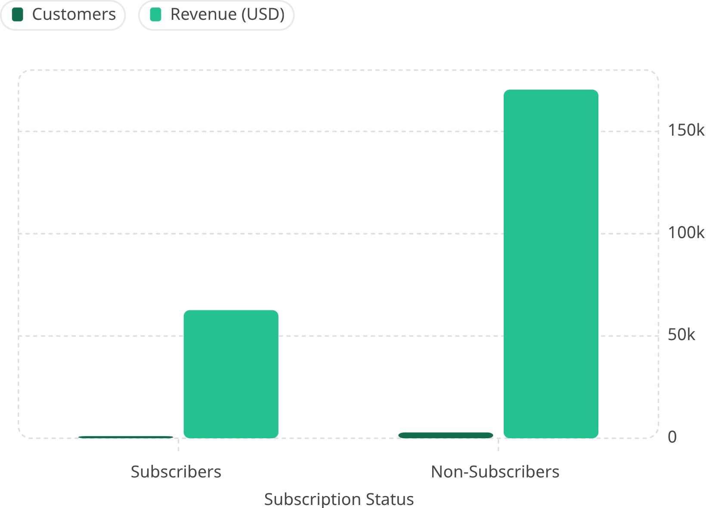
Subscription & Discount Insights
Subscribers
27% of customers — avg spend $59.49
Non-Subscribers
73% of customers — avg spend $59.87
Top Discounted Products
Hat (50%), Sneakers (49.7%), Coat (49.1%)

Slide 6
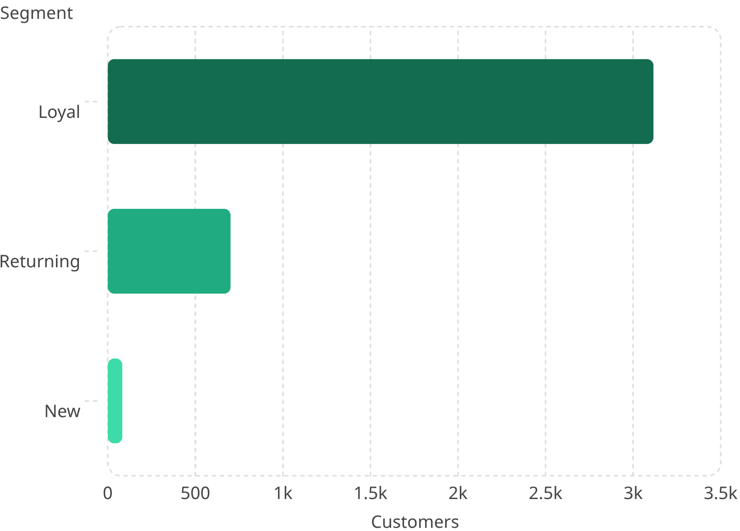
Customer Segmentation
Loyal Customers Dominate
80% of customers are classified as Loyal. Only 2% are New buyers.
958 repeat buyers (5+ purchases) hold subscriptions

Slide 7

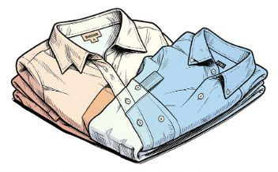
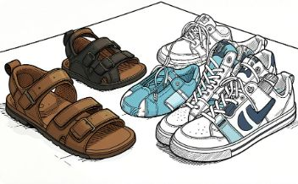

Top Products by Category
Accessories
Clothing
Footwear
Outerwear
Jewelry · Sunglasses · Belt
Blouse · Pants · Shirt
Sandals · Shoes · Sneakers
Jacket · Coat

Slide 8
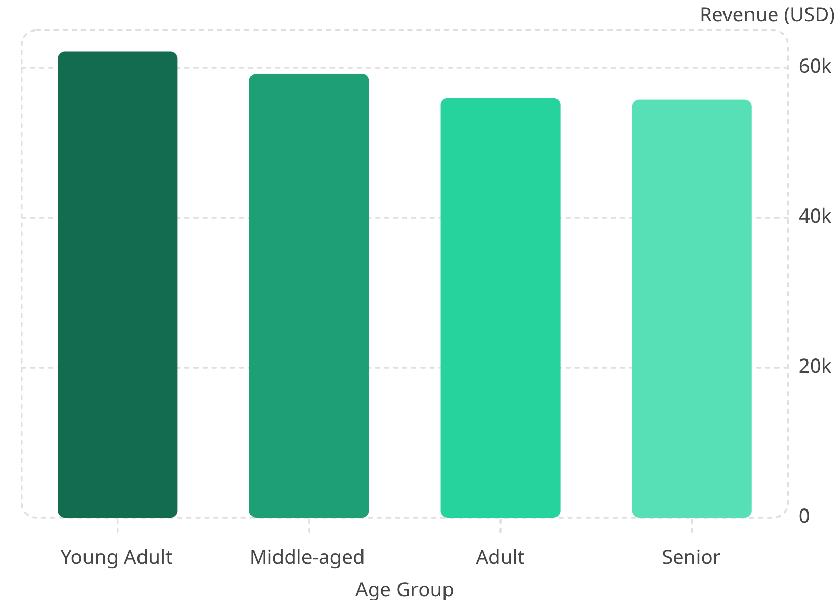
Revenue by Age Group
Young Adults Lead
Highest revenue contributors at $62,143. Revenue declines gradually with age.
Shipping Premium
Express shipping avg: $60.48 vs Standard $58.46

Slide 9
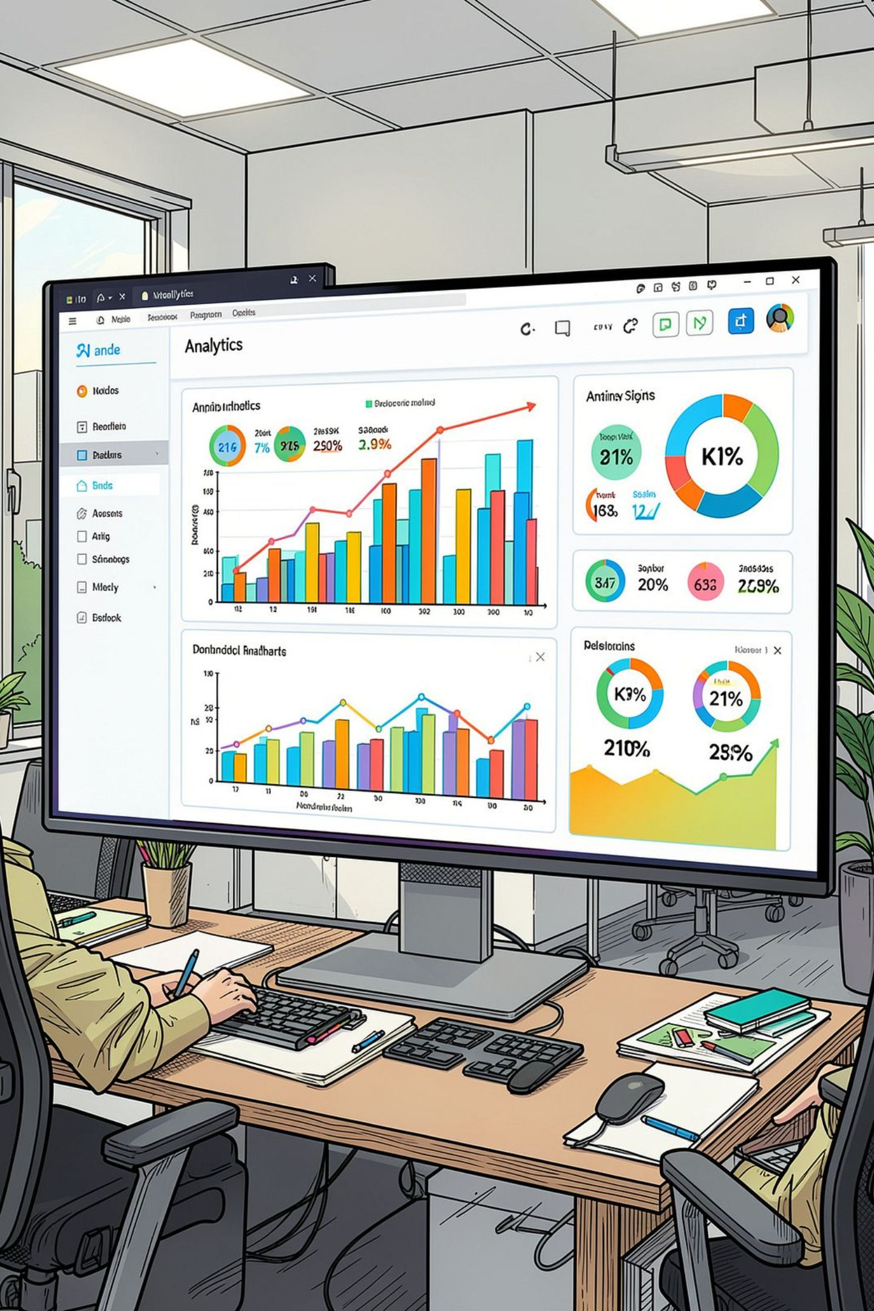
CustomerPulse Dashboard
3.9K
Customers tracked
$59.76
Avg purchase amount
3.75
Avg review rating
Filters
Gender, Category, Shipping

Slide 10





Business Recommendations
Boost Subscriptions
Loyalty Programs
Review Discounts
Promote exclusive subscriber benefits
Reward repeat buyers
Balance sales and margins
Product Positioning
Targeted Marketing
Highlight top-rated products
Focus on high-revenue age groups

