Slide 1
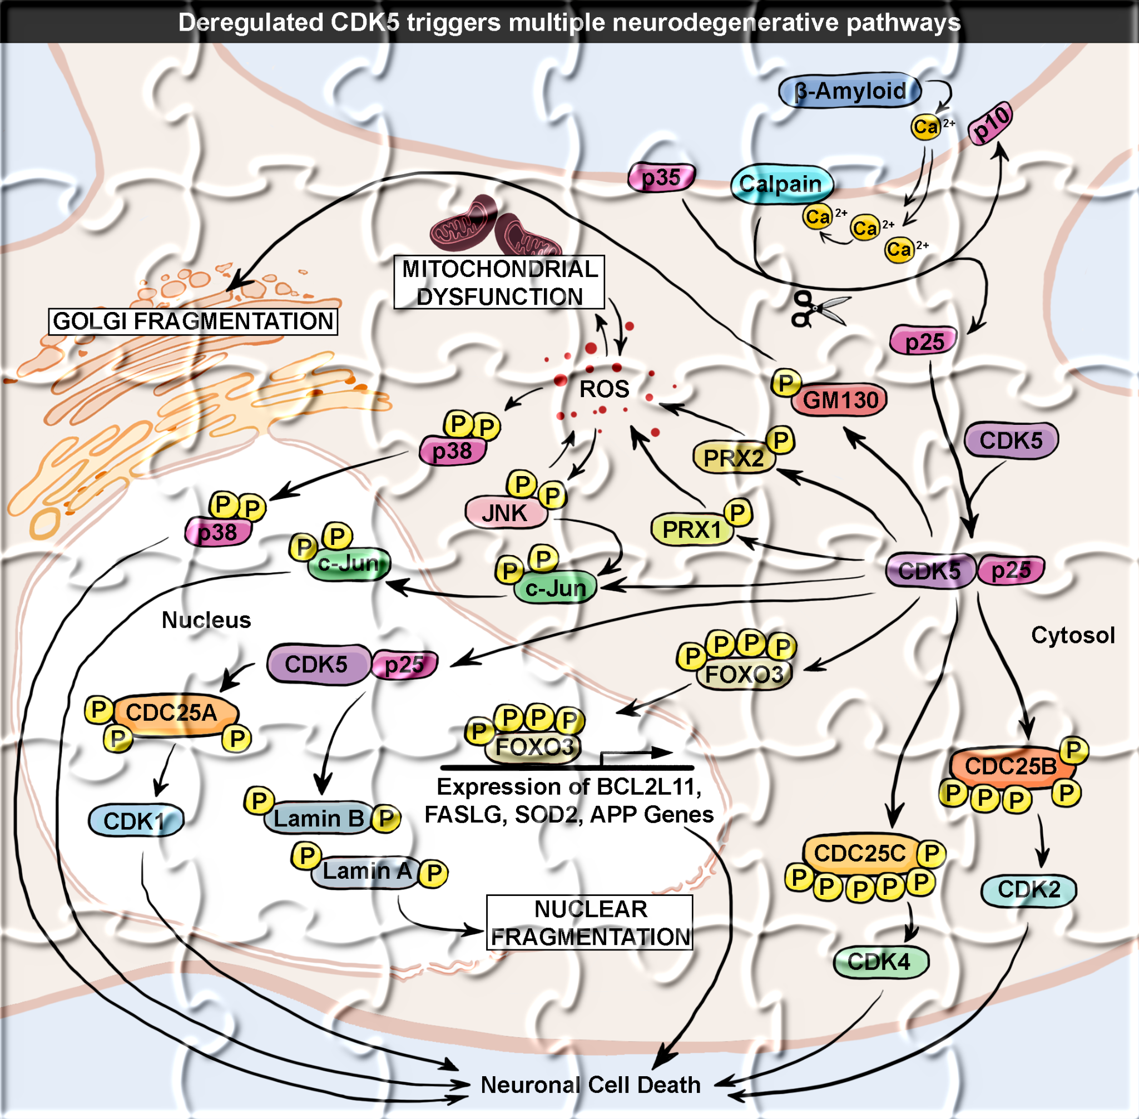

Connecting pathway and phenotype
Deregulated CDK5 triggers multiple neurodegenerative pathways
in Alzheimer's disease models
Alzheimer's disease
Notes:
The easiest way is semantic annotation.
Take this Reactome pathway: 'Deregulated CDK5 triggers multiple neurodegenerative pathways in Alzheimer's disease models.'
The disease is explicitly mentioned, so we can assign all genes in this pathway to Alzheimer's.

Slide 2
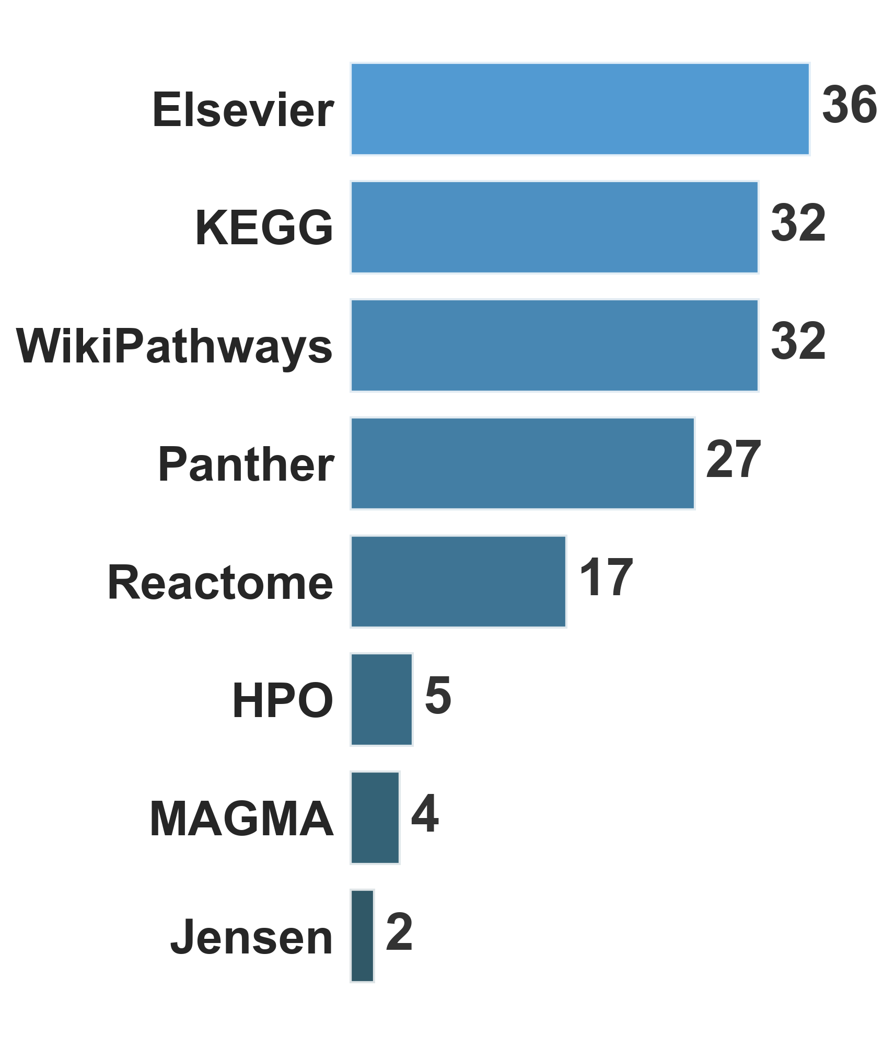
Target prioritisation for ?NeuroFlux validation screens
155 pathways
annotated with
"Alzheimer" or "Parkinson"
from 9 databases
2,919 hits
3 disease groups
prioritised by
MAGeCK criteria
20
targets
+ Genetic evidence
for Alzheimer, Parkinson, or
Lysosomal Storage Diseases
from Open Targets Platform
Notes:
This is exactly the approach we used for NeuroFlux.
Lewis had about 3,000 hits from primary screens and needed to decide which to validate.
He already had MAGeCK-based criteria, and we layered on pathway prioritization.
We looked for genes with both curated pathway annotations - querying 9 databases for 'Alzheimer's' or 'Parkinson's' terms - and genetic evidence from Open Targets.
Pathways give us mechanism, genetics gives us disease validation - together they identify high-confidence targets.
That brought us from 3,000 down to 20 genes for secondary screens.

Slide 3
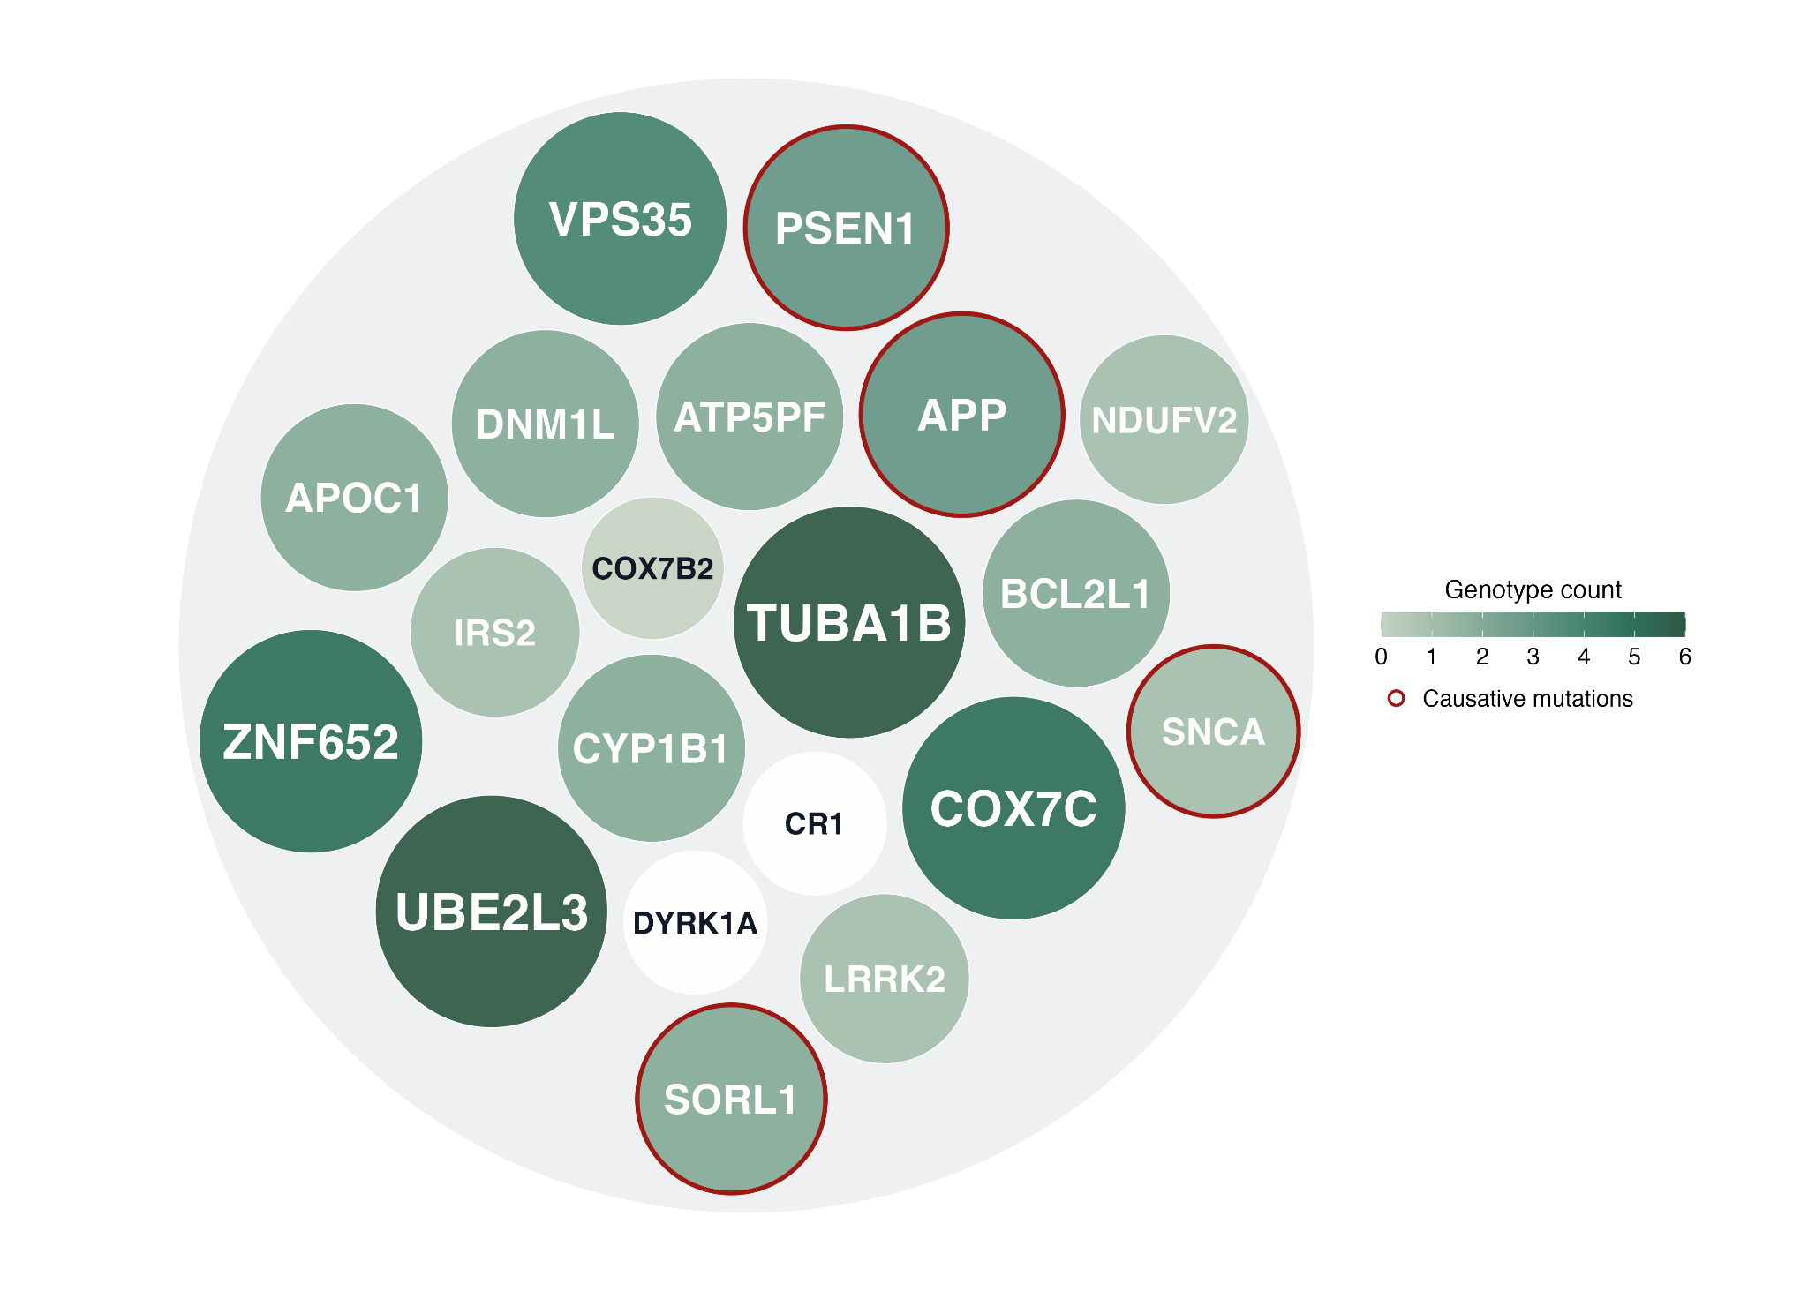
18/20 genes were significant in secondary screens
NeuroFlux
10 secondary screens
8 causal genotypes:
AD: APP^{V717I}, PSEN1^{I4},SORL1
PD: LRRK2^{G2019S}, SNCA
LSD: GBA^{D448H}, NPC1, SMPD1
Notes:
So how did they perform?
The secondary screens tested our 20 targets across multiple genotypes - 3 for Alzheimer's, 2 for Parkinson's, 3 for LSDs.

Slide 4
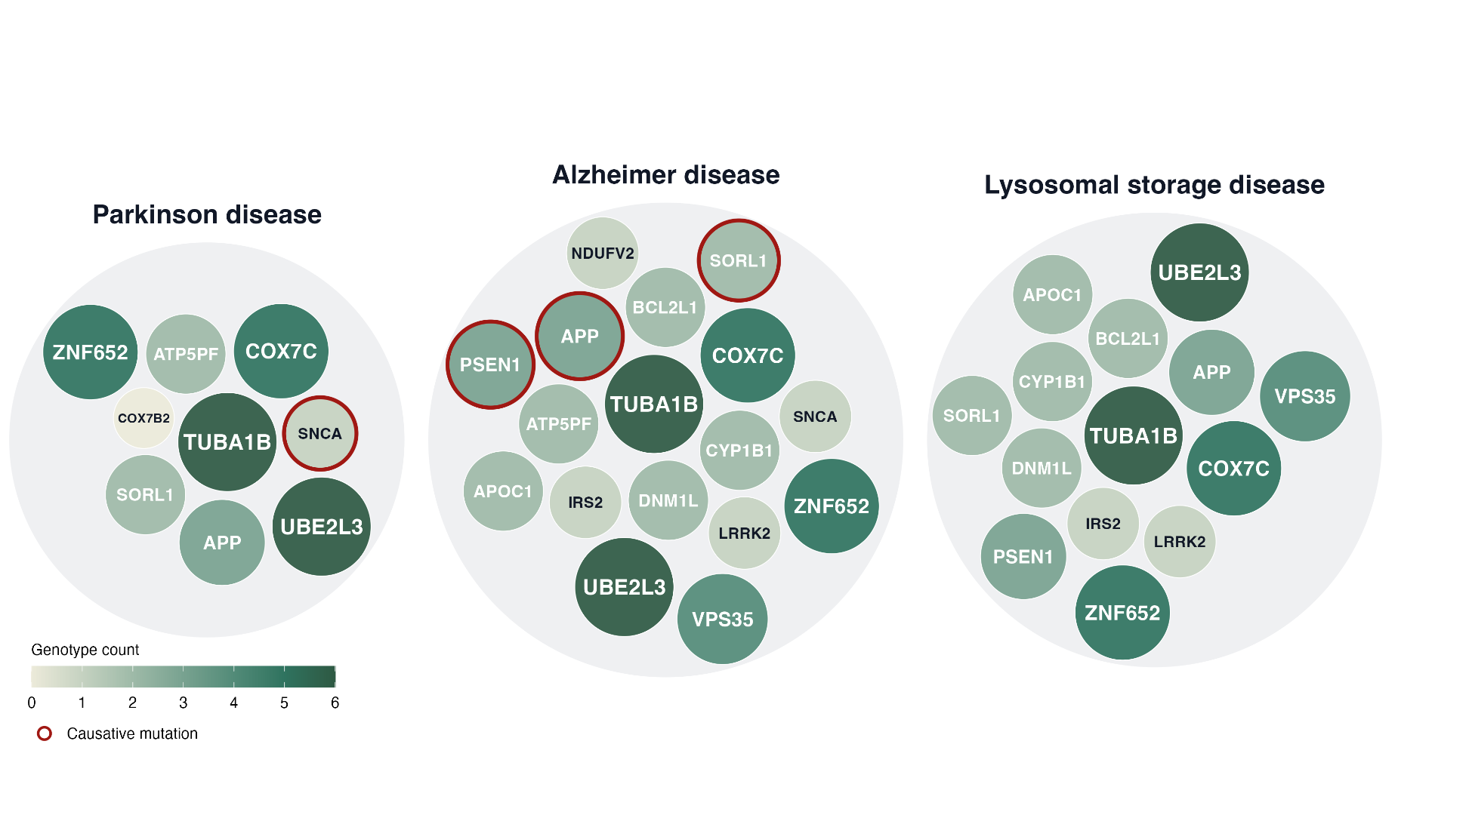
18/20 genes were significant in secondary screens
Notes:
And we saw really good validation: 18 out of 20 were significant in at least one screen.
In this figure, the bigger and more colored the point, the more screens that target validated in.

Slide 5
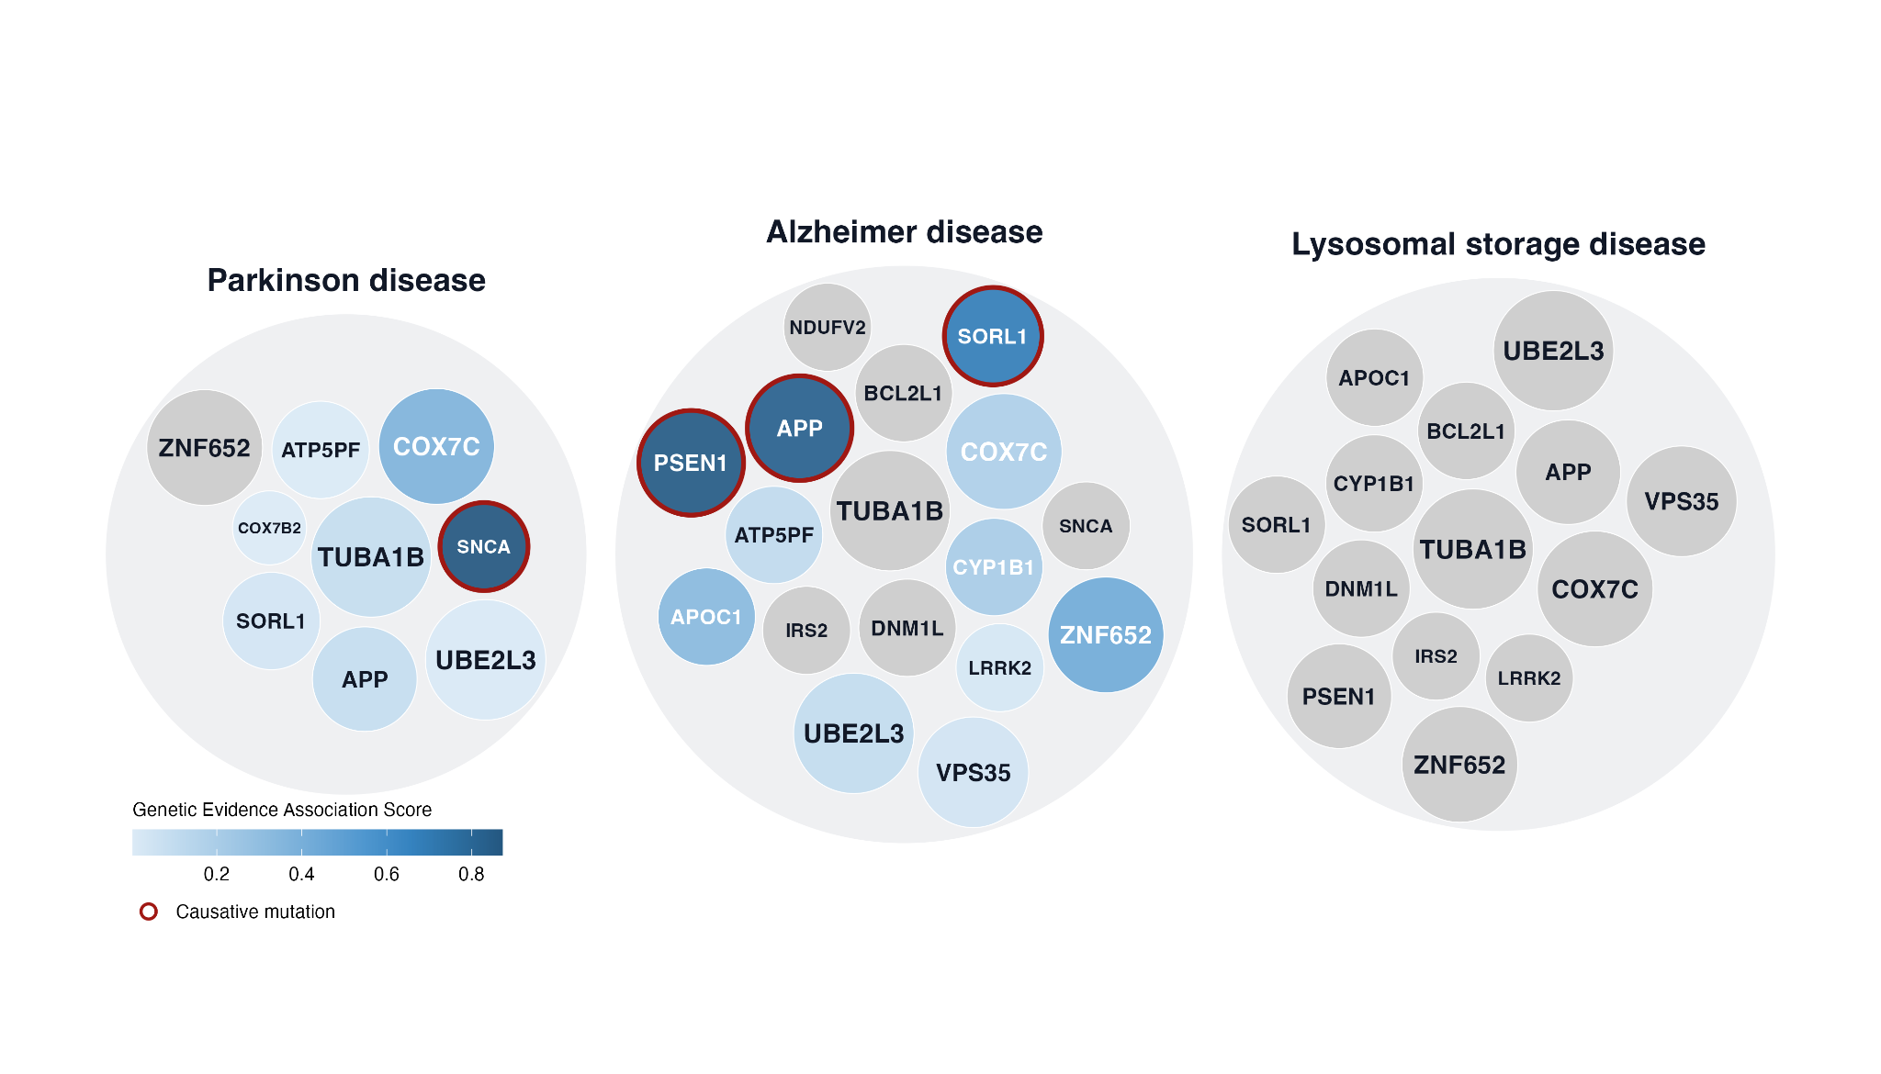
..and 13/20 showed disease-genotype concordance
Notes:
13 out of 20 showed disease-genotype concordance - meaning they validated specifically in the disease context they were nominated for.
For example, if we nominated a gene based on Alzheimer's pathways and genetics, it showed significance in the AD genotype screens.
Interestingly, several targets also validated in LSD models, which is particularly valuable since there's limited genetic data and no curated pathways for LSDs.

Slide 6
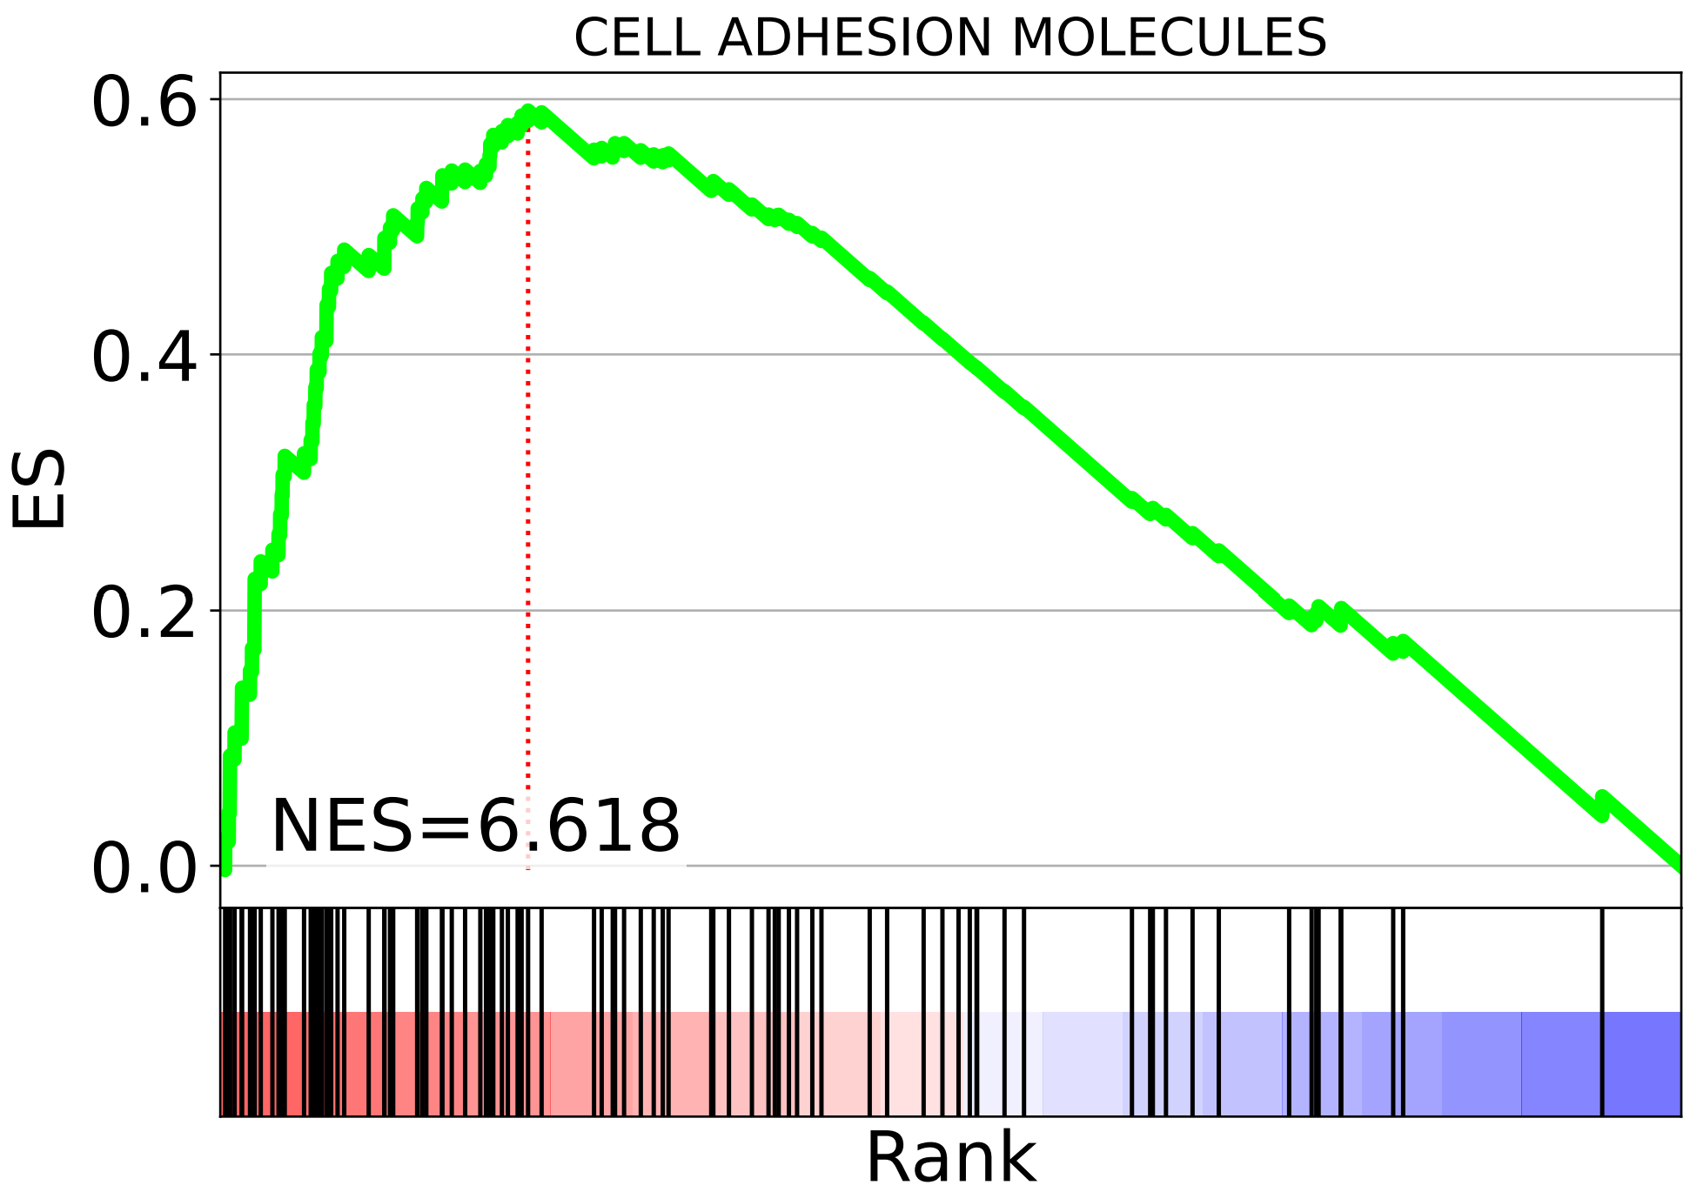



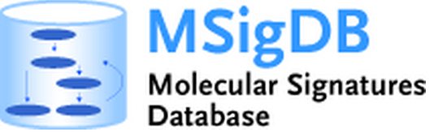
Genetically-inferred disease pathways
Genetic
evidence*
Canonical pathways
GSEA
Disease pathways
T1
Target 1
T1
T2
T3
T1
T2
T3
Pathway 1
Pathway 1
T2
Target 2
Pathway 2
T3
T5
Pathway 2
T3
T5
T1
T1
T3
Target 3
Pathway 3
T4
…
T3
T5
…
…
* Genes linked to diseases
ranked by genetic
Association Score
from OT Platform
finds pathways where genes occur more often than expected by chance
pathways enriched by targets with genetics support
Notes:
We developed an approach using disease genetics + GSEA to infer disease-relevant pathways
How it works: use GWAS/genetic data, run GSEA to identify pathways enriched in disease genetics
This gives us indirect evidence for disease association - pathways that genetics points to, even if not yet curated
This expands beyond the curated pathway universe

Slide 7
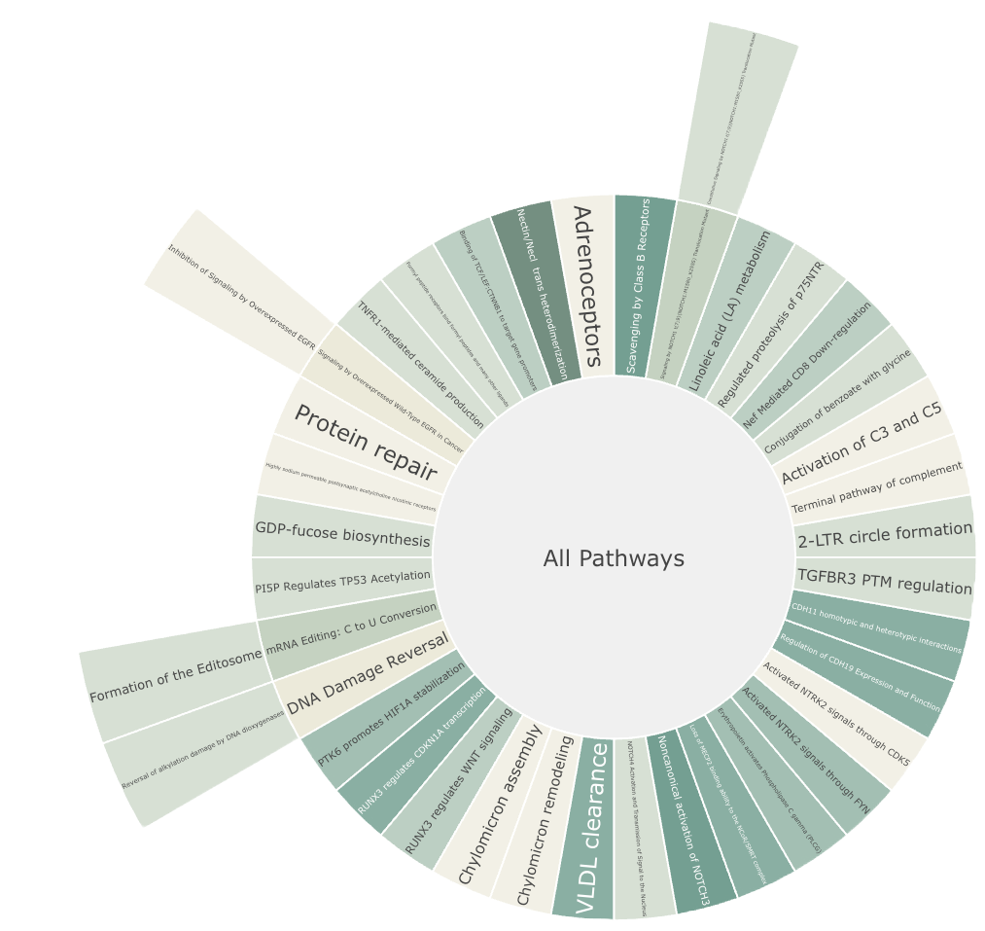

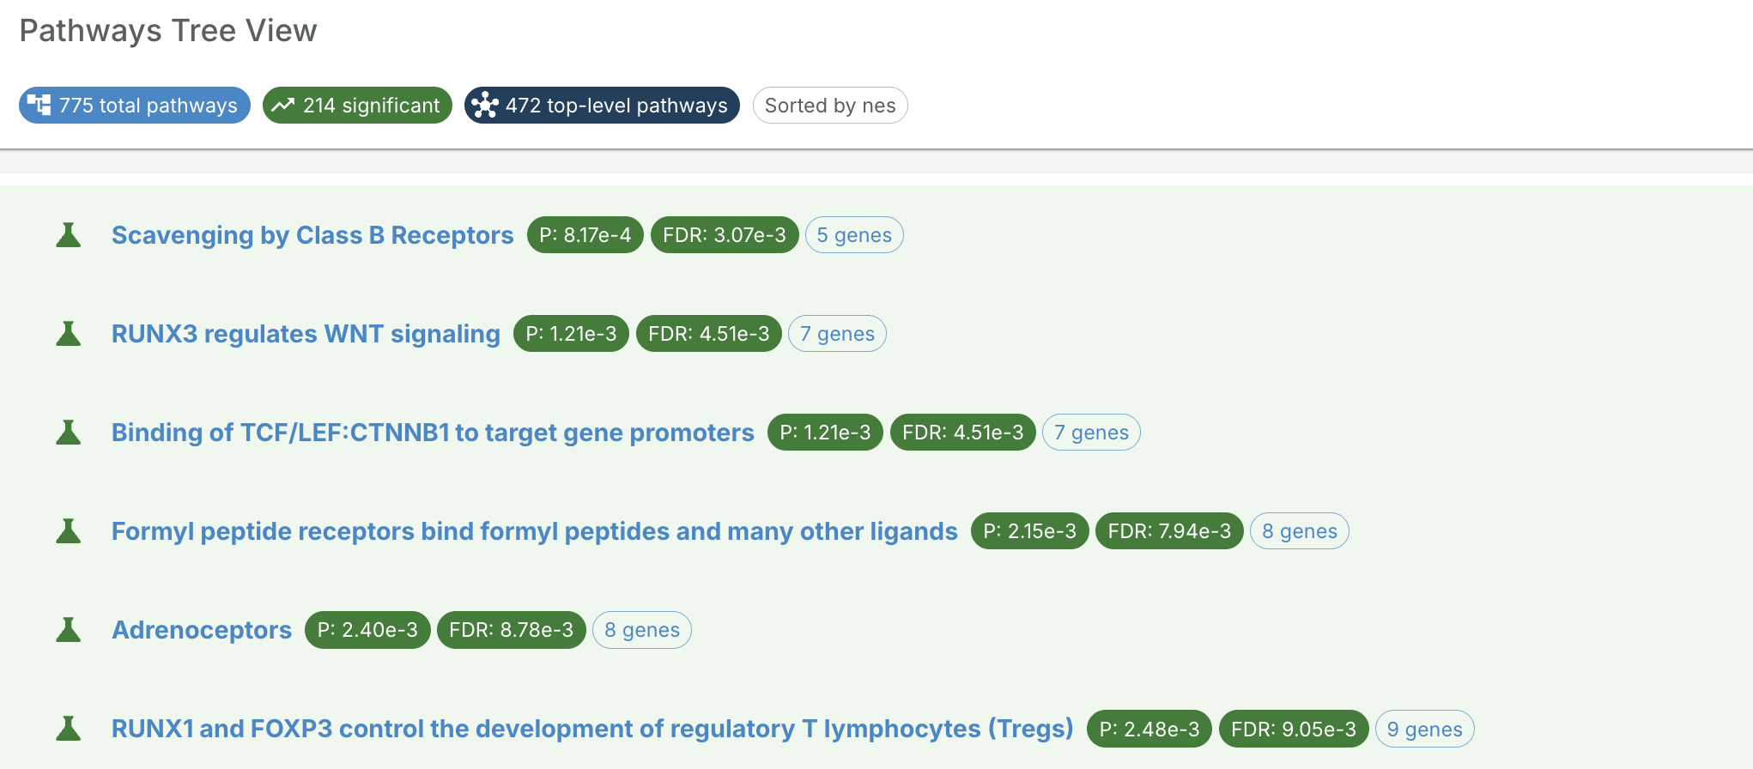
Alzheimer's disease-inferred pathways
NeuroFlux
NES > 2.8
FDR < 0.05
Notes:
"Looking retrospectively at NeuroFlux: this approach would have identified 75 additional candidates from the secondary screens
[If you calculate overlap]: "Of these, Y overlap with our current nominated set, and Z would be new additions"
[If you calculate significance]: "X of these were significant in the secondary screens"
"At that stage Lewis already had the targets he needed, but this shows the potential to expand the discovery space"
This sunburst shows all Alzheimer's disease-inferred pathways from genetics - a much broader universe than curated databases
Beyond just discovery, you can also use disease pathways to EXPLORE and understand the targets you've already selected. Here's how.

Slide 8
Alzheimer's disease-inferred pathways
NeuroFlux
NES > 2.8
FDR < 0.05
75 additional targets with genetic evidence
9/11 of them showed significance in secondary screens
(retrospective evaluation)
Notes:
"Looking retrospectively at NeuroFlux: this approach would have identified 75 additional candidates from the secondary screens
[If you calculate overlap]: "Of these, Y overlap with our current nominated set, and Z would be new additions"
[If you calculate significance]: "X of these were significant in the secondary screens"
"At that stage Lewis already had the targets he needed, but this shows the potential to expand the discovery space"
This sunburst shows all Alzheimer's disease-inferred pathways from genetics - a much broader universe than curated databases
Beyond just discovery, you can also use disease pathways to EXPLORE and understand the targets you've already selected. Here's how.

Slide 9
Genetically-inferred disease pathways catalogue
Alzheimer's disease
1,700 genes (1,480 in library) · 377 hits at FDR < 0.05
LDL cholesterol measurement
3,327 genes (2,912 in library)· 654 hits at FDR < 0.05
Gene scoring
weight every gene by the enrichment (NES) of the pathways it belongs to
1
Pathway | Source | NES | FDR
Negative Regulation of Cellular Process | GO BP | 3.89 | ***
Regulation of Cell Migration | GO BP | 3.62 | **
Immune System | Reactome | 3.58 | **
Expression and translocation of olfactory receptors | Reactome | 3.54 | **
Olfactory Signaling Pathway | Reactome | 3.50 | **
Signaling by Receptor Tyrosine Kinases | Reactome | 3.40 | **
Positive Regulation of Amyloid Fibril Formation | GO BP | 3.26 | **
Pathway | Source | NES | FDR
Expression and translocation of olfactory receptors | Reactome | 5.83 | ***
Olfactory Signaling Pathway | Reactome | 5.45 | ***
Metabolism | Reactome | 4.05 | ***
Transport of small molecules | Reactome | 4.00 | ***
Positive Regulation of DNA-templated Transcription | GO BP | 3.94 | ***
Lipid Metabolic Process | GO BP | 3.92 | ***
Metabolism of lipids | Reactome | 3.85 | ***
Frequency adjustment
down-weight genes that appear across many pathways
2
Normalisation
scale scores to a comparable range across diseases
3
3,766
>25 genes with
genetic evidence
blitzGSEA protocol
17,206-gene background
Add as L2G features
feed per-gene pathway scores into the Locus-to-Gene model
4
diseases & measurements
Hallmark
i
ii
Notes:
Score each gene
Adjust for total appearances
Normalise
Use as model features

