Slide 1


Automatic extraction
of disease pathways
Presented by
Polina Rusina

Slide 2
Library
Red Dragon
How to Train
Your Dragon
Dragon Rider
The Girl with the Dragon Tattoo
A Dance with Dragons
Dragons of Autumn Twilight
The Last Dragon
The Flight of Dragons

Slide 3
Reactome
1
Curation is incomplete
Red Dragon
How to Train
Your Dragon
Labels that name a disease, and nothing follows
2
And it has stopped
Dragon Rider
The Girl with the Dragon Tattoo
A Dance with Dragons
Dragons of Autumn Twilight
Reactome left EMBL-EBI, so nothing new is added
The Last Dragon
3
And it is one library of many
The Flight of Dragons
Every other pathway database is untouched

Slide 4

Automatic extraction of disease pathways from Reactome
LLM
Disease fragments
Pathway labels
Mapping verification
Evidence benchmark
disease
reactome
evidence_reactome
Genes are dysregulated in type two diabetes
Genes are dysregulated in type two diabetes
Type two diabetes
Gene X
Gene Y
Gene Z
Type two diabetes
type
two
diabetes
type two
two diabetes
Gene X
Gene Y
Gene Z
type two diabetes
type two diabetes

Slide 5
DISEASE FRAGMENTS
How a disease name becomes a searchable fragment
1
Expand
Pendred syndrome
deafness with goitre
thyroid dyshormonogenesis 2b
name plus every exact synonym
2
Cut
deafness
with
goitre
deafness with
with goitre
deafness with goitre
every run of neighbouring words
3
Score and keep
deafness with goitre 24.3 shared by 1
deafness 4.4 shared by 253
4 more spans dropped
rarity summed
over its words
A word's rarity = log of word(s) in all diseases / word(s) in those that use it.
A span scores the sum of its words, and is kept only as a whole form scoring >8 if it stands alone.
Rule

Slide 6
MATCHING REACTOME LABELS
A disease reaches a label in three ways
They differ in what has to appear in the label: a known shape, a complete name, or one distinctive word.
1
Fixed pattern
Defective ABCC6 causes PXE
pseudoxanthoma elasticum
85 pathway-disease links
One of four fixed shapes. The slot holds a disease by construction, so even a bare acronym is safe to read.
2
Complete name
Fanconi Anemia Pathway
Fanconi anemia
171 pathway-disease links
No fixed shape. The complete name or an exact synonym turns up somewhere in the label, in one span.
3
Single word
Uptake and function of diphtheria toxin
diphtheria
95 pathway-disease links
No fixed shape and no complete name. One distinctive word, six letters or more, never a gene symbol.
HD is a protein domain here, not Huntington disease. Read acronyms anywhere and 61 wrong links arrive for every 10 right ones.
Acronyms ?
NOTCH1 HD Domain Mutants

Slide 7
LLM JUDGE
The judge only reads the doubtful links
351 pathway-disease links, judged by Claude Sonnet 5
11 rejected
200 not sent
140 kept
85 fixed pattern, plus 115 complete name scoring >12
judged
A different disease
A protein, not a condition
Another sense of the word
6 of the 11 rejects
2 of the 11 rejects
2 of the 11 rejects
SARS-CoV-2 Infection
Regulation of gene expression by Hypoxia-inducible Factor
NTRK3 as a dependence receptor
severe acute respiratory syndrome
hypoxia
substance dependence
SARS-CoV-2 causes COVID-19, not SARS
part of the protein name, not the state
a dependence receptor is a molecular class

Slide 8
RESULTS
What the pipeline adds to Reactome curation
253
Benchmark stage
121 of 653
curated links recovered (18.5%)
new pathway-disease links
87 exact, 28 more specific than the curated term, 6 more general
Most curated links name no disease in the label at all
Curators work from pathway biology, the pipeline works from label text
177
+947
diseases covered
target-disease pairs
444 of the 947 come from four large pathways: SARS therapeutics (154 genes), MLL4/MLL3 (134), SARS-CoV-2 immune modulation (125), TPR (64).
Merge, do not replace. The pipeline reaches what labels name, curation reaches what biology implies.
Verdict

Slide 9
MEASURED, NOT GUESSED
Why 532 curated links are not recovered
The label names no disease
We name a different disease
453
79
Out of scope
453
Disagreement
79
Mapping comes from biology, with no disease name in the label
Automatic mapping is more precise in 82% of cases
pathway label
pathway label
Signaling by plasma membrane FGFR1 fusions
Defective HLCS causes multiple carboxylase deficiency
manual curation
manual curation
automatic extraction
cancer
inborn vitamin metabolic disorder
multiple carboxylase deficiency
Our term is broader, or an acronym in the slot resolved to the wrong disease (see backup)
Other 18%

Slide 10
GENE ONTOLOGY
The next library along the street
Reactome
GO
KEGG
WikiPathways
Elsevier
BioPlanet
BioCarta
NCI-Nature
Panther
MSigDB
Open Targets curates one of these libraries. The pipeline can read any of them.
Third gap

Slide 11
ENRICHR
All pathway libraries covered
Reactome
GO
KEGG
WikiPathways
Elsevier
BioPlanet
BioCarta
NCI-Nature
Panther
MSigDB
Open Targets curates one of these libraries. The pipeline can read any of them.
Third gap

Slide 12
ALL SOURCES COMPARED
4/5 of pathway evidence comes from new sources
Open Targets sources 481
Enrichr, 12 libraries 1,118
340
Reactome
141
GO
737
Elsevier
179 WikiPathways
202
six more libraries
21%
9%
46%
11%
13%
Source
Labels scanned
Links matched
Links kept
Rejected of judged
Diseases
Reactome
2,870
351
340
11 of 151
215
GO biological process
24,136
165
141
24 of 77
16
Enrichr, 12 libraries
28,064
1,144
1,118
26 of 1,144
349
Open Targets Platform release 26.06 and Enrichr pathway libraries, judged with Claude Sonnet 5.

Slide 13
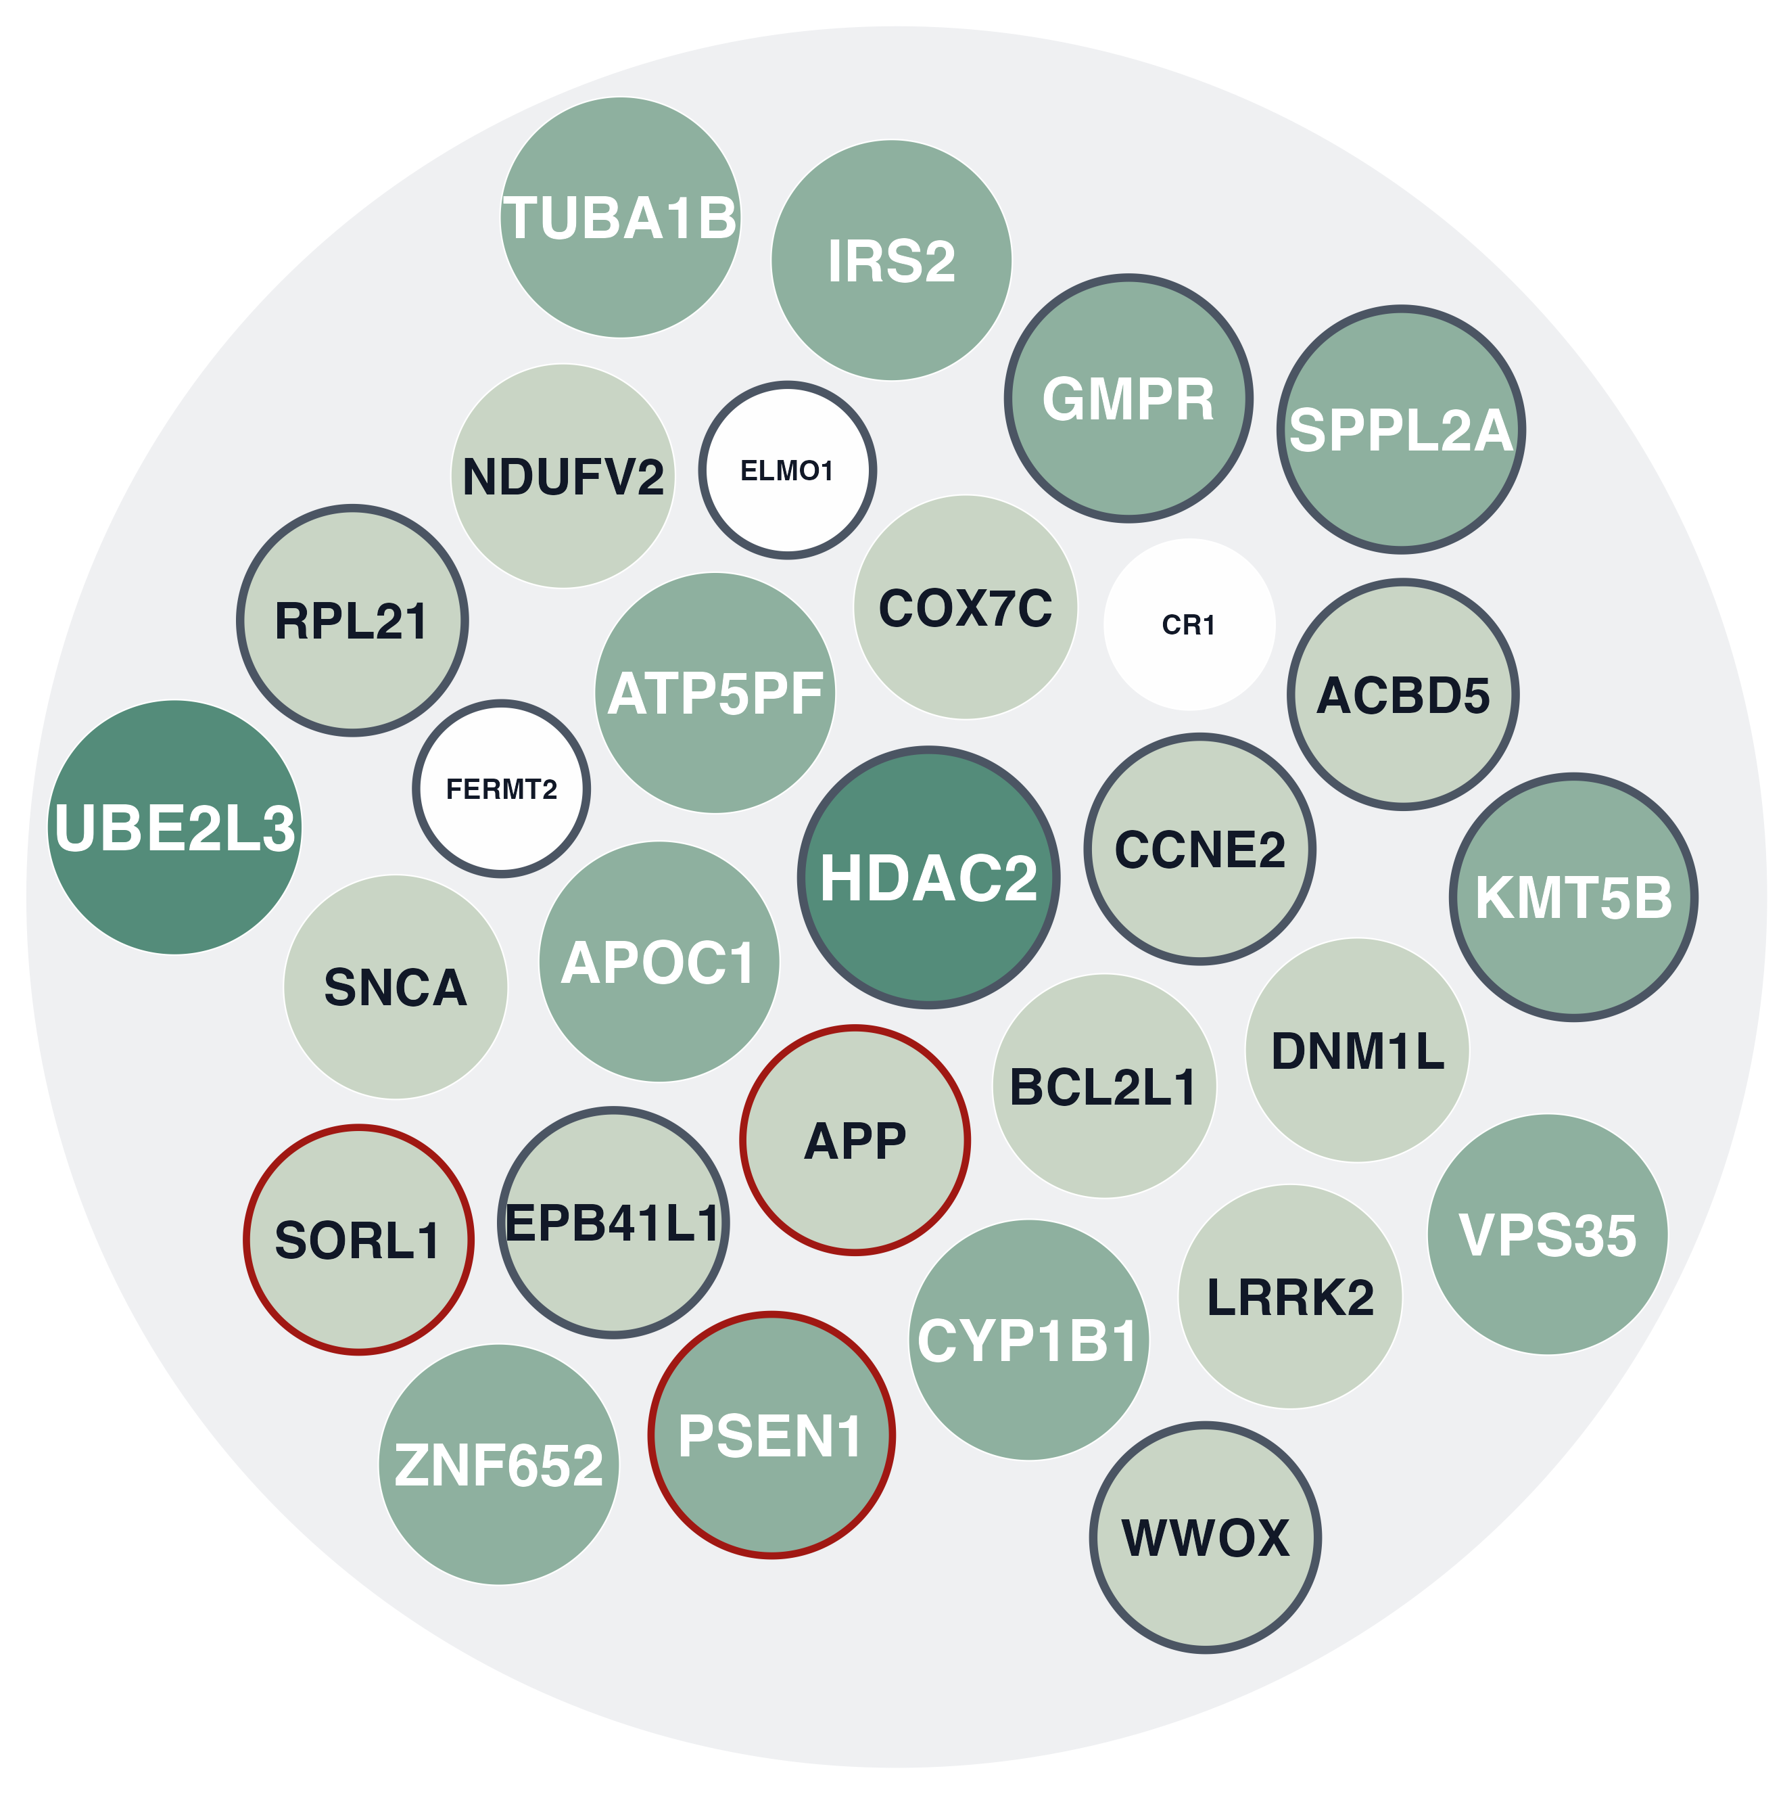
CONCLUSION
Benefits of disease pathway
1
Scale
+947 target-disease pairs and 44 specificity fixes, from Reactome
2
Works on any source
A new resource needs no method change
3
Demonstrated need
Pipeline was already beneficial for NeuroFlux and NeuroId target prioritisation
NeuroFlux targets
prioritised by disease pathways

Slide 14
Thank you
Red Dragon
How to Train
Your Dragon
Dragon Rider
A Dance with Dragons
The Last Dragon
Dragons of Autumn Twilight
The Flight of Dragons
The Girl with the Dragon Tattoo

Slide 15
BACKUP: MATCHER DETAIL
Why acronyms are refused
4,426 acronyms in the index. 802 name more than one disease.
Acronym
Disease terms it names
Where an acronym is still allowed
HAND
101
Complete-name list
never
An acronym is not a spelled-out name, so it never reaches this list. No exception exists.
AML
72
Single-word list
four only
CDG
58
SOURCE: HUMAN REVIEW
FACE
54
HIV, SARS, HSE and MSUD, each mapped by hand to one disease. Nothing joins automatically.
49
Template slot
always
GSD
SOURCE: THE LABEL ITSELF
AS
36
Defective ABCC6 causes PXE. The sentence proves the slot holds a disease before the acronym is read.
Measured
Searching acronyms freely was tested: 10 more correct links, 61 wrong ones. It stays off.

Slide 16
BACKUP: THE REVIEW PILE, ONE OF TWO
Every acronym disagreement
Every disagreement whose disease came from an acronym sitting in a template slot. Fifteen rows in total, and the pile to read first.
Acronym
Pathway label
Disease we read
Curated disease
AEXS
Defective CYP19A1 causes AEXS
aromatase excess syndrome
pseudohermaphroditism
CDG-1I
Defective ALG2 causes CDG-1i
ALG2-congenital disorder of glycosylation
Congenital myasthenic syndromes
CMS
Defective ALG14 causes ALG14-CMS
congenital myasthenic syndrome
Congenital myasthenic syndromes
DRTA
Defective SLC4A1 causes hereditary spherocytosis type 4 (HSP4), distal renal tubular acidosis (dRTA) and dRTA with hemolytic anemia
distal renal tubular acidosis
non-autoimmune hemolytic anemia
FFDD4
Defective CYP26C1 causes FFDD4
focal facial dermal dysplasia type IV
skin neoplasm
HFE4
Defective SLC40A1 causes hemochromatosis 4 (HFE4) (duodenum)
hemochromatosis type 4
infantile epileptic encephalopathy
HFE4
Defective SLC40A1 causes hemochromatosis 4 (HFE4) (macrophages)
hemochromatosis type 4
infantile epileptic encephalopathy
IFD
Defective CBLIF causes IFD
Congenital intrinsic factor deficiency
Grasbeck-Imerslund disease
Reactome, release 26.06. Fifteen of the 79 disagreements, all from the one place acronyms are licensed.

Slide 17
BACKUP: THE REVIEW PILE, TWO OF TWO
Every acronym disagreement
Every disagreement whose disease came from an acronym sitting in a template slot. Fifteen rows in total, and the pile to read first.
Acronym
Pathway label
Disease we read
Curated disease
IFD
Defective CBLIF causes IFD
hereditary intrinsic factor deficiency
Grasbeck-Imerslund disease
MGA1
Defective AMN causes MGA1
3-methylglutaconic aciduria type 1
Grasbeck-Imerslund disease
MGA1
Defective CUBN causes MGA1
3-methylglutaconic aciduria type 1
Grasbeck-Imerslund disease
OI
Defective SLC6A2 causes orthostatic intolerance (OI)
osteogenesis imperfecta
Sensorineural hearing impairment
PPS
Defective B3GALTL causes PpS
popliteal pterygium syndrome
Peters plus syndrome, orofacial cleft
SPG42
Defective SLC33A1 causes spastic paraplegia 42 (SPG42)
Autosomal dominant spastic paraplegia type 42
cataract, hemochromatosis
SPG42
Defective SLC33A1 causes spastic paraplegia 42 (SPG42)
hereditary spastic paraplegia 42
cataract, hemochromatosis
Reactome, release 26.06. Fifteen of the 79 disagreements, all from the one place acronyms are licensed.

Slide 18
BACKUP: HOW THE LIBRARIES WERE CHOSEN
Twelve more public pathway libraries
228 Enrichr libraries
curated Pathways category
latest version, no Reactome, GO or mouse
12 libraries
Labels and gene sets ship in one GMT file, so gene membership needs no target-to-pathway join.
Library
What it is
Labels name
Elsevier_Pathway_Collection
commercially curated disease-mechanism pathways
diseases
KEGG_2026
metabolic, signalling and human-disease pathways
pathways
WikiPathways_2024_Human
community-curated biological pathways
pathways
BioPlanet_2019
NCATS, integrated and deduplicated human pathways
pathways
BioCarta / NCI-Nature / Panther
legacy maps, PID signalling, PANTHER classification
pathways
HumanCyc / PFOCR
human metabolic pathways, gene sets mined from figures
no disease
MSigDB (3 collections)
hallmark states, computational modules, oncogenic signatures
no disease
maayanlab.cloud/Enrichr

Slide 19
HAIKU, SONNET, OPUS
The judge is the one non-deterministic step
Every other stage is string work and arithmetic, identical in every run. Three models were given the same candidates and the same prompt.
Model
Reactome rejects
False rejects
GO rejects
$ / 1M in
$ / 1M out
Claude Haiku 4.5
6
2
37
1.00
5.00
Claude Sonnet 5 (default)
11
1
24
3.00
15.00
Claude Opus 4.8
8
1
21
5.00
25.00
Where they agree
Where they split
Safeguard
Reactome: 137 of 151 (91%)
GO: 60 of 77 (78%)
The "sars" alias, hypoxia as process or disease
GO: Haiku strictest, rejecting on tissue
False-reject check against curated evidence
Human review of every candidate
The model shifts a handful of borderline calls, not the result. Sonnet 5 is the default.
Verdict
Anthropic list prices, USD per 1M tokens. Sonnet 5 has an introductory rate to 2026-08-31.

