Slide 1
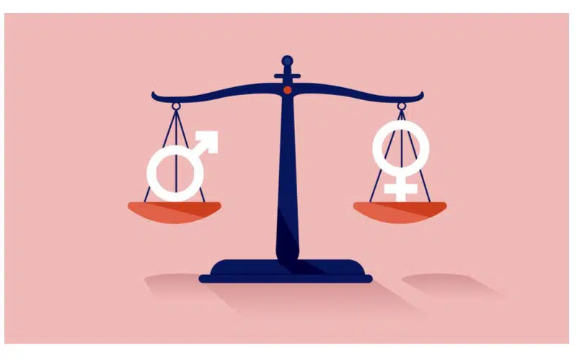
State-Level Gender Equality: Comparing Anti-Discrimination and Equal Pay Legislation
By: Abby Stacy

Slide 2
Relationship Between Gender Discrimination Laws and Equal Pay
Theory
States with greater protections for gender equality will see smaller gender-based wage gaps
Anti Discrimination Laws
Gender Equality
Smaller Gender Wage Gap

Slide 3
Independent and Dependent Variables
Independent Variable
Presence of gender discrimination laws
Operationalization 1:
Year of implementation
Operationalization 2:
Anti Discrimination Laws
Dependent Variable
Support for equal pay
Operationalization 1:
Gender equal pay
Operationalization 2:
Minimum wage

Slide 4
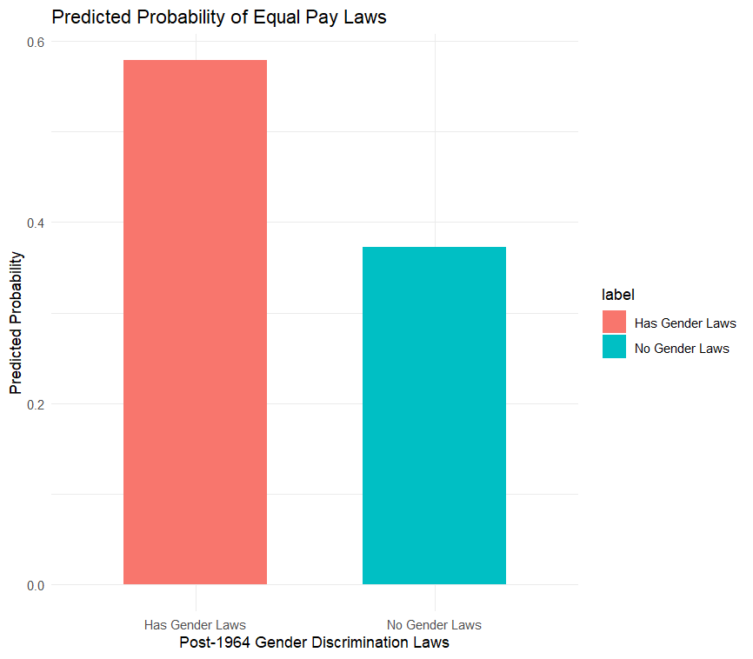
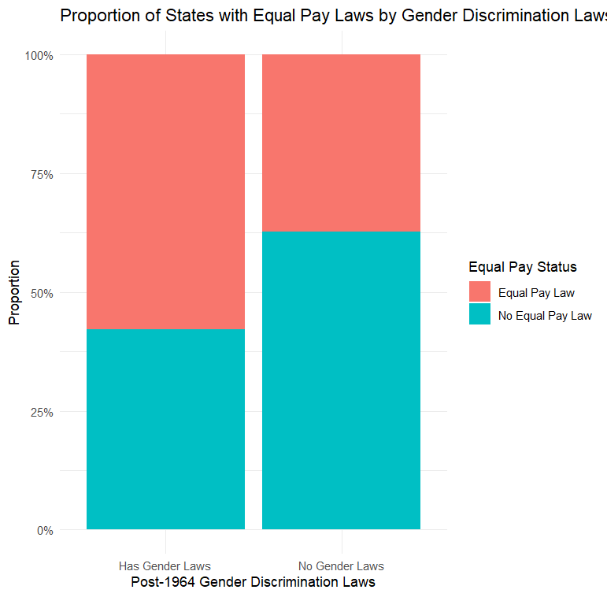
Regression: Probability of Having Equal Pay with the presence of Anti Discrimination Laws.
States without post-1964 gender discrimination laws have a 37.2% chance of equal pay laws. With such laws, it rises to 57.9% (coef = 0.2068, p < 0.001).

Slide 5
Hypothesis
States that implemented gender equality laws, will exhibit smaller gender based wage gaps.
Gender Equal Pay Laws
Gender Wage Gap

Slide 6
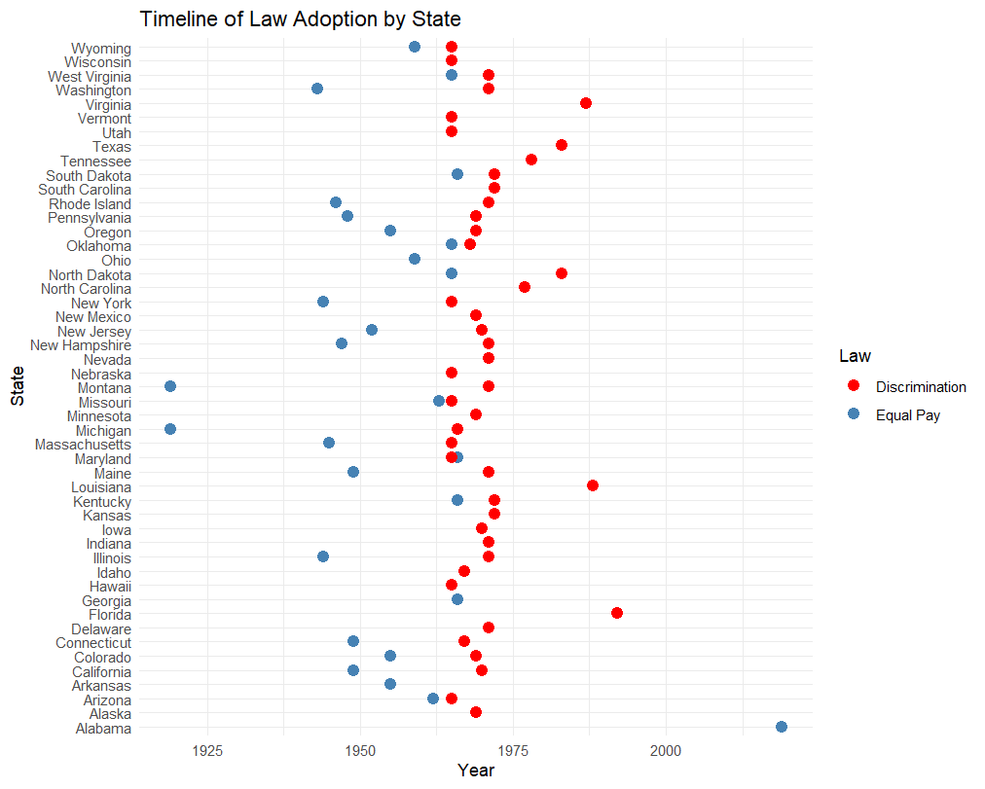
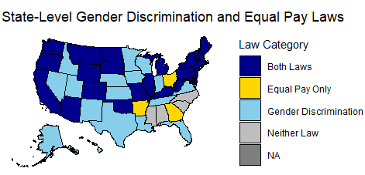
Map: Gender Laws by State and Implementation Timeline
According to the timeline, equal pay laws were largely adopted before discrimination laws. With the majority of discrimination laws being adopted between 1960-1970 due in part to the federal discrimination law put in place.

Slide 7
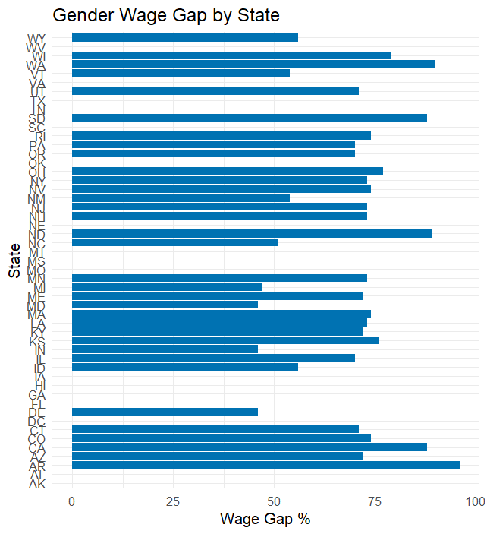
Gender wage gaps by state

Slide 8
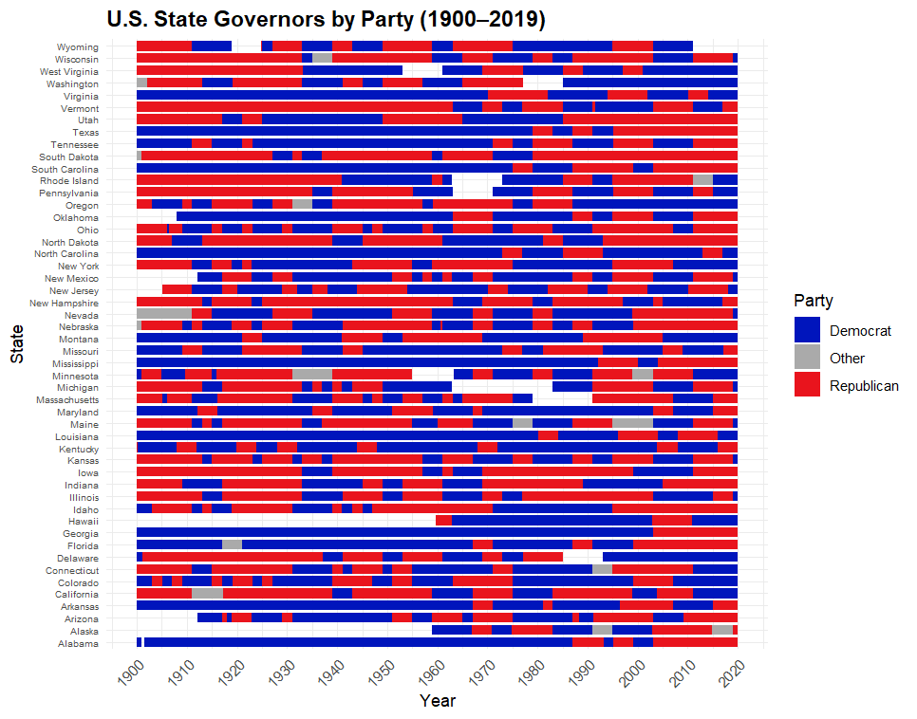
Control Variable: Political Affiliation in 2005
Control Variables
Political affiliation
Political leanings can influence state legislation on social issues including gender and labor laws

Slide 9
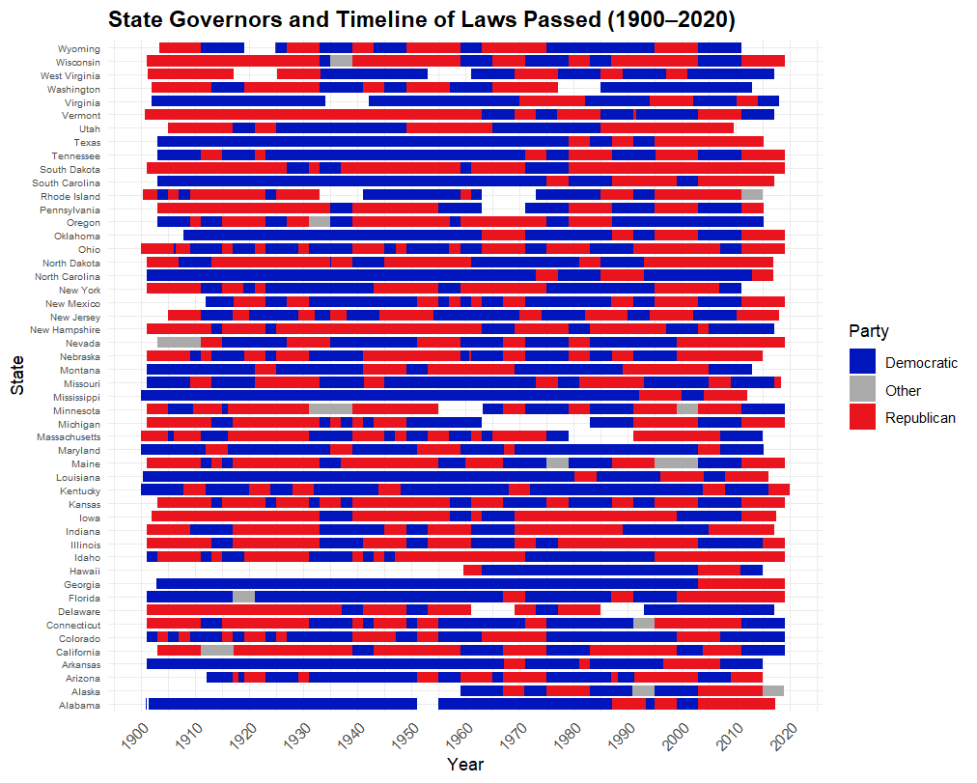
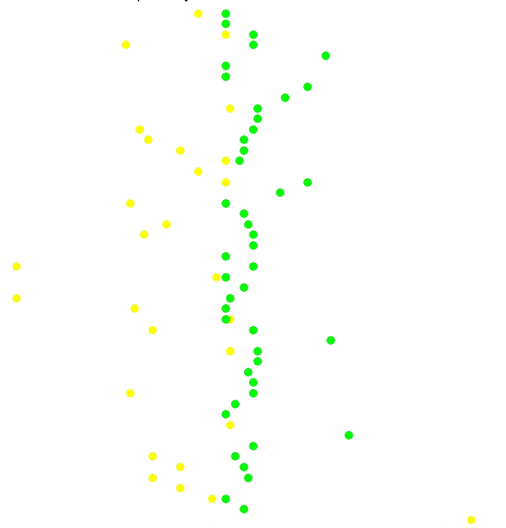
Of the 50 U.S. states, 56% adopted equal pay laws (64% Democrat-led and 36% Republican-led). 90% adopted anti discrimination laws (69% Democrat-led and 31% Republican-led). Democrat-led states were more likely to adopt laws related to equal rights.
Laws
Discrimination
Equal Pay

Slide 10



Anticipated Challenges:
Missing Data: multiple NA’s
Binary versus continuous data
Hard to separate timing vs. effect of laws
Different enforcement levels across states
Wage gap may be affected by unobserved cultural/economic factors

Slide 11
Bibliography
Dataset
R Studio
Graphs and other visualizations
Kaggle Dataset

