Slide 1
Introduction
Introduction The project will display district location in city Poznań. For that task I will be looking the best location for Supermarket.

Slide 2
Data
District of Poznan https://en.wikipedia.org/wiki/Administrative_division_of_Pozna%C5%84
Geo data gather from the python function
FourSquare API.

Slide 3
Method
Data gather form wiki and then fill up with location information. Thanks to this, I am able to display a map with districts.
Foursquare api uses the limit of 5000 records in the area of 2500. It allows obtaining 2194 objects.
The most popular 5 categories for a given district are used for the study.

Slide 4
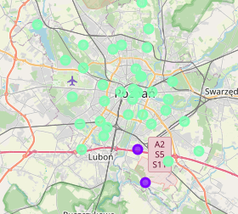
Results
The result shows that the best location for a supermarket can be chosen among districts within cluster 1.

Slide 5
Discussion and Conclusion
The use of the k means algorithm allows for quite precise analyzes as to the choice of location. The result is a choice from among cluster 1.

