Slide 1
Airbnb Price Prediction in London
Text Mining for Economics & Finance
4 March 2026

Slide 2
Motivation
Airbnb Pricing
Airbnb listing prices reflect observable housing characteristics captured by structured variables
Some quality signals may not be fully captured by structured variables
Listing descriptions may contain additional information about these signals
Research Question: Does listing text improve price prediction beyond structured housing features?

Slide 3
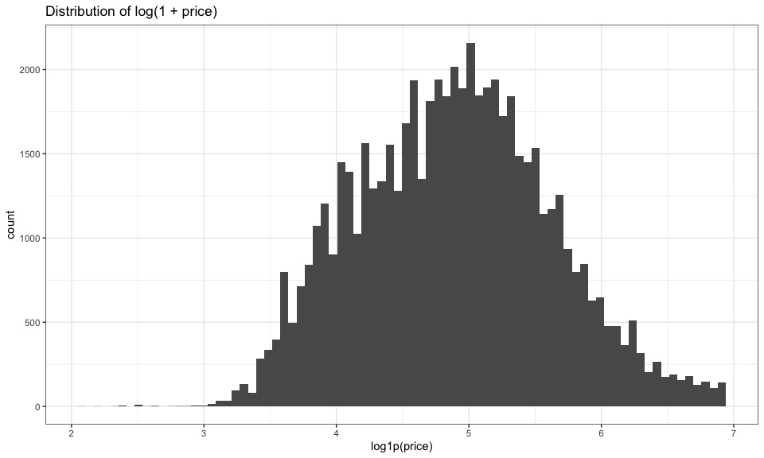
Population & Quantity of Interest
Airbnb Pricing
Population of Interest:
London Airbnb Listings priced below £1000 per night
We restrict ultra-luxury outliers to avoid a separate pricing regime.
Quantity of Interest
Primary:
Log(price)
Log transformation stabilizes variance and improves model fit + interpretability
Secondary:
Incremental reduction in prediction error when text is added
We study: How much additional price variation is explained by text?

Slide 4

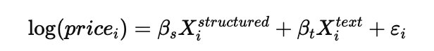
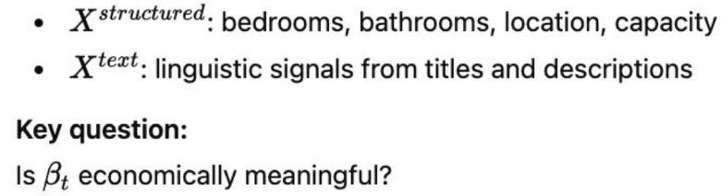
Economics: Hedonic Pricing Framework
Airbnb Pricing
Economic intuition:
In a hedonic model, price reflects the bundle of characteristics a listing contains.
Where:
Notes:
In a hedonic pricing framework, the price of a good reflects the bundle of characteristics it contains. In the case of Airbnb listings, structured variables such as bedrooms, bathrooms, and location capture observable housing fundamentals. However, listing descriptions may encode additional signals such as prestige, amenities, or perceived quality. Our model treats structured and linguistic features as two sets of characteristics and tests whether text provides incremental explanatory power in predicting price.

Slide 5
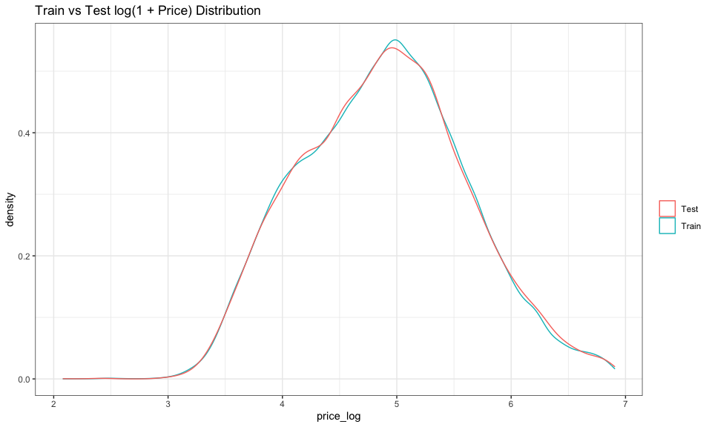
Data Overview
Airbnb Pricing
~60k listings
Avg title length: 6 words
Avg description length: 64 words
Structured features:
latitude
longitude
bedrooms
bathrooms
beds
accommodates
Train/Test split: 80/20 (stratified on log price)

Slide 6
Methods
Airbnb Pricing
Methods:
N-grams (Bag-of-Words)
Regularization
Word Embeddings
Transfer Learning
Benchmark Comparisons

Slide 7
Benchmark Models
We must compare against simple baselines.
Benchmarks:
Structured-only LASSO
Description n-grams
Embeddings-only
This shows whether complex NLP adds value.
Airbnb Pricing

Slide 8
Section I: Title vs. Description
Which linguistic object better captures latent characteristics?

Slide 9
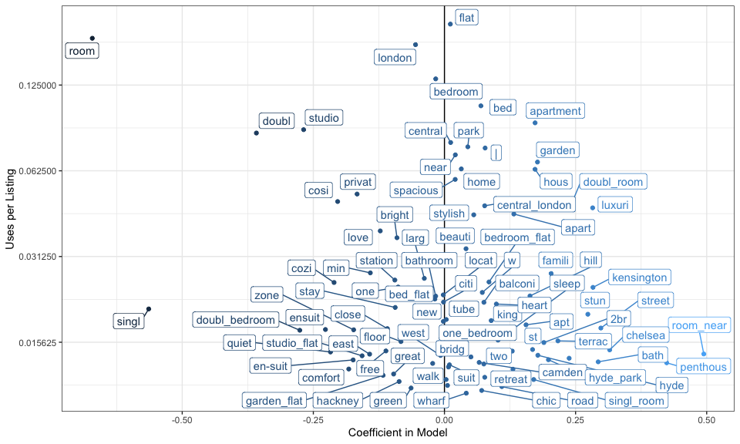
Title Models
Airbnb Pricing
1:2 n-grams
RMSE_log = 0.591
Interpretation:
Titles encode location & property type
But short documents → limited richness
Lesson: Document length affects predictive power

Slide 10
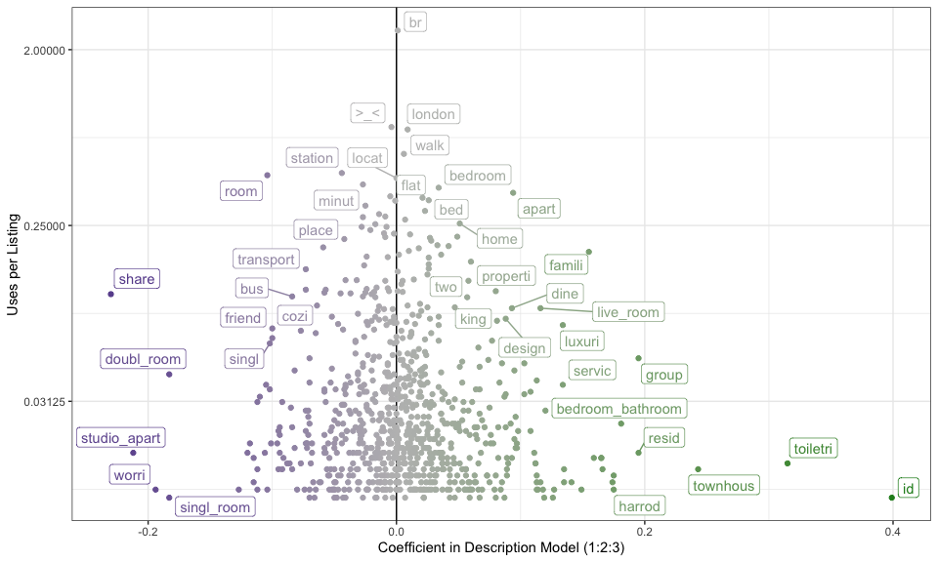
Description n-Grams
Airbnb Pricing
Tested:
Unigrams
1:2
1:2:3
Best: 1:2:3
RMSE_log = 0.557
Interpretation:
Descriptions contain structured economic signals
Location prestige
Accommodation type
Amenities

Slide 11
Section II: Embeddings
Are economically meaningful signals embededed in semantic structure, not just word presence?

Slide 12
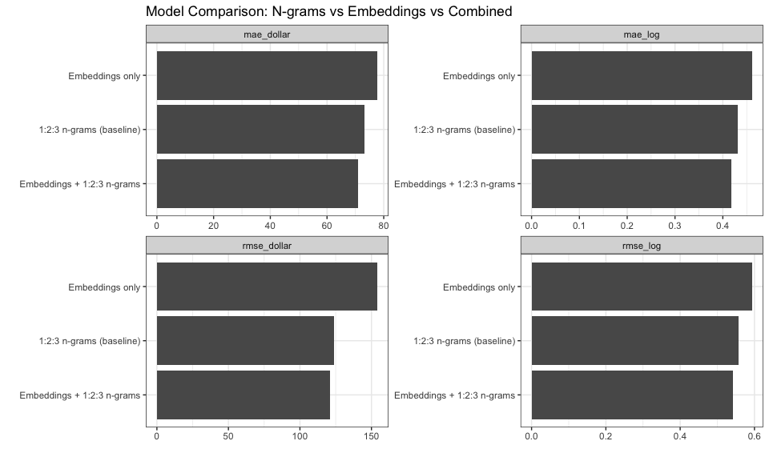
Transfer Learning (Embeddings)
Airbnb Pricing
Instead of estimating word meaning from scratch:
We use pre-trained word embeddings.
What is Transfer Learning?
Vectors trained on large external corpora
Capture semantic similarity
Project Airbnb descriptions into 300-dim space
Embeddings only: RMSE_log = 0.593
Embeddings + n-grams: RMSE_log = 0.543
Insight:
Transfer learning improves semantic richness, but embeddings alone underperform sparse n-grams.

Slide 13
Section III: Structures vs Structured + Text
Does description text provide incremental explanatory power beyond structured housing fundamentals in the hedonic pricing function?

Slide 14
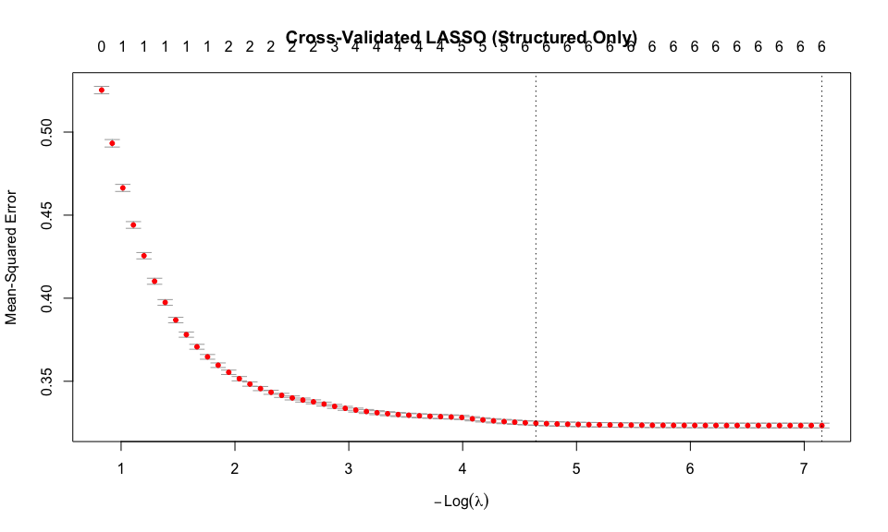
Structured Model
Airbnb Pricing
Features (Structured Fundamentals):
Bedrooms
Bathrooms
Capacity
Geographic coordinates
RMSE_log = 0.570
Interpretation:
Housing fundamentals explain most variation.
Text alone predicts price about as well as structured fundamentals.

Slide 15
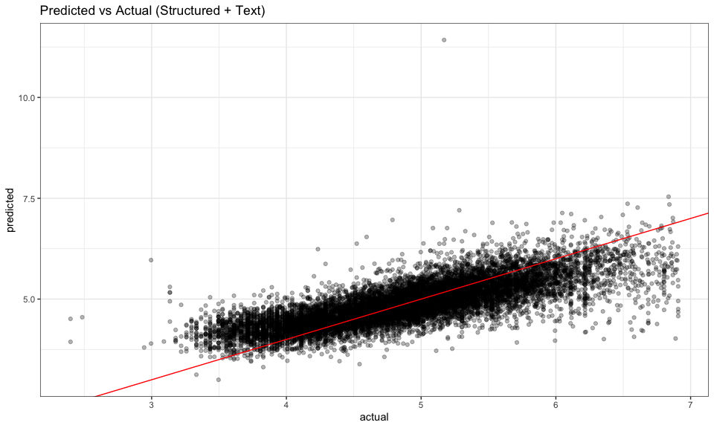
Structured + Text (Best Model)
Airbnb Pricing
Combined:
Structured
Embeddings (transfer learning)
1:2:3 n-grams
RMSE_log = 0.464
This is the best performing model.
Interpretation:
Both capture different aspects of listing
Structured: housing fundamentals
Description: additional signals (amenities, prestige)

Slide 16
Model Comparison
Airbnb Pricing
Model | RMSE_log
Structured Only | 0.570
Text (1:2:3) | 0.557
Embeddings + Text | 0.543
Structured + Text | 0.464
Key Economic Result
Text reduces prediction error substantially when combined with structure.
This implies:
Descriptions encode incremental economic information.

Slide 17
Economic Interpretation
Airbnb Pricing
High-price signals:
luxury
harrods
townhouse
serviced
Low-price signals:
shared
single_room
Bus
Interpretation
Text captures:
Prestige
Space
Exclusivity
Transportation access
Language reflects economic quality.

Slide 18
Model Evaluation Strategy
Airbnb Pricing
We use:
Train/Test split
Stratification on log price
Cross-validated LASSO
RMSE & MAE
We compare to benchmarks to measure incremental value
This follows best practices from class.

Slide 19
Boundary Conditions
Airbnb Pricing
When might this fail?
Extreme luxury listings
Time-varying demand shocks
Missing neighborhood income
Nonlinear pricing mechanisms
LASSO assumes linear effects.
Future improvements:
Borough-level income merge
Review sentiment
Central vs Outer London subsample
Nonlinear models (tree-based)
Dynamic pricing effects
19

Slide 20
Conclusion
Airbnb Pricing
Titles contain limited signal
Descriptions contain meaningful economic information
Structured housing features dominate price
Text provides incremental predictive power
Transfer learning adds semantic richness
Final Takeaway:
Airbnb descriptions encode economically meaningful signals beyond observable housing characteristics.

Slide 21
Thank you
Air BnB Price Prediction In London
04/03/2026

