Slide 1
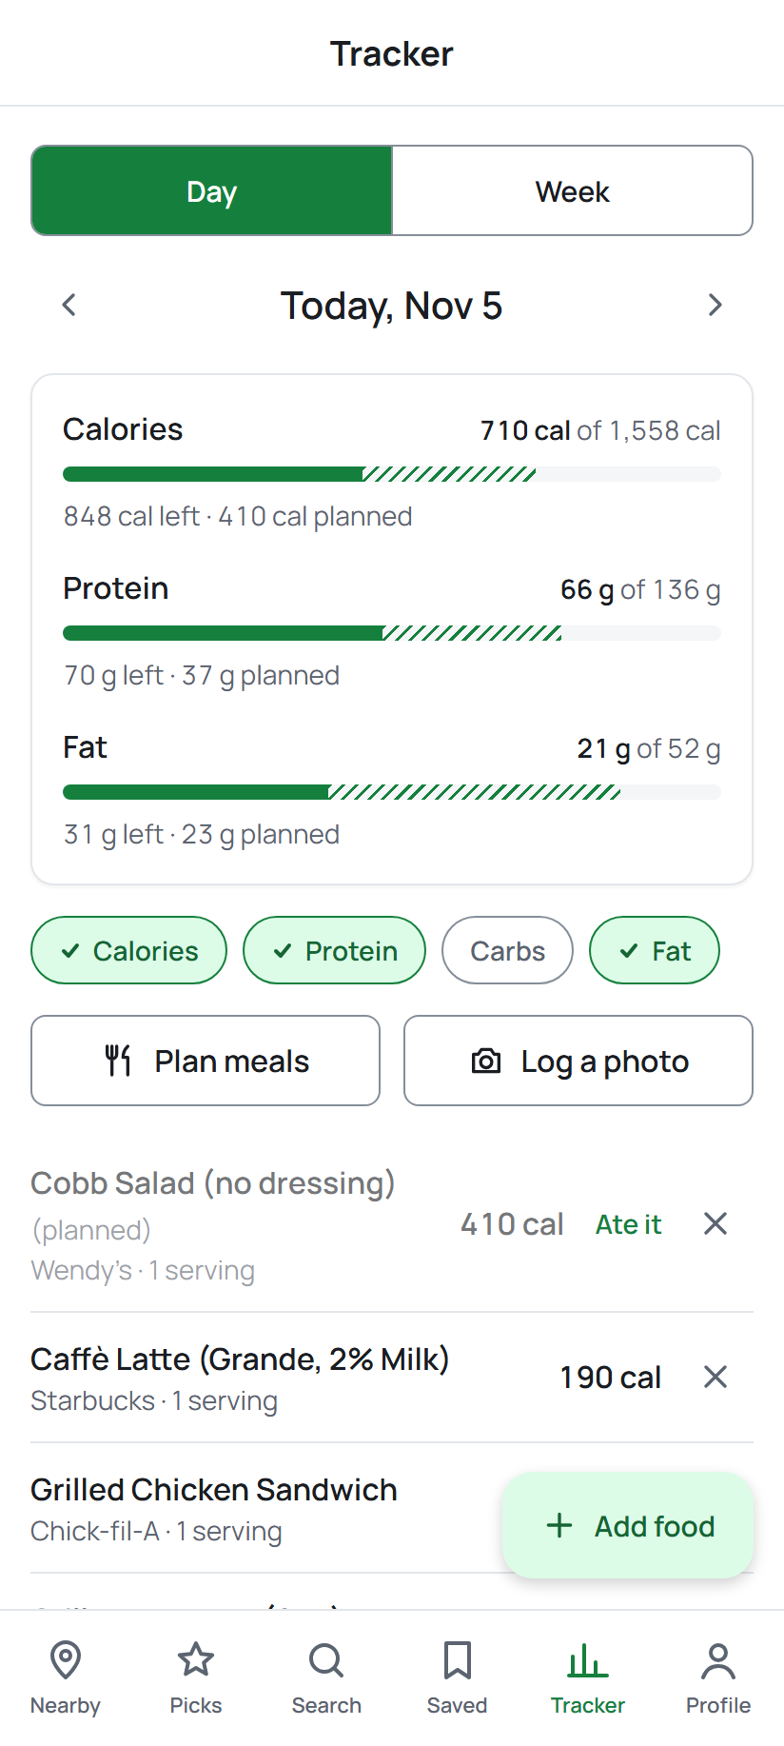
Menu Macro Fitter
Find food near campus that fits your calorie goal
Team 6 · COP 4331C · cop4331ruth.lol
Notes:
Presenter: Marcus (about 20 s). One sentence: students pick a goal, we work out their calories, then show what fits at the restaurants around them. Live at cop4331ruth.lol, Android app too.

Slide 2
What it does
1
2
3
4
Set up a profile
Find food nearby
Track and plan
Keep the data right
Height, weight, age, sex, activity and goal give a daily calorie target and macros
Restaurants within 5 to 20 miles; items ranked high-protein or high-carb under a per-meal limit
Log meals, see day and week totals, get a meal plan, or log a meal from a photo
Suggest corrections or new items; auto-moderation plus admin review
10
restaurant chains near UCF
85
menu items checked against official nutrition pages
2
clients: web and Android, one API
Notes:
Presenter: Marcus (about 30 s). Walk the four steps left to right. Calorie target uses Mifflin-St Jeor; estimates, not medical advice.

Slide 3
Team and roles
MR
MF
AK
RM
Marcus Ruth
Matthew Feyler
Alex Kemper
Richard Magiday
Project manager, API
API
Mobile
Database, web
Server, domain and HTTPS; CI and auto-deploy; API contract; meal plans, photo analysis, submissions and admin API; UML, Gantt, SwaggerHub
Auth with email verification and reset; profile and calories; search, recommendations, favorites, nearby, meal logs; Postman and API tests
Flutter app: every screen on Android; Figma prototypes; mobile class diagram
MongoDB schema, seed and nutrition data, ERD; React web app; M6 prototypes
Notes:
Presenter: Marcus (about 20 s). Each person then presents their own part. Check Marcus's last name.

Slide 4
Technology
Database
Backend
Web
MongoDB 8 with schema validators; Mongoose 9
Node.js + Express 5; JWT, bcrypt; SendGrid email
React 19 + TypeScript; Vite; Tailwind CSS
Mobile
Outside services
Hosting and teamwork
Flutter on Android; geolocator, image_picker
OpenStreetMap (Overpass) for nearby places; Claude Haiku 5.5 for meal photos
DigitalOcean droplet, Nginx, pm2, Let's Encrypt; GitHub issues, PRs and reviews; GitHub Actions CI; Figma, PlantUML, SwaggerHub, Postman
Notes:
Presenter: Marcus (about 25 s). MERN plus Flutter, as the assignment requires. Add Discord (or whatever chat you used) if the team wants it listed.

Slide 5
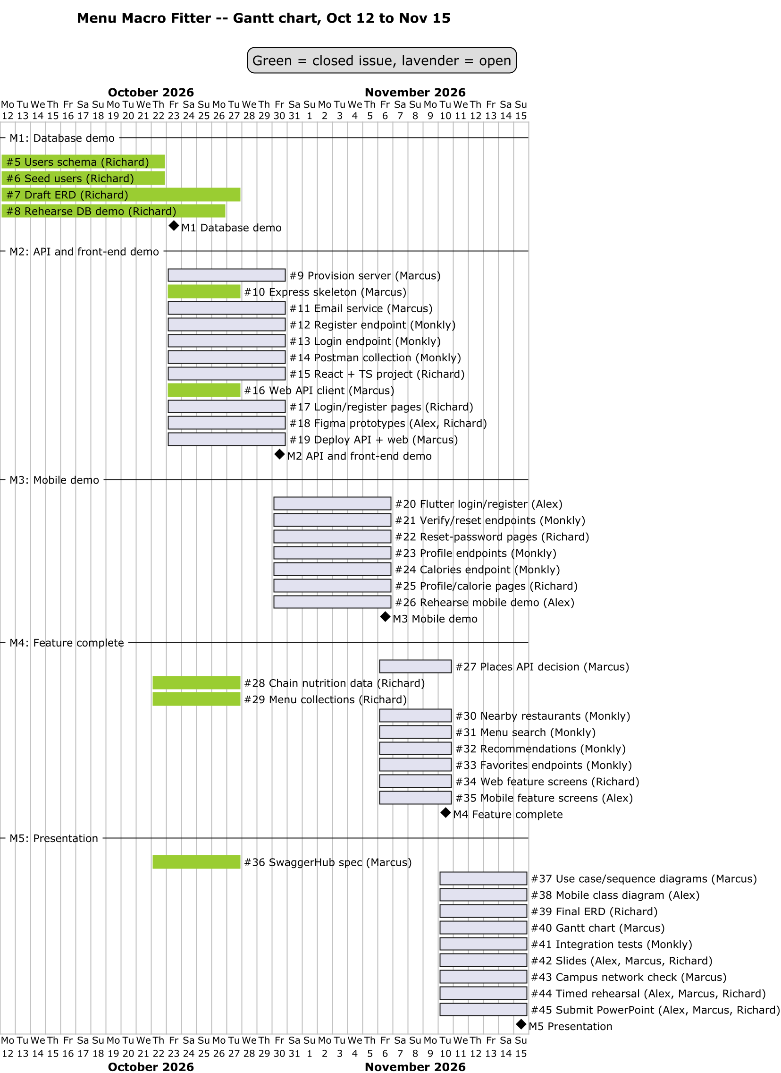
Gantt chart: Oct 12 to Nov 15
1
M1 Oct 23
Database demo
2
M2 Oct 30
API and front-end demo
3
M3 Nov 6
Mobile demo
4
M4 Nov 10
Feature complete
5
M5 Nov 15
Presentation
Notes:
Presenter: Marcus (about 20 s). Every bar is a GitHub issue with an owner. Before presenting: re-render docs/diagrams/gantt.png so finished issues show green (it still shows most as open).

Slide 6
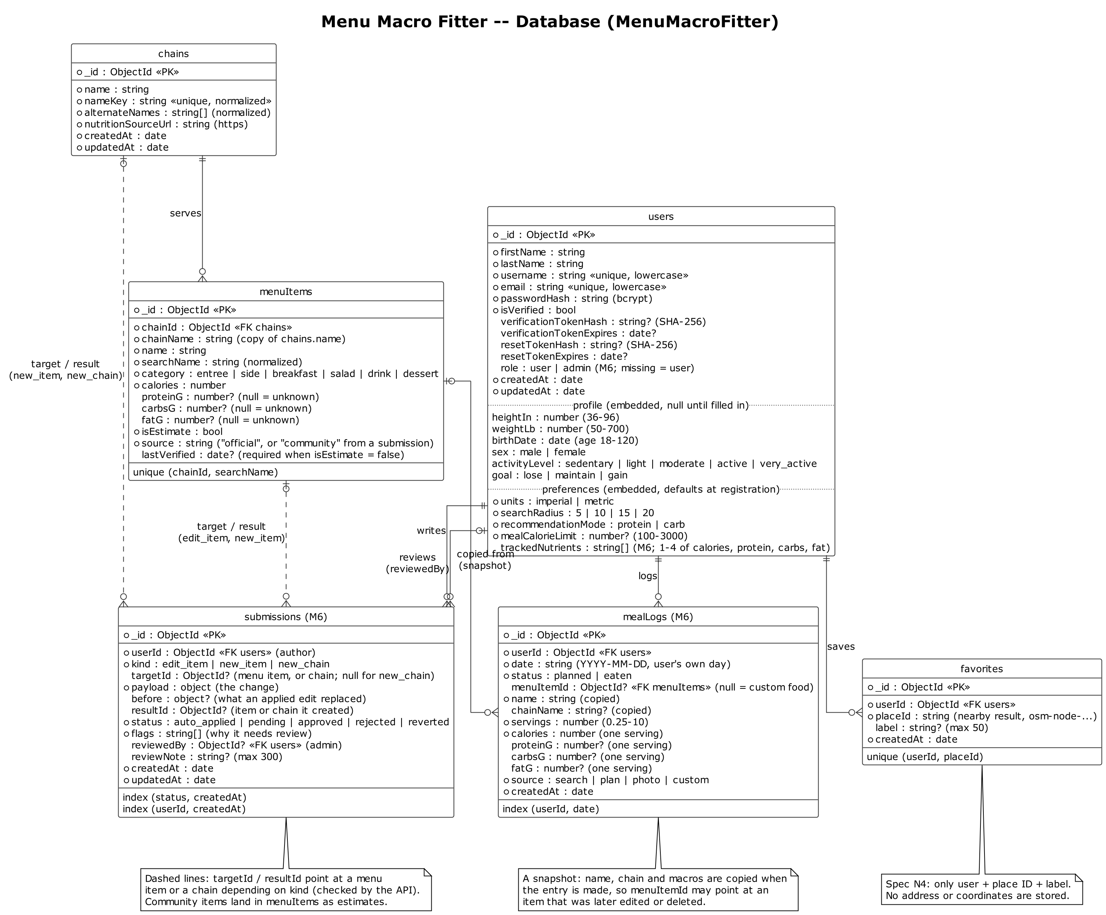
Database: ERD
6 collections
users, chains, menuItems, favorites, mealLogs, submissions
Embedded documents
A user holds its profile and preferences
Validated in MongoDB
Ranges and enums enforced by the database, not just the API
Snapshots
A meal log copies the item, so later edits don't change history
No location stored
A favorite keeps only a place ID and a label
Notes:
Presenter: Richard (about 30 s). Unknown macros are null, never 0, so ranking never treats a missing value as zero.

Slide 7
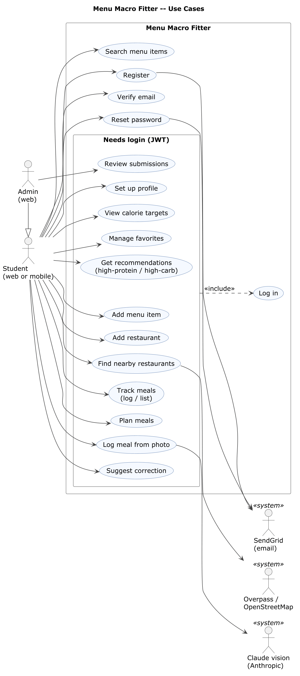
Use case diagram
Student (web or mobile)
Register, verify email, reset password, search; with a login: profile, targets, nearby, recommendations, favorites, tracking, plans, photo logging, suggestions
Admin (web)
Everything a student can do, plus reviewing community submissions
Outside systems
SendGrid sends the emails; OpenStreetMap finds nearby places; Claude reads meal photos
JWT
Everything inside "Needs login" includes Log in
Notes:
Presenter: Marcus (about 20 s).

Slide 8
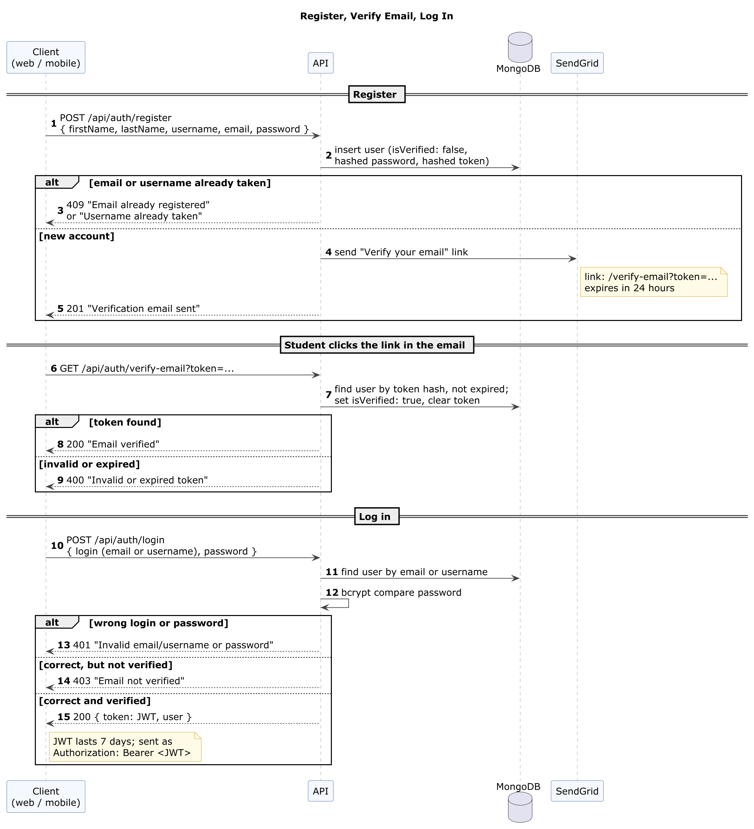
Email verification and password reset
1
Register
Password hashed with bcrypt; a one-time link is emailed through SendGrid
2
Verify
The link's token is checked against its stored SHA-256 hash and expiry
3
Log in
Refused until verified, with a resend option; then a 7-day JWT
4
Reset
Forgot password emails a reset link; the new password replaces the hash
Notes:
Presenter: Matthew (about 35 s). Rubric item: email verification and recovery. Only token hashes are stored, so a database leak can't be used to verify or reset an account.

Slide 9
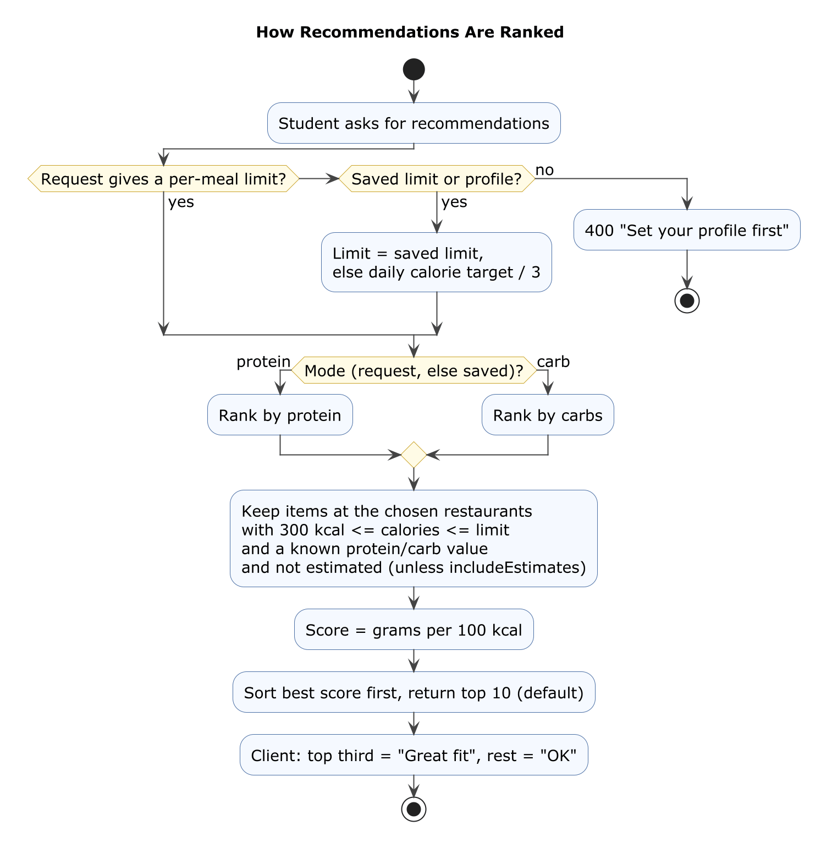
Activity: ranking menu items
Per-meal limit
Daily target split over 3 meals, or the user's own limit
Filter
Items from 300 cal up to the limit, with the macro known; verified items by default
Rank
Grams of protein (or carbs) per 100 calories
Fit
The top third are "Great fit", the rest "OK"
Notes:
Presenter: Matthew (about 20 s). This is our own logic in backend/src/services, covered by unit tests.

Slide 10
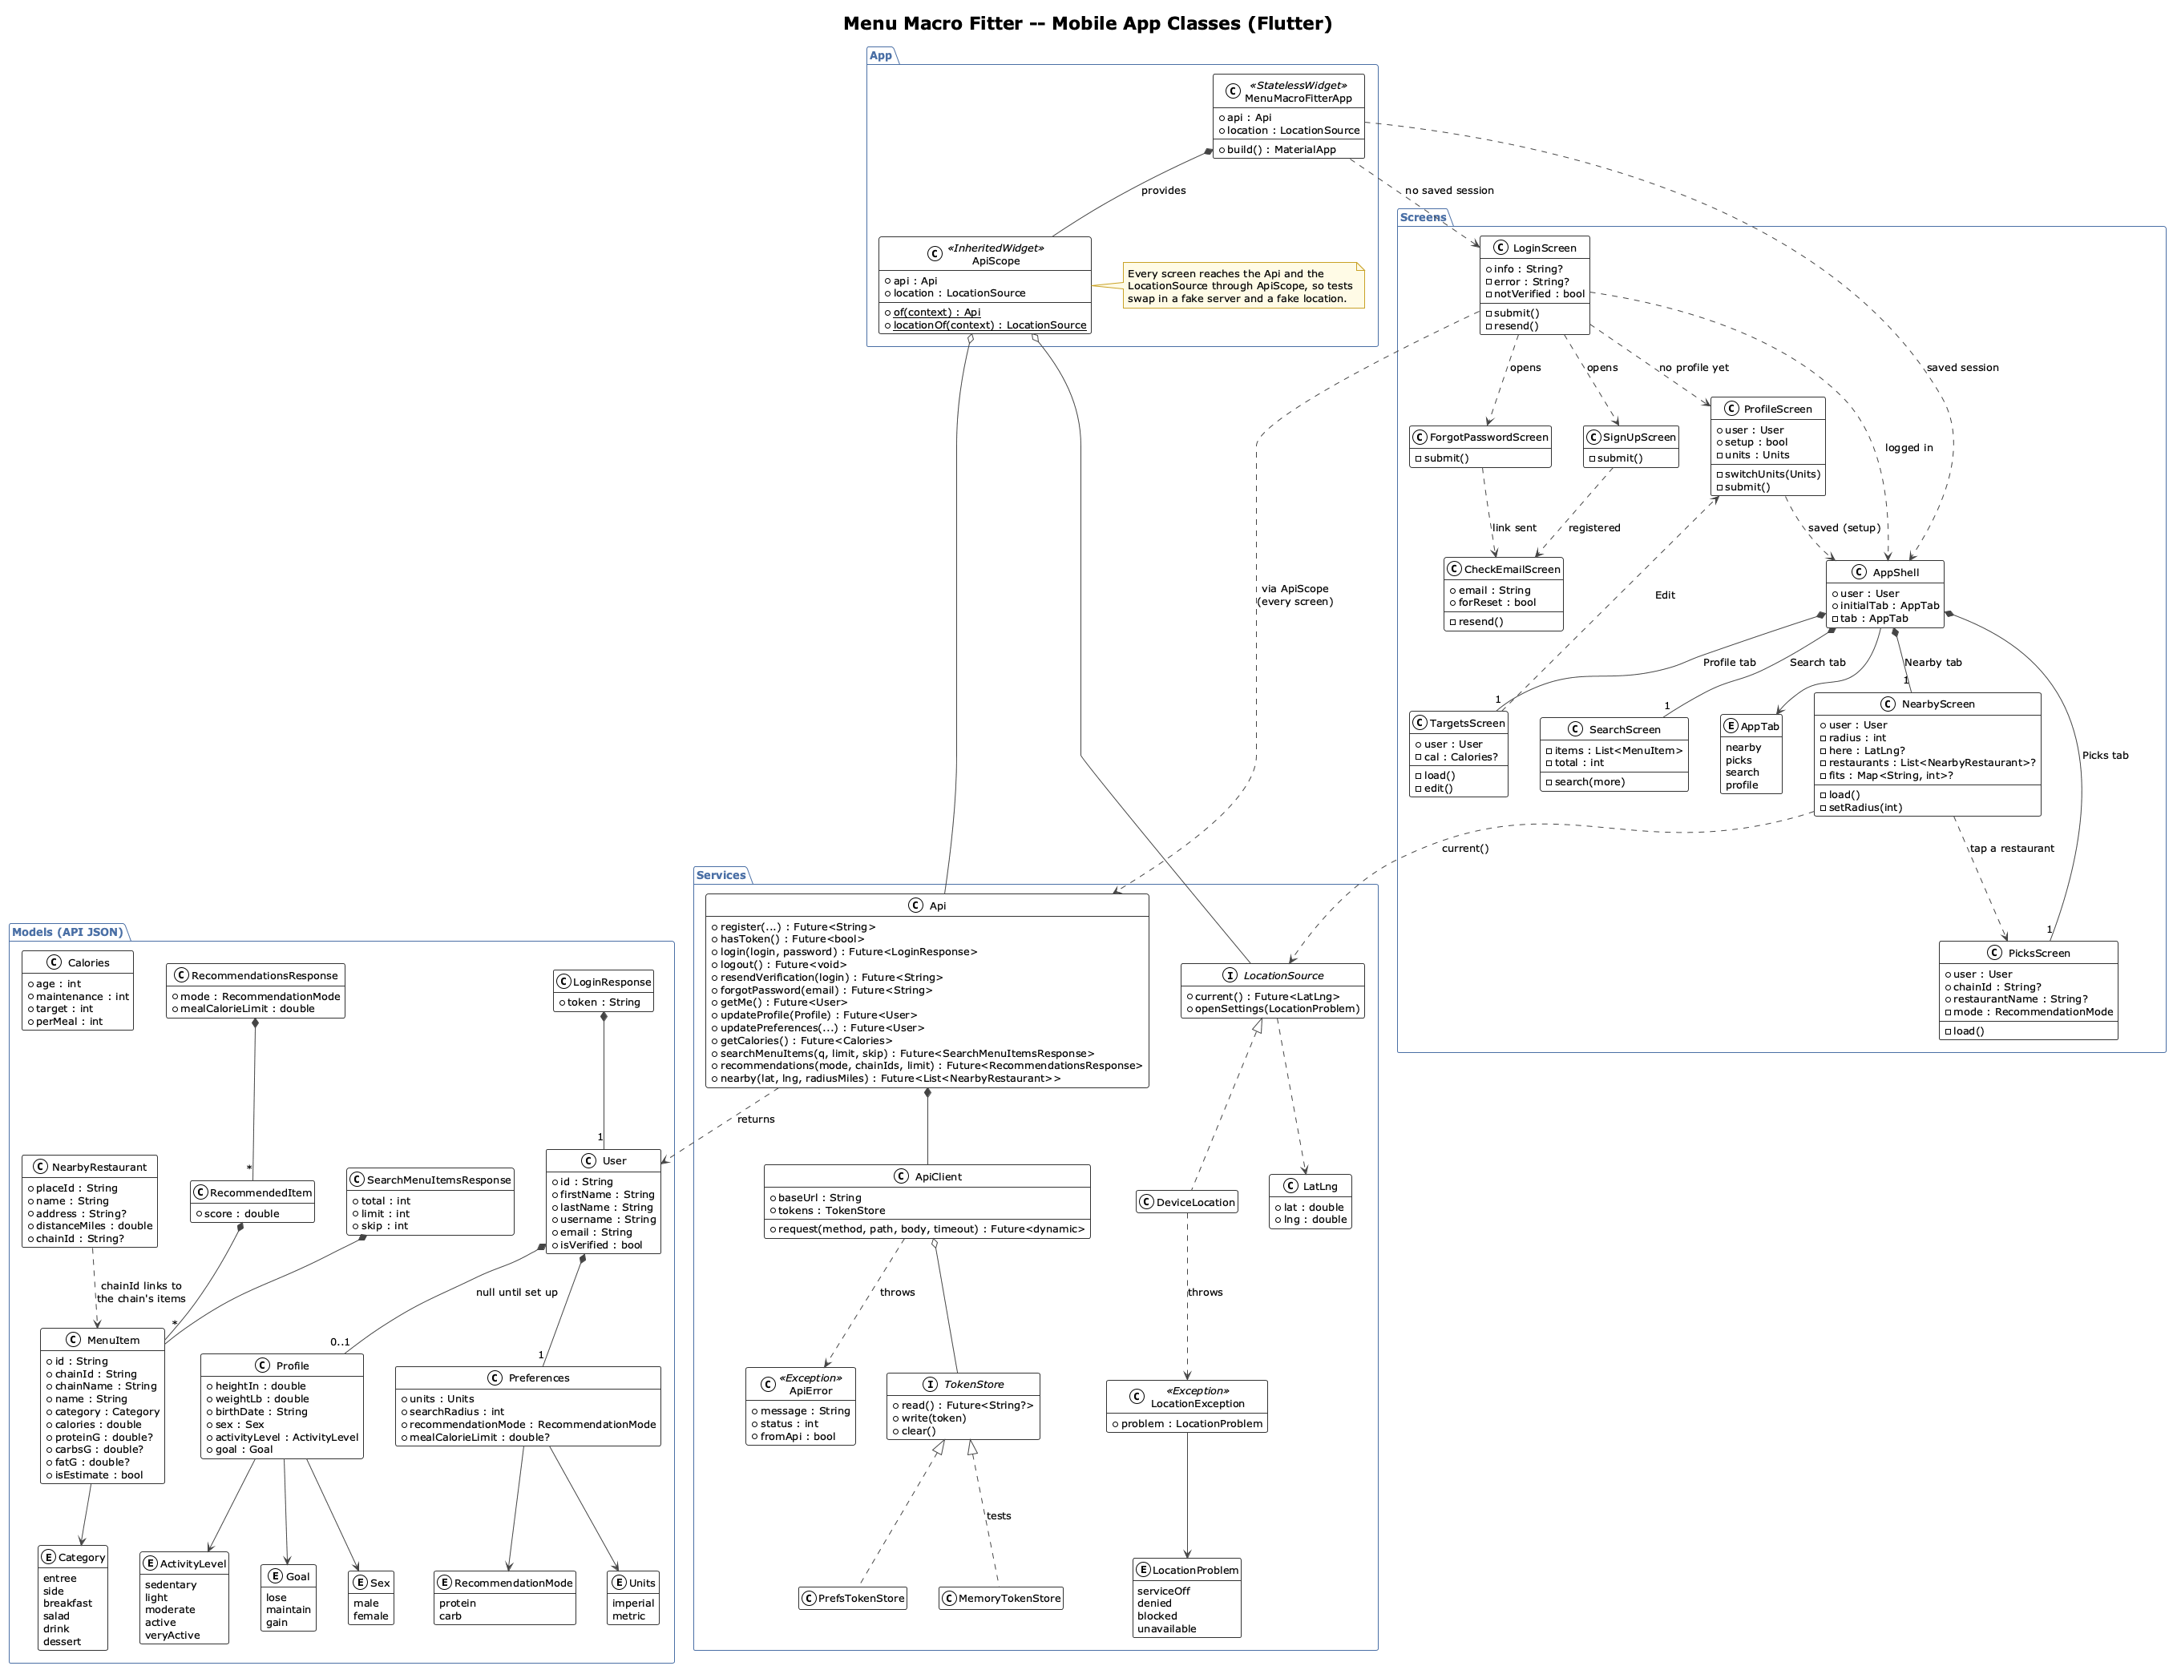
Mobile app: class diagram
Notes:
Presenter: Alex (about 25 s). Screens, the Api service with ApiScope, models, and the location and photo sources tests can fake.

Slide 11
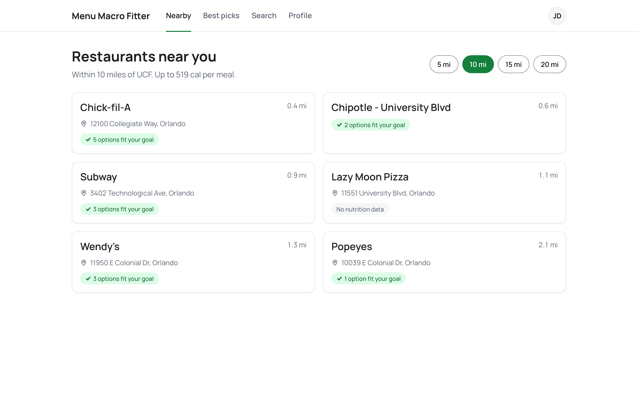
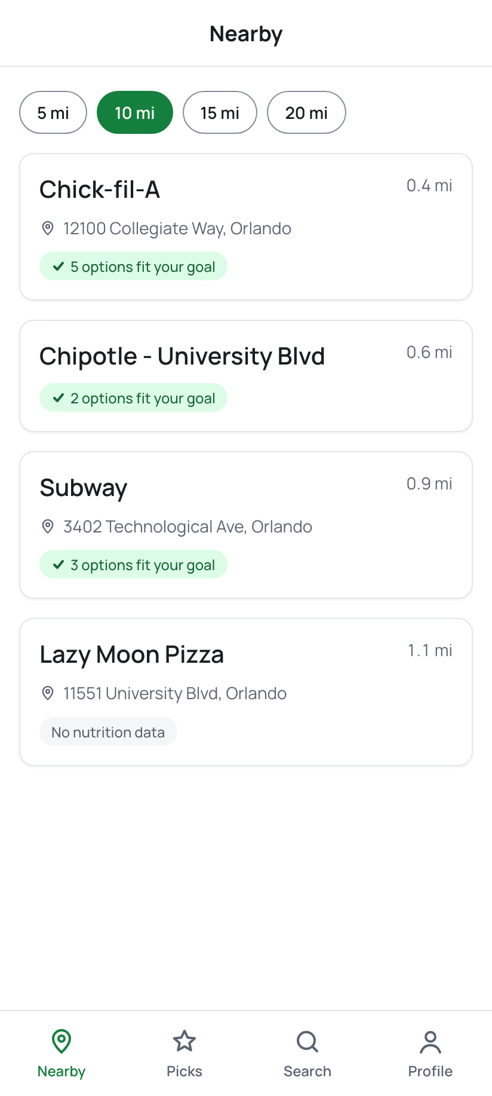
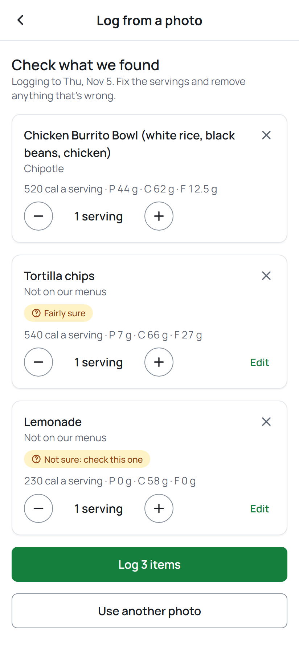
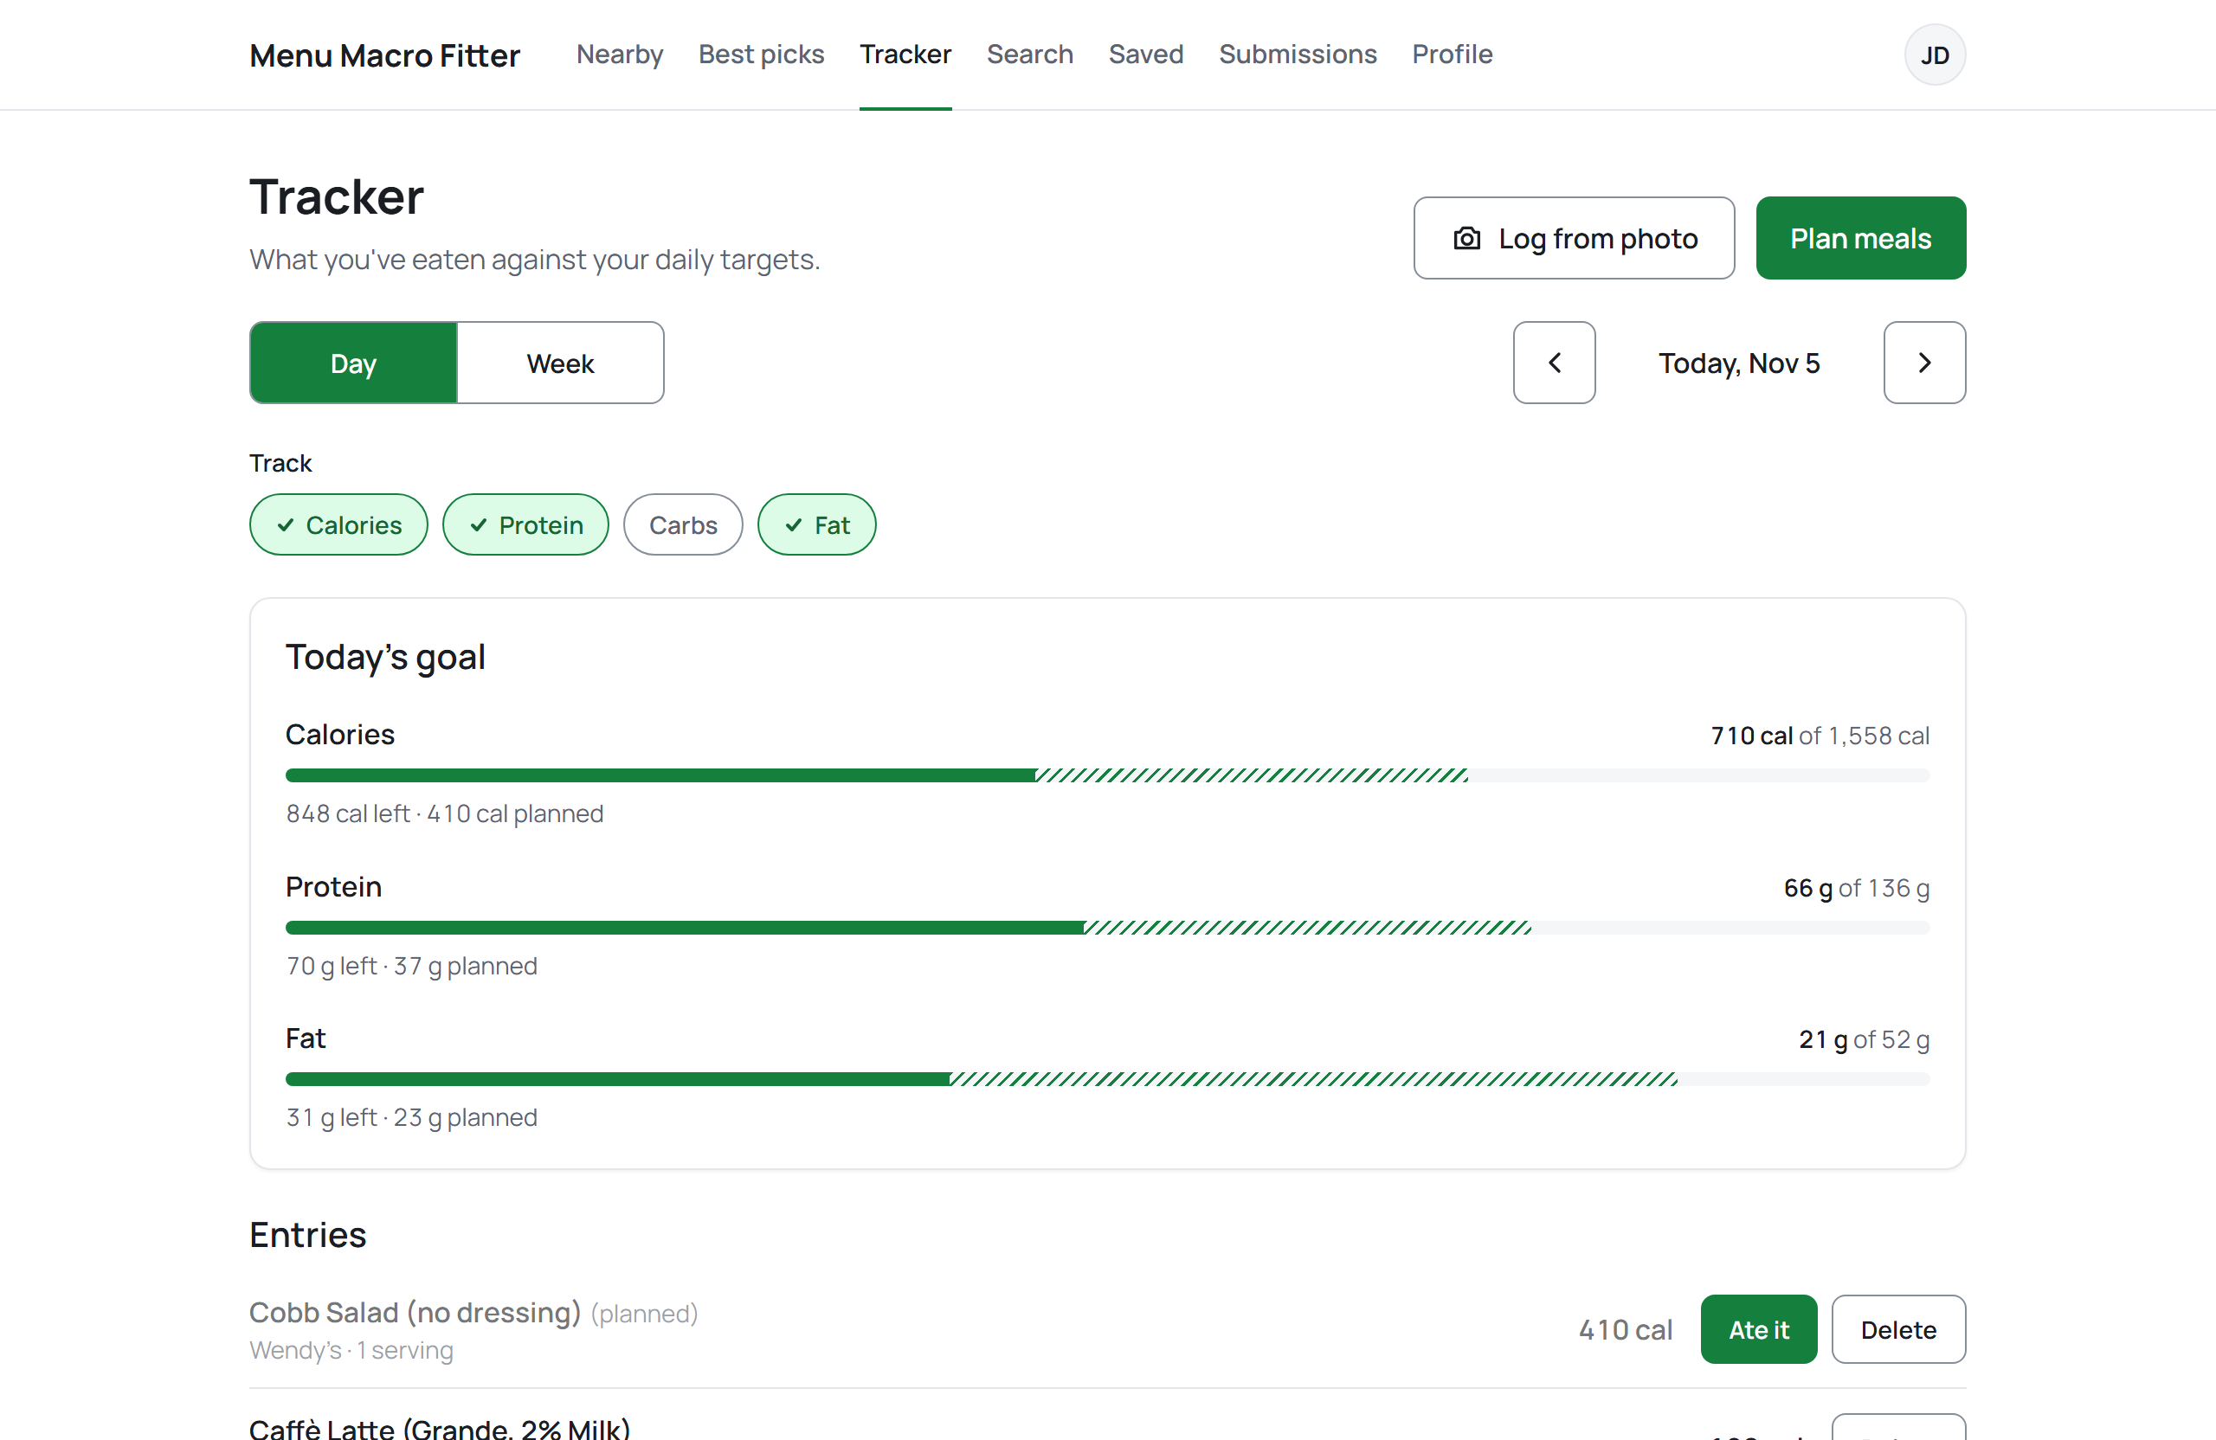
Prototypes: 20 web and 18 mobile frames in Figma
Notes:
Presenter: Alex and Richard (about 25 s). Figma: https://www.figma.com/design/uCeypcfI3bj6y6EFCIOISn/Menu-Macro-Fitter. One design spec (colors, type, components) for both apps.

Slide 12
Server-side search with partial match
Normalized the same way twice
Stored names and the query are lowercased, accents and punctuation removed, "&" becomes "and"
GET /api/menu-items/search?q=CHICK-FIL
200
{ "items": [
{ "name": "Chick-fil-A Chicken Sandwich",
"chainName": "Chick-fil-A",
"calories": 420, "proteinG": 29, ... },
{ "name": "Chick-fil-A Nuggets (8 ct)" }
],
"total": 2, "limit": 20, "skip": 0 }
Partial match in MongoDB
An indexed match on the normalized name: "chick fil" finds "Chick-fil-A Chicken Sandwich"
Paged
limit and skip, with the total for "Show more"
Safe
User text is escaped, never run as a pattern
Notes:
Presenter: Matthew (about 25 s). Rubric item: effective server-side search. The example is the live result on Nov 13.

Slide 13
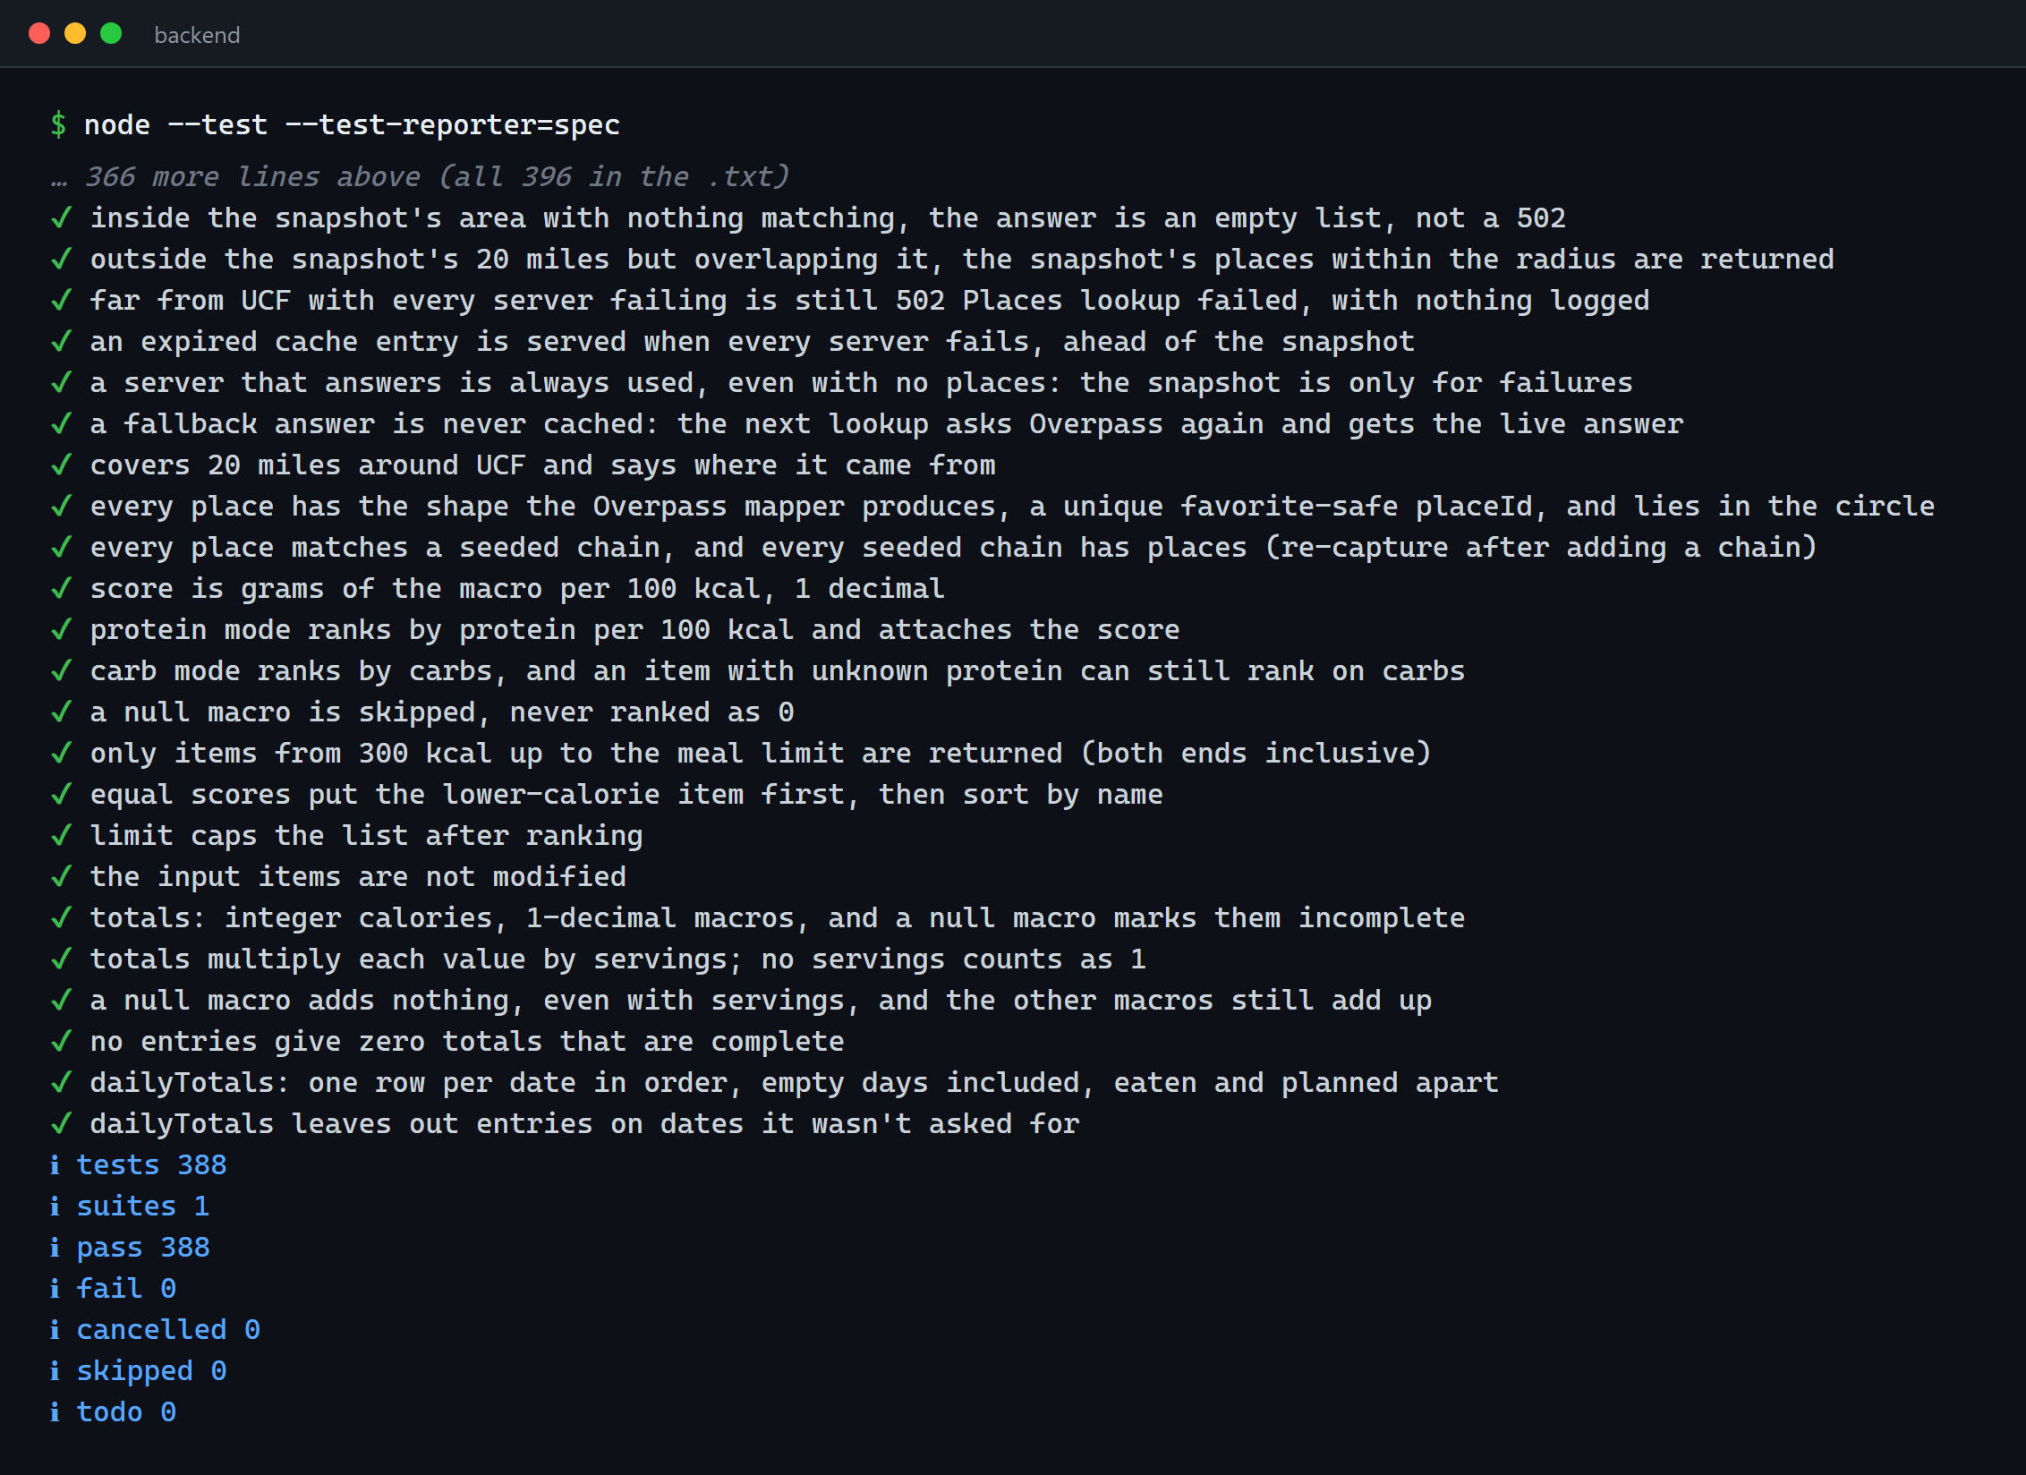
Unit and integration tests
388
unit and integration tests, every endpoint
20
end-to-end tests on a real MongoDB
0
failures; both suites run in CI on every PR
Notes:
Presenter: Matthew (about 25 s). Node's built-in test runner. The 388 stub the database and outside services; the 20 run against MongoDB loaded with schema.js and seed.js. Flutter widget tests run in CI too.

Slide 14
API demo: SwaggerHub
POST
/api/auth/login
Email or username and password; returns a JWT and the user. Shows the 403 for an unverified account.
GET
/api/menu-items/search?q=chick
Partial match, live against production. Change q, limit and skip.
Spec: docs/swagger/menu-macro-fitter.yaml
Notes:
Presenter: Matthew or Marcus (about 1 min). Rubric: one or two endpoints in SwaggerHub. Have SwaggerHub open in a tab before the talk, with a verified test account ready. Put the SwaggerHub link here.

Slide 15
App demo: web and Android
Web · cop4331ruth.lol
Android · APK from GitHub
Log in (unverified account is refused)
Your targets
Nearby and Best picks
Search "chick"
Tracker: add food, Ate it
Plan meals, log from a photo
Suggest a correction; admin review
Log in
Nearby with location
Best picks, high-protein vs high-carb
Tracker tab, week view
Log a photo with the camera
Community forms
Notes:
Presenters: Richard (web) and Alex (Android), about 3.5 minutes together. Rubric: working demo on both, 20 points. Log in before the talk where you can; have a backup recording on the USB drive in case the network or domain is blocked.

Slide 16
What went well
✓
Contract first
✓
Reviews and CI
docs/api-contract.md fixed every request and response, so the API, web and mobile were built in parallel
Protected main, a reviewed PR for every change, and tests, builds and the APK on every PR
✓
One design for two apps
✓
Deployed early
A shared design spec kept web and Android looking like one product
Auto-deploy on merge meant the live site was always the latest main
Notes:
Presenter: everyone can add a line (about 30 s). Draft from the repo history: edit to what the team actually felt.

Slide 17
What did not go well
!
Map servers went down
!
Production database drift
The free OpenStreetMap servers timed out, so Nearby failed. Fix: a cache and a saved UCF snapshot (#128)
An old validator on the live database broke one save. Fix: every deploy re-applies the schema (#149)
!
Nutrition data by hand
!
Late scope growth
85 items typed in from chain websites; slow, and new items start as estimates
Tracker, plans, photo logging and moderation all landed in the last two weeks
Notes:
Presenter: everyone (about 30 s). Draft from the repo history: edit to what the team actually felt.

Slide 18
Questions?
cop4331ruth.lol
github.com/polter-dev/POOSD_large_proj
Notes:
Keep about 1 minute. Total with every slide at its time: about 11 min 50 s, so rehearse with a timer (#44). The backup slides after this hold the other diagrams in case someone asks.

Slide 19
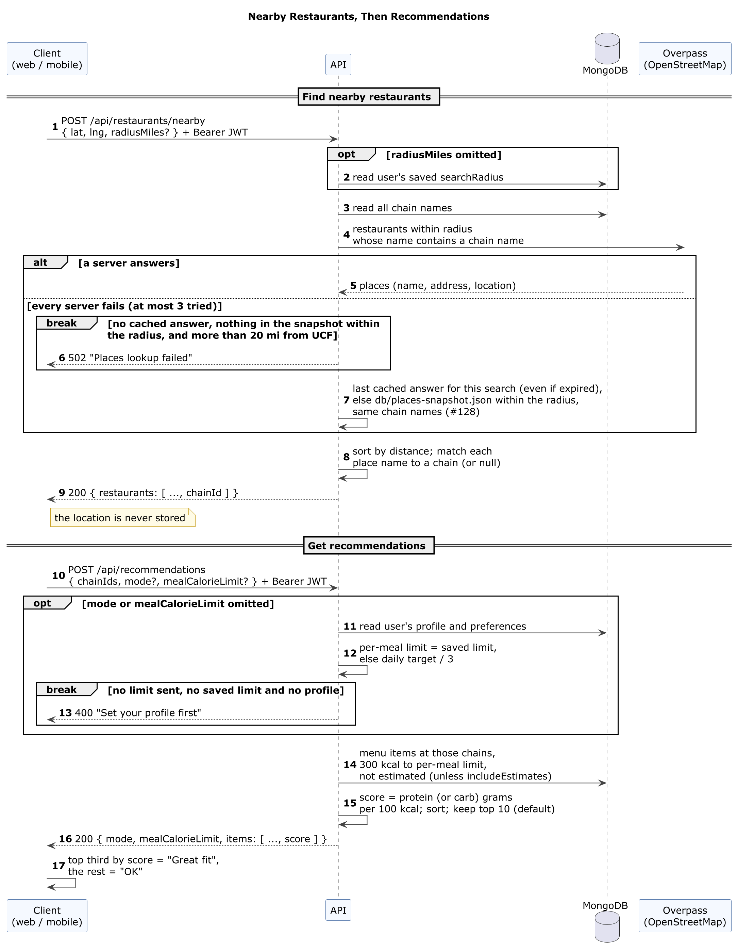
Backup: recommendations sequence
Notes:
Backup slide: only if asked.

Slide 20
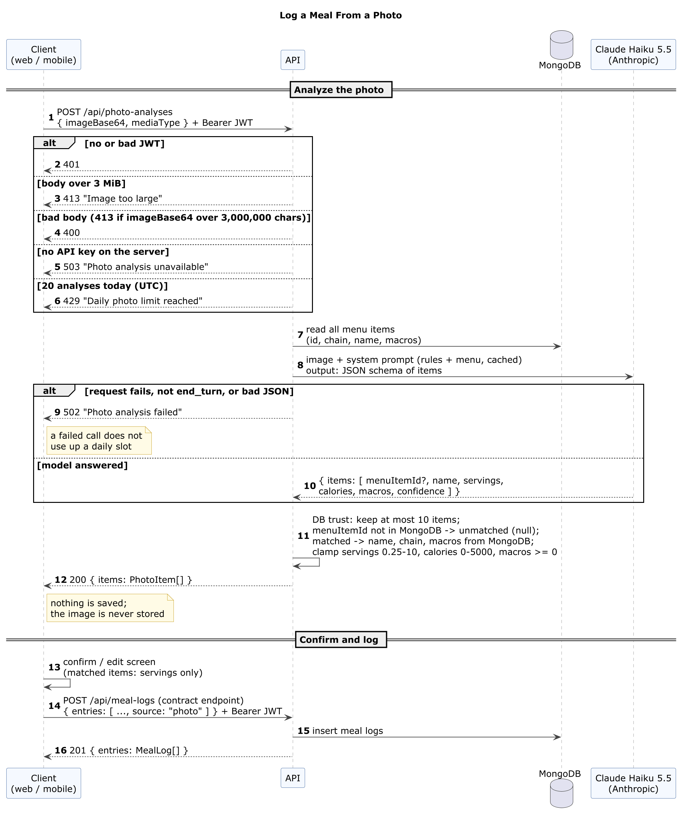
Backup: photo logging sequence
Notes:
Backup slide: only if asked.

Slide 21
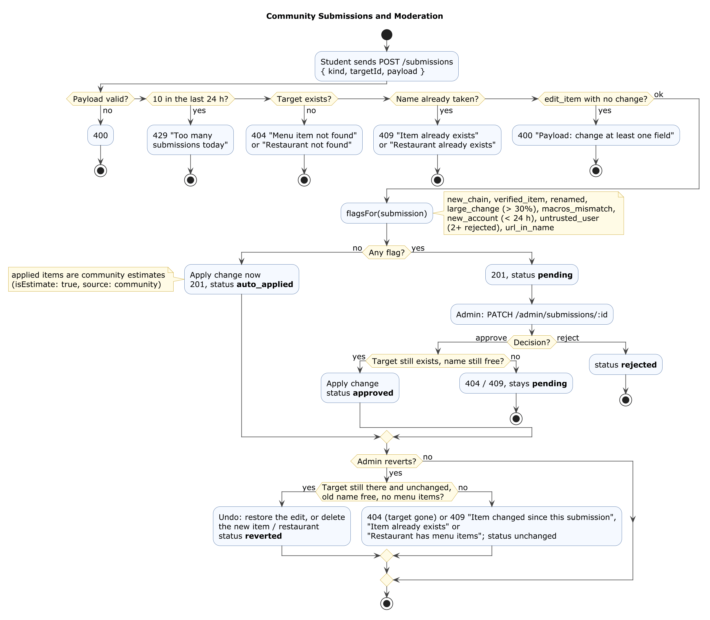
Backup: moderation activity
Notes:
Backup slide: only if asked.

