Slide 1
Week5
Exposing Applications & Service Mesh in Kubernetes

Slide 2
Agenda
Load Balancer
MetaLB
Ingress Controller – Nginx
Service Mesh with Istio

Slide 3
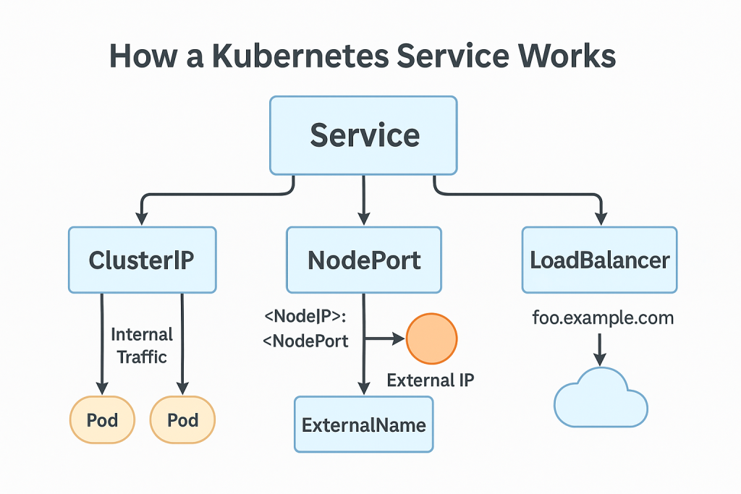
EXPOSE Application - Load Balancer

Slide 4
Drawbacks of Load Balancers
Cost - 10 services → 10 load balancers 💰 , Pay for External IP, Traffic in/out
One IP per Service – DNS Management , Scaling issue
Vendor Dependency (Cloud Lock-in)
Slow Provisioning
Not Available on Bare Metal - MetaLB
Less Flexible Traffic Control – Service Mesh with Istio
Limited Routing (Layer 4 only) , Not possible to do Path-based routing (/api, /app) Host-based routing (app.com, api.com) – Ingress controller
Limited Security Features – No auth, No Rate Limiting, No WAF – Ingress Gateway /WAF Tool

Slide 5
Quick Comparison
Problem | LoadBalancer | Better Alternative
Cost | High | Ingress
Routing | Basic | Ingress
Traffic control | Limited | Istio
Bare metal | Not supported | MetalLB

Slide 6
MetaLB in K8s
Core Components
Controller (IP allocator) – Runs inside cluster , Watches service of Type LB, Assigns IP from the IP pool
Speaker (IP announcer) – Daemon set, Announced Assigned IP to the network

Slide 7
Traffic Flow with METALB
You create a service:
type: LoadBalancer
MetalLB Controller:
Picks an IP (e.g., 192.168.1.100)
Speaker:
Announces: “I own this IP”
External client:
Sends request to that IP
Traffic reaches node:
Forwarded to Kubernetes Service
Service:
Routes to Pods

Slide 8
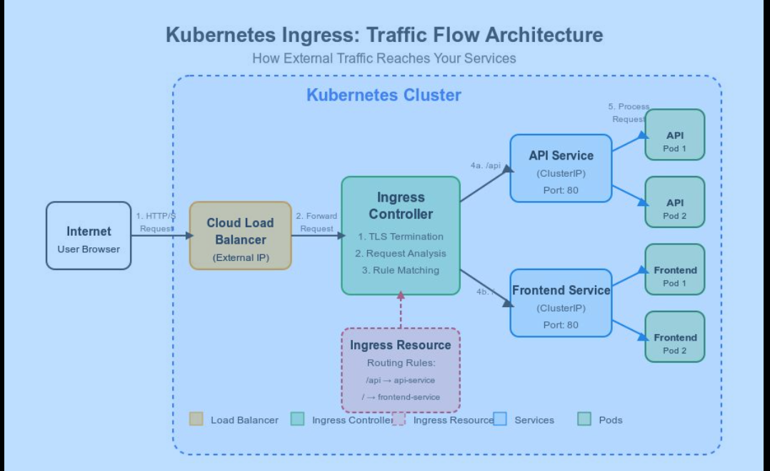
Ingress Controller

Slide 9
Deprecated Notice – Nginx
https://kubernetes.io/blog/2025/11/11/ingress-nginx-retirement/
Gateway API implementations to consider:
Istio Gateway (if using a service mesh)
Contour
Traefik v3
Envoy Gateway
Calico Ingress Gateway
Cilium Ingress Gateway
Kong

Slide 10
✅ Features
Path-based routing
Host-based routing
SSL/TLS termination
Traffic Splitting, Advanced
Use Case
Load balancing Simple architectures
Few services
Basic routing needs
❌ Limitations
Limited advanced traffic control
No built-in service mesh features
Basic observability

Slide 11
Assignment GATEWAY API
https://gateway-api.sigs.k8s.io/guides/getting-started/
https://gateway-api.sigs.k8s.io/guides/getting-started/simple-gateway/

Slide 12
Problem in Ingress Controllers / Microservices
TLS encryption
Retry logic
Load balancing
Monitoring
Traffic Management
Failure handling

Slide 13
Istio Documentation
https://istio.io/latest/docs/ops/deployment/architecture/

Slide 14
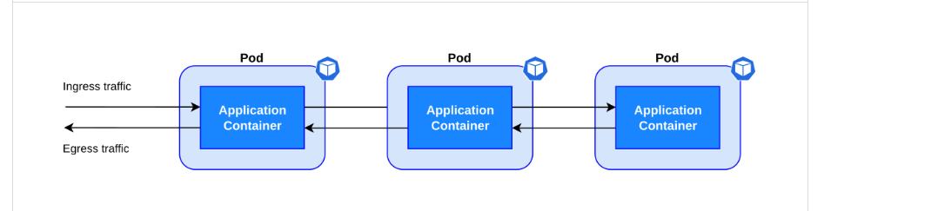
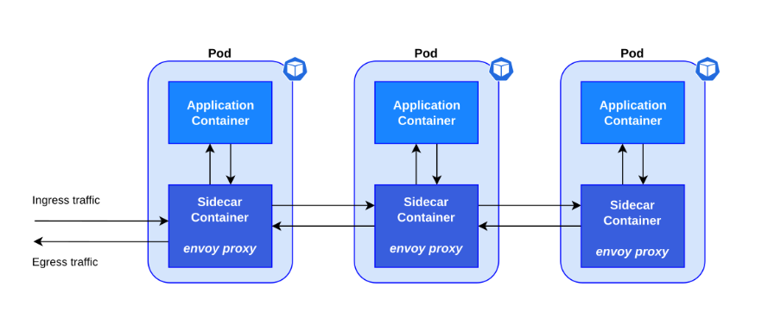
What is Istio Sidecar ?

Slide 15
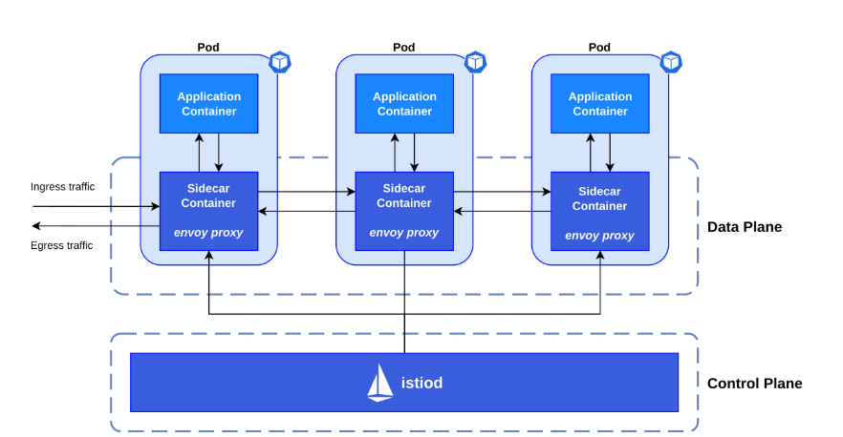
Istio Architecture

Slide 16
How Istio solves the problem?
Service Mesh uses Sidecar Proxy Pattern
Each service pod gets:
Application Container Sidecar Proxy (Envoy)
Envoy proxy
monitor traffic
enforce security
control routing

Slide 17
RECAP of Envoy
Envoy proxies are the only Istio components that interact with data plane traffic.
smart network proxy
Pod
├── Application Container
└── Envoy Sidecar Proxy
Before:
Service A -> service B
After:
Service A → Envoy → Envoy → Service B

Slide 18
Install Istio
Istioctl
Helm chart
K8s manifests

Slide 19
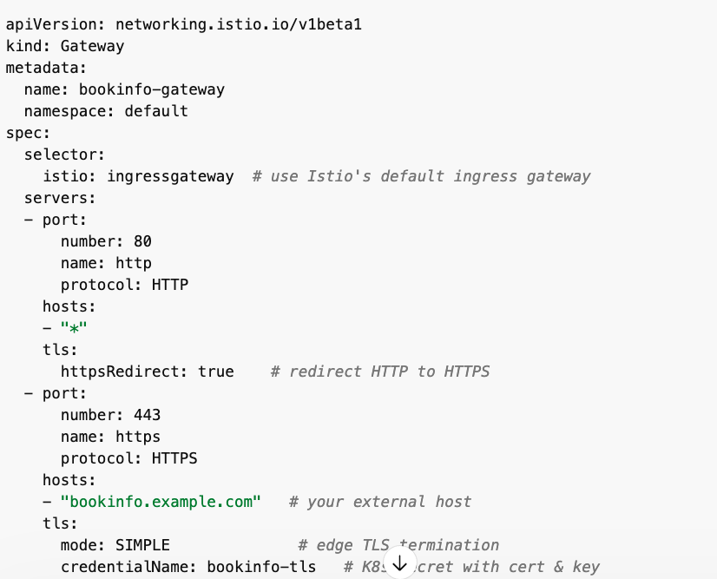
GAteway
Hosts:
https://matrixkube.org

Slide 20
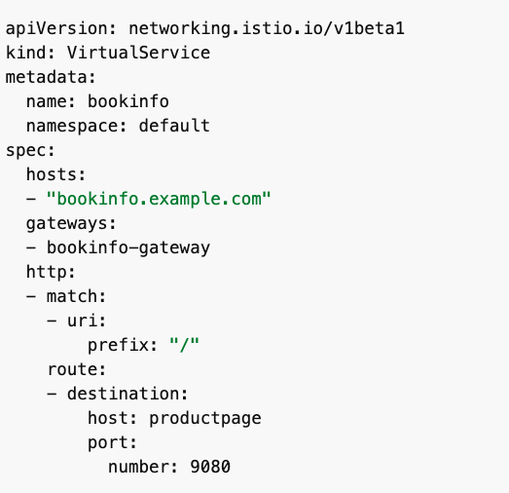
VIRTUAL SERVICE

Slide 21
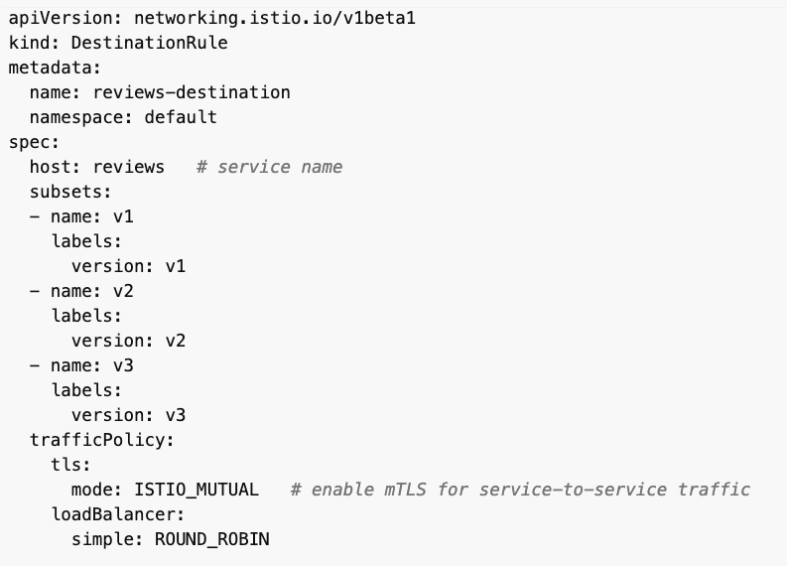
DESTINATION RULE

Slide 22
Traffic Management
Blue Green Deployment
Canary Rollout
Traffic Mirroring

Slide 23
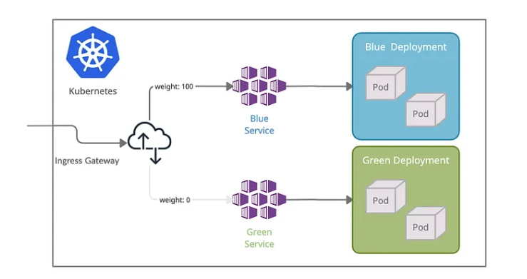
BLUE Green DEPLOYMENT

Slide 24
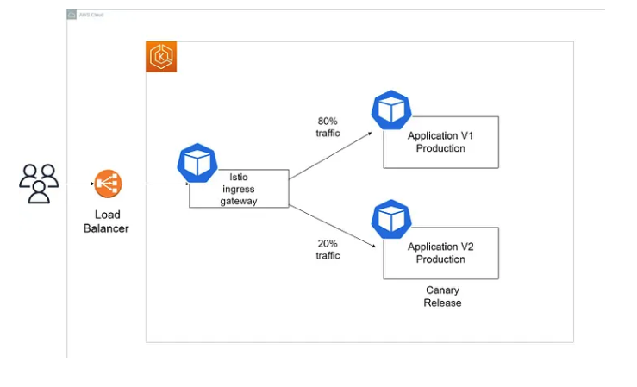
CANARY Deployment

Slide 25
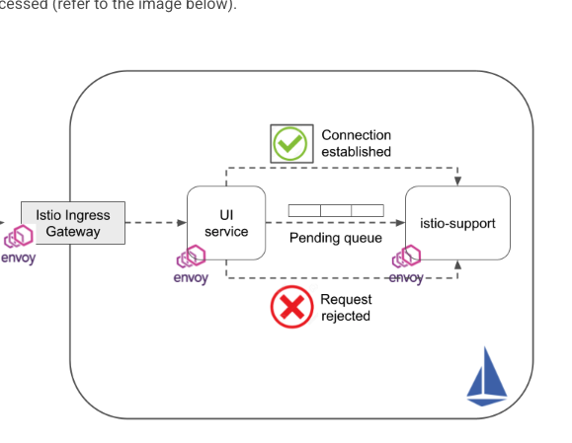
CIRCUIT BREAKING

Slide 26
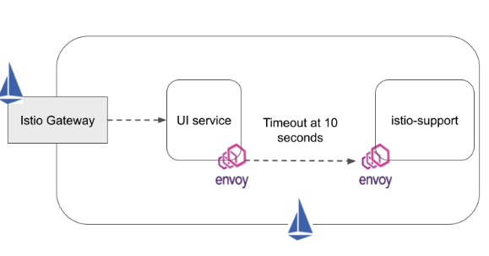
TIMEOUTS

Slide 27
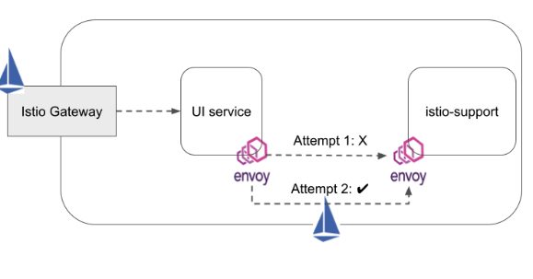
RETRY

Slide 28
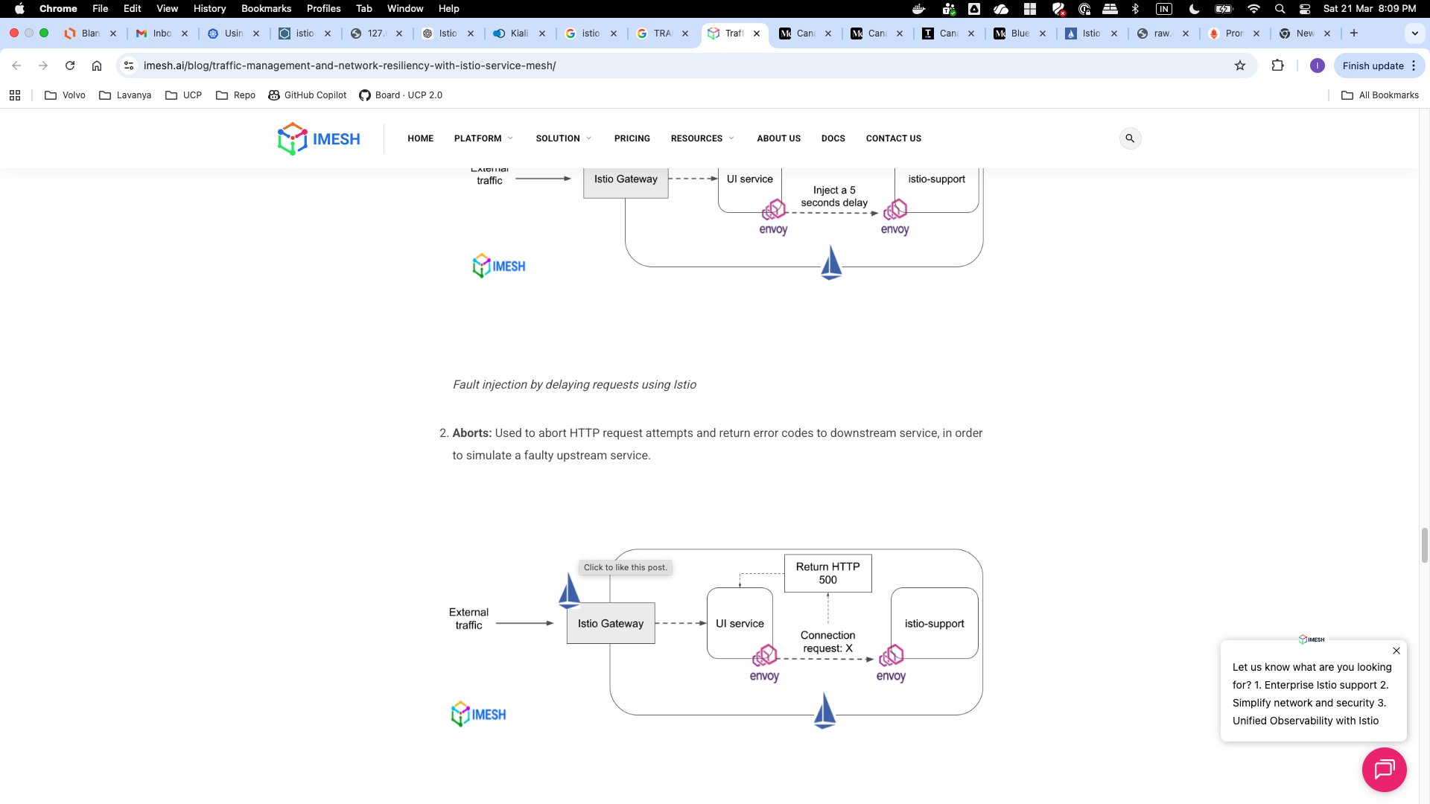
Delay and ABORTS

Slide 29
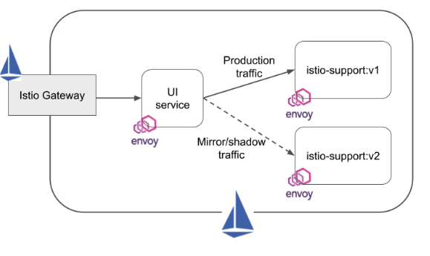
Traffic MIRRORING

Slide 30
TLS
Client HTTPS → Istio Gateway (terminates TLS) → Sidecar → Service
apiVersion: networking.istio.io/v1beta1 kind: Gateway metadata: name: bookinfo-gateway namespace: default spec: selector: istio: ingressgateway # use Istio's ingress gateway servers: - port: number: 443 name: https protocol: HTTPS tls: mode: SIMPLE # Edge TLS termination credentialName: bookinfo-tls # Kubernetes secret with cert/key hosts: - "bookinfo.example.com"
TLS Type | Where Termination Happens | Use Case
Ingress Gateway TLS (Edge TLS) | At the Istio Ingress Gateway | External clients connect via HTTPS; Gateway decrypts TLS and forwards plain HTTP to the mesh.
Mutual TLS (mTLS) in Mesh | Between Envoy sidecars in pods | Traffic inside the mesh is encrypted end-to-end between services.
Destination TLS / HTTPS | Envoy sidecar terminates TLS for egress or calls to internal HTTPS services | When a service communicates over HTTPS inside the mesh.

Slide 31
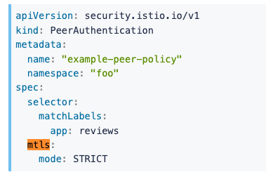
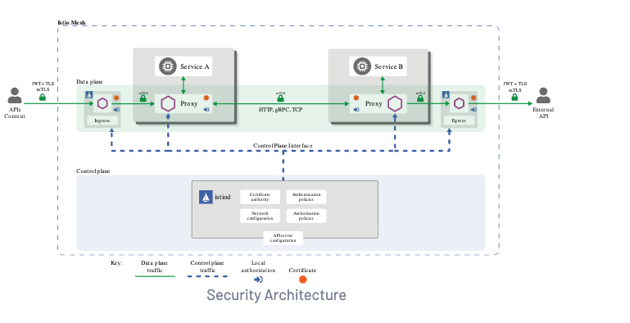
TRAFFIC ENCRYPTION – MTLS

Slide 32
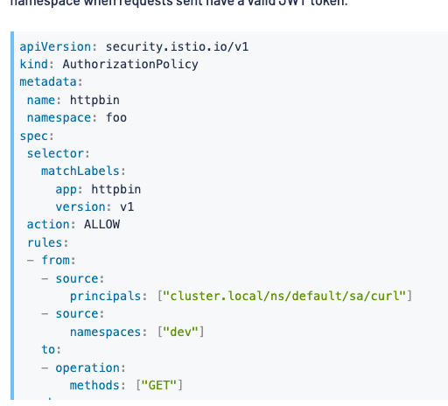
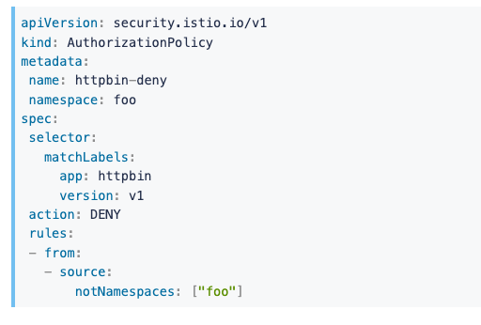
AUTHORIZATION POLICY
https://istio.io/latest/docs/concepts/security/

Slide 33
EGRESS TRAFFIC
Allowing egress traffic
apiVersion: networking.istio.io/v1beta1 kind: ServiceEntry metadata: name: allow-all-external spec: hosts: - "*.google.com" # or "*" for all
- “www.maps.com” location: MESH_EXTERNAL ports: - number: 443 name: https protocol: HTTPS resolution: DNS
apiVersion: networking.istio.io/v1beta1 kind: Gateway metadata: name: istio-egressgateway namespace: istio-system spec: selector: istio: egressgateway servers: - port: number: 443 name: https protocol: HTTPS hosts: - "api.external.com"

Slide 34
Observability
Kiali
Promtheus and Grafana

Slide 35
Features
Timeout , Retry
Fault Tolerance
Circuit Breaking
CANARY Rollout
Blue Green Rollouts
MTLS Encryption
TLS TERMINATION

