Slide 1
WEEK 6
GitOps with ArgoCD, Kubernetes-native policy engine with Kyverno

Slide 2

Why ARGOCD ?
Declarative GitOps Approach
Continuous Delivery Made Simple
Powerful UI
Visualization & Monitoring
Multi-Cluster Support
Works with Helm & Kustomize

Slide 3
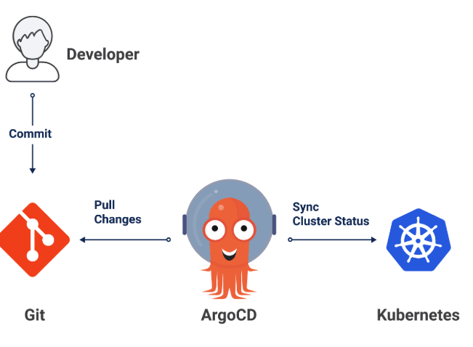
Argo Flow

Slide 4
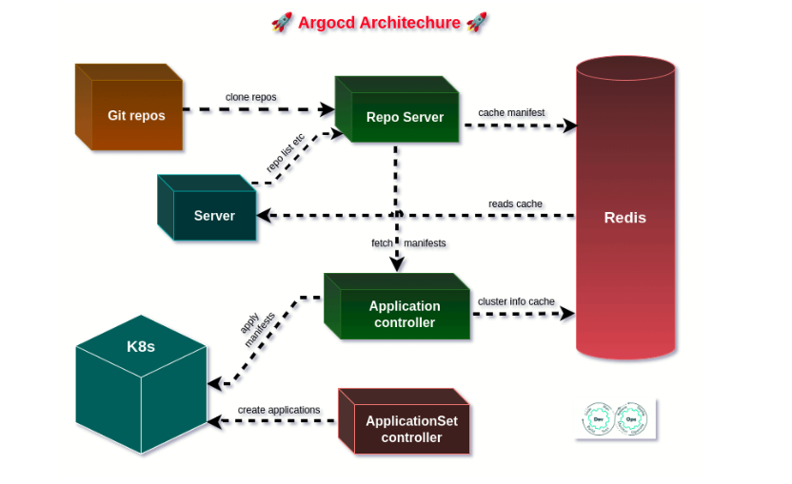

Slide 5
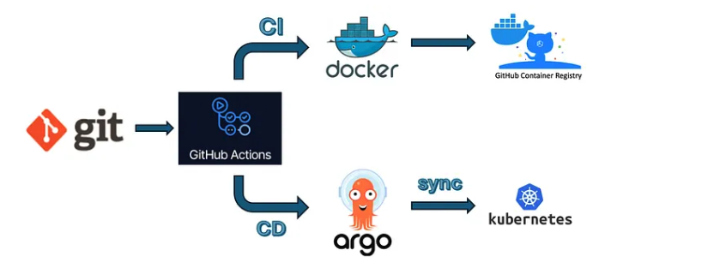
GitOps CI/CD Workflow

Slide 6
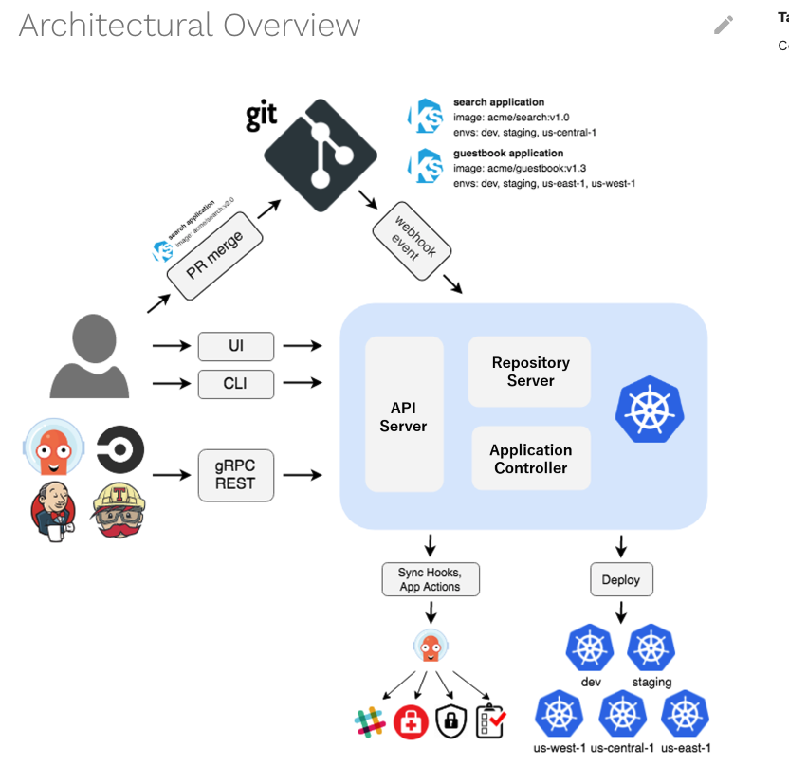
ARgoCD ArCHITECUTURE

Slide 7
ArgoCD sync policies
Manual Sync Policy
Changes in Git will not be applied automatically to the cluster. You have to trigger the sync manually via CLI or UI.
Pros:
Safer for critical environments
Prevents accidental changes
Cons:
Slower deployments
Requires human intervention
Automatic Sync
ArgoCD automatically applies changes from Git to the cluster.
Pros:
Continuous delivery, faster deployments
Ensures Git and cluster are always in sync
Cons:
Risky if a bad manifest is pushed to Git
Might apply unintended changes immediately

Slide 8
Pod Name | Role | Rollback Role
argocd-server | API & Web UI | Accept rollback commands
argocd-repo-server | Fetch manifests from Git/OCI | Provide manifests of previous revisions
argocd-application-controller | Reconciliation engine | Apply previous revision to cluster
argocd-redis | Caching & state | Stores cached manifests for fast rollback
argocd-dex-server | Authentication | N/A

Slide 9

Ways to Create
Argo UI
Create Argo Application
Create application using Argo CLI

Slide 10
Rollback kubectl vs Argocd
kubectl Rollback
Uses Kubernetes ReplicaSet history
Command: kubectl rollout undo
Works on Deployments only
Cluster is source of truth
Limited history
Argo CD Rollback (Argo CD)
Uses Git history (version-controlled)
Command: argocd app rollback
Works on entire application
Git is source of truth
Fully reproducible

Slide 11

Argo Security and SSO
Authentication methods:
Local users
SSO (OIDC)
Integrations:
GitHub
Google
Azure AD

Slide 12
Sync waves
Sync Waves → Task sequence 📋 - Order of deployment
Hooks → Custom steps 🔧 - Lifecycle actions (before/during/after)
Pruning → Clean up 🧹- Remove unwanted resources
Self-healing → Auto-repair 🔁 - Fix drift automatically

Slide 13
Multi-Cluster & Scaling
Managing multiple clusters
Adding external clusters
Cluster secrets
Deployment strategies across clusters
Multi-tenancy
Namespaces vs Projects
Scaling Argo CD

Slide 14
Observability & Troubleshooting
Metrics (Prometheus)
Alerts
Monitoring Argo CD
Logs & debugging
Application health checks
Argo Events

Slide 15
Production Grade Apps
Argo Rollouts (progressive delivery)
Blue-Green deployments
Canary deployments
GitOps for microservices

Slide 16
KYVERNO POLICY ENGINE
Problem:
Kubernetes is flexible but not strict
Developers can deploy anything
Security & compliance risks
No built-in enforcement
Solution:
Securing and Governing Kubernetes with Policies

Slide 17
What is Kyverno?
Built specifically for Kubernetes
Uses Kubernetes resources (CRDs) like:
ClusterPolicy
Policy
Kubernetes-native policy engine
Uses YAML (no new language)
Works as admission controller
Enforces rules on resources

Slide 18
Admission Controller
User / Argo CD sends request
Kubernetes API receives it
Kyverno checks policies
Decision:
✅ Allow
❌ Deny
🔧 Modify
Exection flow:
User / Argo CD → Kubernetes API → Kyverno → Decision → Cluster
Detects violation
Blocks deployment ❌

Slide 19
Type of Rules
✅ Validate
Block invalid configs
Example: no root user
🔧 Mutate
Modify resources automatically
Example: add labels
🔄 Generate
Create resources automatically
Example: create NetworkPolicy

Slide 20
Kyverno Capabilities
✅ Validate → Block invalid configs
🔧 Mutate → Auto-fix configs
🔄 Generate → Create resources
🔐 Verify → Check image security

Slide 21
Block Unsafe Deployment
Prevent containers running as root
Enforce security best practices
PSA Standards

Slide 22
Generate Manifests
Add missing labels automatically
Enforce naming standards

Slide 23
Kyverno + Argo CD
Argo CD → Deploys applications
Kyverno → Enforces policies
Together → Safe automation

Slide 24
Real Use Cases
Configure
Configure readiness and liveness probes , Label checks,
Configure
Configure resource quotas, Resource Limit configuration, Image Validation
Do not use
Do not use mutable (latest) image tags
Restrict
Restrict image registries
Configure
Configure pod security
Allow
Not allow Resource creation / Modification – resource Quota

Slide 25
Modes of Operation
Kyverno = Security Guard 🚧 Enforcement Modes:
Audit → Report violations
Enforce → Block violations

Slide 26
Kyverno Recap
Policy-as-Code
Kubernetes-native
Improves security & governance
Works with GitOps

