Slide 1
Week 4 – Day1
Kubernetes Core Concepts: Storage and RBAC

Slide 2

Agenda
Volumes
Persistent Volumes (PV)
Persistent Volume Claims (PVC)
Storage Classes
RBAC
Roles
RoleBindings
ClusterRoles
ClusterRoleBindings

Slide 3
Storage in Kubernetes
Problem
Containers are ephemeral.
Pod Restart → Container created → Data lost
Solution
Kubernetes provides storage mechanisms.

Slide 4
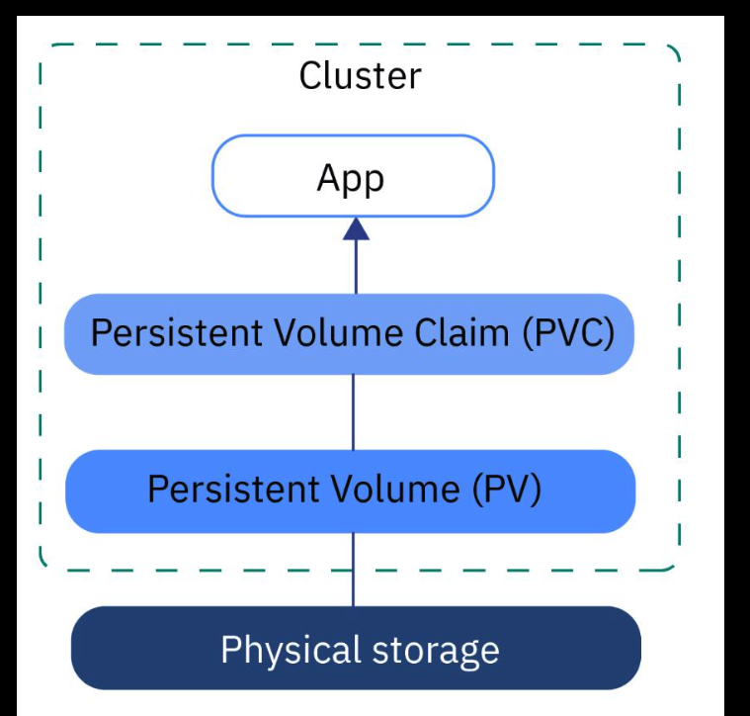
K8S Storage
Persistent Volume (PV) – Actual disk / Storage
PVC - Storage request by a pod
Field | Meaning
volumes | Storage definition
volumeMounts | Mount inside container
emptyDir | Temporary storage

Slide 5
Static Provisioning
Process
Create a PV
Create a PVC
Mount in the Pod
Drawback:
Manual Process
Hard to Scale
Use Case:
Learning

Slide 6
Dynamic Provisioning
Process:
Kubernetes creates PV automatically
Advantage:
Automatic process
Cloud-native
No Manual PV Creation
Use Case:
Used in production (Frontend service, Backend API, Database (MySQL)
Flow:
Application Pod ↓ PersistentVolumeClaim ↓ StorageClass ↓ Kubernetes automatically creates PersistentVolume ↓ Cloud / Storage Backend

Slide 7
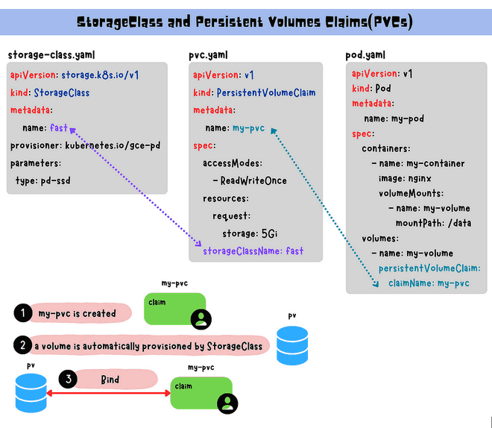

Slide 8
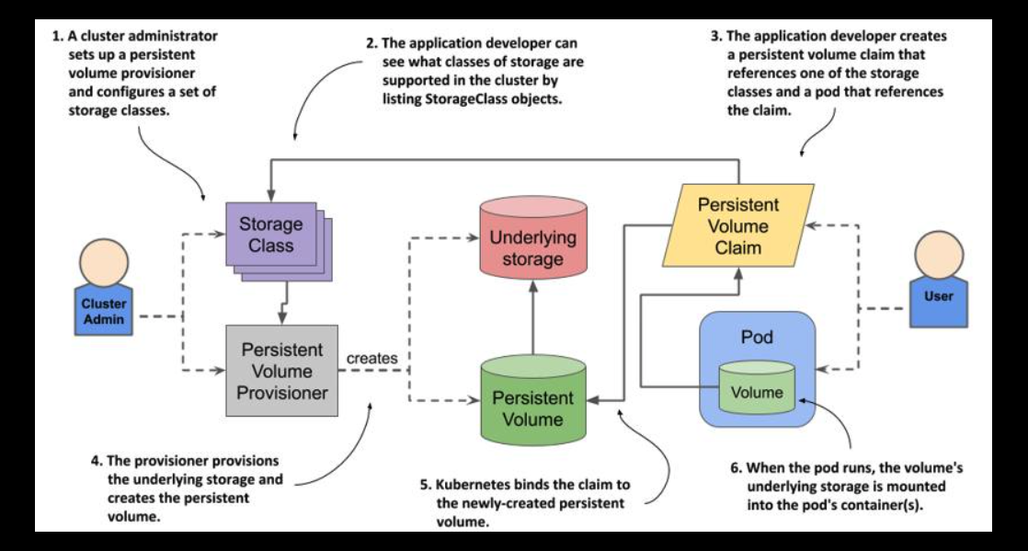
End to End Flow

Slide 9
Summary
Static
Admin → PV → PVC → Pod
Dynamic
PVC → StorageClass → Auto PV → Pod

Slide 10
External Storage Options
Storage | Type | Best For
NFS | File | Shared storage
AWS EBS | Block | Databases
Azure Disk | Block | Cloud workloads
Google Persistent Disk | Block | GKE workloads
Ceph | Distributed | Large clusters
NetApp | Enterprise | Production workloads
Pod → PVC → StorageClass → External Storage (AWS / NFS / Ceph)

Slide 11
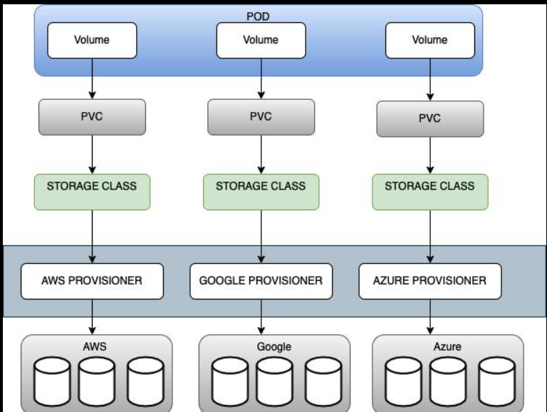

Slide 12
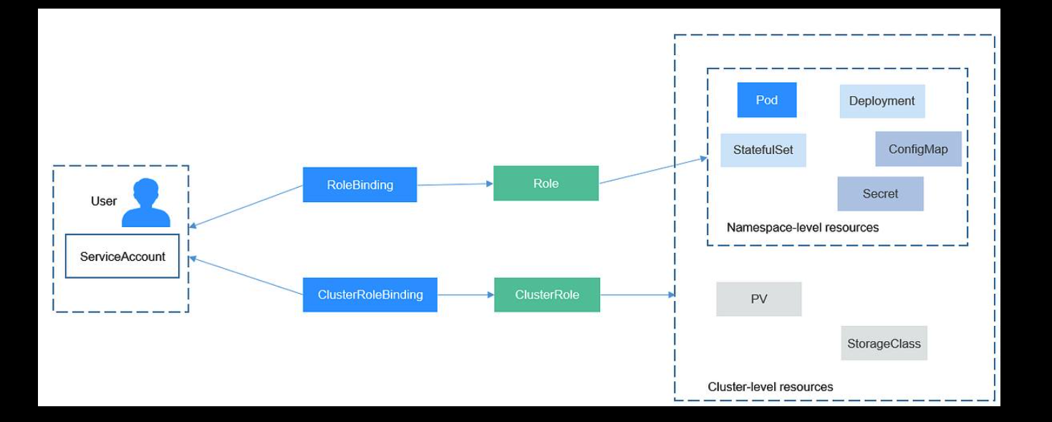

Slide 13
Role Base Access Control
Right User → Right Permission → Right Resource
Achieve:
✔ Secure cluster access ✔ Limit permissions ✔ Protect critical resources ✔ Implement least-privilege security

Slide 14
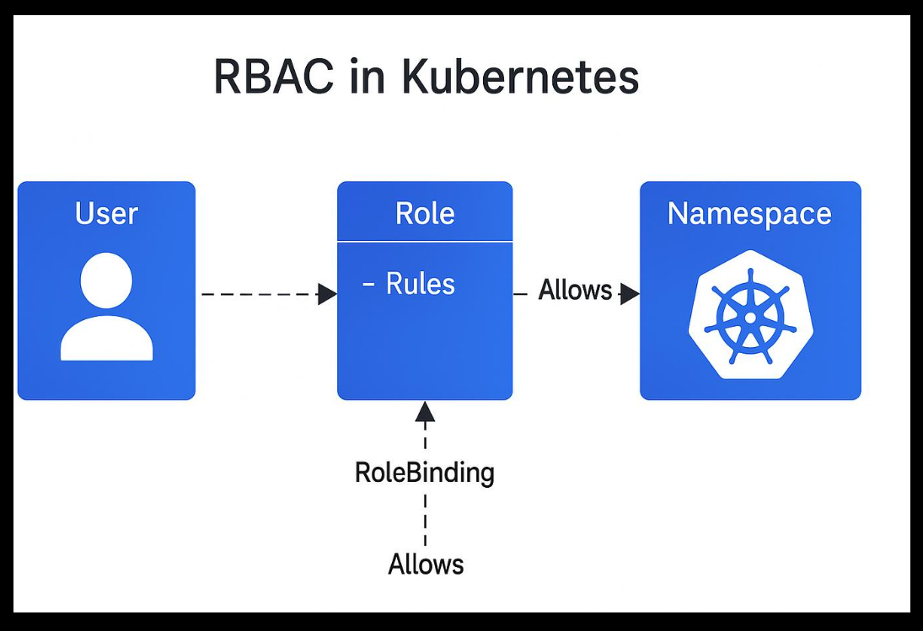
Role and Role Binding Flow
Role + RoleBinding ↓ Namespace permissions

Slide 15
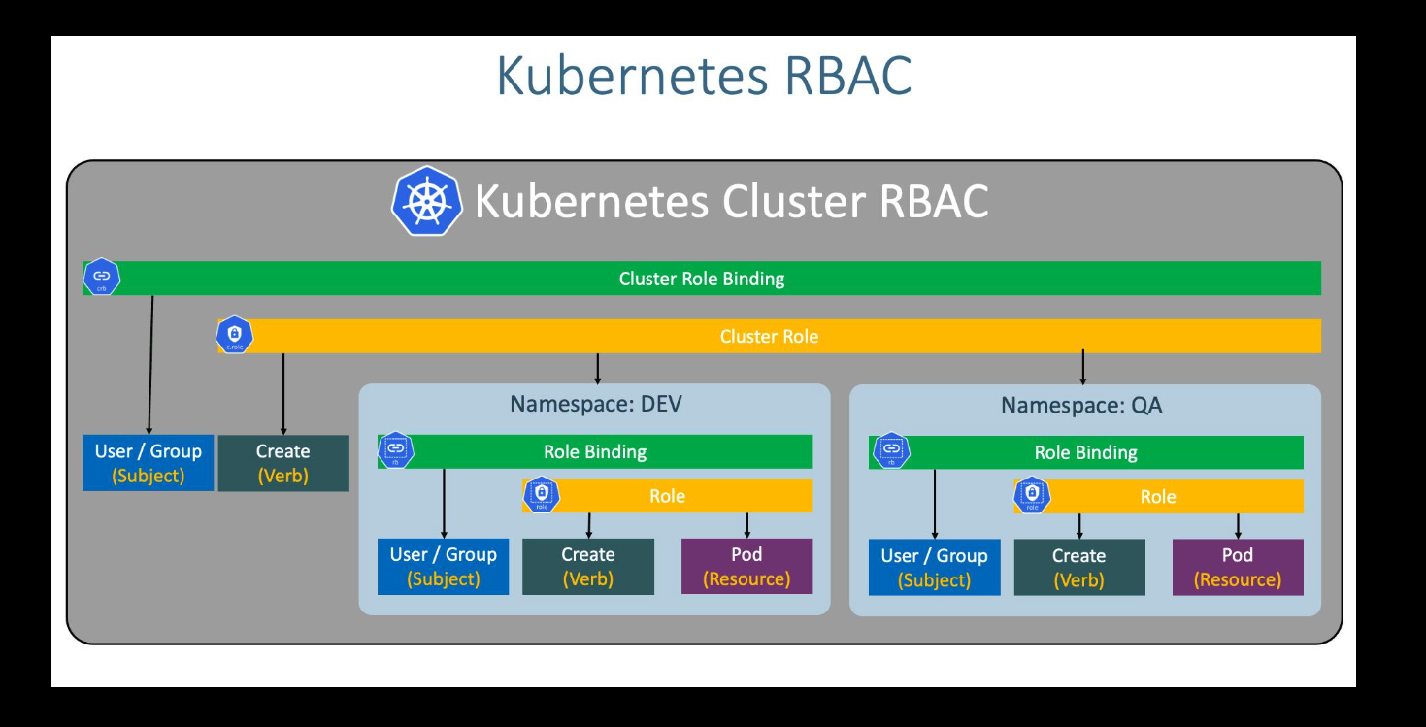
Cluster role and Cluster Role Binding Flow

Slide 16
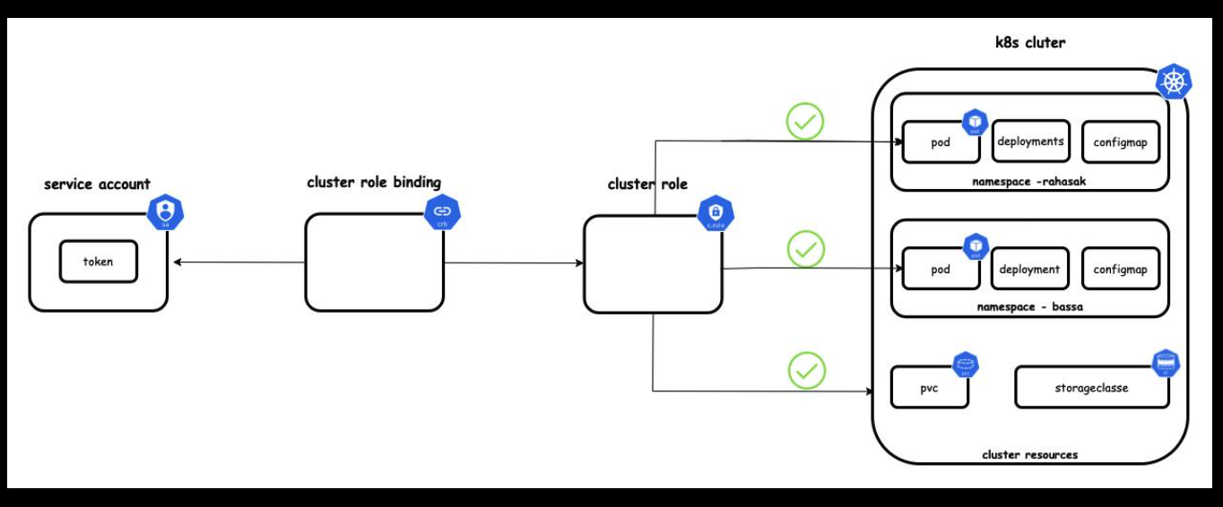
Mapping Service Account

Slide 17
When to use Role and Cluster Role
Feature | Role | ClusterRole
Scope | Namespace | Entire Cluster
Binding | RoleBinding | ClusterRoleBinding
Example | dev namespace access | cluster-wide access

