Slide 1
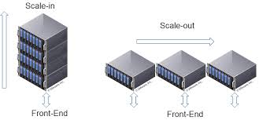
Week 3
Autoscaling in Kubernetes: HPA, VPA, KEDA, and Node Scaling

Slide 2
Recap
K8s Cluster Components
Cluster State Restore
Cilium

Slide 3

HPA (Horizontal Pod Autoscaler) - Demo
VPA (Vertical Pod Autoscaler) – Demo
Cluster Autoscaler
Karpenter
KEDA (event-driven autoscaling) - Demo
Choosing the right scaler + common pitfalls

Slide 4
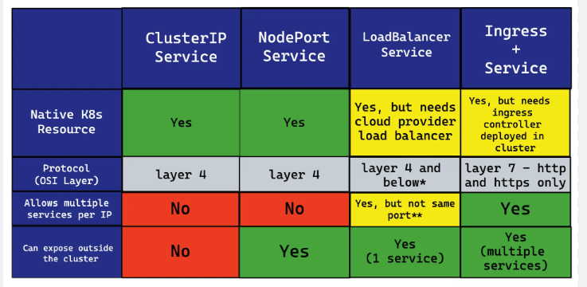
K8S Services

Slide 5
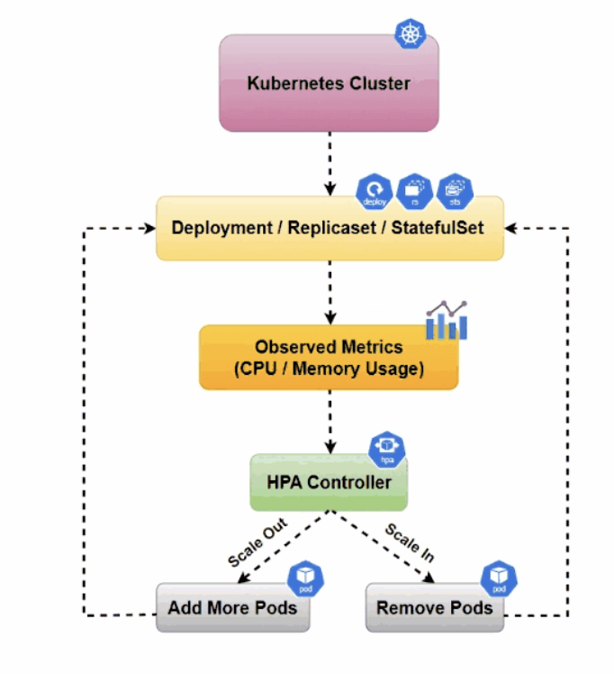
Horizontal Pod Autoscaler
Scope:
Deployment/ReplicaSet/StatefulSet
Based on metrics:
CPU/Memory (resource metrics)
Custom metrics / External metrics (via Prometheus adapter, etc.)
Key settings:
minReplicas / maxReplicas
target utilization or target value
Best for: stateless services, web APIs

Slide 6
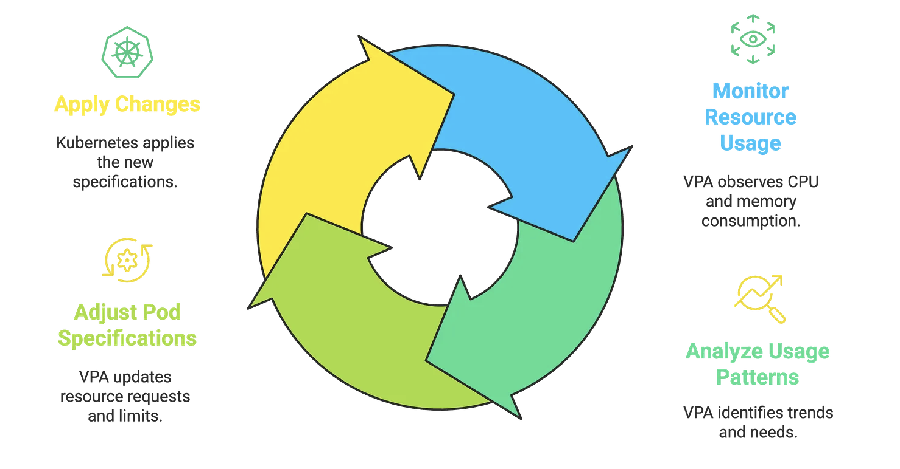
Vertical Pod Autoscaler
Adjusts pod resource requests (CPU/memory)
Components:
Recommender (calculates)
Admission Controller (mutates pod on creation)
Updater (evicts pods so they restart with new requests)
Modes:
Off (recommend only)
Initial (set on first pod create)
Auto (apply + evict/recreate)
Best for: batch jobs, services with stable usage patterns
Important: VPA changes requests, not replicas

Slide 7
Compare HPA and VPA
Copilot said: | Aspect | HPA (Horizontal Pod Autoscaler)
Aspect | HPA (Horizontal Pod Autoscaler) | VPA (Vertical Pod Autoscaler)
What it scales | Number of pods (replicas) | Pod size by adjusting container resource requests (CPU/memory)
Effect (simple) | More pods when load increases | Bigger/smaller pods based on observed usage
Primary goal | Handle varying load by spreading work across replicas | Right-size requests to improve scheduling + reduce waste / avoid OOM
Metrics behavior | Needs a metrics pipeline; typically reacts quickly to changes (near real-time depending on metrics resolution) | Needs longer observation window to generate stable recommendations (minutes to hours depending on workload)
What you “watch” to validate | kubectl get hpa -w shows replicas changing | Pod requests changing after restart/eviction; kubectl describe vpa shows recommendation targets
How changes take effect | HPA updates spec.replicas on the target workload | VPA applies via admission controller on pod creation; in Auto it may evict/recreate pods
Main pitfall (together) | Using HPA + VPA on the same workload is OK only with care | Avoid VPA + HPA on CPU for the same workload (feedback loop: VPA changes requests, HPA uses CPU% of requests → can “fight”)
Common safe pattern | HPA for CPU (replicas) | VPA for memory (right-size) + set VPA controlledResources to memory only (or use VPA recommendations in Off mode first)

Slide 8
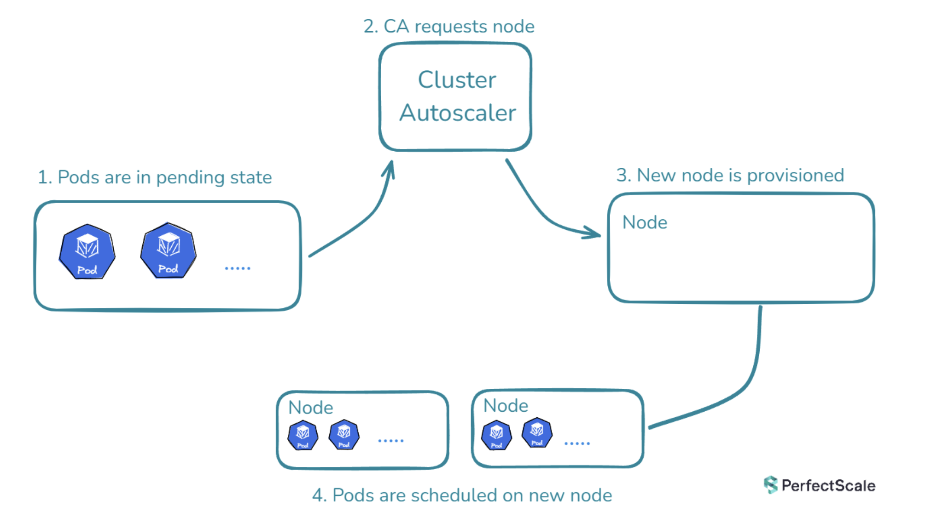
Node Scaling – Cluster AutoScaler ( Cloud )
Cluster Autoscaler (CA)
Scales node groups (ASGs / MIGs / node pools)
Adds nodes when:
pods are Pending due to insufficient resources
Removes nodes when:
nodes are underutilized and pods can be moved
Pros:
Mature, widely supported
Cons:
Limited by node group shapes; slower provisioning depending on cloud

Slide 9
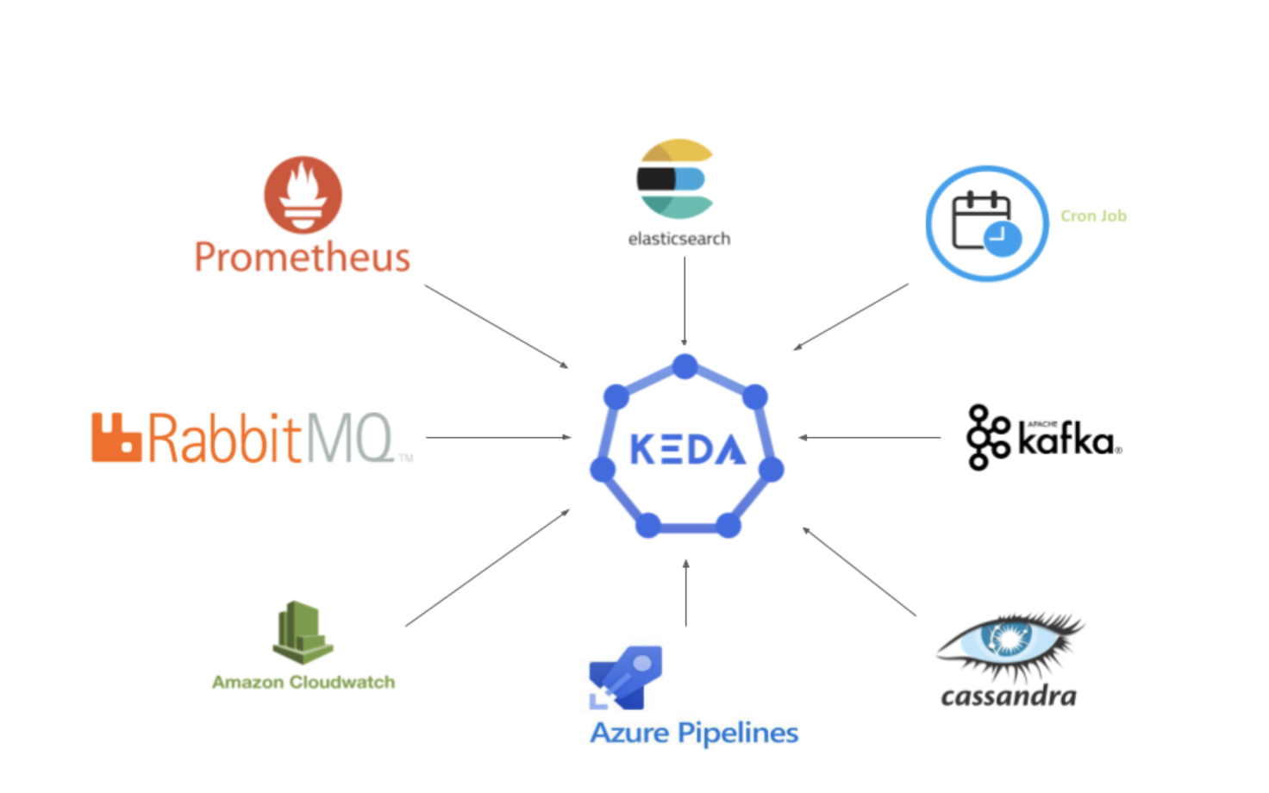
KEDA (Event-Driven Autoscaling)
Scales workloads based on events, not just CPU
Examples:
Kafka lag, SQS queue depth, RabbitMQ, Prometheus metrics, HTTP, cron
Can scale:
Deployments (via HPA under the hood)
Scale-to-zero (including to 0 replicas)
Good for:
background workers / consumers
cost optimization (scale to 0)

Slide 10
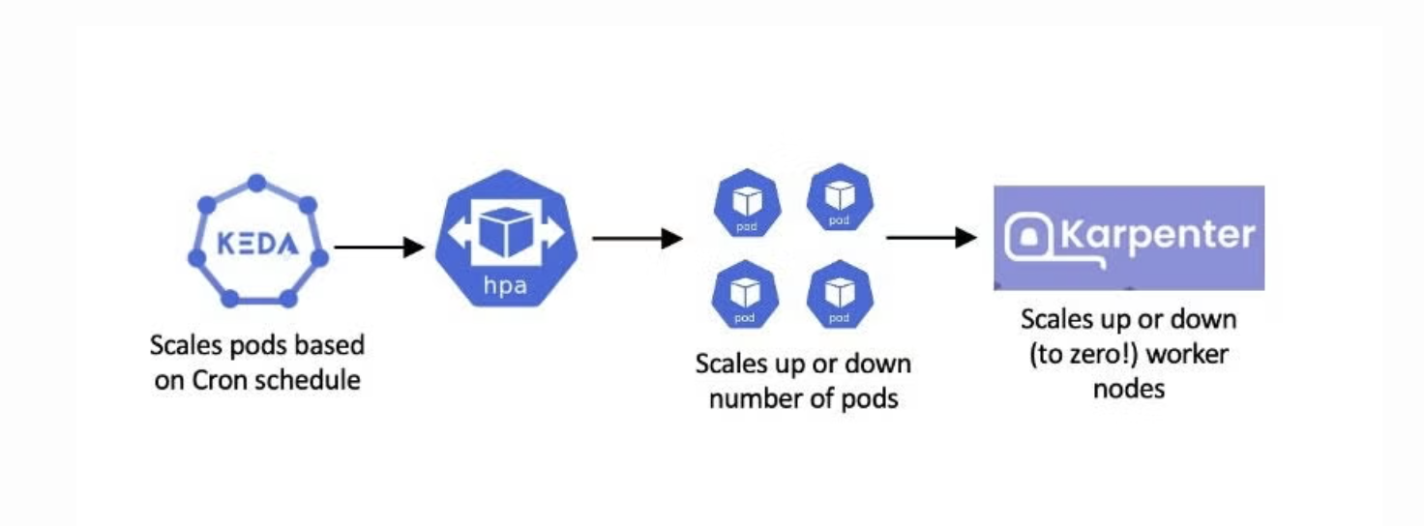
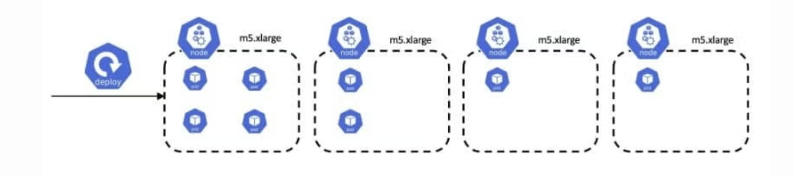
Node Scaling – Karpenter ( cloud )
Node provisioning “just-in-time”
Chooses instance types dynamically (bin packing / cost-aware)
Works great for:
spiky workloads
many instance type options
Key concepts:
Provisioners / NodePools (depending on version)
Constraints: zones, instance families, capacity type (spot/on-demand)
Compared to CA:
Typically faster + more flexible

Slide 11
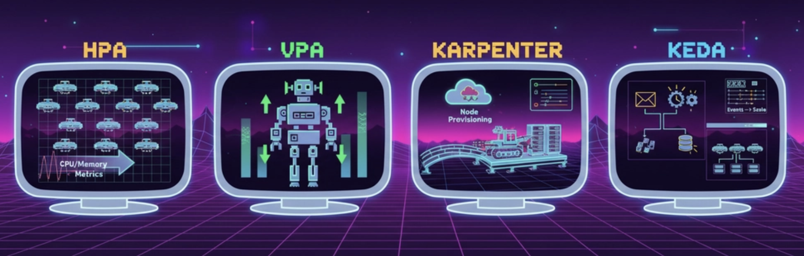
Reference Architecture
App tier:
HPA/KEDA → replica scaling
VPA → right-size requests (start with recommendation mode)
Cluster tier:
Cluster Autoscaler or Karpenter → add/remove nodes
End-to-end flow:
Load/event spike → HPA/KEDA increases replicas → pending pods → CA/Karpenter adds nodes

Slide 12
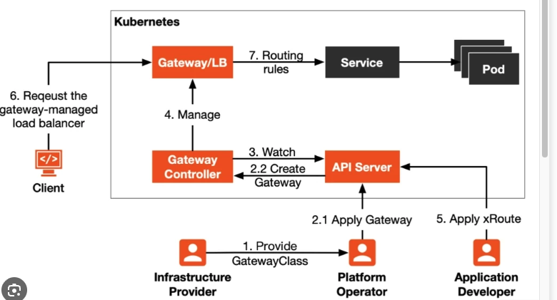
Gateway API Architecture

