Slide 1
Week2 - Day2
Cilium Networking and Cluster State Management in Kubernetes

Slide 2

EBPF in Linux Kernel
eBPF (Extended Berkeley Packet Filter) allows small programs to run directly inside the Linux kernel.
Capabilities
Observe network traffic
Filter packets
Modify network behavior
Extend kernel functionality without modifying kernel code
Traditional Kubernetes Networking
Traffic Flow:
Pod → Linux Kernel → iptables (many chains & rules) → Destination
Challenges
Performance decreases as iptables rules increase
Difficult to debug complex rule chains
Packets may traverse the kernel multiple times
Higher latency in large clusters

Slide 3
Cilium - Networking with eBPF
eBPF enables high-performance packet processing directly inside the Linux kernel, allowing real-time decisions on network traffic.
Packet Flow
Packet → eBPF Program → Decision
Example Flow in Kubernetes:
Frontend Pod → NIC → eBPF Hook (Allow / Deny / Modify) → Linux Network Stack → Destination Pod
eBPF programs can inspect, filter, or modify packets before they reach the traditional networking stack, improving performance and reducing latency.
Common eBPF Terminology
XDP (eXpress Data Path)
High-performance packet processing at the NIC driver level
Used for fast packet filtering and DDoS protection
TC (Traffic Control)
Used for traffic shaping, filtering, and monitoring within the Linux networking stack
Kernel Tracing (Kprobe/Tracepoints)
Used to observe and trace kernel events for debugging and monitoring

Slide 4
Advantages of Cilium Networking
Key Benefits
Runs inside the Linux Kernel eBPF programs operate in kernel space, enabling very fast packet processing.
No Kernel Recompilation Required eBPF programs can be loaded dynamically without modifying or rebuilding the kernel.
Safe Sandboxed Execution eBPF programs run in a verified and secure sandbox, preventing unsafe kernel operations.
Deep Observability Provides detailed insights into network flows, latency, and dropped packets through tools like Hubble.
Dynamic Networking Policies Supports fine-grained security policies based on identities (labels) rather than static IP addresses.
Tool | Purpose
Cilium | Kubernetes networking
Hubble | Network observability
Falco | Security monitoring

Slide 5
Compare IP tables Vs EBPF
Feature | iptables | eBPF
Rule processing | Sequential | Direct map lookup
Performance | Slower | Very fast
Observability | Limited | Deep visibility
Policy | L3/L4 mostly | L3/L4/L7

Slide 6
Cilium Observability
Flow visibility
DNS monitoring
HTTP request
Tracing
Policy debugging
Network flow logs

Slide 7

Cilium
eBPF-based Kubernetes CNI
high-performance networking,
identity-based security,
kube-proxy replacement,
deep observability ( Hubble )
Service Mesh ( similar to istio )
Gateway API ( Ingress )
Network Policy ( replace k8s netpol)
Encrytion (Wireguard , IPSec )

Slide 8
Calico vs Cilium
Calico:
Pod → iptables → routing → destination pod
Cilium:
Pod → eBPF program → policy + load balancing → destination pod
Calico → Traditional Kubernetes networking
Cilium → eBPF-powered modern networking
Feature | Calico | Cilium
Core Technology | iptables / routing | eBPF native
Packet Processing | Netfilter rules | eBPF kernel programs
Performance | Good | Very high
Network Policies | L3 / L4 | L3 / L4 / L7
Observability | Limited logs | Built-in with Hubble
kube-proxy Dependency | Usually required | Can fully replace kube-proxy
Service Load Balancing | kube-proxy | eBPF load balancing
Scalability | iptables rule chains grow | Scales well with maps
API-aware Security | Not supported | HTTP / gRPC filtering
Architecture | Traditional networking | Next-generation kernel networking

Slide 9
Cluster and Context
Cluster Components:
Control Plane (API Server, Scheduler, Controller Manager)
Worker Nodes
Namespaces
Cluster :
server → Kubernetes API server address
dev-cluster – dev ns - devuser staging-cluster production-cluster minikube kind-cluster
Config - name: dev-cluster cluster: server: https://192.168.49.2:6443 certificate-authority-data: ...
Context : Cluster + User + Namespace
Config: - name: dev-context context: cluster: dev-cluster user: dev-user namespace: demo
kubectl → dev-cluster → as dev-user → in demo namespace

Slide 10
Clusters | Context
kubectl config current-context
kubectl config get-contexts
kubectl config use-context prod-context
kubeconfig │ Cluster │ └── API Server │ User │ └── Credentials │ Context └── Cluster + User + Namespace

Slide 11
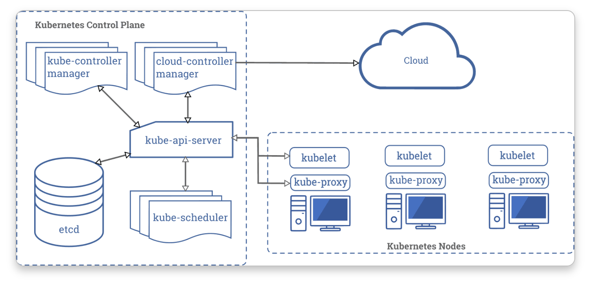
ETCD

Slide 12
Task
Cilium Network Policy for endpoints , Namspace, UDP, IP address Based policy, CIDR address allow /Deny

