Slide 1
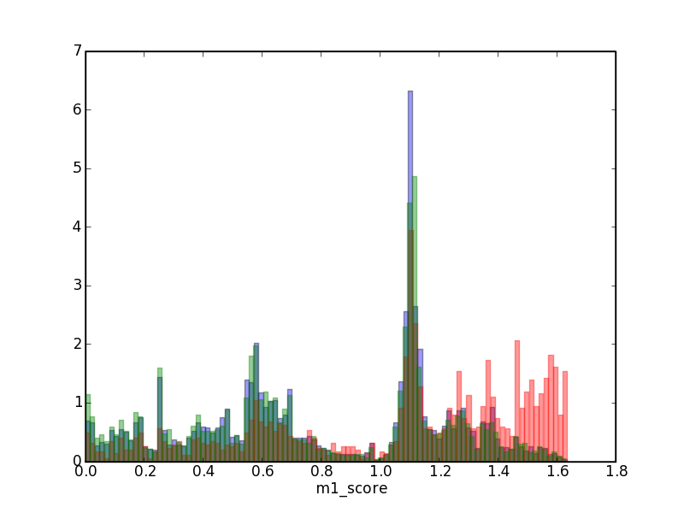
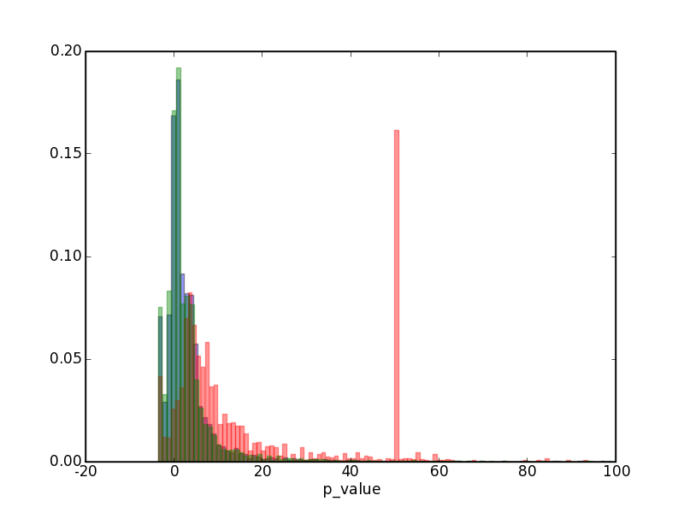
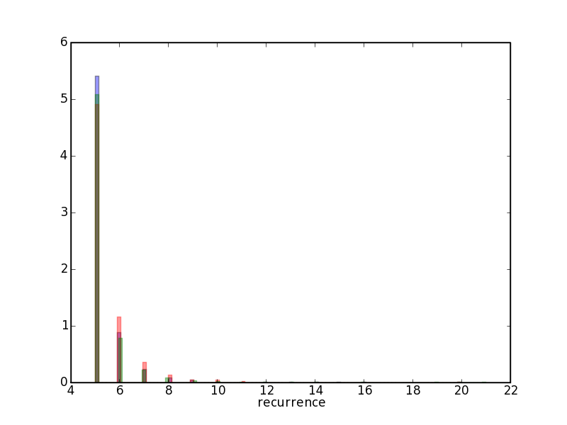
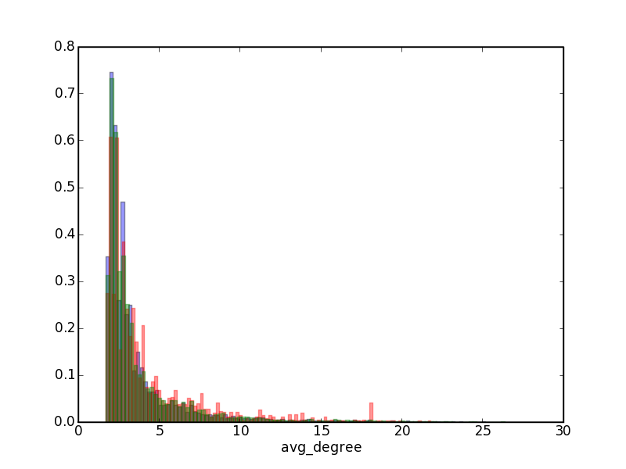
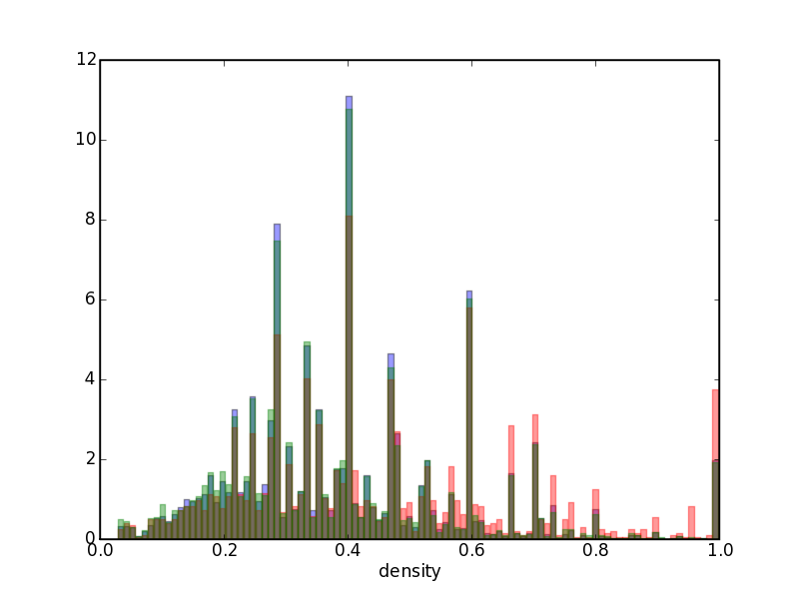
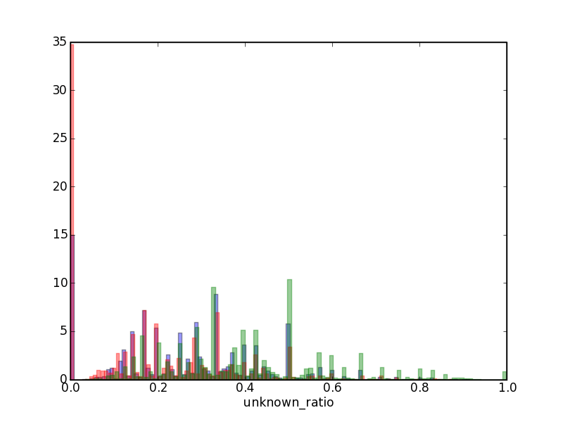

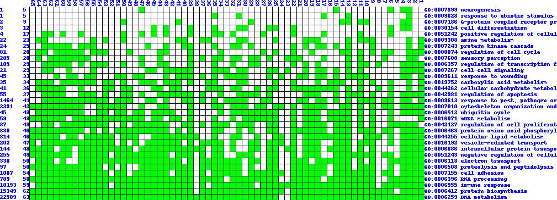

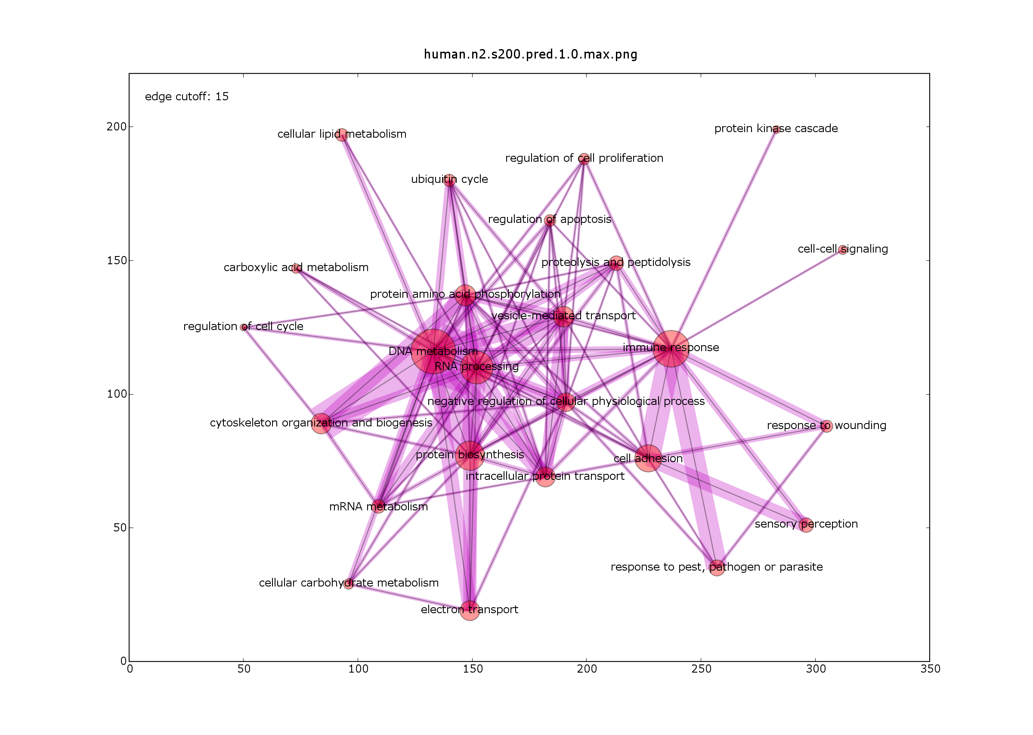
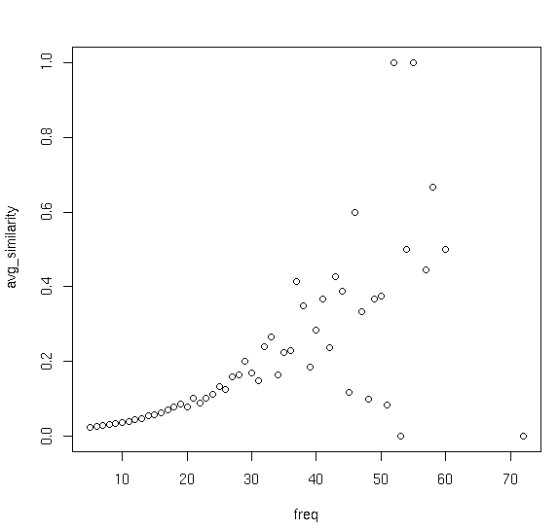
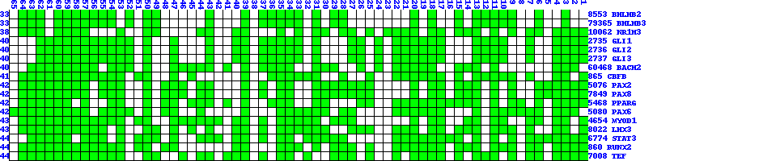
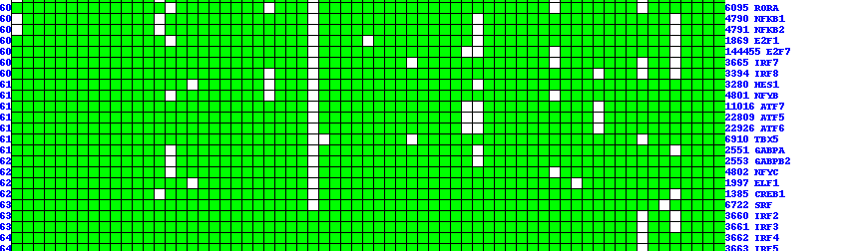
Context-based Large scale Function Prediction in Human
With the goal of mining recurrent patterns, we turn this frequent sub-graph mining problem into a frequent itemset mining(FIM) one by regarding one edge as one transaction/record, and one graph as one item. One edge(transaction) containing one graph(item) means this edge appears in this graph. It's an inverse of usual modeling in which graph is transaction and edge is item.
In practice, we applied the following FIM implementation.
Grahne,Gosta; Zhu,Jianfei(2003) Efficiently Using Prefix-trees in Mining Frequent Itemsets
We got 179923 patterns in total.
Removal of Redundant Patterns
Due to the exhaustive nature of FIM algorithm, we need to remove highly overlapping patterns. An outline of procedures are below:
Classification of predictions
For the known genes, we know whether the prediction is true or not.
Each prediction has lots of attributes associated, i.e. recurrence of
the pattern, average degree, hypergeometric p-value, m1_score, etc.
Based on the information from the predictions for the known genes, we
try to choose unknown predictions.
Below are a few histograms showing the distribution of the attributes
of predictions. Red is for correct predictions, blue for wrong, green for
unknown.
Yu Huang¹, Haifeng Li¹, Haiyan Hu¹, Xifeng Yan², Jiawei Han², Xianghong Jasmine Zhou¹
1: Program in Molecular and Computational Biology, University of Southern California Los Angeles, CA 90089, USA
2: Department of Computer Science, University of Illinois at Urbana-Champaign Urbana, IL 61801, USA
Introduction:
The biological question is that under what condition/tissue, with what kind of partners, under the control of which transcription factors(TF), one gene carries out its function(s).
With the advent of vast amount of public microarray data and genomic sequences, we see the hope of tackling the question above.
Data
Our study focuses on human. We took 216 human microarray datasets from GEO and SMD and 2005-Nov human genome sequence.
Our approach is graph-based, in which each gene is node, two genes are connected with an edge if their expression vectors are correlated. We convert each dataset to a graph based on gene-gene expression correlation(p-value<=0.01). See Figure Below.
Remove Redundant Patterns
Merge Similar Patterns
Biclustering (simulated annealing)
Get Connected Components
As you see the subtle difference between good and bad predictions
among most attributes, it's hard to come up with a good classification
sheme.
We applied RandomForest to classify unknown predictions
The work is ongoing. Tentatively, we got 822 known genes with 984
predictions with 74.39% accuracy and 368 unknown genes with 404
predictions. Among 368 unknown genes, 189 were masked unknown
(pseudo unknown) during informative GO node construction.
Figure below shows a function map with each column as dataset,
each row as a function, sorted by the number of datasets associated.
Datasets
Coexpression
Networks
Recurrent
Patterns
Annotation
Transcription Factors
Genes
Network topology score(m1_score)
We come up with a network topology score which incorporates the pattern topology(distance between genes) and Gene Ontology association information.
----
----
----
----
----
a
c
f
h
j
a
c
f
h
j
e
b
e
b
e
k
g
d
g
i
k
d
g
i
h
f
e
h
i
----
----
----
----
----
a
c
e
f
h
j
a
c
e
h
j
g
i
Transcriptional Annotation
b
d
g
i
k
b
d
g
i
k
Gene Ontology
a
c
f
h
j
a
c
f
h
j
a
f
----
----
----
----
----
b
d
e
k
b
d
e
i
k
b
g
i
g
d
i goes from 1 to 3.
leave one out, set diagonal of P = 0.
a
c
f
h
j
a
c
f
h
j
Functional Annotation
----
----
----
----
----
b
d
e
k
b
d
e
i
k
g
i
g
65 datasets 65 graphs 179923 patterns
Two filtering procedures were applied to eliminate low-variance genes and humongous graphs(with #edges >= 3% of # possible edges) We ended up with 65 graphs under various conditions.
Algorithm
The idea behind our algorithm is based on the following notions: The more the number of datasets in which a pattern occurrs, the more the functional homogeneity of the pattern.
This notion is exemplified with following figure. We tried on triplets (three-gene module). X-axis(frequency) is the number of datasets in which one triplet occurrs. Y-axis is the percentage of same-function patterns among all patterns with that particular frequency. It starts to be sporadic as the frequency goes to >40 because the number of patterns with that high frequency is very few (sample too small).
O is the GeneOntology binary matrix.
M is the final score matrix for each gene to each GO.
For each gene in each pattern, we assign the function with
maximum m1_score to the gene.
Figure below shows how the predicted function are distributed among
all informative Gene Ontology nodes. Each node is a function category.
The size corresponds to the number of genes predicted to this category.
Two nodes are connected if they share >= 15 genes and the width of
the edge corresponds to the number of genes shared.
gene-function map: column is gene, row is function.
Finally, we assessed the TFBS enrichment for each pattern. TFBS hits for each gene
were got through following procedures.
download genome sequences and gene location information from NCBI
get 10kb upstream based on CDS starting site or TSS(transcription starting site)
Use RepeatMasker to mask the upstream sequences
Run TRANSFAC's match over masked sequence
This is TF map. Each column is a dataset. Each row is a TF, sorted by
the number of datasets associated. (too long, middle part omitted)

